Slide 1
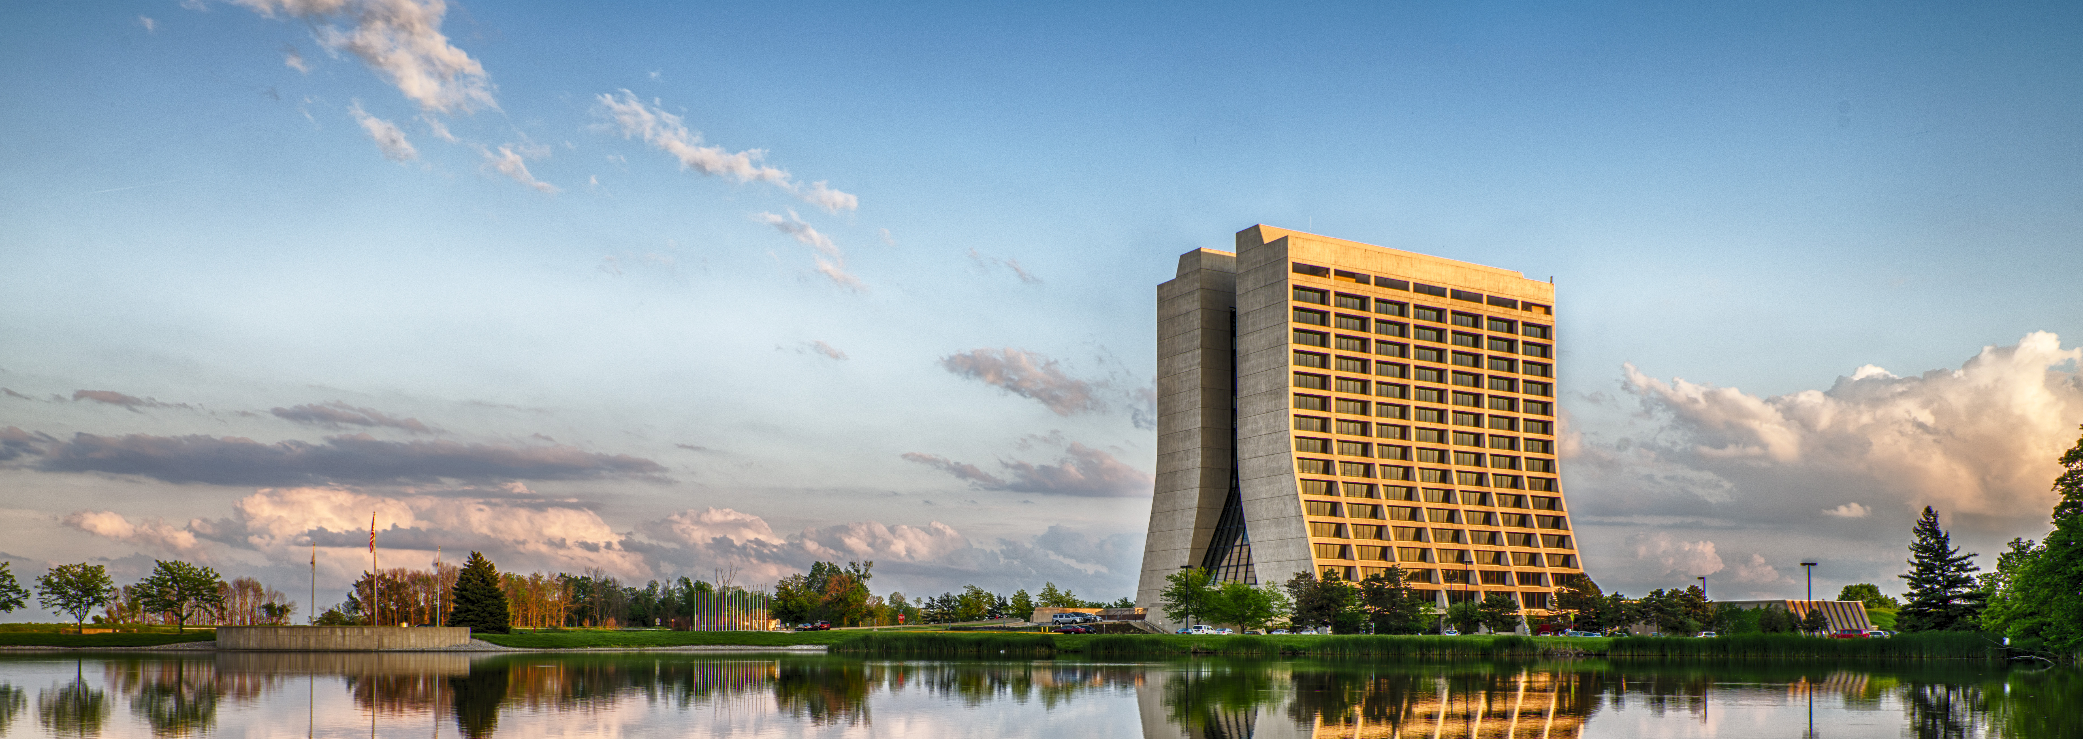
Daily Summary- Day 1
Operations and Maintenance Experience of LHe Systems

Slide 2
LHe availability and controls
LHC Cryogenics (Laurent Delprat, CERN)
  Experience from Run 1 & 2, large campaign to solve problems and improve reliability
ARIEL 2K cryogenic system (Ruslan Nagimov, TRIUMF)
  Issues with startup and subatmospheric operation
SNS instrumentation and controls (Matthew Howell , ORNL)
  Addressing operation modes, maintenance, redundancy and standardization

Slide 3
Oil contamination
Oil contamination of cryogenic systems (Kim Florian Rautert, Linde Kryotechnik AG)
  Causes, effects, detection, repair
  Revolutionary Ionic liquids to avoid carry-over
Cleaning of He refrigerator after hydrocarbon contamination
(Caroline Fabre, CERN)
  Process described, very systematic approach to resolve issue
  Lessons learned
  In depth study

Slide 4
Further LHe operating experience
RHIC collider operations and operation of SC magnet (Victor Soria, BNL)
Vibration monitoring of rotating machines (Olivier Pirotte, CERN )
  predictive maintenance plan
  Analysis
H2 target at ESS (John Jurns, ESS)

Slide 5
Questions
How do the experiences presented compare to your facility and experience?
What are future improvements that the cryogenic operations field should address?
Some topics for discussion….
  Sources of un-availability
  Control architecture
  Oil contamination management

