Slide 1
Workshop on Cryogenic Operations
Anindya Chakravarty
Poster Session III Summary
27 October 2016

Slide 2
Topics
1. Helium liquefier plant at Cryo Technology Division, BARC. (16)
2. Shaft seal systems of rotary equipment in Cryogenic Plants. (17)
3. Cryogenic controls for the RAON SRF test facility. (18)
4. Performance mapping of the CLS SRF Cryoplant. (19)
5. Commissioning of the cryogenic system for SRF test facility of RAON. (21)
6. SRF Operating experience: Cavity detuning from helium microphonics/vibration pulses - 56MHz/112MHz SRF CAVITY at 4.5K. (22)

Slide 3
Poster 16
Notes
Helium liquefier plant(about 35 l/hr) developed and run for 1 month at CrTD, BARC.
Discussed equipment performance (TEX and HEX).
Discussed some operational problems.

Slide 4
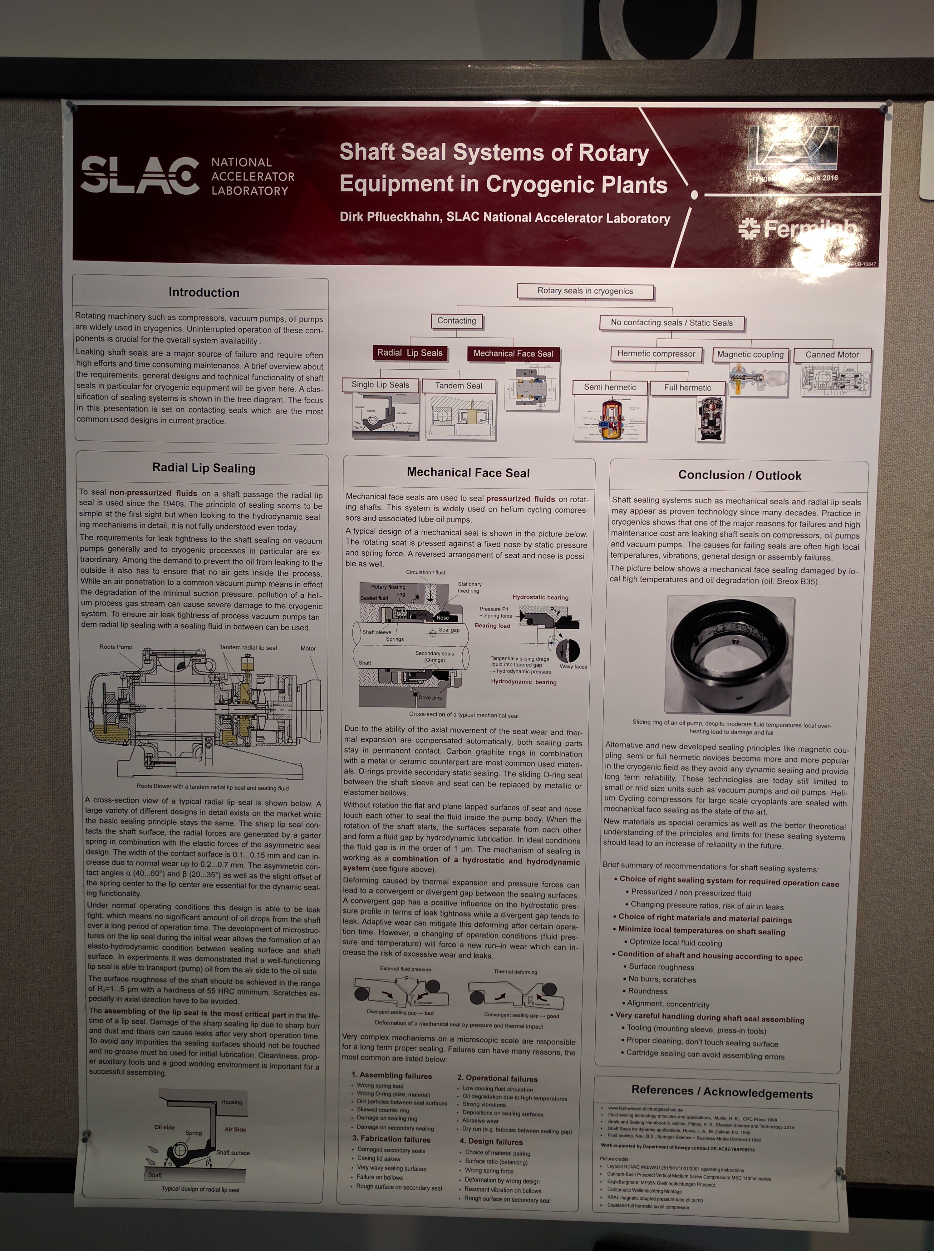
Poster 17
Notes
Discussed Radial lip sealing (eg. Vac pumps)
Discussed Mechanical Face seal (eg. Process compressor)
Recommendations for the correct sealing choice and handling.

Slide 5
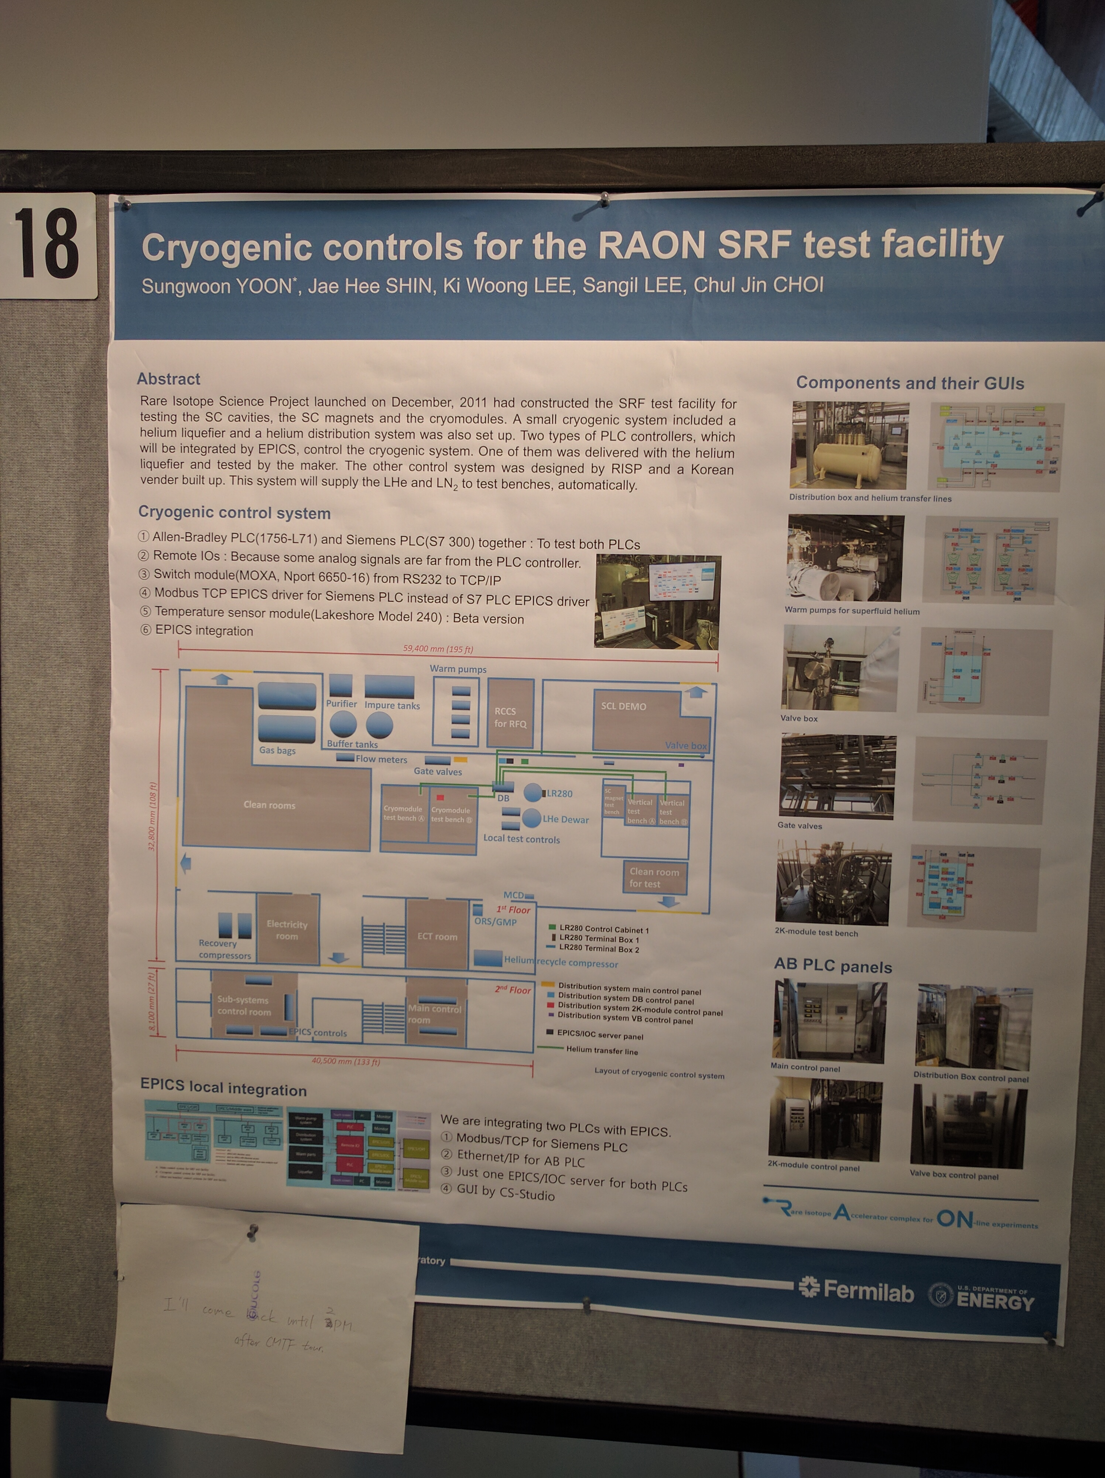
Poster 18
Notes
2 different PLC controllers, 1(Siemens) supplied by LINDE for liquefier and Allan Bradley for DB.
Using EPICS the two was integrated
Future plan to make a push button cryo distribution system.

Slide 6
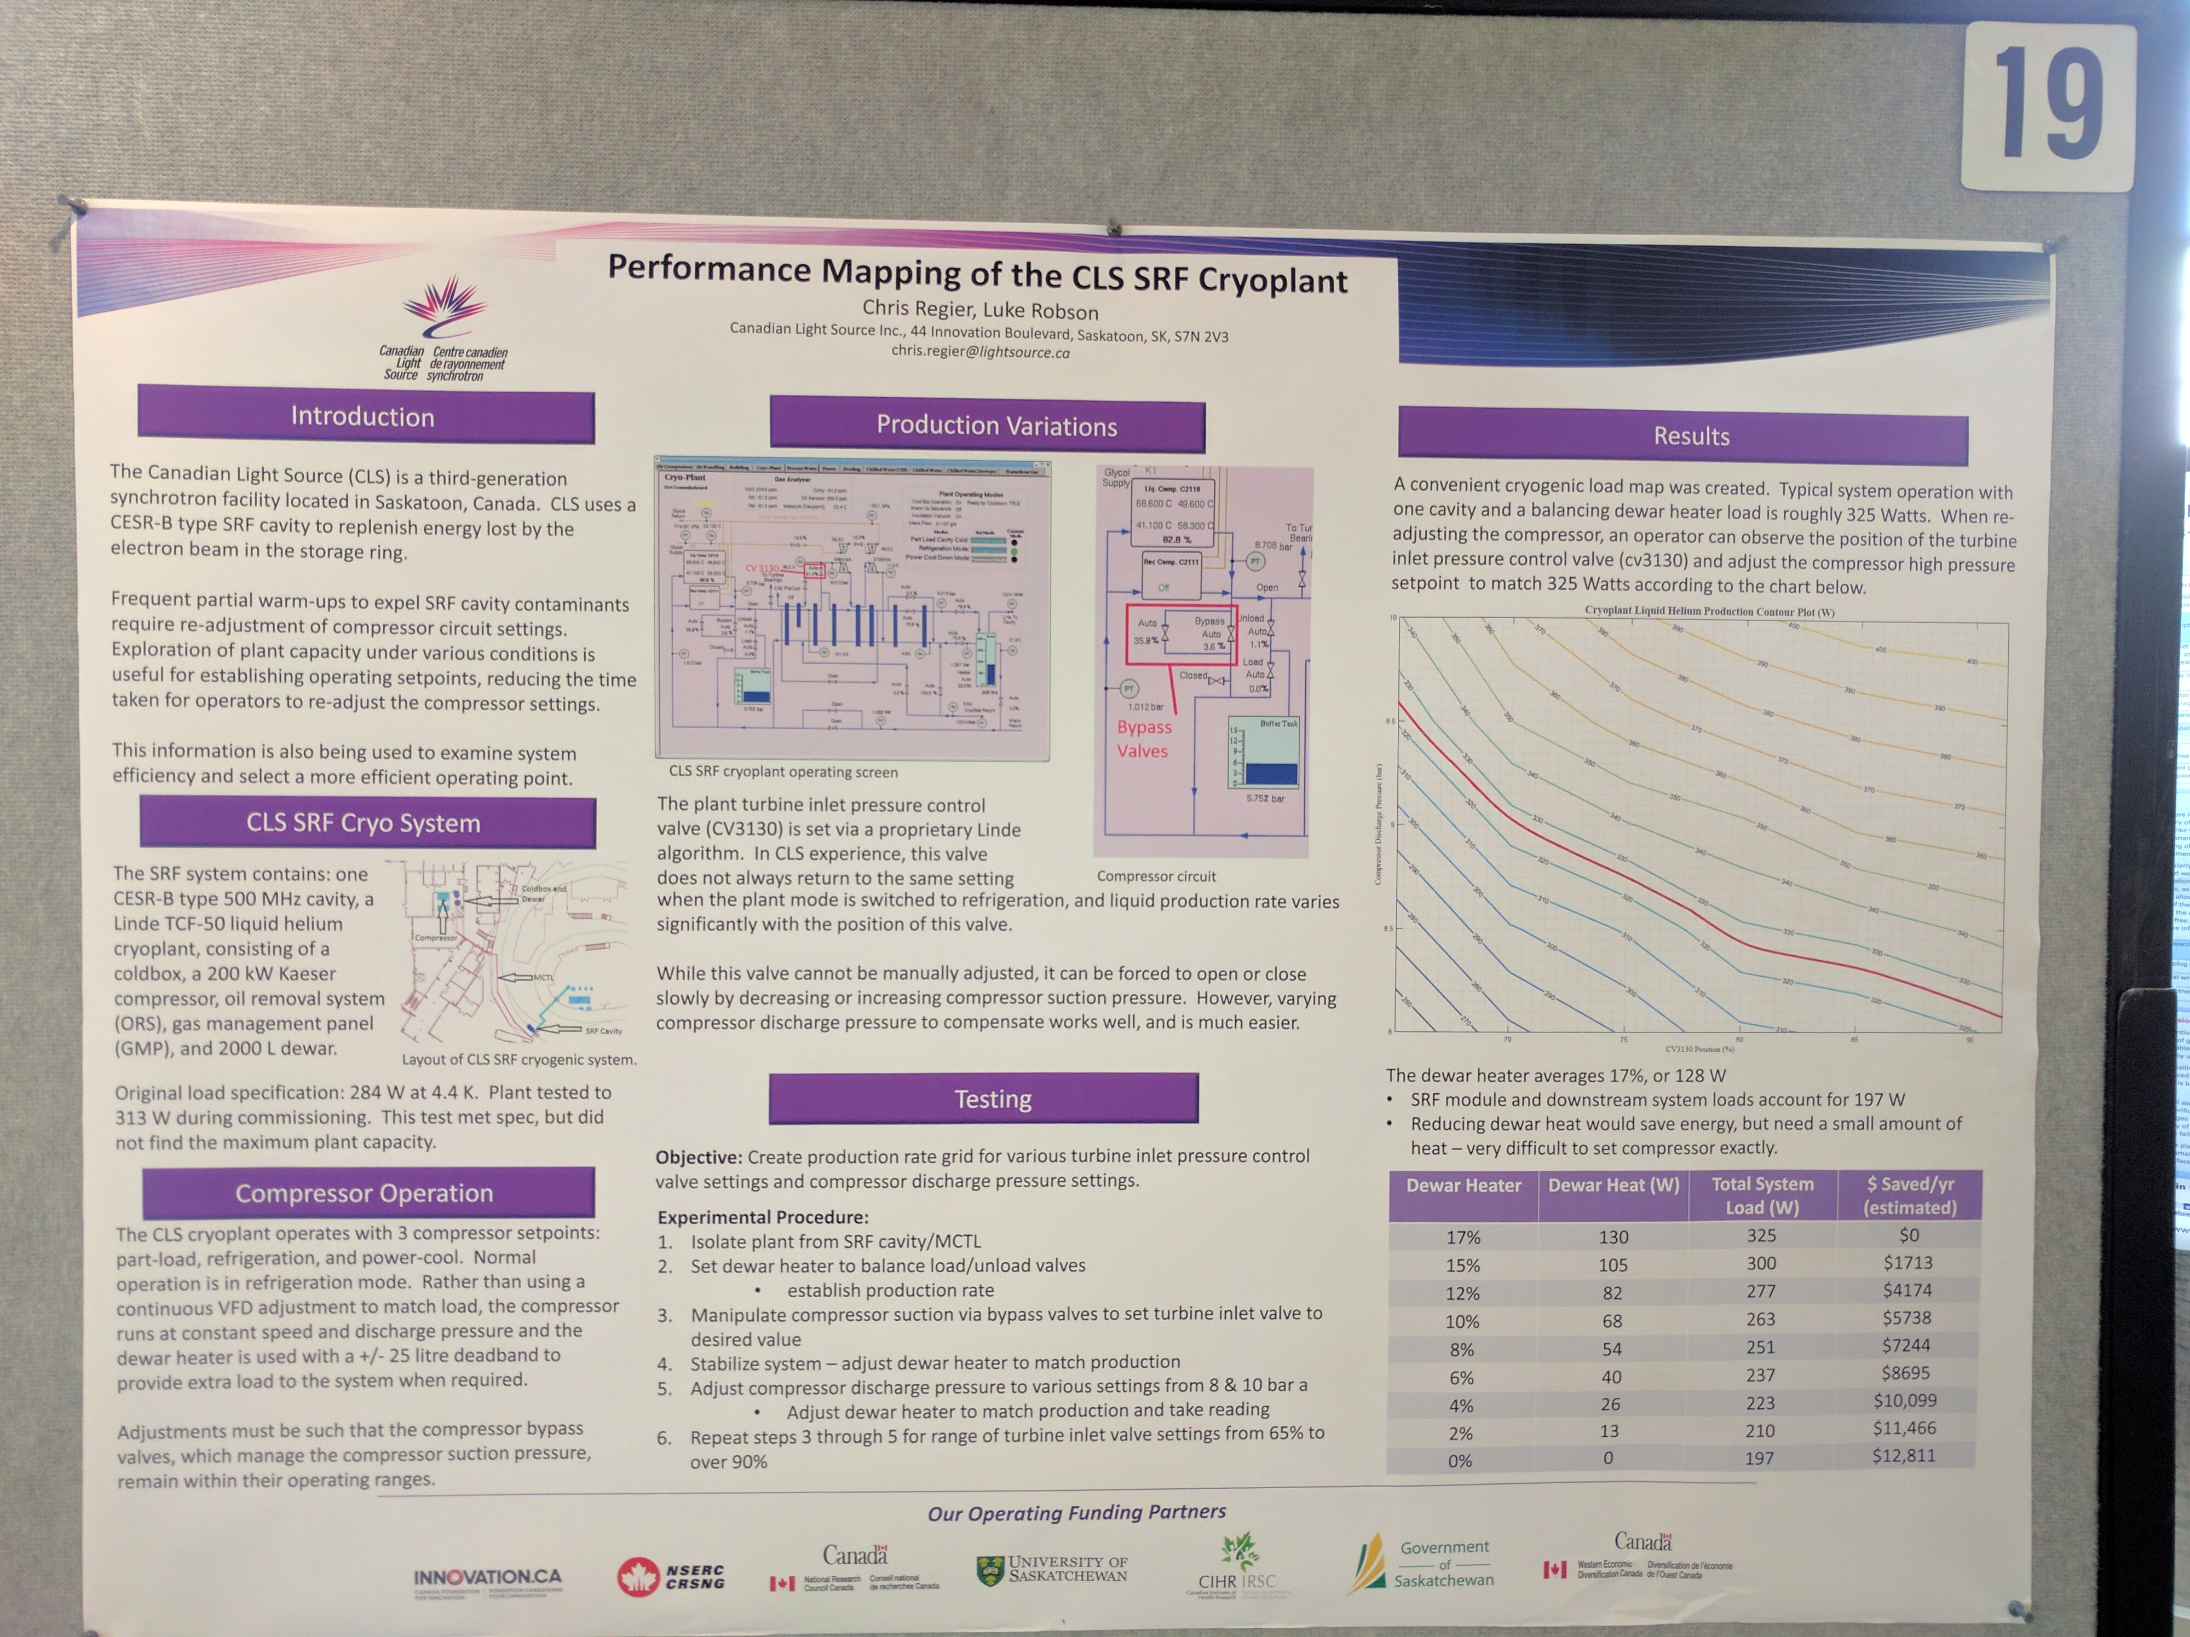
Poster 19
Notes
Cross plots of TEX string inlet valve vs. Process compressor discharge pressure for stable operation at different Dewar heat load

Slide 7
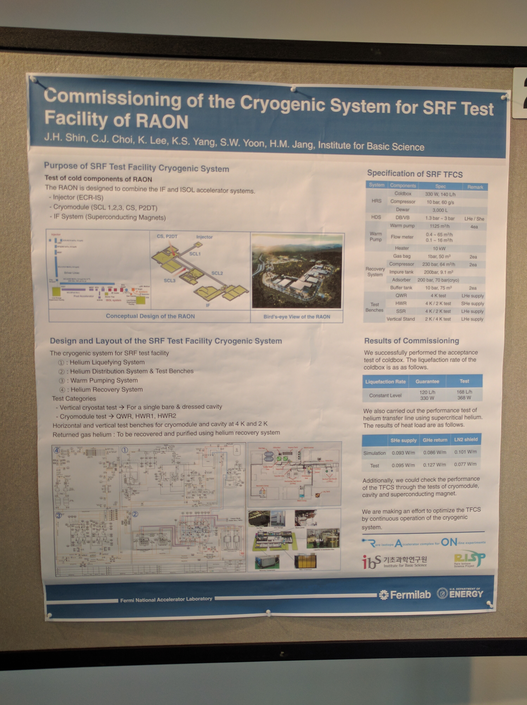
Poster 21
Notes
Purpose: Test of cold components of RAON
Test Benches:
QWR – 4K test
HWR – 4K/2K test
SSR – 4K/2K test
Vertical stand – 2K/4K test
Performance test carried out
CB: 330W at 4.5K

Slide 8
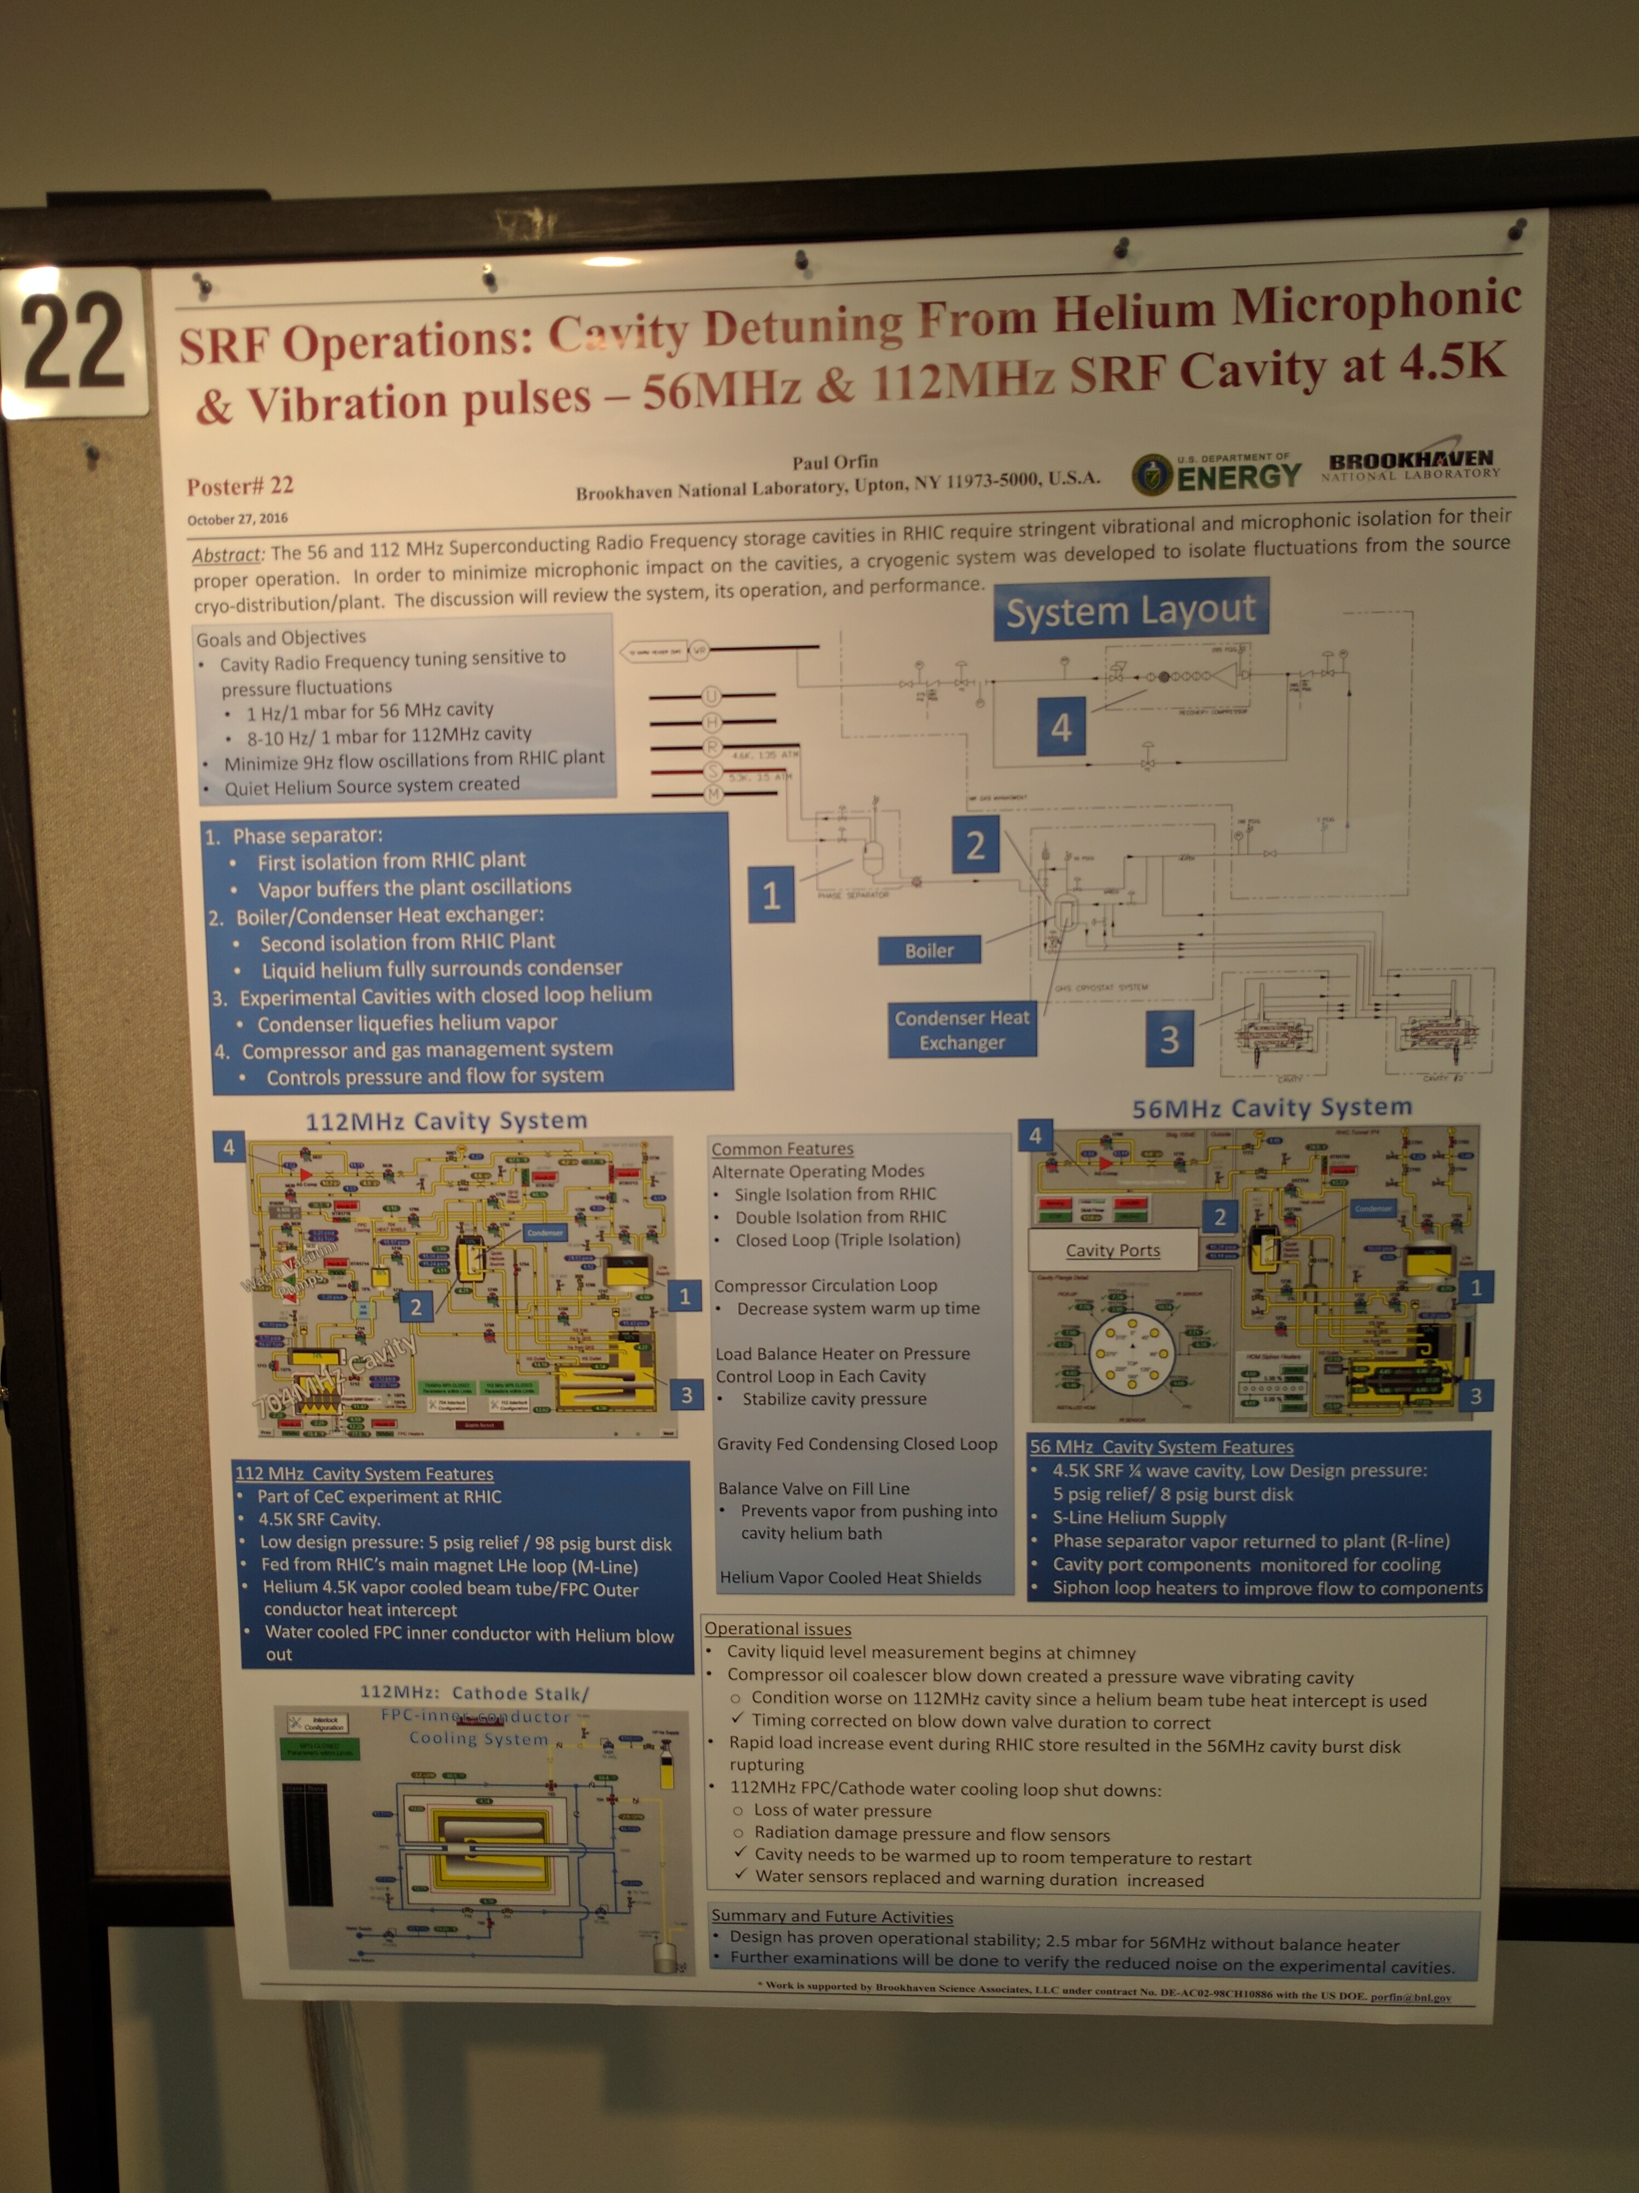
Poster 22
Notes
Gravity fed cavity cooling system isolated from the cold box to take care of the tight specifications on pressure fluctuations.
2 stage isolation from the RHIC cryo plant.

