Slide 1


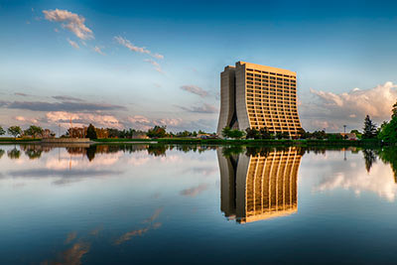
LHC Cryogenics Operation:
Post-LS1 restart and main achievements of Run 2
Gerard FERLIN on behalf of Cryogenic group
Head of Cryogenic operation for Accelerators section
CERN, Technology Department, Cryogenic Group

Slide 2
Agenda
Short recall on LHC cryogenics
Main Long Shutdown1 (LS1) consolidations / maintenance
Run 2 cooling down
Cryogenics during magnet qualification tests and associated issues/mitigations
Run 2 with benefits of adjustments and remaining issues
Conclusions & Perspectives

Slide 3
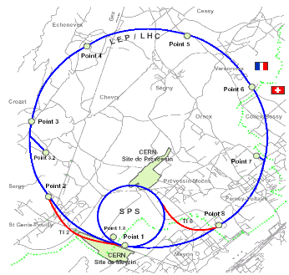
Layout of LHC cryogenics
LHC: 24 km of high-field superconducting magnets (36 000 Tons) operating in superfluid helium at 1.9 K
CMS
SRF
8 x 18kW @ 4.5 K
1’800 sc magnets
24 km & 20 kW @ 1.8 K
36’000 t @ 1.9K
130 t He inventory
ALICE
LHCb
Magnets
Distribution
ATLAS

Slide 4
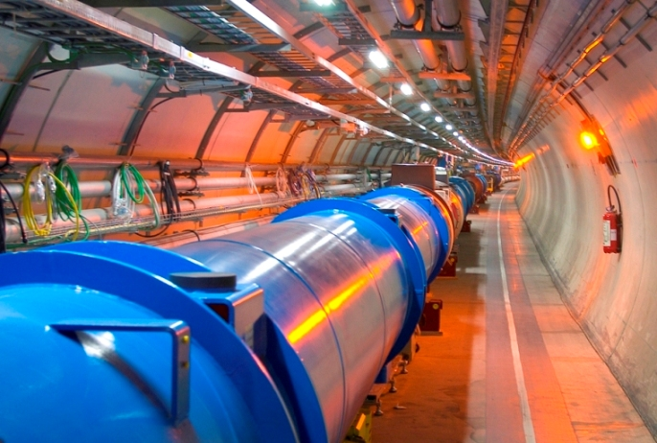
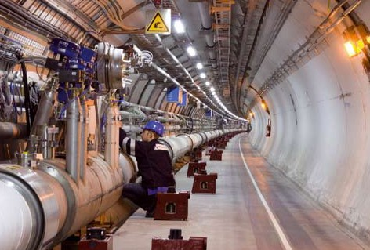
LHC cooling system
LHC
8 sectors
4.5 K
1.8 K
Basic
LHC sector
scheme
Interconnection
Distribution line 3.3 km

Slide 5
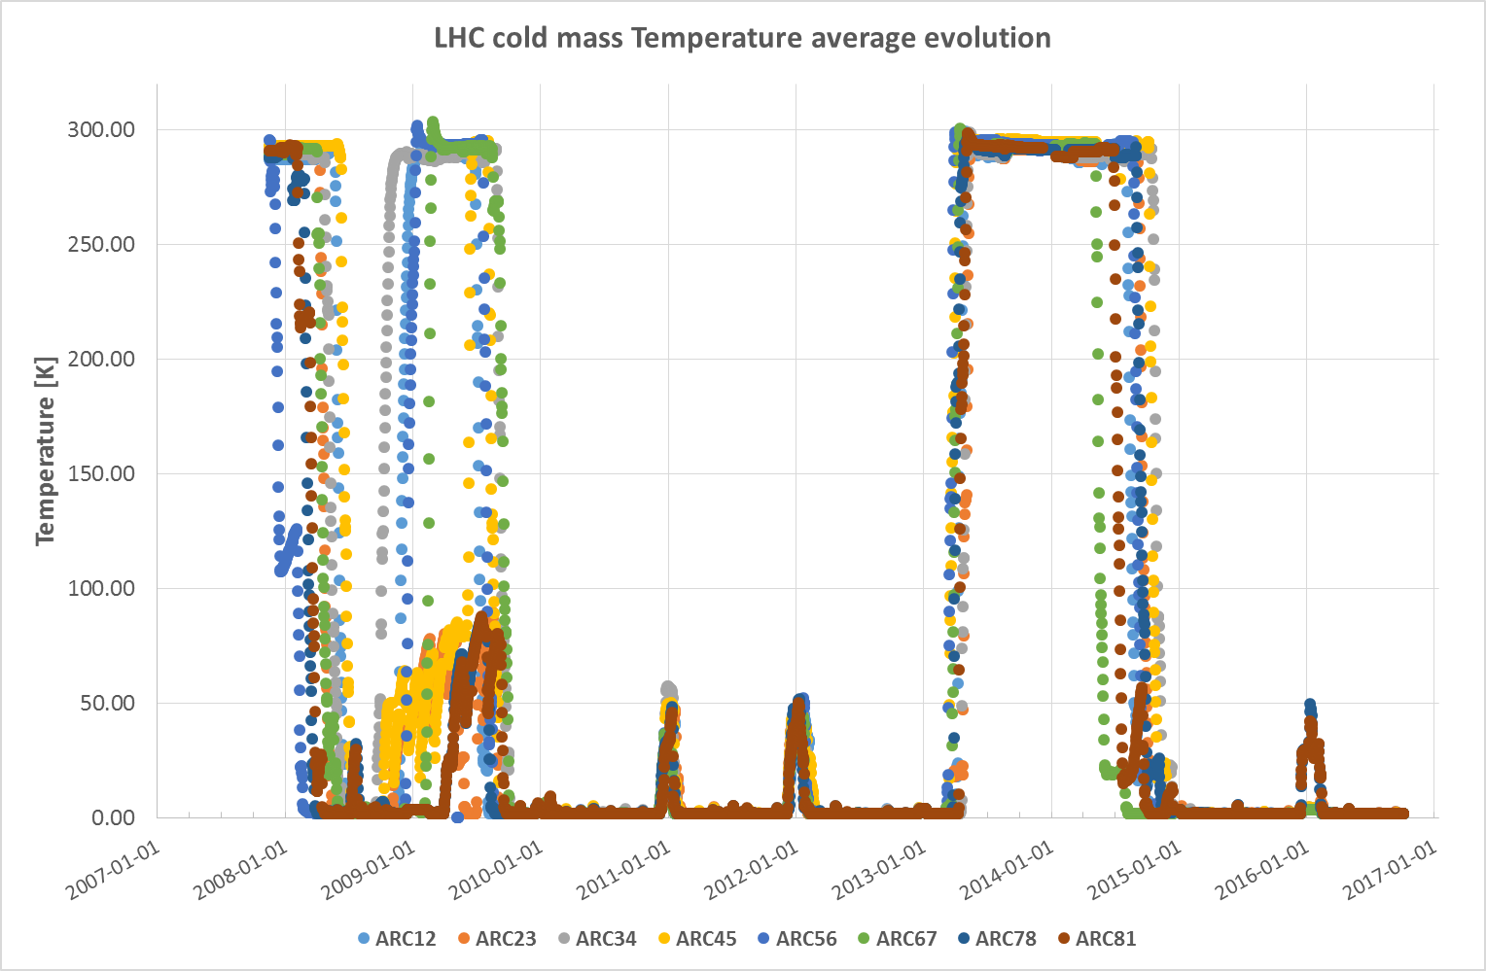
From 1st commissioning to … 10 years of LHC temperature evolution
3.5 / 4 TeV ~6732 A
6.5 TeV ~10979 A
Commisionning
Repair
RUN1 2010-2012
LS1
RUN2 2015-2018
YETS
YETS
YETS
YETS: Year End Technical Stop

Slide 6
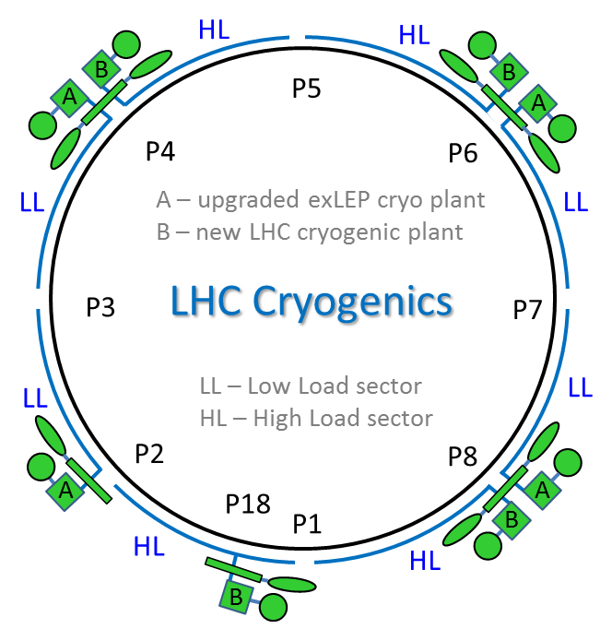
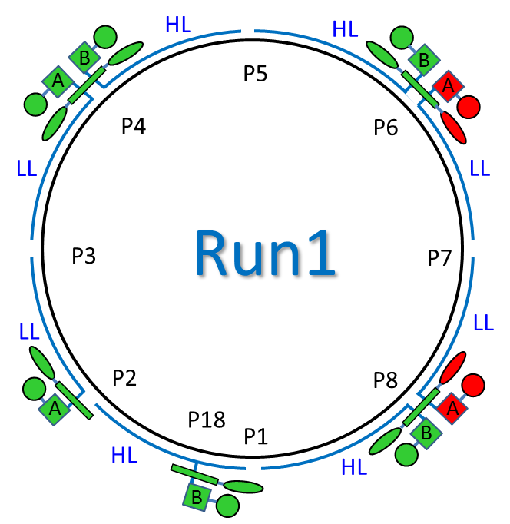
Cryogenic cooling capacity for LHC, Run1
Cooling capacity of A and B are designed to cover nominal LHC operation with equal margins on LL and HL sectors.
Thanks to build-in interplant connections some special configurations were possible during Run1 for hardware issue mitigations, lower power consumption and availability optimization.
Compressor station
4.5 K refrigerator
Interconnection box
1.8 K pumping unit (cold compressor)
Lowest capacity margin

Slide 7
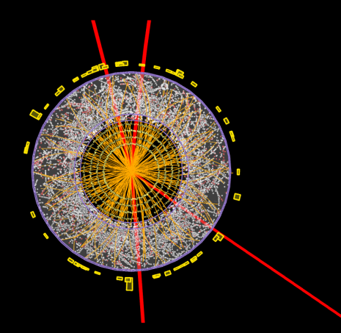
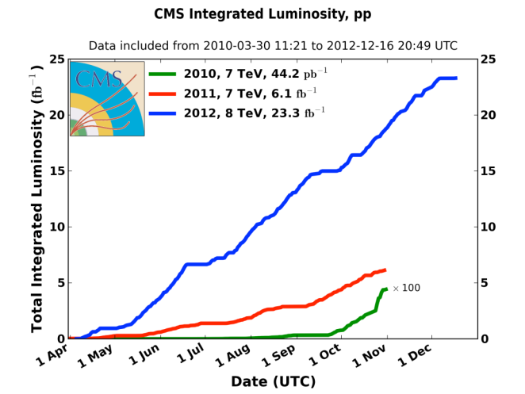
LHC Run 1 (2010-2012 @ 3.5 et 4 TeV)
Σ ∼30 fb⁻¹
Despite all, thanks to the efforts of all staff, the first campaign has been awarded by a Premium price

Slide 8
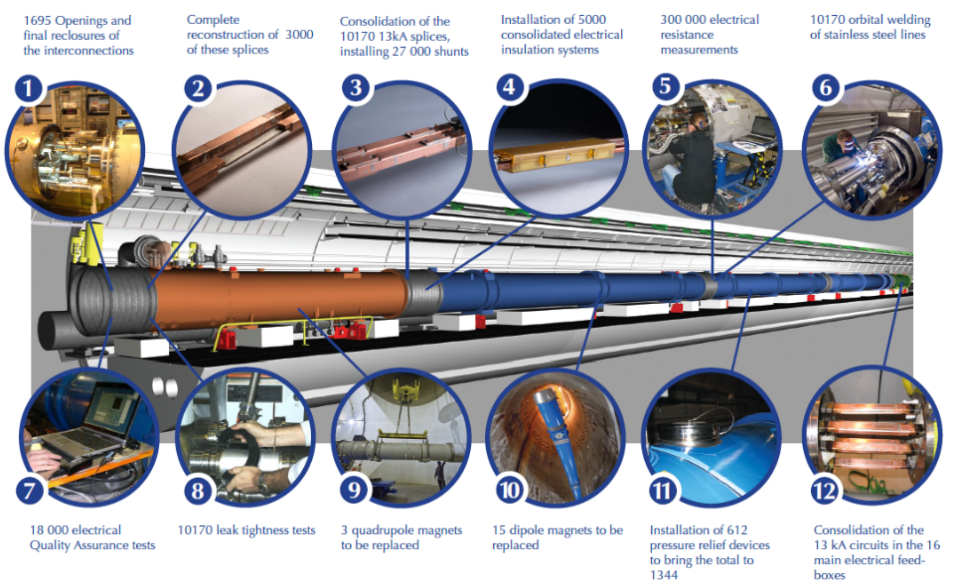
Main LHC overall consolidations during Long Stop (LS1) 2013-2014

Slide 9
Cryogenic equipment's: Main LS1 activities
Maintenance of all warm compressors and their electrical motors
Known from Run 1, 2 main refrigerators to be repaired but 4 refrigerators repaired (2 repairs done on LN2 pre-coolers)
During Run1 , 1 QRL leak to be repaired but 16 QRL interconnections repaired during LS1
Replacement of 71 QRL cryogenic valves (38 on beam screen circuit to increase cooling capacity of the loop) & 8 DN250 butterfly valves maintained.
Distribution feed boxes: 4 Gimbolt bellows replacement
R2E (radiation to electronics): displacement of components
M
HL
HL
M
B
R
P5
B
A
A
M
P4
P6
M
LL
M – maintenance of 64 compressors
LL
R – Repairs of 4 refrigerators
3TU – 3 turbines replacement
P3
6 Cold Compressor cartridges replacement
P7
- QRL compensators replacement
LL
LL
- DFBAs SM repairs
M
M
P2
- R2E campaign
P8
A
P18
A
R
P1
B
HL
HL
R
3 TU
M
… and many other small activities not visible on large scale.
B
R
M
Transient reveal hidden issues and could generate new issues (HX leak)

Slide 10
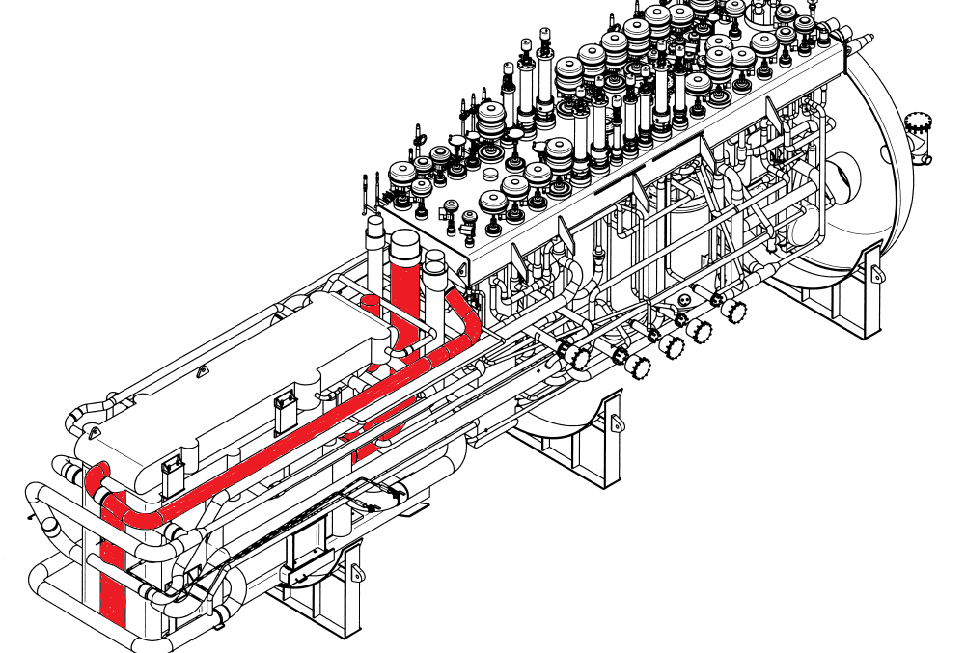
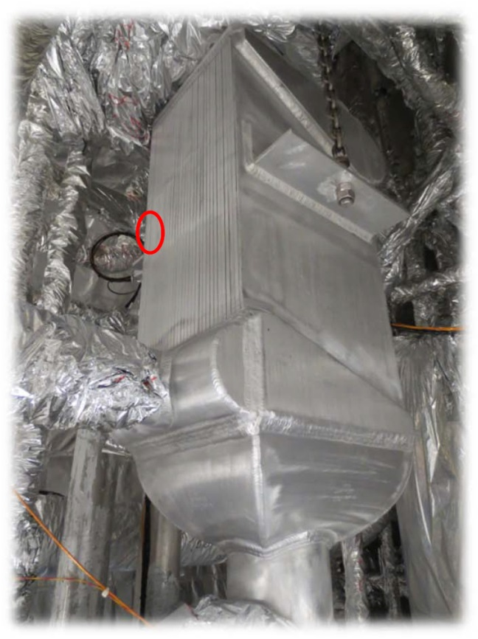
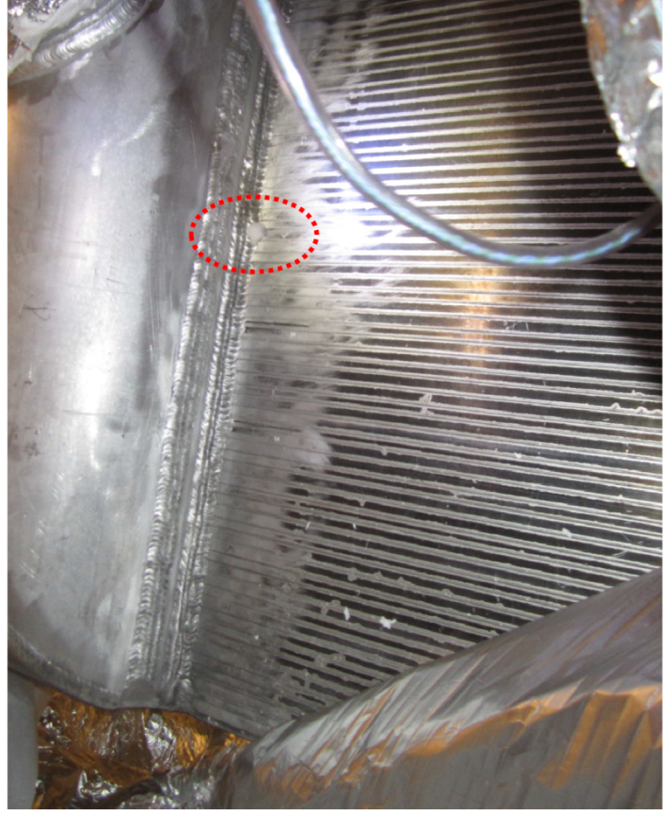
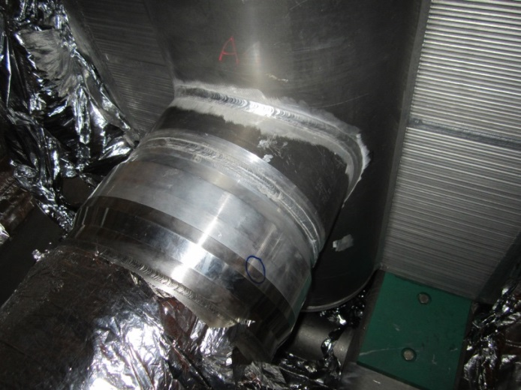
Cold boxes repairs
Cold box:
Leak on LN2 pre-cooler
Cold box:
Leak on Stainless-steel/AL transition (DN400)
Cold box:
Leak on HX collector MP side

Slide 11
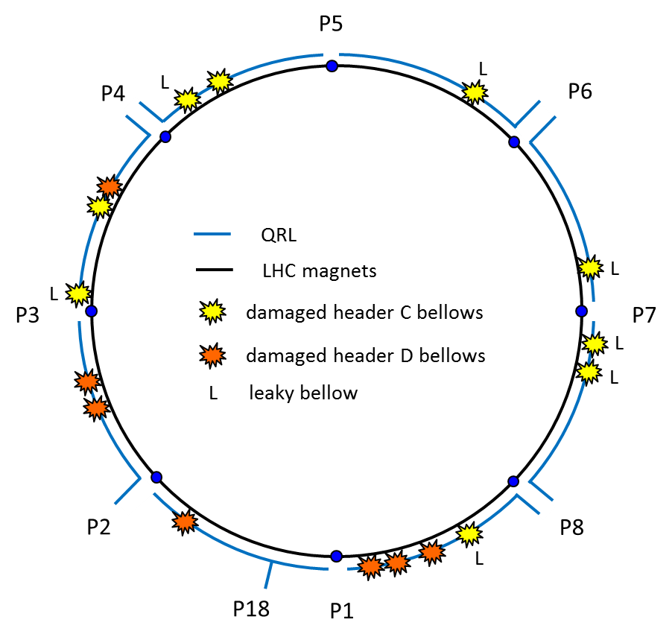
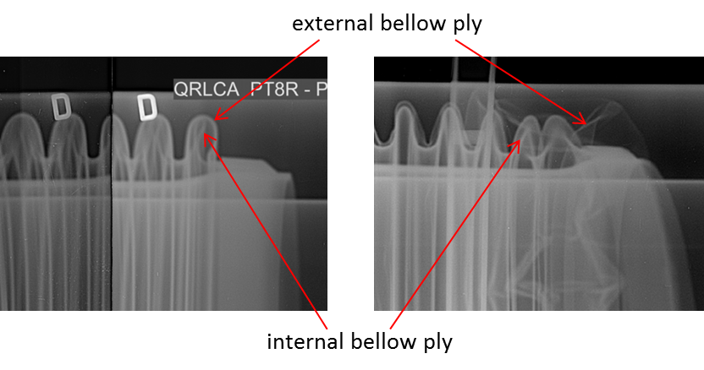
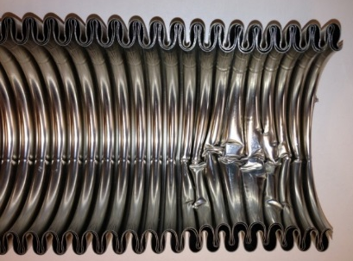
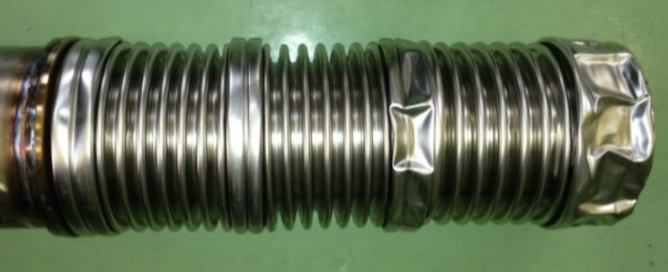
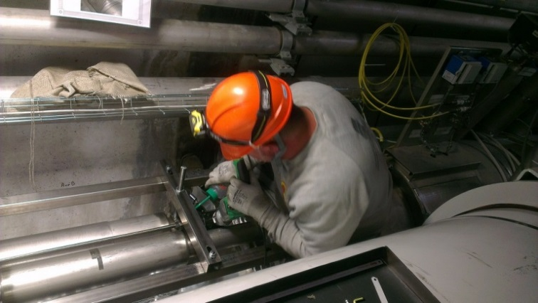
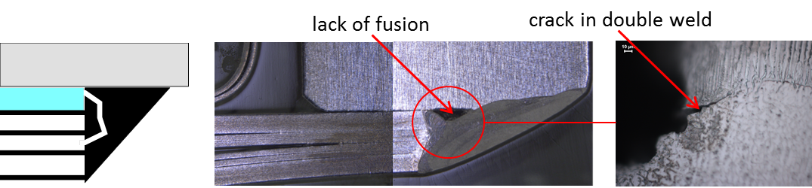
LS1: unexpected surprises during warm-up
~2000 X-ray analyzed
16 compensators to be exchanged on site (1.4 %)

Slide 12
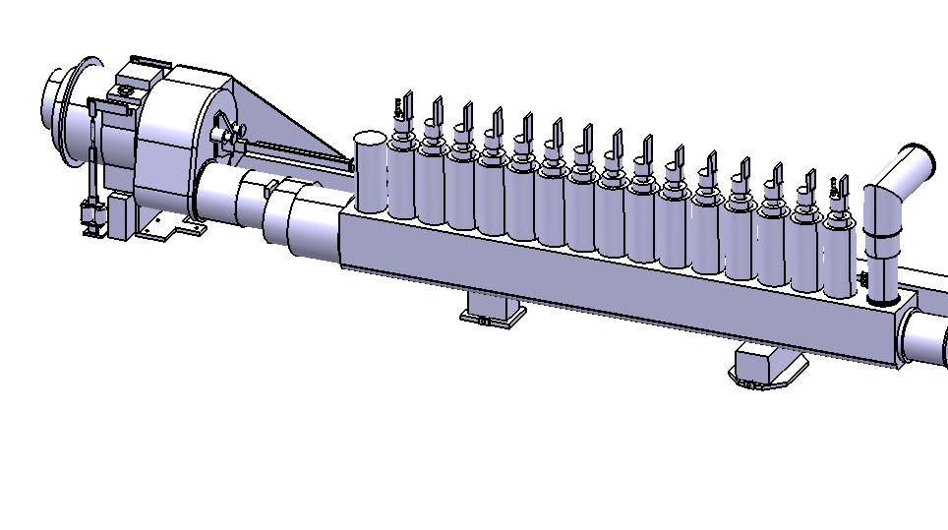
LS1: Unexpected surprises Distribution Feedboxes
Damaged Gimbolt bellows
Bellow multi-layers DN120
(2 layers, 0.2 mm / layer)
~ 32 endoscopic inspections
4 bellows to repair (12.5 %)
2 repairs requests a complete removal (back to workshop) of the feedbox

Slide 13
Cold Compressors cartridges; Maintenance during LS1
6 cartridges (on 28 + 7 spares) has been sent back to supplier for maintenance (including 1 damaged during tests done by CERN on a spare cartridge).
Major maintenance items:
Emergency Touch-Down Bearings (ETDB)
Restore electrical insulation
Mechanical damage on shaft rotor
MTBM is 100000 hours for one vendor and 90000 for the other one (Cold compressor cartridges only)
Presented CEC 2015 Tucson

Slide 14
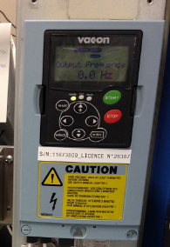
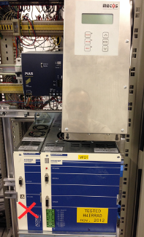
Cold Compressors cartridges; Consolidations & upgrades
Consolidations
Upgrades
VFD electronic unit exchange
Improve the utilities availability
AMB electronic unit exchange
Move electrical cabinet to a beam noise free area
75 % done; Expected to be finished 2017
Improve the inspection of all components ( adding remote communication) to detect a potential failure asap.
Improve driving software

Slide 15
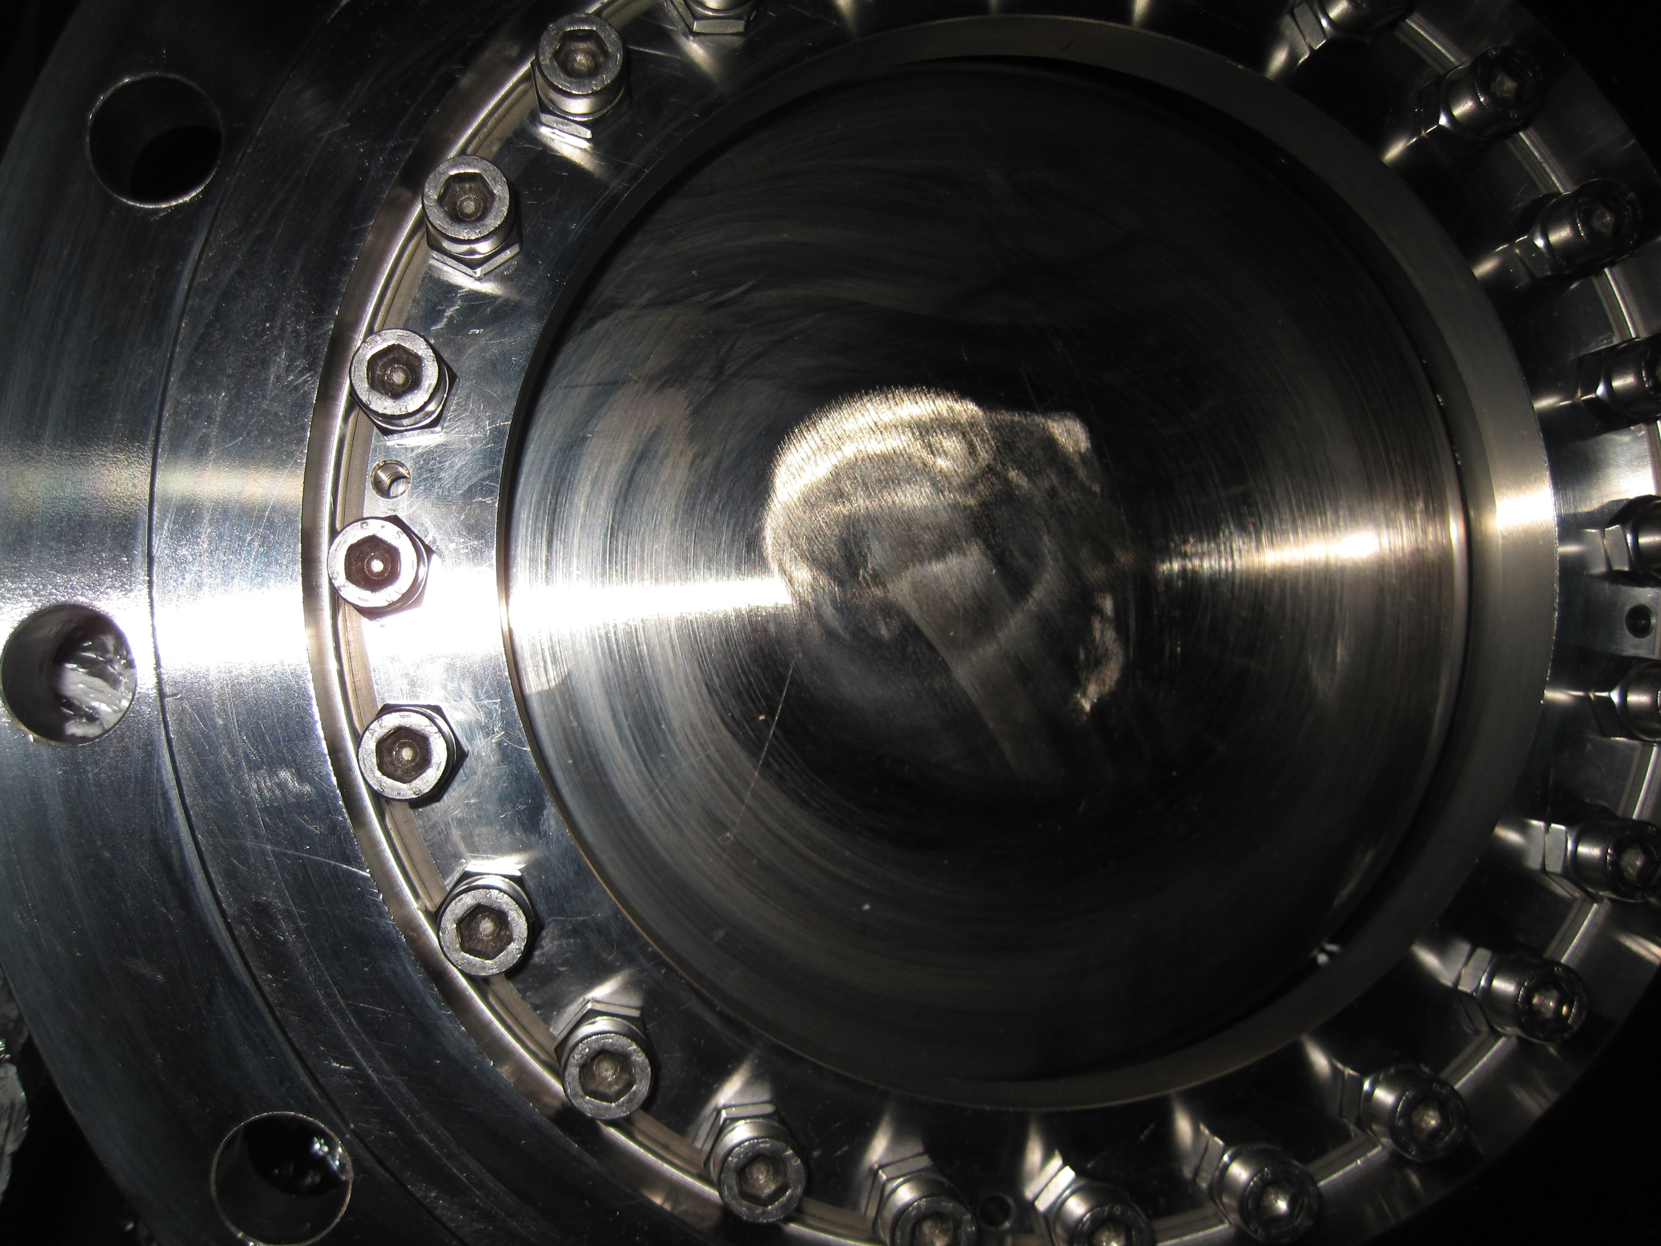
DN250 cold butterfly valve maintenance
This valve is the unique separation between the 3.3 km cold pumping line and the 1.8 K pumping unit. We have to trust in during the 4 continuous years of the Run.
Maintenance scheme of the 8 * DN250 Cold butterfly Valve for low pressure units [vendor: MAPAG]
Warm leak test [CERN]
Sealing system exchanged [Mapag]
Actuator maintenance (springs and membranes) [Mapag]
Warm leak test for acceptance [CERN & Mapag]
Cold acceptance tests [CERN]

Slide 16
Scope of LHC_Run2; Cryogenic operation point of view
Deliver Cryo availability higher than 95 % during physics run (~ 5500 hours/year)
Adapt the configuration of Cryoplants to fit with the requested power namely:
  Less power needed at the 1.8 K level thanks to lower thermal losses than expected
  More power used than specified at the non isothermal refrigeration level 4.6-20 K. This request is link to high thermal losses on the Beam Screen circuits (Electron cloud effect)
Deliver adapted configuration for non standard tests campaign foreseen by the Beam operation team (Copper Stabilizer Continuity Measurement @ 20K; Training quench of Cryomagnets & other Machine developments)
Optimize the power and helium consumption.
Electron cloud effect:
Synchrotron radiation from proton bunches in the LHC creates photoelectrons at the beam screen wall. These photoelectrons are pulled toward the positively charged proton bunch. When they hit the opposite wall, they generate secondary electrons which can in turn be accelerated by the next bunch and then create additional thermal losses.

Slide 17
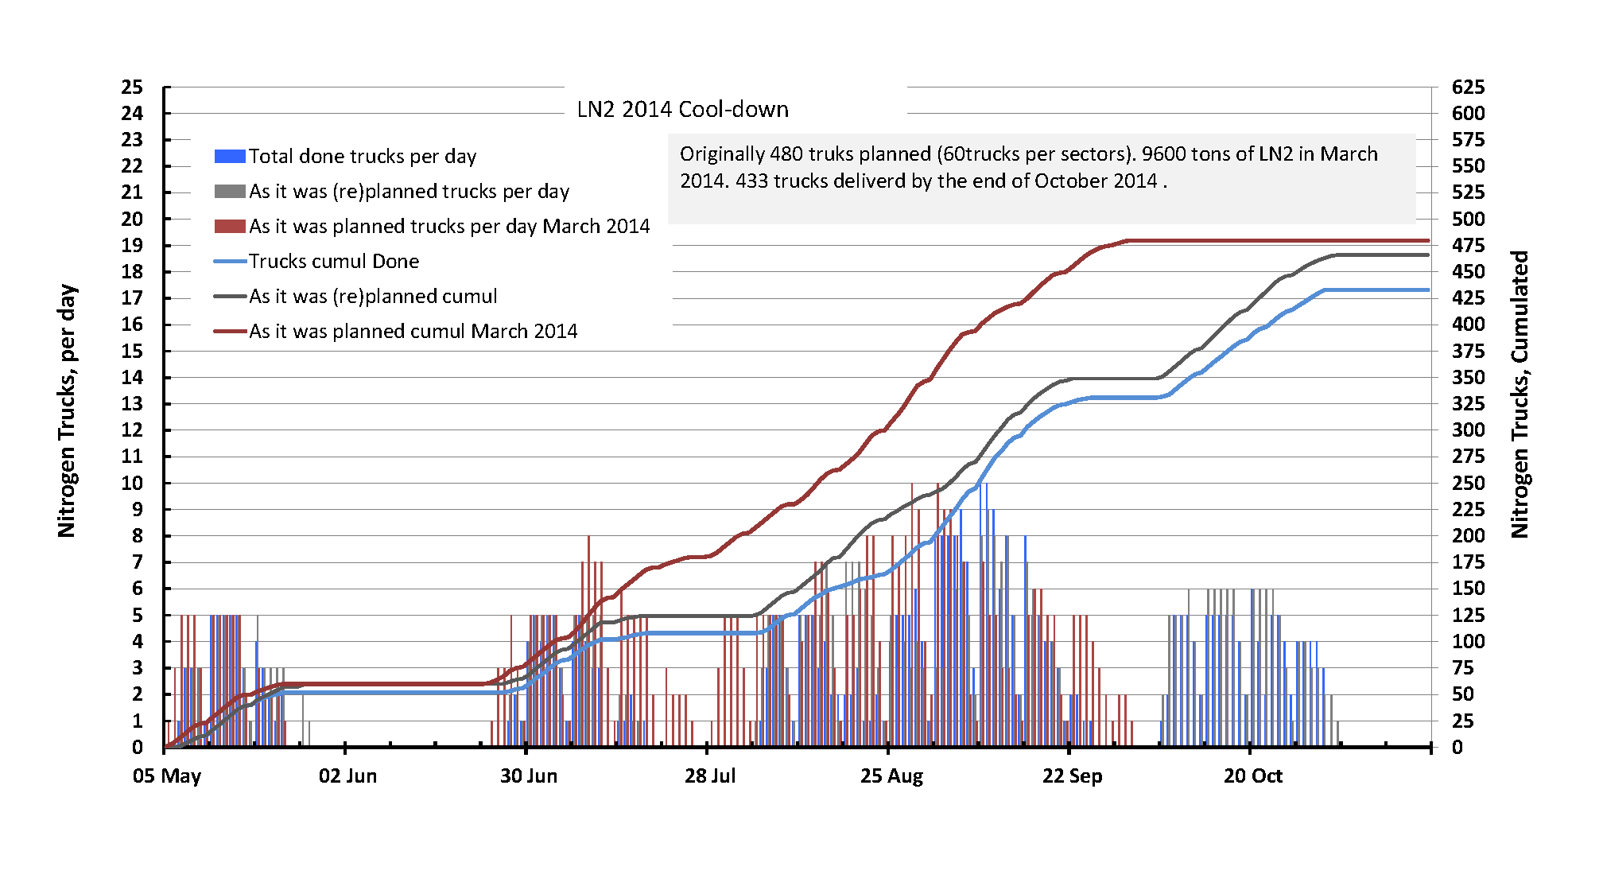
Cooling down of LHC: Nitrogen phase
LHC cooling down use 8660 Tons of LN2, in average 54 trucks per sector

Slide 18
Training for sectors towards 6.5 TeV
6.55 TeV
142 Primary quenches!
Cryodipoles training
Cryogenic recovery time after quench
The cryodipoles training phase up to 6.5 TeV last more time than expected (142 done vs 80 expected)

Slide 19
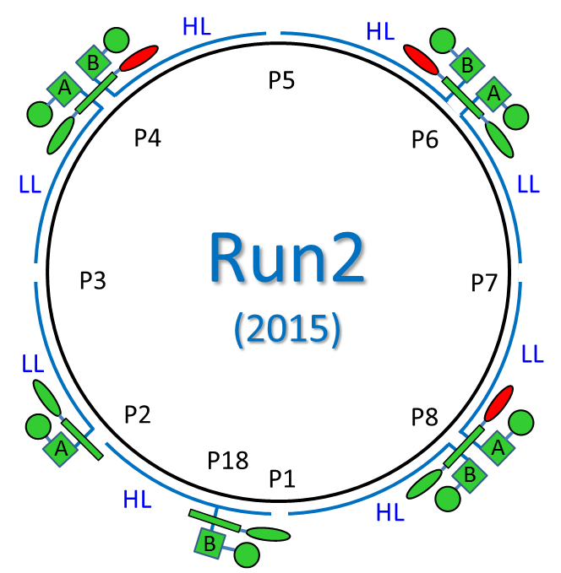
Cryogenic cooling capacity for LHC, Run2 (2015)
Configuration (two 4.5 K cold boxes + one cold pumping unit) was tested end of LS1 and put in production for a first time during Run2.
Stop of some Cold Pumping Units is possible thanks to overcapacity margin, lower than expected heat load at 1.9 K and built-in interplants piping in cryogenic infrastructure.
(P2/P18 – more difficult – tests to be done hopefully during YETS).
Main benefit:
less rotating machines => less failures => more availability
… but with 10-20 % longer recovery time in case of failures
Limitations:
Some modifications in hardware still to be studied and applied for better process control, optimization and gain in the non isothermal capacity 4.5 K – 20 K

Slide 20
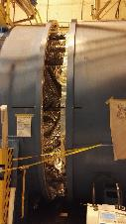
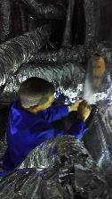
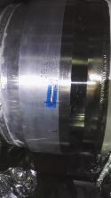
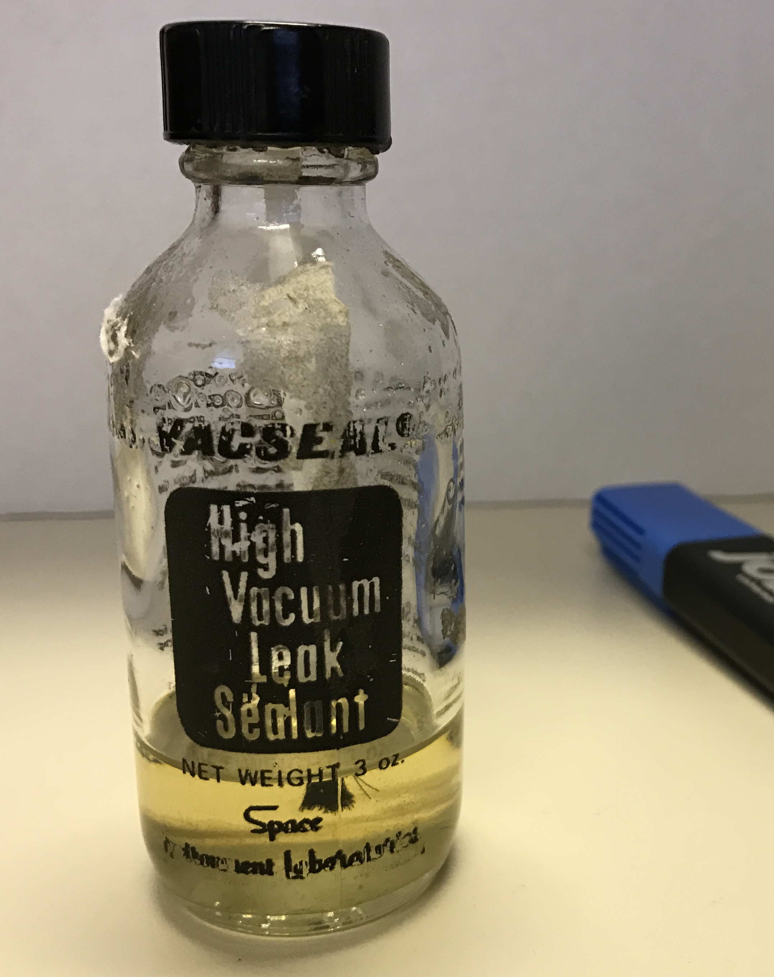
Hardware issues during Run2 (2015) solved during YETS2015
Warm compressor degradation diagnosed preventively and replacement without damage nor impact
Refrigeration hardware issue (Major Internal leak) temporary solved during YETS 2015 thanks to varnish “high vacuum leak sealant [Vacseal®]
Final repair foreseen during YETS 2016.
3 turbines failure, No impact, compensated by Liquid Nitrogen

Slide 21
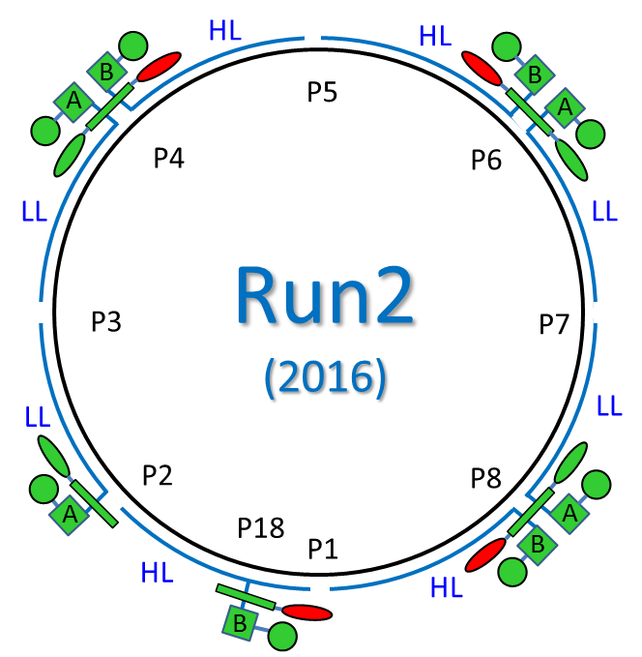
Cryogenic cooling capacity for LHC, Run2 (2016)
To cope with the imperative requests of non-isothermal cooling capacity 4.6-20 K (electron cloud load), a new configuration has been studied and tested during YETS 2015.
Temperature level | Average capacity for Nominal configuration | Installed Capacity | Run 2-2016 Maximum load
4.6-20 K | 5400 W | 7700 W | ~ 10000 W
1.9 K | 1350 W | 2400 W | ~ 1100 W
The above table shows the refrigeration capacity for one LHC sector.
Based on the Run2(2015) configuration, this new configuration requests:
Tuning of all 4.5K cryoplants to adjust the non-isothermal load up to 10 kW.
Configuration of Cryo-island P18/P2 where one cold pumping unit is now used instead of 2 in 2015. As the two 4.5 K cryoplants are not installed in the same area, a complex warm gas transfer system has been connected.

Slide 22
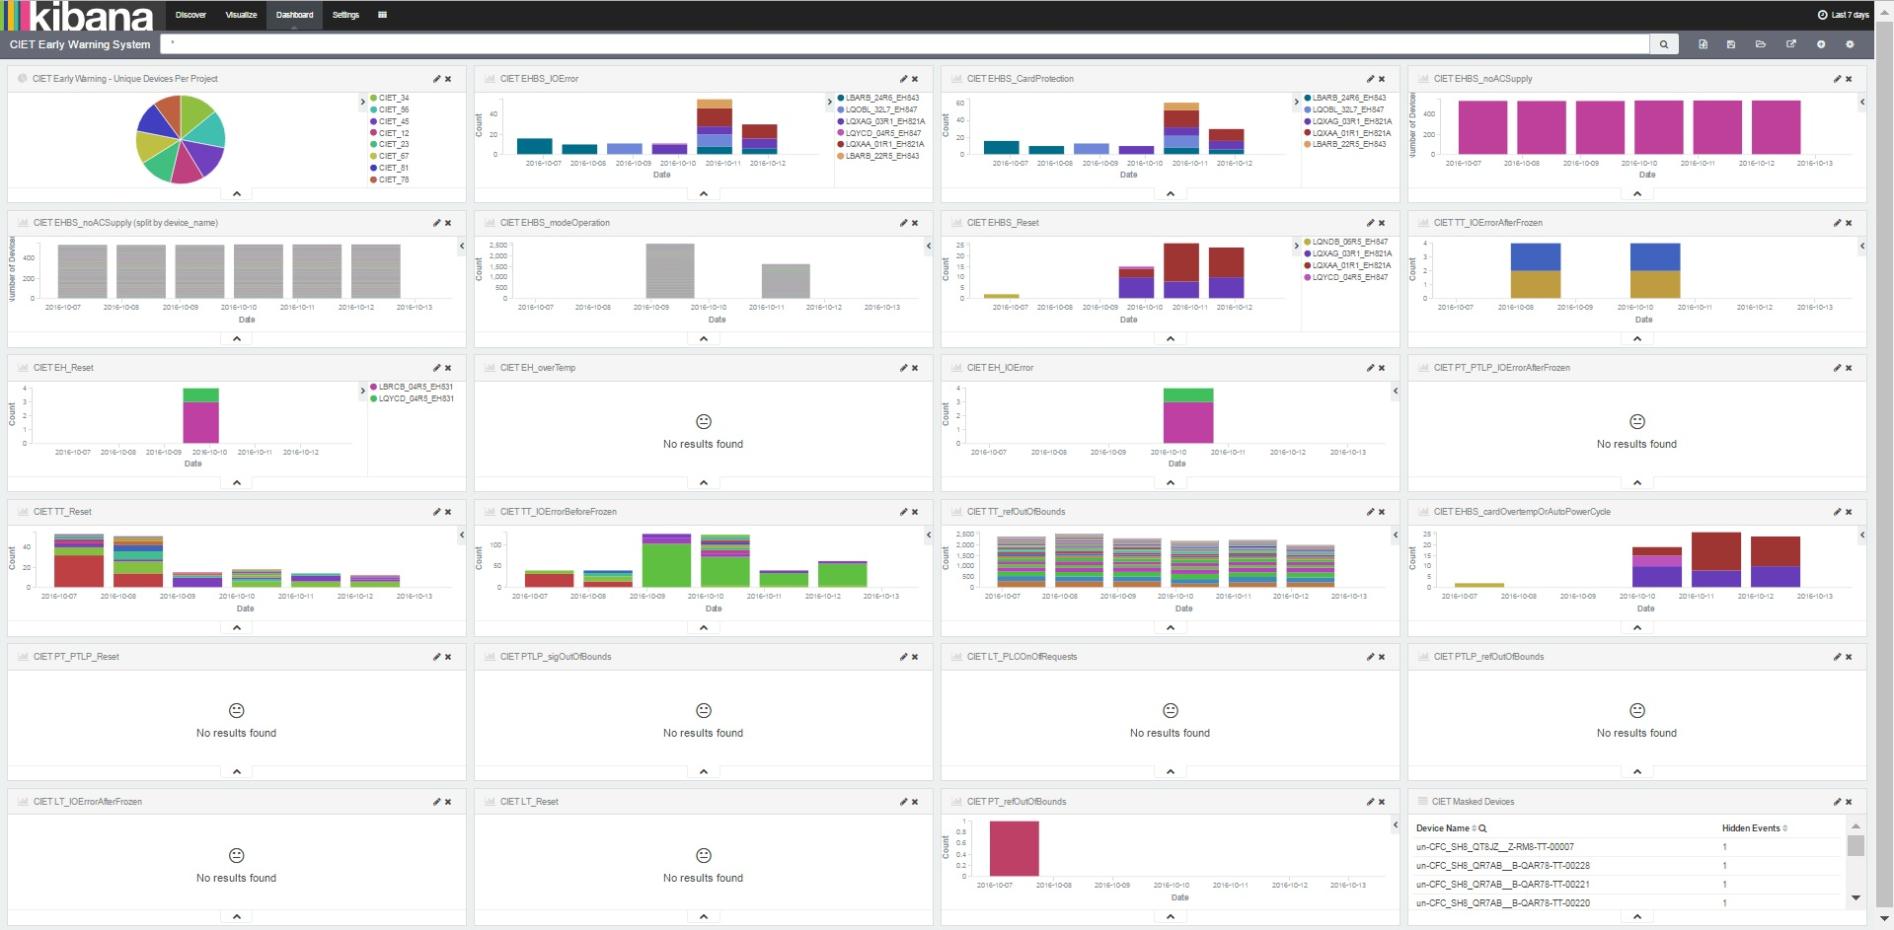
An early warning system for the Cryogenics Instrumentation Expert Tool (CIET) based on Elasticsearch/KIBANA is under development
Early warning system for instrumentation
Based on data mining scripts, this early warning system is used to generate pre-alert for altered components
A set of rules for the early detection of anomalous conditions (electronics or operating conditions).
Options for channel filtering, queries, channel masking (acknowledge), selection of time-spans.
Operational prototype stage (21 active rules) with new rules to be added.

Slide 23
Medium Term Plan for advanced controls of the process
A new follow-up system will be developed to compare process answer to a perturbation with simulated answer. In case of deviation, pre-alarm will be generated.
In parallel our support team is planning to develop a majority voting system for the massive parallel instrumentation of the magnets and distribution line.

Slide 24
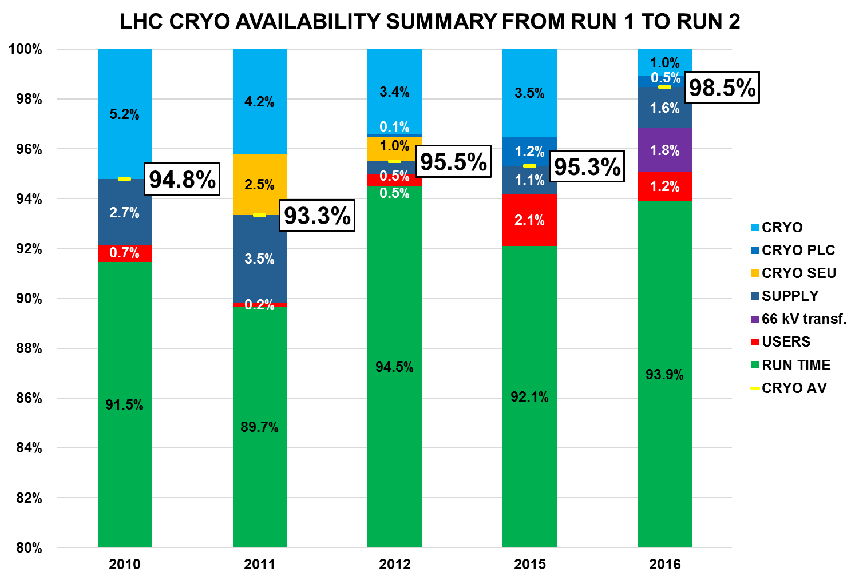
LHC RUN 1 & 2 Overall availability (Cryo Maintain)
Preliminary

Slide 25
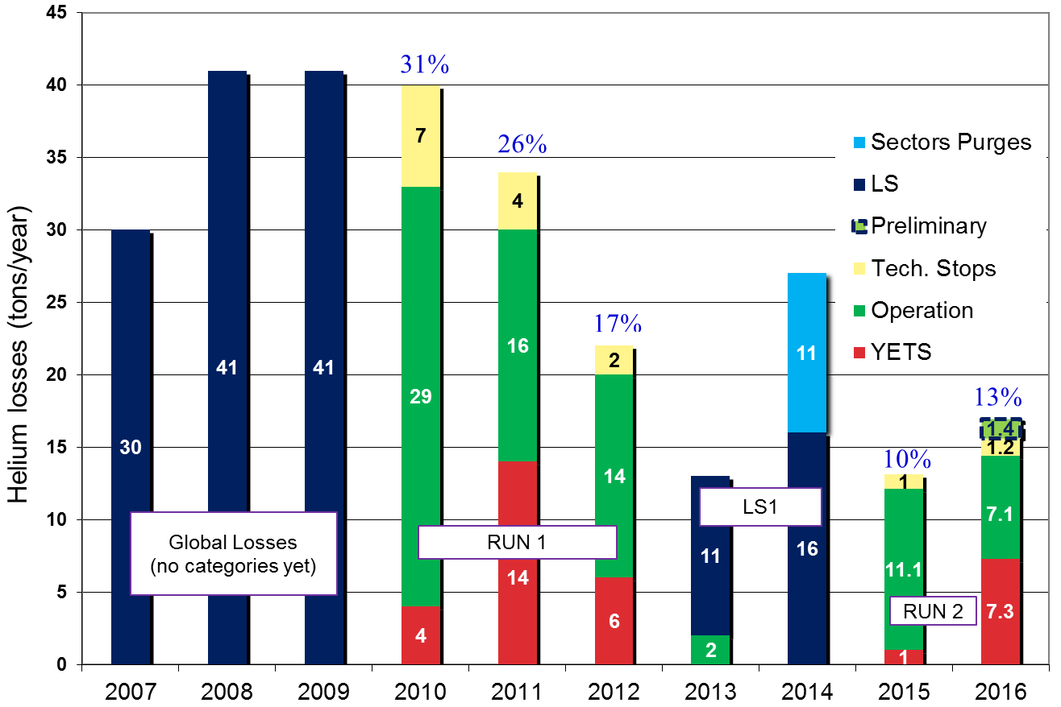
Helium consumptions and losses

Slide 26
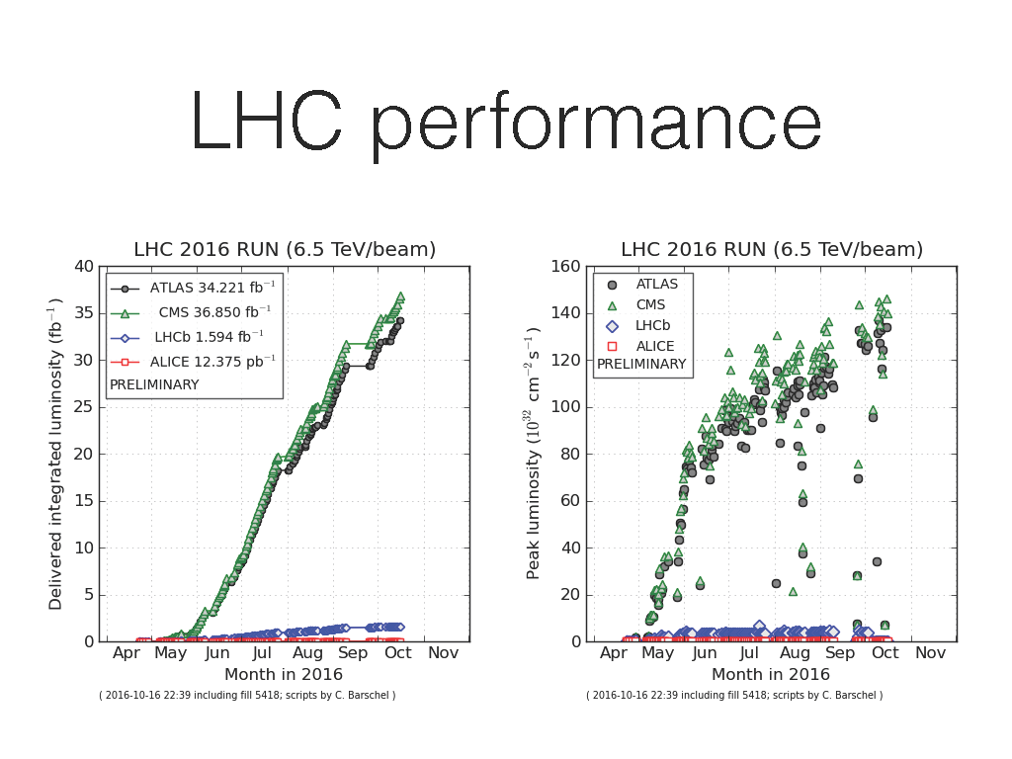
Quite goods results for 2016

Slide 27
Conclusions & Perspectives
Experience gained from Run1 is now used to boost the availability results during Run2 under high level of non isothermal load.
The reconfiguration of operation for Run2 optimise the cryoplants and gives a good feeling. This configuration copes with possible failures of major equipments, keeping cooling capacity at sufficient level for physics run.
Data mining, advanced control simulation & majority voting will be enforced to anticipate the aging effect on electromechanical equipment's such as valve positioners and on all the instrumentation.
The next challenge will be to keep the actual level of availability during several years

Slide 28
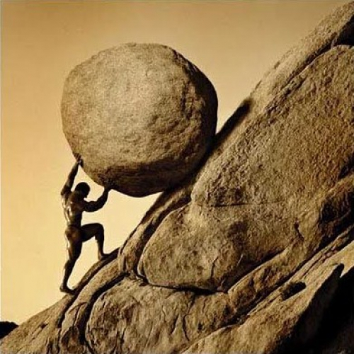
In Greek mythology Sisyphus was the king of Ephyra (now known as Corinth). He was punished for his self-aggrandizing craftiness and deceitfulness by being forced to roll an immense boulder up a hill, only to watch it come back to hit him, repeating this action for eternity. [Wikipedia]
From a personal point of view, cryogenic operation can appear as being a Sisyphean task as it requires to repeat permanently endless tasks such as
Helium leak search
Vibration check
Oil leak search
Visual inspection of the cryoplants
Remote inspection of the unreachable areas
…
But all of us could succeed!!!
Thank you for your attention! Questions ?

