Slide 1
35 Ton Run 2 Operation and Experiences
Fritz Schwartz
October 26, 2016

Slide 2
Outline
Background information
Overview of system and key components
Operating modes of 35T
Piston Purge
Cooldown & Filling
Issues seen during operation
Liquid Pump Seizure
Power outage
Loss of LN2 cooling to condensers
Vapor pump failure leading to gross contamination of liquid argon
Future plans for 35T system

Slide 3
Background Information
Prototype Cryostat at Fermilab to show the suitability of the membrane technology for LAr detectors
Constructed in 2012 in a decommissioned proton beam line, adjacent to the existing Liquid Argon Purity Demonstrator (LAPD)
Reuse the existing purification and instrumentation infrastructure of LAPD
Run 1 of 35T was a successful demonstration of techniques of piston purge, cooldown and purification in the membrane cryostat of rectangular shape and warm top plate without TPC (detector)
Run 2 was initiated in 2015 to test operations of the newly installed TPC
Filtration stopped on March 19, 2016 after warm pump failed resulting in intake of atmospheric air and contaminating 35T LAr inventory

Slide 4
Cryogenic System Overview
System as installed in PC4 facility

Slide 5
Key System Components
Cryostats
Liquid Argon Pumps
Condensers
Filtration
Purity Monitoring

Slide 6
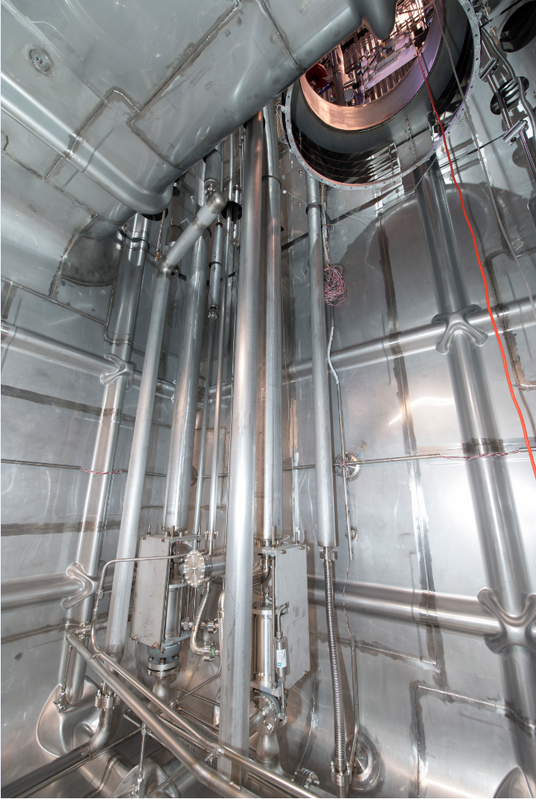
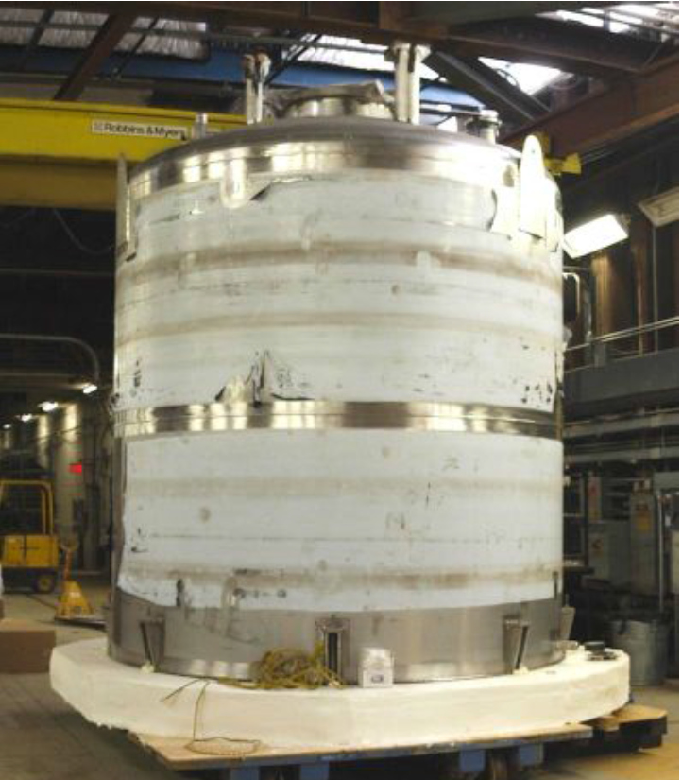
Cryostats

Slide 7
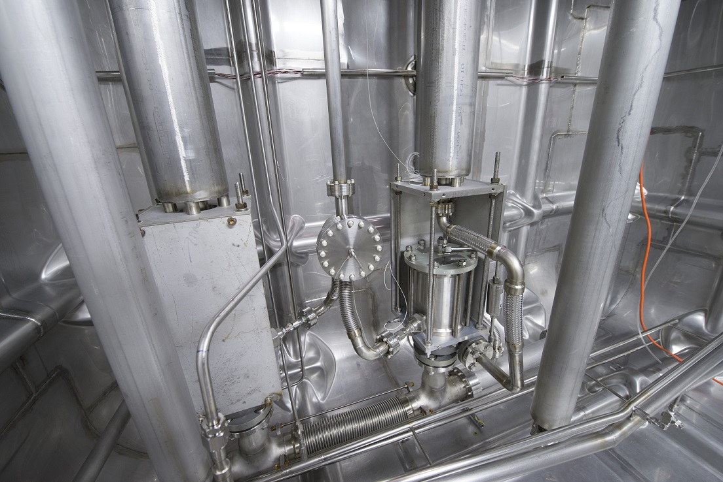
Liquid Argon Pumps
ACD submersible AC32 pumps

Slide 8
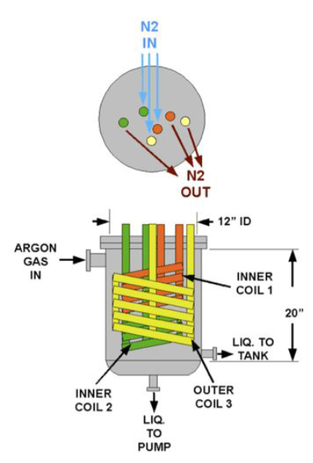
Condenser Design
Coiled tubing circulating liquid nitrogen
Seamless tubing with connections outside vessel to decrease possibility of leak into cryostat argon
Control valves regulate the flow to each coil depending upon heat load

Slide 9
Filtration
Water filter
~80 liters 4A porous sphere molecular sieve
Regenerated using heated argon gas, followed by evacuation
Upstream of oxygen filter because oxygen filter also removes water
Oxygen filter
~80 liters of copper catalyst
A thin layer of copper on a high surface area alumina substrate
Regenerated using a heated mixture of hydrogen/argon gas which removes oxygen from the copper to form water, followed by evacuation
Capacity at LAr temperature is approximately 0.5g O₂ per kg of filter material
Particulates
Sintered metal filters, large surface areas
Used to protect other equipment from debris

Slide 10
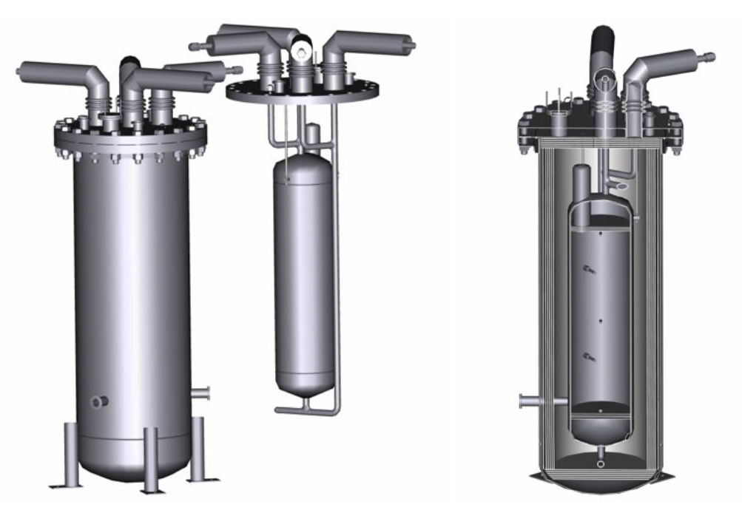
Water & Oxygen Filter Design

Slide 11
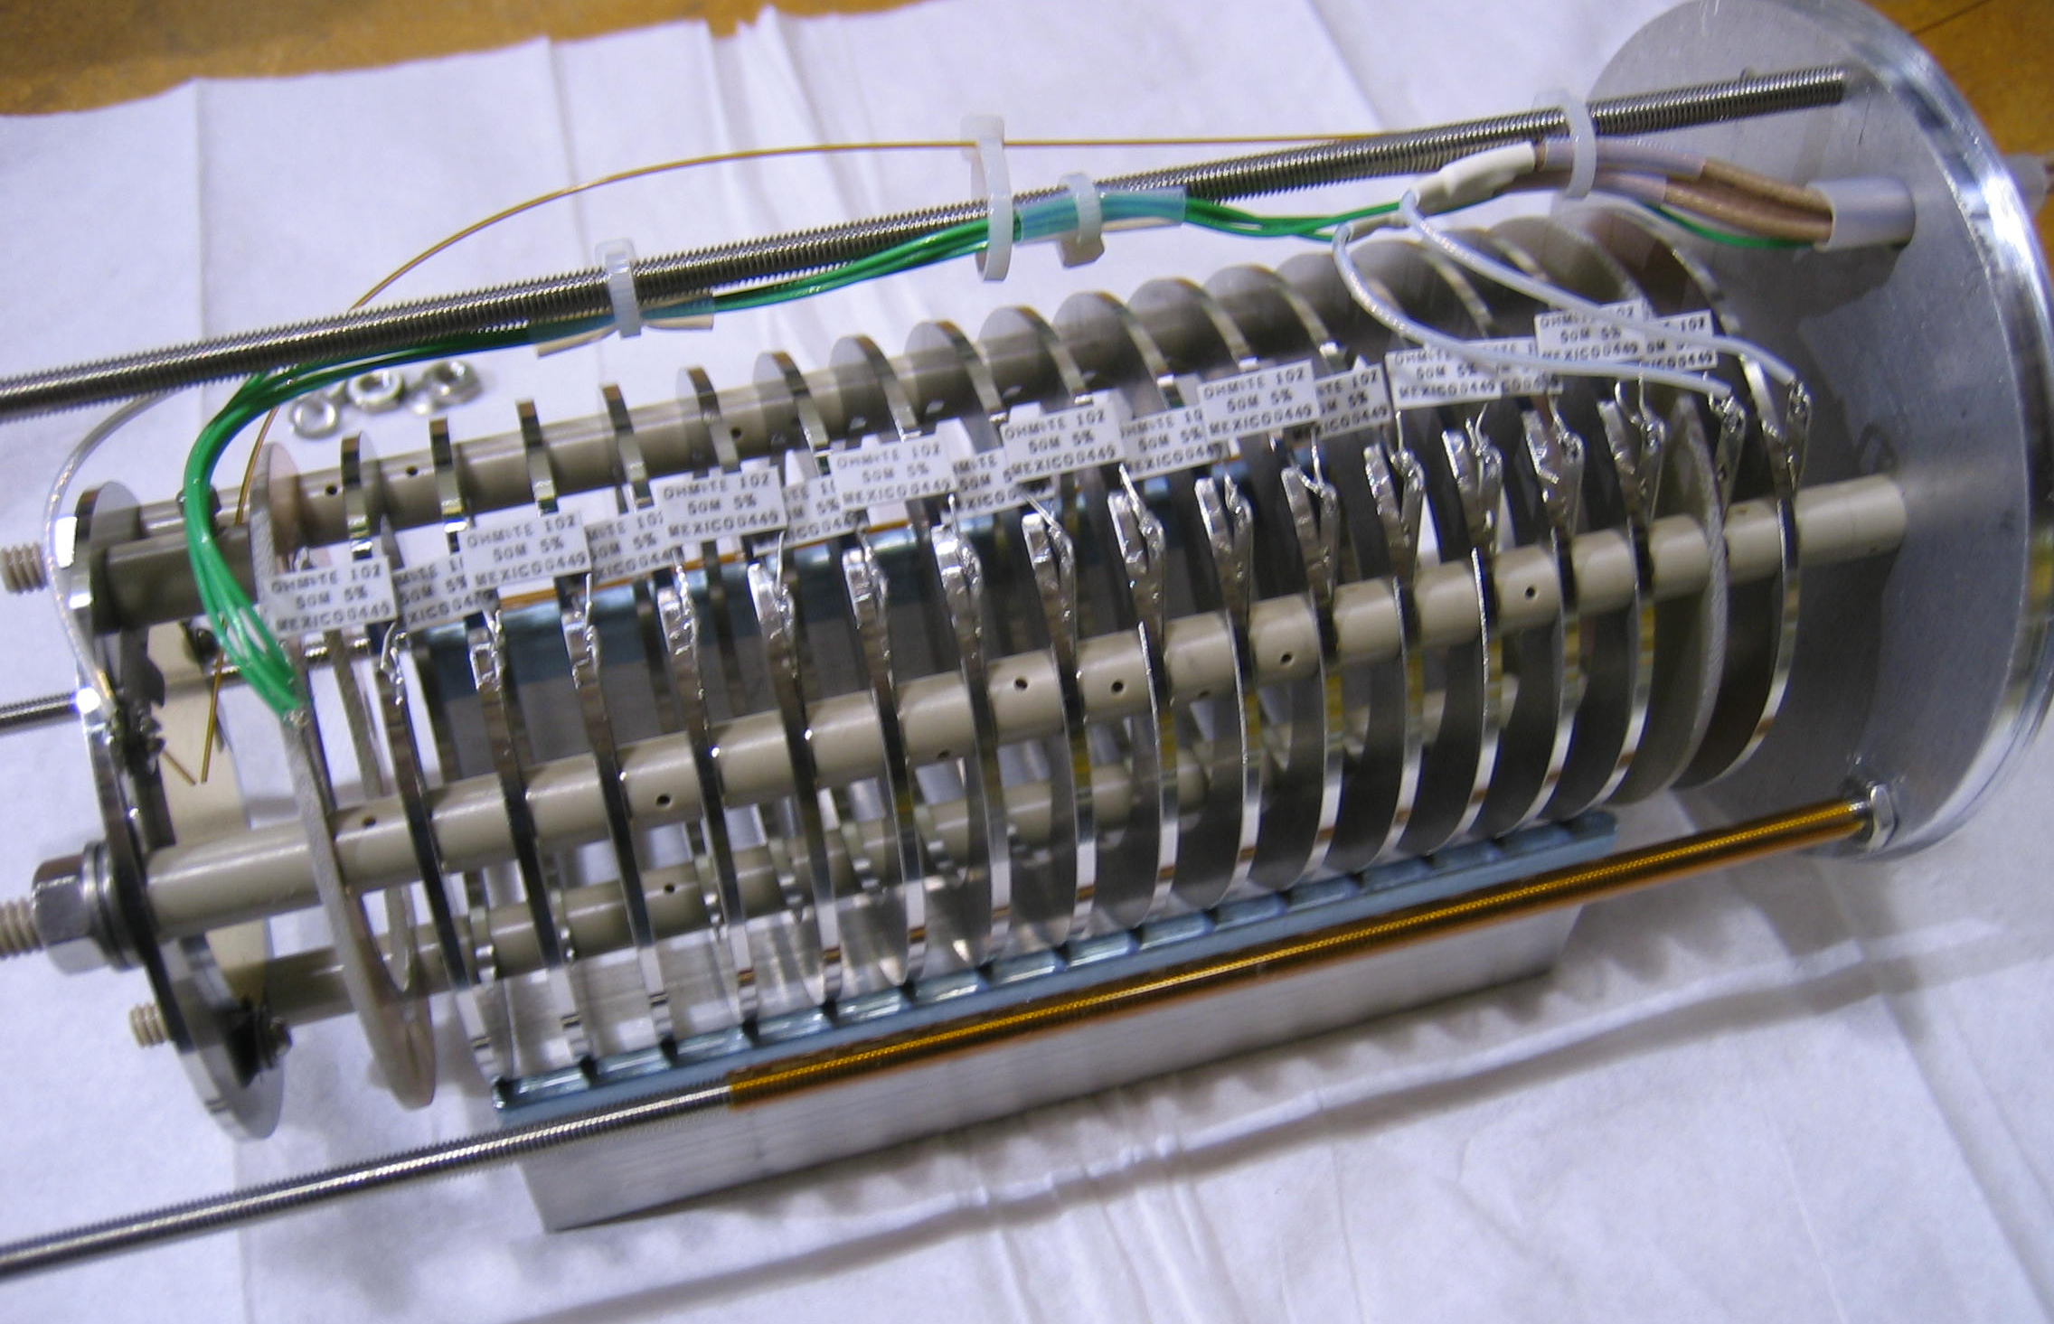
Purity Monitoring
Commercial/Laboratory Gas Analyzers
Nitrogen
Oxygen (3 with multiple ranges)
Water (Rough dew point and higher precision)
Purity Monitor
Creates an electron drift using xenon flash lamp and photo cathode
In-line and cryostat installations

Slide 12
Outline
Background information
Overview of system and key components
Operating modes of 35T
Piston Purge
Cooldown & Filling
Issues seen during operation
Liquid Pump Seizure
Power outage
Loss of LN2 cooling to condensers
Vapor pump failure leading to gross contamination of liquid argon
Future plans for 35T system

Slide 13
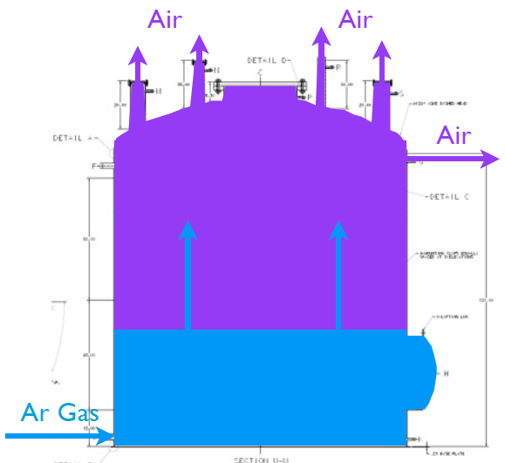
35T Piston Purge & Recirculation
Using higher density of argon to push out other gases from bottom to top
Vertical velocity of 1.2 meters per hour determined best to reduce mixing

Slide 14
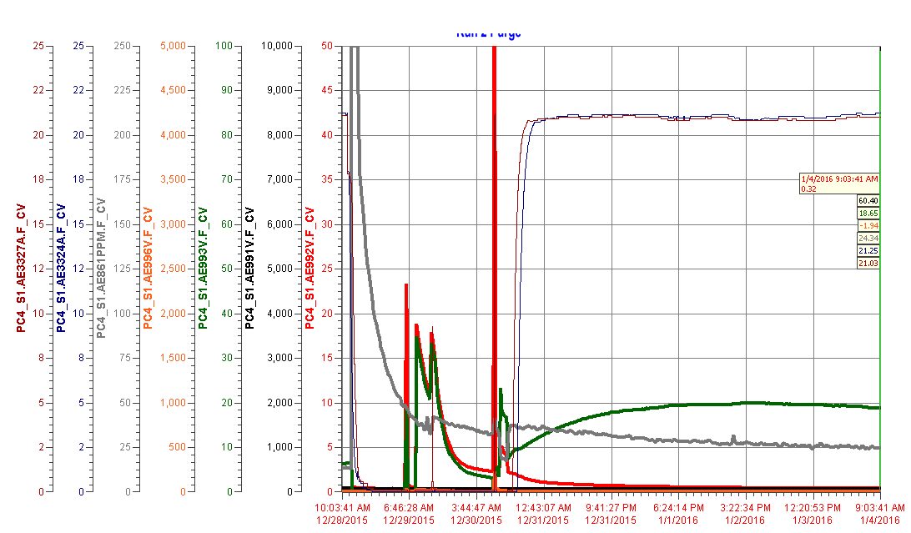
35T Piston Purge & Recirculation
O₂%, Instrument sampling other source
N2 = 18 ppm
H2O = 25 ppm
O2 = 0.2 ppm
35T Piston Purge
35T Recirculation and Filtering

Slide 15
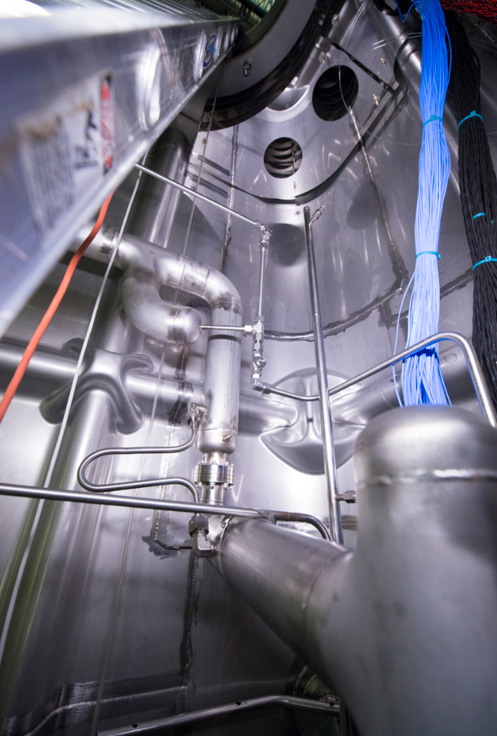
Cooldown Sprayers
Mix liquid and gas argon
Additional nozzles provide necessary momentum to circulate flow around volume of cryostat
Design rate of 10K/hr supplied by cryostat manufacturer

Slide 16
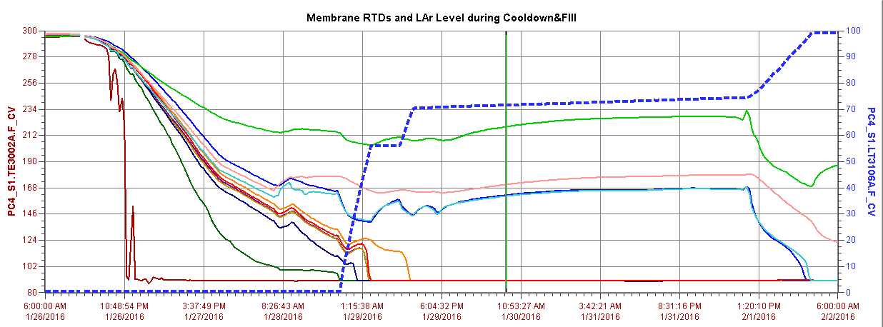
Cooldown and Fill of 35T
Transfer from
LAPD
Fill from
LAr Trailer
GAr transfer from LAPD (over weekend) ~1.5 tons
Membrane
Temperature
sensors
Gas Supply Issue
LAPD Pump trip

Slide 17
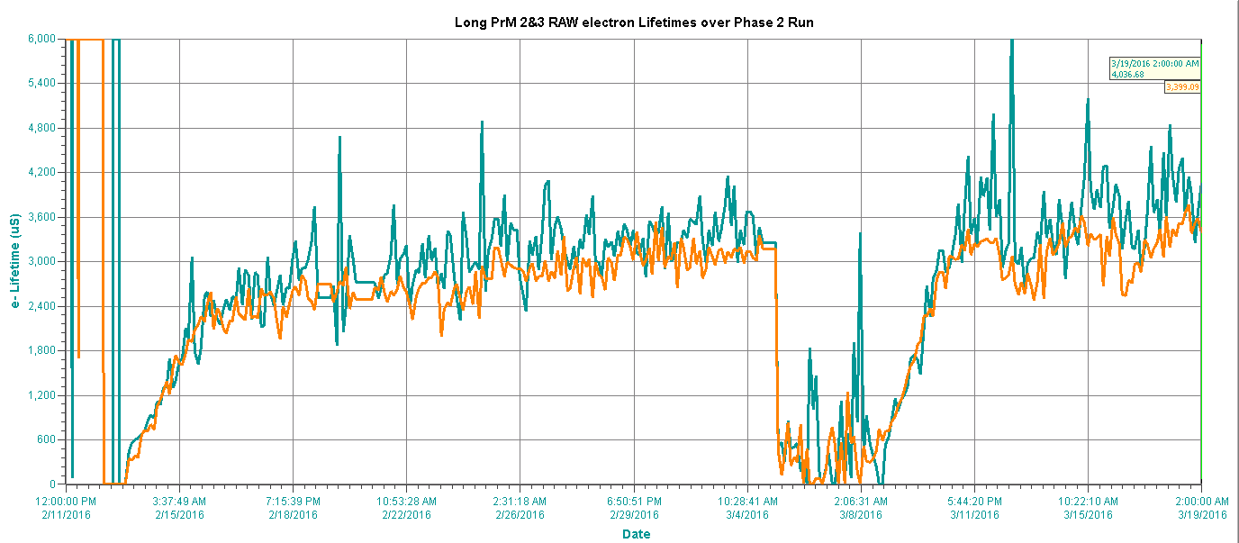
Results of Run 2
Several issues occurred during this run – did provide valuable lessons for future systems
PrM2 & 3 lifetimes
Failures
3 ms lifetime
Pump Start
Sitewide Power Outage
LN2 Cooling Loss
Tubing Break

Slide 18
Outline
Background information
Overview of system and key components
Operating modes of 35T
Piston Purge
Cooldown & Filling
Issues seen during operation
Liquid Pump Seizure
Power outage
Loss of LN2 cooling to condensers
Vapor pump failure leading to gross contamination of liquid argon
Future plans for 35T system

Slide 19
Liquid Pump Seizure
With 35T cryostat completely filled, the submersible pumps were seized up and blowing fuses
Pumps were rebuilt after Run 1, suspected that they were not tested prior to trying to operate them now
Controls group bypassed fast acting fuses with disconnect fuses and installed simple ON/OFF switch to bump motor several times (momentarily ON, 1 minute OFF)
The pump finally broke free after 12 repetitions
Restored original wiring once pumps were freed

Slide 20
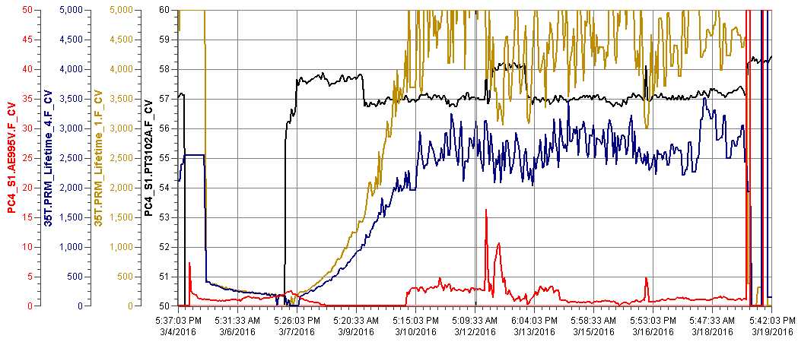
Power Outage
The power outage provided an opportunity to identify purity gradients within the liquid
Pump Off

Slide 21
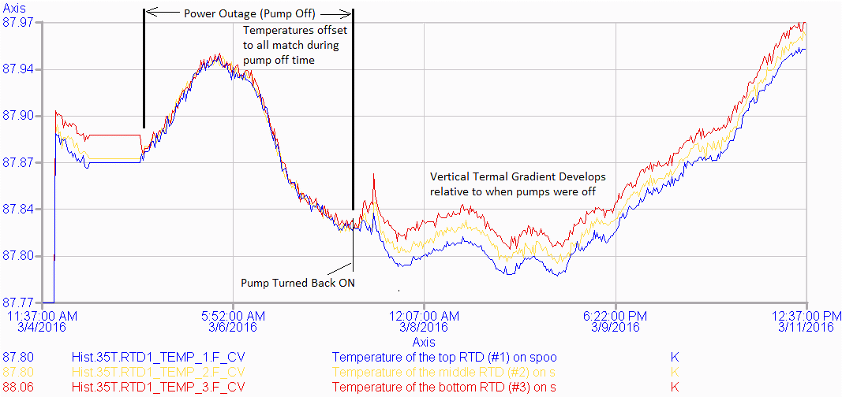
Power Outage
Small thermal gradients were also noticed

Slide 22
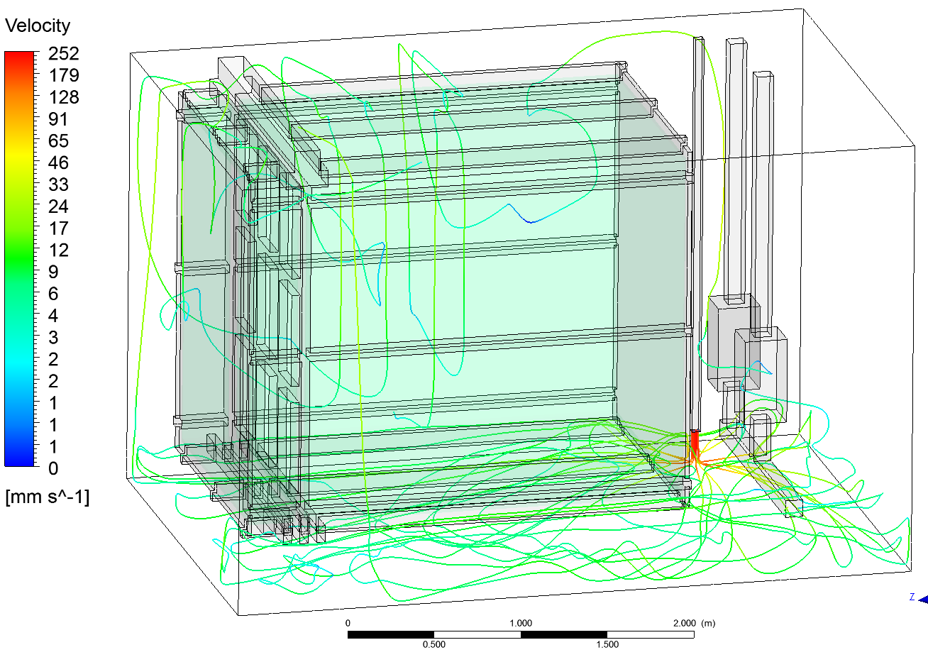
CFD Analysis (Erik Voirin)
Suspected that the liquid return was the primary cause
CFD analysis performed to confirm
Liquid Return
Pump Suction

Slide 23
Loss of LN2 Cooling
Loose valve plug on LN2 supply line
Cryostat LAr Level
Condenser LN2 Level
LN2 runs dry, lose control of internal pressure. Vents at 1.5 psi, LAr Level begins to drop
Cryostat Internal Gauge Pressure
RTD Temp. Probes
DF-560 O2 Analyzer

Slide 24
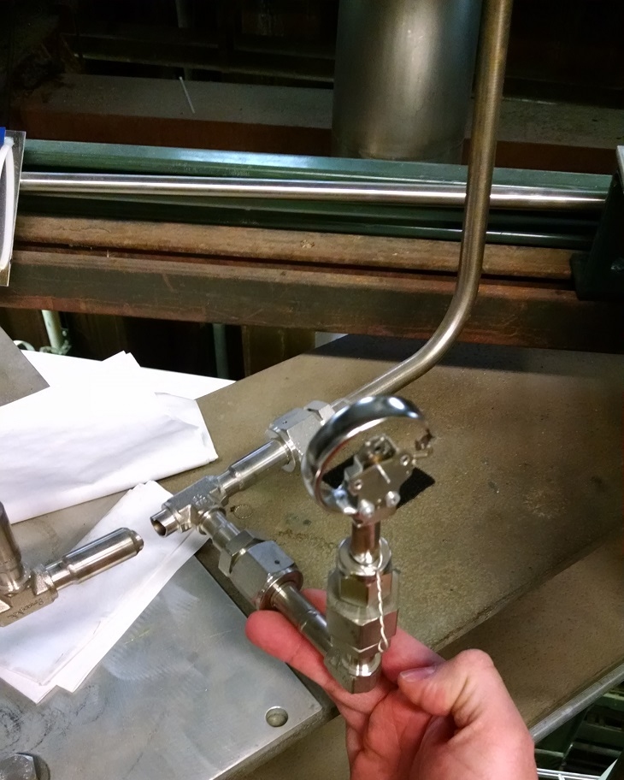
Vapor Pump Failure
From Cryostat
Pump Inlet

Slide 25
Vapor Pump Failure
Gas analyzers sampling from ullage space
Filters saturate, see response from analyzers within 20 minutes
Complete loss within 30 minutes…ending the run

Slide 26
Recommendations to Reduce Major Contamination
A panel was formed to investigate the failure of the pump
Conclusion was that design was done to acceptable codes and standards, also considering the short expected runtime
Panel suggested that analyzers be installed at locations where contamination can be caught prior to entering cryostat
Location is likely to be at liquid return line to cryostat where nitrogen (or oxygen) analyzer can be utilized
Upon detection of impurities, controls need to isolate cryostats – total shutdown mode

Slide 27
Outline
Background information
Overview of system and key components
Operating modes of 35T
Piston Purge
Cooldown & Filling
Issues seen during operation
Liquid Pump Seizure
Power outage
Loss of LN2 cooling to condensers
Vapor pump failure leading to gross contamination of liquid argon
Future plans for 35T system

Slide 28
Future Plans of 35T
Two runs planned for 2016-2017, with preparation work being performed now
High voltage test of ProtoDUNE style field cage assembly
Beam plug test to investigate effects of reducing amount of liquid argon between detector and cryostat wall
Modifications to liquid argon return line in 35T cryostat
Investigate effects on the purity gradient issue
Addition of heating elements in 35T cryostat to increase boil-off between runs, also useful for boil-off of pooling liquid during the spray cooling phase

Slide 29
Questions?

