Slide 1
ICARUS Operations experience
C. Montanari
CERN and INFN-Pavia
Workshop on Cryogenic Operations – FNAL – October 26, 2016

Slide 2
Outline
Foreword
Basic requirements
Cooling plant
Purification and recirculation plants
Safety
Conclusions

Slide 3
Foreword
The ICARUS T600 detector, the largest liquid Argon Time Projection Chamber (LAr-TPC) was installed and successfully operated for more than 3 years at the INFN Gran Sasso underground Laboratory.
The cooling plant ensured an extremely stable operation with negligible temperature gradients over all the sensitive volume and a fast and uniform cooling during the commissioning.
One of the most important issues was the need of an extremely low residual electronegative impurity content in the liquid Argon, to transport the free electrons created by ionizing particles with very small attenuation along the drift path.
The solutions adopted for materials, the cleaning and commissioning procedures and for the Argon recirculation and purification systems have permitted to reach impressive results in terms of Argon purity and a free electron lifetime exceeding 15 ms → ≈ 20 ppt of O₂-equivalent contamination.
  A major milestone for any future project involving LAr-TPCs and the development of higher detector mass scales.

Slide 4
Basic Requirements
Physics Required Parameter | Value
LAr purity in cryostat | >3 ms electron lifetime (<100 ppt O2 equivalent)
Verifiable contamination levels for LAr delivery | O2 < 1 ppm, H2O < 1 ppm, N2 < 2 ppm
Max Design Over-Pressure | 350 mbarg (~5 psig)
Operating gas pressure | 150 mbar (~2 psig) with +/- 5% (~0.1 psig)
Vacuum tightness | Localized leaks < 10⁻⁸ mbar x liters / s Global leak rate < 10⁻⁶ mbar x liters / s
Minimum inner dimensions cryostat | 3600 mm (Transv) x 19900 mm (Para) x 3900 mm (H) (-0 mm +10mm for all dimensions)
Cool-down rate | ≈ 2 K/hr (5 days to cool to LAr temperature)
TPCs max gradients | < 70 K < 50 K (vertically)
LAr recirculation rate | ≈2 m³/hr/T300 module (one volume / week)
Purification Technique | Pump down to vacuum and fill with purified LAr
LAr flow speeds (convection) | < 20 cm / sec
Minimum depth of liquid argon | 3783 mm (From the floor)
Maximum static heat leak | <10 W/m² (Sides/Floor) 10 W/m² (Roof)

Slide 5
Cooling Plant
The cooling plant has to provide three main functions:
  Cool down the apparatus before the start of the filling (≈100 ton of St. Steel and Aluminum) in about five days while maintaining the prescribed maximum temperature gradients on wire chambers.
  Provide a continuous cooling of the main argon volume during operation ensuring temperature gradients in the LAr not exceeding 1 K.
  Provide cooling for operation of the LAr and GAr recirculation systems both during commissioning and operation.
To achieve the first two goals the cryostats are surrounded by a common cooling shield that almost completely intercepts the heat coming from the insulation. During operation, the shield is flown with saturated bi-phase Nitrogen at the chosen temperature. LN2 pressure is regulated.
The LAr and GAr recirculation systems are flown with LN2. The LN2 temperature is regulated again by pressure to set the GAr recirculation speed.
The shield circuit can run both on pumps (primary mode) and by gravity (secondary mode). The argon re-condensers of the GAr recirculation systema can also run both modes.

Slide 6
T600 P&I (Nitrogen Scheme)
Storage Dewars
Cooling Shield
Circulation Pumps
Phase Separator
Purification Circuit

Slide 7
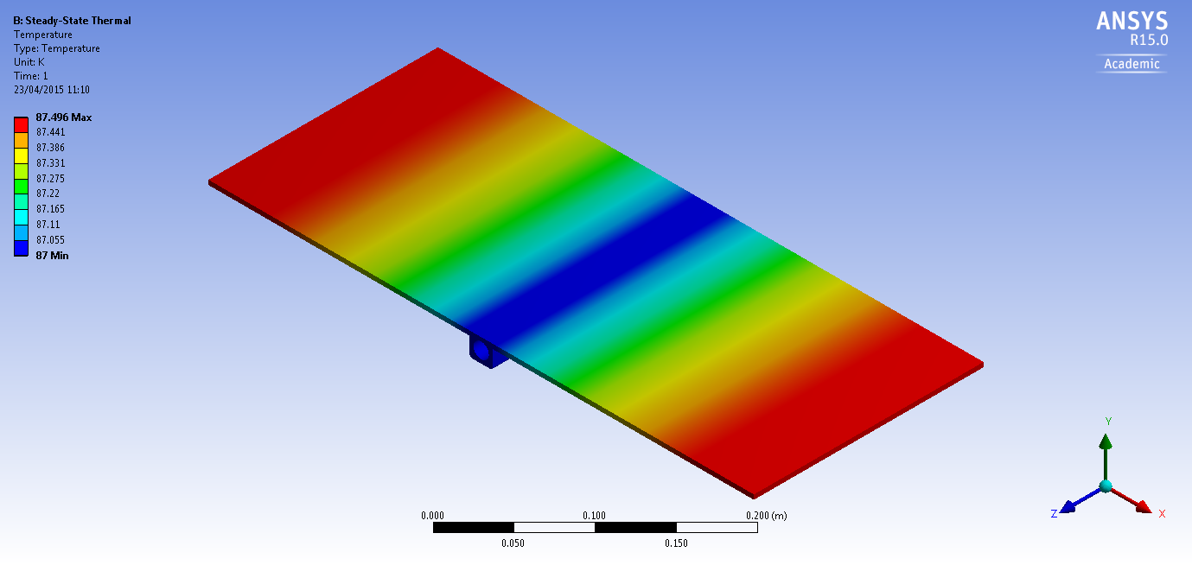
Cooling shield (new version)
The cooling shield is
based on aluminum
extruded panels with
St. Steel pipes where
two phase nitrogen is
flown.
The panels have been
dimensioned at CERN
for a heat load of
20 W/m² (twice the nominal) and a maximum gradient across the panel of 0.5 K.
The thermal calculations have been validated experimentally.
Heat load 20 W/m²
Two-phase flow LN₂
Top View
Picture 9: Temperature profile along the panel width

Slide 8
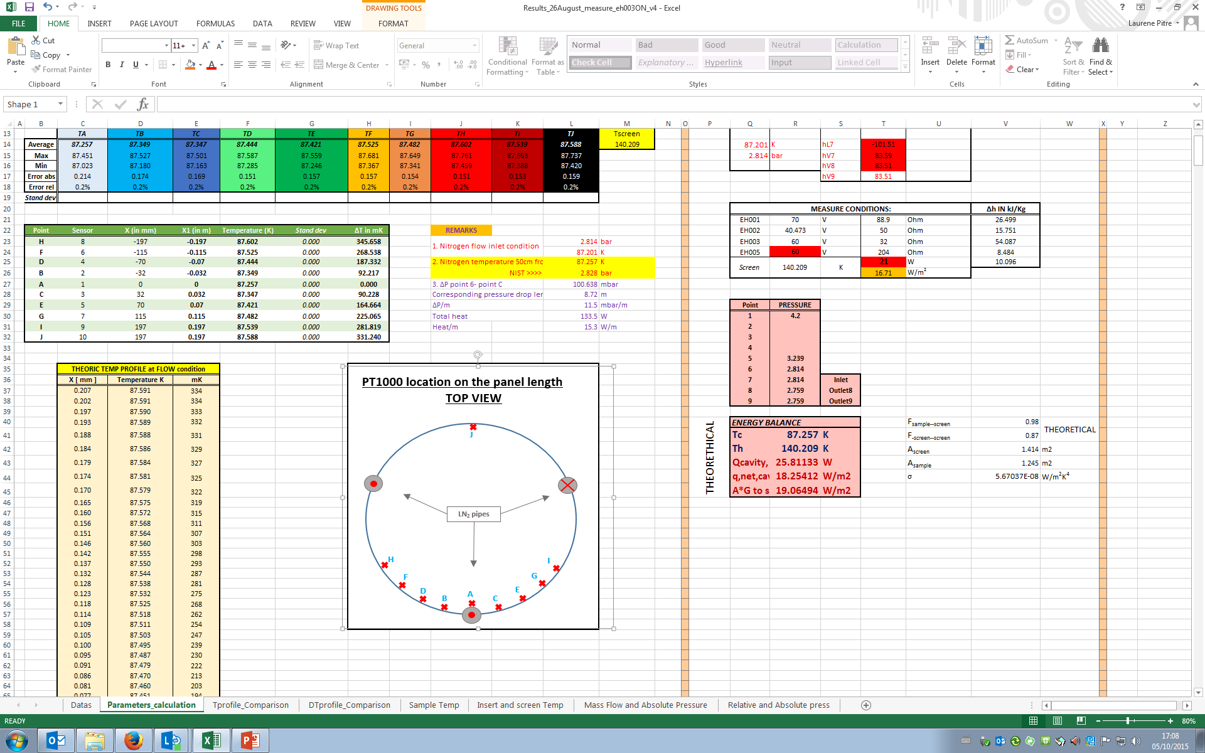
5. Results Measurement Run2
Theory T-profile
Measured T-profile
OUTCOME:
The measurement has validated the expected analytic values
uT = ±17 mK
uX = ± 2 mm
D. Santandrea, T. Koettig, L. Pitre, F. Cacherat, J. Bremer
Cryolab – October 2015
Page 8

Slide 9
Cooling shield layout
The Cooling Shield is arranged in 22 sub-units that constitute 10 sub-circuits with independent regulation.
All together they form a complete enclosure of the two main argon containers (T300 modules).
Sub-unit
4.1 m
6.5 m
Two phase Nitrogen

Slide 10
Cool down in Gran Sasso
Cool down in Gran Sasso took about one week, by flowing LN2 in the shield during the day and stopping the circulation in the night.
The maximum temperature gradient on the TPC was always ≤ 40 K.
The last part of the cooling, when most of the thermal shrinkage had occurred, was done during the LAr filling.
TPC top
TPC bottom
TPC top
TPC bottom
LAr filling

Slide 11
Temperature uniformity and stability
The temperatures were continuously monitored for the first few months of operation and at the end of the run.
The temperature uniformity was always <0.3 K all over the detector structure.
A slight increase of temperature (≈ 0.3 K) was observed over the time.
Note the heat load on the shield was about three times the design value (≥ 30 W/m²)

Slide 12
Pressure stability
Also the absolute pressure in the gas phase was very stable (≈ 5 mbar) in spite of the large variations of the ambient pressure.

Slide 13
Argon purification and recirculation
The argon purification strategy developed by the ICARUS Collaboration during more than 25 years is based on a number of steps:
  Materials selection;
  Surface treatment and materials cleaning;
  Assembly in a clean environment;
  Initial high vacuum;
  Initial argon ultrapurification;
  Continuous argon recirculation and purification both in the liquid and in the gas phases.

Slide 14
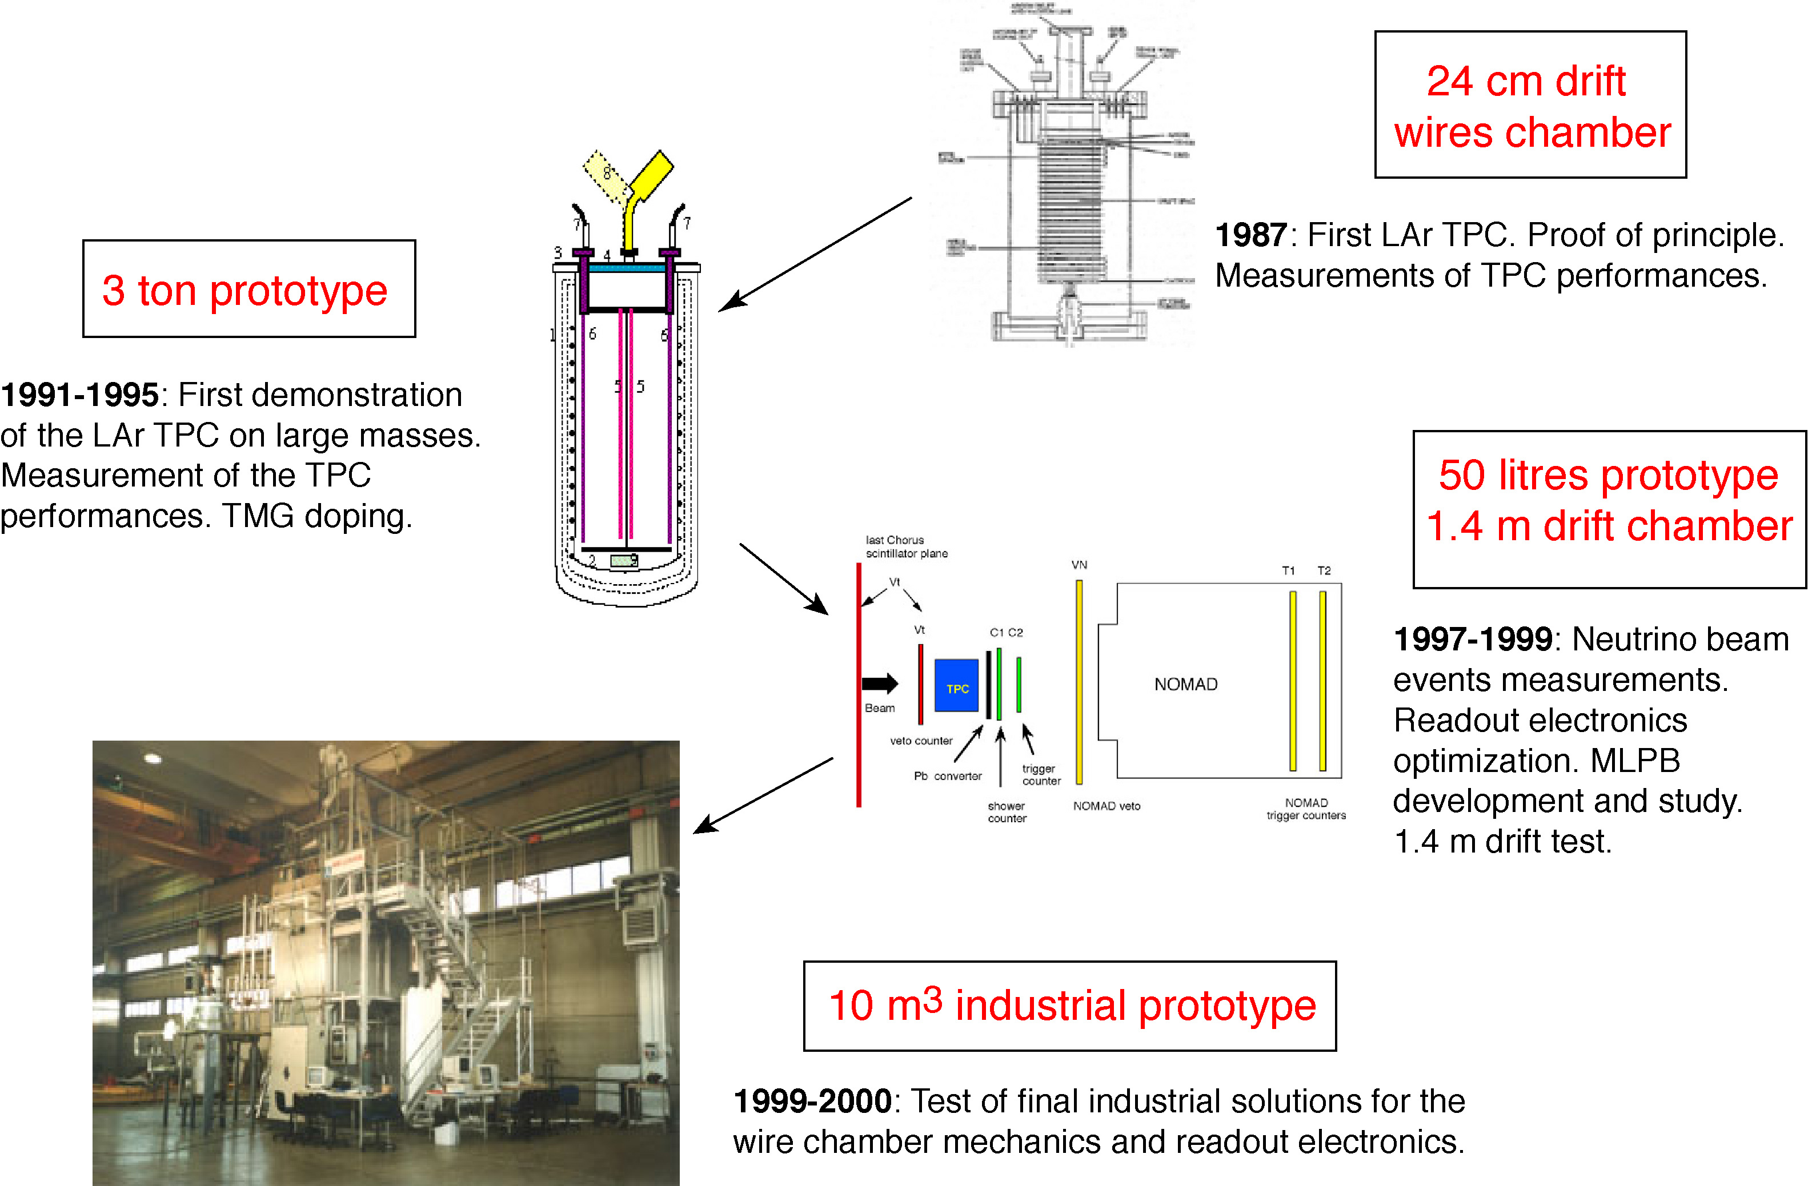
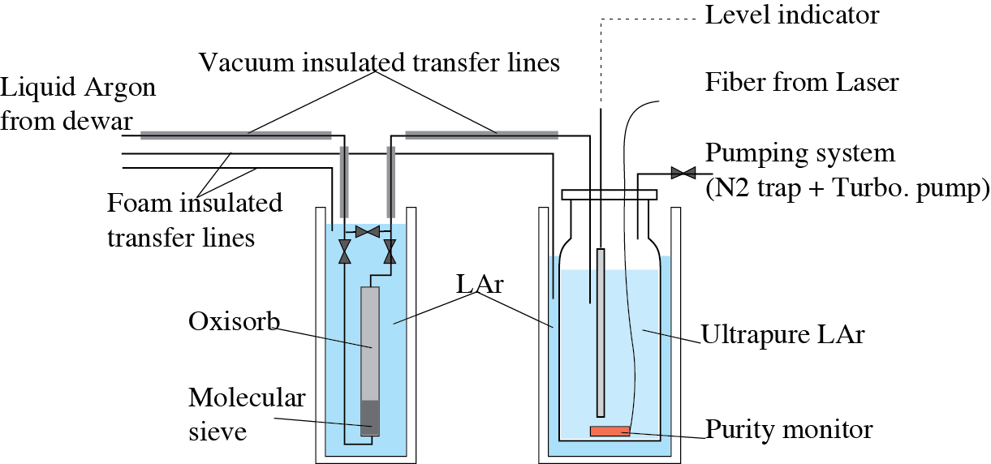
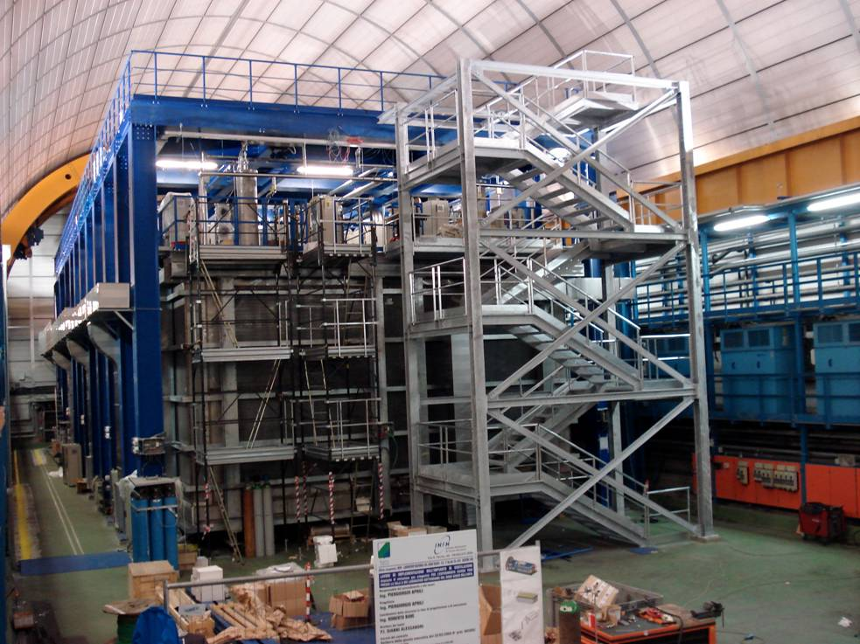
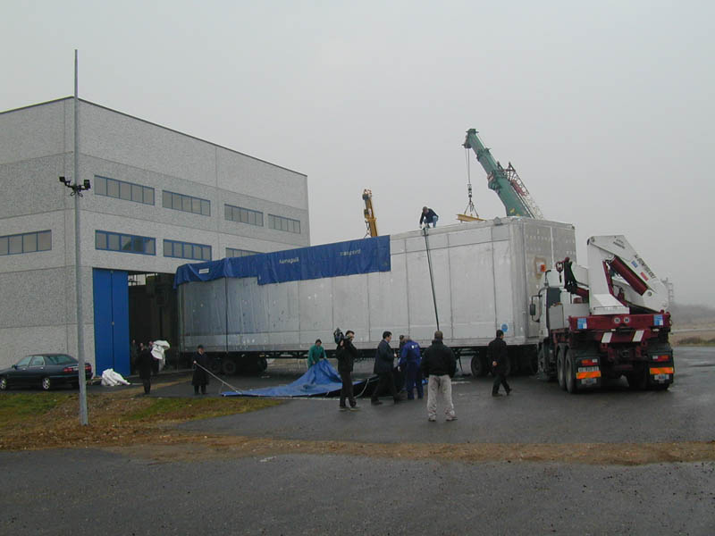
The path to larger LAr detectors
First recirculation in the gas phase
CERN
1
Argon purification in the gas phase. L.T. ~ 10 ms
2
Laboratory work
3
CERN
Purification in liquid phase
1994
CERN
Liquid recirculation
Icarus T600 experiment
4
2010-2013: Data taking with C-rays and CNGS beam
Pavia
T600 detector
Cooperation with industry:
AirLiquide, Breme, Cinel, CAEN
2001: First T600 module
6
5
20 m
LNGS Hall-B

Slide 15
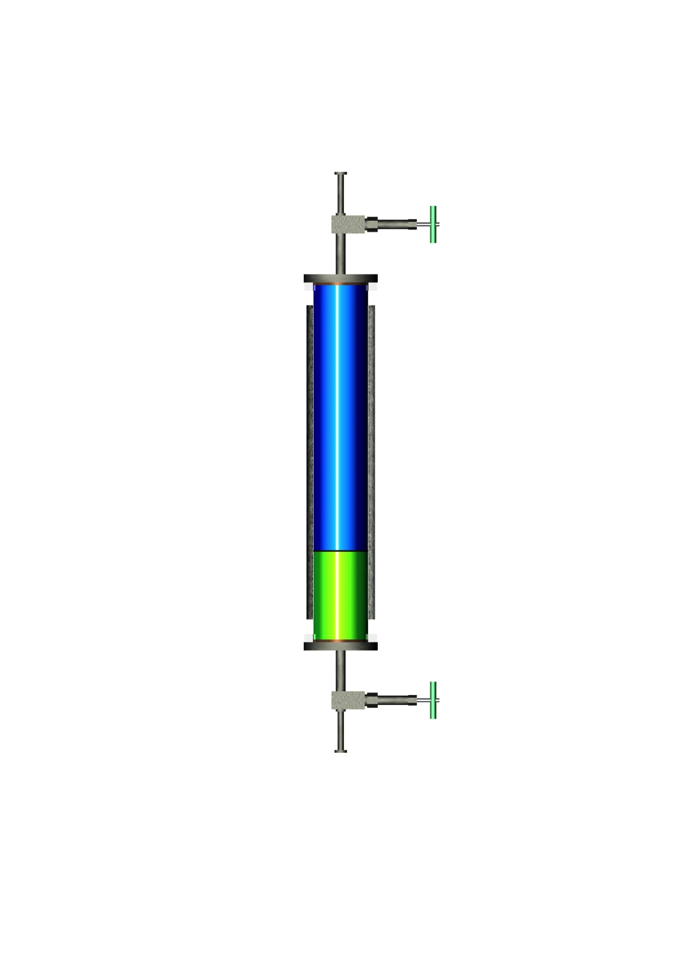
Argon purification: choice of filters
At the very beginning of our development on LAr purity, in 1987, we have identified the most effective filters for Argon purification as a combination of Oxysorb (Chromium) and Hydrosorb (Molecular sieves 4A/13X).
Oxysorb has the largest attachment energy for Oxygen among the most commonly used adsorbants; Hydrosorb, placed before Oxysorb, efficiently removes water, preserving the Oxysorb adsorption efficiency for Oxygen and other electronegative impurities.
For the run at Fermilab we will substitute Oxysorb with a copper based absorber. We tested this filter at CERN with one of our prototypes and obtained similar results as for Oxysorb/Hydrosorb filters.
Oxysorb
Argon Flow
Hydrosorb

Slide 16
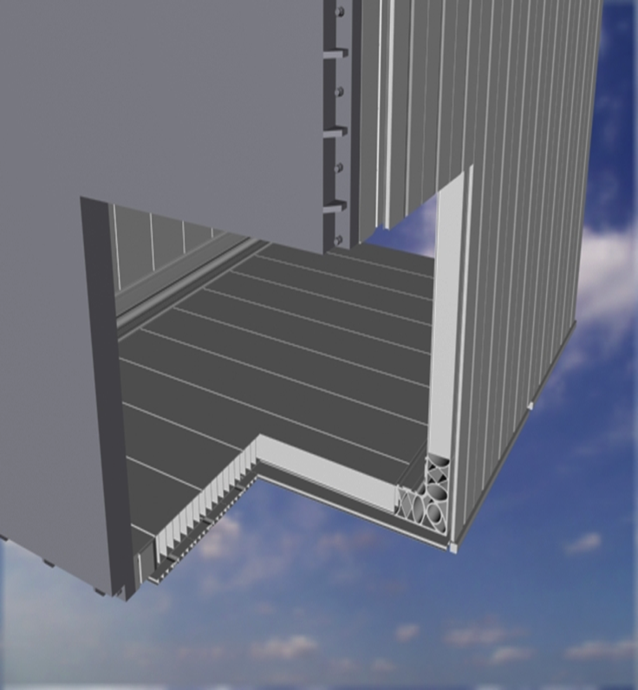
Argon purification: Argon containment
Vacuum tightness is a mandatory requirement to attain high LAr purities. We employ ConFlat flanges or welds for all connections.
For the new main LAr containers we have chosen a double walled structure made of Aluminum
extruded profiles. Aluminum couples lightweight with good thermal conductivity and electrical shielding.
The double wall structure ensures a safe LAr containment and an effective leak tightness (both walls are tight).
We require: a global Helium leak tightness a factor 10 lower than the expected outgassing rate (< 10⁻⁶ mbar•liters/s); a localized Helium leak tightness below the detection limit (< 10⁻⁸ mbar•liters/s).

Slide 17
Argon purification: materials selection
All the materials used for the construction of our detectors were carefully selected considering their mechanical properties at LAr temperature and outgassing composition and rates.
Whenever possible we used materials selected for application in space. We performed specific outgassing measurements of plastic components.
All materials are cleaned using Ultra High Vacuum standard procedures: pickling and passivation for metals; washing with ultrasounds in demineralized water; drying in vacuum hoven; packaging in dry Nitrogen atmosphere.
Prior to their acceptance for use in the T600 detector construction, prototypes of all the components and mechanical assemblies were tested in LAr to verify their compatibility with our purity requirements.

Slide 18
Argon purification: air removal and materials outgassing
Up to the T600 construction we have always considered High Vacuum (molecular regime) as the method to remove air from the volumes to be filled by Argon and to clean the internal surfaces by outgassing.
With this method we have been able to ensure High Vacuum tightness and to reach a free electron lifetime in the range of 1 ms just after the detector filling.
Pressure evolution in the T600 during the vacuum phase

Slide 19
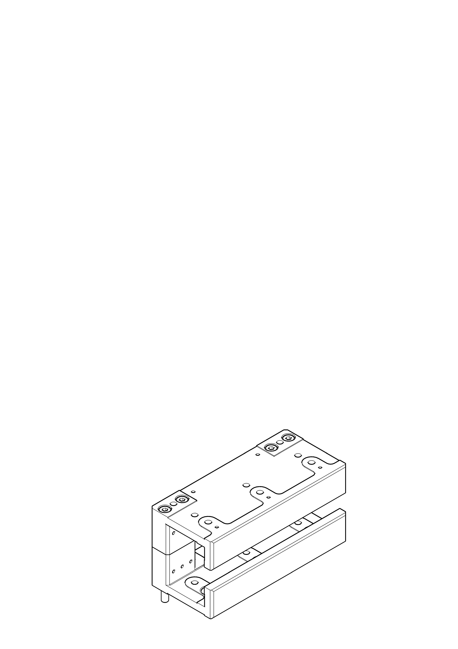
Argon purification: designing for Ultra High Vacuum
All T600 detector components were designed using Ultra High Vacuum prescriptions: avoid tapped holes or volumes, minimize contact surfaces, etc..
Already from the T1200 design (2002) we started to consider the idea to replace vacuum with pure argon gas purging.
The T600 TPCs are not suited for cleaning with gas purging.
Example of a T600 mechanical component
Through holes for pins and bolts
Lowered surfaces to minimize contact

Slide 20
Argon purification: gas and liquid recirculation
To achieve and maintain the purity levels required for long drift distances (meters) continuous Argon recirculation and purification is required both in the gas and in the liquid phase.
Gas recirculation was first implemented in the 3 ton prototype that operated at CERN between 1991 and 1995 with lifetimes consistently above 2 ms. In subsequent versions, the filter of the gas recirculation system was moved after the re-condenser (operating in the liquid phase) to decrease the impedance and therefore the main operating pressure.
Liquid recirculation was first developed in the 10 m³ prototype (the T600 prototype) in 1998 allowing to reach, at the first attempt, a lifetime ≈ 3 ms. Subsequent improvements in the argon distribution and in the pumps allowed, in the T600, to improve the lifetime by about a factor 5!

Slide 21
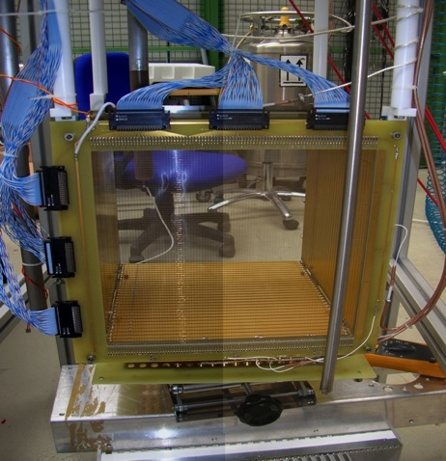
Argon purification: achievements in the lab.
Future requirements: τ_{ele}>12 ms with E_{drift} = 0.5kV/cm for 15% attenuation at 3.0 m,
Extremely high τ_{ele} have been already obtained at lab scale in the ICARINO R&D program where the short path length used (30 cm) is compensated by the accuracy in the observation of the specific ionization of cosmic muons.
The result repeatedly reached is τ_{ele} > 20 ms corresponding to ≈15 ppt, namely a ≈10⁻¹¹ molecular Oxygen eq. impurities.

Slide 22
Argon purification: purity in the T600
In the three years of T600 underground operation at the LNGS, electron lifetimes constantly exceeding several ms were obtained. During the last part of this data taking, a free electron lifetime exceeding 15 ms has been achieved.
New recirculation pump (Barber-Nichols)

Slide 23
LAr circulation pumps
We have been using for most of the time ACD pumps with immersed motors. Their maintenance cycle was relatively short (≤ 3000 hours) resulting in quite frequent stops and consequent deterioration of the lifetime. In the last period of the run we replaced one ACD pump with a Barber-Nichols pump with external motor and larger speed. The same type of pumps have been used for LN2 circulation and have run continuously for more than 3 years.

Slide 24
T600 P&I (Argon scheme)
LAr (Filling)
LAr (Operation)
GAr (Operation)
PreFilters
Main Filters
Main Filters
GAr Recirc.
GAr Recirc.
Recirculation Pump
Recirculation Pump

Slide 25
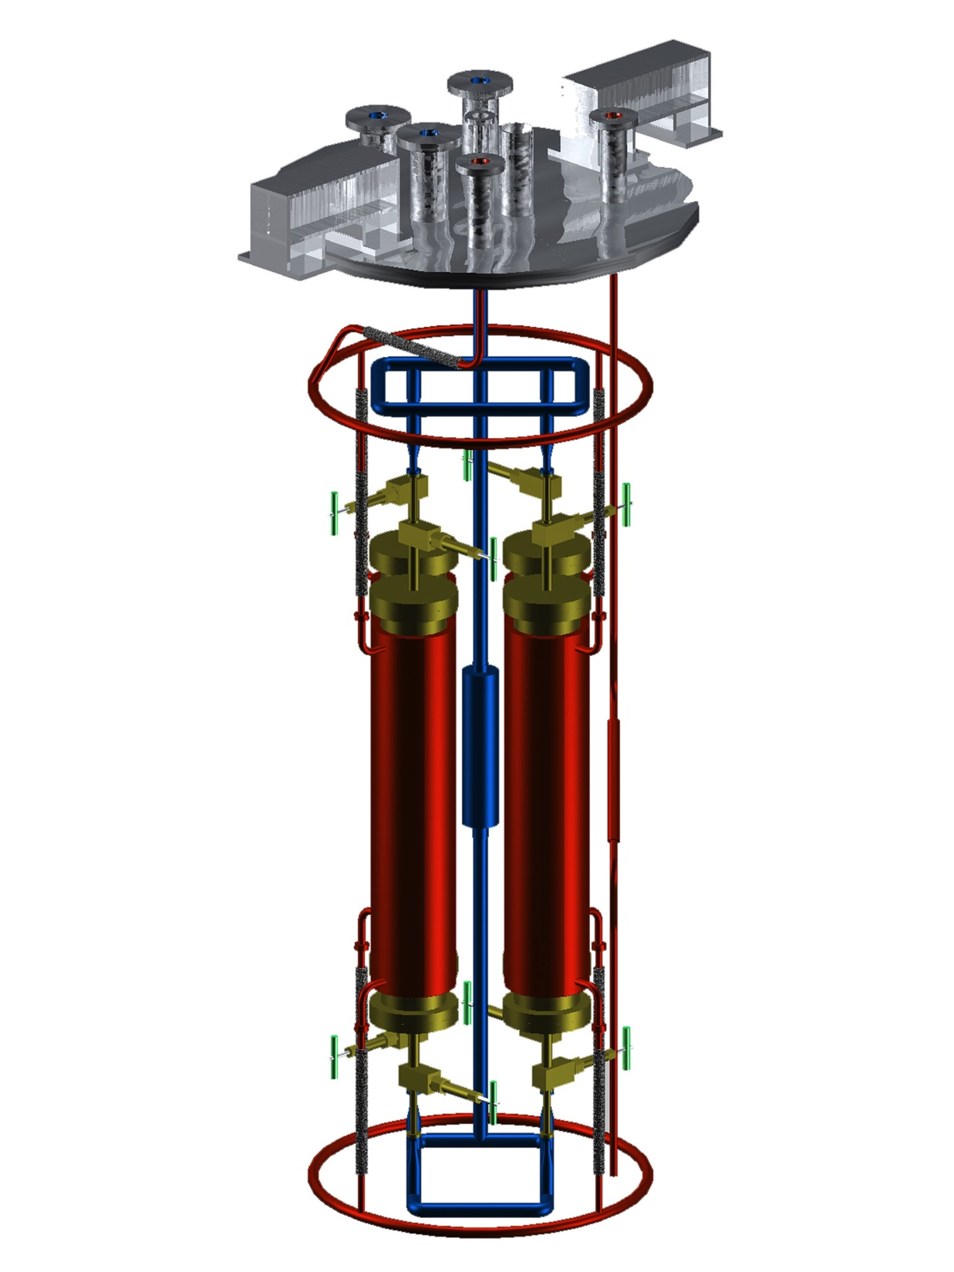
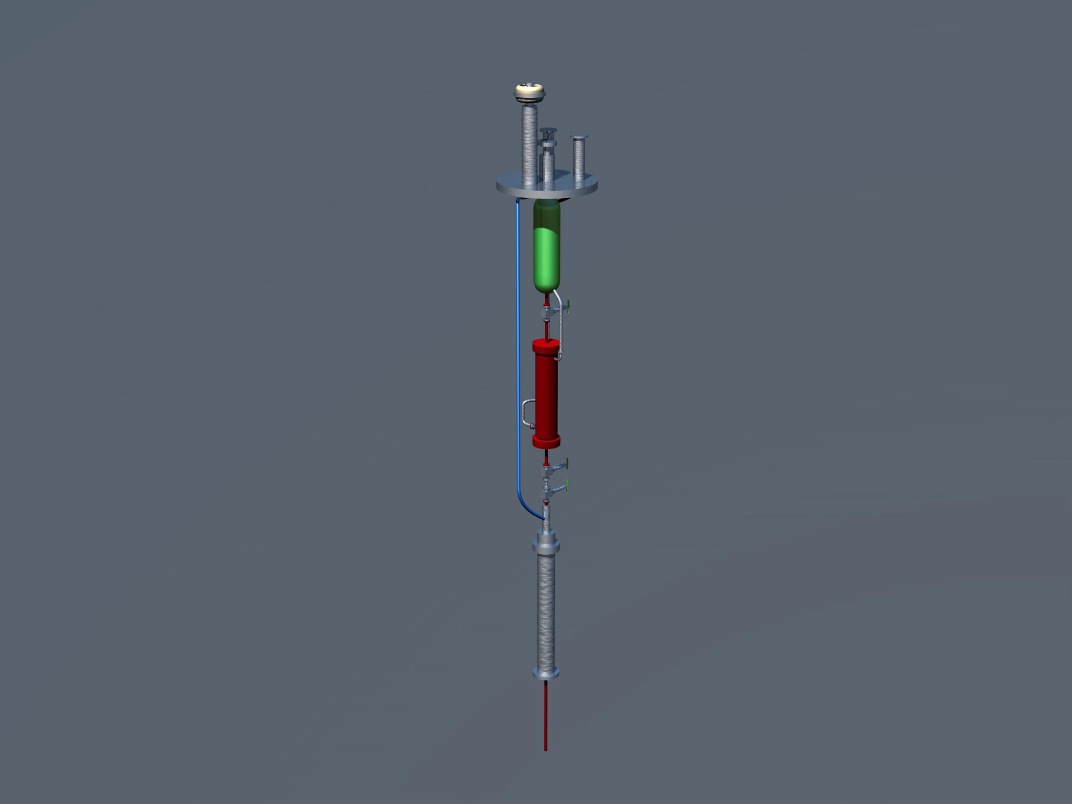
T600 Filters
Main LAr Purifier
GAr Recirculation Unit
4 Filters in parallel
Single filter volume ≈ 17 lt
25% Hydrosorb
75% Oxysorb
Filter size ≈ 4.3 lt
100% Oxysorb

Slide 26
Filters capacity
Oxisorb O₂ adsorption capacity is ≈ 2 O₂ lt / Oxisorb lt
Hydrosorb H₂O adsorption capacity is ≈ 20 H₂O lt / Hydrosorb lt
Each one of the main LAr filters has an adorption capacity of 26 O₂ liters and of 88 H2O liters.
  With 4 filters in parallel the total adsorption capacity is: 104 O₂ liters and 352 H₂O liters;
The filters were dimensioned to allow for the filling of the two modules starting from an O₂ contamination of 0.5 ppm. The copper based filters, for the same filter volume, have an adsorption capacity about 1/8 of Oxysorb.
  For the run at Fermilab a significantly larger, dedicated, filter is required for the filling (filling filter).

Slide 27
Safety
Safety was a particularly relevant matter, not only because the experiment was underground, but also due to the simultaneous presence of many other activities and to the seismic area.
Safety aspects have been treated through:
  Intrinsic safety from design: triple containment from LAr spillage; area isolation with physical barriers; mechanical protections of critical parts; vessels and coupled systems designed to withstand an earthquake that would have destroyed the gallery.
  Redundancy: installed and ready to start redundancy of all critical equipment: power lines; pumps; recondensers; control systems; spare parts for all non critical equipment.
  Environment control and protection: extensive and redundant ODH grid; continuous control; dedicated fire extinguisher systems; dedicated venting system.

Slide 28
Conclusions
The commissioning of the ICARUS T600 detector at LNGS was successfully and safely performed during first half of 2010. The detector smoothly reached optimal working conditions and took cosmic and CNGS neutrino beam data with extremely high liquid argon purity, performing even beyond expectations.
The T600 successfully completed its first physics run during summer 2013, about six months after the end of the CNGS neutrino beam operation. The detector has been emptied from the liquid argon and brought back to room temperature.
The ICARUS T600 represents so far the state of the art of the liquid argon TPC technology. Its operation in a difficult underground environment demonstrates that the technology is mature as realized with industrial construction techniques and is scalable to several kton mass as required by future projects.

