Slide 1
Current Fermilab Neutrino Program
Regina Rameika, Fermilab Neutrino Division
Neutrino – Latin America Workshop
27 April 2016

Slide 2
Neutrinos at Fermilab
We are excited about being the host laboratory for a fully international flag-ship neutrino experiment, DUNE (Mark’s talk at the end of the day!)
This will be a mega-science project of unprecedented size here in the United States
  While we are building for the future we will operate a world class program which will produce science, train students and perfect the technologies needed to insure the success of the major investment being made
In this talk I will introduce and highlight the current neutrino program which includes experiments using the two Fermilab neutrino beams, NuMI and BNB as well as test beam and detector development activities

Slide 3
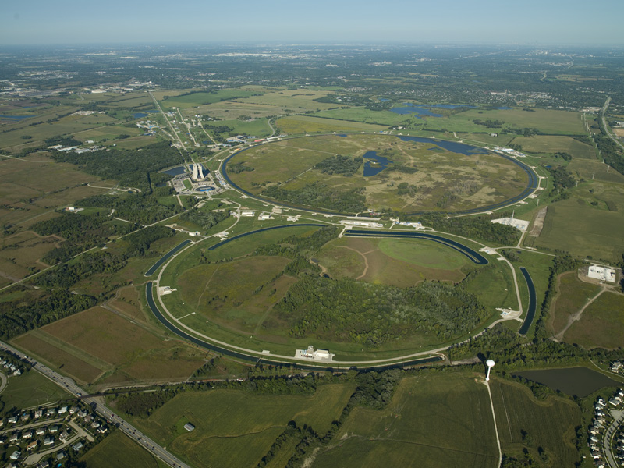
Fermilab Neutrino Experiments
Booster ν beam
MicroBooNE, SBN program
Booster
proton energy: 8 GeV
NuMI ν beam
NOvA, MINERvA, MINOS+
Main Injector
proton energy: 120 GeV
DUNE ν beam
3
3

Slide 4
Ambitious Goals for the Neutrino Program!
Deliver the world’s highest power beams for neutrino science
  Achieve 15Hz Booster Operations – FY16 3
  Achieve 700kW NuMI operations – FY17
  Fully exploit the science of NOvA – FY22
  Establish PIP-II with > 1MW beam power – FY25
  Establish PIP-III with multi-megawatt beam power – FY26 or beyond
Establish the short-baseline neutrino program
  Install and commission the ICARUS detector and begin taking data – FY18
  Build SBND and begin taking data – FY18
Establish the long-baseline neutrino program
  Begin pre-excavation work at SURF – FY17
  Install 10 kilotons of LAr deep underground at SURF – FY21
  Excavate space for an additional 30 ktons of LAr at SURF – FY22
  Complete neutrino beamline directed towards SURF – FY23
  Complete the full detector for the long-baseline neutrino program – FY26 or beyond
Support detector R&D and new initiatives in neutrino science
  Exploit existing facilities for neutrino science and add capabilities

Slide 5
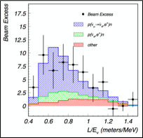

A new era of neutrino physics
A two prong approach :
  Exploiting what we know
  Exploring what we don’t know
PDG, 2014
LSND 199?

Slide 6
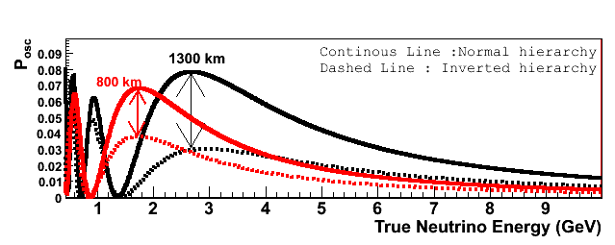
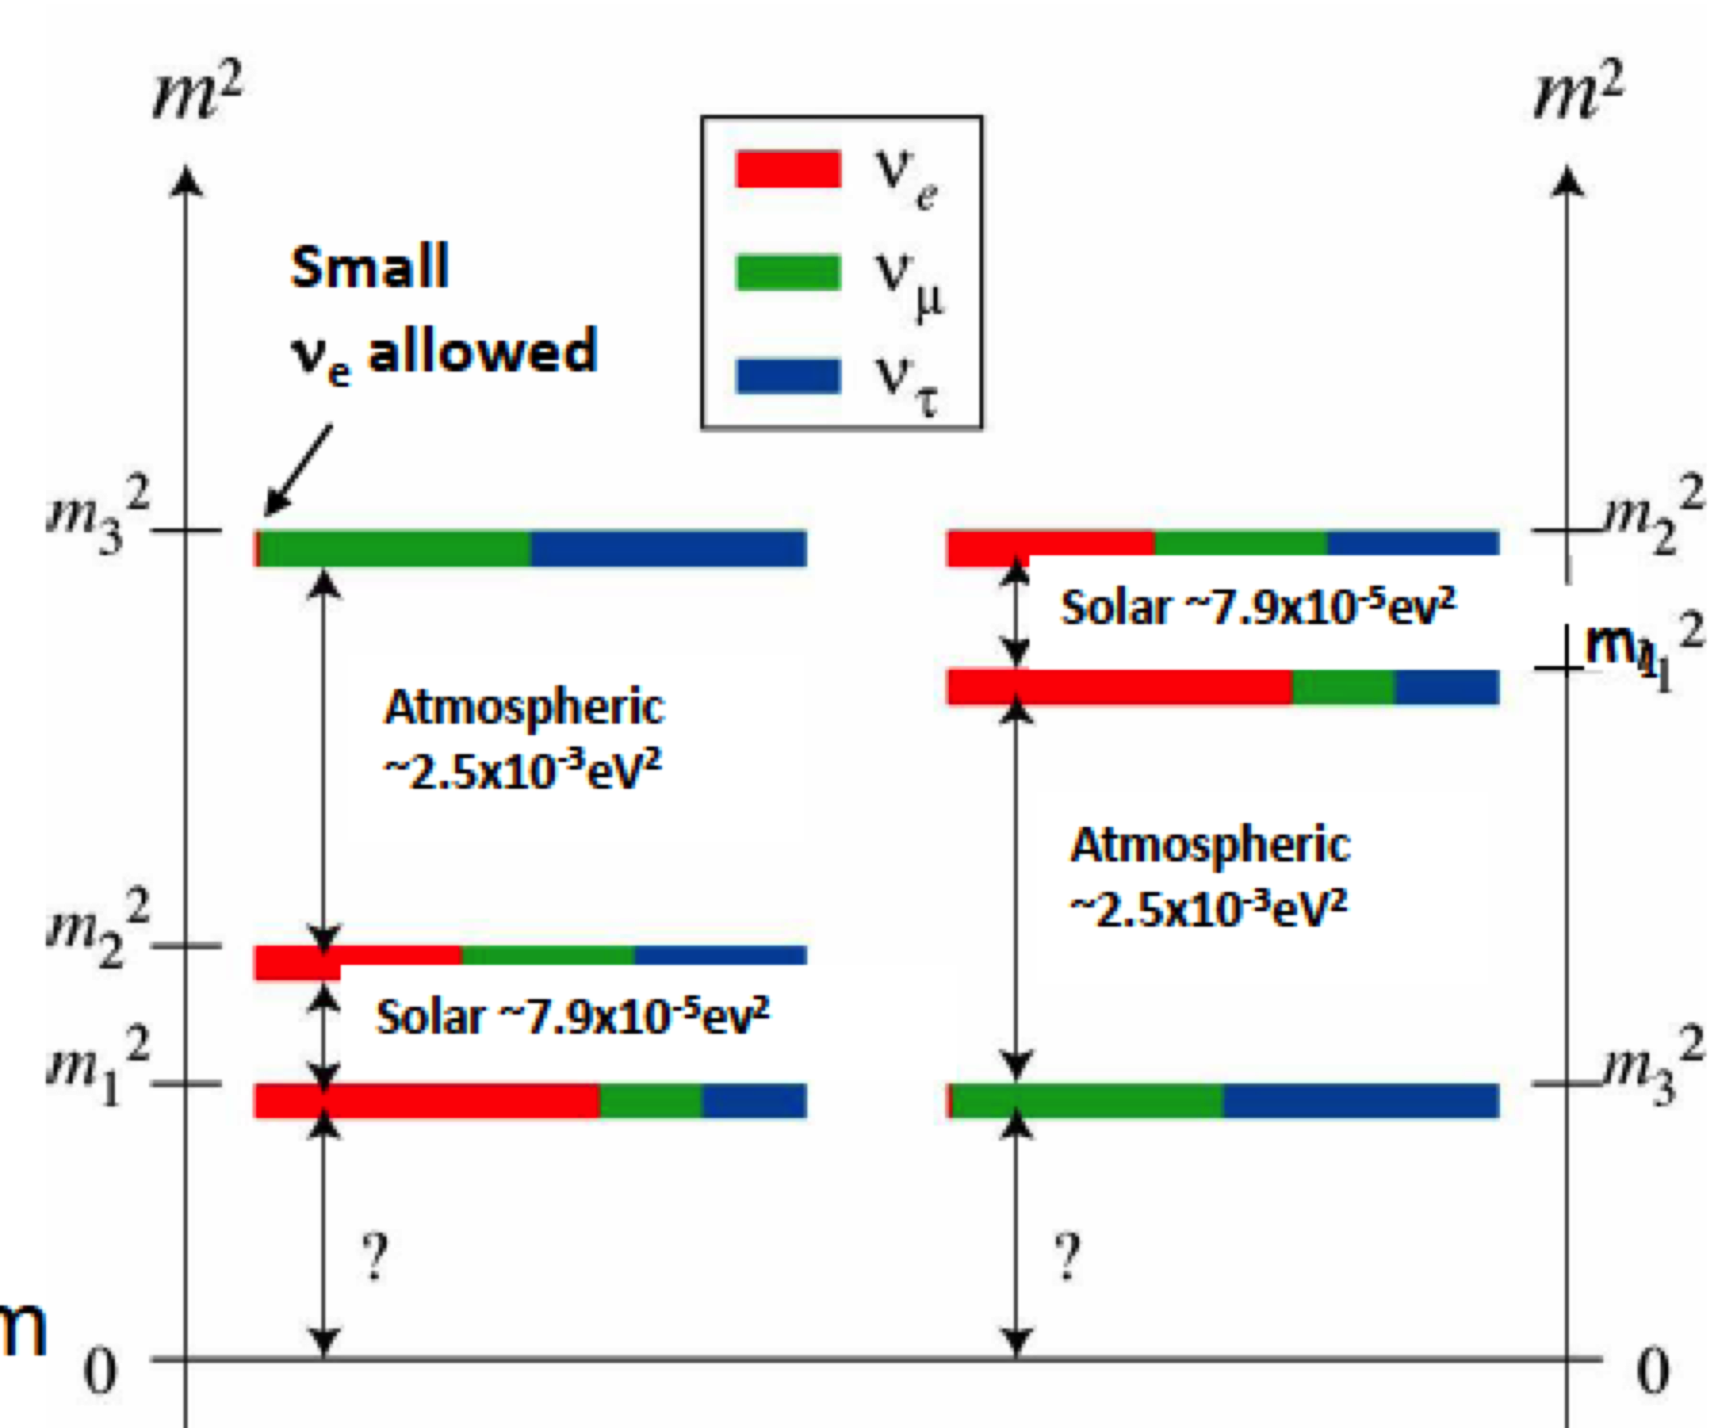
What we know (or hope to know soon) …
There are three neutrinos which have masses : m₁, m₂, m₃
We can determine the Δm² between each pair by measuring the interactions as a function of propagation distance and energy (L/E)
In a three neutrino system there is a phase angle, δ, which if not equal to 0 or π, implies that neutrinos violate CP
We can use long-baseline experimental set-ups to measure these parameters, including the not-yet-determined mass ordering

Slide 7
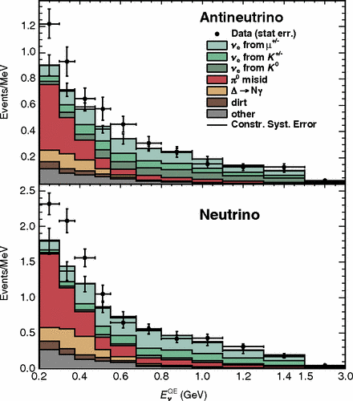
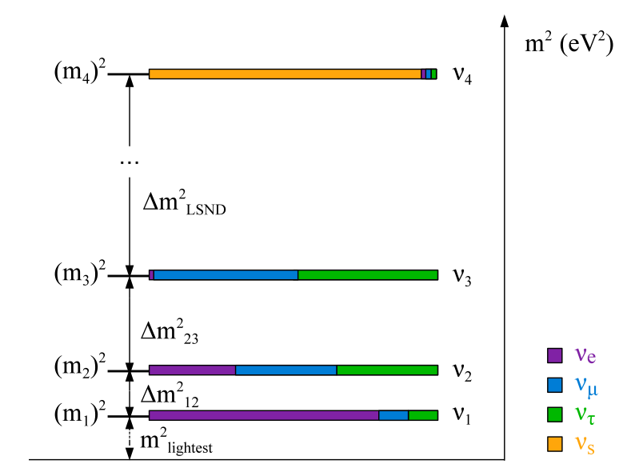
What we don’t know …
reference
The cause of several neutrino anomalies
  New physics ?
  Experimental errors?
1st generation exploration : MiniBooNE sought to confirm or refute the LSND signal ;
  Neutrino mode (3.4σ e-like excess)
  Anti-neutrino mode (2.8σ e-like excess)
  + A new, low energy anomaly
  24 physics publications
Are we seeing the effect of one or more sterile neutrinos
  Ability to resolve this has been limited by detector resolution and no ND
Evolution of ideas, detectors and facilities drives us forward !

Slide 8
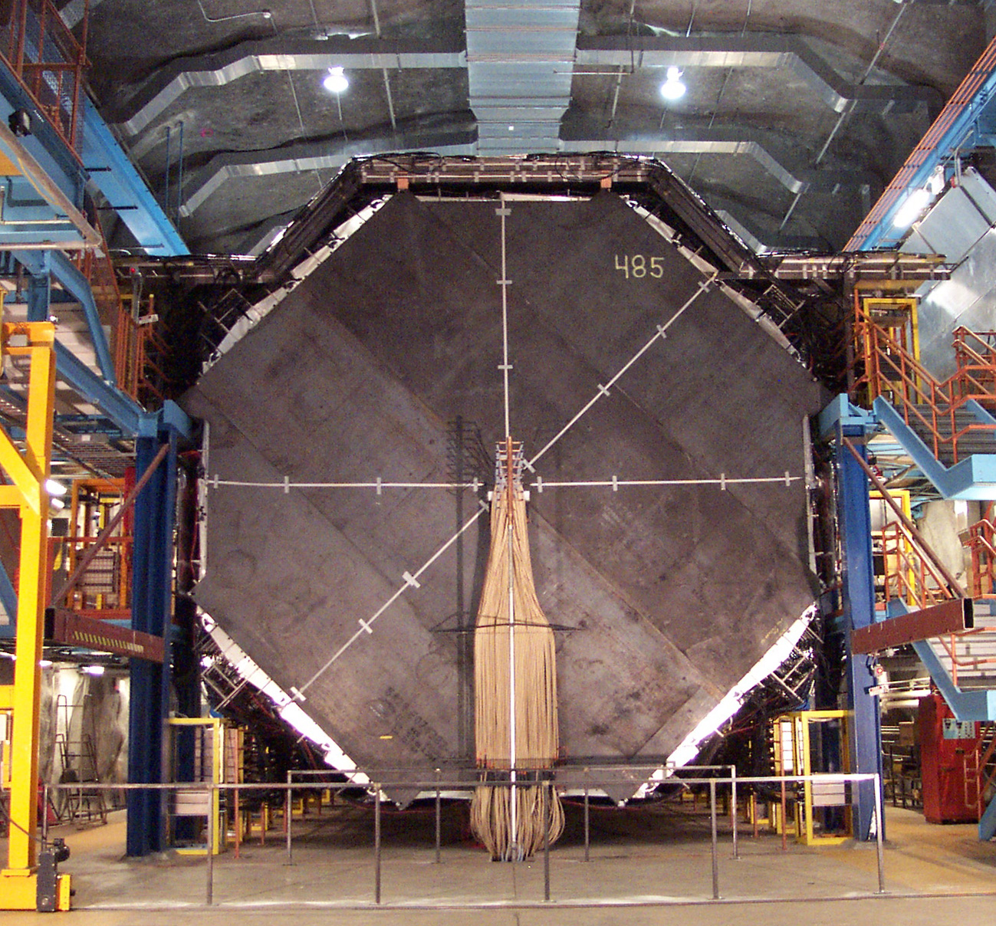
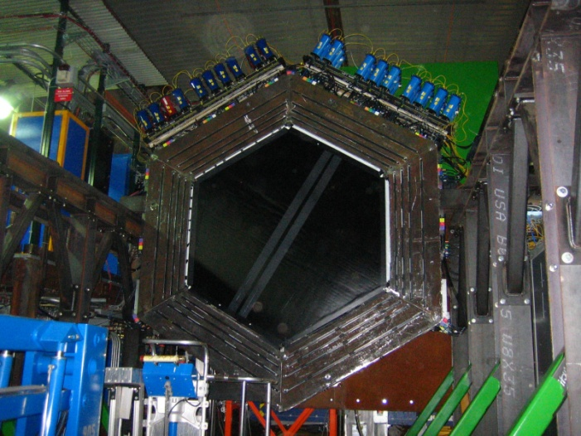
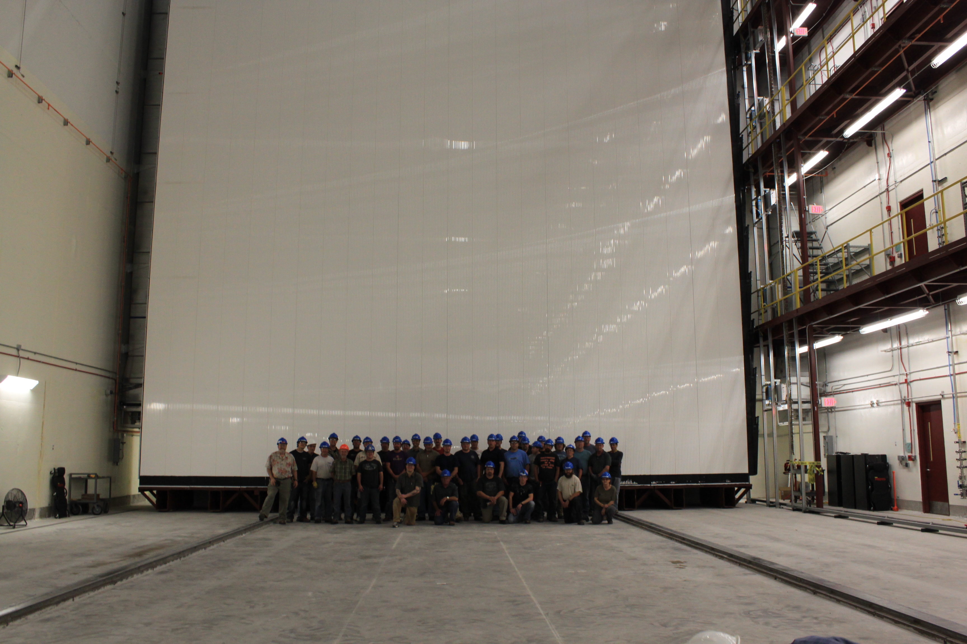
Fermilab 1st and 2nd generation long-baseline experiments
2005 : Begin operation of NuMI/MINOS
  2007 : publish first results from MINOS
  2014 : MINOS ➔ MINOS+
  As of 2016 : > 35 physics publications
2010 : Begin operation of MINERvA in the NuMI Near Detector Hall
  By end of 2016 : >15 publications
2014 : Begin operation of NOvA in NuMI ME beam
2016 : 1st results for ν_{e} and ν_{μ} published

Slide 9
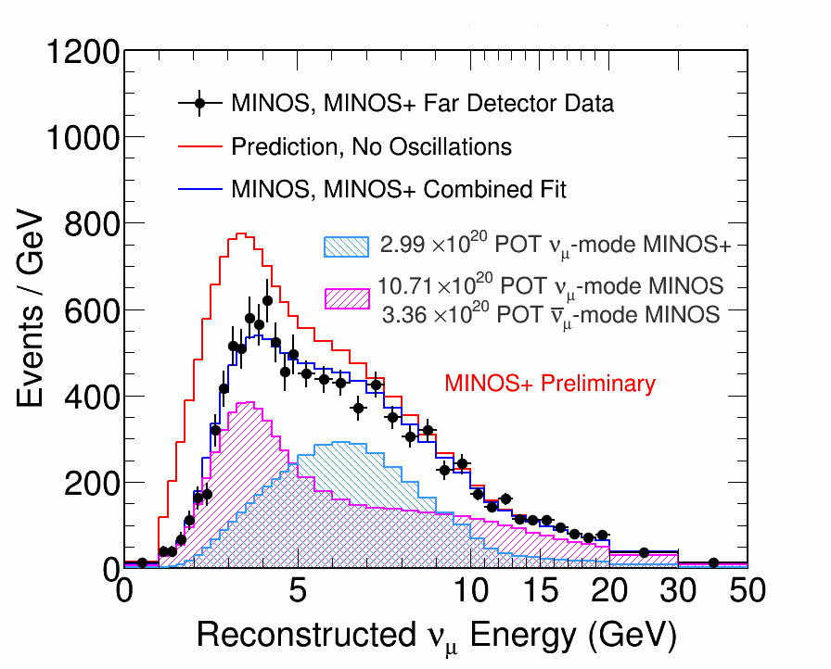
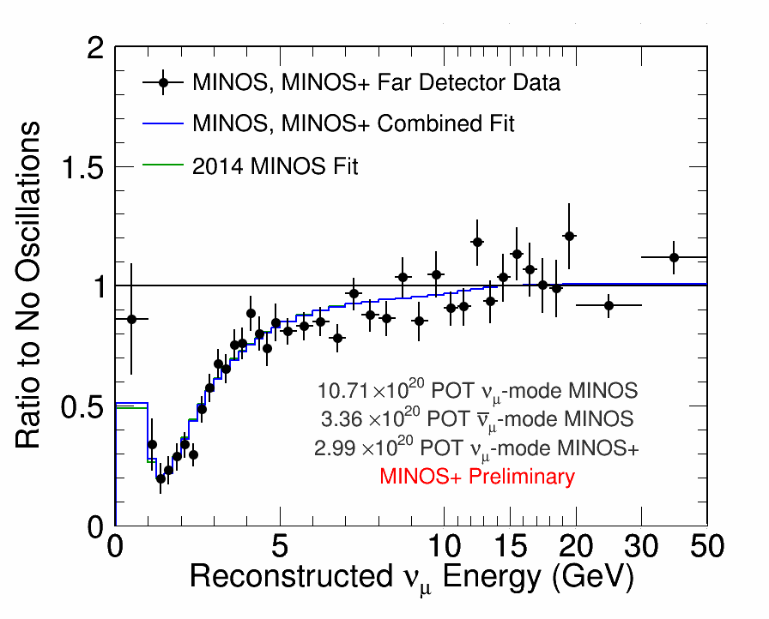
MINOS ➔ MINOS+

Slide 10
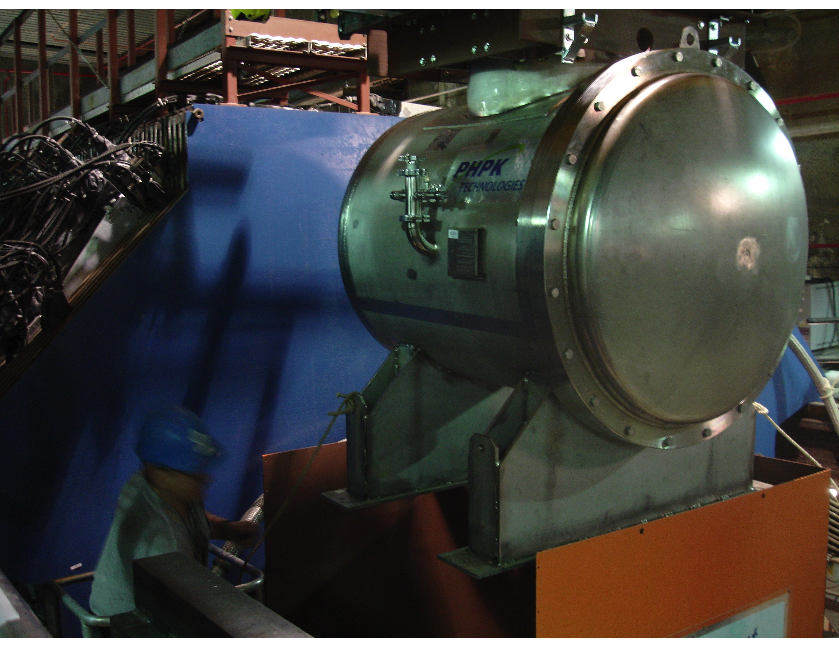
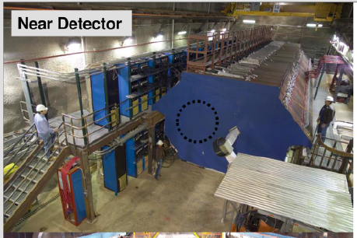
NuMI Near Site – Home to many efforts
MINOS Near
ArgoNeuT
MINERvA
MINERvA + He
Captain MINERvA?
2004
2009
2010
2016

Slide 11
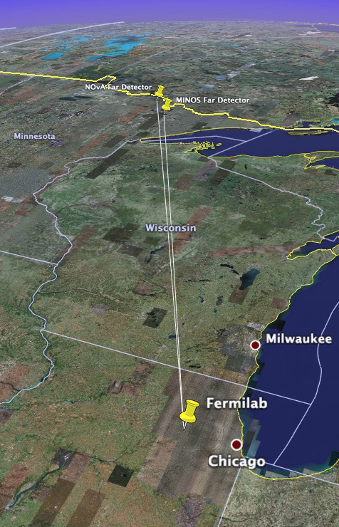
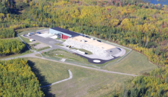
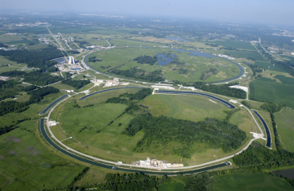
NOvA http://www-nova.fnal.gov
NOvA measures ν_{μ}[ν_{e} and ν_{μ}[ν_{μ} oscillations of neutrinos and antineutrinos using
  Upgraded NuMI beam
  300 ton Near Detector
  14 kt Far Detector at Ash River, MN
To address the next questions in neutrino physics
  What is the neutrino mass hierarchy?
  Is θ₂₃ maximal? Is there a new symmetry? What is the flavor content of the ν₃?
  Is CP violated in the lepton sector?

Slide 12
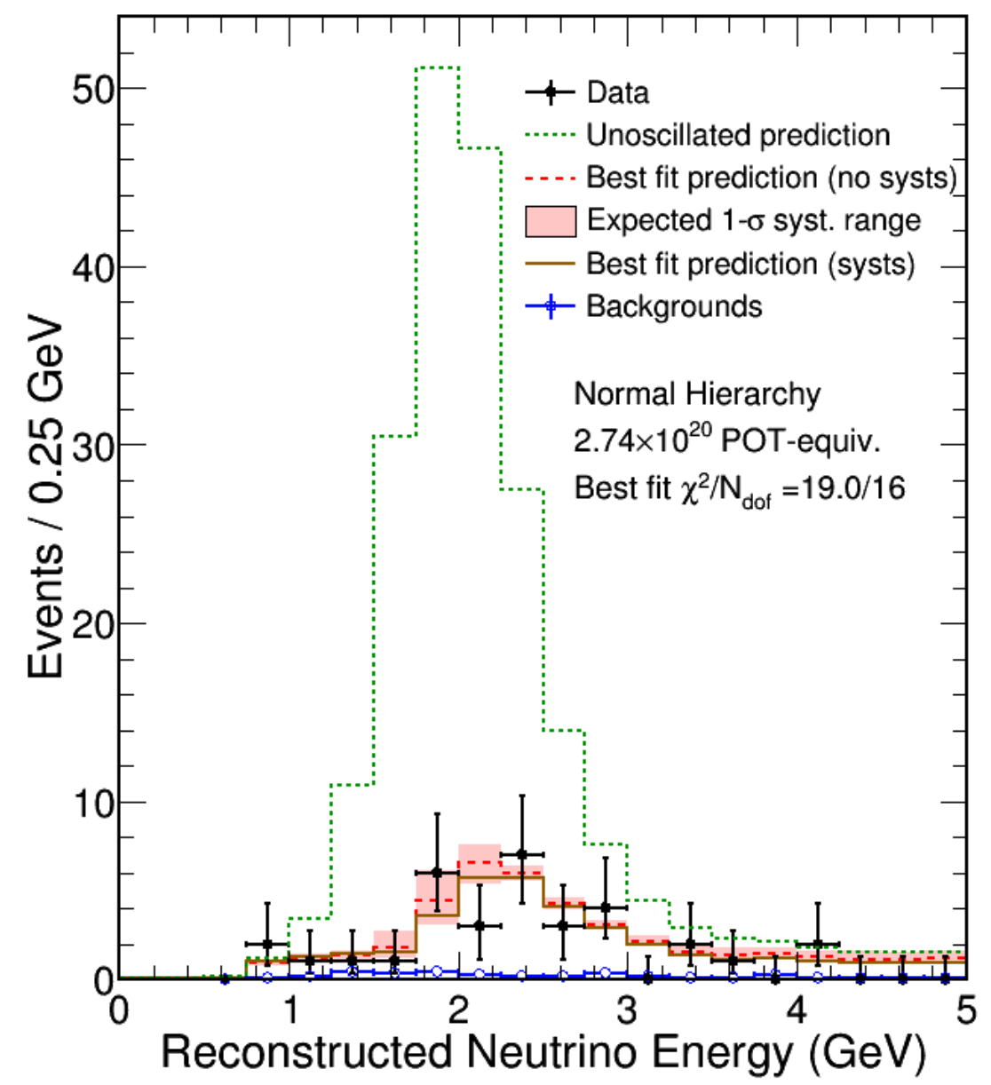
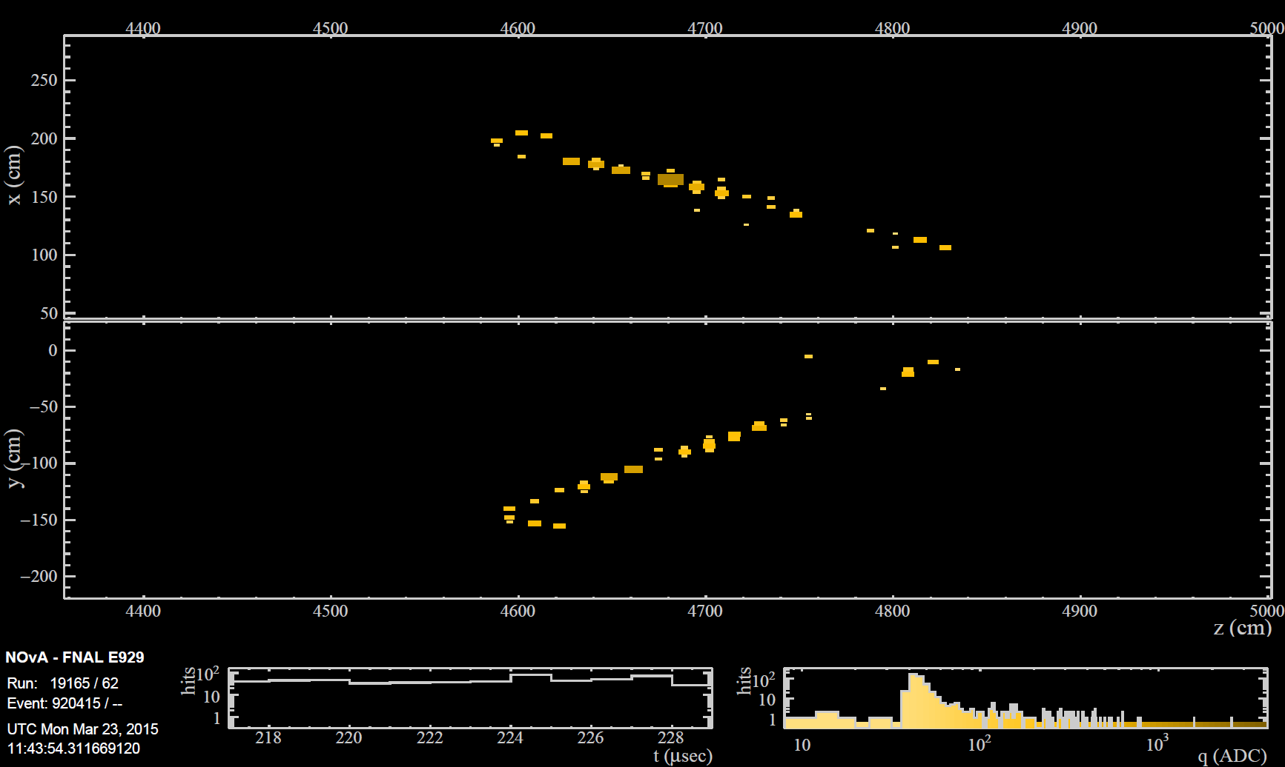
NOvA
ν_{μ}➔ν_{μ}
First oscillation results :
8% of planned exposure
  ν_{μ} disappearance (PRD RC)
    compelling initial measurement,
    consistent with previous measurements
  ν_{e} appearance (PRL)
    6 events observed on
    a background of 1 (3.3 σ)
    Slight favoring of large CP
    violating effect and Normal
    mass hierarchy
First cross-section result
presented at NuInt2015 and
at Fermilab on 2/26
ν_{μ}➔ν_{e}Candidate
Notes:
Secondary analysis sees 11 events on background of 1, for 5.3 sigma

Slide 13
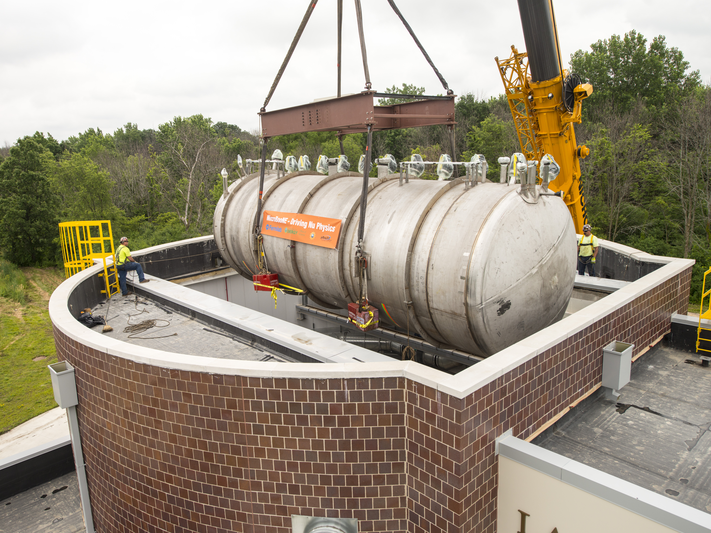
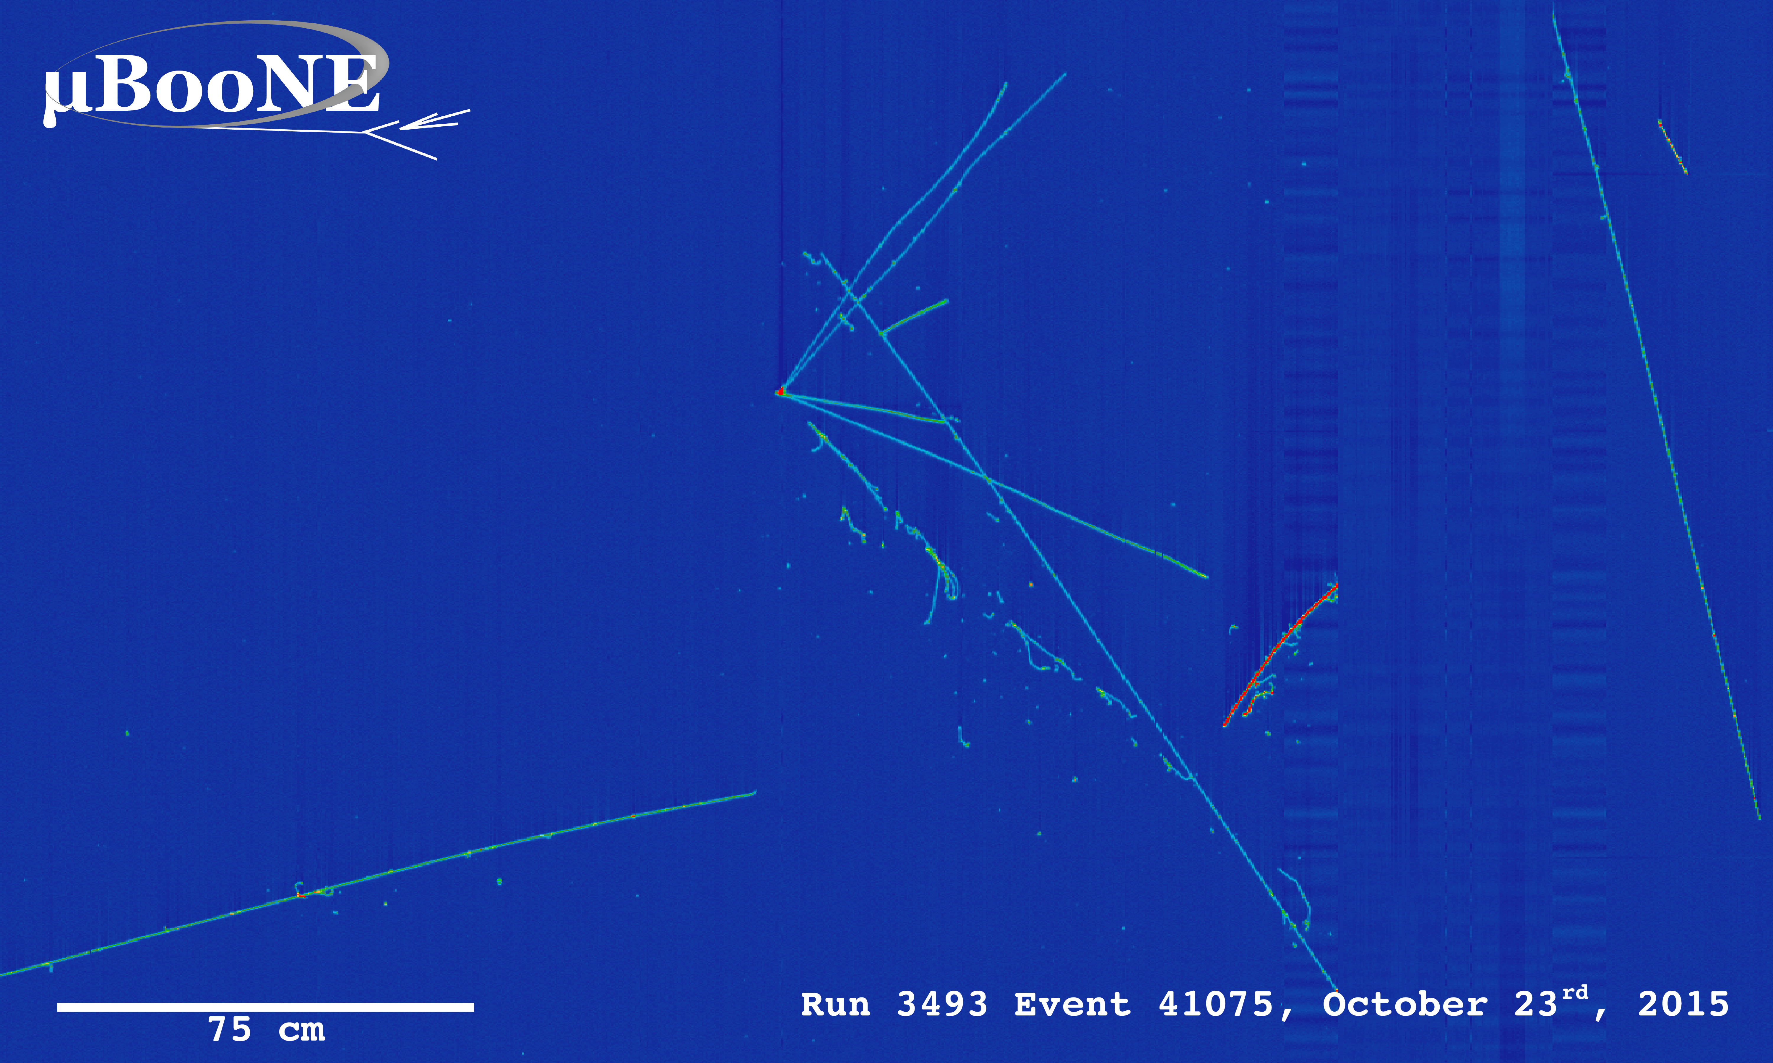
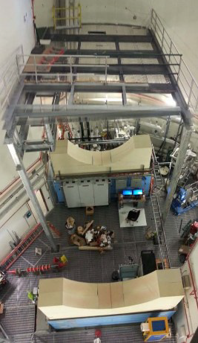
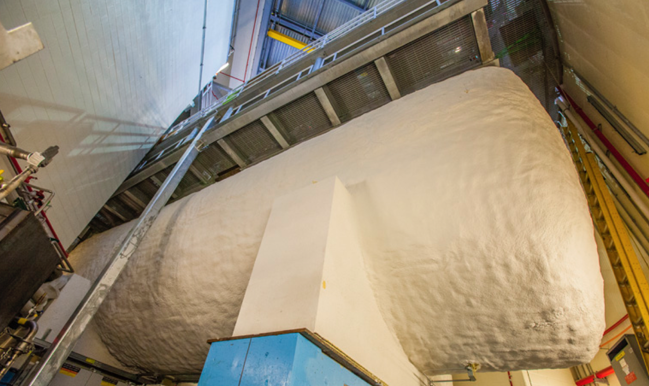
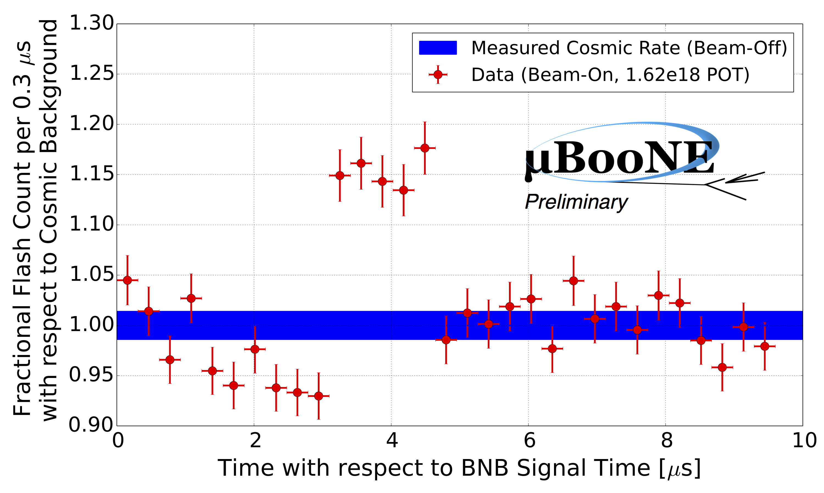
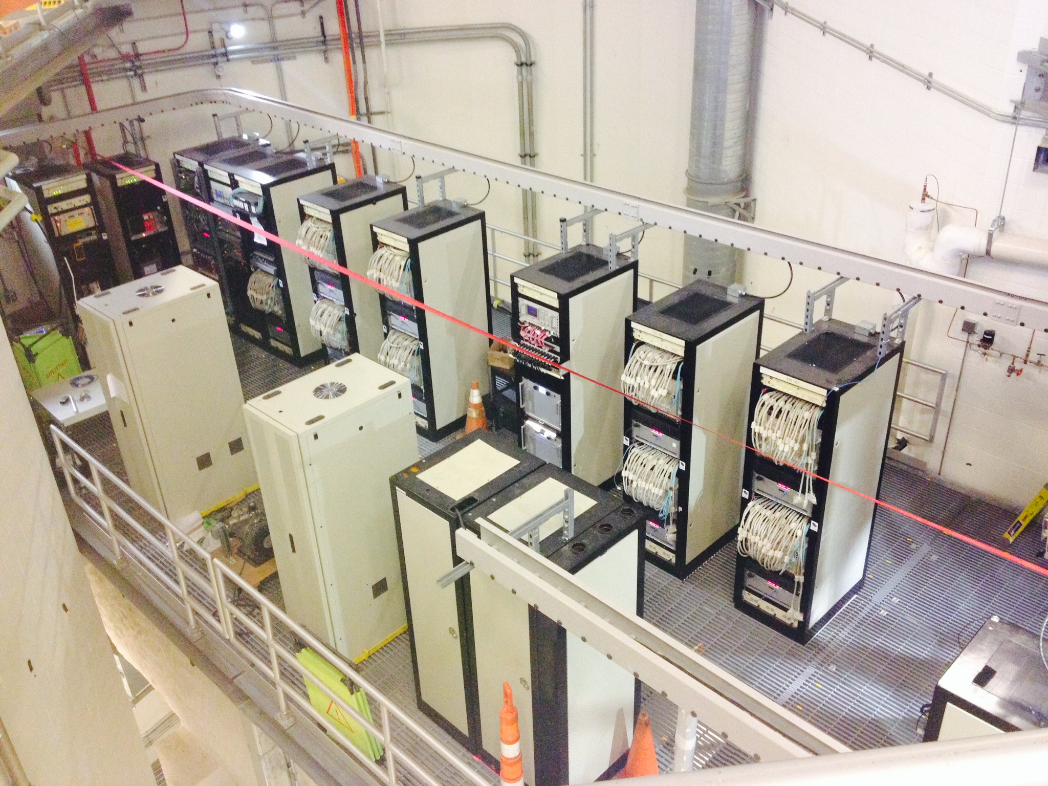
Advancing detector technology : MicroBooNE
FY15 highlights!
first neutrinos
in MicroBooNE!
1.6μs BNB beam spill
Notes:
.

Slide 14

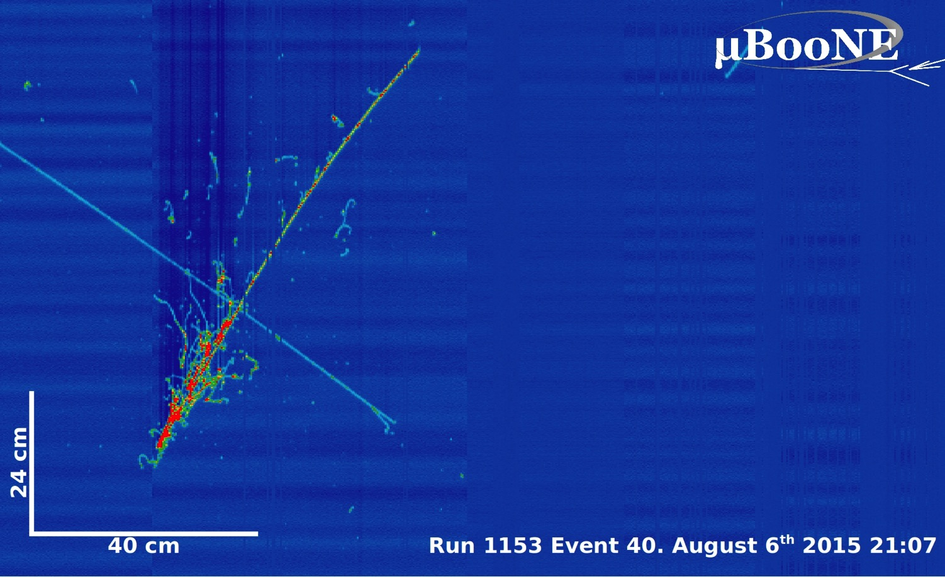
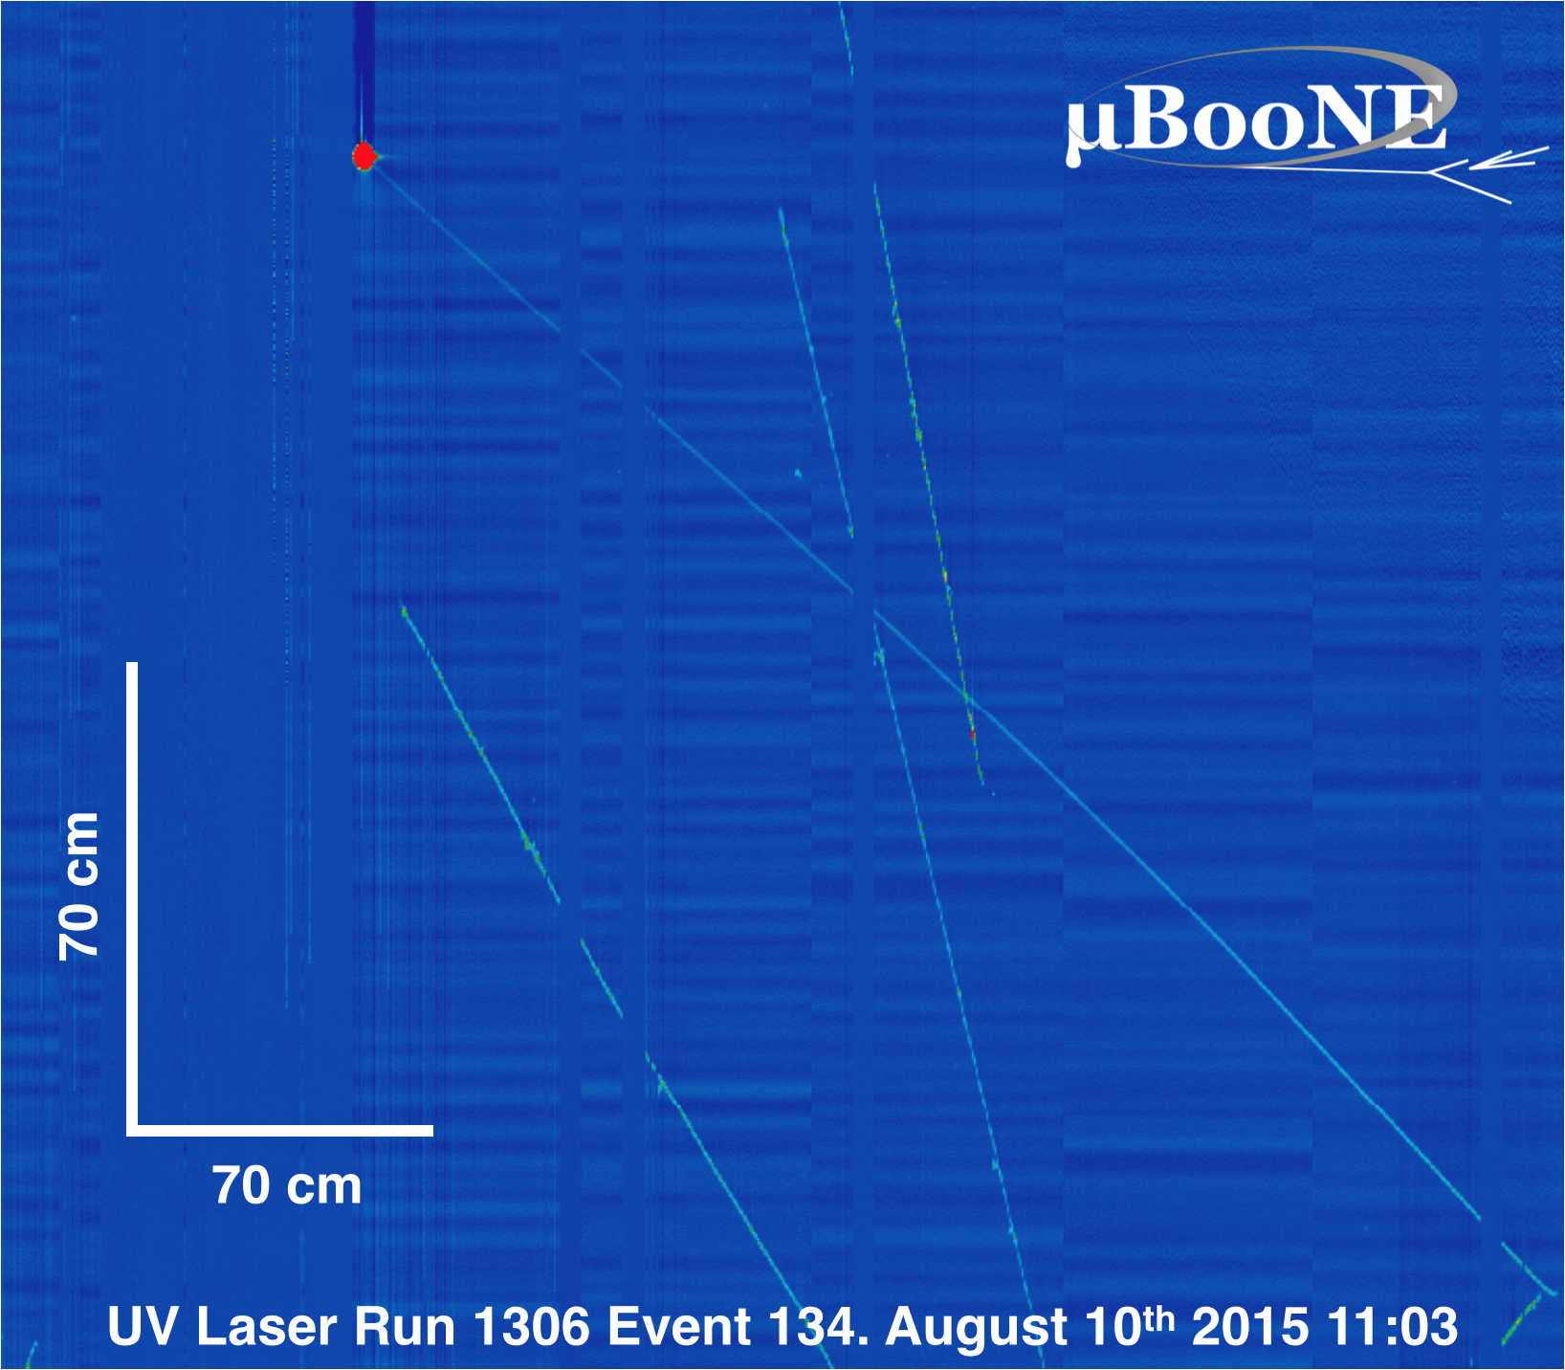
MicroBooNE
MicroBooNE is in stable operations
- detector/DAQ uptime typically >97% (with beam on)
- cold electronics performing with S/N = 40:1
- cryogenics system outperformed expectation
achieved and surpassed one of our main
R&D goals: excellent LAr purity without
evacuation of a fully instrumented vessel
- argon purity is a factor 2 better than design;
mitigates running at drift HV of 70 kV
(consistently >6 ms e⁻ liftetime, <50 ppt O₂ contamination)
MicroBooNE has been collecting
neutrinos since October 15, 2015
- Booster is running extremely well
- have already collected >2.5x10²⁰ POT
first physics analyses underway!
August 6, 2015
first cosmic ray tracks
laser track!
August 10, 2015
first UV laser calibration run
Notes:
Cryogenic and purification systems outperformed expectation!

Slide 15
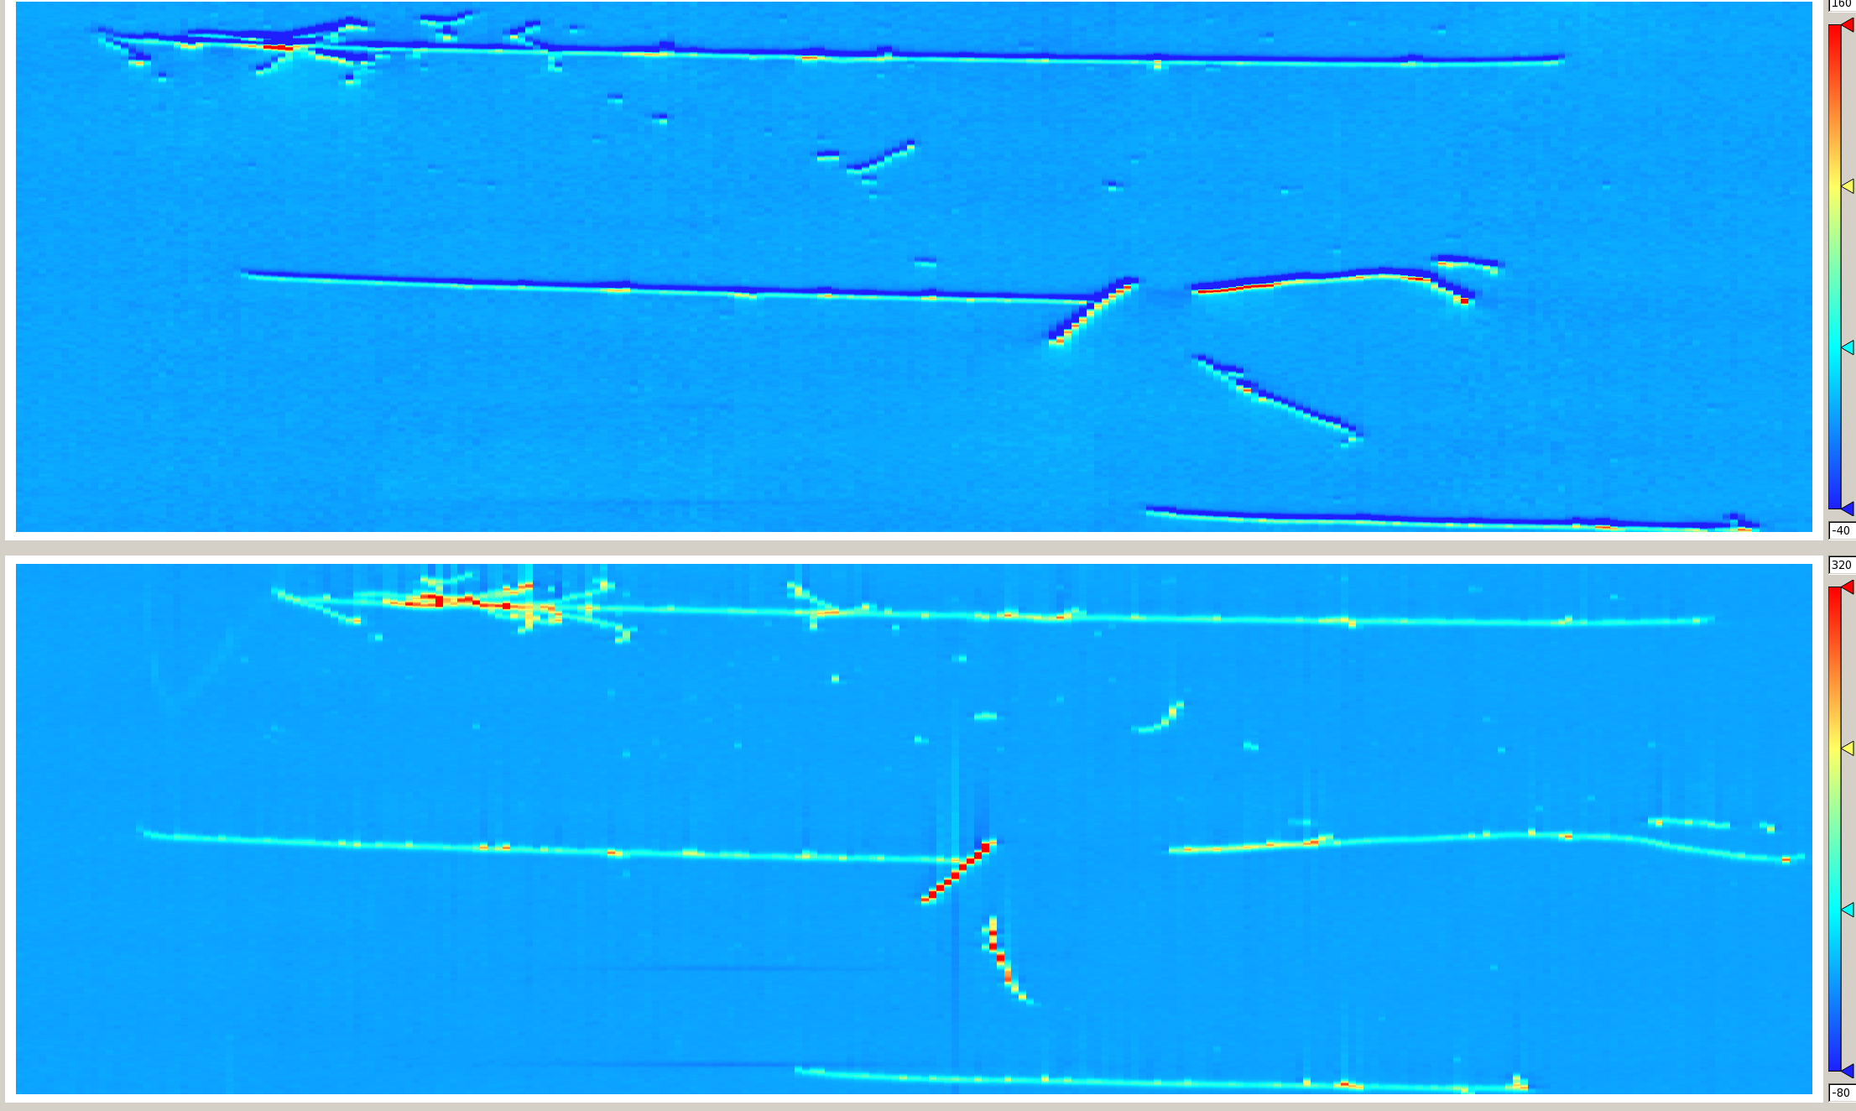

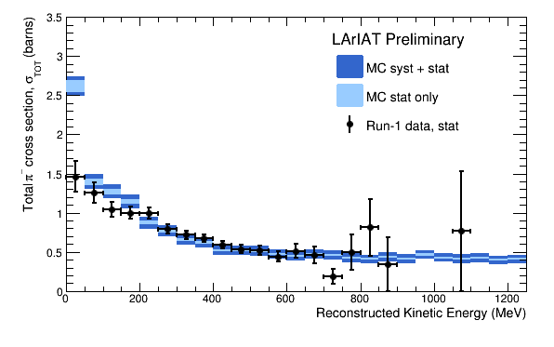
LArIAT (T-1034)
Run-1: April 30, 2015 – July 3, 2015
Run-2: Feb. 18, 2016 – ongoing
Goals Characterize LArTPC performance in the range of energies relevant to upcoming SBN and LBN programs for neutrino physics and for proton decay searches.
Charged pion interaction cross section measurements
Optimize pion and kaon ID
Experimentally measure e-γ separation capabilities
Develop criteria for charge sign determination
Study energy resolution improvement by combining information from scintillation light and ionization charge signals

Slide 16
A decade of accomplishments
Fruitful operation of two neutrino beams, NuMI and BNB and many experiments :
  MINOS, MINOS+, MINERvA, ArgoNeuT, NOvA in NuMI
  MiniBooNE, SciBooNE, MicroBooNE and now ANNIE in BNB
NOvA was a major construction project completed on time and under budget
  Received a Project Management Excellence Award (2015)
MicroBooNE also completed on time and under budget
  Also received a Project Management Excellence Award (2016)
NOvA has already produced significant physics results and MicroBooNE is on its way to do the same
MINOS+ will conclude operations at the end of current run

Slide 17
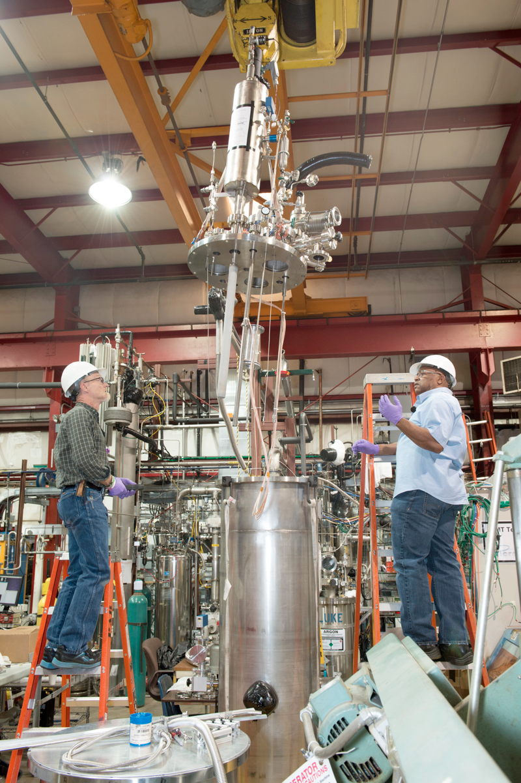
Liquid Argon TPC R&D Facilities
PAB has become the launch pad of Fermilab’s efforts to enable the deployment of a multi-kiloton LArTPC
Have intentionally established the infrastructure over the last decade to support variety of small scale tests
Focus on technical topics not previously fully explored
These smaller tests led to ArgoNeuT, LAPD, LBNE 35t, and MicroBooNE
Key components include
  An excellent staff of technicians to support experimenters
  Dedicated liquid argon distribution system with purification from electronegative contaminants
  Analyzers to monitor the level of contaminants
  Condensers to maintain closed systems of liquid argon
  Common safety system including ODH and ventilation
Fermilab organizes and hosts workshops dedicated to R&D efforts
Technicians supporting R&D at PAB

Slide 18
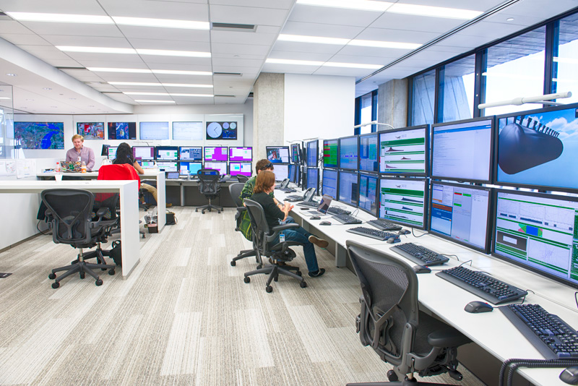
ROC-West
The Remote Operations Center (West) is a new control room facility available to any onsite experiment.

Slide 19
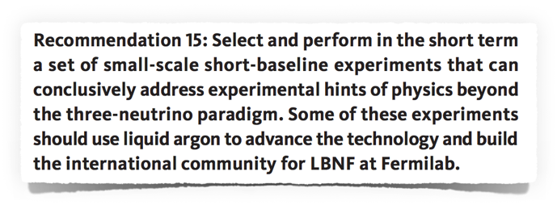
P5 Recommendation on Neutrinos
Plan launched in 2014 and approved in current form in 2015
  Collaborative arrangement between Fermilab/DOE, CERN and INFN to bring ICARUS to FNAL, via a refurbishment stop at CERN
  Fermilab GPP funds used for building construction
  Near detector collaboration emerged from a pre-P5 proposal to build a 1-kton (LAr1) short-baseline experiment
  SBND collaboration obtained funding from NSF, UK, Switzerland and LANL LDRD
  CERN contributing to the Near Detector

Slide 20
SBN Proposal Author List
Collaboration spokespeople
Fermilab SBN Program Coordinator

Slide 21
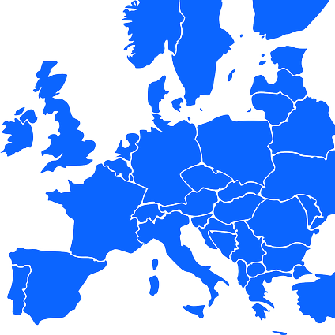





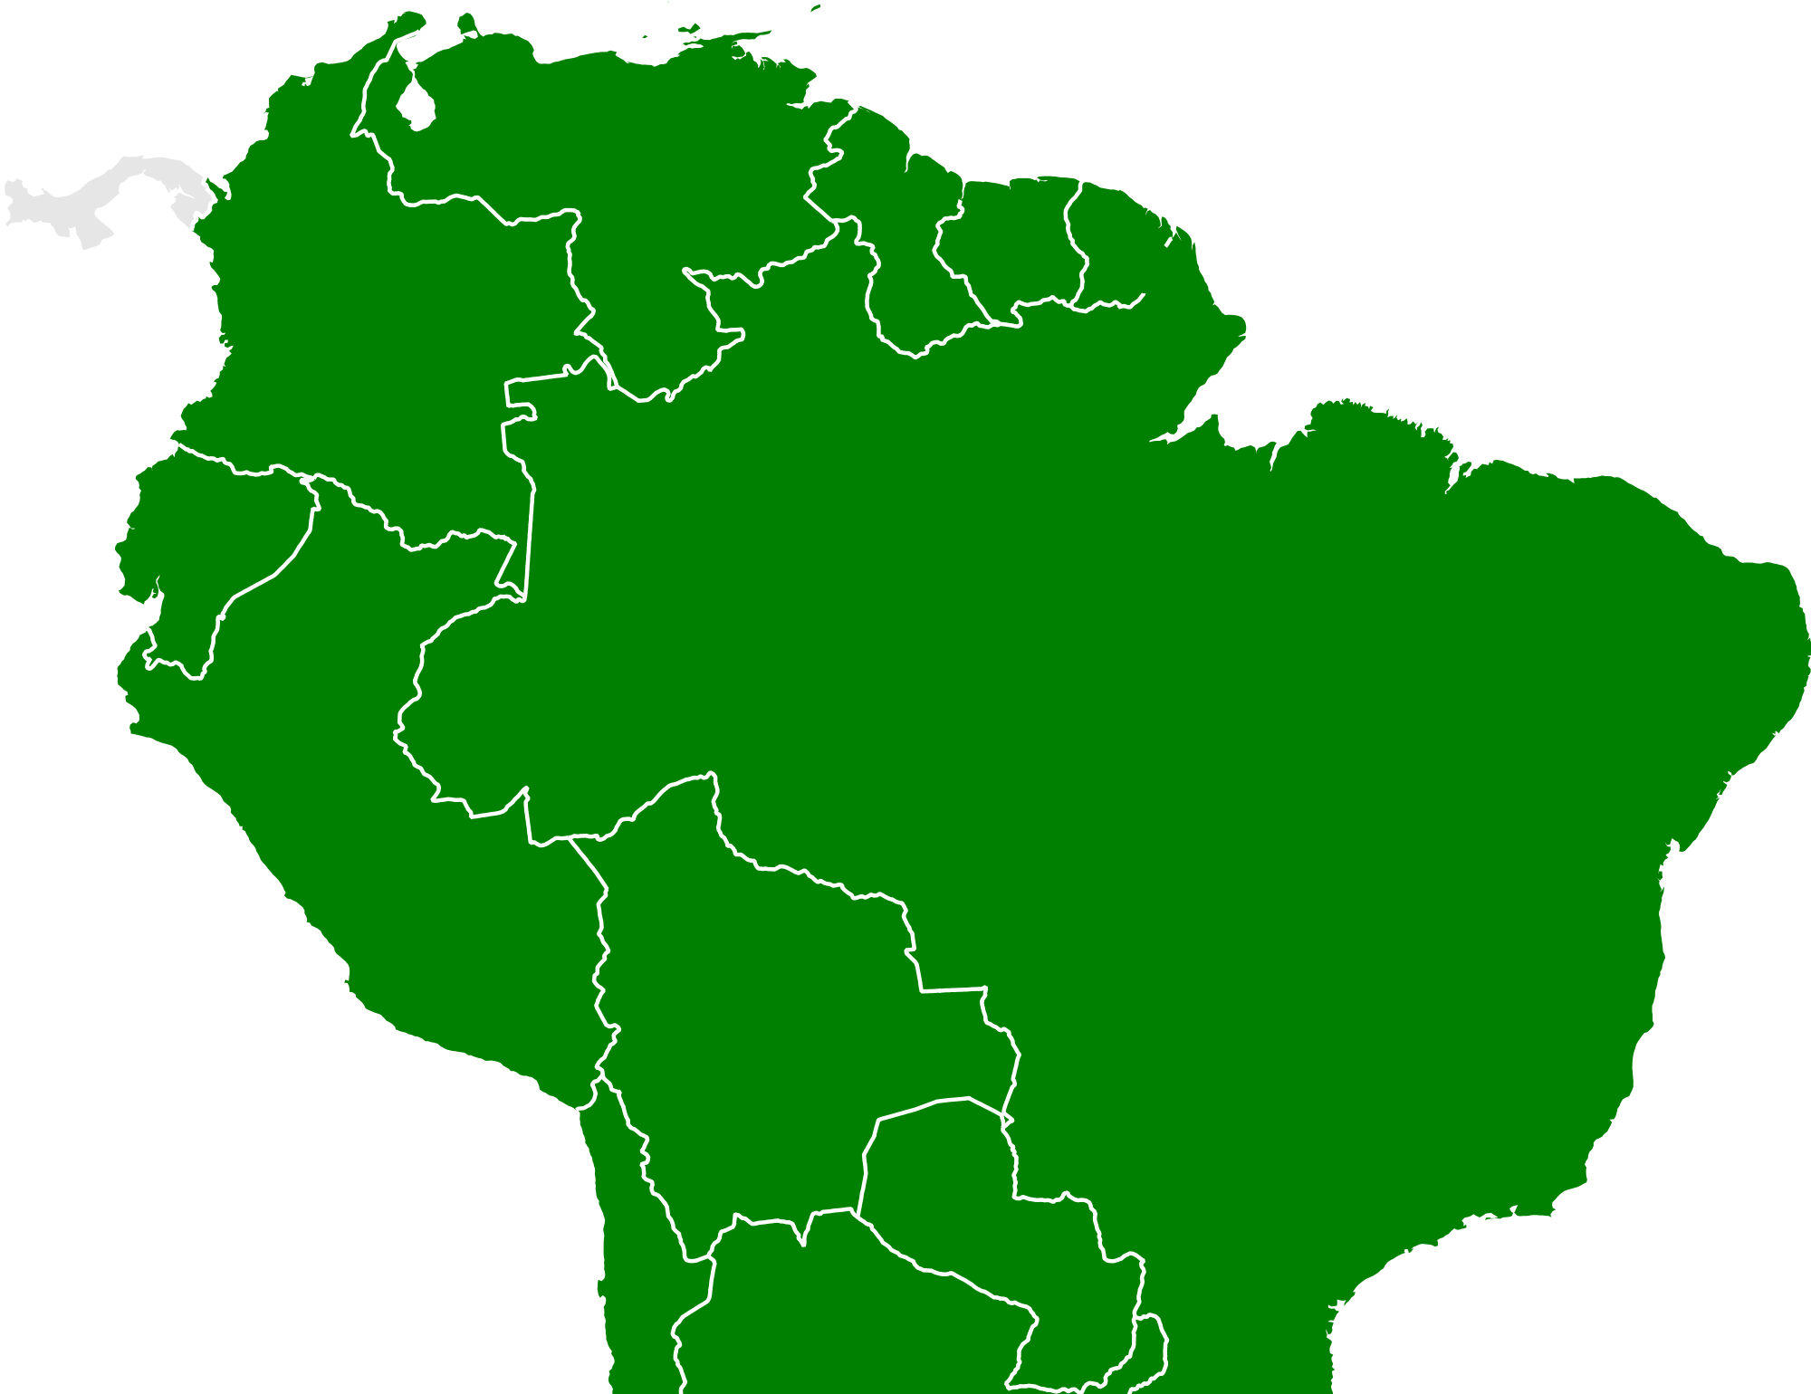

SBN Institutions - 2016
Over 225 Authors Total
Russia 1
UK 7
US 27
Poland 5
CH 1
Italy 9
Turkey 1
Institutions | SBN | SBN-DUNE Overlap
US | 27 | 25
Non-US | 28 | 24
Brazil 3

Slide 22
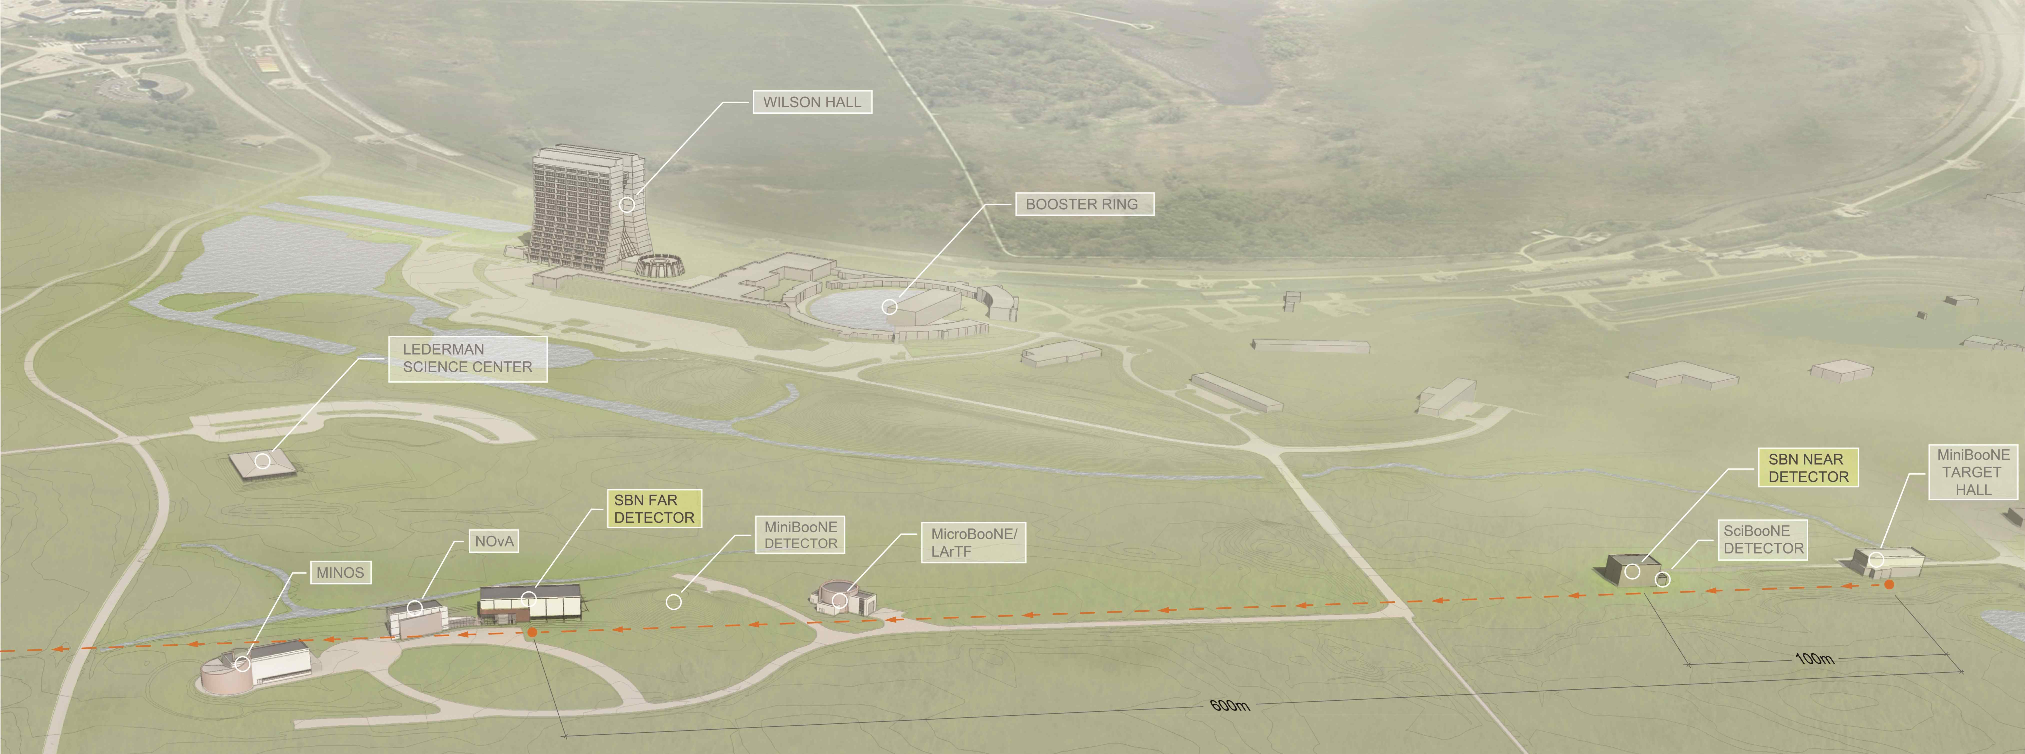
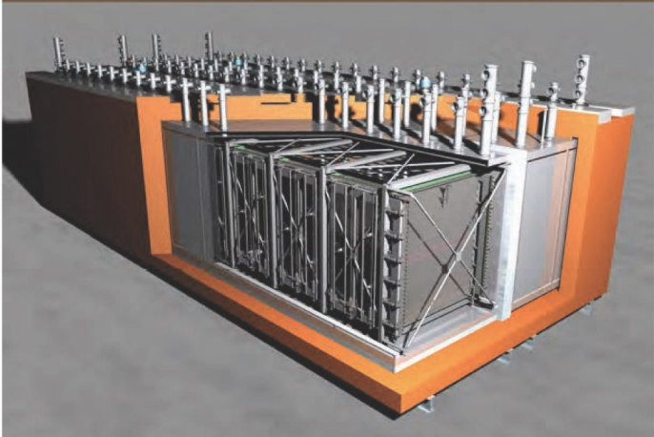
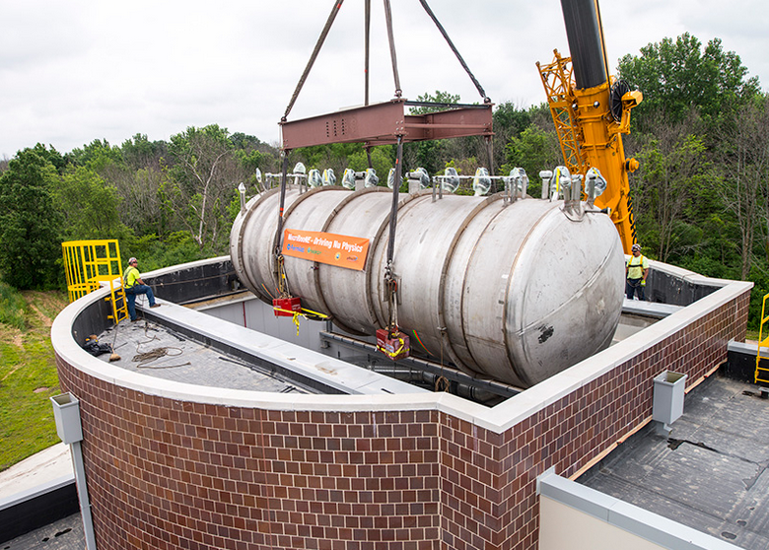
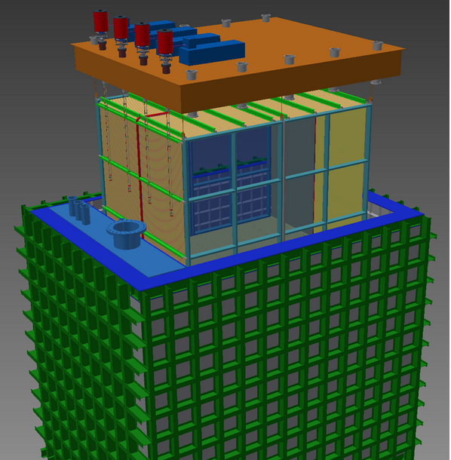
The Short-baseline Neutrino Program
ICARUS
(476 t @ 600 m)
MicroBooNE
(89 t @ 470 m)
SBND
(112 t @ 110 m)
Infrastructure for Far and Near detectors : FY14-FY16 FNAL GPP
ICARUS refurbishment at CERN : 2015 – 2016; WA-104 CERN-INFN
SBND = DUNE style technology development program + physics

Slide 23
SBN Status
Buildings
  Far building well along, complete at end of CY 2016.
  Near building started, complete at end of CY 2016.
ICARUS detector: upgrade progressing well
  All new PMTs delivered to CERN
  Assembly of first cryostat in progress
  First TPC installed in cryostat in mid-2016
  Fermilab leading active integration and installation planning with CERN and INFN institutes: delivery to Fermilab in early CY 2017
SBND: moving to final designs and start of component fabrication
  First final design review: TPC anode plane frames (2/23/16)
  Fermilab leading integration plan: TPC assembly at Fermilab starting in CY2017
Cryogenics for near and far detectors in detailed design phase
  CERN design contract for LAr filtration skids to bidding process: Spring 2016
  Fermilab designs of LAr and LN2 delivery following

Slide 24
Timeline to Physics for SBN Program
MicroBooNE: Operations and First Physics
SBN Physics Operations
Commission
ICARUS Detector:
Upgrade and Install
SBN Physics Operations
Commission
Short Baseline Near Detector:
Assemble and Install
SBN Physics Operations
MicroBooNE Results on Low Energy Excess
First ν_{s} search Results
New Building Construction
2016
2017
2018
2019
2020
2021

Slide 25
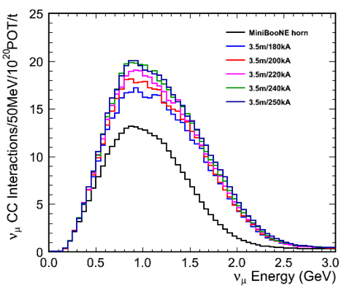
Upgrading the Booster Neutrino Beamline
A longer horn + refurbished power supply doubles the event rate in all 3 SBN detectors.
It costs $6.5M and, with design starting now, would be in operation in 2019
  Guarantees definitive results before protons become scarce (PIP II shutdown + Muon ops)
  Avoid problems with low proton delivery
  All the physics arrives twice as quickly
  Enable scientists to move onto DUNE 2x faster

Slide 26
Diverse Activities aiming towards the Future Program
Many different activities – each requiring a different model/approach towards
support
Detector R&D : LAr Test stands, LAPD, 35 ton
  Relatively small efforts; good training grounds for students and post-docs
Test Beam efforts
  Detector development and training ground : i.e. LArIAT
  Detector calibrations and upgrades : MINERvA (t.b. operations complete in FY15), NOvA (under discussion for an FY17-18 time-frame)
ANNIE –
  FNAL scientists are not collaborators
  FNAL provided installation and liaison support
Captain MINERvA
  We are determining the resources that will be needed to support installation and operation
  Will require continued support for MINERvA detector and MINOS near detector (legacy detectors)
DUNE via SBN and ProtoDUNEs

Slide 27
Near Term Activities (FY16-18)
MINOS+ will conclude and a decommissioning plan for the Soudan Laboratory is being developed
NOvA will continue to run and produce important results on mass hierarchy and δ_{CP}
In the first phase of the SBN program MicroBooNE will address its primary physics goal
Future run plan for MINERvA : Liquid targets : H₂O, He; ν_{μ}
  Captain MINERvA ; Stage 1 approval
  Deployment planning under way
SBND and ICARUS will be installed
ProtoDUNE at CERN will be constructed
LBNF/DUNE will prepare for CD-2 in 2019

Slide 28
Neutrino Physics Center (npc.fnal.gov)
Goals
  To bring researchers to Fermilab for short term and long term stays to work on Fermilab Neutrino experiments and/or within the Fermilab Theory Community
  Organize the weekly Neutrino Seminar Series and the summer “Neutrino University”
  Host experimental and theoretical topical workshops in Neutrino Physics
  Coordinate the International Neutrino Summer School and host it in odd years
  Provide facilities to host visitors, enable remote participation, and foster interaction at Fermilab
Status of “launch”
  $100K initial funds received Sept. 2015
  1 award for DUNE support in place
  1st round of formal Fellowship applications are now being evaluated
  Awaiting additional funding from DOE

Slide 29
Conclusion
Suite of running experiments, lots of data to analyze :
  MINOS+ (concluding), NOvA, MINERvA
Three SBN Liquid Argon detectors being operated, refurbished and constructed (MicroBooNE, ICARUS, SBND)
  Will lead to experience, lessons learned, software and analysis techniques developed, ….
Planning for DUNE/ProtoDUNEs ramping up
This is an exciting and productive time for the neutrino program!
Thank you!

