Slide 1

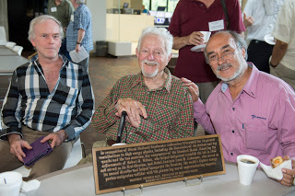
Latin American contributions to MINERvA/Captain MINERvA
Julián Félix
Laboratorio de partículas elementales*, Departamento de Física, División de Ciencias e Ingenierías, Campus León, Universidad de Guanajuato, México.
felix@fisica.ugto.mx
L. Lederman
Gerardo Zavala
Julian Félix
MINERvA icon
12 June 2015. FERMILAB, USA.
*http://laboratoriodeparticulaselementales.blogspot.mx/

Slide 2
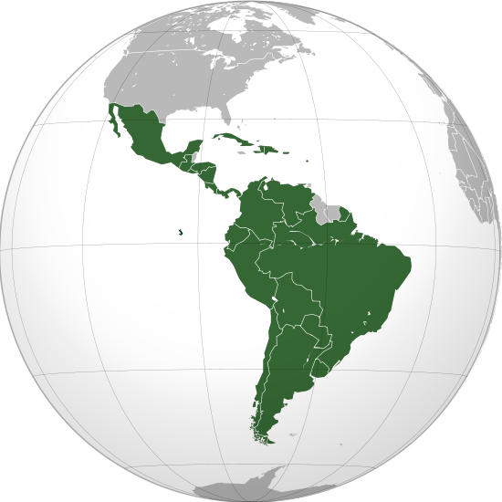
Introduction.
Minerva Collaboration. Latin American Contributions.
3. Some New Ways of Collaboration Between Fermilab and Latin American Institutions.
4. Conclusions.

Slide 3
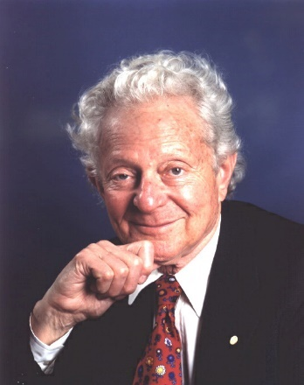
Introduction.
To describe the general situation in experimental high energy physics and related technologies in Latin Americas is no so simple and straightforward task.
The average situation was this when Lederman came to LA (1979):
--no identified groups devoted to experimental high energy physics and related technologies;
--some identified groups dedicated to theory or phenomenology on high energy physics;
--almost no scientists related with the local industry;
--almost null progress in the construction and use of modern instruments for high energy physics and related technologies;
--lack of good educational and scientific training programs.
Lederman

Slide 4

Thirty five years later the situation has improve, there is still challenges even with the modern technologies of information and communication at hand:
--strong groups on experimental high energy physics exists in México, Brazil, Argentina, Colombia, Chile, and Perú. In Mexico this is the situation:
--Almost the total absence of scientists in the industry,
--progress in the construction and use of modern instruments runs behind,
--the lack of good educational and training programs.
In these days, Jorge Morfin is coordinating most of the Fermilab efforts with LA
Symmetry Magazine

Slide 5

Those groups participate in many experiments at Fermilab, CERN and other scientific research centers around the world.
In particular groups
---from Brazil, led by professor Helio da Motta, LAFEX/Centro Brasileño de Pesquisas Físicas;
---From Perú, led by professor Alberto Gago, Pontificia Universidad Católica del Perú
and professor Javier Solano, Universidad Nacional de Ingeniería;
---from Chile, led by professor Jon Miller, Universidad Santa María;
---and from México, led by professor Julian Felix, Universidad de Guanajuato,
participate in the MINERvA collaboration since around 2006, and in CAPTAIN MINERvA collaboration, since 2015.

Slide 6
2. Minerva Collaborations. Latin American Contributions .
MINERvA collaboration (htto://Minerva.fnal.gov) is currently composed by 65 members, from the fields nuclear and particle physics, in seven countries, and 21 institutions.
These are the current member universities:
College of William and Mary, Williamsburg, Virginia, USA. Hampton University, Hampton, Virginia, USA. Massachusetts College of Liberal Arts, North Adams, Massachusetts, USA. Northwestern University, Evanston, Illinois, USA. Otterbein College, Westerville, Ohio, USA. Pontificia Universidad Catolica del Peru, Lima, Peru. University of Florida-Gainesville, USA. Universidad de Guanajuato, Mexico. University of Minnesota-Duluth, Duluth, Minnesota, USA. Universidad Nacional de Ingenieria, Lima, Peru. University of Oxford, Oxford, United Kingdom. University of Pittsburgh, Pittsburgh, Pennsylvania, USA. University of Rochester, Rochester, New York, USA. Universidad Técnica Federico Santa María, Valparaíso, Chile. Rutgers University, New Brunswick, New Jersey, USA. Tufts University, Medford, Massachusetts, USA.

Slide 7

MINERvA stands for Main Injector Neutrino ExpeRiment ν(neutrino) A(nucleus).
This is, a designed experiment to study the interactions between neutrino (antineutrino) -both, electron neutrino and muon neutrino- with different nuclei -He, H2O, Pb, C, Fe-.
This experiment has no precedent in the detailed studies, in variety of used targets, and in providing data to present and future neutrino oscillation experiments.
The main goals established for low energy run are as follows:
---Study, both signal and background, reactions important to present and future neutrino oscillation experiments;
---study nuclear effects in inclusive reactions;
---measure nuclear effects on exclusive final states as function of measured neutrino energy;
---study differences between neutrinos (anti neutrinos) nuclei interactions.
The MINERvA beam energy distribution

Slide 8
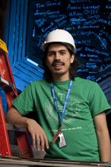
here are many physics topics under study:
--Muon neutrino and muon anti neutrino charged current quasielastic reactions.
--Muon neutrino quasilelastic reactions with observed proton recoil.
--Electron neutrino charged current quasi elastic reactions.
--Charged current diffractive scattering reactions from H.
--Charged pion production.
--Coherent pion production.
--Neutral pion production.
--Muon neutrino charge current inclusive double
differential cross sections.
--Ratios of inclusive charged current reaction on nuclei.
--Ratios of charged current deep inelastic scattering on nuclei.
--Neutrino electron scattering.
--And many others to come.
Cristian Peña

Slide 9
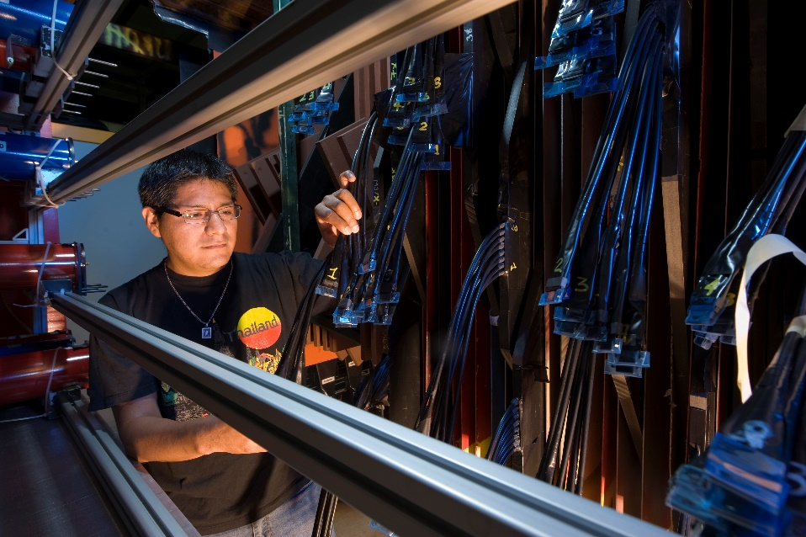
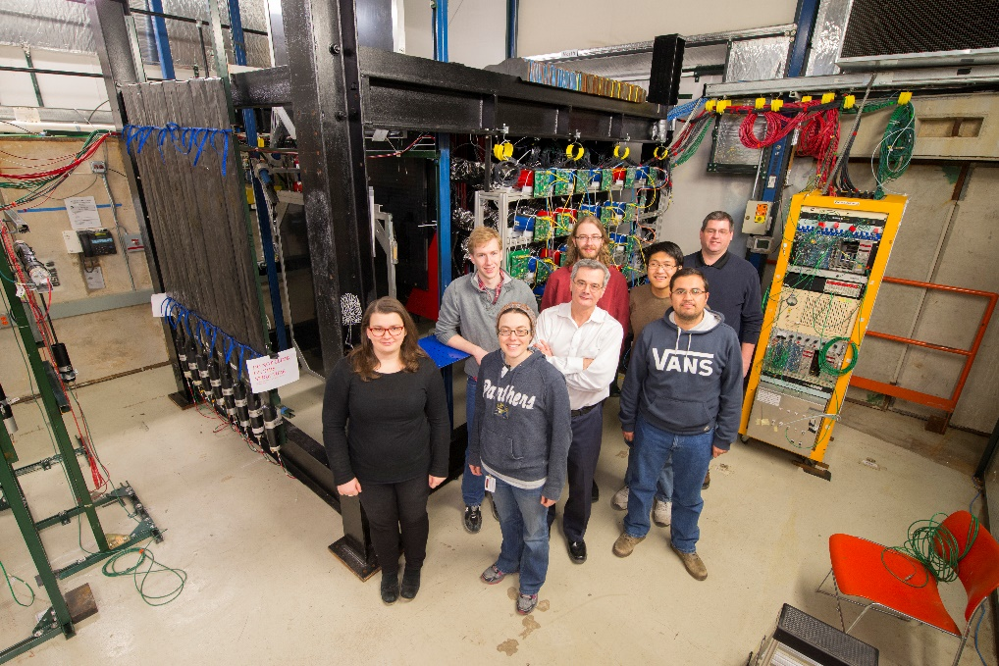
In parallel to the main MINERvA detector has been a MINERvA test beam detector, a small replica of the MINERvA main detector, for calibration purposes. Test beam detector was placed in tertiary test beam designed by MINERvA LA students.
Test Beam MINERvA detector second run

Slide 10
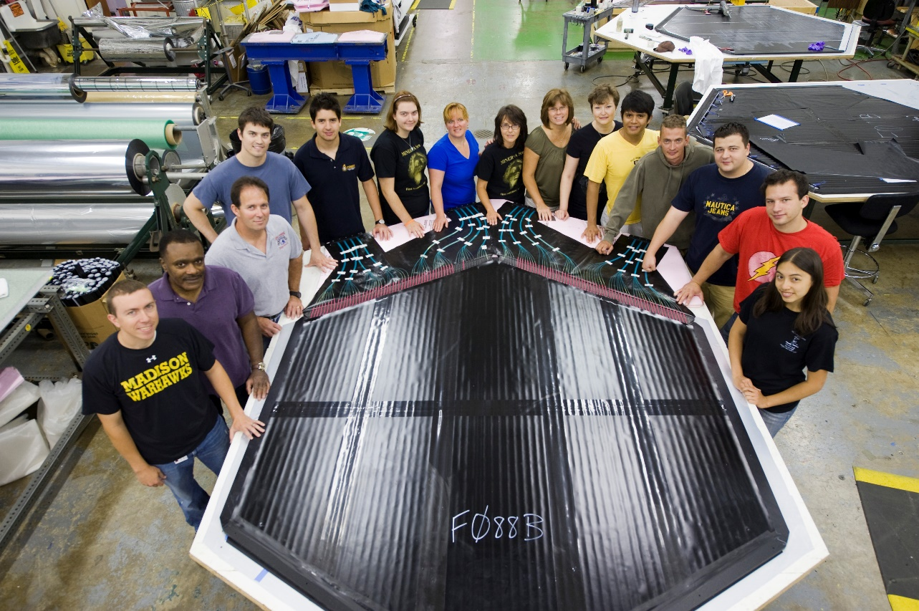
The LA groups have participated in almost all aspects of MINERvA experiment.
--R&D and final design, construction, installation, commissioning, operations, and analyses with the main MINERvA detector and in the test beam (first and second run);
--Monte Carlo; and data analyses.
Most of this work is reported in references 3-11, where more specific references can be found like theses and conference proceedings.
--For example, Julio Cesar Capetillo and Alfonso Balcazar, from the Universidad de Guanajuato, worked in the
construction of the main
MINERvA plane detectors.
--Many BSc, MSc, and PhD theses,
and postdoctoral positions have
been accomplished.

Slide 11
Resume of all LA participants and their obtained degrees.
BRAZIL
CBPF
Last year in program | Fist name | Last name | Institution | Thesis advisor | “Local” advisor | position | Following position | Current Institution
2014 | David | Martinez S. | CBPF | Helio DaMotta | David Schmitz | PhD student | Postdoc on Daya Bay | IIT
2011 | David | Martinez S. | CBPF | Helio DaMotta | José Palomino | Master student
2013 | Arturo | Florentini | CBPF | Helio DaMotta | David Schmitz | PhD Student | Postdoc on T2K | York University (Canada)
2009 | Arturo | Florentini | CBPF | Helio DaMotta | David Schmitz | Master Student
2014 | Kenyi | Hurtado | CBPF | Helio DaMotta | Joytsna Osta | PhD student | Postdoc at ATLAS | Notre Dame
2013 | José | Palomino | CBPF | Helio DaMotta | David Schmitz | PhD student | Postdoc on T2K | Stony Brook
2013 | José | Palomino | CBPF | Helio DaMotta | Jorge Morfin | Master student
2012 | César | Castromonte | CBPF | Helio DaMotta | Jorge Morfin | Postdoc | Research faculty | Goias
2014 | Thiago | Muhlbeir | CBPF | Helio DaMotta | Howard Bidd | Postdoc | Postdoc in phenomenology | UNI Rio
2015 | Harold | Yepes R | CBPF | Helio DaMOtta | Debbie Harris | Postdoc | Faculty on NEXT (0nubb) | Universidad Antonio Nariño Sede Circunvalar, Bogotá Colombia
2016 | Gian | Fredy | CBPF | Helio DaMotta | Minerba Betancourt | Master student | Current student
2015 | Anushree | Ghosh | CBPF | Helio DaMotta | Minerba Betancourt | Postdoc | Now a postdoc on MINERvA | USM
2016 | Mateus | Carneiro | CBPF | Helio DaMotta | Jorge Morfin | PhD student | Received a postdoc offer from OSU

Slide 12
Last year in program | Fist name | Last name | Institution | Thesis advisor | “Local” advisor | position | Following position | Current Institution
MEXICO
UGTO
2010 | Zaida | Urrutia | UdeGuanajuato | Julian Felix | Jorge Morfin | PhD student | Department Head | Universidad del Valle de Guatemala
2014 | María | Barrios | UdeGuanajuato | Julian Felix | Minerba Betancourt | undergraduate | PhD student in Astronomy | Stony Brook
2011 | Maria | Zarazúa | UdeGuanajuato | Julian Felix | Julian Felix | undergraduate | PhD student at IPN Mexico
2014 | Aaron | Higuera | UdeGuanajuato | Julian Felix | Jorge Morfin | PhD student |  | Rochester and now University of Houston
2010 | Aaron | Higuera | UdeGuanajuato | Julian Felix | Jorge Morfin | Master student
2010 | Jorge | Castorena | UdeGuanajuto | Julian Felix | Jorge Morfin | Master student | PhD student at University of Missouri
2015 | Edgar | Valencia | UdeGuanajuato | Julian Felix | Minerba Betancourt | PhD student |  | Accepted an honorary position UdeGuanajuato
2011 | Edgar | Valencia | UdeGuanajuato | Julian Felix | Julian Felix | Master student
2016 | Alejandro | Ramírez | UdeGuanajuato | Julian felix | Jorge Morfin | PhD student | UdeGuanajuato
2015 | Alejandro | Ramírez | UdeGuanajuato | Julian Felix | Leo Bellantoni | Master student
2010 | Alfonso | Balcazar | UdeGuanajuato | Julian Felix | Jorge Morfin | Master student | Mechanical engineering student | PhD in automotive engineering, Germany
2010 | Julio Cesar | Capetillo | UdeGuanajuato | Julian Felix | Jorge Morfin | Master student | Mechanical engineering student | Guanajuato automotive industry

Slide 13
PERU
Last year in program | Fist name | Last name | Institution | Thesis advisor | “Local” advisor | position | Following position | Current Institution
2014 | María José | Bustamante | PUCP | Alberto Gago | Mike Kordosky | Master student | PhD student in astronomy | Austin TX
2010 | Noemi | Ochoa | PUCP | Alberto Gago | Jorge Morfin | Master Student | PhD student at Regina on T2Kabout to be Fermilab staff | University of Regina
2008 | Leonidas | Aliaga | PUCP | Alberto Gago | Mike Kordosky | Masters student | (SCD), was grad student at W&M | William and Mary/Fermilab
2008 | Jose | Bazo | PUCP | Alberto Gago | Jorge Morfin | Masters student | Postdoc at DESY | DESY
2010 | Carlos | Perez | PUCP | Alberti Gago | Jorge Morfin | Masters students | Postdoc at Utrect
2010 | Carmen | Araujo | PUCP | Alberto Gago | Jorge Morfin | Masters student | Adjunct faculty | UNI Cusco
2012 | Gonzalo | Diaz | PUCP | Albert Gago | Jeff Nelson | Masters Student | Now PhD student | University of Rochester
PUCP

Slide 14
Last year in program | Fist name | Last name | Institution | Thesis advisor | “Local” advisor | position | Following position | Current Institution
PERU
2011 | Marco | Alania | UNI | Javier Solano | Rik Gran | Masters student | Now PhD student | Antwerp, Antwerp, Belgium
2007 | Adolfo | Chamorro | UNI | Javier Solano | Jorge Morfin | Masters student | Now PhD student | Universite Pierre et Maria Curie (UPMC) of Paris, France
2012 | Cesar | Sotelo C. | UNI | Javier Solano | Jose Palomino | Masters student | Adjunt faculty | Universidad peruana de ciencias aplicadas (UPC) Lima, Peru
2008 | Carlos | Romero | UNI | Javier Solano | Jorge Morfin | Masters student | Adjunt faculty | Instituto del mar del Peru (IMARPE), Lima Peru
2016 | Gerald | Salazar | UNI | Javier Solano | Leo Bellantoni | Master student | Finishing his Masters
2016 | Antonio | Zegarra | UNI | Javier Solano | Leo Bellantoni | Masters student | Finishing his masters
2009 | Kenyi | Hurtado | UNI | Javier Solano | Mike Kordosky | Masters student | Became CBPF doctoral student
UNI

Slide 15
Last year in program | Fist name | Last name | Institution | Thesis advisor | “Local” advisor | position | Following position | Current Institution
CHILE
2016 | Nuruz | Zaman | USM | Jon Miller |  | Postdoc | Now a postdoc on MINERvA | Rutgers
2016 | Roger | Galindo | USM | Jon Miller |  | PhD student | Just started as PhD student
2016 | Barbara | Yaeggy | USM | Jon Miller |  | PhD student | Just started as a PhD student
2011 | Christian | Peña | USM | Jon Miller | Jorge Morfin | Masters student | PhD at Caltech
2012 | Guiliano | Maggi | USM | Jon Miller | Steve Manly | Masters student | PhD at VUB on ice Cube
USM
Participation by institution; the numbers inside () mean currently running.
Country(Institution)/students | BSc | Masters | PhD | Postdoc
Brazil(CBPF) | -- | 3(1) | 4(1) | 3(1)
Mexico(Universidad de Guanajuato) | 4 | 4 | 3(1)
Perú (PUCP, UNI) | -- | 7,7
Chile (USM) | -- | 2 | (1) | (1)

Slide 16
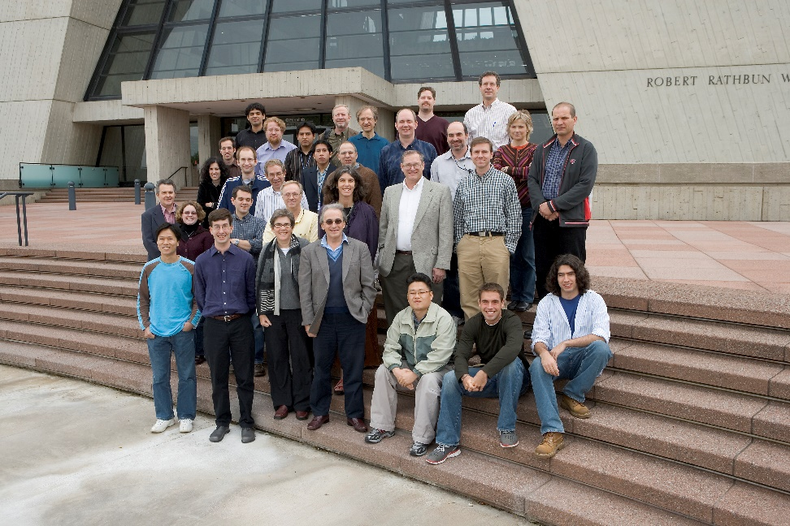
---Approximately ¼ of the participant institutions on MINERvA collaboration comes from LA.
---People learn up to date neutrino physics, many scientific techniques, organization skills, ways of working, and discipline.
---Other data obtained from Table 1: Many of the high technically trained people from LA remain outside LA after graduating. This is a big disadvantage for LA.
---LA groups so far are getting technical capabilities to lead scientific research at international level, to create all needed technology, and to achieve scientific results.
---LA industry is now becoming ready to collaborate on experimental high energy physics, on detectors, computing, etc.

Slide 17
Recently, Captain MINERvA(http://captain-minerva.fnal.gov/) collaboration has been created, and all the groups from Latin America involved with MINERvA experiment have joint it.
LAr, TPC
Captain MINERvA detector

Slide 18
3. Some New Ways of Collaboration Between Fermilab and Latin American Institutions.
---These are mere ideas to help the LA scientific and technical situation shown above. The same rules should not be applied like a formula to all Latino American countries.
---Collaborate with international groups in experimental high energy physics, like MINERvA, DUNE, etc.
---Create infrastructure for high energy physics at universities. Laboratories, machine shops, etc., even small ones will be good.
---Define experimental high energy physics challenges and propose solutions.
---Participate with the local and international industry, to create new technology and to transfer it to private industry.
---Create very good university educational and technical training, with enough technical and scientific capabilities to create new technology.

Slide 19
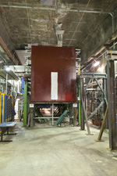
4. Conclusions.
There are some advances at the very well identified experimental groups in Argentina, Brazil, Colombia, Mexico, Peru, Chile.
LA groups are prepared to collaborate outside their own countries with success, as is shown in the MINERvA collaboration.
Some actions must be taken to alleviate LA chronic scientific and technical situation, besides scientific collaborations with international groups.

Slide 20
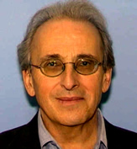
Special thanks to Jorge Morfin
for his big fruitful efforts to scientifically bridge
Fermilab and LA institutions.

Slide 21
Thanks!

Slide 22
REFERENCES
1. Leon M. Lederman. Fermilab and Latin America. http://scitation.aip.org/content/aip/proceeding/aipcp/10.1063/1.2359388 .
2. Leah Hesla. 30 years of inter-American. Symmetry magazine. http://www.symmetrymagazine.org/article/march-2014/30-years-of-inter-american-collaboration
3. J Félix, G Zavala, Z Urrutia, A Higuera, E Valencia (MinerνA Collaboration)3. MINERνA Project (FNAL e938)'s Mexico Contribution. Published under licence by IOP Publishing Ltd, Journal of Physics: Conference Series, Volume 287, Number 1, 2011.
4. J. Castorena et al. Commissioning of the MINERvA tracking prototype MINERvA Collaboration. AIP Conf.Proc. 1182 (2009) 104-107.
5. J. Felix et al. Simulation and characterization of the MINERvA dipole magnets. MINERvA Collaboration, 2009. Published in AIP Conf.Proc. 1182 (2009) 108-111.
6. A. Higuera et al. MINERvA test beam commissioning. MINERvA Collaboration, 2009. AIP Conf.Proc. 1182 (2009) 112-115.
7. J. Felix et al. The FNAL E938 experiment: The Mexican contribution to the MINERvA Collaboration. MINERvA Collaboration. AIP Conf.Proc. 1116 (2009) 223-226.
8. L. Aliaga et al (MINERvA Collaboration). MINERvA neutrino detector response measured with test beam data MINERvA Collaboration. Jan 26, 2015. 15 pp. Nucl.Instrum.Meth. A789 (2015) 28-42.
9. A. Higuera et al (MINERvA Collaboration). Measurement of Coherent Production of π± in Neutrino and Antineutrino Beams on Carbon from E ν of 1.5 to 20 GeV. Phys.Rev.Lett. 113 (2014) no.26, 261802.
10. L. Aliaga et al (MINERvA Collaboration). Design, Calibration, and Performance of the MINERvA Detector MINERvA Collaboration May 22, 2013. 30 pp. Nucl.Instrum.Meth. A743 (2014) 130-159.
11. G.A. Fiorentini et al ((MINERvA Collaboration). Measurement of Muon Neutrino Quasielastic Scattering on a Hydrocarbon Target at Eν∼3.5 GeV. May 9, 2013. 6 pp. Phys.Rev.Lett. 111 (2013) 022502.

