Slide 1
Neutrino-Latin America Workshop
Strategic Vision for the Future of Fermilab
Nigel S. Lockyer
April 27, 2016

Slide 2
First Baby Bison Arrives 2016

Slide 3
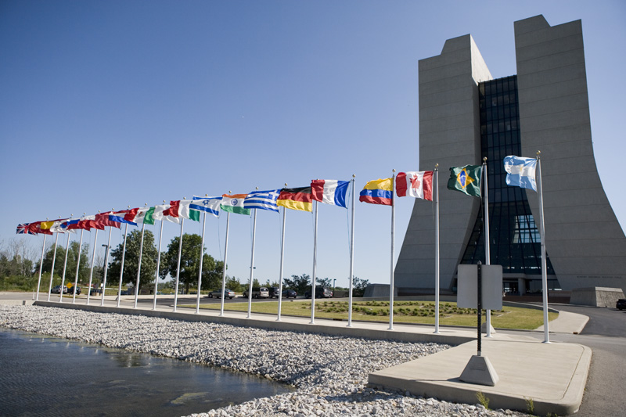
Result: From 450 institutions in 44 countries
- More than 3,500 scientists use our facilities.
- They are from more institutions and more countries than ever before; and we want to grow even more international

Slide 4
Brazilian President José Sarney (1989)

Slide 5
P5 Report…still very impactful in Washington
P5 report has had and is having a major impact on US planning for particle physics because:
Excellent report that made difficult choices and has focused field
Community support very high
Secretary of Energy has expressed strong support for report because of community support
P5 top priorities: LHC and Neutrinos
Notes:
Removed two slides that came before this and added a new slide at the end instead

Slide 6
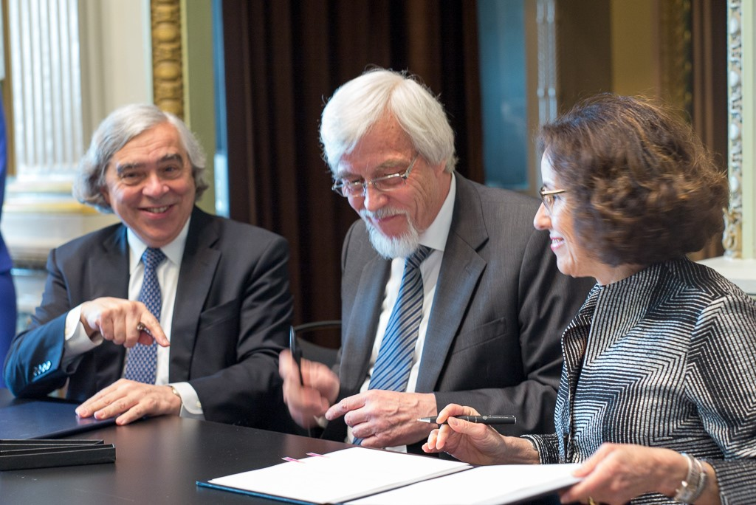
CERN/DOE/NSF Agreement: Signers…Moniz, Heuer, Cordova

Slide 7
What’s happening?
Our focus for 2016 will be:
Advance our flagship: LBNF/DUNE
Do science…LHC/CMS, neutrinos, DES, DM
Move infrastructure projects forward…IER (FY18)
Keep focus on projects: SBN, g-2, Mu2e
Modernize accelerator complex (700kW is goal)
Advance a diverse workforce succession plan
Fermilab turns 50: A half-century of discovery…plan to celebrate starting next year

Slide 8
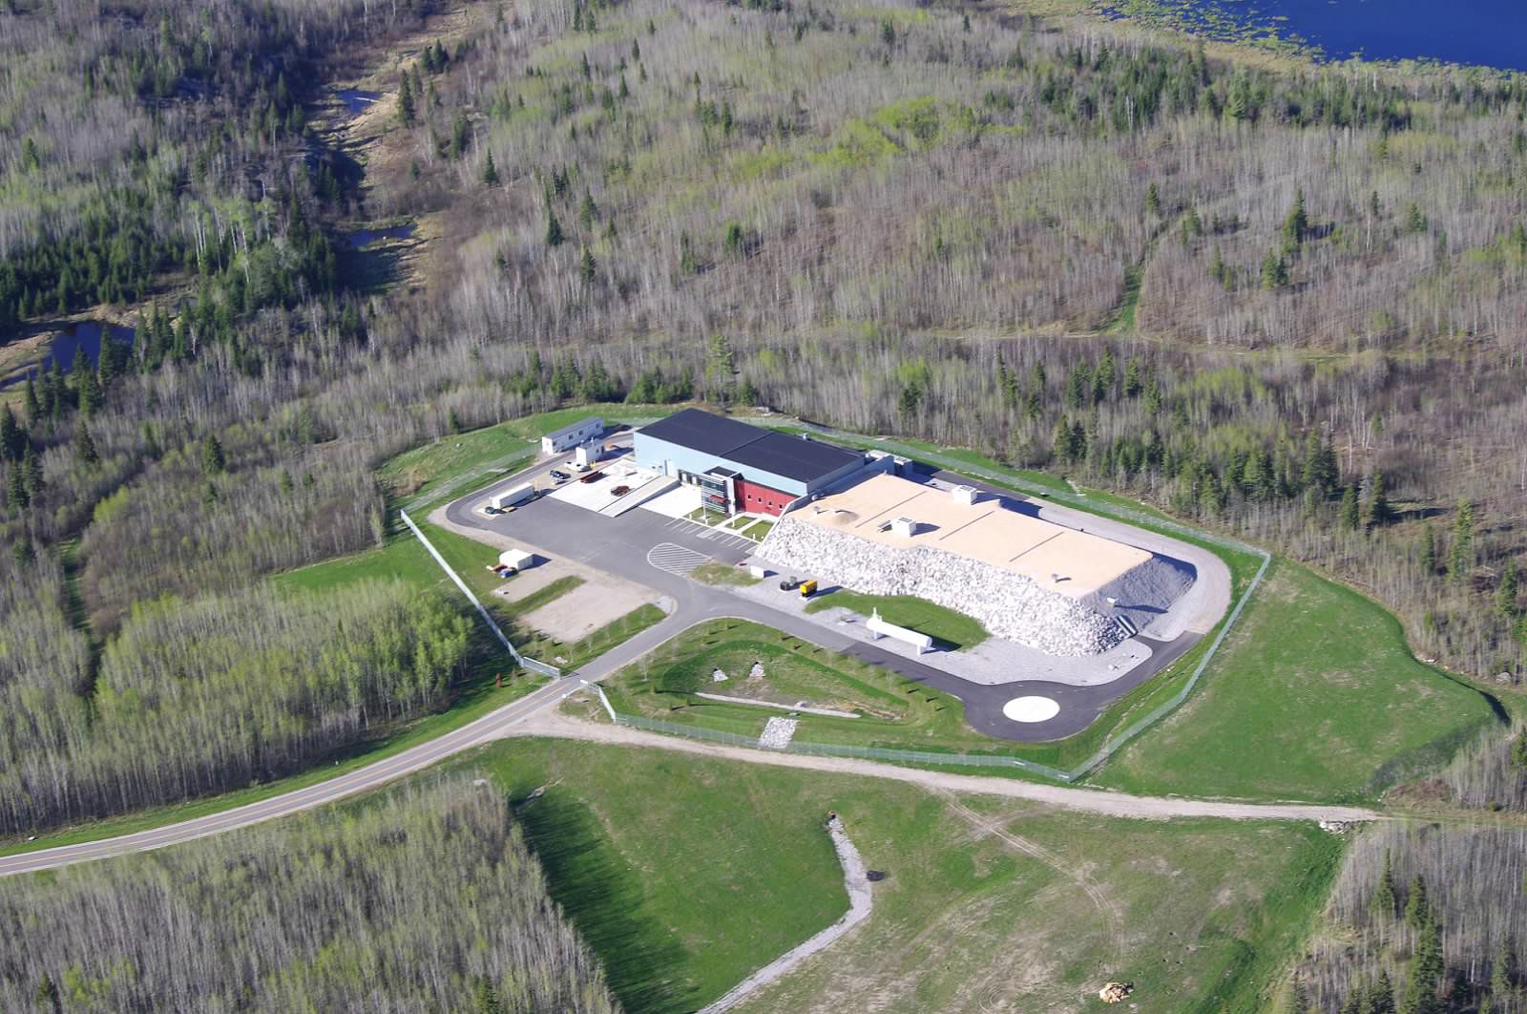
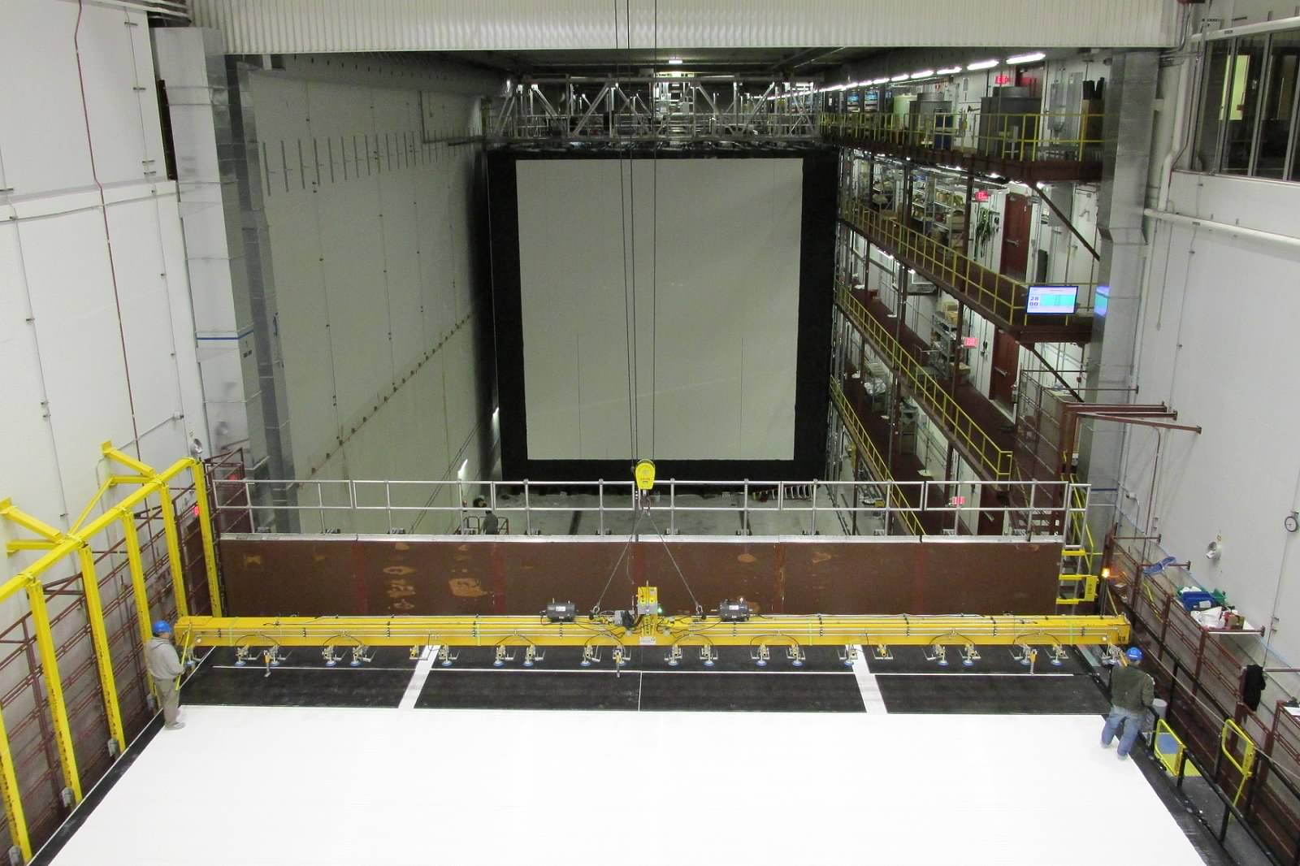
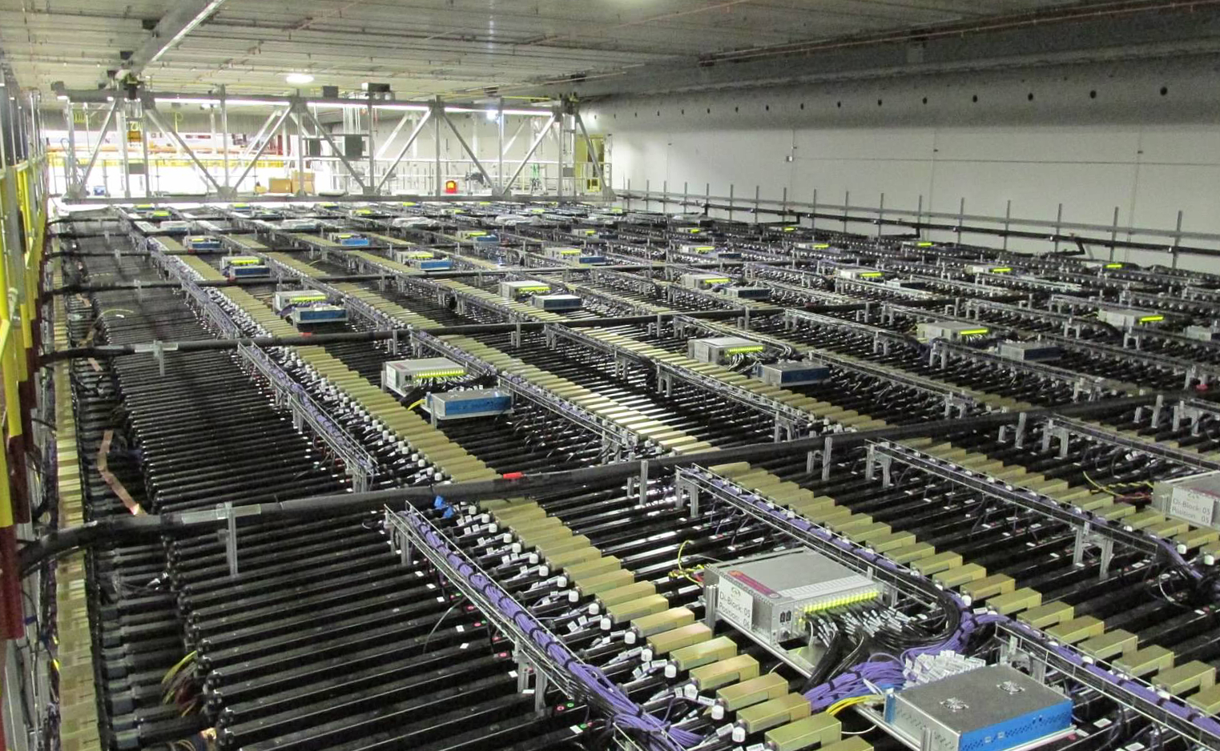
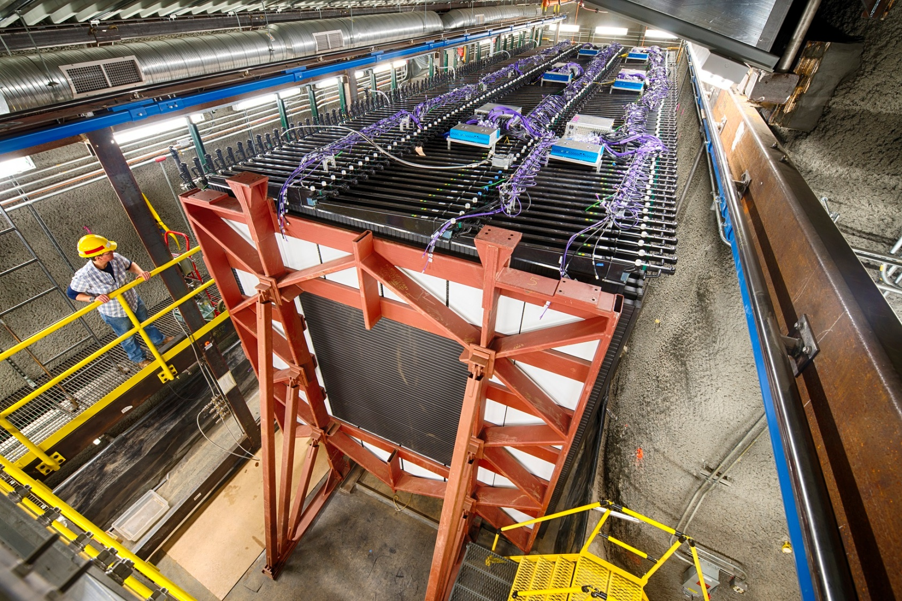
NOvA…our present flagship neutrino experiment

Slide 9
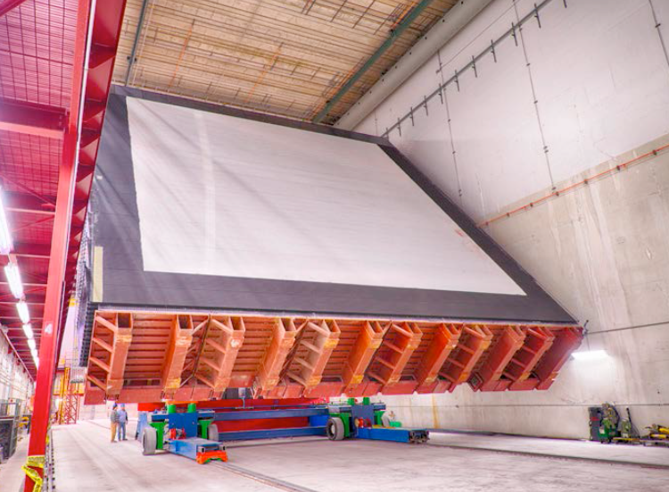
The NOvA detector

Slide 10
Current Neutrino Program
NOvA
has published its first two papers, based on its first results announced last summer.
is looking forward to an update at Neutrino 2016 in July with about twice the dataset of the first results.
MINOS+
will reach the end of its 1- year beam run in July
has had one paper published in 2016, with five more in final collaboration reviews.
MINERvA
has published 5 results on 5 different neutrino interactions that are important for oscillation experiments
has also collected 2.6E20POT with high detector livetimes.

Slide 11
615 kW to NuMI
Thanks and congratulations go out to the Main Injector/Recycler and Proton Source departments, along with all the support departments and everyone at the lab who contributed to this success
615 kW
615.3 kW for one hour
6+6 Slip Stacking without switchyard

Slide 12
P5 Mandate: a new international collaboration
P5 recommendation 13: “Form a new international collaboration to design and execute a highly capable Long-Baseline Neutrino Facility (LBNF) hosted by the U.S. To proceed, a project plan and identified resources must exist to meet the minimum requirements in the text [of the report]. LBNF is the highest-priority large project in its timeframe”
Basically asks Fermilab to do for neutrinos what CERN did for the Higgs, involving the worldwide community
Notes:
international collaboration for neutrinos

Slide 13
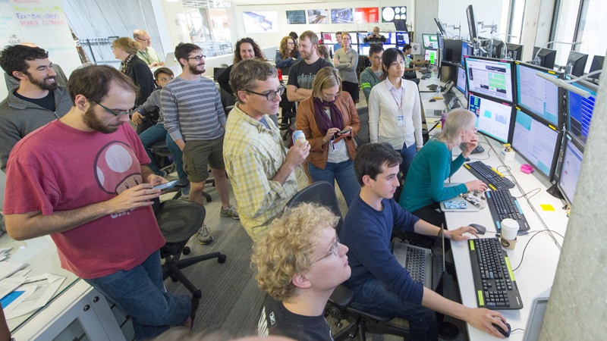
MicroBooNE: collecting data….Short Baseline soon
MicroBooNE is the newest neutrino experiment at Fermilab to come online and is the first step in the short-baseline neutrino program.
MicroBooNE saw its first neutrinos and first laser events, and has been collecting neutrino beam data since October!

Slide 14
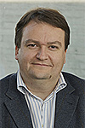
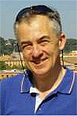
LBNF/DUNE status….they are off and running
Tremendous progress by collaboration:
Dune spokespeople:
André Rubbia (ETH) and Mark Thomson (Cambridge)
Notes:
Removed bullets about CD-1 and about delaying near site
Changed numbers to agree with Slide 22
Added pix of spokes

Slide 15
Big Picture LBNF/DUNE Project Goals – 2017 through 2026
2017
Start pre-excavation construction work
2018
Complete Sanford Laboratory “reliability projects”
Progress protoDUNEs to enable testing in CERN beam
Start major cavern excavation work
2021
Complete first cryostat and cryo systems construction to enable DUNE detector installation to begin
2024
Commission first DUNE detector – start science!
2026
World’s most powerful neutrino beam turns on!

Slide 16
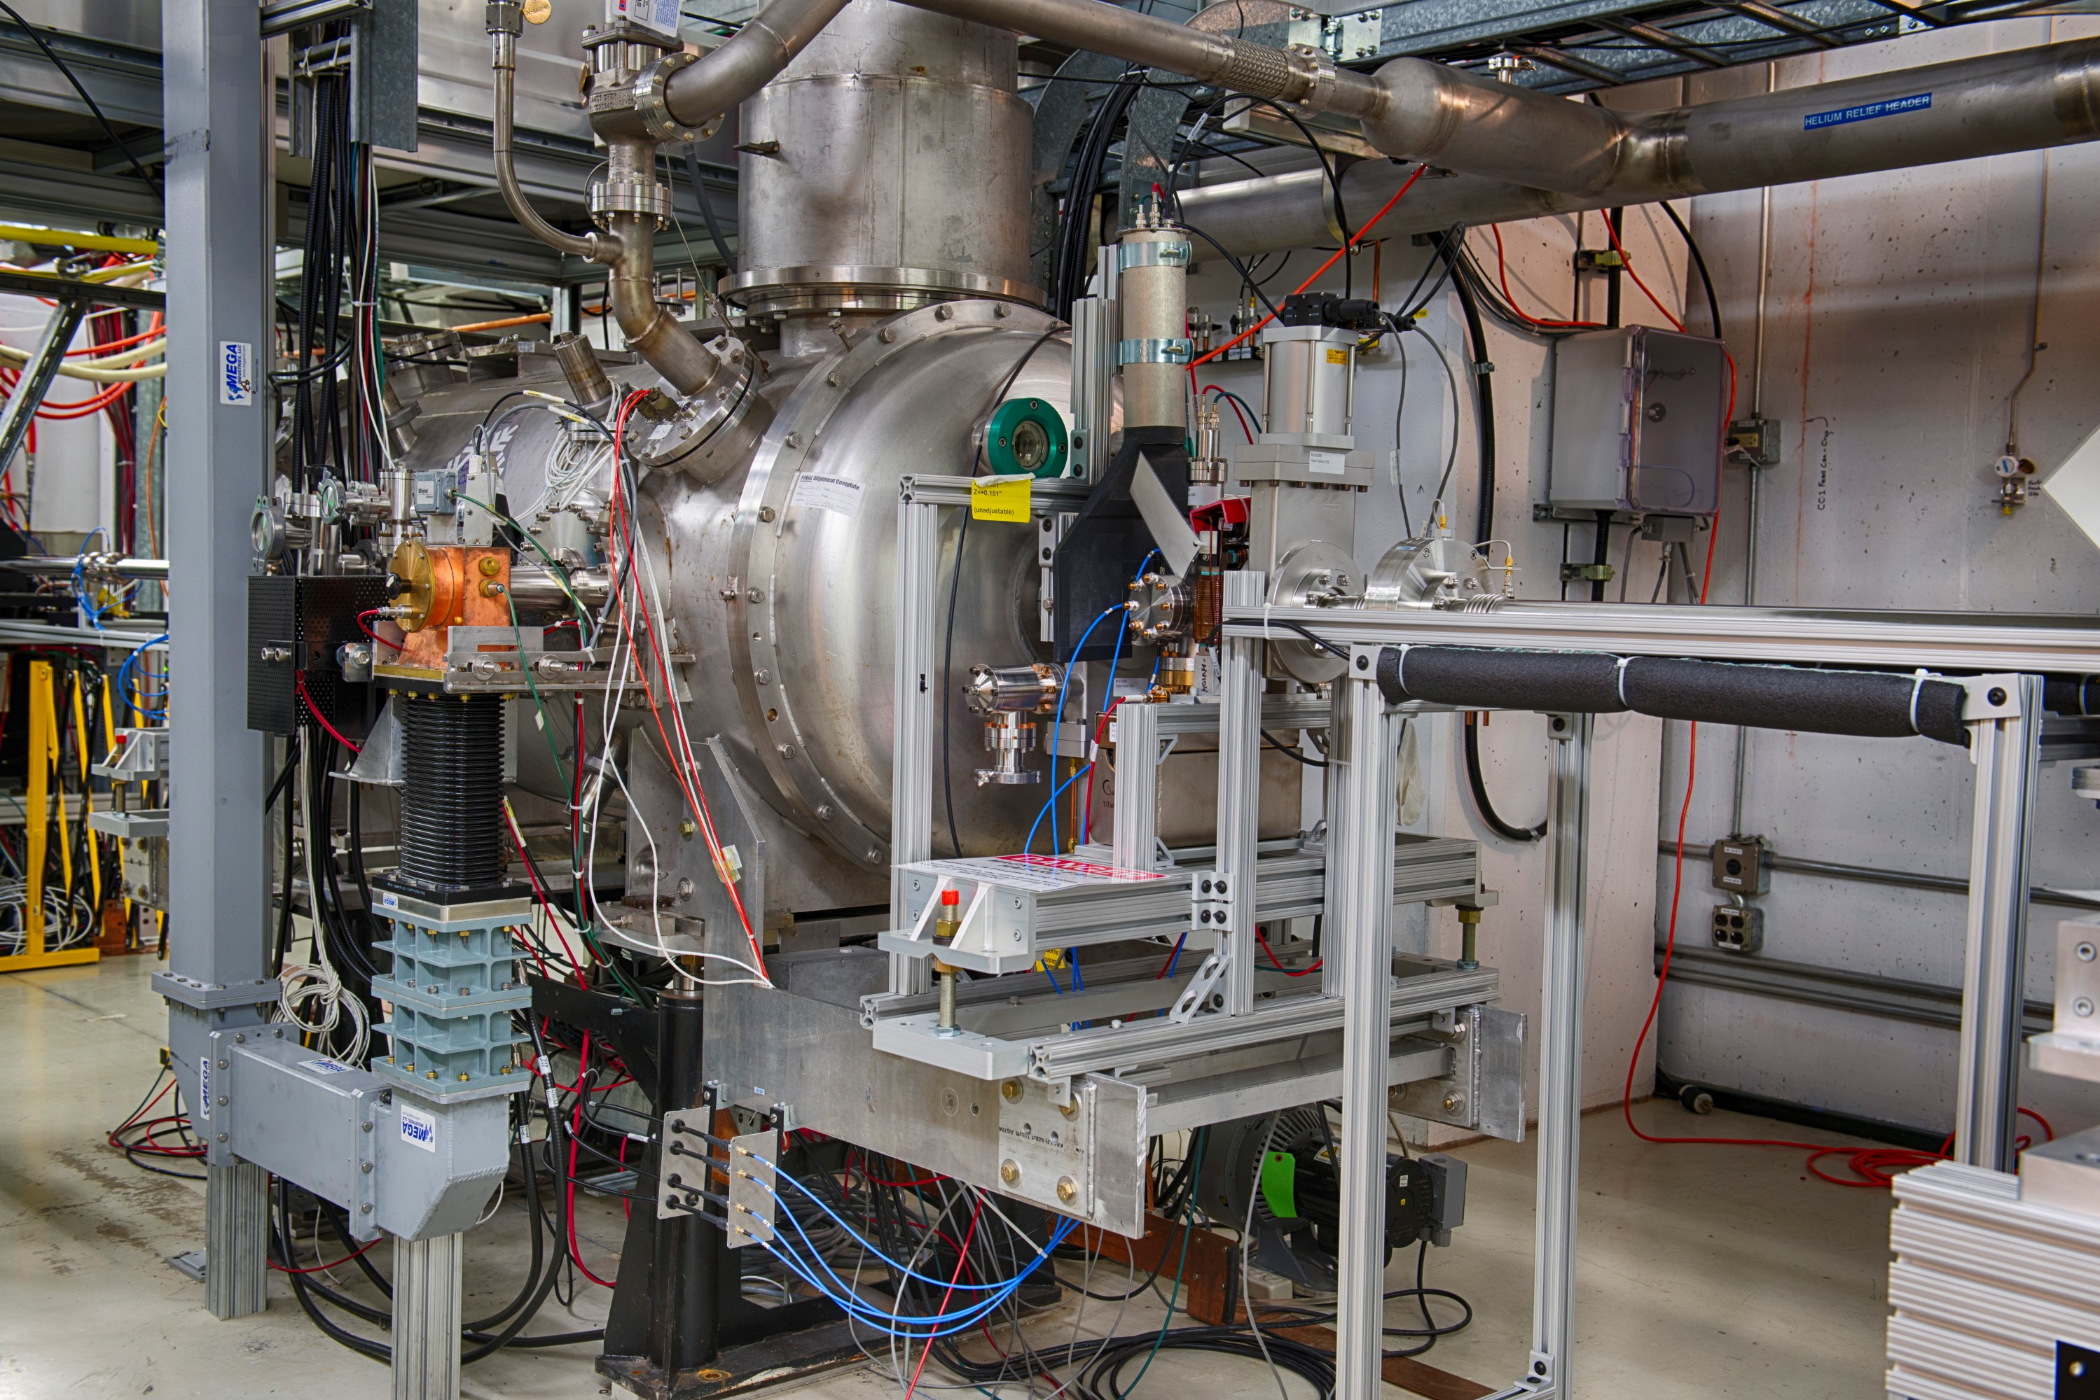
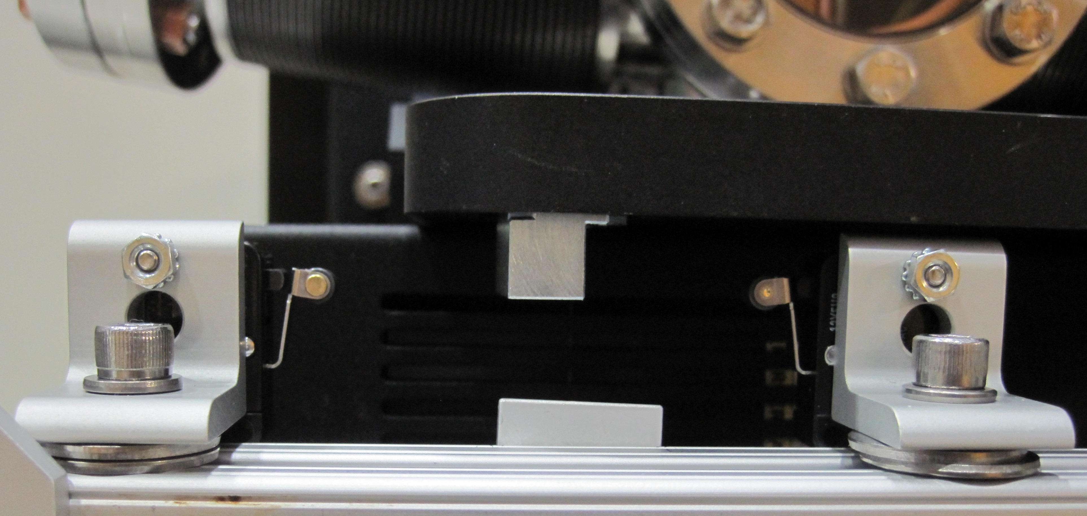
FAST/IOTA
Explore the unknown
Science goal: launch a test facility (IOTA ring & its e- and p+ injectors) to enable transformative accelerator science of integrable beam optics and space charge compensation
Status/Progress: 1.3 GHz SRF booster cavity CC1 repaired, cool-down to finish tomorrow → 50 MeV electrons by 05/01 (last year 20 MeV)
Next: FAST/IOTA Annual Scientific program meeting/workshop June 14; first experiments with 50 MeV beam; on track - 1st beam in IOTA in Fall’17
FAST SRF Capture Cavity #1
Partnerships
DOE labs: ANL,BNL, JLab, LANL,
LBNL, ORNL, SLAC,
U.S. universities: 10
International: 5
Goniometer installed for Xray Crystal
channeling experiment (NIU)
16
Nigel S. Lockyer | Fermilab All Hands
4/25/2016

Slide 17
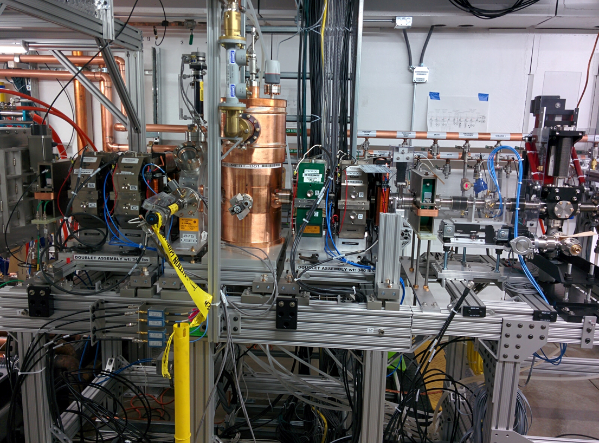
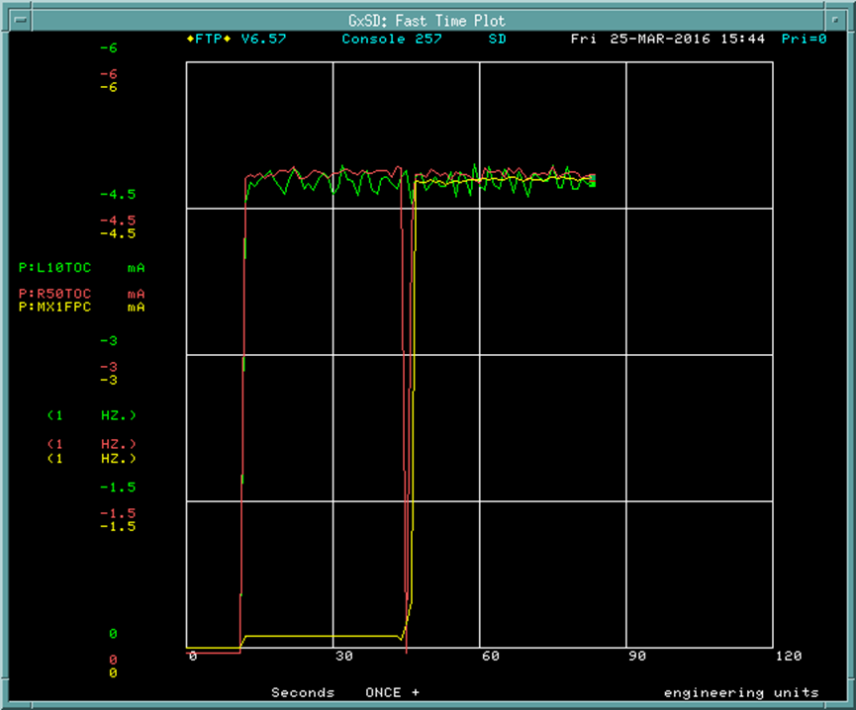
PXIE: Commissioning of RFQ with Beam
PIP-II RFQ built in collaboration with LBNL has been installed and successfully commissioned with beam at PXIE.
Beam studies are in progress to increase intensity and repetition rate.
6
RFQ exit
RFQ
Current transformer
Faraday Cup
At Faraday Cup
Beam Current (mA)
Quad doublet BARC
0
Time (Sec)

Slide 18
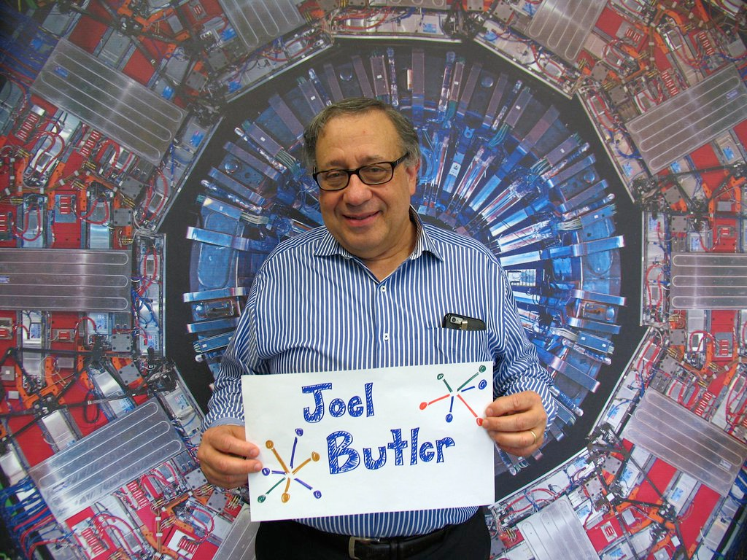
CMS and LHC: 2016 Run
LHC running again after annual winter shutdown
Low intensity collisions last Friday
Expect 25-30 fb⁻¹ of data in 2016
Expect new 2016 physics results at ICHEP in Chicago in August
CMS detector is ready
Work on cryo for magnet went well and new elements are performing better than before
Fermilab’s Joel Butler will be the new CMS spokesperson, starting in September
Upgrades: Phase I & HL-LHC

Slide 19
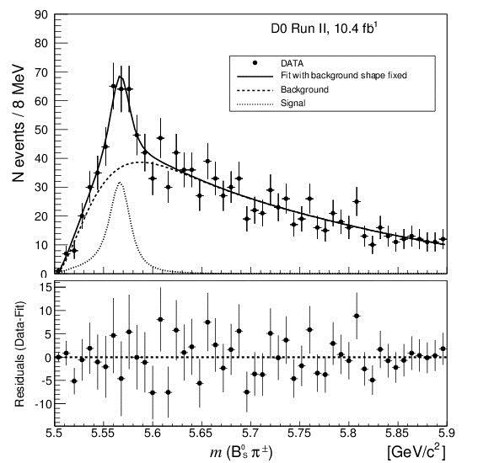
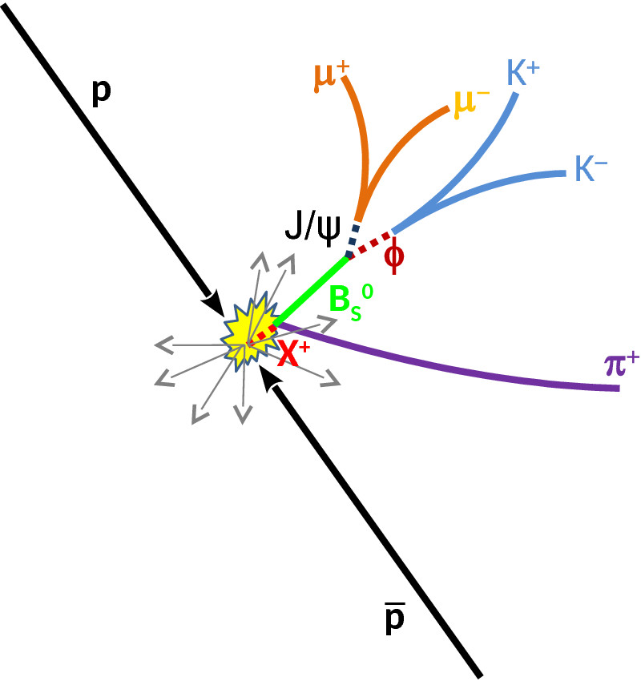
Tevatron Data Continue to Bring Interesting Results
Mass B_{s}⁰ π±
Study the B_{s}π± final state with B_{s} → J/ψ φ → (μ⁺μ⁻) (K⁺K⁻) from B_{s}π threshold 5506 MeV to the B_{d}K threshold at 5774 MeV
Resonance structure observed at M_{x}=5568MeV with 6.6σ local significance
Possible interpretation is 𝒃𝒔𝒅𝒖 tetraquark
First tetraquark state with four different quarks!

Slide 20
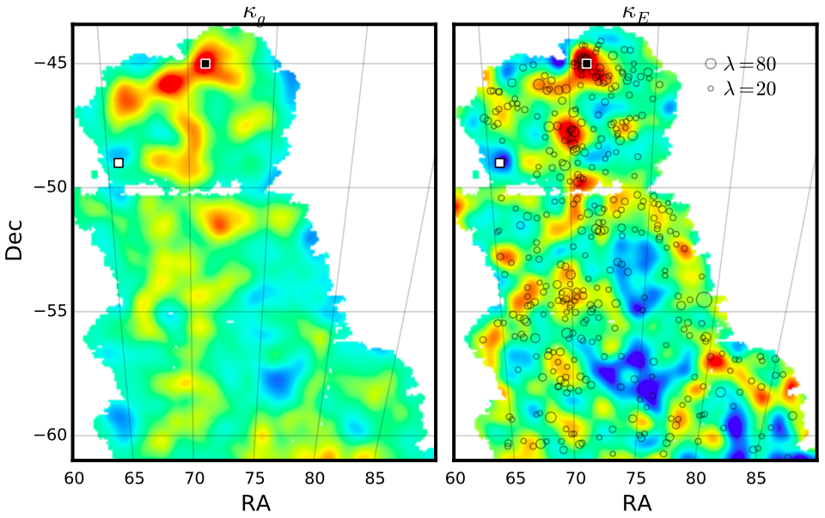
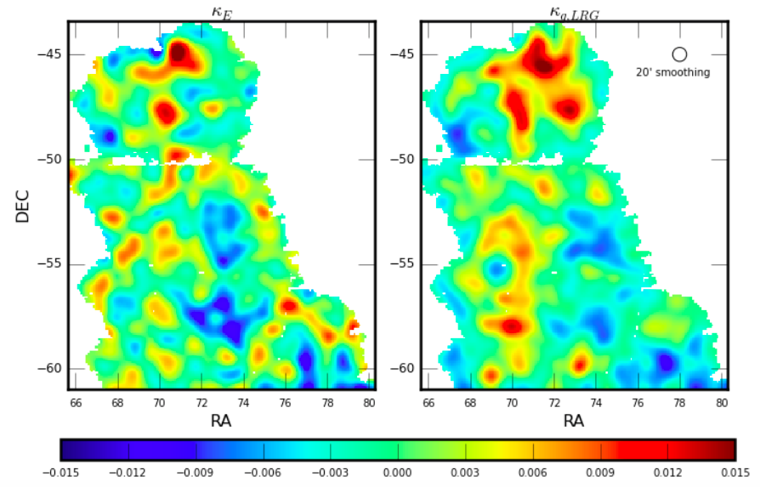
‘Largest Single Dark Matter Map
Vikram, et al, Chang et al
SZ Spectrum
Clusters
high-𝜆 (>70)
DES Galaxies DES Weak Lensing (mass))

Slide 21
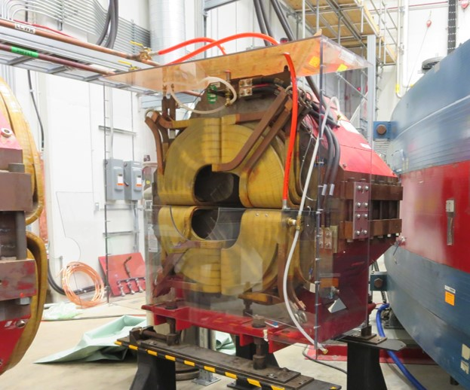
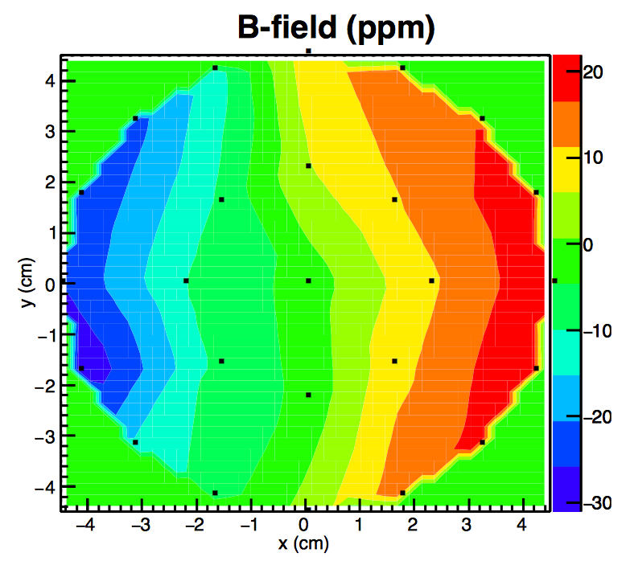
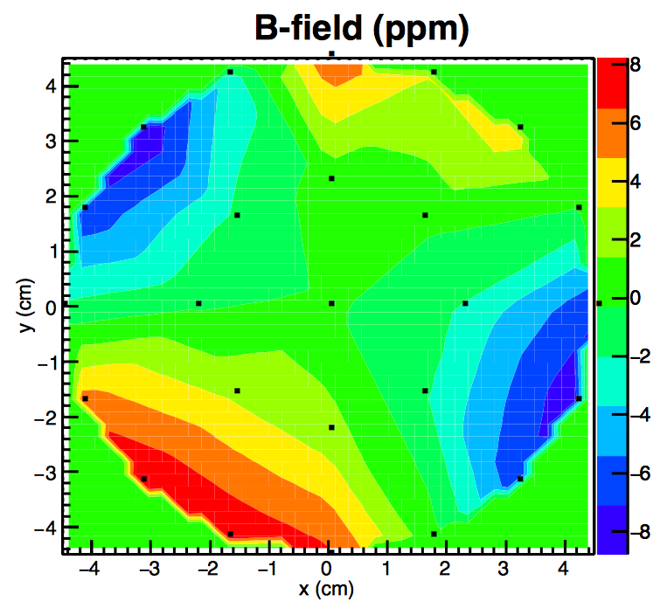
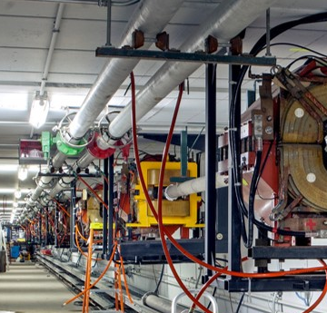
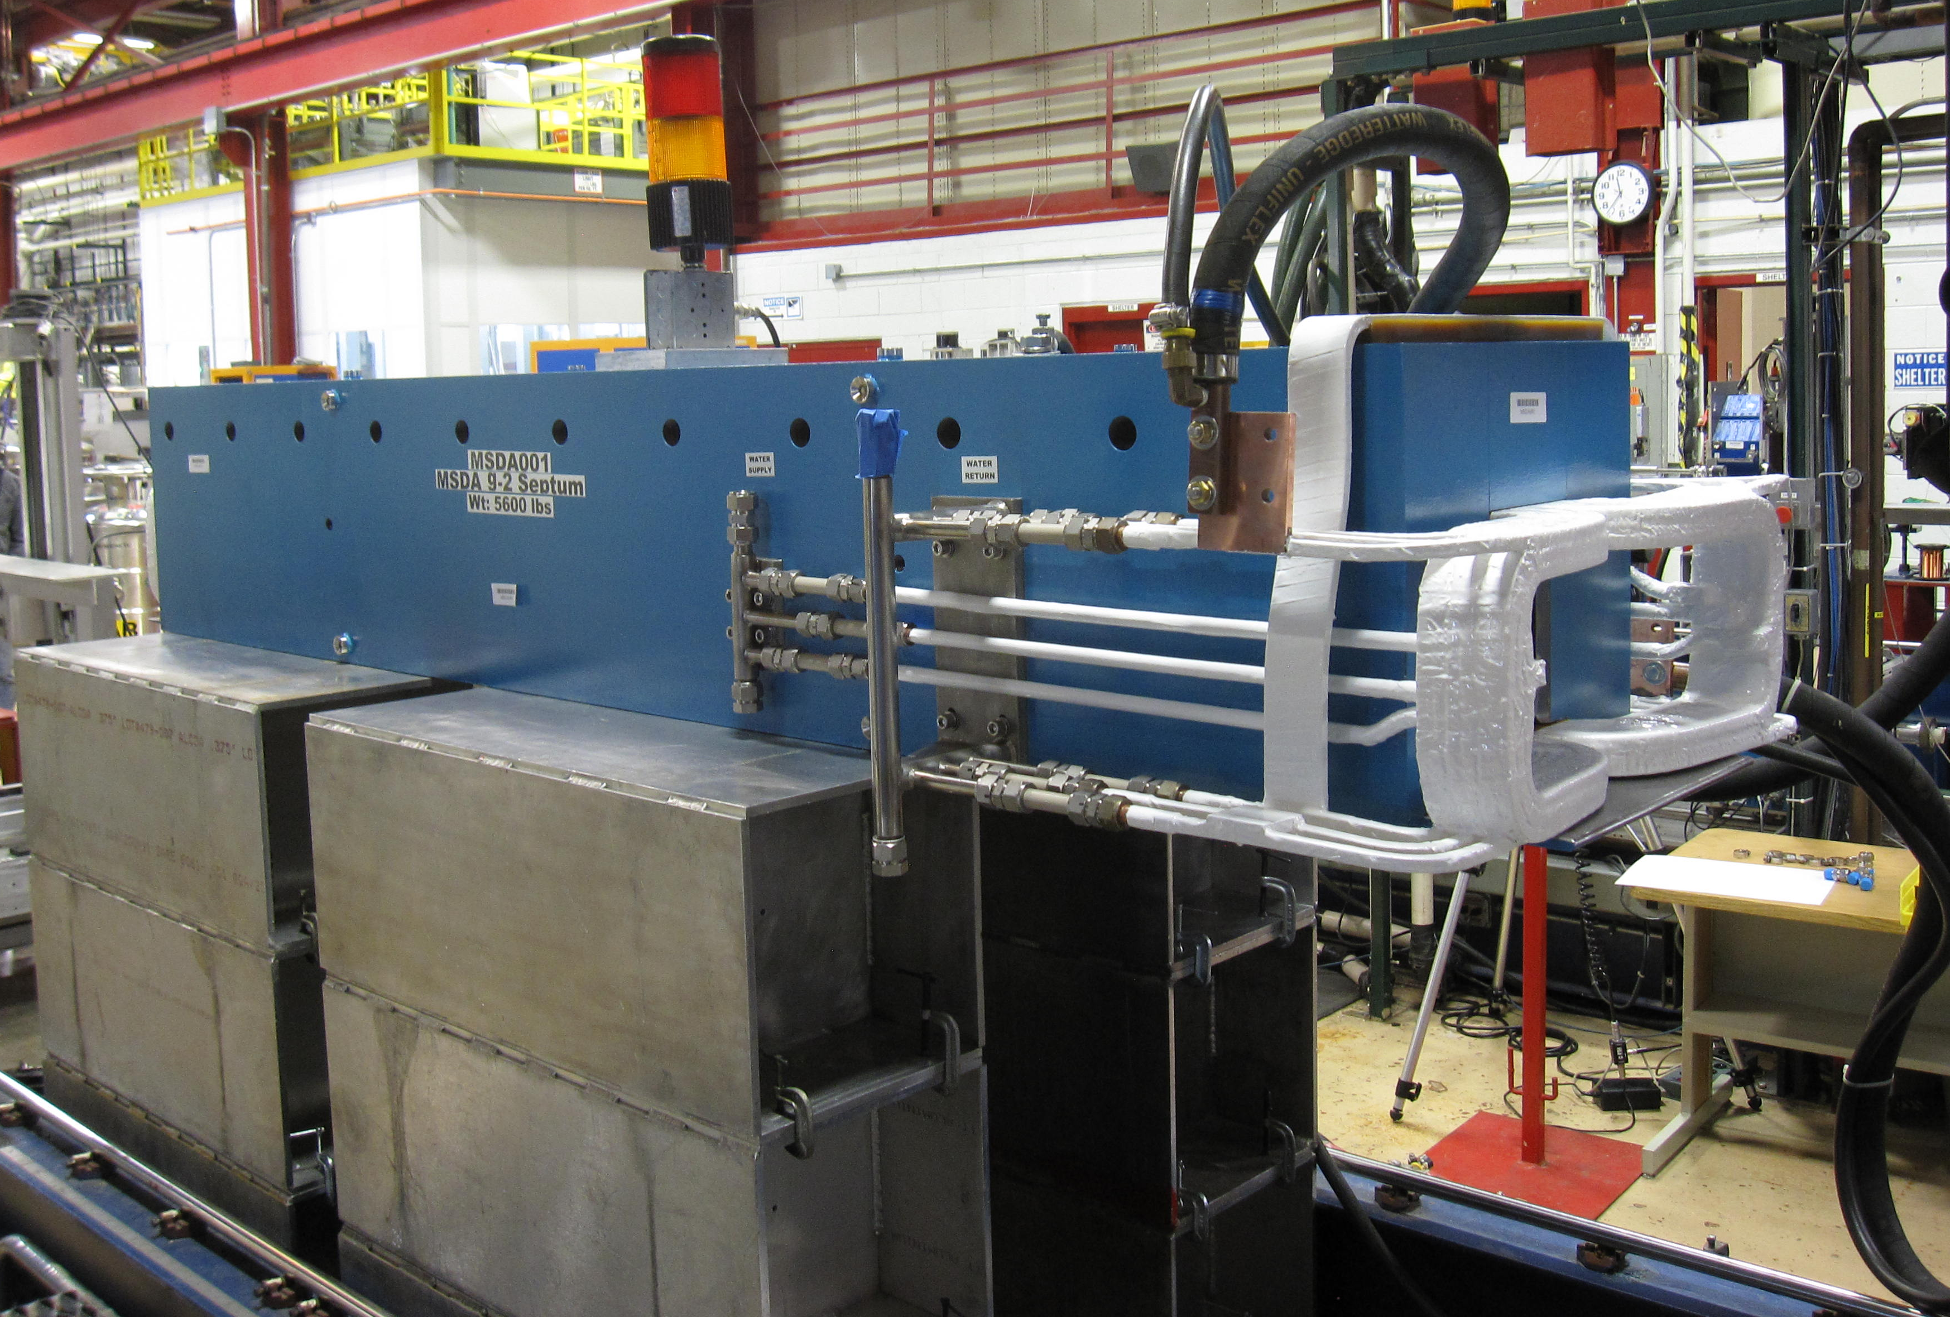
Storage ring progress…g-2…coming soon!
Shimming team making good progress on field uniformity
Beamline construction in full swing
Detector/field/injection subsystems preparing for FY16 installation
On track to store first muons in FY17
Average B-field over azimuth: Goal +/- 1 ppm
New M2/M3 line installed!
Ring injection quads powered
+/- 25 ppm (March)
+/- 8 ppm (April)
New TD
C-Magnet

Slide 22
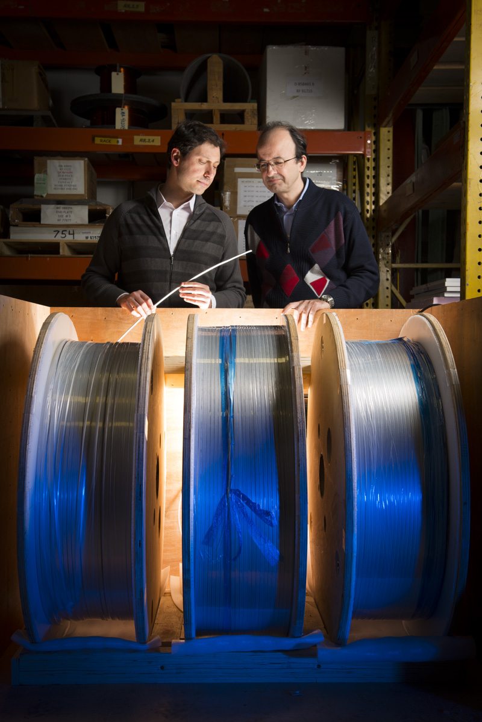
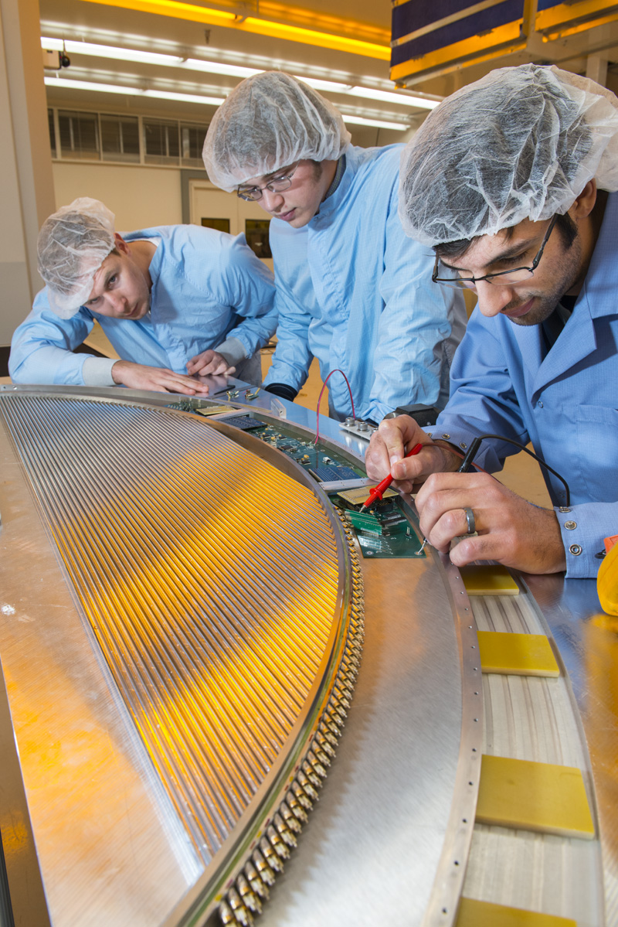
Mu2e
Using muons to advance the search for New Physics
http://mu2e.fnal.gov
Mu2e will probe New Physics mass scales up to 10⁴ TeV/c²
Factor of 10,000 improvement in sensitivity due to new technique using solenoids and pulsed beam.
Significant progress in past year
superconductor at FNAL
tracker panel prototype
Construction of above-grade portion of Mu2e building.
Below grade structural work complete

Slide 23
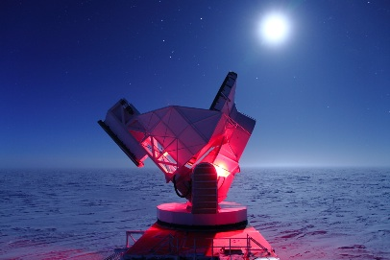
New South Pole telescope……10 meter…coming

Slide 24
Summary
The present HEP program through 2025 ballistic
Discoveries will advise the community on new directions
LHC and Neutrinos are our top priorities
A diverse program is essential for a healthy program

