Slide 1
The Fermilab Program
Marcela Carena
Neutrino Latin America Workshop – Consular Event
28th April, 2016

Slide 2
Fermilab serves a global community of physicists
More than 3500 scientists use our facilities
They represent 450 institutions from 44 countries
We are working to become even more international
Notes:
We do discovery science with national and international partners
Lead the world in neutrino science with particle accelerators
Lead the U.S. in the development of particle colliders and their use for scientific discovery
Advance particle physics through measurements of the cosmos
Although flags occasionally get replaced, the usual order is: Argentina, Brazil, Canada, Columbia, France, Germany, Greece, India, Israel, Italy, Japan, Mexico, Netherlands, People's Republic of China, Poland, Russian Federation, South Korea, Spain, Switzerland, and the United Kingdom. They are flown in alphabetical order. Nearby, flags representing the United States, the Department of Energy, and the State of Illinois are on permanent display.

Slide 3
What type of Science we do at Fermilab?

Slide 4

What type of Science we do at Fermilab?
Science that matters to all of us

Slide 5
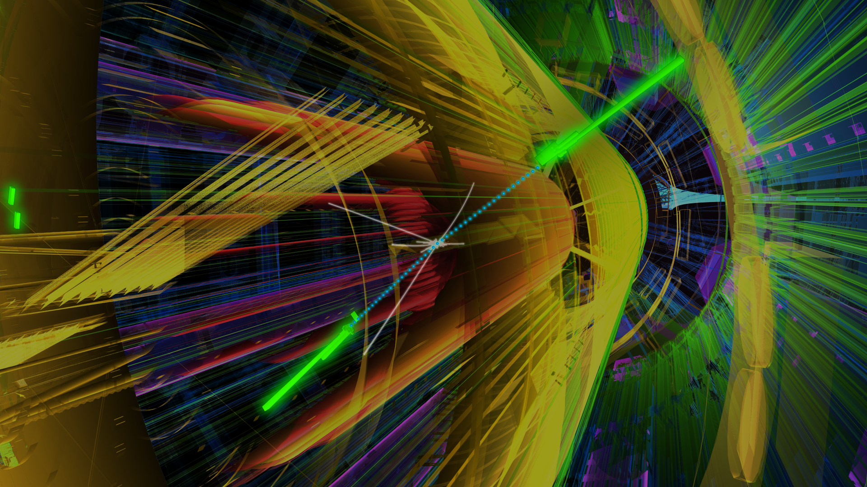
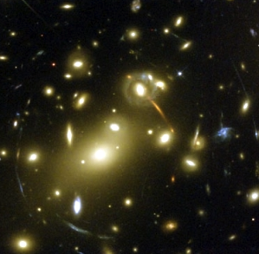
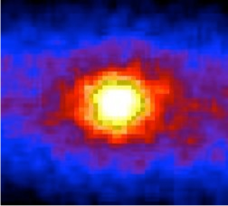
The Big Mysteries of Particle Physics
What causes particles to be massive
and slows them down from moving
at the speed of light?
What distorts the images
of distant galaxies?
What makes the fabric
of the cosmos
and holds it together?
What are the secrets encoded
in the tiny but mighty Neutrinos?
Notes:
What causes particles such as the quarks and electrons that make everything we see to be massive, and slows them down from moving at the speed of light? If they would move at the speed of light the universe as we know it wouldn’t exist
The Higgs boson, als known as the god particle , is at the core of it, here we see a Hb transforming into 2 particles of light (2 photons)
What holds the universe together and produce this distorted images of distant galaxies? We call it dark matter, but we have no clue what it is!
Neutrinos are everywhere! BUT we can barely detected, and yet they probbaly hold the mistery to our existence

Slide 6
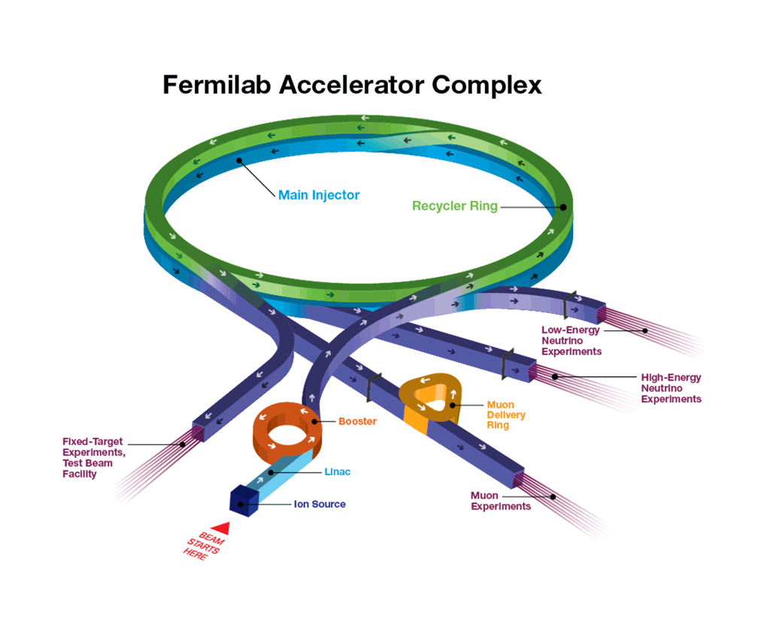
Big Science Questions require Technology Innovation
Advanced Accelerators and Forefront Detectors
Largest accelerator complex in the U.S., second largest in the world
Leading the world in superconducting magnet and radio frequency
accelerator technology
World’s most powerful neutrino beam

Slide 7
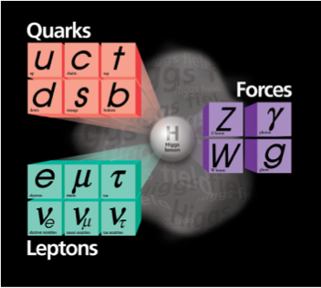

Fermilab history
Three elementary particles discovered
World’s highest energy accelerator until LHC
Important role of Latin American partners
in Fermilab Science and Discoveries
Over Hundred Master and Postdoctoral Thesis
from Latin American Students in Fermilab Experiments
http://www.symmetrymagazine.org/article/march-2014/30-years-of-inter-american-collaboration

Slide 8
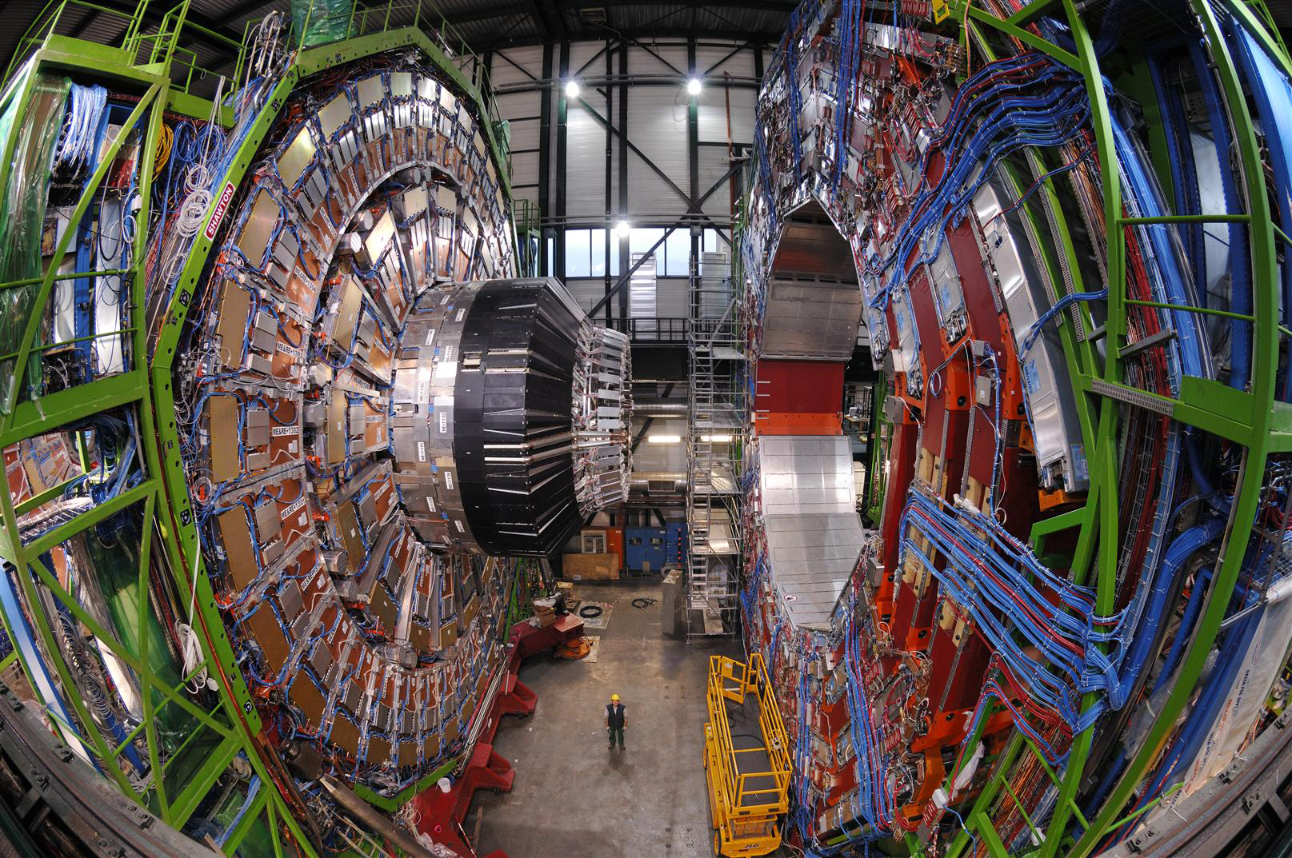
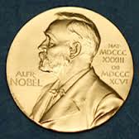
Latin America Contributions to Collider Experiments
DO Experiment: Brazil (LAFEX-CBPF; U. do Estado do Rio de Janeiro);
Colombia (U. de los Andes); Ecuador (U. SF de Quito)
Mexico (CINVESTAV-Mexico City)
Top Quark Discovery
CMS Experiment: Huge, complex detector with cutting-edge technology
Brazil: UNESP, FABC, CBPF
Colombia: U. de los Andes
Ecuador: Escuela Politécnica
Mexico: U. Iberoamericana,
U. Autonoma San Luis de Potosi,
U. de Puebla, Centro de Inv. de
Estudios Avanzados
Higgs Boson Discovery
In Collab. with ATLAS Experiment: with Inst. from Argentina, Brazil, Chile and Colombia
Notes:
Proves the existence of an invisible field
that has the property to make fundamental particles massive
Huge…detectors that take pictures of the collisions: 20 millions pictures /second in 3D

Slide 9

The Discovery of the Higgs Bosons
It is a new type of particle we have never seen before
It demonstrates the existence of a new force in nature
Notes:
Higgs transforming into matter particles
`The machine we need to smash particles at very high speeds and at very high energies. We need a very complicate machine
The most expensive, most complicated, most ambitious machine ever built!!!
In particle accelerators we smash beams of particles together in head-on collisions that are energetic enough to turn the clock back to just after the Big Bang.
Particle accelerators recreate the conditions of the early universe when it was about a tenth to hundredth of a billionth of a second old
The more energetic the collisions, the more likely we are to make fundamental particles appear again.
Once we've produced fundamental particles we can study their behavior to find out why the universe is made the way it is.
If you were inside the accelerator tunnel you would see a tube which runs continuously in either direction. This tube is the "beam pipe" - so-called because inside here, two beams of particles fly round the tunnel. The beams are accelerated to very high energies by magnets surrounding the beam pipe. These make sure that the two particle beams circulate in opposite directions without crashing into each other. When the beams of particles reach their final top energy, the magnets alter their path and bring them into collision at pre-determined points around the accelerator ring.
By this time the particle beams are travelling so close to the speed of light that they collide forty million times a second. Inside each collision we have a snapshot of the fundamental particles that last existed billionths of a second after the Big Bang. Now all we have to do is build gigantic particle detectors at each collision point to try and work out exactly what went on ....

Slide 10
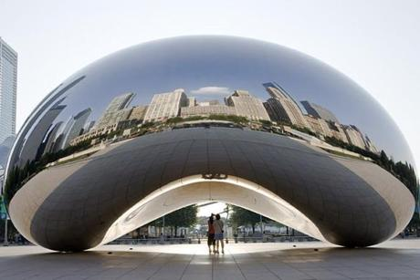
Latin America Contributions to Cosmic
What distorts the images of distant galaxies?
Matter that we cannot
see bends light through
its gravitational effects
DAMIC Experiment:
Ultrasensitive detector for
Dark Matter particles from Space
Inst. from Argentina, Brazil, Mexico and Paraguay
Notes:
Damic: Rio de Janeiro Federal U.
Universidad nacional autonoma de Mexico, Buenos Aires Conicet (bariloche); Universidad nacional de Asuncion

Slide 11
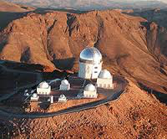

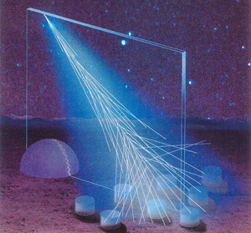
Experiments in Latin American soil : Cosmic
DES (Dark Energy Survey) Exp. in Chile
Understanding why the universe is expanding at an accelerated rate
DES Brazil Consortium
AUGER Experiment in Argentina: Understanding what the highest energy cosmic rays are made of
Many Institutions from Argentina, Brazil ,
Bolivia and Mexico
Notes:
DES mounted on the Blanco 4-meter telescope at the Cerro Tololo Inter-American Observatory,
We egt informstion ion of thhe density in galavity

Slide 12
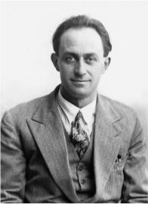
What About Neutrinos? “Fermilab and Neutrinos”
Enrico Fermi named these “little neutral ones”
23 years before they were first detected
Neutrinos are the most numerous matter particles in the universe
1,000,000,000,000 neutrinos pass through
your body every second
Studying neutrinos requires special detectors that are both very large and very sensitive
Fermilab with many international partners is building the world’s most sophisticated neutrino detectors

Slide 13
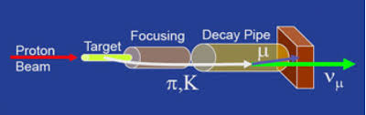
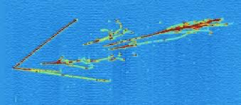
Exploring the Neutrino World
We create neutrinos with protons from the Fermilab Accelerator complex
We study them with many different technologies in different locations to maximize what we can learn (ROC visit)
Notes:
Using Fermilab's Main Injector accelerator as a proton source, the Long-Baseline Neutrino Facility's beamline is expected to make the highest-intensity neutrino beam in the world – i.e., the most highly concentrated beam of these particles that travel at nearly the speed of light.
The processs starts by extracting a proton beam from an accelerator complex and smashing the protons into a target. The protons' interactions with the protons and neutrons in the target material produce new, short-lived particles such as pions and kaons. These particles travel a short distance (about 200 m) through a "decay pipe," and as they do, a good fraction of them decays into neutrinos that continue on in the same direction, forming a neutrino beam. Of the three known neutrino types, a beam produced in this manner contains mostly muon neutrinos.
Using Fermilab's Main Injector accelerator as a proton source, the proposed LBNF beamline will be able to make the highest-intensity neutrino beam in the world.
Like the beam of light produced by a flashlight, the beam of neutrinos produced by an accelerator widens over distance. To make sure that a sufficiently large number of neutrinos hits the particle detector, located hundreds of miles away, the beam must be highly concentrated, highly focused and aimed precisely in the right direction. Because neutrinos have no electric charge, there is no way to change the direction of a neutrino once it has been created.
Neutrino Interactions:
Ionization electrons, resulting from particle interactions in the liquid argon, drift to wire planes (the TPC elements) in the fluid under the influence of an electric field. The electrons are collected on these planes, thereby creating a signal. Three planes of wires allow 3D reconstruction of the electron’s track. The image below shows a beautiful charged current muon neutrino interaction in the ArgoNeut detector, a small-scale LArTPC at Fermilab that ended its data run in 2010. The image shows four gamma-induced electromagnetic showers from the decay of two neutral pions, detached from the primary interaction vertex.
NOVA (near and far in MN) When a neutrino strikes an atom in the liquid scintillator filling the 14-kiloton far detector, it releases a burst of charged particles. Scientists can detect these particles and use them to learn about neutrino interactions.
http://www-nova.fnal.gov/how-nova-works.html

Slide 14
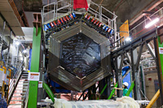
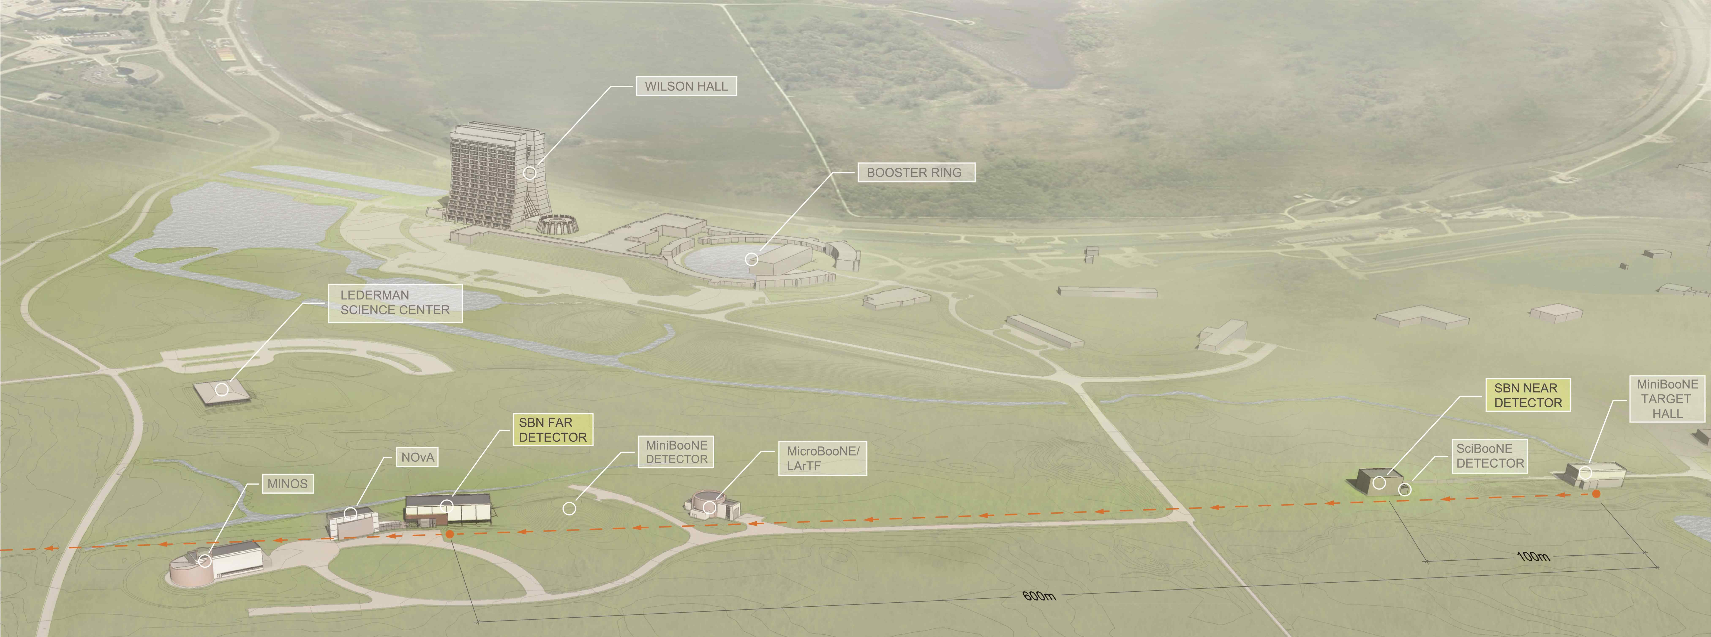
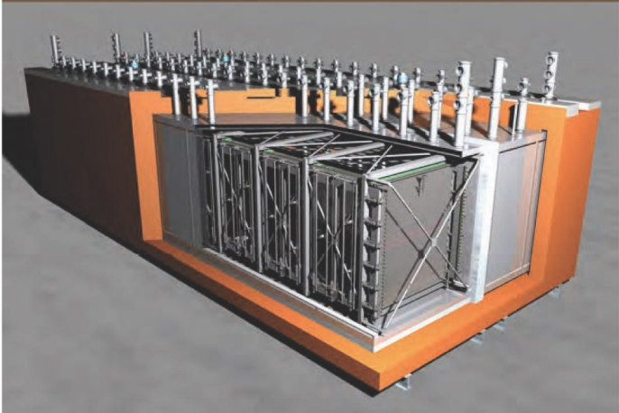
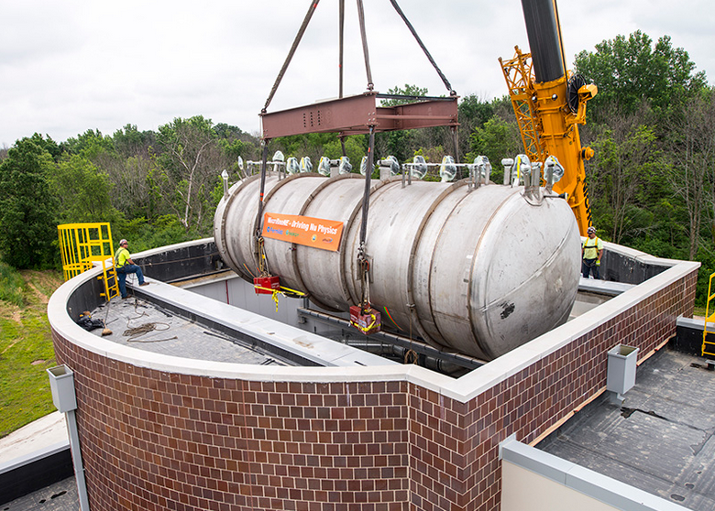
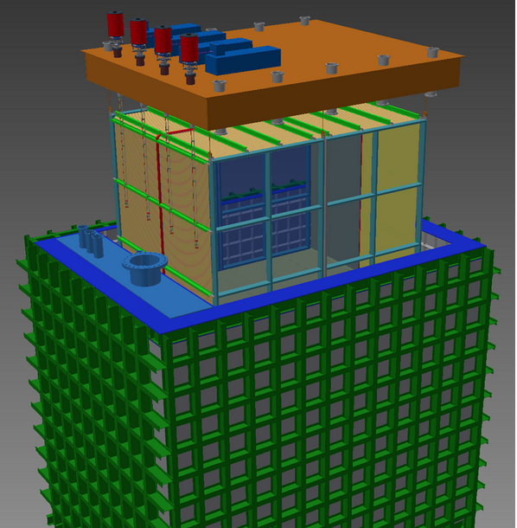
SBN = Short-baseline Neutrino Program
MINERvA
NOvA
MINOS
ICARUS
(476 t @ 600 m)
MicroBooNE
(89 t @ 470 m)
SBND
(112 t @ 110 m)
LA @MINERvA: CBPF, Brazil; U. Tecnica Federico de Santa Maria, Chile;
U. de Guanajuato, Mexico; U. Nac. de Ingenieria, Peru
Pontifica U. Catolica de Lima, Peru
Notes:
Sterile neutrino search
ICARUS refurbishment is jointly supported by CERN and INFN
TPC = Time Projection Chamber
The Short-Baseline Near Detector (SBND) will be one of three liquid argon neutrino detectors sitting in the Booster Neutrino Beam (BNB) at Fermilab as part of the Short-Baseline Neutrino Program. MicroBooNE and the ICARUS-T600 are the intermediate and far detectors in the program, respectively.
SBND is a 112 ton active volume liquid argon time projection chamber (LArTPC) to be located only 110 m from the BNB neutrino source. The detector is currently in the design phase and is anticipated to begin operation in 2018.
SBND will record over a million neutrino interactions per year. By providing such a high statistics measurement of the un-oscillated content of the booster neutrino beam, SBND is a critical element in performing searches for neutrino oscillations at the Fermilab Short-Baseline Program. The large data sample will also allow studies of neutrino-argon interactions in the GeV energy range with unprecedented precision. The physics of these interactions is an important element of future neutrino experiments that will employ the LArTPC technology, such as the long-baseline Deep Underground Neutrino Experiment (DUNE).
MicroBooNE is the newest neutrino experiment at Fermilab to come online and is the first step in the short-baseline neutrino program.
• MicroBooNE saw its first neutrinos and first laser events, and has been collecting neutrino beam data since October

Slide 15
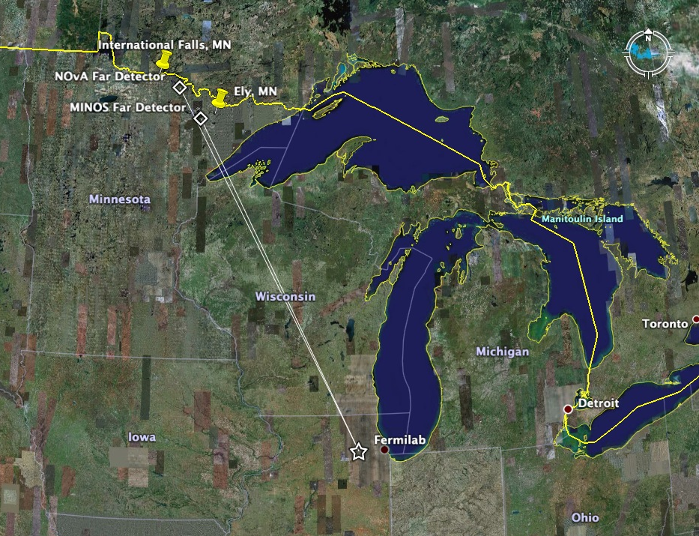
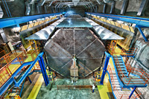
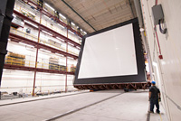
Neutrino beam from Fermilab to MINOS and NOvA
Right now we are sending neutrinos
~750 km through the Earth to the
MINOS and NOvA detectors
MINOS
LA@MINOS : USP, UNICAMP & Goias, Brazil
LA@NOvA : Goias, Brazil
U. del Atlantico, Colombia
NOvA

Slide 16

Fermilab’s Neutrino Future; LBNF/DUNE
Build a more powerful neutrino beam
Send the beam 1,300 km through the Earth to South Dakota
40,000 ton liquid argon neutrino detector, a mile underground
Address most of the big questions about neutrinos in a single powerful experiment
Already
Already Instituions frrm Brazil, Colombia, Mexico and Peru are part

Slide 17
The Neutrino Latin America Workshop April 17-18, 2016
35 Scientists came from 20 Institutions
in Argentina, Brazil, Chile, Colombia Múxico and Perú
(also from Puerto Rico, Canada and many LA scientists at US inst.)
We had a good overview of the many contributions from LA scientists
to Fermilab Neutrino experiments throughout the past decades
-VERY IMPRESSIVE-
We discuss opportunities for continuing collaboration and
for new possibilities In the arena of the international Neutrino platform
We hope this is a start of a new era of even stronger partnerships
between Fermilab and Latin America, and we welcome your help

Slide 18
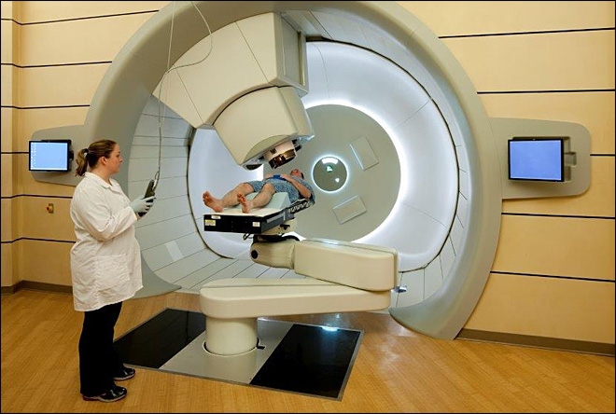
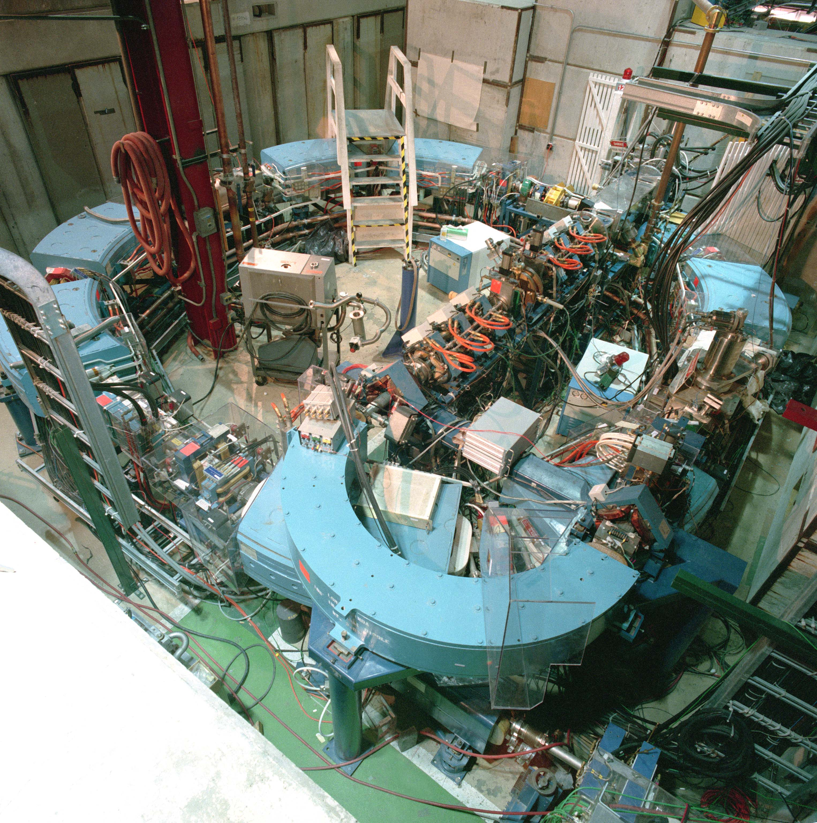
Accelerator Technology impacting Society:
Protons: A Beam of Hope
Fermilab designed and built
the first proton therapy accelerator for cancer treatment

Slide 19
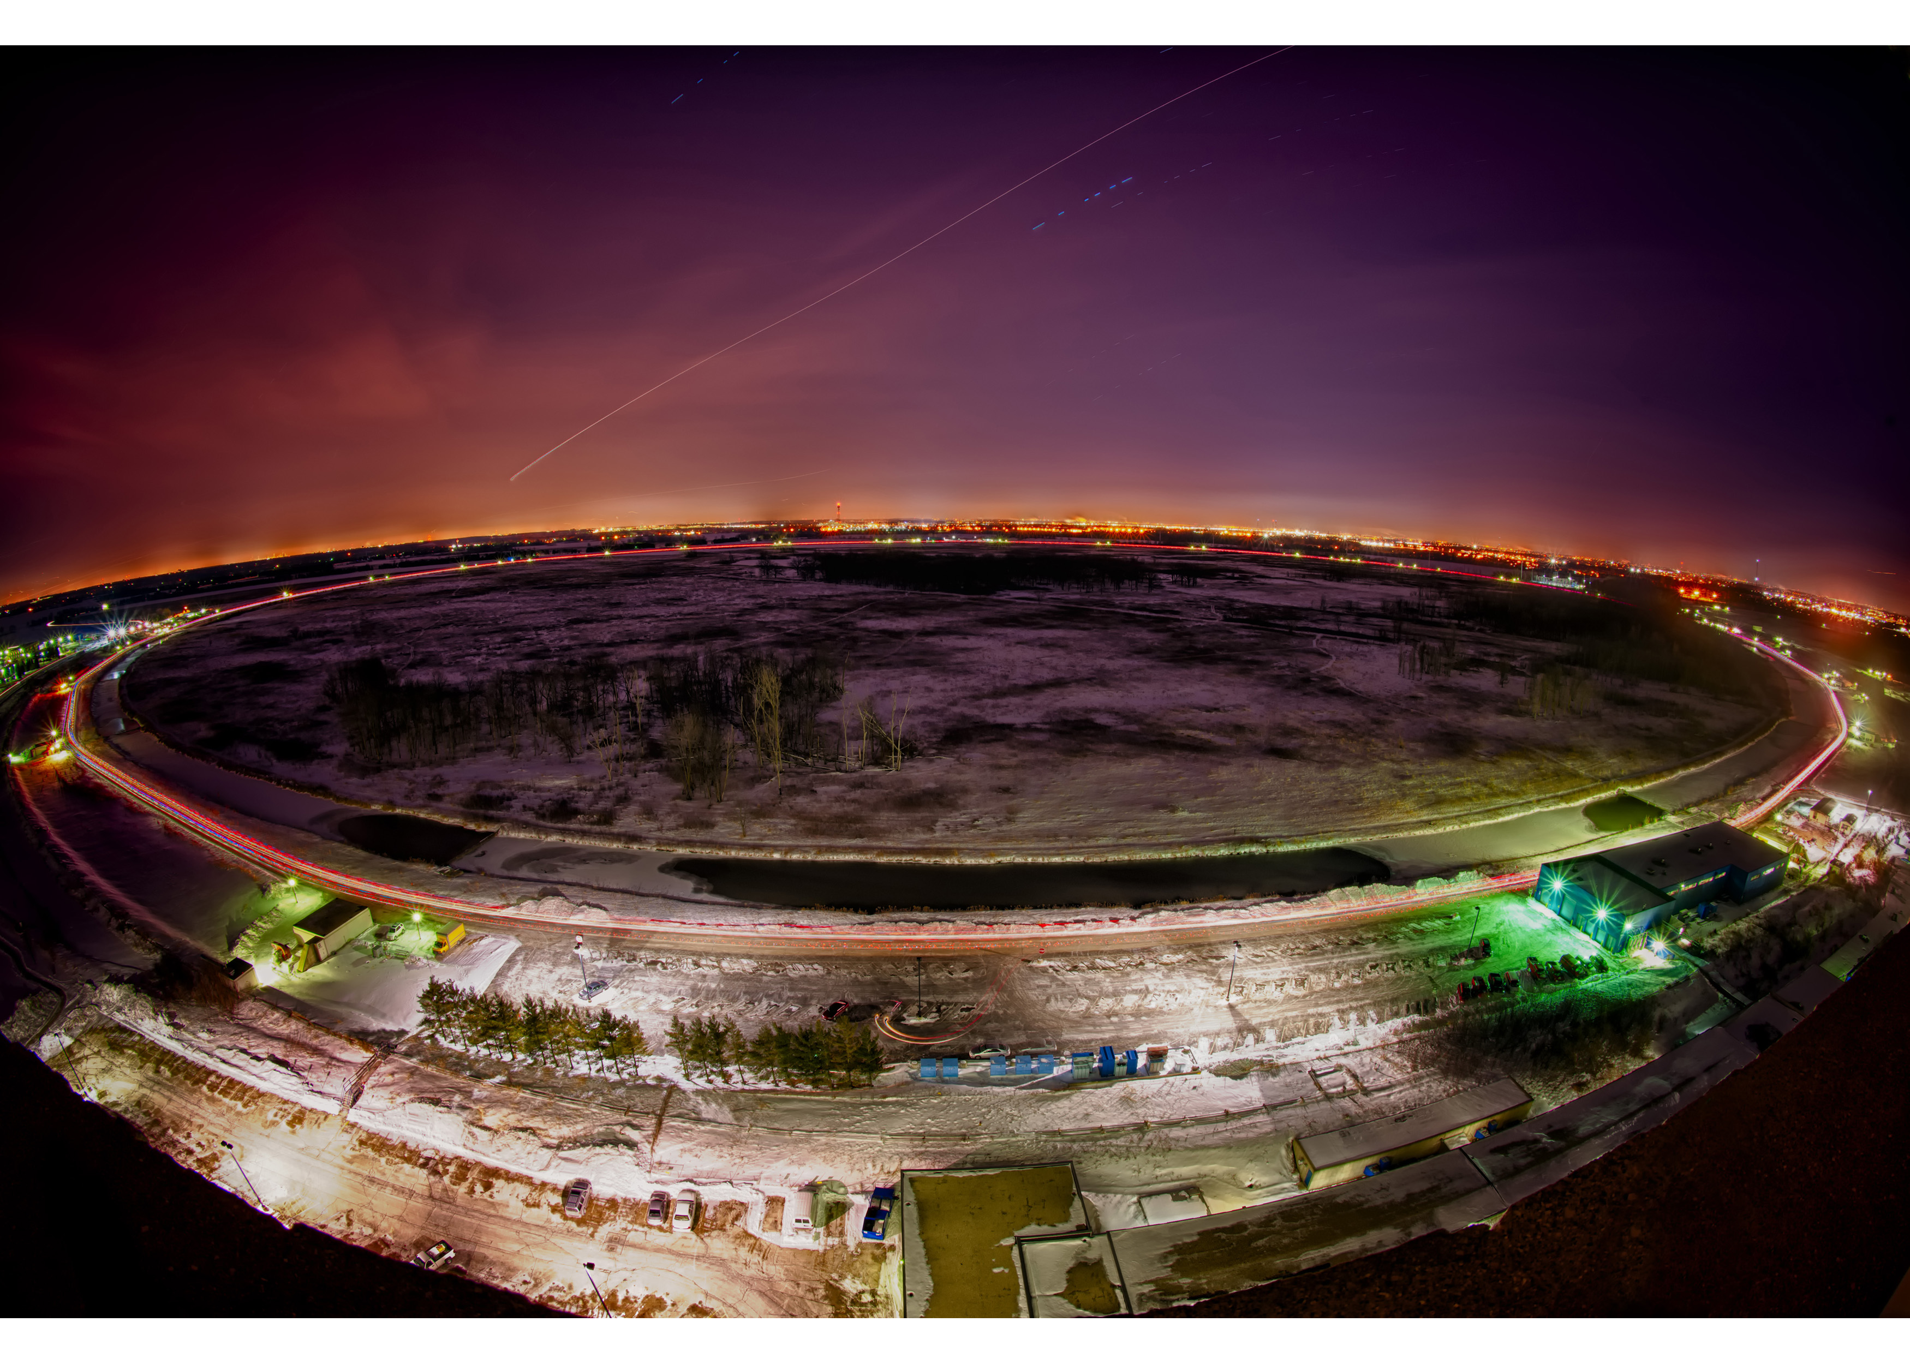
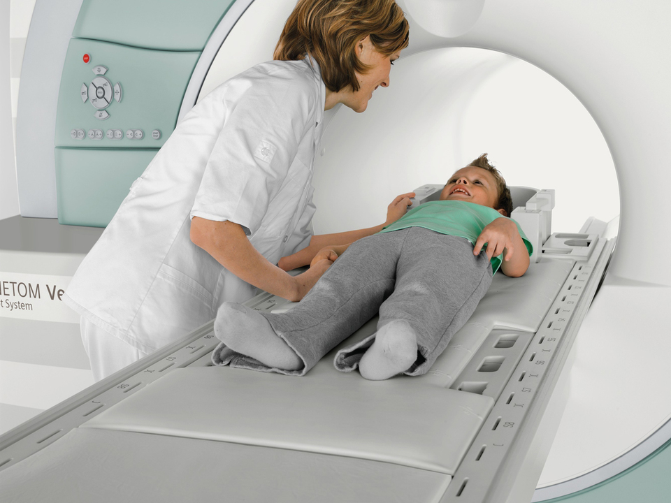
Accelerator Technology impacting Society:
Fermilab Tevatron enabling the industralization of MRI medical scanners

