Slide 1
PIP-II Overview: Goals, Status, and Strategy
Steve Holmes
PIP-II Machine Advisory Committee Meeting
15-17 March 2016

Slide 2
Since Last Year’s Meeting
At the time of last year’s meeting we were completing the PIP-II Reference Design Report and preparing for a DOE Review. Since then…
Reference Design Report released (May)
  http://pip2-docdb.fnal.gov/cgi-bin/ShowDocument?docid=1
DOE Independent Review of PIP-II (June)
  https://indico.fnal.gov/conferenceDisplay.py?confId=9939
  “The proposed concept is well advanced, beyond what is required at this stage…most likely will satisfy the P5 recommendation”
Two SSR1 cavities received from IUAC, successfully processed/tested (July)
LEBT commissioned
RFQ delivery from LBNL (September) – full peak power achieved (Feb)!
  Many support systems verified
Seven Indian engineers arrived for 2-year residencies (October)
CD-0 granted (November)
Collaboration meeting (November)
Joint Review of the IIFC R&D Program (January)
Lab2 converted to SRF assembly facility (January)

Slide 3
Outline
Motivation, goals, and technical strategy
R&D program overview
Project status and (management) strategy
Collaboration
Recommendations response
Organization of the Meeting

Slide 4
Motivation and Goals
The goal of PIP-II is to support long-term physics research goals as outlined in the P5 plan, by delivering world-leading beam power to the U.S. neutrino program and providing a platform for the future.
Design Criteria
Deliver >1 MW of proton beam power from the Main Injector over the energy range 60 – 120 GeV, at the start of LBNF operations
Support the current 8 GeV program including Mu2e, g-2, and short-baseline neutrinos
Provide an upgrade path for Mu2e
Provide a platform for extension of beam power to LBNF to >2 MW
Provide a platform for extension of capability to high duty factor/higher beam power operations
At a cost affordable to DOE
Goal: Initiate operations in newly-configured complex in ~2025

Slide 5
PIP-II Proposed Technical Approach
Construct a modern 800-MeV superconducting linac, of CW-capable components, operated initially in pulsed mode
  Increase Booster/Recycler/Main Injector per pulse intensity by ~50%
Increase Booster repetition rate to 20 Hz
  Maintain 1 MW down to 60 GeV or,
  Provide factor of 2.5 increase in power to 8 GeV program
  Improve slip-stacking efficiency via larger orbit separation
Modest modifications to Booster/Recycler/Main Injector
  Accommodate higher intensities and higher Booster injection energy
This approach is described in the Reference Design Report:
  Builds on significant existing infrastructure
  Capitalizes on major investment in superconducting RF technologies
  Eliminates significant operational risks inherent in existing 400 MeV linac
    Existing linac removed from service upon completion of PIP-II
  Siting consistent with eventual replacement of the Booster as the source of protons for injection into Main Injector (PIP-III)

Slide 6
PIP-II Performance Goals
Performance Parameter | PIP | PIP-II
Linac Beam Energy | 400 | 800 | MeV
Linac Beam Current | 25 | 2 | mA
Linac Beam Pulse Length | 0.03 | 0.6 | msec
Linac Pulse Repetition Rate | 15 | 20 | Hz
Linac Beam Power to Booster | 4 | 18 | kW
Linac Beam Power Capability (@>10% Duty Factor) | 4 | ~200 | kW
Mu2e Upgrade Potential (800 MeV) | NA | >100 | kW
Booster Protons per Pulse | 4.3×10¹² | 6.5×10¹²
Booster Pulse Repetition Rate | 15 | 20 | Hz
Booster Beam Power @ 8 GeV | 80 | 160 | kW
Beam Power to 8 GeV Program (max) | 32 | 80 | kW
Main Injector Protons per Pulse | 4.9×10¹³ | 7.6×10¹³
Main Injector Cycle Time @ 60-120 GeV | 1.33* | 0.7-1.2 | sec
LBNF Beam Power @ 60-120 GeV | 0.7* | 1.0-1.2 | MW
LBNF Upgrade Potential @ 60-120 GeV | NA | >2 | MW
*NOvA operations at 120 GeV

Slide 7
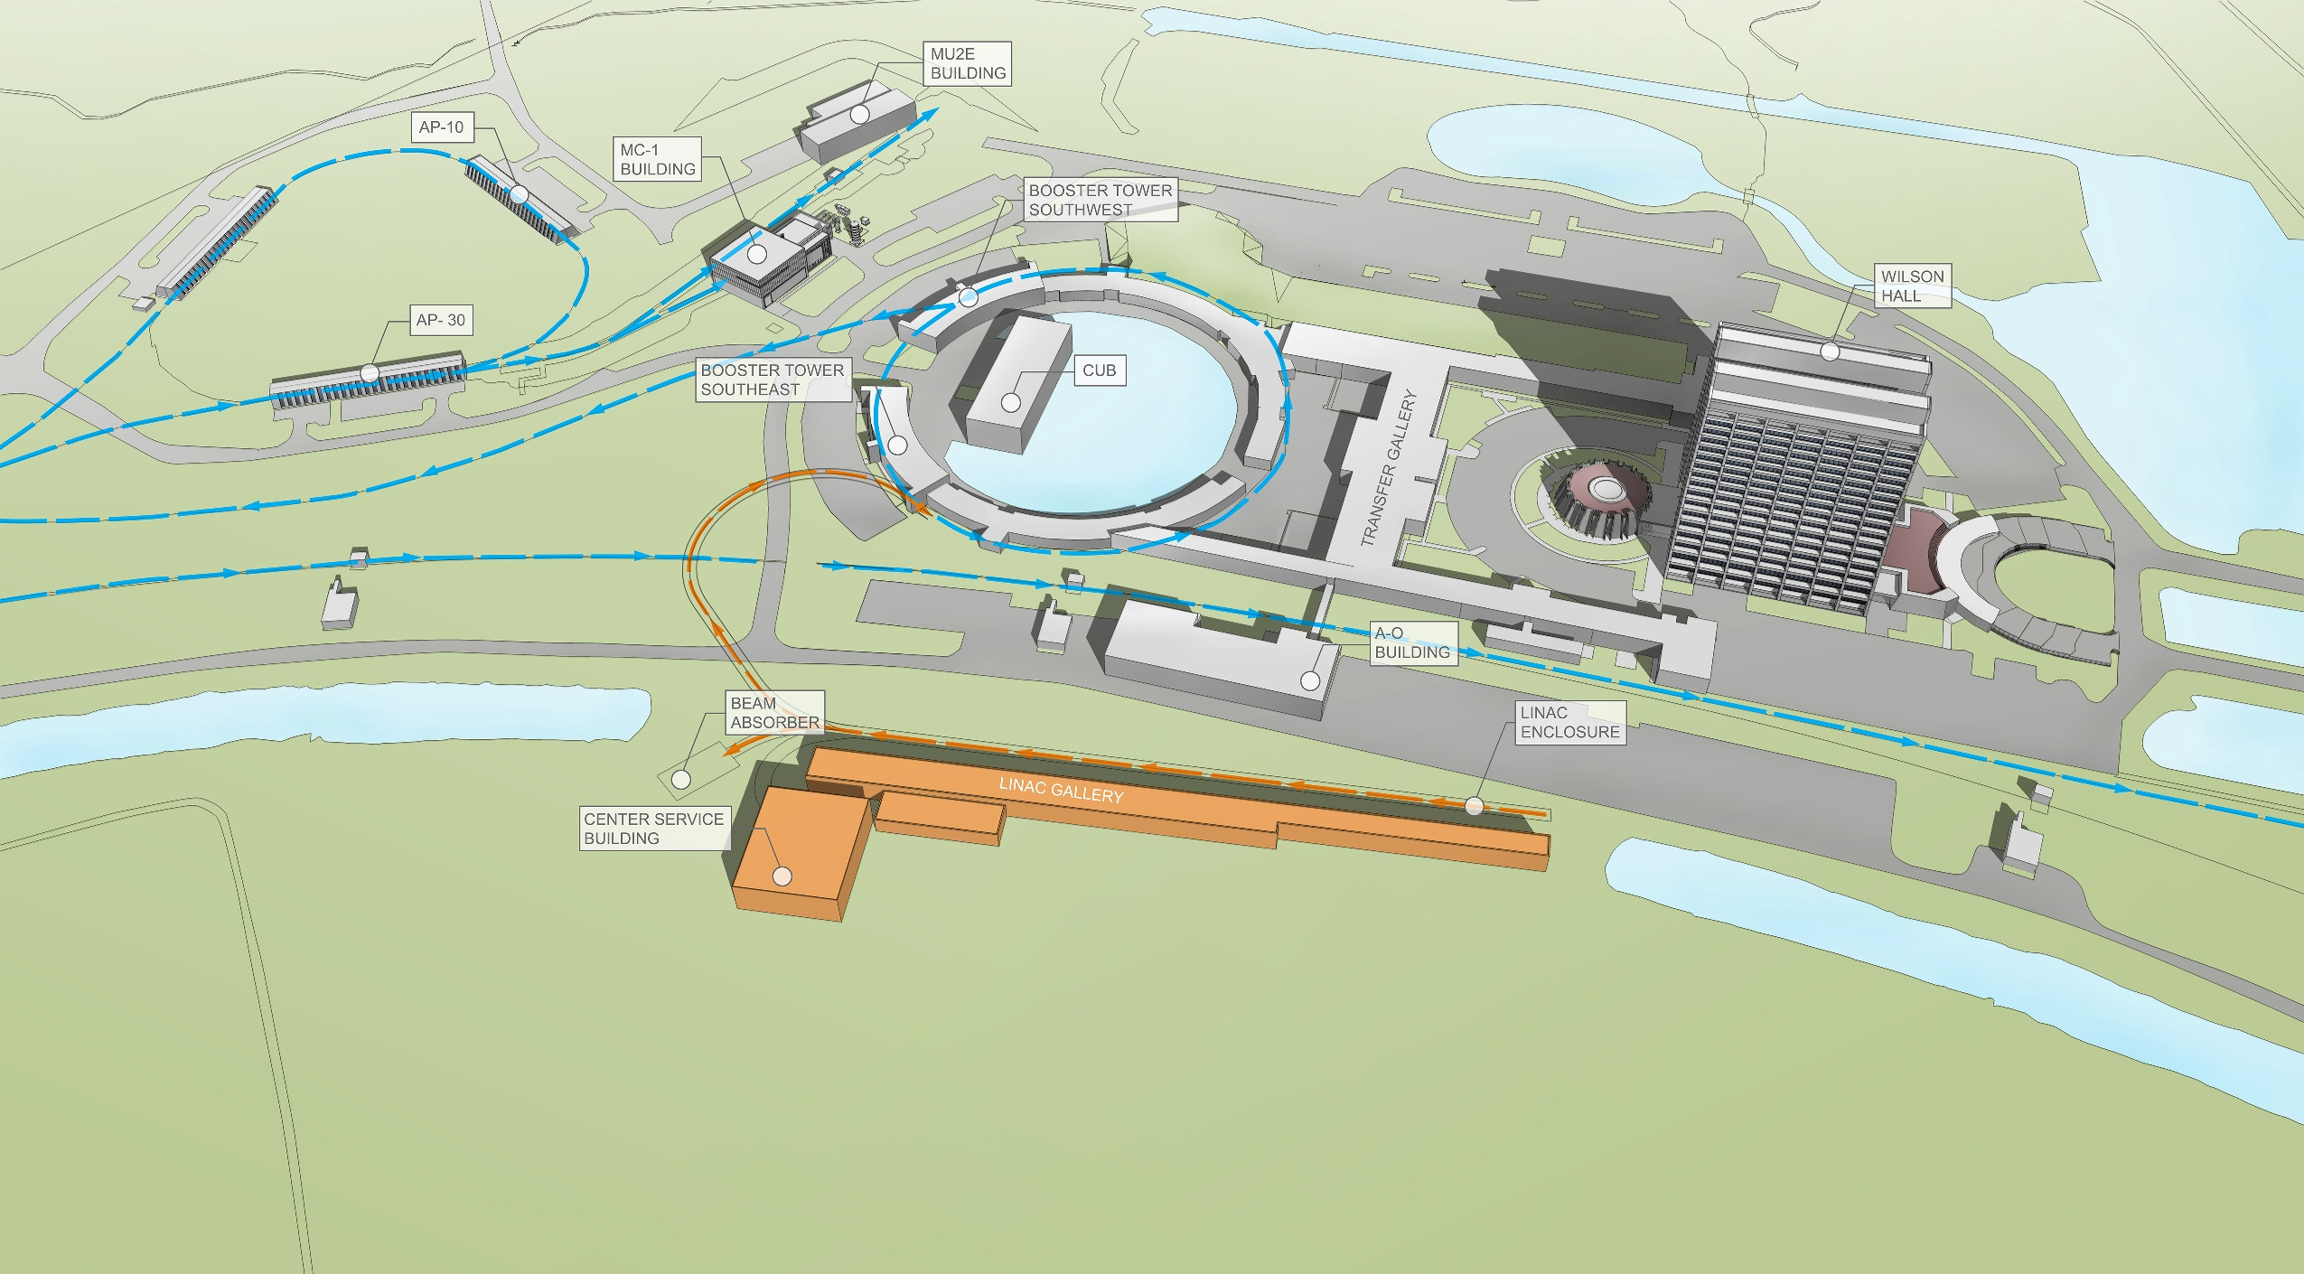
PIP-II Site Layout (provisional)

Slide 8

PIP-II Technology Map
Section | Freq | Energy (MeV) | Cav/mag/CM | Type
RFQ | 162.5 | 0.03-2.1
HWR (β_{opt}=0.11) | 162.5 | 2.1-10.3 | 8/8/1 | HWR, solenoid
SSR1 (β_{opt}=0.22) | 325 | 10.3-35 | 16/8/ 2 | SSR, solenoid
SSR2 (β_{opt}=0.47) | 325 | 35-185 | 35/21/7 | SSR, solenoid
LB 650 (β_{g}=0.61) | 650 | 185-500 | 33/22/11 | 5-cell elliptical, doublet*
HB 650 (β_{g}=0.92) | 650 | 500-800 | 24/8/4 | 5-cell elliptical, doublet*
*Warm doublets external to cryomodules All components CW-capable

Slide 9
Booster/Recycler/MI Requirements
Booster
  New injection region to accept 800 MeV H⁻ and enable transverse beam painting
  RF sufficient to support acceleration and transition crossing manipulations (22 cavities total)
  20 Hz operations
  Upgrades to damper and collimator systems
Recycler/Main Injector
  RF for slip-stacking at cycle times as low as 0.7 sec (RR)
    Supports 60 GeV protons to LBNF target
  RF power upgrade (MI)
  Loss control measures

Slide 10
PIP-II R&D Program
The goal is to mitigate risk: Technical/cost/schedule
Technical Risks
  Front End
    Delivery of beam with required characteristics and reliability
  Operate SC Linac in pulsed mode at low current
    Primary issue is resonance control in cavities
  Booster/Recycler/Main Injector beam intensity
    50% per pulse intensity increase over current operations
    Booster longitudinal emittance (slip-stacking)
    Transition crossing
    Beam loss/activation
  Develop requisite capabilities of partners and vendors
Cost/Schedule Risks
  Superconducting RF
    Cavities, cryomodules, RF sources
Goal: Complete R&D program in 2019
PXIE

Slide 11
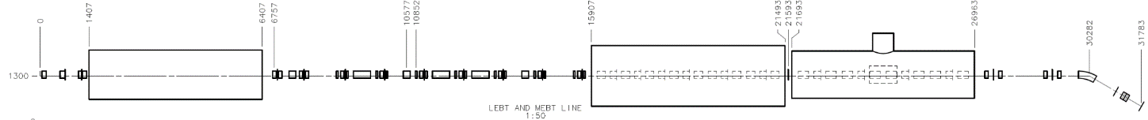
PIP-II R&D: PXIE
Now
2016
2017
2018
30 keV
2.1 MeV
10 MeV
25 MeV
RFQ
MEBT
HWR
SSR1
HEBT
LEBT
40 m, ~25 MeV
PXIE will address/measure the following:
  LEBT pre-chopping: Demonstrated
  Vacuum management in the LEBT/RFQ region: Demonstrated
  Validation of chopper performance
    Bunch extinction, effective emittance growth
  MEBT beam absorber
    Reliability and lifetime
  MEBT vacuum management
  CW operation of HWR
    Degradation of cavity performance
    Optimal distance to 10 kW absorber
  Operation of SSR with beam
    CW and pulsed operation
    Resonance control and LFD compensation in pulsed operations
  Emittance preservation and beam halo formation through the front end
Collaborators
ANL: HWR
LBNL:LEBT, RFQ
SNS: LEBT
BARC: MEBT, SSR1, RF
IUAC: SSR1

Slide 12
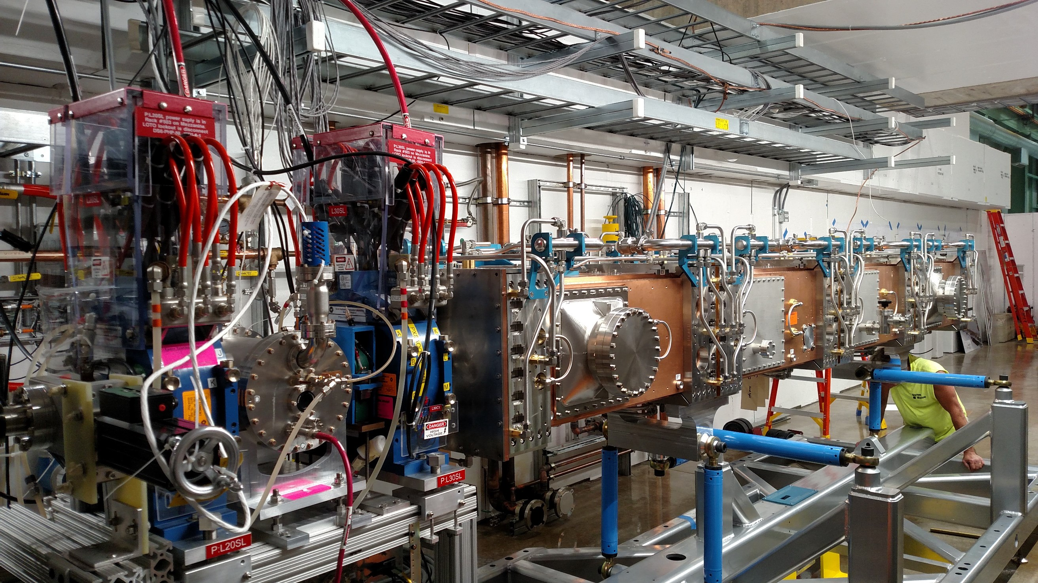
PIP-II R&D: PXIE

Slide 13
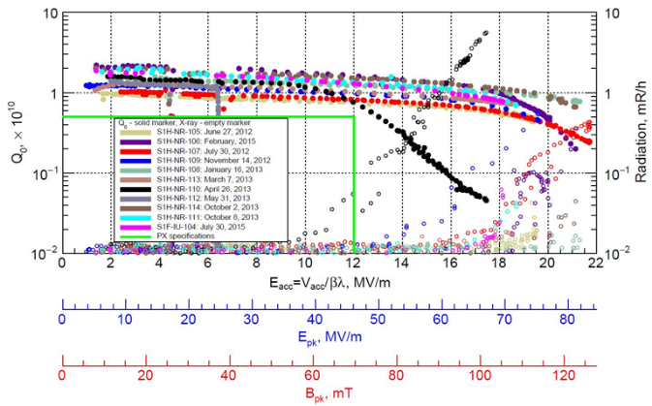
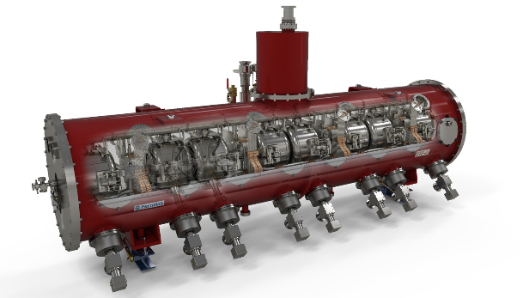
PIP-II R&D: SRF
R&D deliverables include:
  Prototype HWR cryomodule (ANL)
  Prototype SSR1 cryomodule (FNAL, IUAC)
  Two SSR2 dressed cavities (BARC)
  Two LB650 dressed cavities (VECC)
  Prototype HB650 cryomodule (FNAL, RRCAT)
RF sources, LLRF, and RFPI jointly developed by Fermilab and India in support of testing of the above
  325 and 650 MHz
PXIE

Slide 14
PIP-II Project Status and Strategy
PIP-II is now a recognized DOE project (CD-0)
  Conceptual design phase
    Goals established via Mission Need Statement (MNS) and P5 Report
  Cost range upper end established at $650M
  Project scheduled over 2016-2025, with 2020 start of construction
  India collaboration was critical in achieving CD-0
  Next up is CD-1: “Approve Alternative Selection and Cost Range”
CD-1 deliverables:
  Conceptual Design Report, including alternatives analysis
  Updated cost estimate
  Resource Loaded Schedule
  Risk Management Plan
  NEPA strategy
  etc.
  Goal: FY2017
    Draft of CDR + Alternatives by July
    Substantial progress on everything else by September

Slide 15
Alternatives Analysis
DOE413.3b mandates completion of an Alternative Analysis as part of the CD-1 process:
  “The recommended alternative should provide the essential functions and capabilities at an optimum life-cycle cost, consistent with required cost, scope, schedule, performance, and risk considerations. It should be reflected in the site’s long-range planning documents as well.”
A three step approach has been developed by DOE:
  Fermilab will prepare an alternatives evaluation document.
    Analysis and commentary on how the options perform under the evaluation criteria established by DOE.
  The Fermilab report will be evaluated OHEP-sponsored review committee. The committee will be asked to interpret the analysis, but not to provide a recommendation.
  The review committee report will be forwarded by OHEP to the Office of Science, who will make the decision on the preferred alternative
Four alternatives will be analyzed…see Fernanda’s presentation
Next step is to establish evaluation criteria
  We have provided suggest criteria to DOE/OHEP

Slide 16
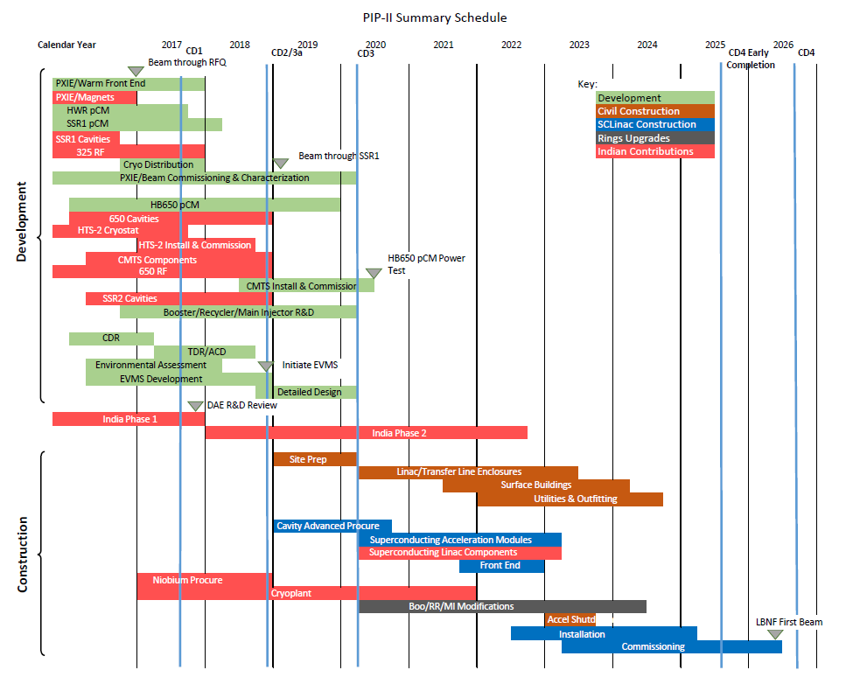
PIP-II Status: Preliminary Schedule

Slide 17
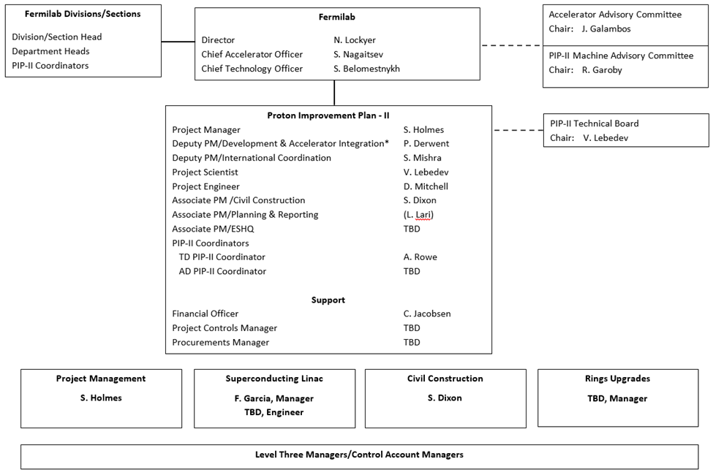
PIP-II Status: Organization
PIP-II will be executed following the requirements of DOE Order 413.3B
Project Office established in fall 2014

Slide 18
India Collaboration
India is major partner during both R&D and construction phases
  Governed by Annex I to the U.S. DOE-India DAE Implementing Agreement, signed in January 2015
Joint Project Document for the R&D Phase
  Signed by DOE and DAE in August 2015
  Establishes scope and dates for all R&D phase deliverables
    56-110 in total (depending how you count)
    Covers all technical aspects of the linac
  Four DAE laboratories (BARC, IUAC, RRCAT, VECC)
  Managed by Sub-project Managers/Coordinators at Fermilab and in Indian laboratories
  Initial DOE/DAE review of progress in January 2016 (BARC, Mumbai)
Seven Indian engineers arrived in fall 2015 for two-year residencies

Slide 19
Other Collaborators
National
  Major collaborators during the R&D phase:
    ANL: HWR cryomodule
    LBNL: RFQ
  Other opportunities:
    ANL: SRF
    LBNL: RF cavity design (Booster), LLRF, instrumentation
    SLAC: RF cavity design (Recycler)
    All currently limited by lack of available funds
Europe
  Discussions center around contribution of LB650 cavities and cryomodules
  INFN, Cockcroft Institute, Saclay
Other contacts: CERN (SPL), RAL/FETS (UK), ESS (Sweden), China/ADS

Slide 20
Response to Last Meeting’s Recommendations
All recommendations have been considered
  Responses are available on the indico site
  9 closed + 4 open with action plans
Selected highlights:
  Studies/analysis of potential limitations in Boo/MI/RR
    Calculations, simulations and benchmarking against experiment underway in Booster/RR
    New longitudinal simulation code in development
    Operational experience at >500 kW in MI/RR
  Risk strategies in multiple areas
    Developing strategies on as-need basis
    Risk Management Plan to be created in advance of CD-1
  Resonance control
    Continue to develop plans based on studies and simulation

Slide 21
Organization of the Meeting
Design Development
Dinner @ Chez Leon
R&D Program/India Collaboration
Executive Session/Closeout

Slide 22
Summary
  PIP-II represents a first step in the realization of the full potential of the Fermilab complex
  Complete concept outlined in the Reference Design Report
  Initial goal is to establish LBNF as the leading long-baseline program in the world, with >1 MW at startup
  Platform for subsequent development of the accelerator complex
    LBNF >2 MW
    Mu2e sensitivity ×10
    MW-class, high duty factor beams for future experiments
R&D program aligned with the requirements outlined in the RDR
  Organized to support a 2019 construction start
  India is a major partner in the R&D program
CD-0 has been received and we are working towards CD-1
  Conceptual Design Report
  Alternatives analysis
We are looking for your input, with particular attention to the charge elements

Slide 23
Backups

Slide 24
Future Directions
The configuration and siting of the PIP-II linac are chosen to provide opportunities for future performance enhancements to the Fermilab proton complex
  >2 MW to LBNF
  100’s kW for a rare processes program
    CW capability at 0.8 – 3 GeV
  Front end for a muon-based facility
The natural next steps would be upgrading the PIP-II linac to CW operations and replacement of the Booster with higher performance accelerator

Slide 25
Alternatives Analysis
Evaluation Criteria
  Cost to DOE
  Beam power from the Main Injector
  Reliability of operations of the Fermilab accelerator complex
  Beam power for the 8-GeV neutrino program
  Suitability as a platform for upgrading the accelerator complex to 2 MW to LBNE
  Suitability as a platform for a second generation Mu2e experiment at 100 kW
  Suitability as a platform for upgrading to high beam-power, high-duty factor operations
  Extent of interruption to ongoing accelerator operations during construction
  Technical risk
  Potential for international contributions

Slide 26
Alternatives Analysis
Alternatives to be analyzed
  Alternative 1 (CW-capable SCLinac; Reference Design): 800-MeV superconducting linac, constructed of CW-capable components, operated initially in pulsed mode at an average beam current (during the pulse) of 2 mA, located on the Tevatron infield, accompanied by necessary modifications to the existing Booster/Recycler/Main Injector accelerators.
  Alternative 2 (Pulsed SCLinac): 800-MeV Superconducting Linac, optimized for low-duty factor pulsed operations, at an average current of 5 mA, located on the Tevatron infield, accompanied by necessary modifications to the existing Booster/Recycler/Main Injector accelerators.
  Alternative 3 (SCLinac after-burner): 800-MeV linac constructed by adding a 400-MeV superconducting linac, optimized for low-duty factor pulsed operations, at an average current of 5 mA, to the existing but relocated 400-MeV linac, accompanied by necessary modifications to the existing Booster/Recycler/Main Injector accelerators.

Slide 27
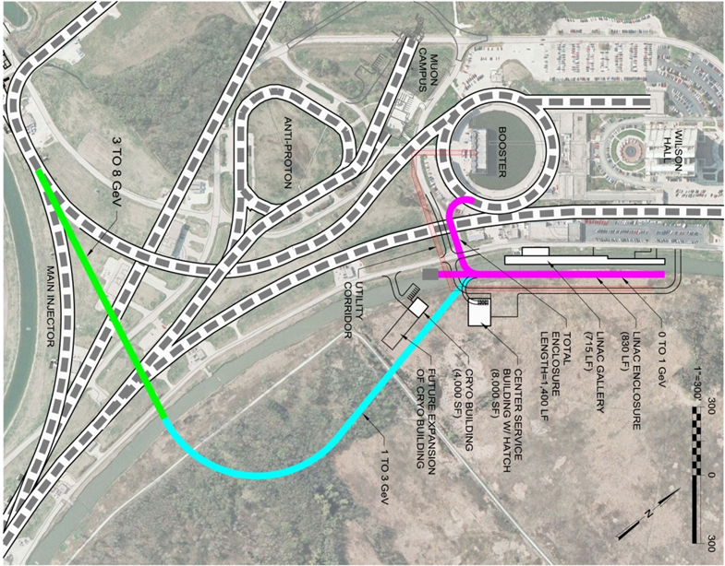
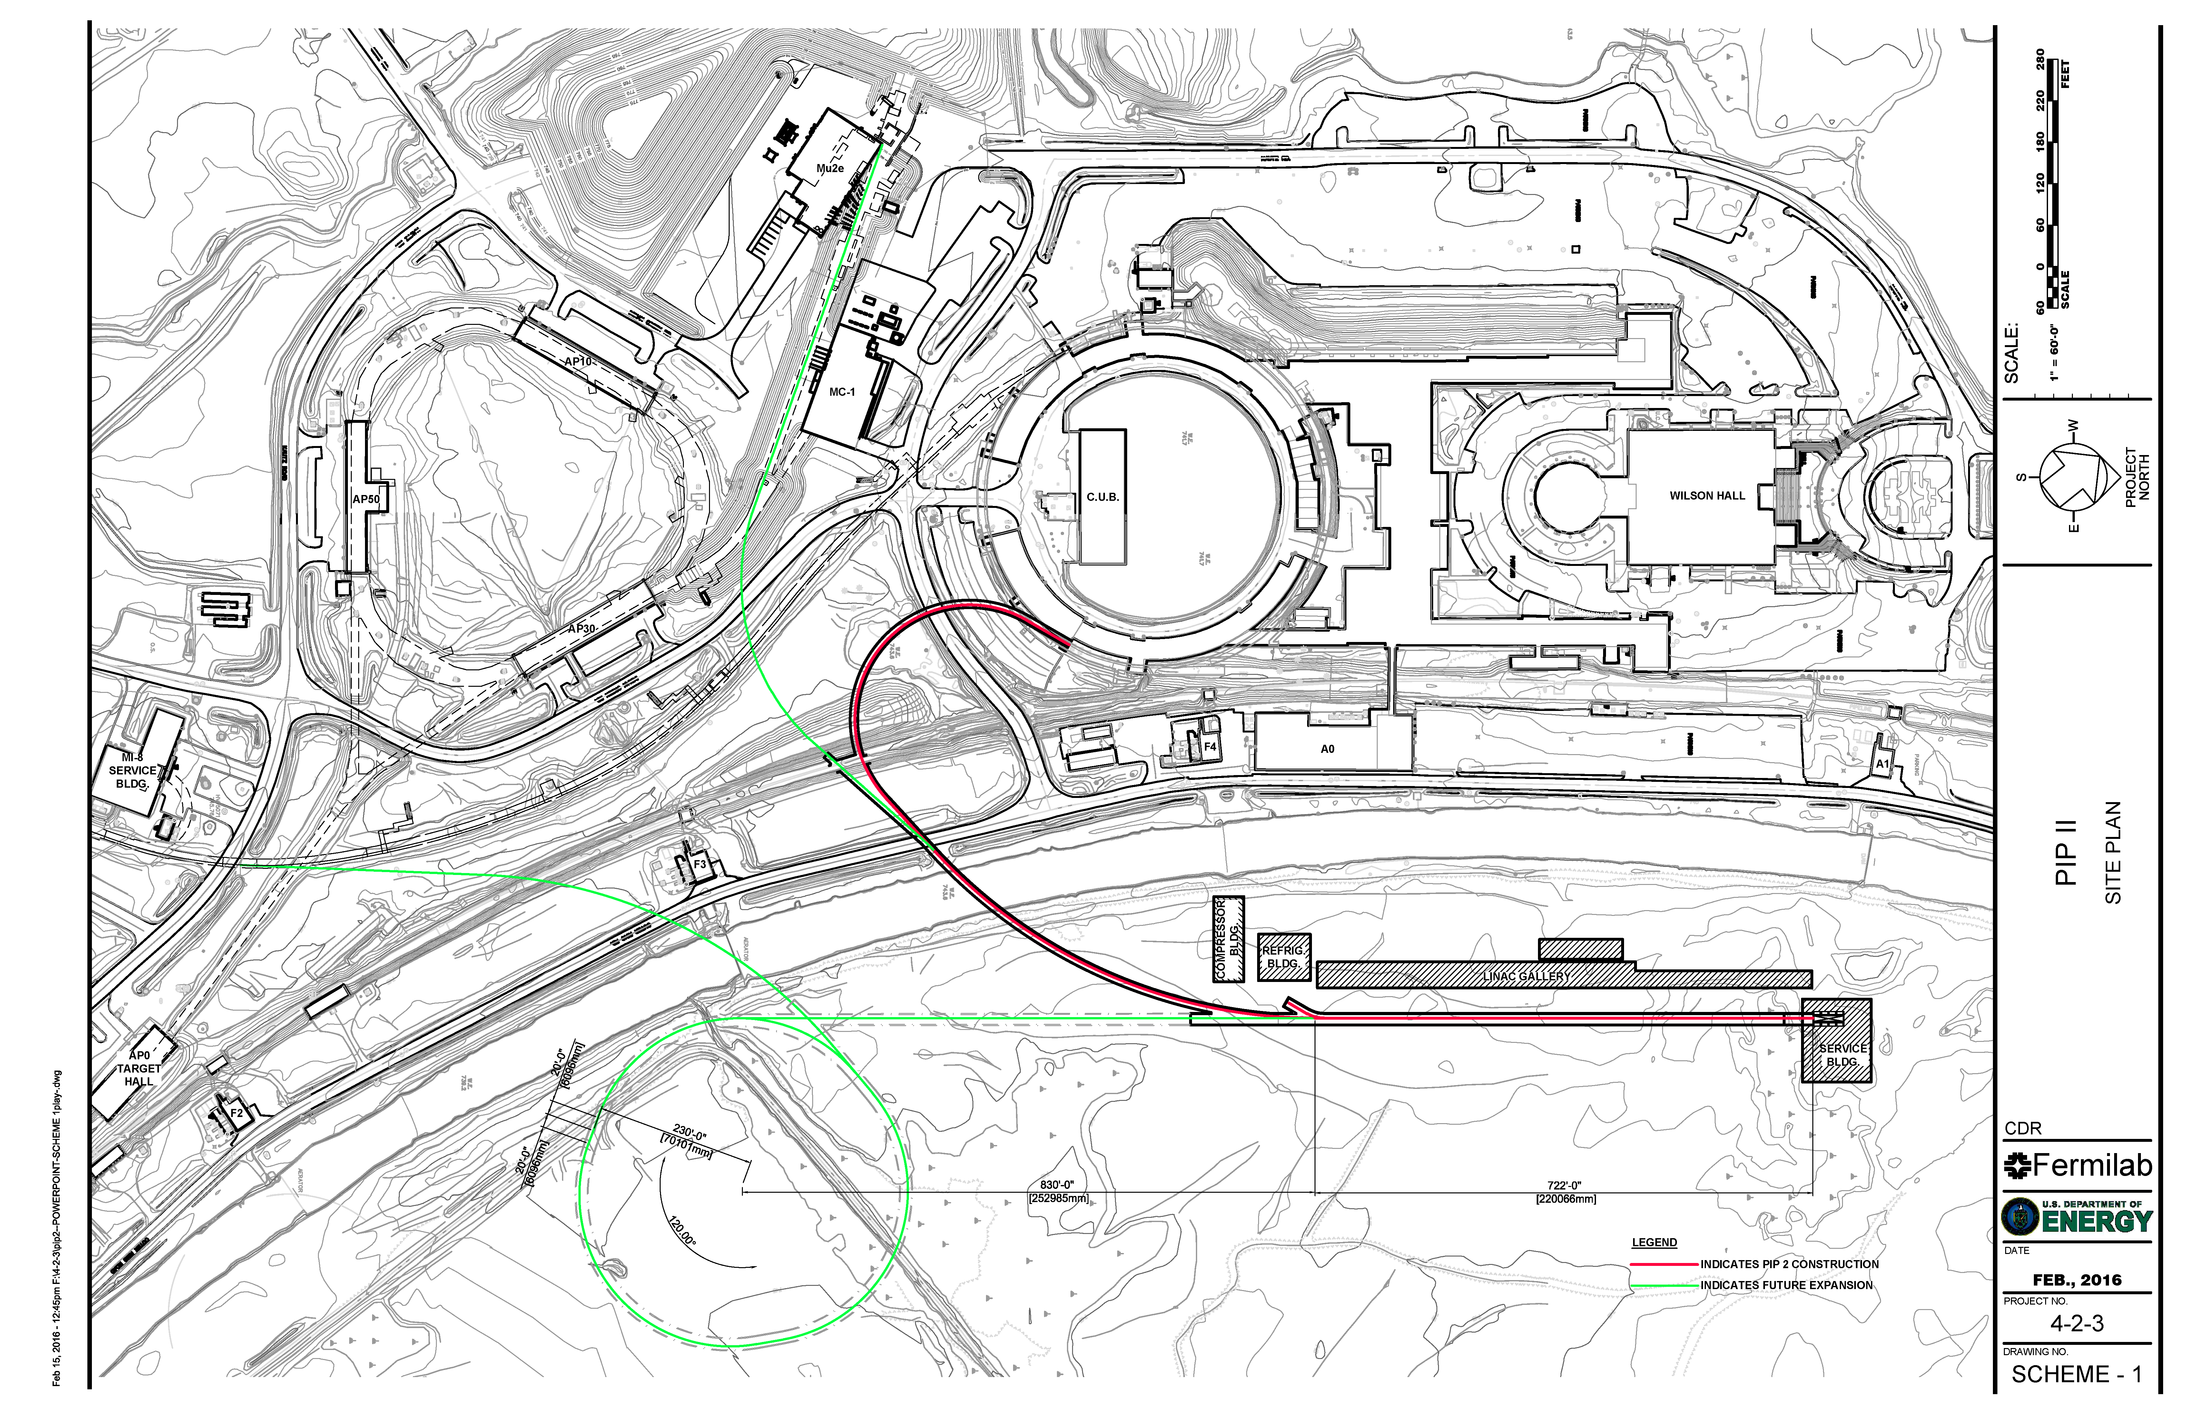
Flexible Platform for the Future
Opportunities for Booster replacement include full energy (8 GeV) linac or RCS

Slide 28
Cost Estimate/Proposed Budget Profile
 | FY16 | FY17 | FY18 | FY19 | FY20 | FY21 | FY22 | FY23 | FY24 | FY25 | TOTAL
Funding Profile (Cost to DOE) | $19.5 | $19.5 | $25.0 | $40.0 | $60.0 | $100.0 | $100.0 | $100.0 | $100.0 | $86.0 | $650
Profile based on FY19-25 construction period
  As presented in MNS
  All amounts are $M then-year
  Inconsistent with FY17 PBR ($18.2M)
Assumes $160M offset from international in-kind contributions

