Slide 1
Transfer Line
A. Vivoli
PIP-II Machine Advisory Committee Meeting
15-17 March 2016

Slide 2
Outline
Transfer Line design developed over the last year.
Main Ring crossing design.
Dump/Mu2e Line switch design.
Dump Line design.
Plans for CDR.

Slide 3
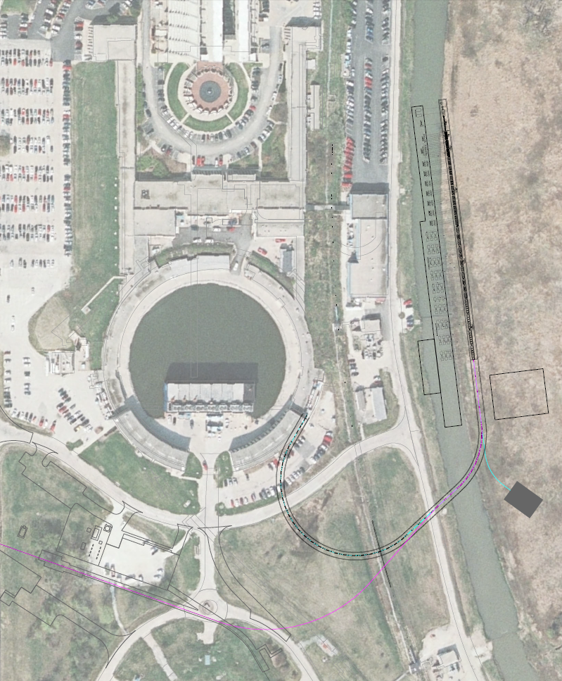
Transfer Line footprint at July 2015
4 slots for additional cryomodules (HB650) available for SC Linac upgrade up to 1.2 GeV.
2 arcs of 32 horizontal dipole magnets (8+24)
Dump line at the end of linac energy upgrade slots.
Straight section with Mu2e line switch (vertical).
Connection from Mu2e switch in straight section to line M4 used by Mu2e experiment.
Linac gallery
SC Linac
Transfer Line to Booster
Beam Dump
SY beams line
M4 Line
Transfer Line to Mu2e
Notes:
Increase font size at minimum to 16pt. Same for all other slides.

Slide 4
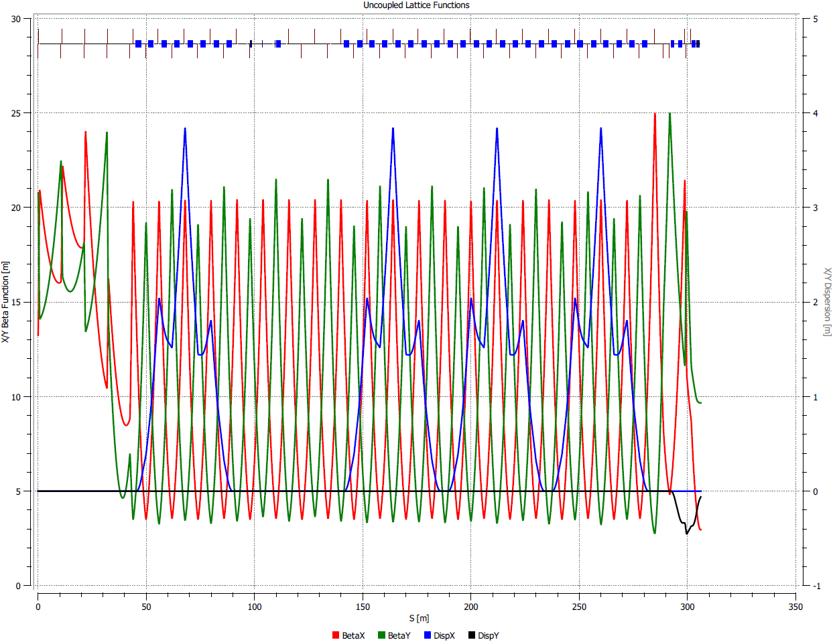
Transfer Line optics at July 2015
Planar lattice except at Booster injection (vertical).
FODO cells with 90°phase advance per cell (H-V).
Vertical injection into the Booster (3 vertical bends).
En. upgrade
1st arc
Mu2e switch
2nd arc
Injection

Slide 5
Transfer Line design at July 2015
Quadrupole families: 20
All F and D quadrupoles in FODO cells and dump line are identical (35)
Quadrupoles in SC Linac upgrade section (10) and quadrupoles at Booster injection (6) are currently in different families (but can be grouped if necessary)
2 large quadrupoles used in Mu2e line switch
Dipole magnet families: 5
All bends in arcs are identical (32).
The 2 vertical bends for Booster injection dog-leg are identical
C-magnet for Booster injection
Mu2e line switch with fast pulsed magnet (vertical) and Lambertson septum (horizontal).

Slide 6
Mu2e line design at July 2015
Preserve the optics of the original line (PIP II beam should be smaller than Mu2e beam) to avoid problems with apertures.
Preserve elements and configurations of the original line to minimize changes necessary for upgrade.
FODO cell lattice like for Booster transfer line.
Employment of a 12-bend arc to connect to M4 line with first and last bends rolled to cover the different elevation (1.8 m).
Quadrupole families: 10
All F and D quadrupoles in FODO cells for Mu2e line are identical (18).
Quadrupoles used for matching (8) are currently in different families (but can be grouped if necessary).
Quadrupoles used in M4 line not counted.
Bend families: 1
All dipole magnets in the arc are identical (12).
Dipole magnets used in M4 line not counted.

Slide 7
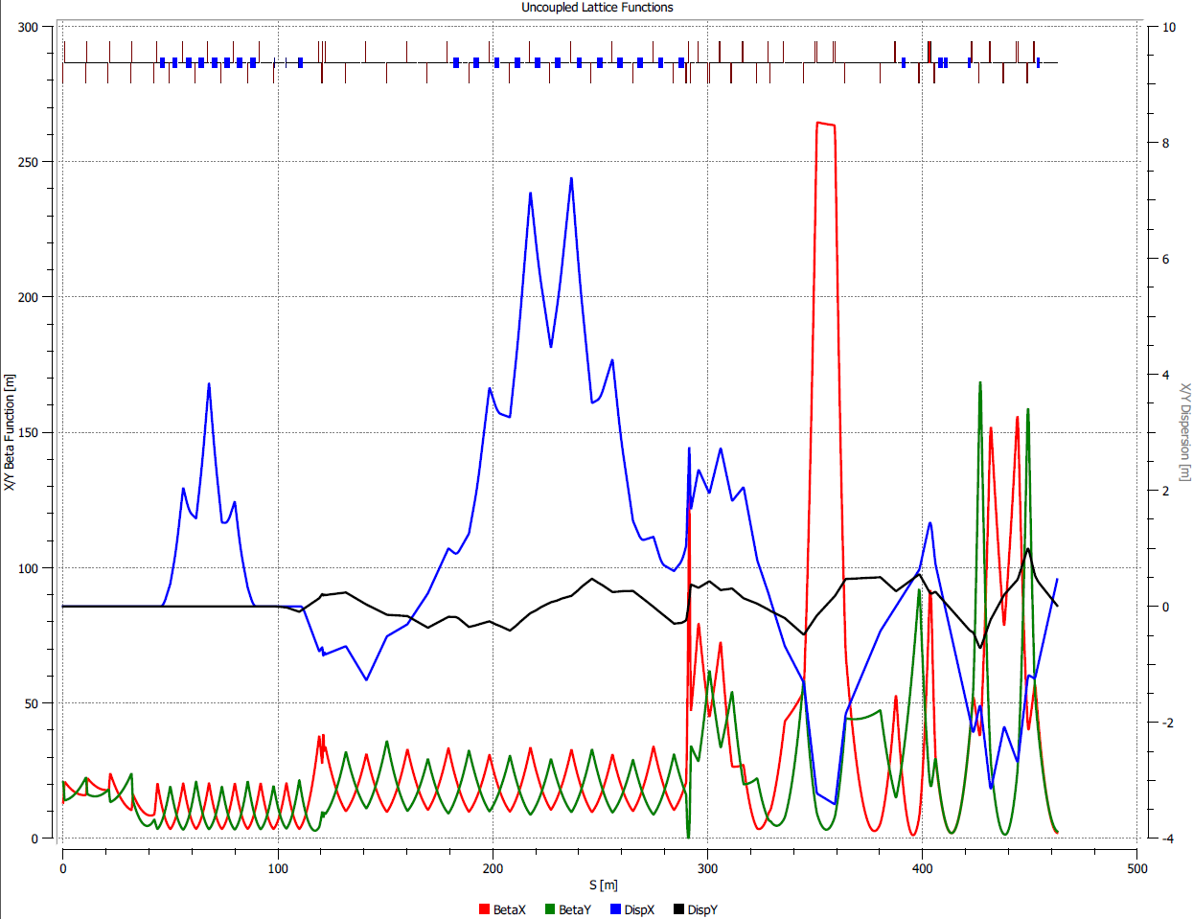
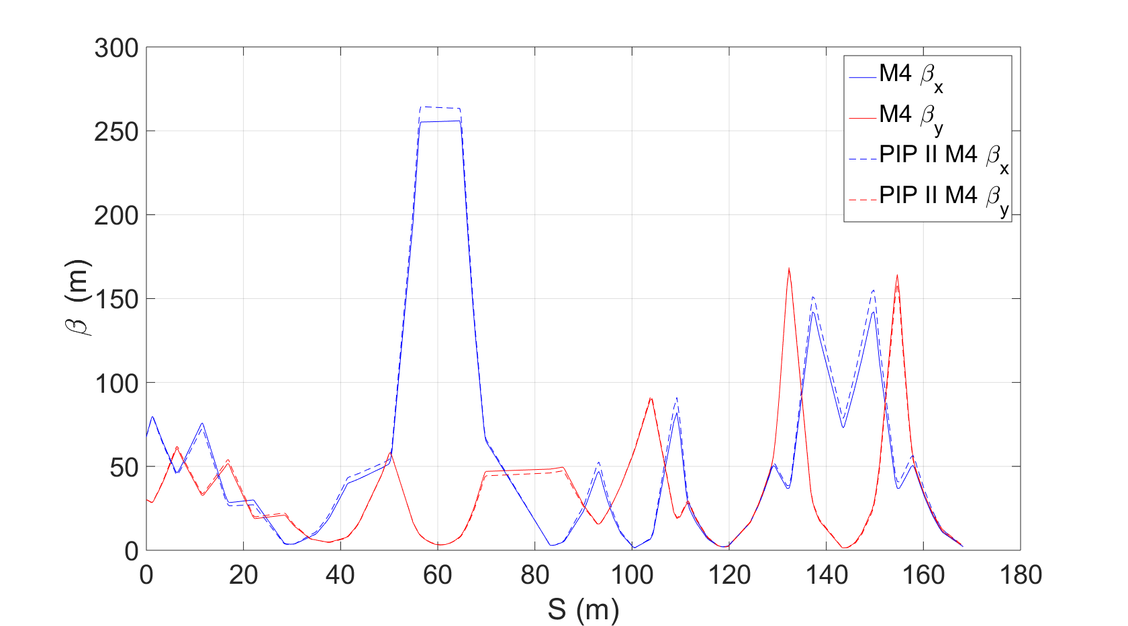
Mu2e line optics at July 2015
En. upgrade
1st arc
Mu2e switch
Mu2e arc
M4 line
Mu2e line optics
Comparison original/new M4 optics

Slide 8
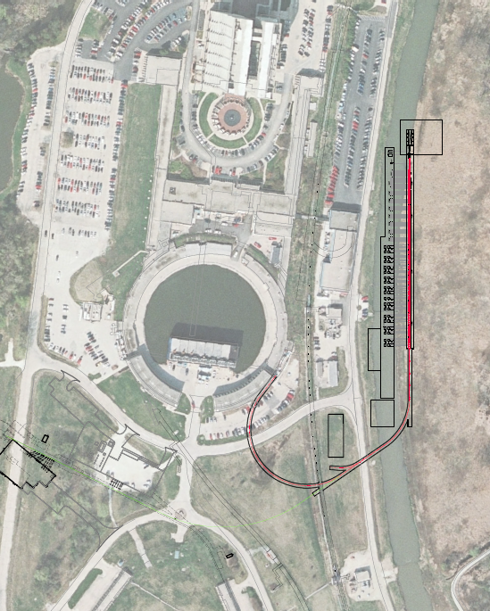
Transfer Line footprint at March 2016
Transfer Line enclosure crosses the Main Ring.
Elevation of Transfer Line in Main Ring crossing changed by rolling the dipoles in 2nd arc.
Same number of elements in the line.
Minimal change in FODO lattice to accommodate the geometric constraints.
Dump line moved to straight section.
Dump Line switch in straight section (horizontal).
Injection into Booster not changed.
Mu2e line not redesigned yet.
Linac gallery
SC Linac
Beam Dump
Transfer Line to Booster
M4 Line
SY beams line

Slide 9
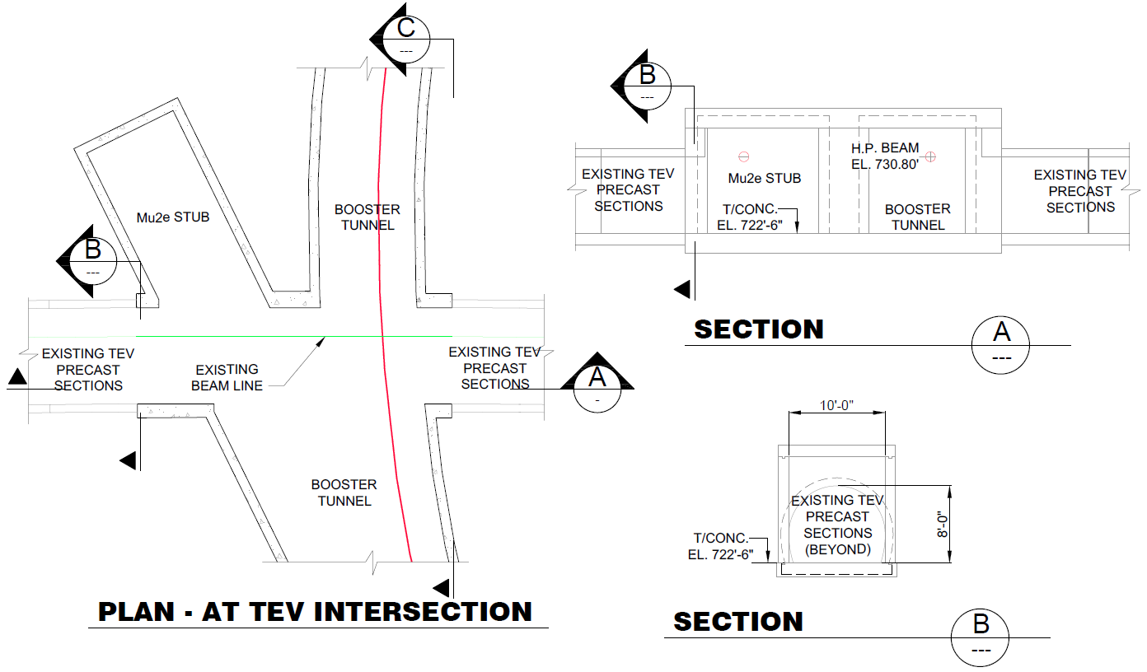
Main Ring crossing
After considering the options of having the Transfer Line enclosure crossing the Main Ring or passing above/below, the technical board decided for the first option.
The elevation of the Transfer Line in the Main Ring needed to be raised 4.3 ft. (1.311 m) to leave at least 8 ft. clearance in the Main Ring.

Slide 10
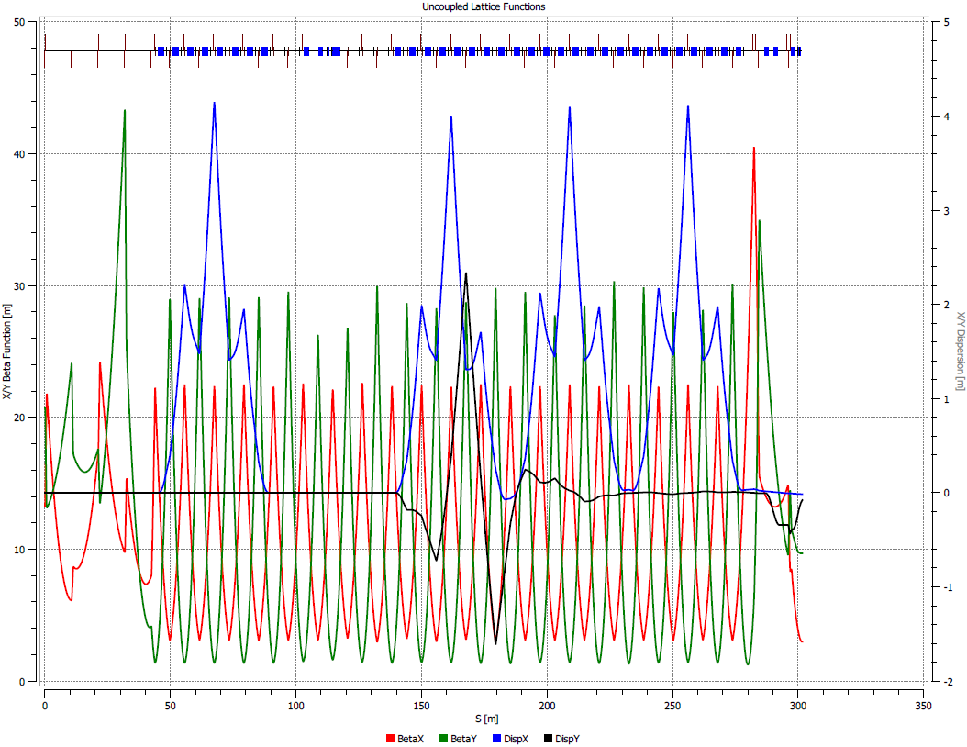
Transfer Line optics at March 2016
Elevation of the transfer line in Main Ring is realized without adding extra dipole magnets, by rolling the dipoles in the 2nd arc.
The vertical dispersion generated is dumped by rolling the other dipoles in the 2nd arc.
Both H and V dispersions are adjusted by changing the phase advance per cell from 90 deg. (H,V) to 90 deg and 134 deg (H and V).
En. upgrade
1st arc
Dump Line switch
2nd arc (rolled dipoles)
Injection

Slide 11
Transfer Line magnet families at March 2016
Dipole magnet families: 5
All bends in arcs are identical (32).
The 2 vertical bends for Booster injection dog-leg are identical
C-magnet for Booster injection
Dump line switch with fast corrector, and Lambertson septum (horizontal).
Quadrupole families: 20
All F and D quadrupoles in FODO cells and dump line are identical (37)
Quadrupoles in SC Linac upgrade section (10) and quadrupoles at Booster injection (6) are currently in different families (but can be grouped if necessary)
2 large quadrupoles used in Dump Line switch

Slide 12
Dump/Mu2e Line switch
Efficient injection into the Booster requires beam based energy stabilization.
Beam energy measured by time-of-flight system in energy upgrade slots. Energy stabilized with feedback system and voltage correction in last SC cryomodule.
During energy stabilization (~100 μs) the beam will be directed to the dump. After stabilization achieved the beam will be switched to the Booster. To avoid significant change of cavity voltage the switching time must be of the order of 20 μs.
The fast switch will be performed with fast corrector and DC Lambertson septum.
Two large quadrupoles are required for this scheme.
In case when fast switching is not required general dipole correctors can be used.
To Mu2e (M4) line
Large Quadrupole D
Large Quadrupole F
Quadrupole F
To Booster
Fast corrector
3-way Septum magnet (Lambertson)
To dump line
Notes:
“stabilization (~20 υs)” -> “stabilization (~100 υs)”
“the order of μs” -> “the order of 20 υs”
Two lines are removed from the slide – see above
I do not think we need a slow magnet. It would be easier to make longer fast magnet. Instead put “in the case when fast switching is not required general dipole correctors can be used.

Slide 13
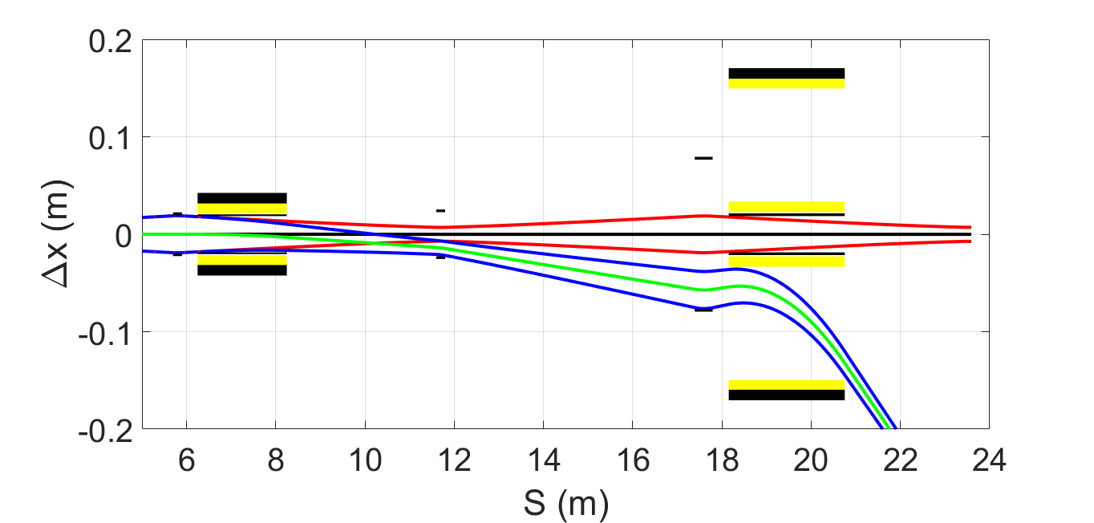
Dump/Mu2e Line switch
Coils
To Mu2e (M4) line
Beam envelopes (10σ) and aperture limitations (H)
3-way Septum magnet
To Booster
Fast corrector
Large Quadrupole D
Large Quadrupole F
To dump line
Quadrupole F
Vacuum chamber horizontal half-aperture:
Fast corrector: 1.9 cm
Large quadrupole (D): 2.3 cm
Large quadrupole (F): 7.7 cm
Septum magnet: 1.9 cm (Booster line) – 2.0 cm, curved (others)

Slide 14
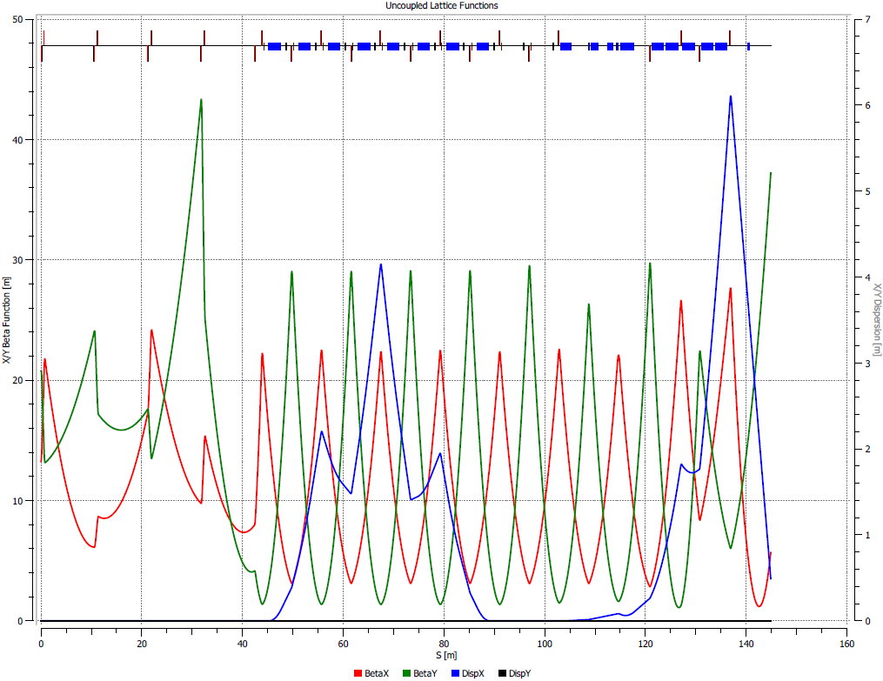
Dump Line optics at March 2016
5 additional dipole magnets of the same family used for the arcs.
Same families of F and D quadrupoles used in the transfer line to Booster.
En. upgrade
1st arc
Dump Line switch
Dump line
Dump
Notes:
The top picture requires aperture limitations and beam envelopes to be shown. We need to discuss the location of general (slow) correctors.

Slide 15
Plans for the CDR
No R&D foreseen for elements in Transfer Line.
Produce a conceptual design of magnets.
Design of Mu2e line.
Write FRS for the elements of the line.
CDR writing.
Notes:
“draft design “ -> “conceptual design”

Slide 16
Backup

Slide 17
Booster injection scheme

