Slide 1
MI/RR Upgrades
Ioanis Kourbanis
PIP-II Machine Advisory Committee Meeting
15-17 March 2016

Slide 2
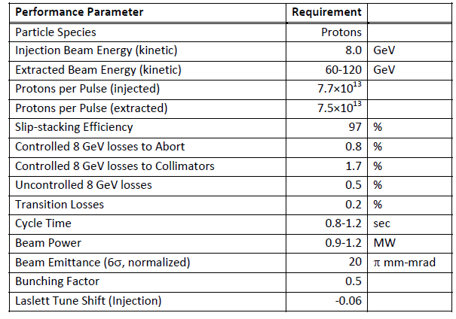
MI/RR Performance Requirements
Slip stack and accelerate 50% more intensity.
Run MI at lower energies.

Slide 3
MI/RR Accelerator Issues
Can we slip stack and accelerate 50% more intensity.
  Power loss from slip stacking (8 GeV)
  RF Power (Acceleration)
Running Recycler 53 MHz Cavities CW (Running at 60 GeV)
Transition crossing.
Electron cloud.
Beam loss control/mitigation.

Slide 4
Slip Stacking in the Recycler
We need to maintain the same power loss from slip stacking with 50% more intensity per bunch (120 GeV operation).
  Increase slip stacking efficiency from 95% to 97%.
  Limits on longitudinal emittance and bunch height from Booster beam are not much different than the NOvA ones due to the higher frequency separation and RF voltage.
  Higher chromaticity will be required.
For MI operation at energies lower than 120 GeV the power loss will increase up to 50% in both MI and RR.
  Have no un-controlled losses (Collimators).
  Collimators should be able to handle the extra loss.

Slide 5
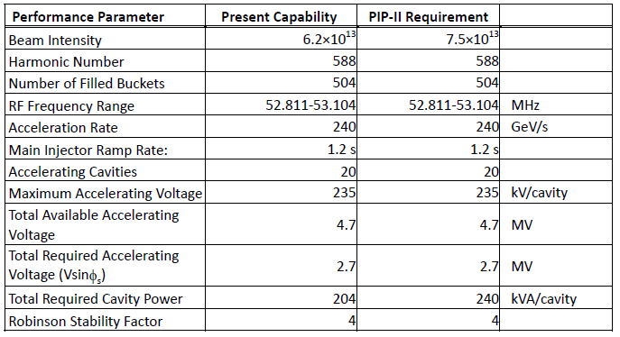
Present and Required MI RF Capabilities
*
* Maximum Beam Intensity capable with current RF system. It is 27% higher than the required Beam Intensity for PIP I (4.9E13).
Present RF System does not have the power to accelerate the PIP-II Beam intensities

Slide 6
MI RF Options for higher power
Operate the current RF cavities with two power tubes instead of one in a push-pull configuration.
  Need to double the number of modulators and solid state drivers.
Use a new more powerful power tube (EIMAC 4CW250,000B).
  New mounting configuration (much longer tube).
  New modulators and upgraded PA cooling.
Establish an R&D plan to test and evaluate both options.

Slide 7
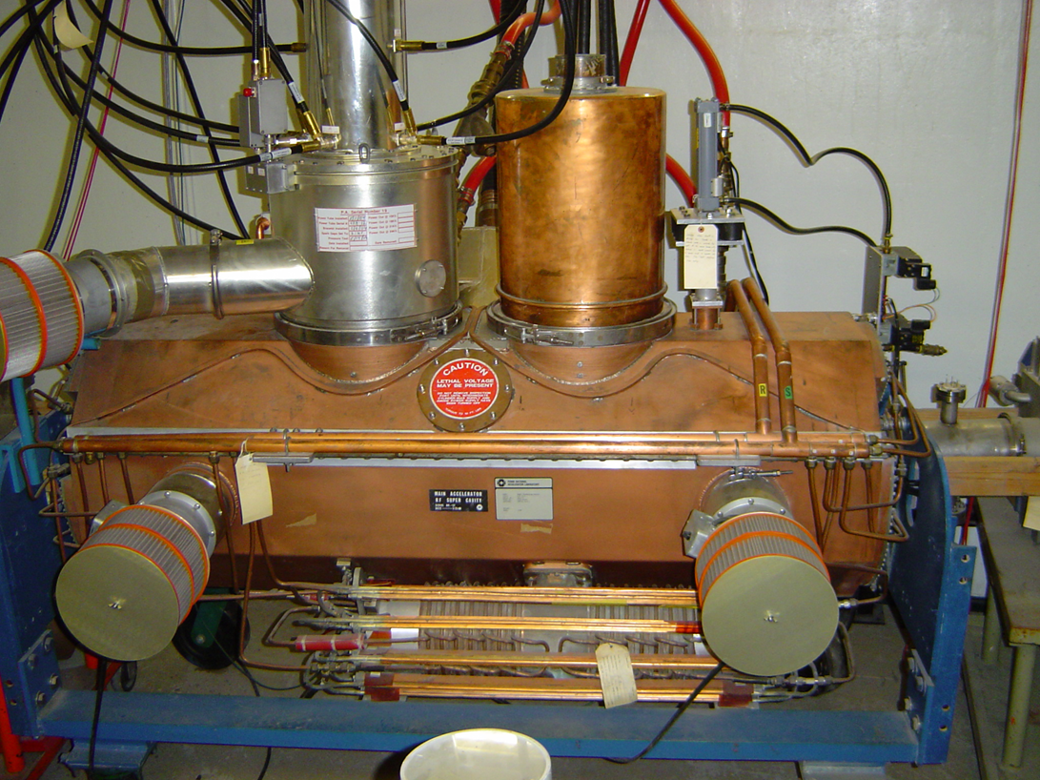
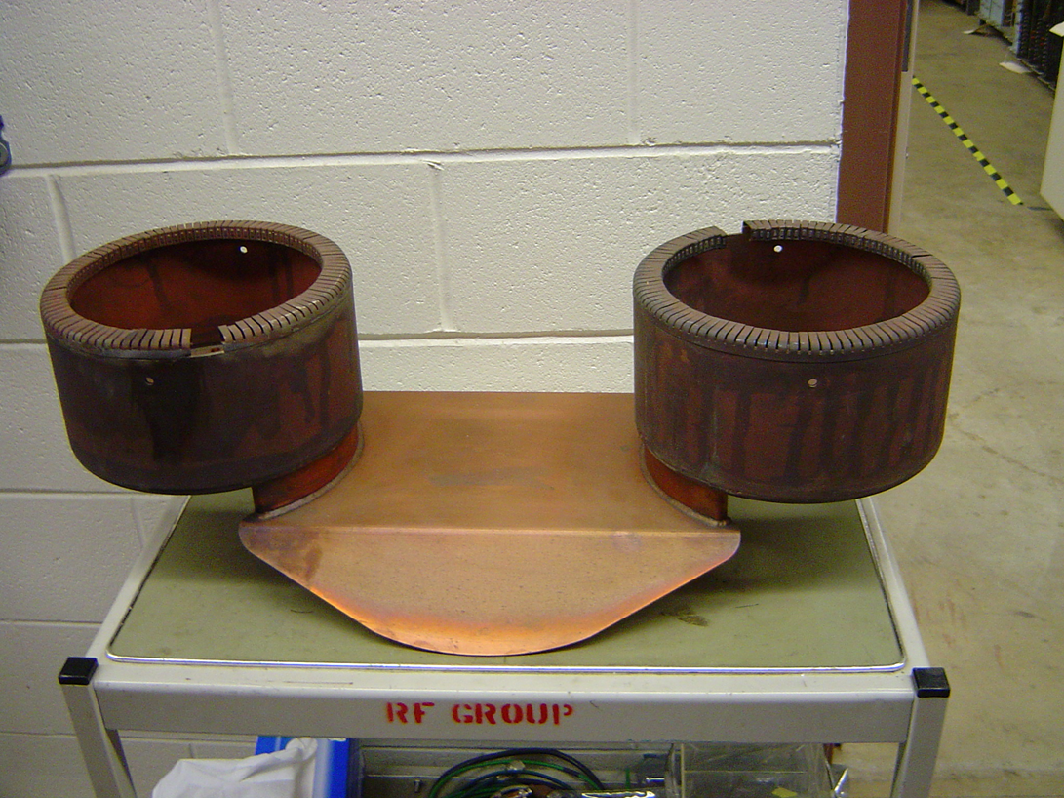
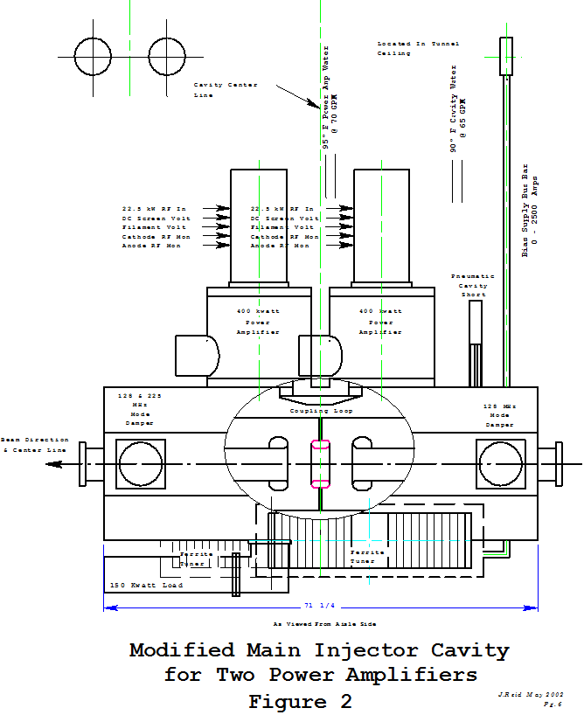
MI RF Power Upgrade
Current MI Cavity
Coupling Loop
Use two PA’s per cavity in a push pull configuration.
We will need to double the modulators and the SS drivers.
We have all the parts needed to test this option on the spare MI cavity.

Slide 8
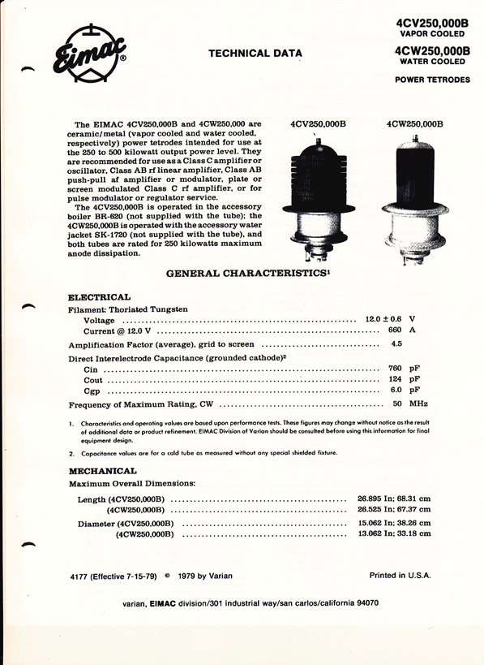
MI RF Power Upgrade (Option 2)
Use new power amplifier (Eimac 4CW250000B)
Size constraints need to be evaluated (much longer tube).
Will need a new modulator.
Can be used for the 2+ MW MI operations.
Should purchase one tube for evaluation.

Slide 9
New RR RF Cavities
The present Recycler 53 MHz cavities used for slip stacking have a high power dissipation (90 KW, 60% DF) because of the low R/Q (13 Ohms).
Running MI at energies as low as 60 GeV will require the slip stacking cavities to run CW.
Running Booster at 20 Hz will require higher RF voltage (140 KV instead of 80 KV).
  We only have space for 3 cavities
We will need a different cavity design with higher R/Q and active beam loading compensation.

Slide 10
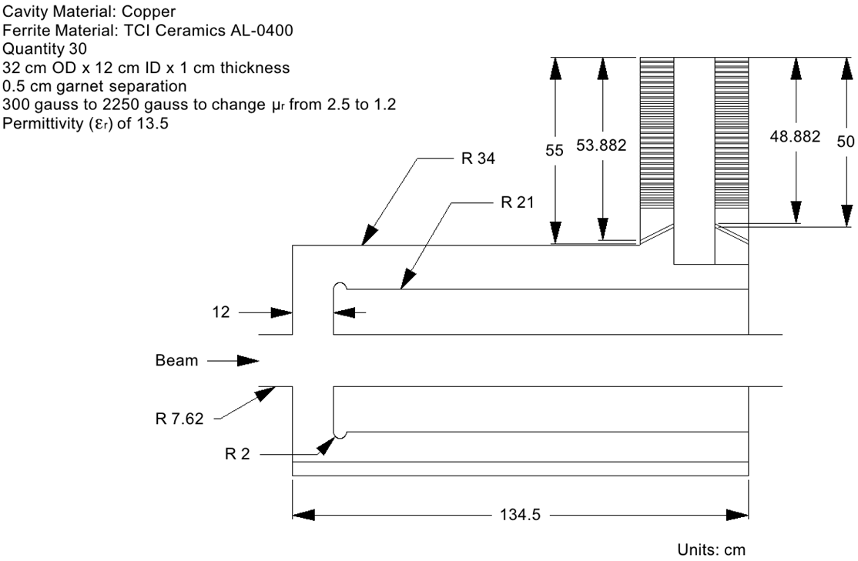
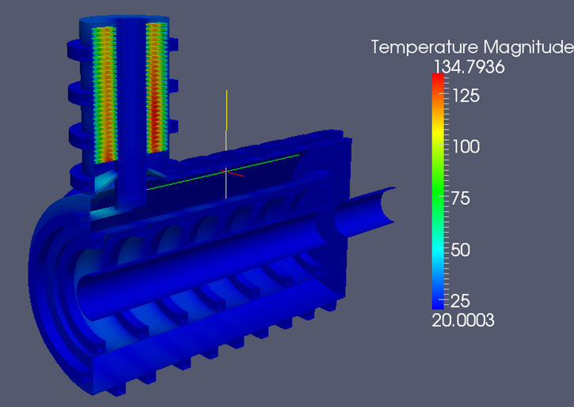
New RR RF cavities
Use the cavity design developed for MI in collaboration with SLAC.
Optimize the design for single frequency and lower voltage.
Investigate different cooling options for tuner.

Slide 11
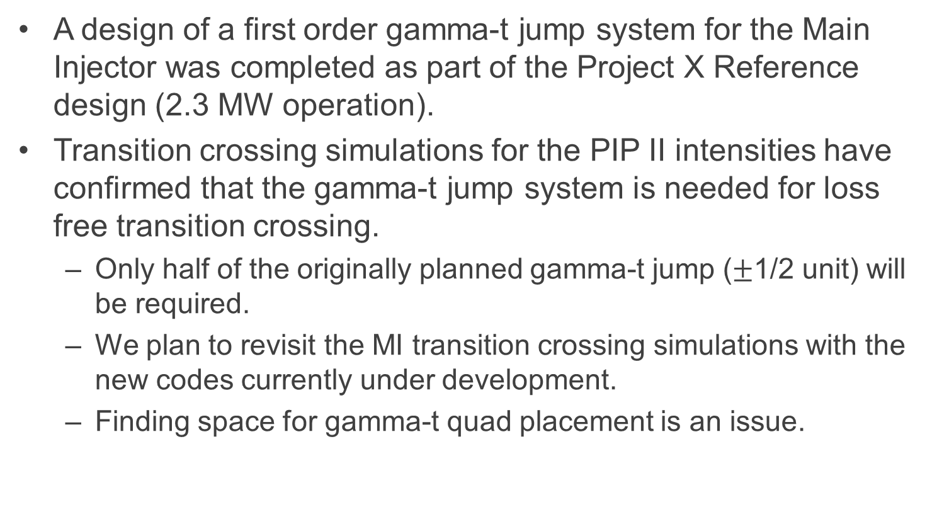
Transition crossing
A design of a first order gamma-t jump system for the Main Injector was completed as part of the Project X Reference design (2.3 MW operation).
Transition crossing simulations for the PIP II intensities have confirmed that the gamma-t jump system is needed for loss free transition crossing.
  Only half of the originally planned gamma-t jump ($±$1/2 unit) will be required.
  We plan to revisit the MI transition crossing simulations with the new codes currently under development.
  Finding space for gamma-t quad placement is an issue.

Slide 12
MI Gamma-t system
A first order jump system with small dispersion increase (taking advantage of the dispersion free region)
Design goal:
  Δγ_{T} = ± 1 within 0.5 ms
  dγ /dt = 4000 1/s
  16 times faster than the normal ramp (240 GeV/s)
Components:
  8 sets of quad triplets
  8 sets of power supplies
  Inconel beam pipe

Slide 13
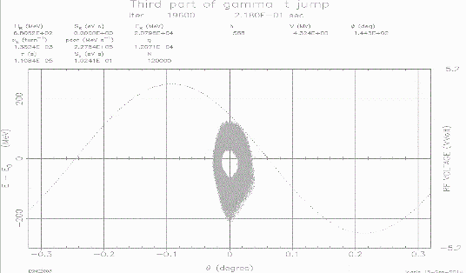
MI transition simulations
Phase space distributions after transition
No Jump
Half Jump
Full Jump

Slide 14
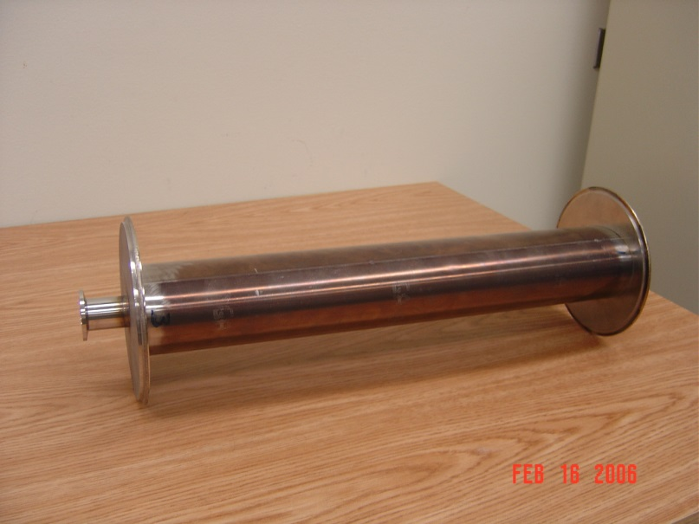
R&D Plan for gamma-t jump
Finalize the design, build and test a gamma-t quadrupole magnet including the Inconel beam pipe.
Estimate about a year for this effort.
Inconel Beam Pipe

Slide 15
Electron Cloud
Recent measurements in MI indicate that beam scrubbing is quite effective in reducing the SEY of the beam pipe so no electron cloud problems are anticipated.
  Beam scrubbing has also been observed in Recycler during slip stacking commissioning.
Electron cloud simulations indicate that a SEY smaller than 1.4 will be sufficient for suppressing the e-cloud in both MI and Recycler.
We have the capability to coat both the MI and the Recycler beam pipe.
  The MI beam coating has to be done in situ.
  The Recycler beam pipe can be replaced.

Slide 16
Electron cloud density vs SEY in MI
7.0E10 ppb
SEY=1.36

Slide 17
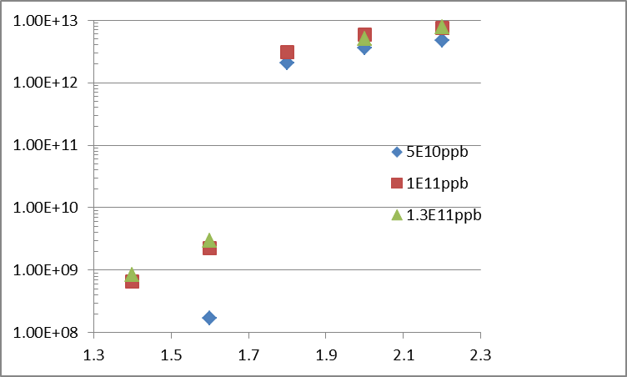

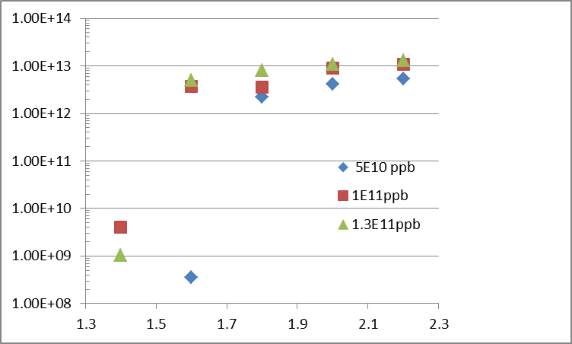
Max e-cloud intensity vs SEY in Recycler
Preliminary
Field Region
Field free region
E-cloud density [m^-3]
SEY
SEY

Slide 18
Beam scrubbing in MI
316L
TiN
Initial
Initial
8.5E10 ppb
8.5E10 ppb
We are currently running with 10E10 ppb

Slide 19
Loss control
Need to understand and control the space charge losses with the higher intensity beam in MI and Recycler.
  In MI the collimators intercept most of these losses.
  We cannot run reliably at 700 KW without Recycler collimators.
  We have developed a plan to install Recycler Collimators.
Realistic simulations(real apertures, magnet multipoles, space charge..) using SYNERGIA are under way.
  Comparing slip stacking in PIP II to current operations.

Slide 20
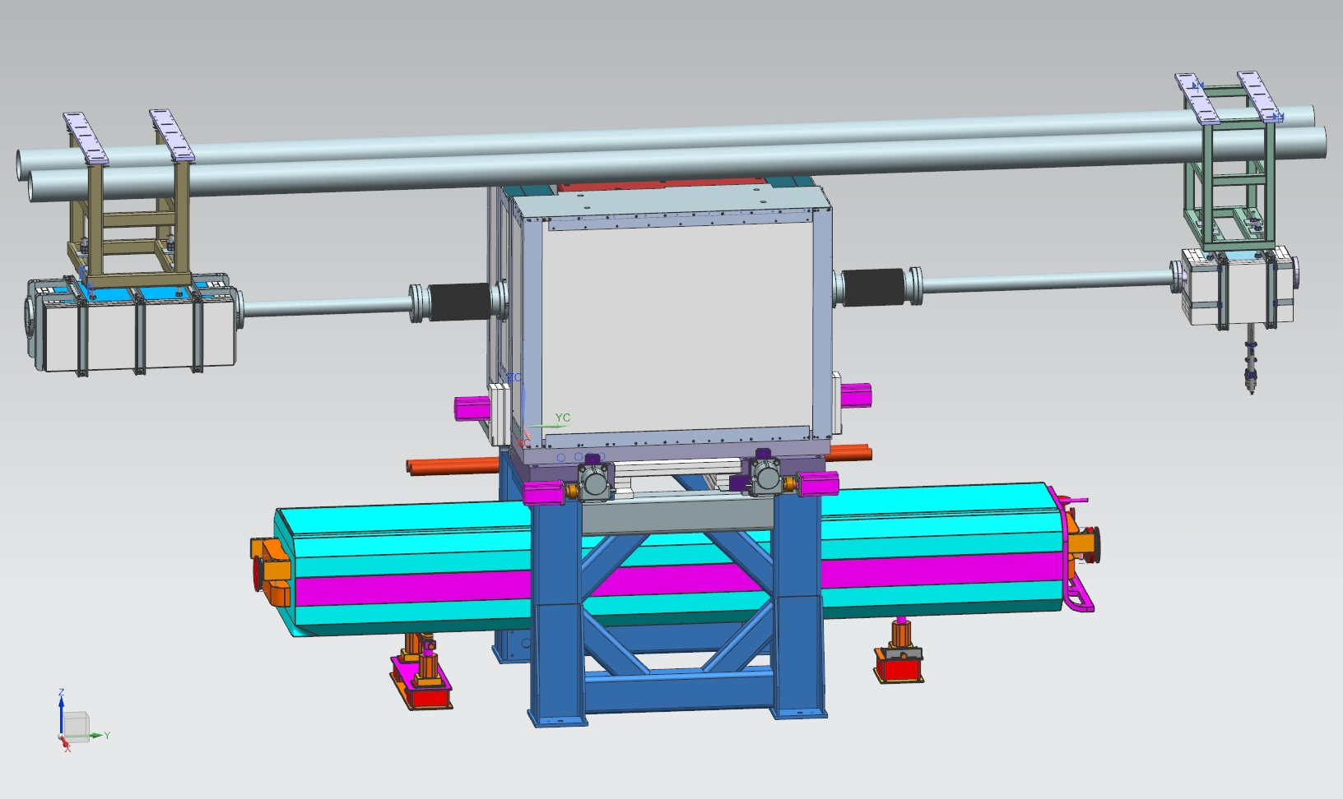
Plan for Recycler loss control
We are going to continue the SYNERGIA multi-particle simulations of slip stacking in the Recycler.
We have finalized the design for a Recycler collimation system (one primary, 4 secondaries) to be installed during the next two summer shutdowns.
  Each of the secondary collimators is designed to handle up to 2 KW of beam loss.
Recycler secondary collimator design
Secondary
Collimator
Primary
Collimator
Mask

Slide 21
Conclusions
We have identified the required MI/RR modifications/upgrades required for running at the PIP-II Intensities.
Loss control in the Recycler will be an issue that we need to address even during the current NOvA running.
  Will continue to perform simulations to understand beam dynamics and losses.
We have developed R&D plans for the major MI/RR upgrades required for PIP II.
  Verify MI Cavity operation with 2 PAs
  Finalize new RR Cavity Design
  Build gamma-t quad prototype.

Slide 22
EXTRA SLIDES

Slide 23
Synergia Simulations of slip stacking
Preliminary

Slide 24
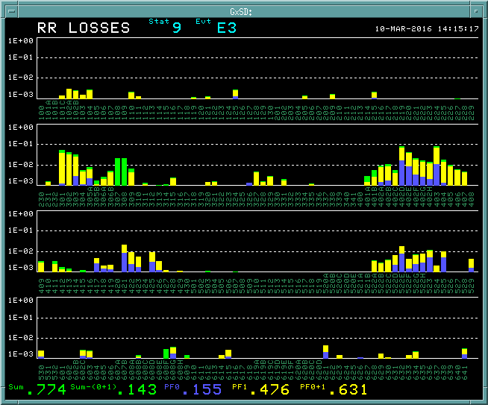
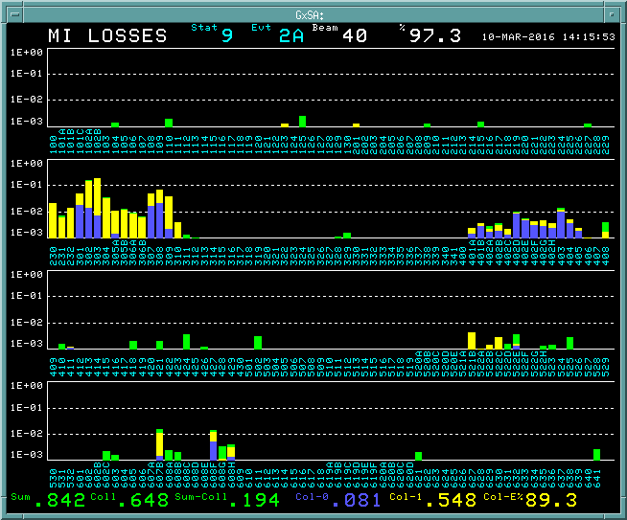
MI and RR losses with 4.2E13 p and 585 KW Beam Power
Recycler Losses (~98% Eff. )
Main Injector Losses (~97%)
MI Collimators

