Slide 1
RFQ Status and Commissioning Plan
James Steimel
PIP-II Machine Advisory Committee Meeting
15-17 March 2016

Slide 2
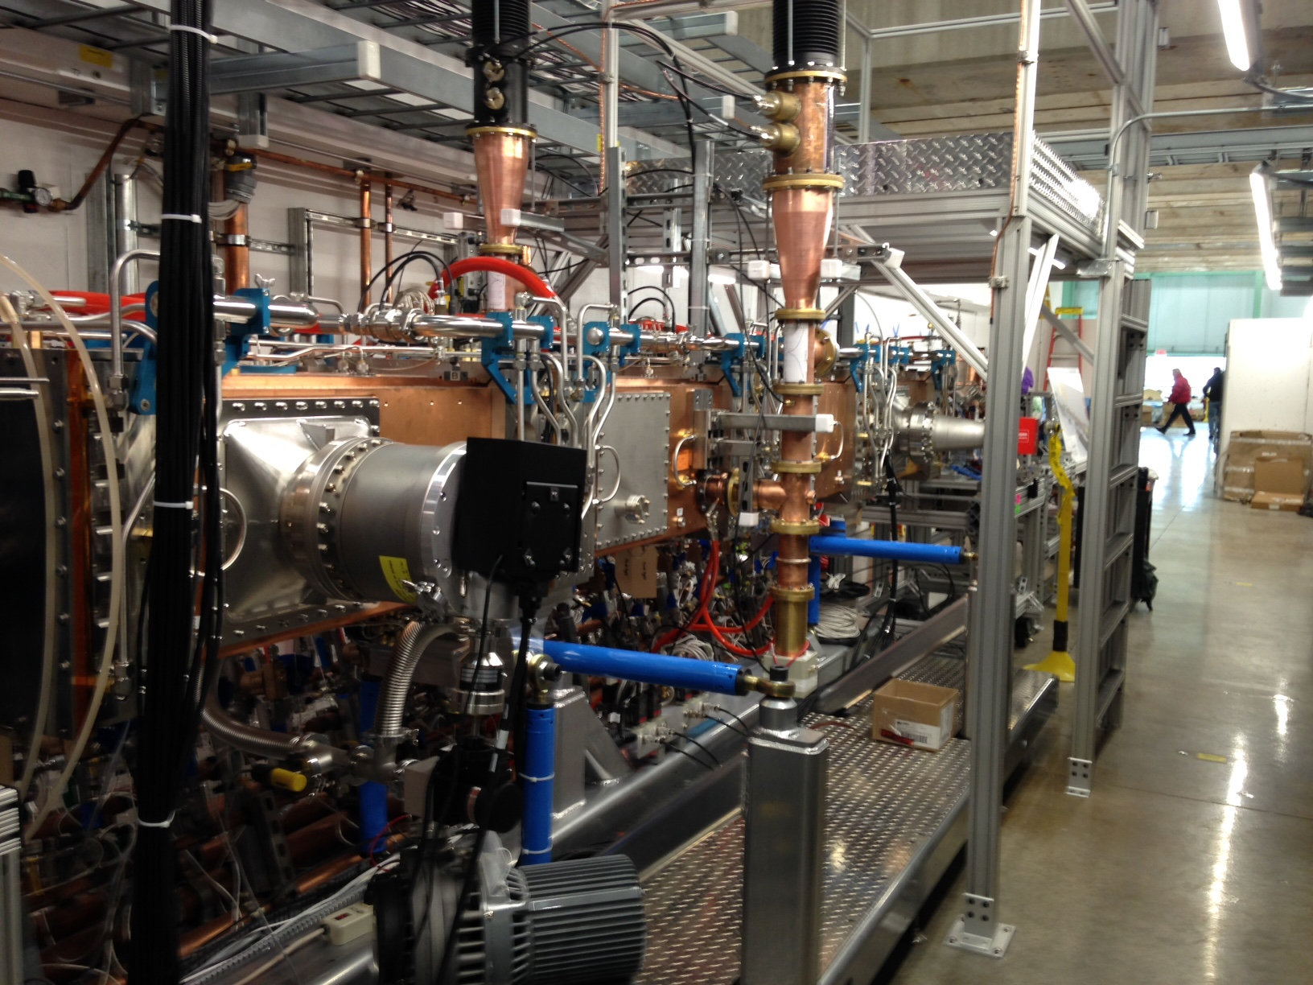
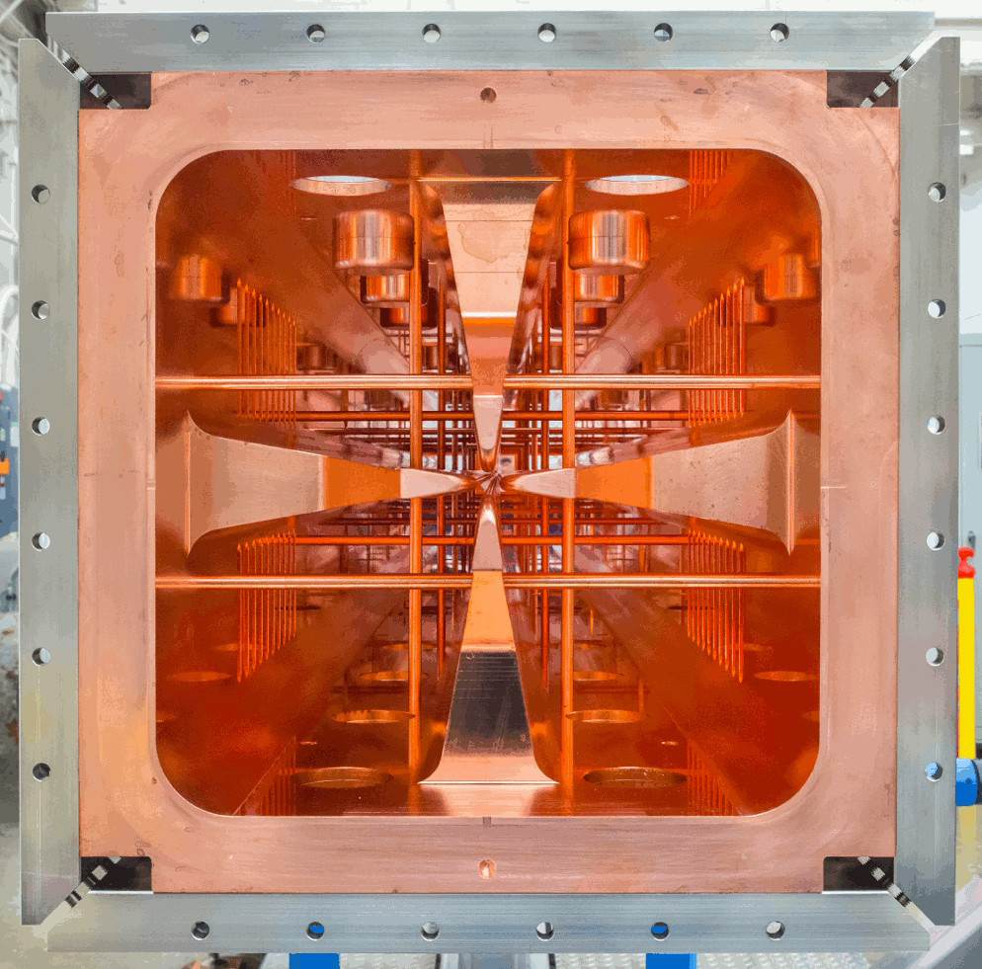
RFQ Installation Status
RFQ Installation is complete.
Two input couplers on hand as of Dec 28, 2016.
Cold pump down better than 10⁻⁸ Torr.
Specifications of resonance control water system verified.
All water, vacuum, RF, and air flow interlocks tested.
RFQ in PXIE Enclosure

Slide 3

Beam Dynamics Requirements
D. Li (LBNL) PXIE RFQ Fabrication Readiness Review 6-26-13
Parameters | PXIE | Unit
Ion Type | H-
Output Energy | 2.1 | MeV
Duty factor | 100 | %
Frequency | 162.5 | MHz
Beam current | 5 (nominal); 1-10 | mA
Transverse Emittance | < 0.25 (norm. rms) | πmm-mrad
Longitudinal Emittance | 0.8-1.0 | keV-nsec
Input energy | 30 | kV
Emittance Growth | < 10 | %
Transmission | > 95 | %
TWISS Parameter αs | Less than 0.2

Slide 4
Design Simulation Results
D. Li (LBNL) PXIE RFQ Fabrication Readiness Review 6-26-13
Simulated beam parameters
Simulated RF and thermal properties
Parameters | Value | Unit
Vane Tip Voltage | 60 | kV
RFQ Length | 4.45 | m
Transmission | 99.8 | %
Transverse Emittance | 0.15 | πmm-mrad
Longitudinal Emittance | 0.70 | keV-nsec
TWISS Parameters α_{x}, α_{y} | 0.187 -0.088
Parameters | PXIE-T | Units
Frequency | 162.493 | MHz
Frequency of dipole mode | 181.99 | MHz
Q factor | 14660
Q factor drop due to everything | -14.7 | %
Power loss per cut-back (In/Out) | 336/392 | watts
Max power loss density at cut-back | 7.9 | W/cm²
Total power loss | 74.6 | kW
H (1/2 of the inner width of the RFQ) | 172.73 | mm

Slide 5
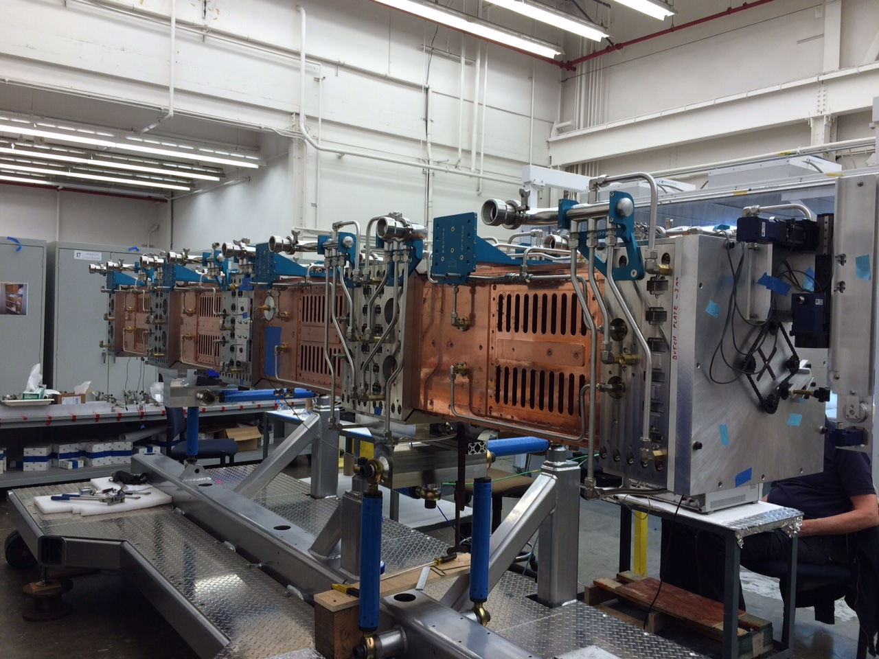
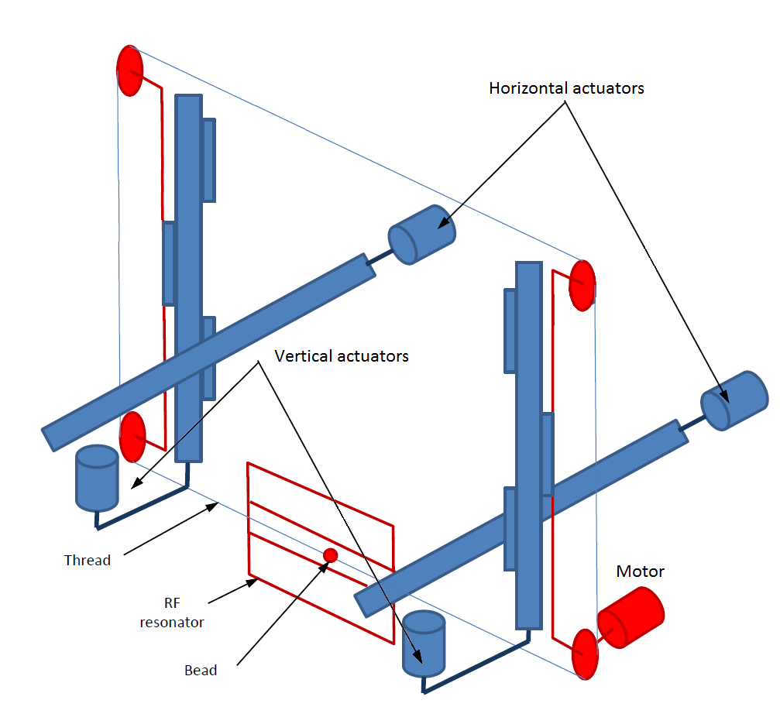
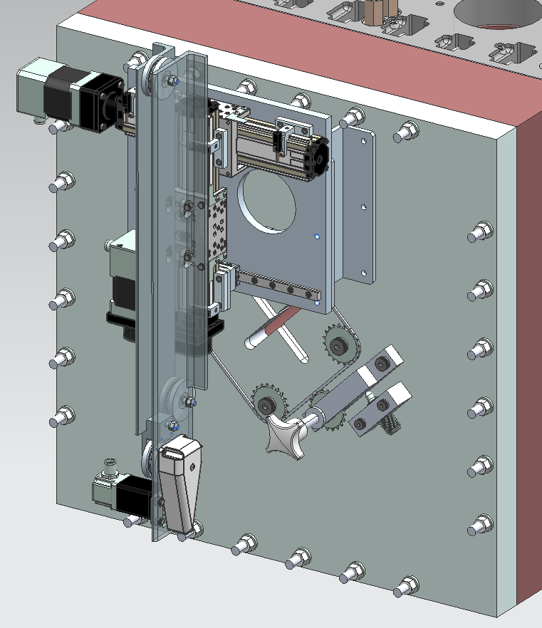
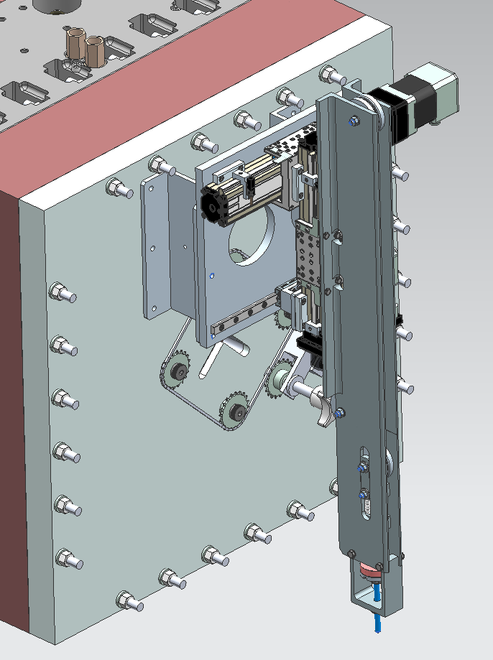
Bead-Pull Setup & Measurement
Horizontal and vertical actuators move the bead pull line between quadrants.
P. Berrutti
Slots in end plates

Slide 6
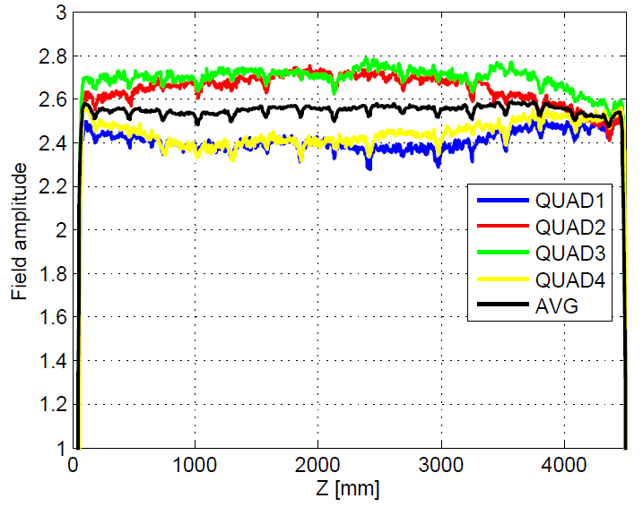
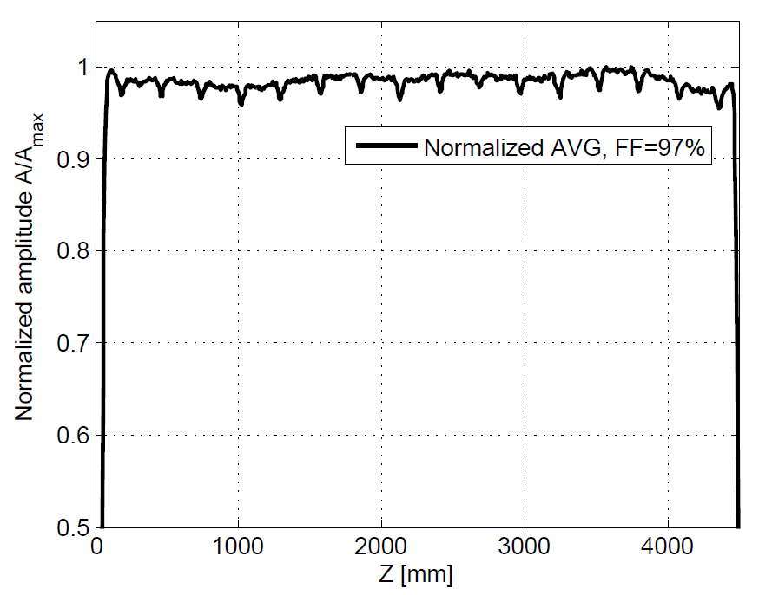
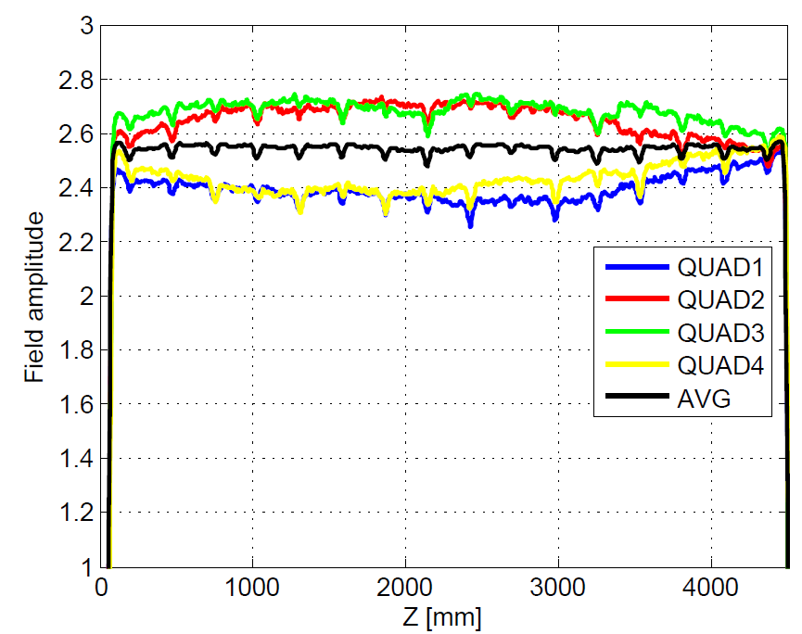
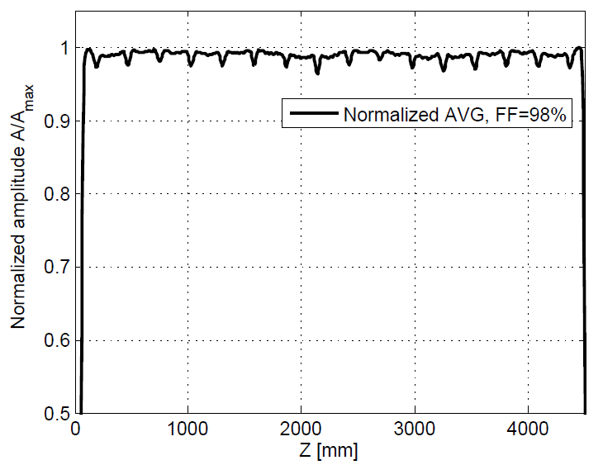
Final Field Flatness Tuning
After frequency tuning: Freq= 162.440 MHz FF=97%
P. Berrutti
After final FF tweak: Freq= 162.443 MHz FF=98%
Asymmetry in quadrant fields due to 1mm horizontal bow in RFQ profile, confirmed by survey.

Slide 7
Field Flatness Measured
Plot at right shows RFQ field flatness with permanent tuners.
This plot shows the average field of the 4 quadrants at 30mm offset from center.
Field flatness still better than 2% over the length of the RFQ.
J. Staples

Slide 8
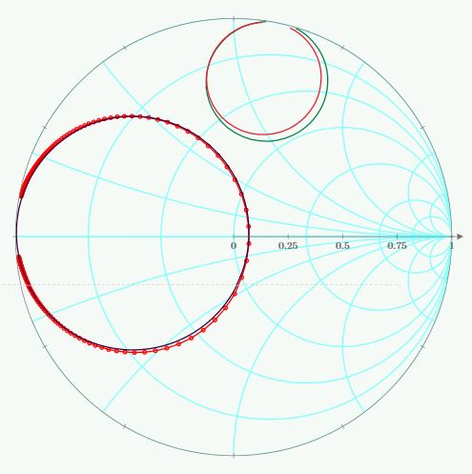
RFQ Coupling Parameters
Plot at right shows Smith Chart of RFQ reflection measurements during coupler tuning.
Small green and red, solid color circles show S11 for each port.
Large circle shows sum mode reflection into RFQ.
We are over-coupled to allow for match at 5mA (r = 1.16).
Q_{L} is about 6100, Q₀ is about 13,180, 90% of the simulated Q₀.

Slide 9
RFQ High Order Modes
Higher order mode measurement performed. Plot shows RFQ response over 50 MHz.
Plot annotations by Gennady Romanov show quadrupole(Q) and dipole(D) modes.
Dipole modes are split due to azimuthal asymmetry of RFQ (bowing).

Slide 10
RFQ Higher Order Modes Cont’d
Measurements are compared to 3D CST Microwave Studio simulations by Gennady Romanov.
Resonant frequencies of higher order modes have been measured and identified by comparison with the simulations. The measured frequencies are consistently slightly lower than simulations predicted, mainly due to terminations at both ends.
Higher order mode frequencies are within expected error of simulations.
G. Romanov
Mode | Simulations | Measurements | Notes
Q0 | 162.5 MHz (at 25 ºC) | 162.46 MHz | First quadrupole mode (operational mode)
Q1 | 165.9 MHz | 165.65 MHz | 2nd quadrupole mode
Q2 | 175.9 MHz | 174.78 MHz | 3rd quadrupole mode
D0 | 181.99 MHz (no terminations) | 180.53 MHz | 1st dipole mode

Slide 11
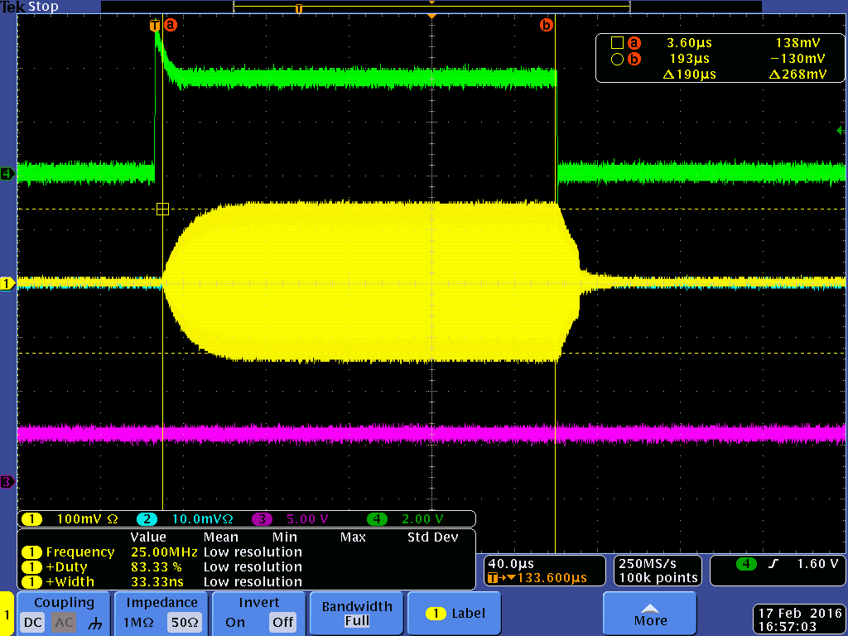
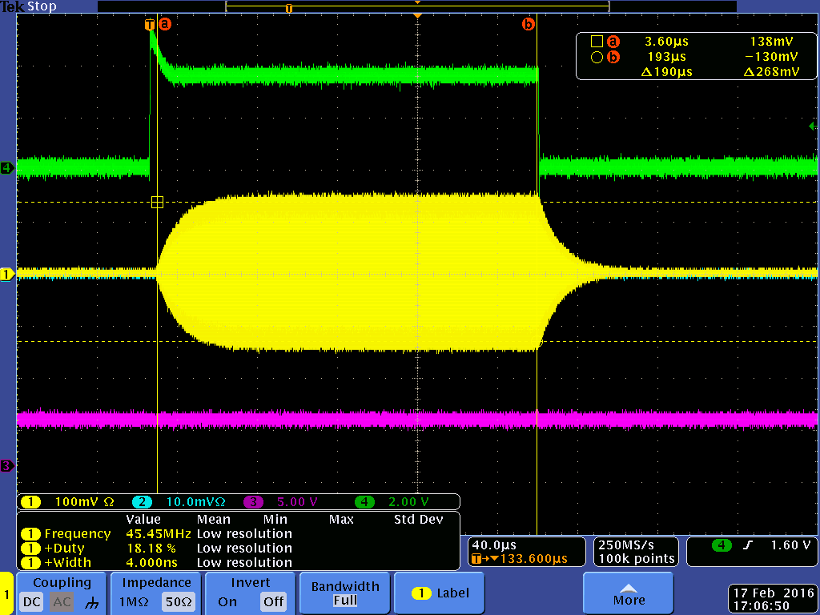
RFQ Input Coupler Conditioning
Plots show start of RFQ conditioning at 30W of input power.
Left plot shows RFQ field probe without bias on input couplers.
Right plot shows RFQ field probe with 1kV bias on input couplers.
Bias voltage mitigates low field multipacting in input couplers but no effect at high field.
We still have brief multipacting at the end of high field decay, but it doesn’t affect operations.

Slide 12
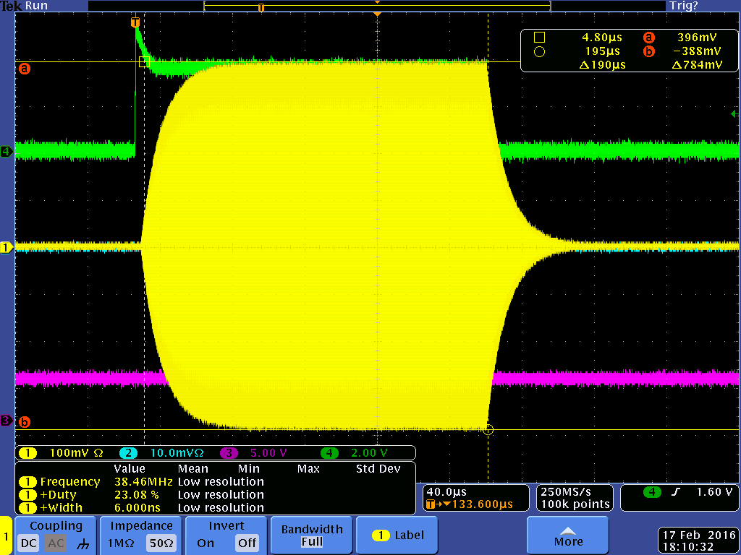
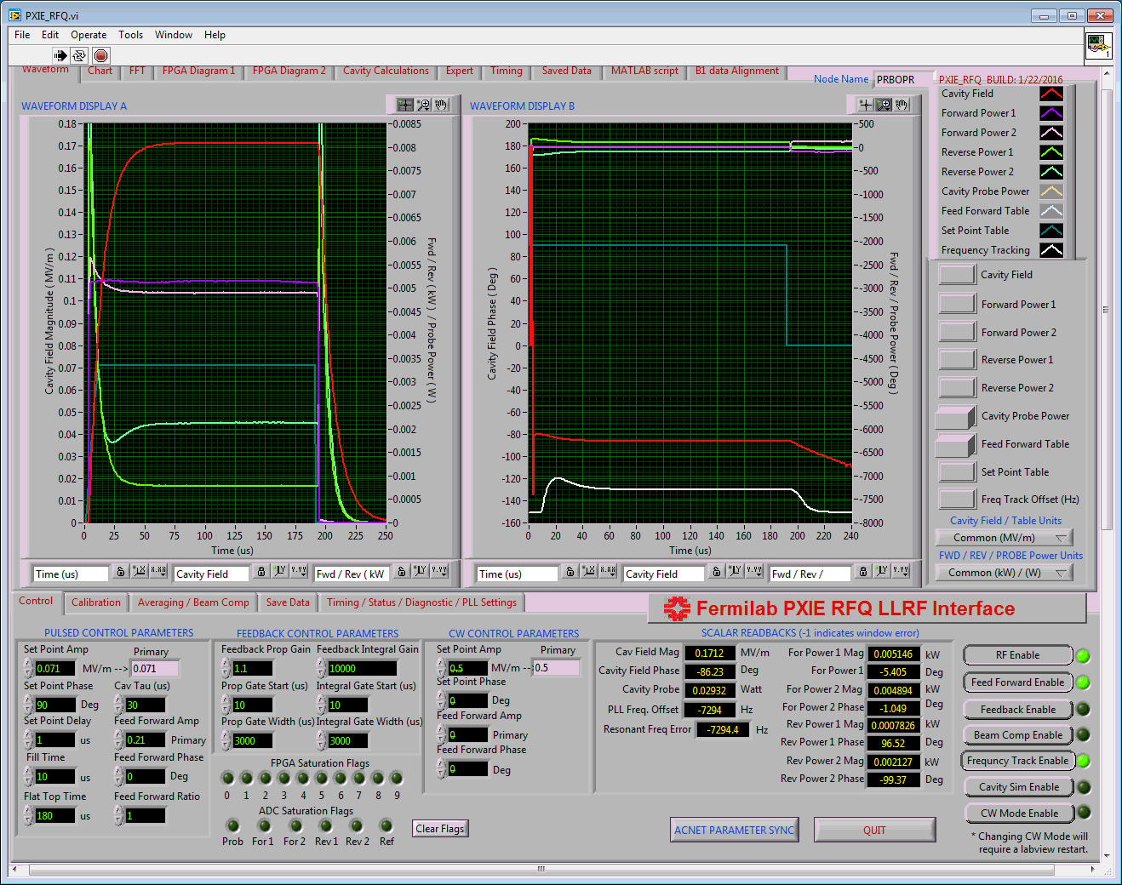
RFQ Conditioning Status
Amplifiers and circulators operating reliably.
LLRF system control and diagnostics are fully operational.
Left plot shows RFQ cavity pickup on scope.
Right illustration shows LLRF system control and diagnostics.

Slide 13
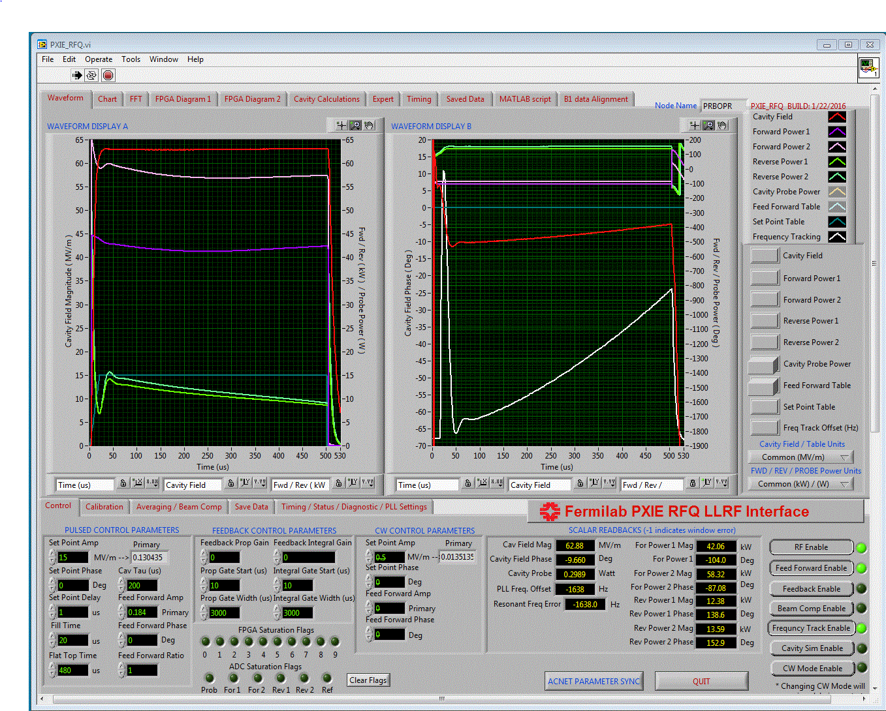
LLRF Commissioning
Forward and reflected power readings are calibrated to earlier NWA measurements.
Cavity field scaling was set for 80kW input to 60kV (not MV/m), but this did not take into account lower Q0 and higher input coupler beta.
Frequency tracking is being commissioned; white plot shows change in output frequency over pulse.

Slide 14
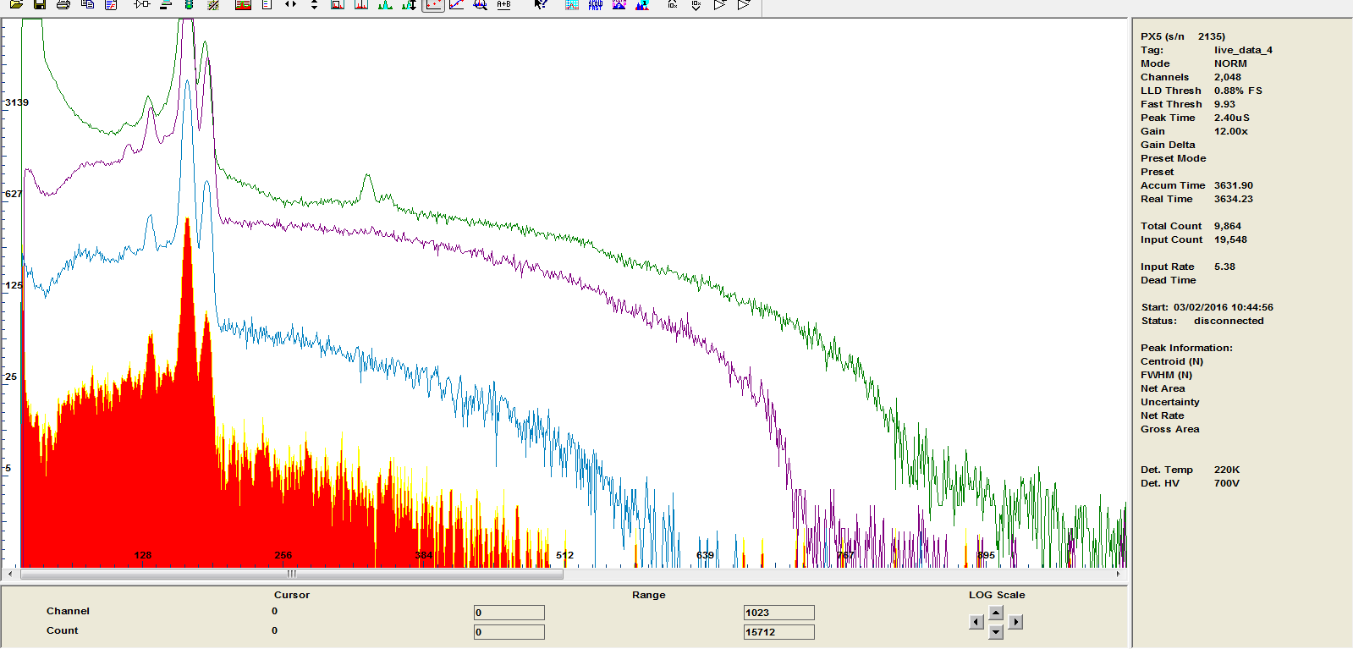
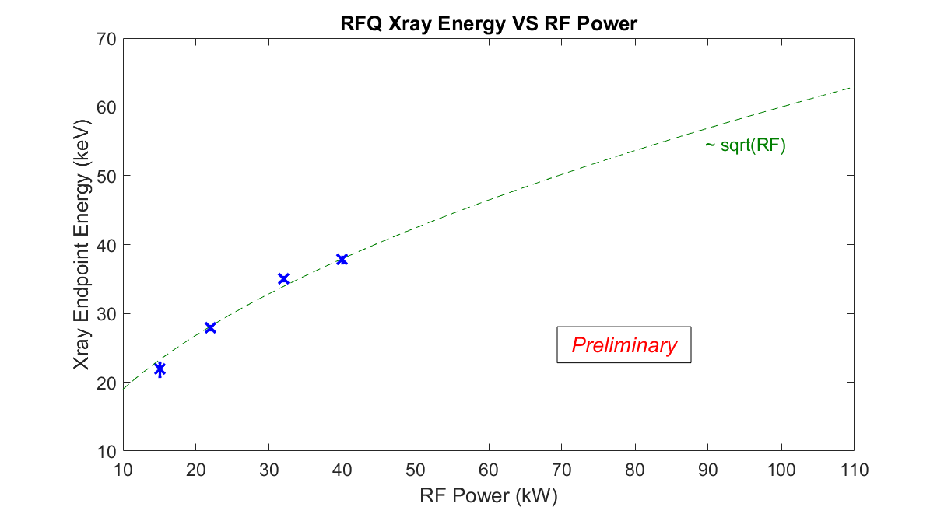
X-ray Spectrum Measurements
Vic Scarpine performed x-ray spectrum measurements in the RFQ vacuum chamber.
The upper plot shows the x-ray spectra histogram for different input power settings.
X-ray power saturates instrument at higher power levels.
Shunt impedance measured ~19kΩ, about 95kW for 60kV, within 10% of derived impedance.
22 kW
40 kW
15 kW
32 kW

Slide 15
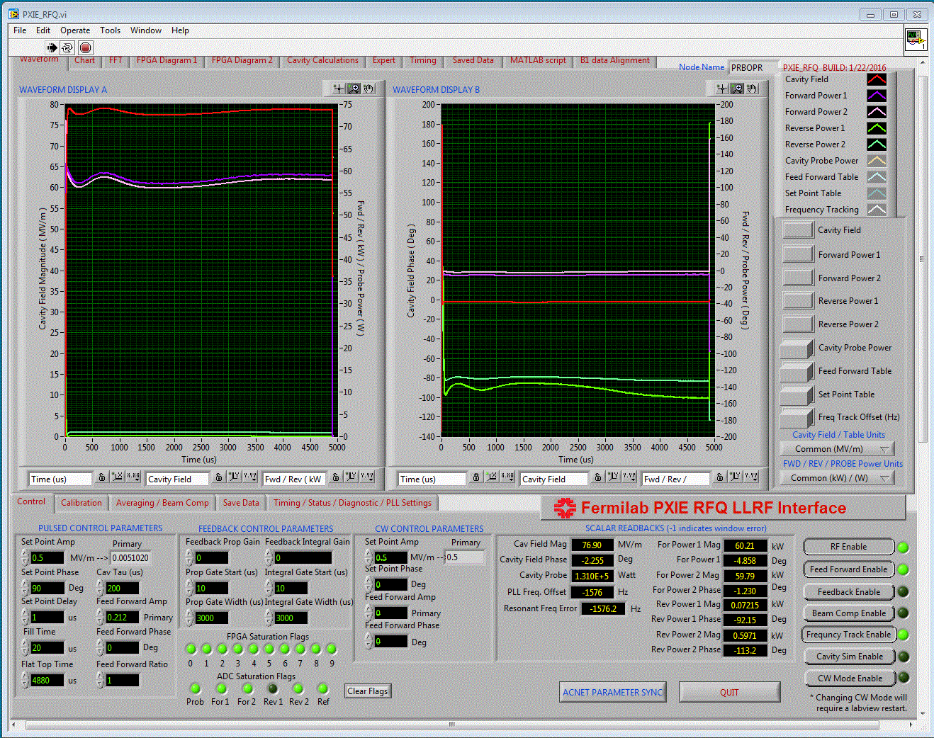
Final Pulsed Power Conditioning
RFQ successfully conditioned with 120kW input power and 5% duty cycle.
Taking into account measured Q0 and beta, estimate vane potential at 66kV (10% above specified).
X-ray measurements around RFQ during operation were at or below background. Enclosure work can commence while operating RFQ.

Slide 16
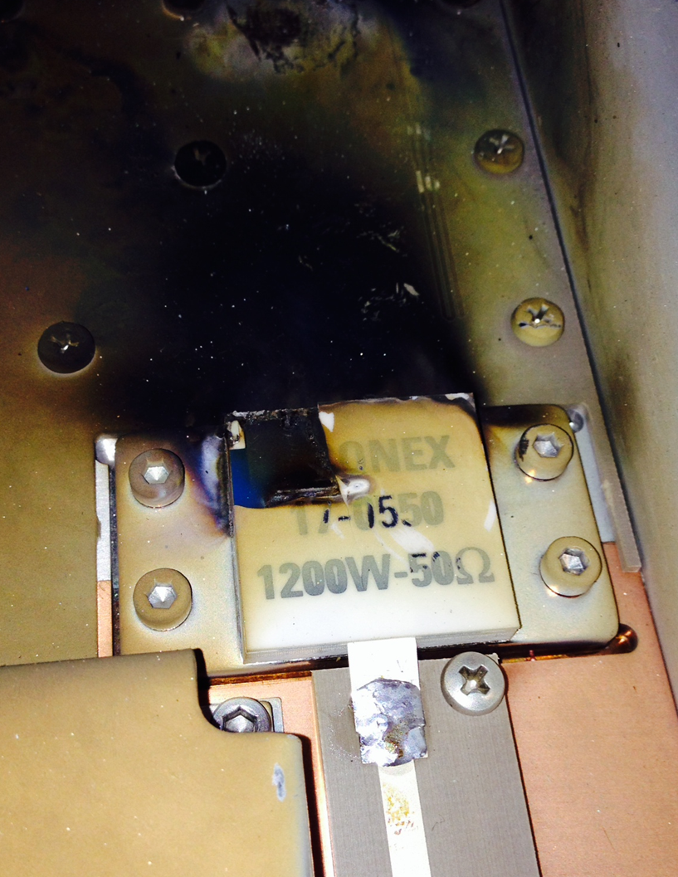
RFQ Power Amplifier
Catastrophic failure of an amplifier slice during CW operation. Believed to be due to high, internal reflected power.
Failure mode still not understood, and we lack sufficient spares to study.
Spare components are ordered and delivery is scheduled for May 2016.
Amplifiers were tested over a week at 60kW output, 20 Hz, 10% duty cycle without failure.

Slide 17
RFQ beam commissioning
Transmission (expectation >95%)
  Identical toroids upstream and downstream of RFQ
Energy: Time-of-flight (movable BPM)
Transverse: scrapers, quad scans, later Allison scanner
Longitudinal: Fast Faraday Cup, buncher cavity scans
CW (or high-duty) beam
  Optics and beam loading effects will be measured with pulsed beam, but CW test is highly desirable at early stage
    Get experience manipulating high-power beam
      MPS, scraping
    Commissioning sub-systems (LLRF, Instrumentation, Controls) in CW mode
    Examine possible effects of residual ions accumulation

Slide 18
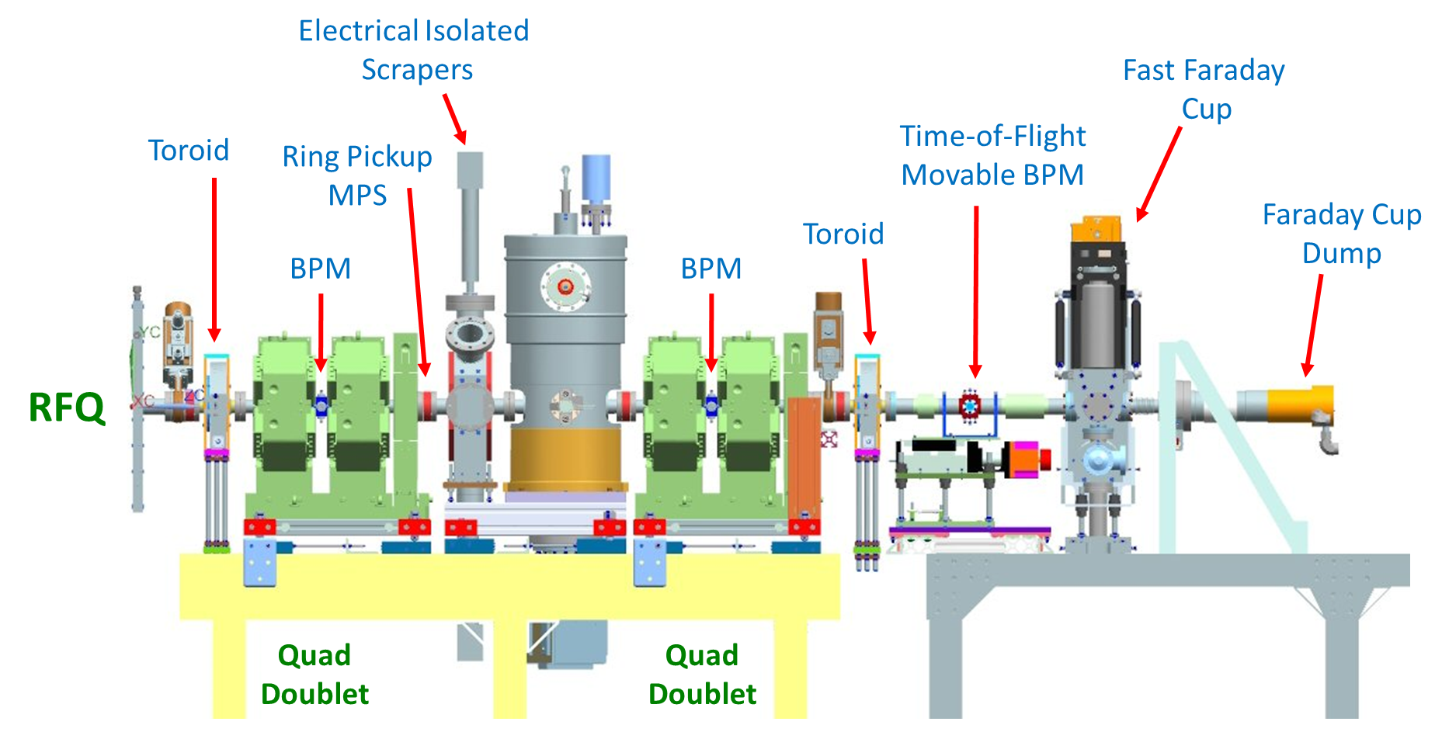
RFQ Beam Commissioning Line - Short MEBT 1 (April 2016)
Plan to start RFQ beam commissioning with front MEBT section fully assembled, including prototype magnets and cavity
Pulsed mode only (<300W average power)
Measurement of beam energy, RFQ transmission, bunch length
Commission prototype buncher cavity.
3D model of MEBT 1, C. Baffes, S. Oplt.

Slide 19
RFQ Beam Commissioning Line - MEBT 1 (Summer of 2016)
First measurements of beam emittance, Twiss functions
Commission MEBT emittance scanner to compare with measurements by slits/scrapers
First high – power tests
Use HINS beam dump (from SNS)
Final MEBT-1 configuration (CW - capable)

Slide 20
RFQ Commissioning Schedule (2015-2016)
Here is the estimated completion time of major milestones in the RFQ commissioning process.

