Slide 1
PIP-II R&D Program
PXIE Ion source and LEBT
Lionel Prost
PIP-II Machine Advisory Committee Meeting
15-17 March 2016

Slide 2
Outline
Performance requirements
  Conceptual design
Status
  Additions/changes since P2MAC 2015
  Operation highlights
  Dipole bending magnet status
Summary & Plan

Slide 3
Performance requirements
Ion Source (IS) capable of delivering 10 mA (5 mA, nominal) DC, H⁻ at 30 keV to the Low Energy Beam Transport section
Low Energy Beam Transport (LEBT) capable of creating pulses over a wide range of duty factors via a chopper
  Prevents beam propagation downstream when fault condition is identified (Machine Protection)
  Includes beam current diagnostics
Kinetic energy stability | 0.5% rms
Beam current stability [for frequencies > 1 Hz (ripples)] | ±5%
Output transverse emittance over 1-5 mA current range | < 0.18 mm mrad
Single pulse flat top | 1 μsec - DC
Maximum pulse frequency | 60 Hz

Slide 4
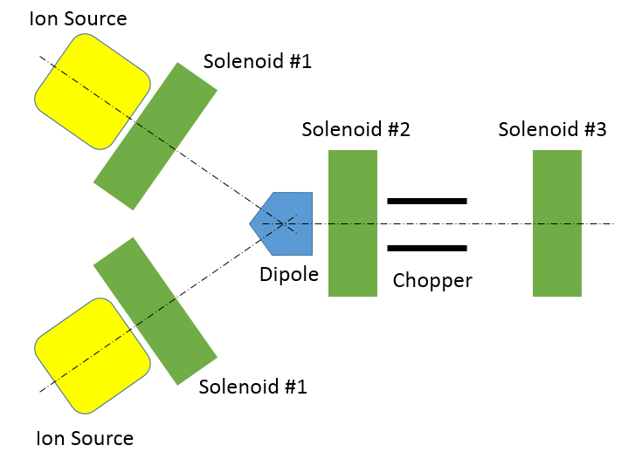
Ion source & LEBT PIP-II conceptual design
Two ion sources
  Maximize beam availability
  Repair/service/install one without interrupting operation of the other
Good vacuum near
RFQ to help achieve
high reliability
  Chopping ‘far’ from RFQ
  No direct line of sight from
  the IS to RFQ
RFQ

Slide 5
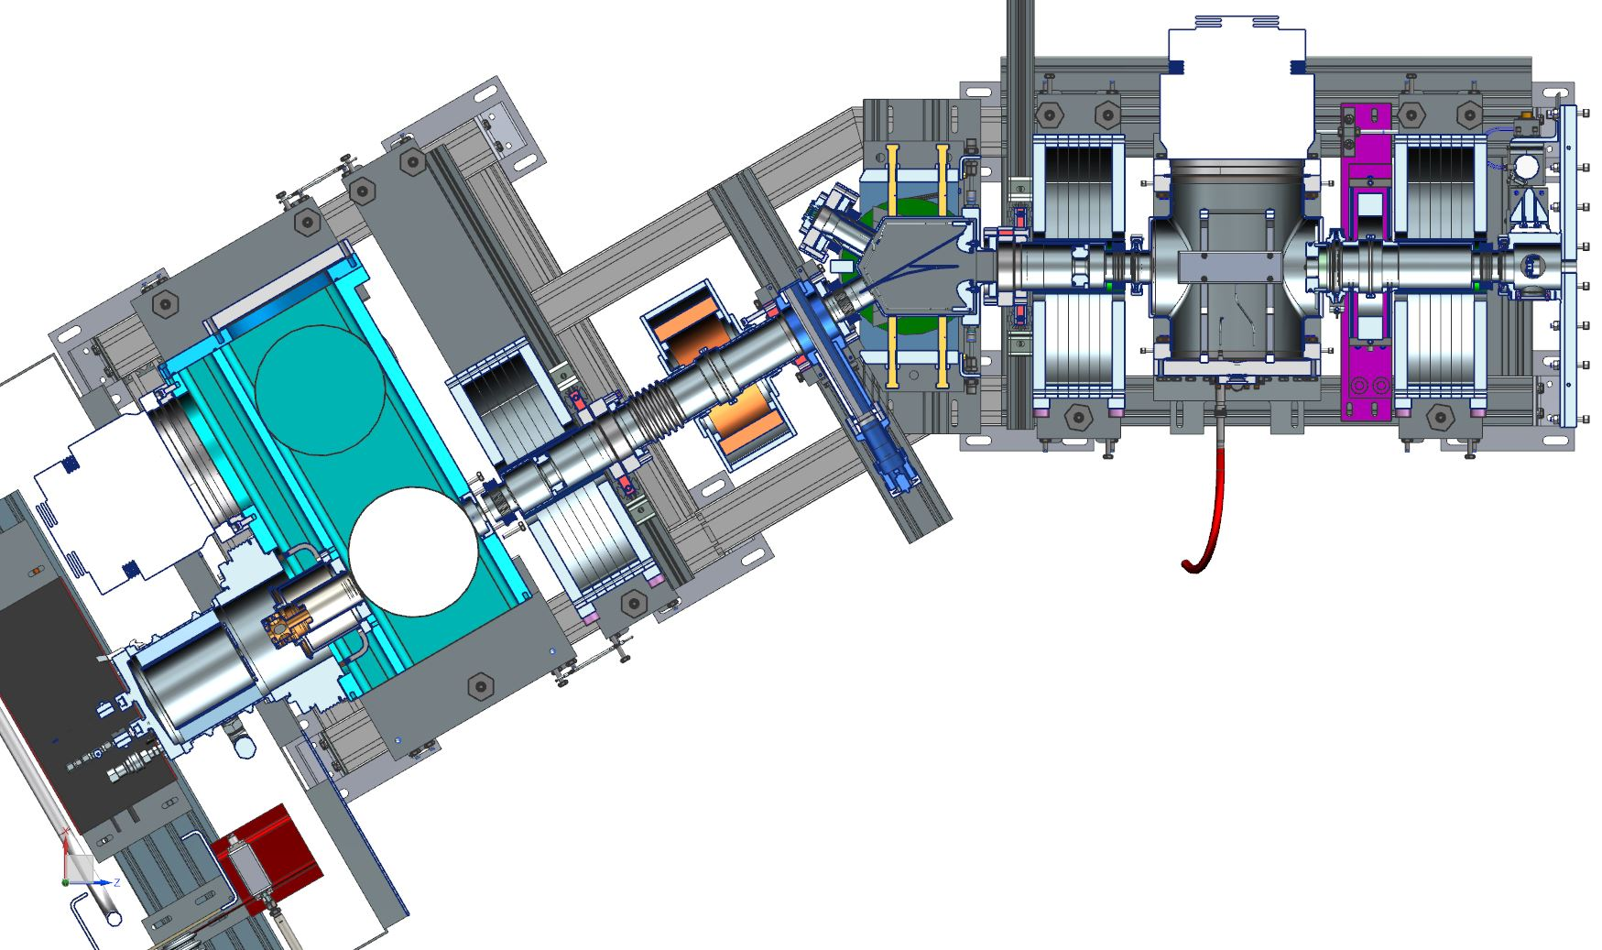
PXIE Ion Source and LEBT
Commercial ion source
  D-Pace, Inc.
3 solenoids
Bending dipole
  Part of Personnel Protection
  System
Diagnostics
  Beam
  current monitors
  Emittance scanner
Electrostatic chopper
  One of the kicker plates is the beam absorber
Current transformer
Gate valve
T. Hamerla
DCCT
Chopper
Ion Source
Port for
emittance scanner
Solenoids
Possibility of partially un-neutralized transport
  Main scheme
Possibility of scraping the beam at various locations

Slide 6
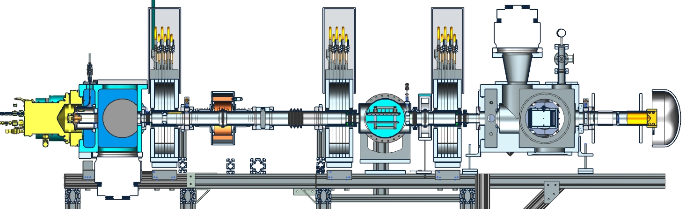
P2MAC 2015 status
Demonstrated up to 10 mA, DC and pulse
  1-60 Hz pulses
Twiss parameters close to those needed for the RFQ
  Solutions for both maximum neutralization and partial neutralization transport schemes
  Stabilization loops to deal with source variability
    IS arc current stabilization, beam current regulation loop
Vacuum valve
Toroid
Faraday cup
Ion Source
Emittance scanner
DCCT
Chopper

Slide 7
Since P2MAC 2015…
Continued beam measurements and analyses
  Focused on readiness for RFQ commissioning
  Beam profiles/sizes, phase space, neutralization
  Moved emittance scanner to the IS vacuum box
    Permanent location
  Comparisons with simulations
Installed LEBT “scraper”
  Water-cooled, electrically-isolated copper paddle
  with 2 round apertures and a D-shaped aperture
T. Hamerla
Bending dipole magnet (and vacuum chamber)
designed and under fabrication
Shutdown for RFQ installation
  IS cleaning/maintenance

Slide 8
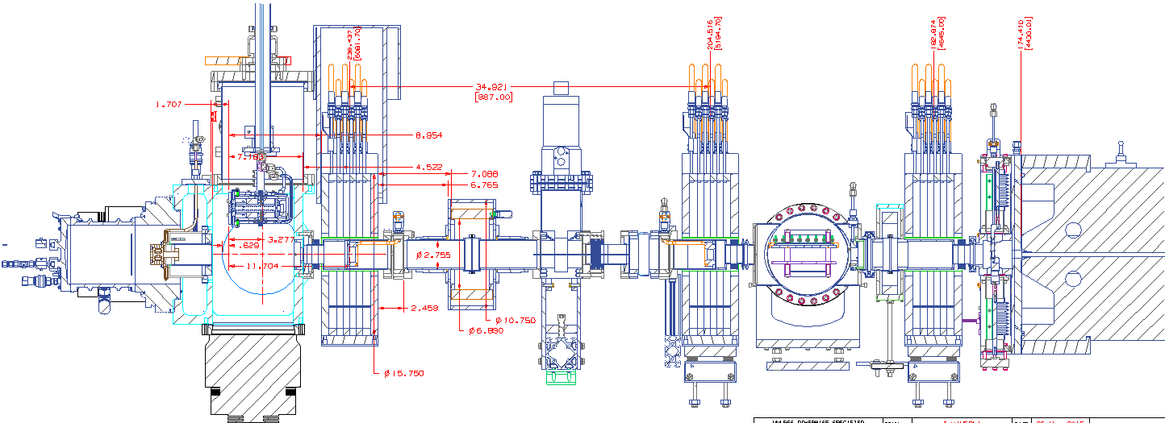
Current beam line configuration
All components except for the bending dipole magnet have been installed and commissioned
  Beam stop will be removed when installing the dipole
Added components since last P2MAC
Emittance scanner
Beam stop
Toroid
LEBT scraper assembly
Collimator
Vacuum valve
Ion Source
DCCT
RFQ
Chopper
T. Hamerla
Solenoid #1
Solenoid #2
Solenoid #3

Slide 9
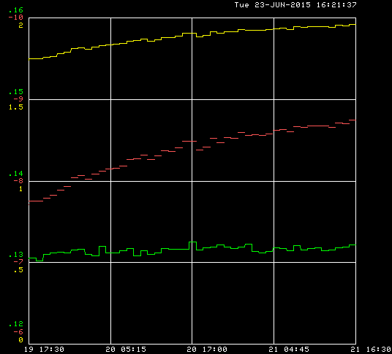
Operation readiness for RFQ commissioning
Two complications with direct consequences on operation
  Near term/temporary: MEBT diagnostics will not be quite ready when starting to
  commission with beam
  ⇨ LEBT diagnostics as the
  primary input to MPS
  Long term: The beam
  parameters have shown
  slow variations over the
  course of several hours
  of operation and from
  day-to-day
Evolution of the Twiss parameters and emittance at the exit of the ion source during a “long run”
β
0.01 mm mrad/div
1 unit/div
0.5 m/div
α
Normalized emittance (rms)
Envelope variations at the entrance of the RFQ
47 hours

Slide 10
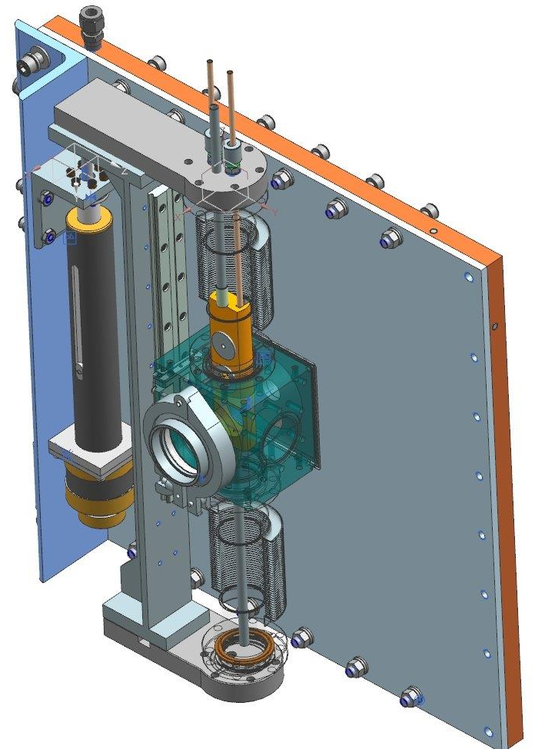
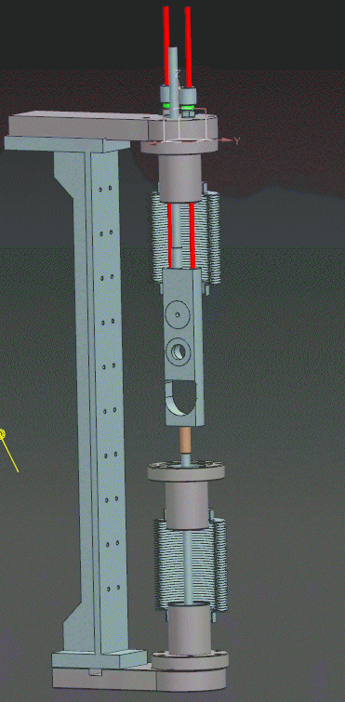
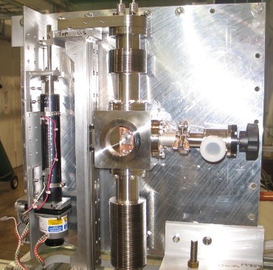
LEBT scraper functions
Large round aperture
  Protects RFQ vanes
  Beam size stabilization
  Machine Protection
  System input
LEBT/RFQ Interface flange
T. Hamerla
Pencil beam aperture
T. Hamerla, R. Andrews, D. Snee
‘Regular’ aperture
Small round aperture
  Pencil beam
D-shaped aperture
  Beam size
  measurements
  Max transmission
D-shaped aperture

Slide 11
LEBT scraper in use
Use LEBT scraper current read back to monitor
possible variations of the beam condition & structure
  Beam envelope stabilization
    Regulate solenoid #3 current to keep beam
    loss on the scraper constant
    ⇨ Constant beam size
      ‘Large’ round aperture has been sized
      to let the beam with the proper Twiss
      functions go through with <1% loss on
      the scraper
  Machine Protection System
    Set limits on LEBT scraper losses signal’s
    pulse width and amplitude
      Beam deflected onto the absorber upstream of Solenoid #3 when pulse violates limits
LEBT scraper aperture
outmost particle
2σ beam envelope
RFQ vanes
I_{scraper}

Slide 12
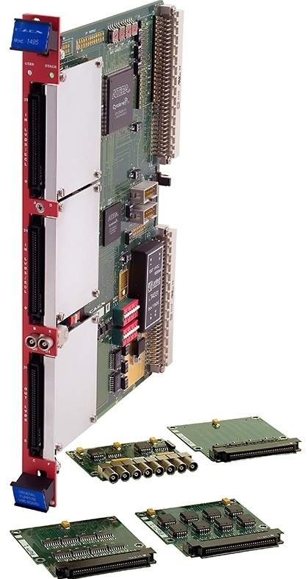
MPS Configuration to-date
Primary beam inhibit – LEBT Chopper (~ 150 ns delay + 110 ns rise time + propagation)
Secondary beam inhibit – IS HV bias supply
125 MHz digitizer - 30 MHz carrier output( arbitrary) monitors scraper beam loss and beam pulse width thresholds to drive Permit line to LEBT chopper
General purpose FPGA Board
  64 inputs expandable to 162
  32 outputs
  405 MHz max for registered logic
A. Warner

Slide 13
IS phase space measurements and beam steering
Beam phase space measurements at
the exit of the ion source
  Up-to-date beam parameter inputs for simulations
Position and angle bumps at the LEBT scraper
= 4.2 mm
ε_{rms} = 0.12 mm mrad
1% cut above background
mrad
3.7 mA in DCCT
DC
J-P. Carneiro, B. Hanna
AllisonScan-2015-07-13_14-57
  “Correctors in solenoidal field” model
  for calibration
  Accuracy:
    ~5% for position
    ~10% for angle
  Tuning with RFQ
    Center the beam in LEBT scraper hole, then change the angle without changing the position to maximize transmission
mm
Within measurements errors

Slide 14
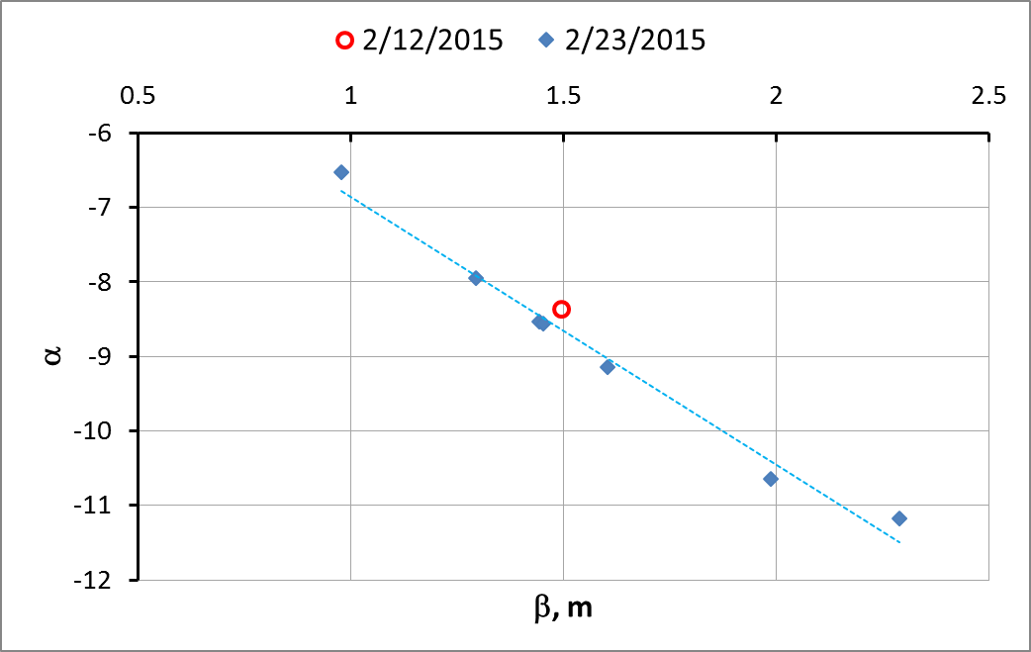
Phase space measurements at the end of the beam line
Solenoid #3 scans
  Multiple data sets
    Partially un-neutralized transport is the main scheme
  Beam envelope stabilization ‘proof-of-principle’
5.5 mA, 1.5 ms IS pulse, chopped down to 50 μs, 60 Hz
Same settings but initially different Twiss parameters ⇨ a few amps adjustment on Solenoid #3 to correct
ΔI_{Sol3} = 8 A
Same focusing settings for all data points
Initial measurement

Slide 15
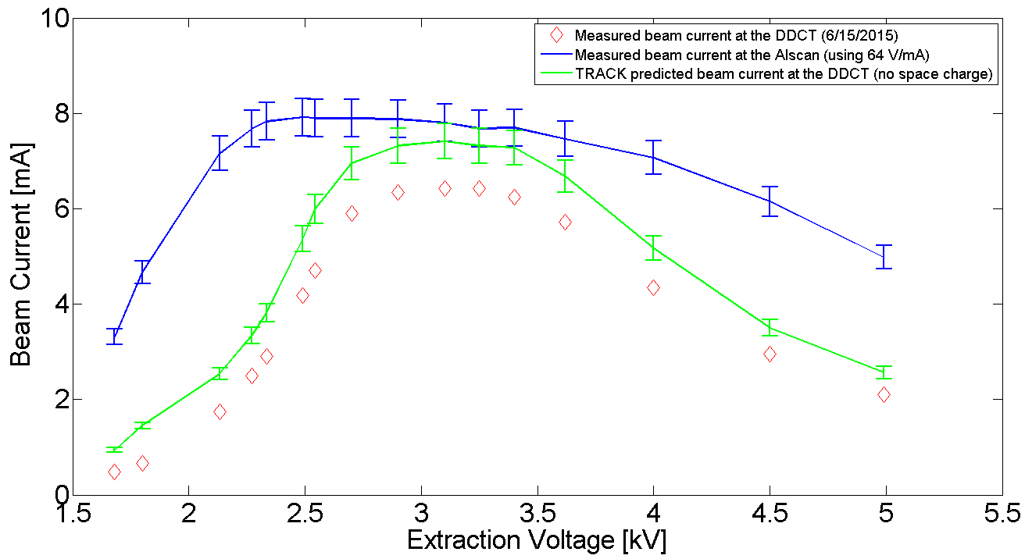
Beam transmission through 1st solenoid
Based on phase space integrals, for nominal IS settings and 5 mA measured by the DCCT, ~30% of the beam is lost at the IS vacuum chamber exit aperture
  PIC simulations that include the beam line aperture profile show fairly good agreement
Modified beam line design
to move this uncontrolled
loss to EID #1
  Allows measuring the
  amount of beam being
  scraped off
  Possibility to change EID #1 aperture
  Installation of the modified beam line at the same time as a dipole magnet
J-P. Carneiro
Beam current vs. Extraction voltage

Slide 16
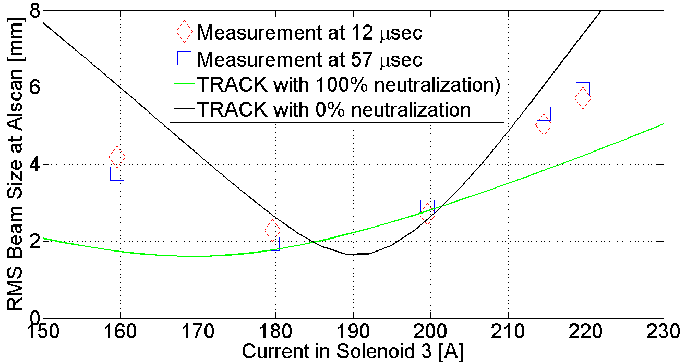
Comparison with PIC simulations
Agreement between measurements and simulations depends mostly on the assumption of the neutralization pattern
  Dedicated measurements indicate 70-80% neutralization upstream of the chopper
    No good measurement downstream + it will be different with the RFQ (i.e. no potential well due to diagnostics)
Solenoid #3 scan, 50 μs chopped beam, 5.5 mA
Envelope simulation for 5 mA. Initial conditions obtained from phase space measurements at the exit of the IS.
cm
J-P. Carneiro

Slide 17
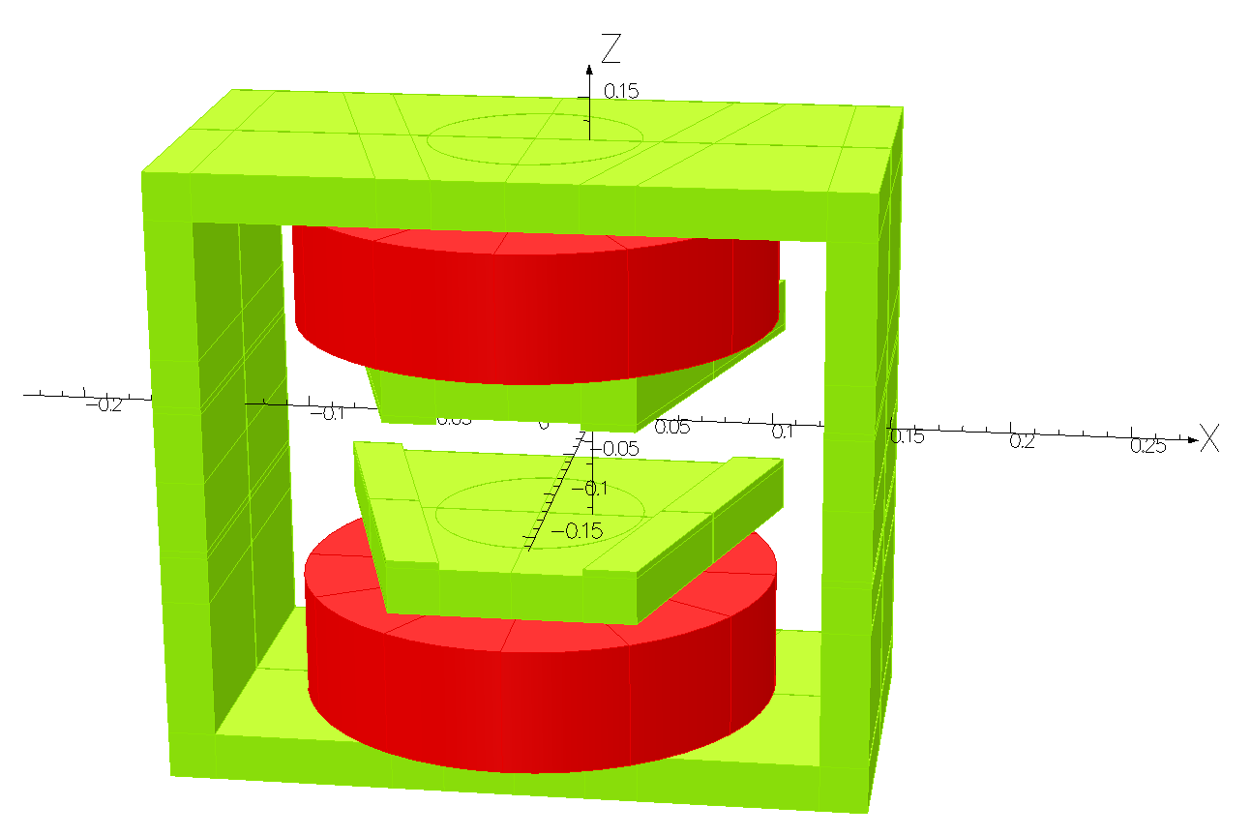
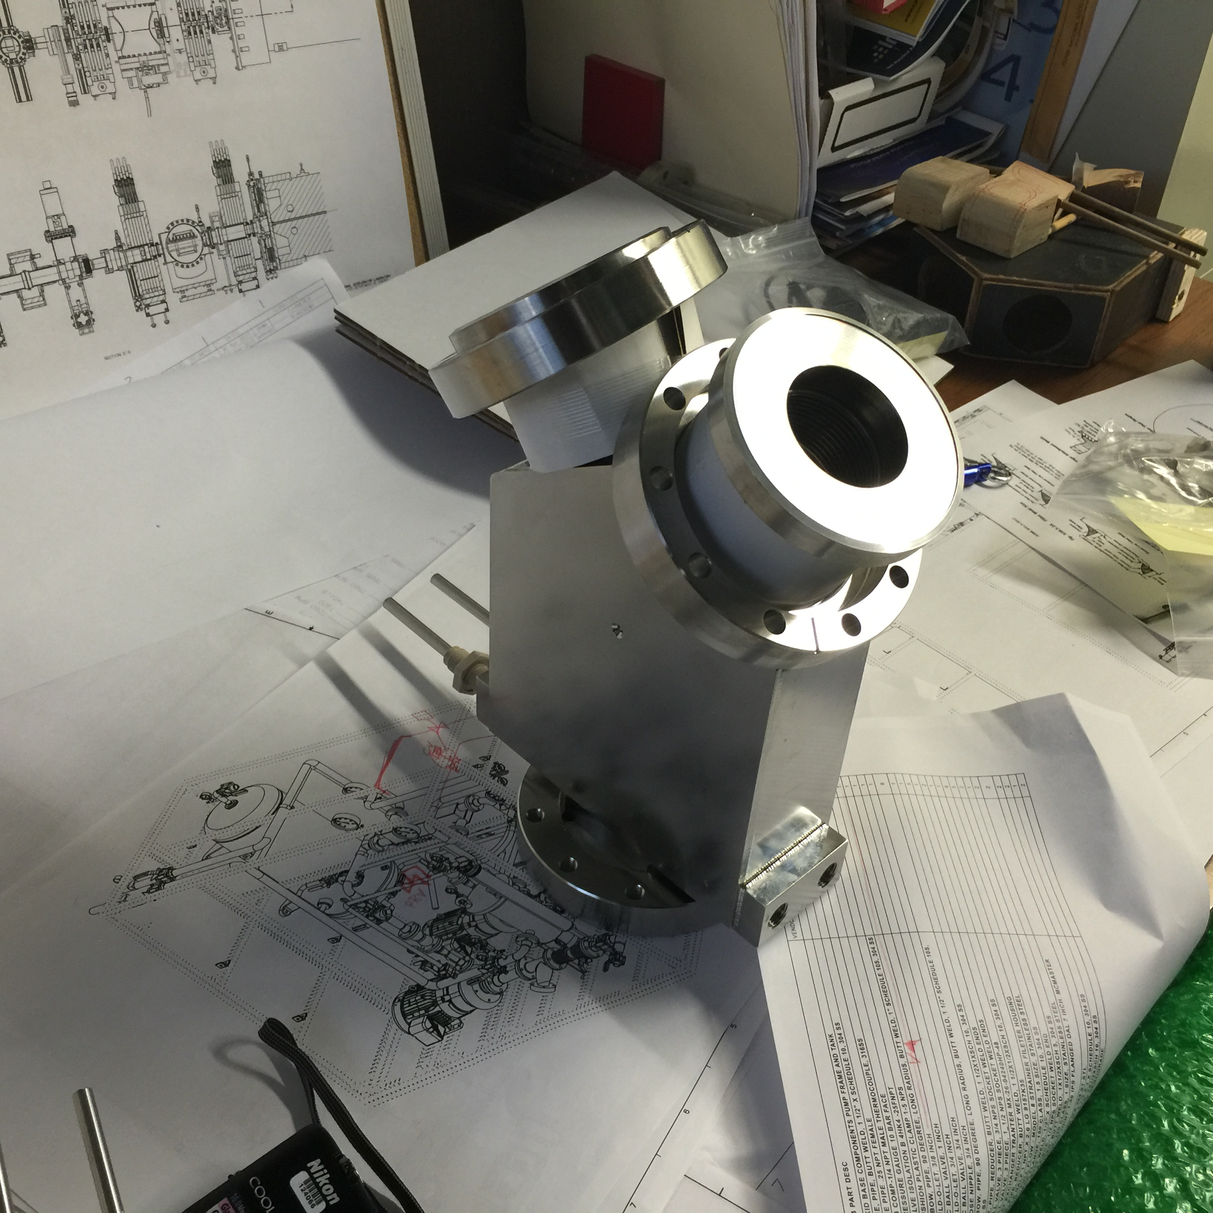
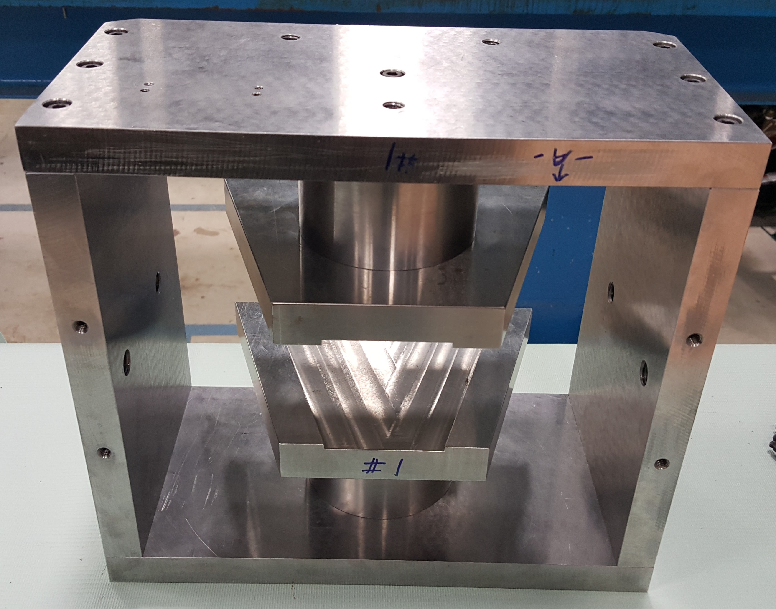
Bending dipole magnet and vacuum chamber
Designs completed in Fall 2015
  Dipole magnet:
    Air cooled
    Removable pole tips
  Vacuum chamber:
    Water-cooled, electrically- isolated beam
    absorbers
Construction close to completion
  Magnet built by Technical Division
V. Kashikhin
W. Robotham
S. Krave
T. Hamerla
R. Andrews
D. Snee

Slide 18
LEBT performance summary
Up to 10 mA, DC and pulsed (up to 60 Hz)
  Low uncontrolled beam loss (<2%) beyond IS vacuum chamber exit aperture
    IS vacuum chamber aperture restriction to be corrected
Uninterrupted operation for > 48 hours
  Average filament lifetime > 300 hours (max up to 800 hours)
Twiss parameters appropriate for RFQ commissioning
  Drift of the beam Twiss parameters corrected via adjustments to Solenoid #3 current (automated)
    Beam lost on the LEBT scraper as a diagnostic of the beam size variations
Optics solutions for different transport schemes (see backup slides) at 5 mA
  Measured emittance within specs

Slide 19
LEBT performance summary (cont’)
Accurate beam steering at the entrance of the RFQ
  Position & angle
Machine Protection Scheme under development
  Beam loss on LEBT scraper as the main input for unexpected changes to the beam conditions
    Timing and amplitude
  LEBT kicker for fast response
    Secondary action: turn off IS HV
      To be complemented with turning off the IS modulator in the future
  More diagnostics at the exit of the RFQ will be included
    Ring pickup
    Expected to become the primary input

Slide 20
Plan
Support RFQ (and MEBT) commissioning
  Safe start with ‘pencil beam’ first, 20 μs max. pulse length
    Ensures that there are always beam losses on the LEBT scraper whatever the focusing solution is
      Pulse length limit protection using the LEBT scraper signal
  Switch to normal aperture and beam size regulation
    MPS primary signal from MEBT diagnostics as soon as ready
    Tune beam line
Complete dipole construction
  Measure magnetic field
    Compare with model ⇨ Possibly modify pole tips/shimming
  Installation this summer
    Assumes that the beam coming out of the RFQ is sufficiently characterized

Slide 21
Additional slides

Slide 22
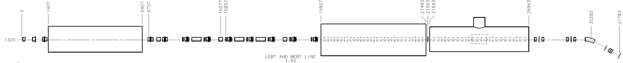
Proton Improvement Plan II Injector Experiment (PXIE)
PIP-II is designed as a CW linac, operated initially in pulsed mode
PXIE is part of the R&D program, which addresses the risks associated with the front-end of PIP-II
  Nominal regime is CW
    Needs to work in pulsed mode for commissioning and for Booster injection scheme
30 keV
2.1 MeV
10 MeV
25 MeV
LEBT
RFQ
MEBT
HWR
SSR1
HEBT

Slide 23
Maximum vs. partial neutralization transport schemes
Beam potential profile along the beam line tailored by means of biasing electrodes (located in solenoids #1 and #2, a.k.a. EID #1 & #2), the kicker plate and/or an additional electrode downstream (EID #3 or LEBT scraper)
  Maximum neutralization: EID #1 @ +50V, EID #2 and kicker plate grounded, EID #3 or LEBT scraper @ +50V
  Partial neutralization: EID #1 & #2 @ +50 V, kicker plate at -300 V, EID #3 or LEBT scraper positively biased or grounded
Zero current
Full current
Partial neutralization scheme
For illustration only
Complete neutralization transport

Slide 24
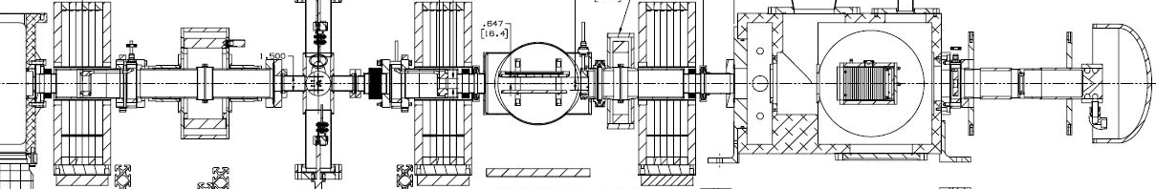
Space-charge ‘enhanced’ configuration (i.e. partial neutralization scheme)
Positive biasing of electrically isolated diaphragms to contain ions
Clearing field at the chopper
Vacuum downstream of
solenoid #2: low 10⁻⁷ torr
Chopped beam
5 ms
Ion source extractor voltage
0 kV
-300 V
1 ms
Chopper voltage
-5 kV
3 ms
Ion clearing
+40 V
+40 V
Approximate location of RFQ 1st vane
Ions trap
-300 V

Slide 25
Configuration without ion clearing (i.e. maximum neutralization scheme
Positive biasing of electrically isolated diaphragms
No DC offset at the kicker
plate
Chopped beam
5 ms
Ion source extractor voltage
0 kV
1 ms
Chopper voltage
-5 kV
3 ms
+40 V
+40 V
Approximate location of RFQ 1st vane
Ions trap
Grounded

Slide 26
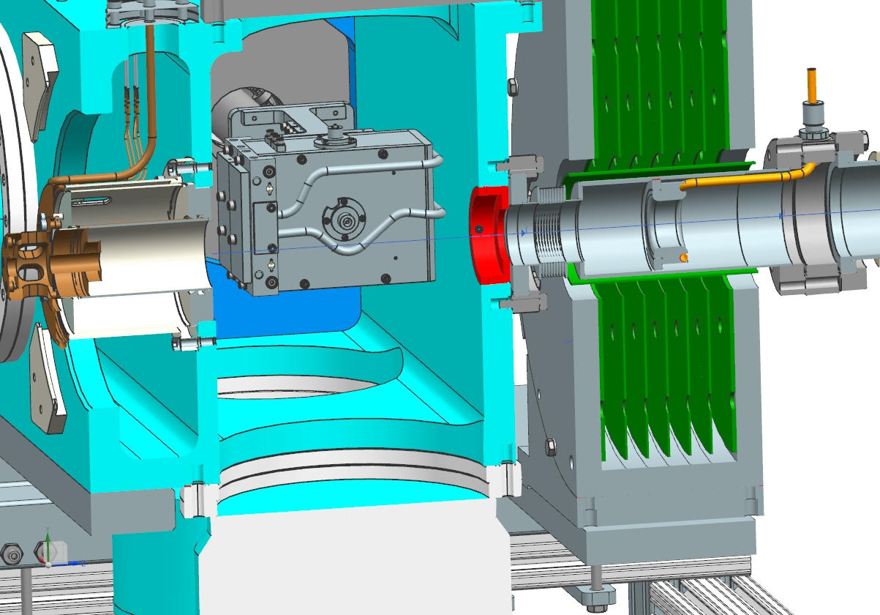
Beam scraping before solenoid #1
When Solenoid #1 was first installed, losses were observed on the bellows
  Added a ‘bellows shield’
  Unknown amount (a priori)
With emittance scanner
relocated in the IS vacuum
chamber, one can use the
phase space ‘integral’ as a
measurement of the beam
current being extracted
  Phase space integral vs. beam current calibration from measurements downstream

