Slide 1
MEBT Status and Commissioning Plan
A. Shemyakin
PIP-II Machine Advisory Committee Meeting
15-17 March 2016

Slide 2
Outline
MEBT functions and challenges
MEBT elements and their status
  Magnets, bunching cavities, scrapers, chopping system
  Diagnostics and RF will be covered in separate talks
MEBT stages
MEBT at PXIE vs PIP-II MEBT

Slide 3
MEBT functions
2.1 MeV; 5/10 mA (nom./max) CW; emittance 0.23/0.31 µm rms n (transv./long.)
Optical matching from RFQ and to HWR
Chopping
  Any bunch from initial CW train can be removed
Scraping
Transition from HV to particle-free, UHV part upstream of HWR
Measuring beam parameters; MPS

Slide 4
PIP-II MEBT challenges to address
The main challenges are related to the goal of bunch-by-bunch selection
Beam chopping
  Fast kickers; beam loss and extinction
  High-power beam absorber in vicinity of passing bunches
Vacuum management near SRF
  Absorber gas load, dust, accident scenarios
Measuring beam optics; stability of operation
  Passing the beam through 3 tight apertures (kickers and differential pumping insert)
  Interaction with the scraping system
  Emittance growth
All will be studied at PXIE

Slide 5
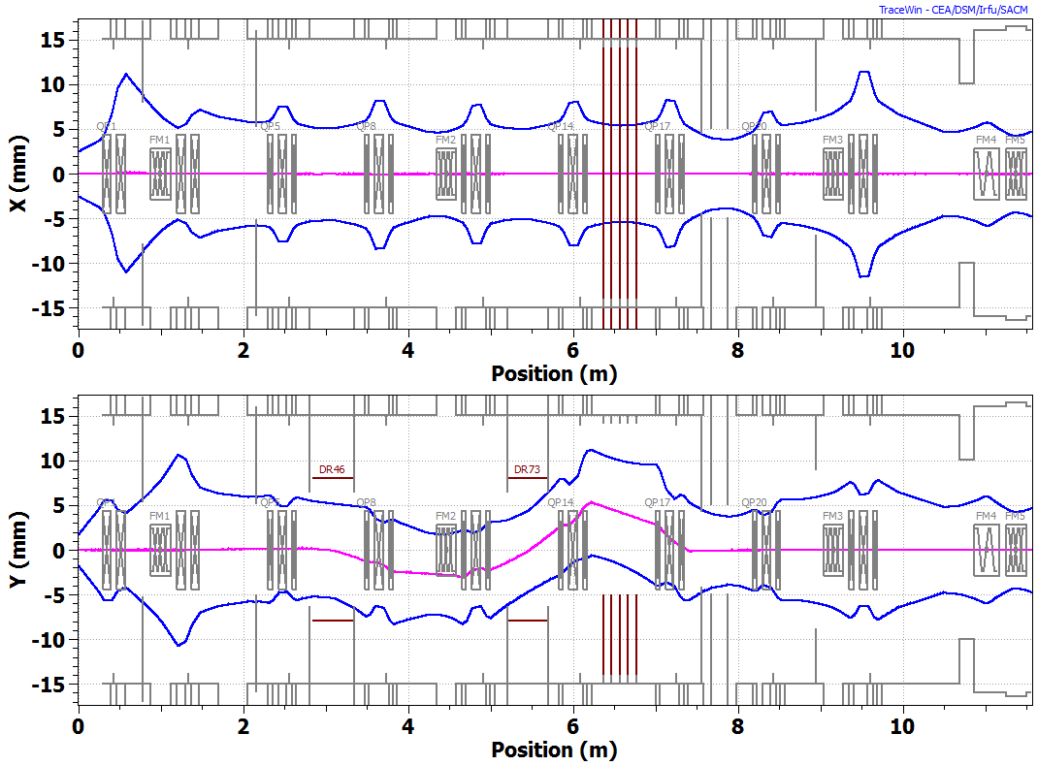
PXIE MEBT configuration
3σ envelopes of passing bunches. 2.1 MeV, 5 mA. TraceWin.
A. Saini.
Two doublets and 7 triplets; three bunching cavities
  No dramatic changes in the optical design since 2011
Chopping system: two kickers and absorber
Smaller beam size after absorber for differential pumping

Slide 6
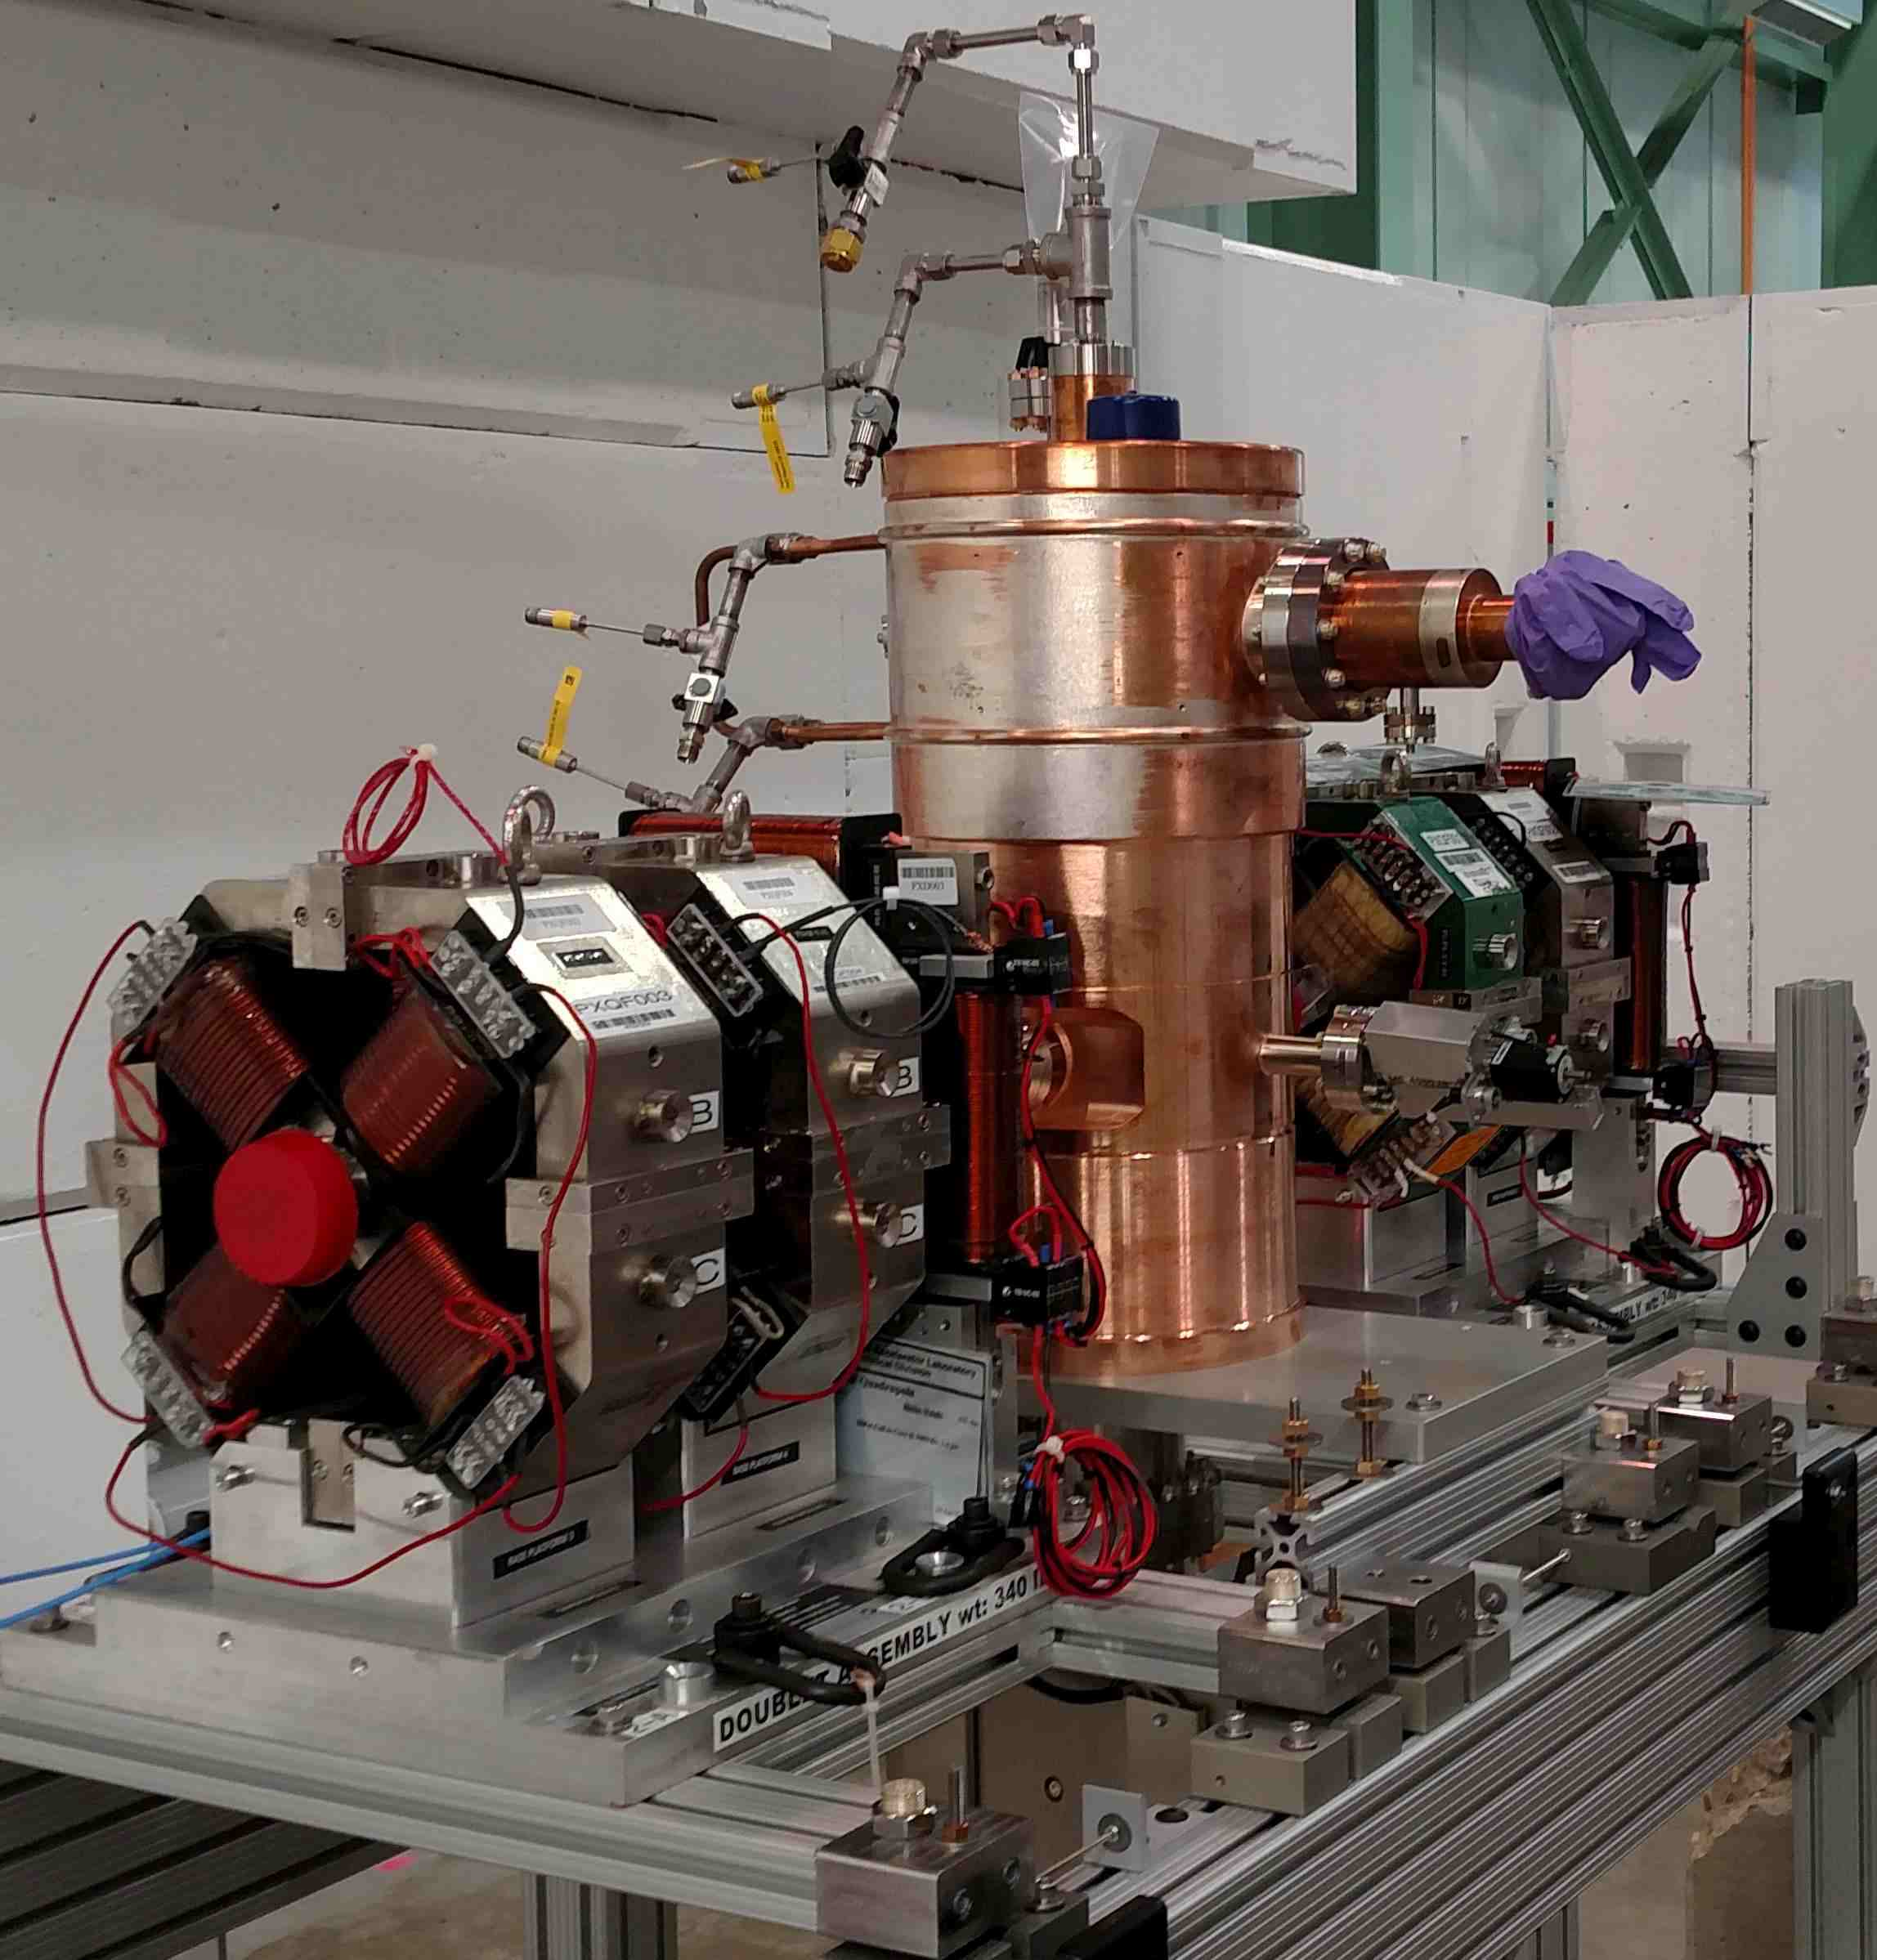
Focusing elements
Magnets: 25 quadrupoles, 9 x 2 dipole correctors + spares
  Produced by BARC, India and delivered in batches
    First two doublets with dipole correctors are installed on girder
      Considered prototypes, but quality within specs
    Four triplets are coming in August 2016
    The rest in FY17
  Power supplies are inherited from Ecool
Bunching cavities: procured at HiTech
  A prototype was fully tested and is used in MEBT-1
  3 production cavities have been ordered (May’16 delivery)
  bunching cavity amplifiers are being commissioned (see R. Pasquinelli’s report)
Two doublets and bunching cavity installed on a girder in the PXIE cave

Slide 7
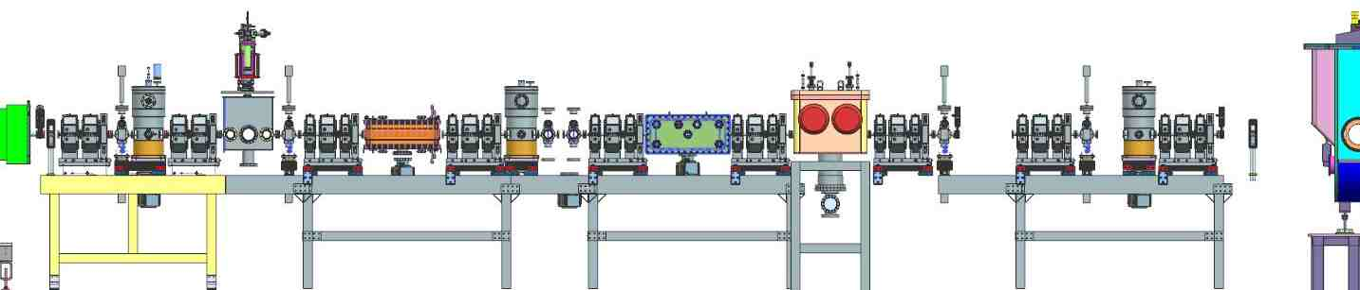
MEBT scraping system
4 scraper sets, 4 blades in each set. Will be used for
  Diagnostic
    Beam size and profile measurements; beam halo
  Part of active protection system
    Increased scraper current generates alarm signal for MPS
  Scraping (the main function)
    Scrape the beam halo or intercept the beam in case of incidents
One set was successfully tested at LEBT (200W/set rating)
Scraper location in MEBT

Slide 8
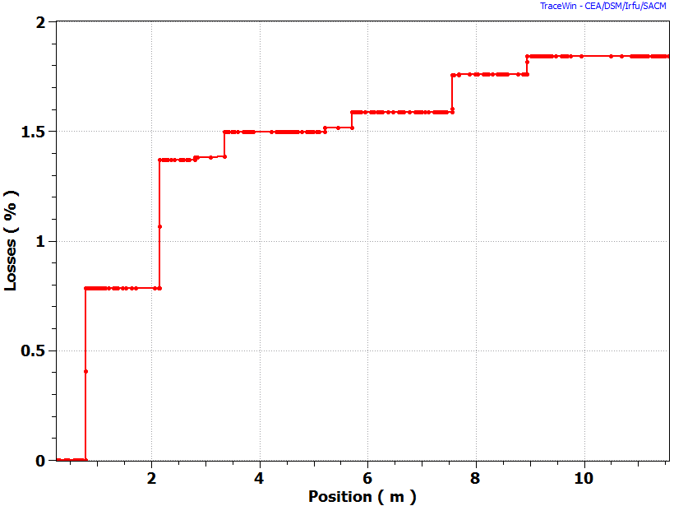
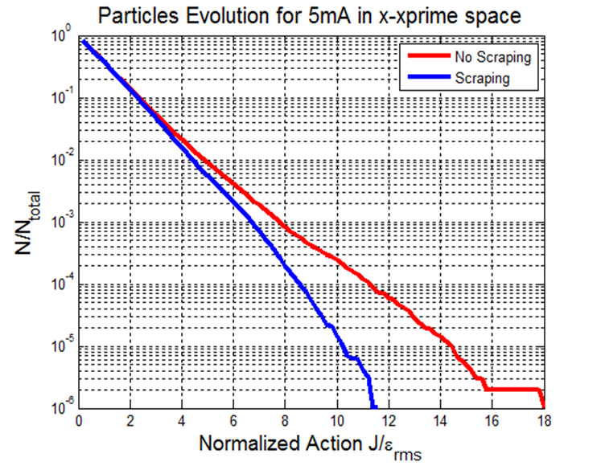
Nominal scraping scenario
  Scraper positions are adjusted to be close to 90⁰ of transverse phase advance
  Protect SRF from trajectory or envelope errors
Scraper 2
Scrapers 3 & 4
Scraper 1
Scraper 1 | Scraper 2 | Scraper 3 | Scraper 4
0.8 % | 0.6% | 0.16 % | 0.08 %
Beam losses for passing bunches. Nominal beam (5 mA, ε_{tr/z}=0.21/0.28 µm). A. Saini.

Slide 9
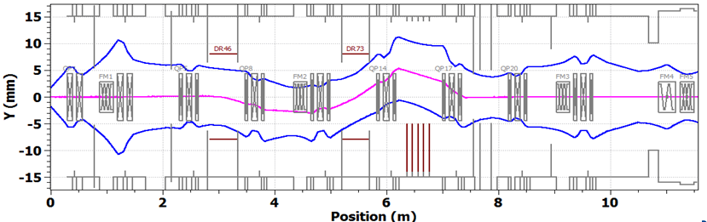
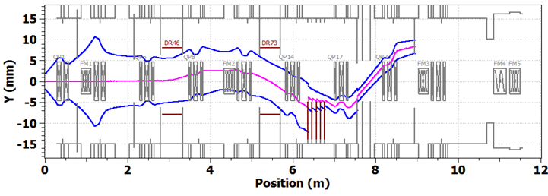
Chopping system
Two travelling-wave kickers working in synch and absorber
  Two kicker versions, 50 Ohm and 200 Ohm
Passing bunch.
-250V, +250V on upper plates.
Removed bunch. +250V, -250V on upper plates. Case with 0.05% of beam leaking to scrapers is shown.
3σ envelopes. 2.1 MeV, 5 mA. A. Saini. Bipolar kicker version.

Slide 10
Chopping system - development
Absorber: 21 kW CW; 0.5m; 29 mrad grazing angle
  Separate TZM plates pressed against a water-cooled aluminum base; ¼ prototype tested
  No new development for the absorber since last P2MAC
Kickers: 2 versions distinguished by characteristic impedance
  Main version – 50 Ohm; bipolar kick; AC-coupled
    Driver: linear amplifier with pre-distortion; commercially available
  Second version – 200 Ohm
    Higher impedance allows considering a fast switch as a driver
    Potentially simpler and cheaper solution; DC-coupled

Slide 11
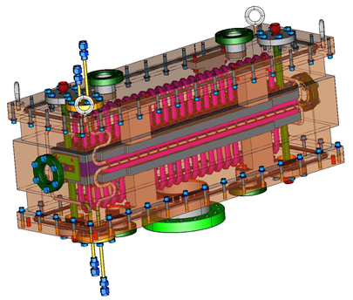
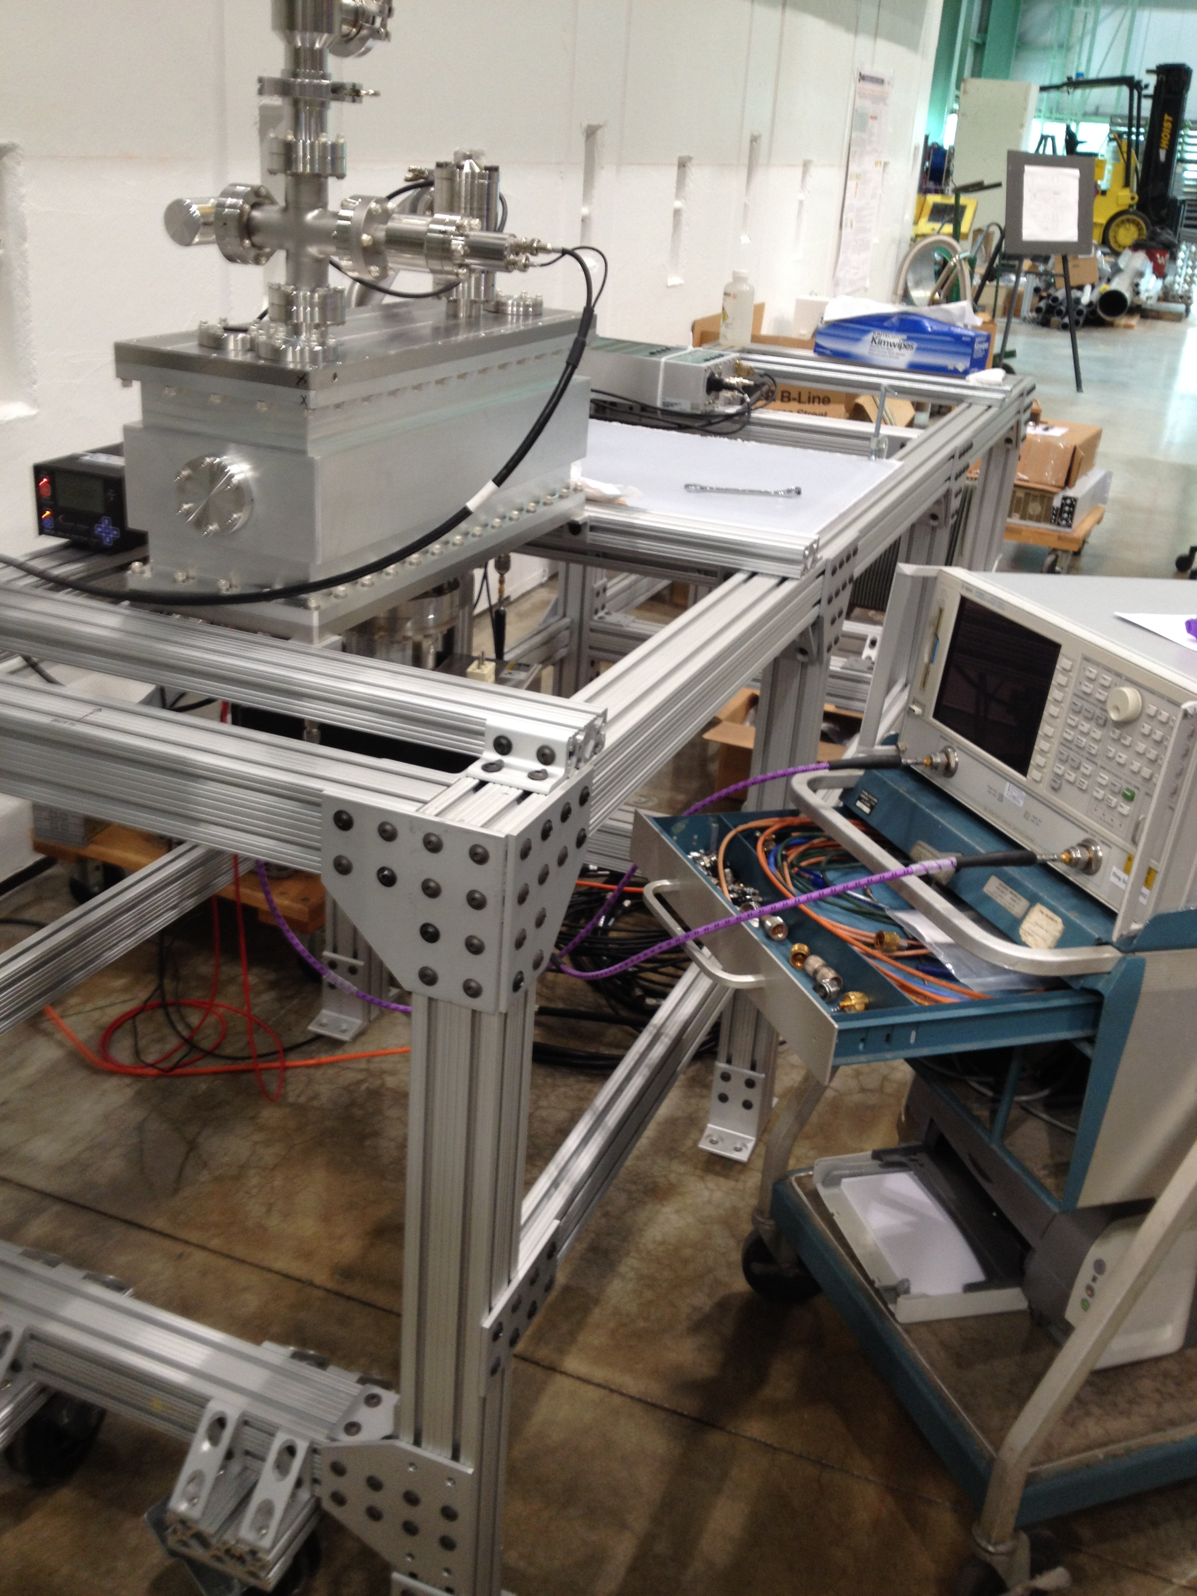
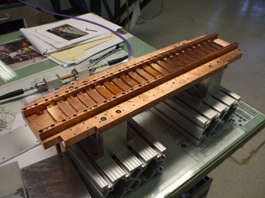
50 Ohm kicker
Features
  Bipolar signal; bunches to be removed or passed are kicked in opposite directions
  Plates connected in vacuum with 50 Ohm cables
Status
  One plate was successfully tested in vacuum
    Full-power and RF measurements
  Final prototype is fully assembled
    Will be power-tested at MEBT
3D model. A.Chen, M. Jones
Half of the kicker (one plate) assembled. D.Sun
Kicker under testing. D.Sun, D. Peterson

Slide 12
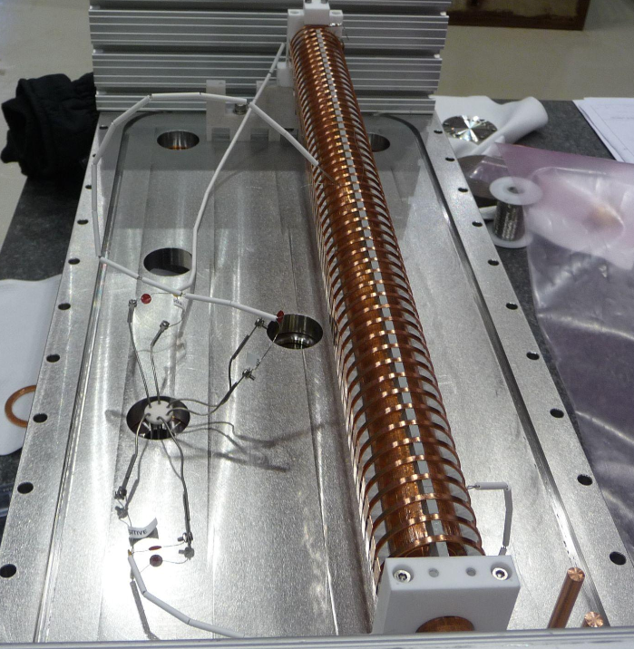
200 Ohm kicker
TW structure is a helix with welded plates
A vacuum-compatible helix was tested
  Power testing in vacuum is successful
  The phase velocity was found off by 5%; redesigned
A complete kicker with modified helixes is being assembled
  Planned to be fully tested before end of summer 2016
Kicker prepared for power testing in vacuum.
A.Chen, G.Saewert
Each helix will be driven by a switch
  From 0- to- +500 V and from 0- to- -500V, correspondingly
  Switch scheme: 3-4 FETs in series triggered simultaneously

Slide 13
200 Ohm Helix Driver status (G. Saewert)
Evaluation results of 3- GaN FET “-500V” switch
  Load used: 185 Ohm
  3.0 ns turn-on, 4.0 ns turn-off (5-95%)
  Operated at 630 V
  Timing match of 3 boards is <0.2 ns
  Flattop pulse width adjustable range: 2.5 ns to infinity
  Tested 9 MHz CW, and >40 MHz bursts
  Better cooling is required for higher rep rates
Results of thermal modelling of a scheme with water cooling
  4 FETs mounted on BeO ceramic
  ~20 W per FET (extrapolated from data)
  Junction temperature: ~120 ºC (acceptable)

Slide 14
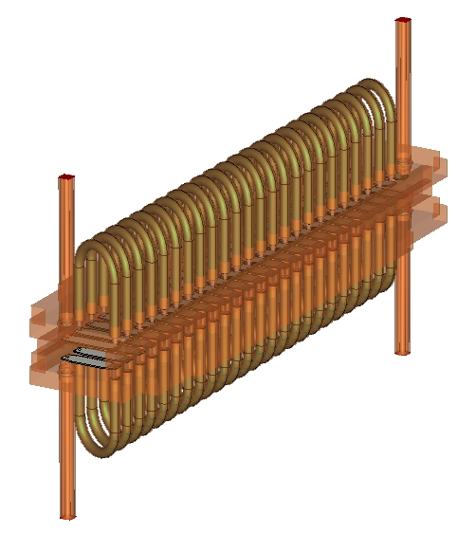
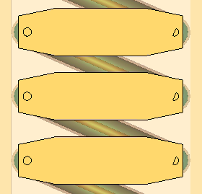
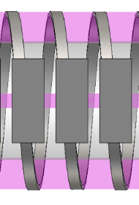
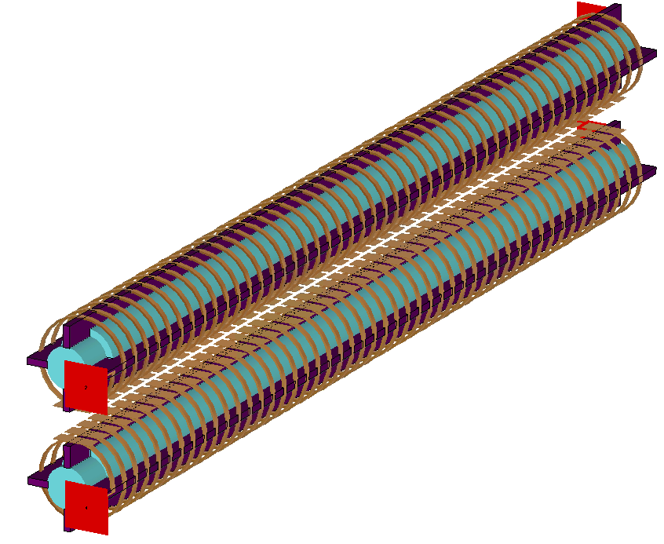
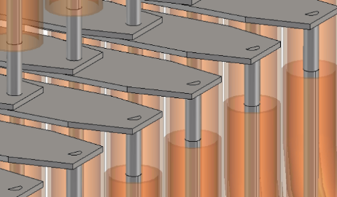
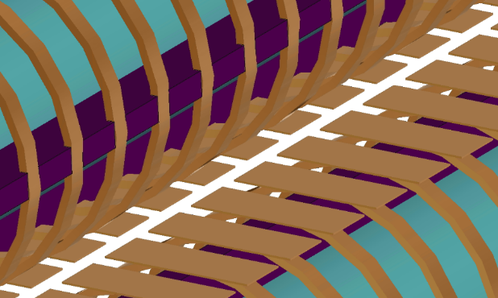
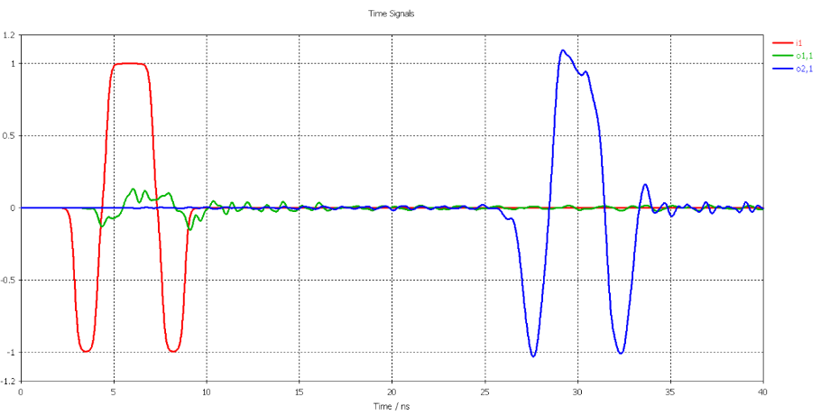
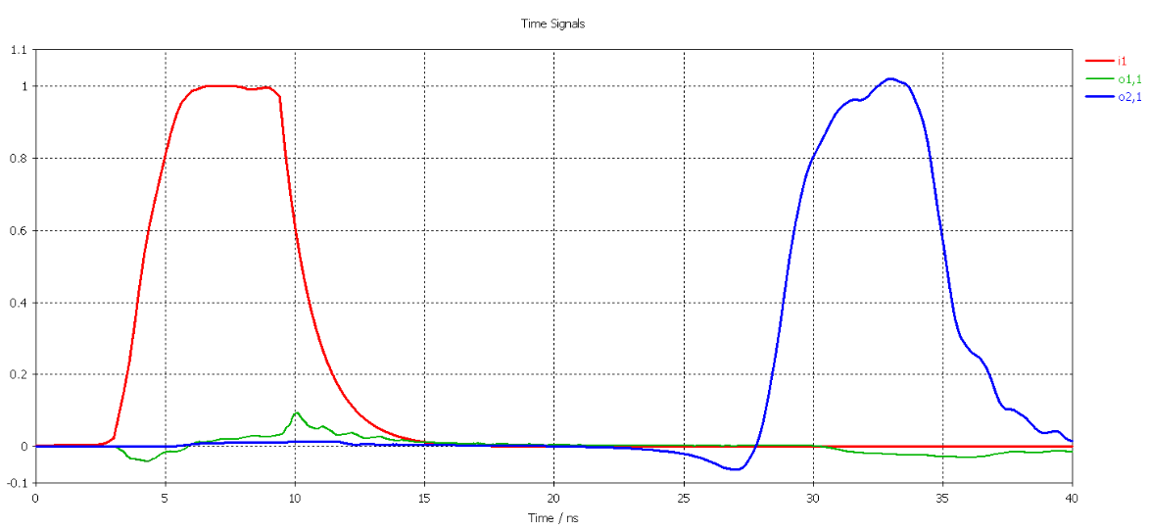
Kickers simulations (M. Hassan)
Both kickers were simulated with time domain solver of CST
  With all mechanical details and realistic pulse shapes
Angles differ from the model of parallel plates by <10%
2.84 mm
5.3 mm
20 mm
10.46 mm
Simulated geometries and propagated signals for two kickers
50 Ohm
200 Ohm

Slide 15
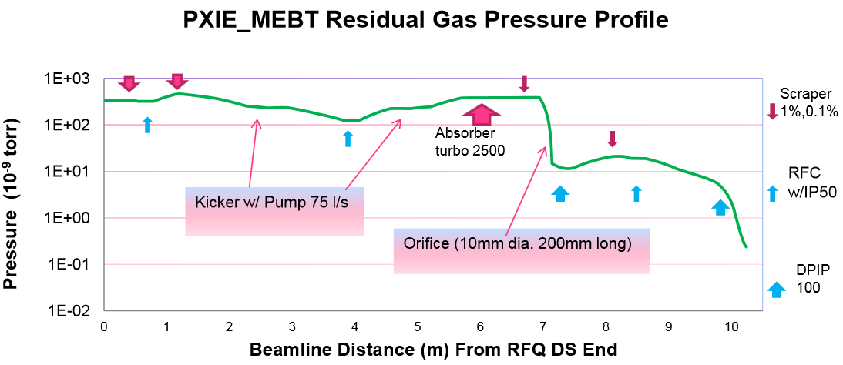
Vacuum components
HV in most of MEBT and UHV, particle-free in last ~3m
  MEBT vacuum concept did not change since 2012
  All vacuum equipment was identified and most purchased
  Design of the differential pumping section begins
  From PXIE experience, need to decide for PIP-II
    Length of particle-free region
    Fast acting valve system area
A. Chen

Slide 16
MEBT commissioning plan
MEBT: 3 intermediate steps
  determined by magnet delivery schedule
  MEBT-1 – 2 doublets, 1 bunching cavity (present configuration)
    To commission the RFQ beam; hopefully 10 kW CW
  MEBT-2 - + 4 triplets, +1 bunching cavity
    Install in Fall 2016, run until Spring 2017
  MEBT-3 - + 3 triplets, +1 bunching cavity
    Install in Spring 2017, run until shutdown to install SRF
    Full length, prototype elements
The final MEBT (install in FY18)
  Particle-free vacuum chamber in front of HWR
  Final chopping system (final kickers, drivers, and absorber)
    Bunch-by-bunch selection

Slide 17
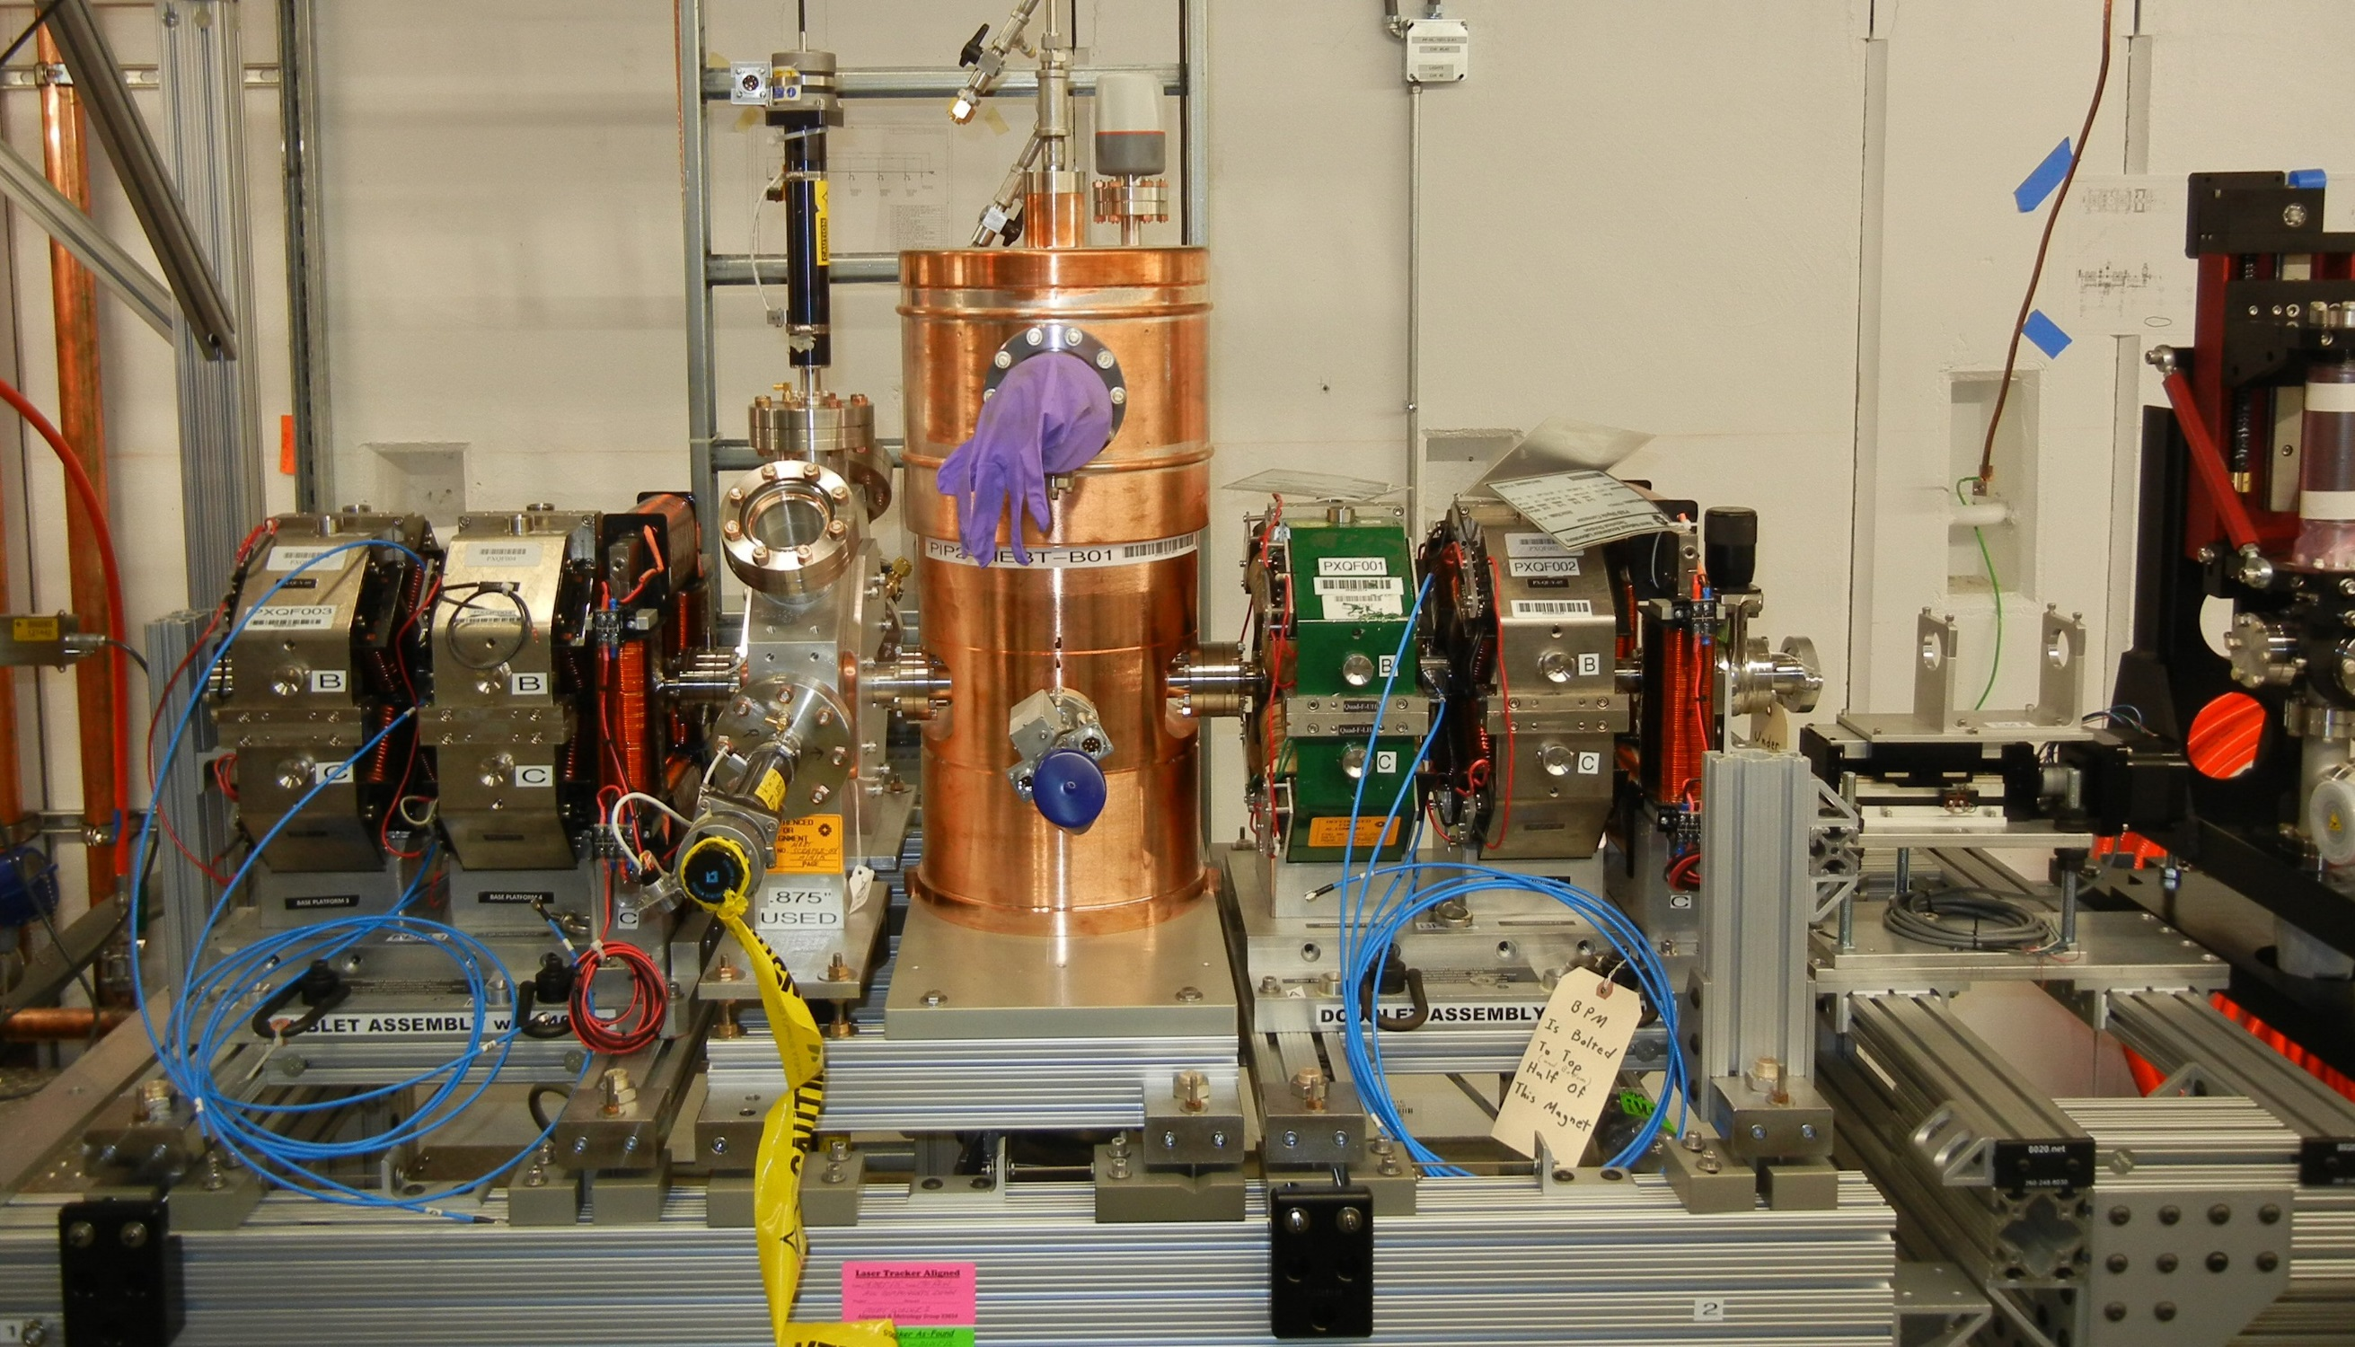
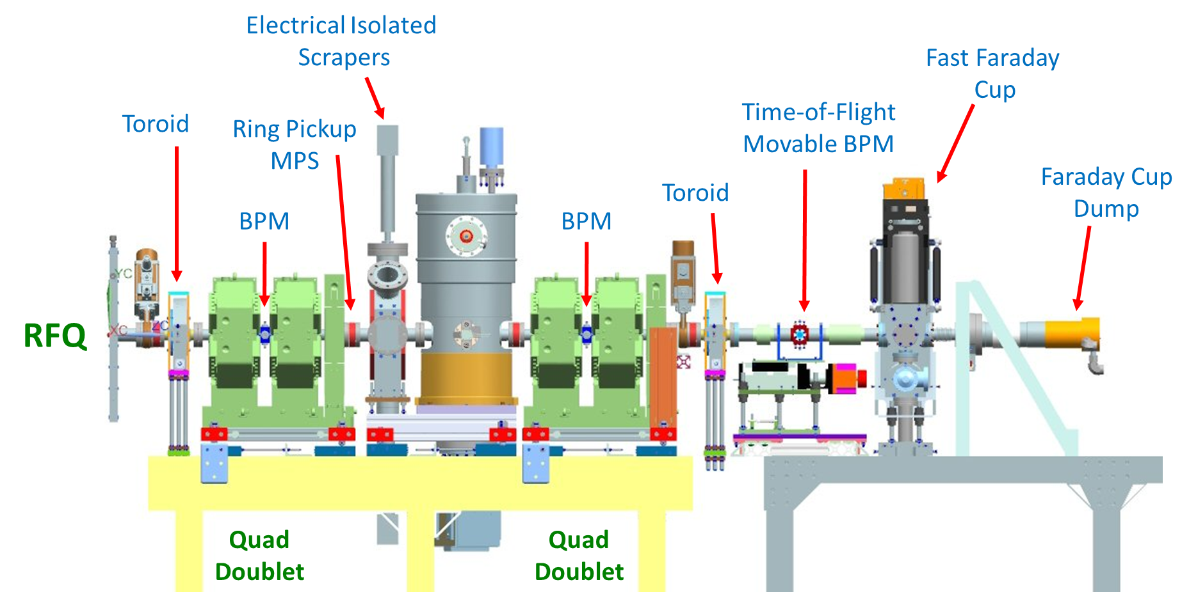
MEBT-1: 2 doublets, 1 bunching cavity
Initial MEBT-1 configuration
≤1 ms beam; 20 Hz, ≤5 ms RFQ RF
Characterization of the beam from RFQ
Commissioning of sub-systems
  MPS, LLRF, Instrumentation
Beam optics
  Bunching cavity, magnets
Final MEBT-1 configuration (CW - capable)

Slide 18
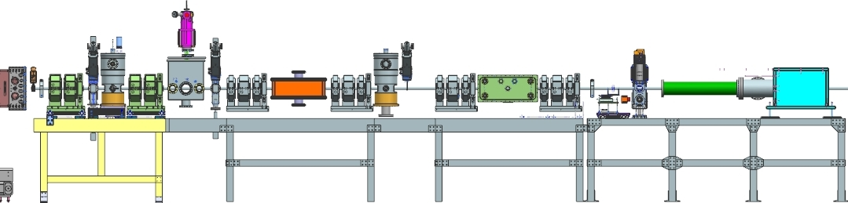
MEBT-2: 2 doublets, 4 triplets, 2 bunching cavities
The main goal is to test kickers
  Install both prototypes
  Test: kickers survival and angle to the beam
    50 Ohm: two 81.25 MHz CW drivers
    200 Ohm: two 500V switch prototypes
  Proceed with fabrication of final kickers
Optics; tests of laser wire and extinction monitor (RWCM)
  Could be 1-3 versions differing by placement of diagnostics
Space for laser wire
50 Ohm kicker
200 Ohm kicker
RWCM
FFC
ToF

Slide 19
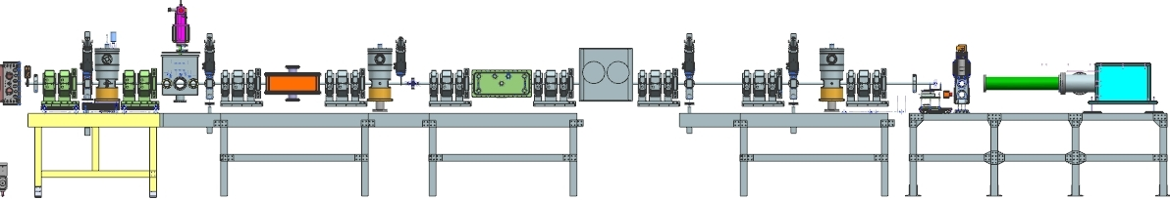
MEBT-3 : 2 doublets, 7 triplets, 3 bunching cavities
All magnets, cavities, and scrapers are in final locations
  The kickers are still 50 Ohm and 200 Ohm prototypes
  5kW absorber prototype instead of full absorber
The last ~2m are “cleanable” but assembled not particle-free
Main goals
  Prepare beam for injection into HWR
  Optics; UHV sections and differential pumping
  Finalize measurements started in previous versions
Absorber prototype
Differential pumping section
Diagnostics

Slide 20
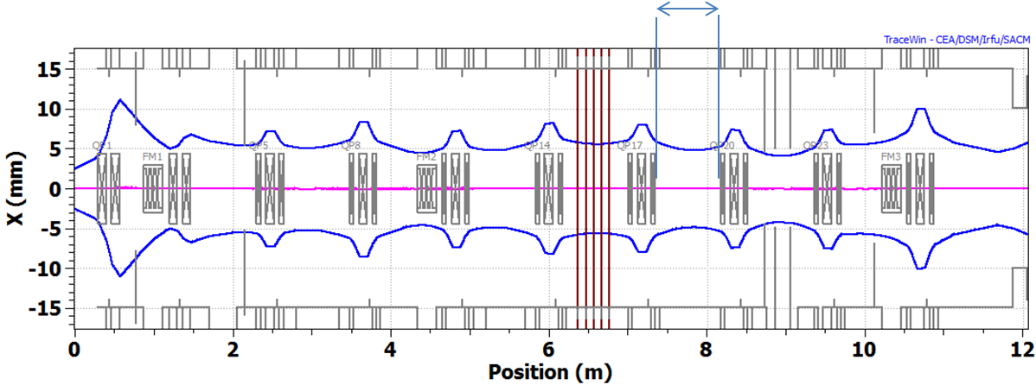
PXIE MEBT vs PIP-II MEBT
While all PXIE MEBT components are designed to PIP-II specs, there may be differences
  Plan to have the ion sources accessible during linac operation
    Need a radiation wall (similar to SNS) in MEBT; requires one more section
  May need a longer particle-free region in MEBT
  More detailed analysis of risks may require a longer distance from the MEBT chopper absorber to SRF to provide protection by the fast acting valve
  Longer MEBT would require additional triplets and may need an additional bunching cavity
Possible wall location
A.Saini

