Slide 1
PIP II Booster
William Pellico
PIP-II Machine Advisory Committee
15 - 17 March 2016
Notes:
Wrong date: 9-11 March 2015

Slide 2
Outline
Present Booster operations
  Booster numbers today
    PIP numbers and goals relative to PIP II
  PIP II Booster
    PIP II Booster parameters
    Systems impacted by PIP II
      Injection/capture
      RF
      20 Hz operations
      Beam dynamics/loss control
      Misc. – long term viability, reliability and loses

Slide 3
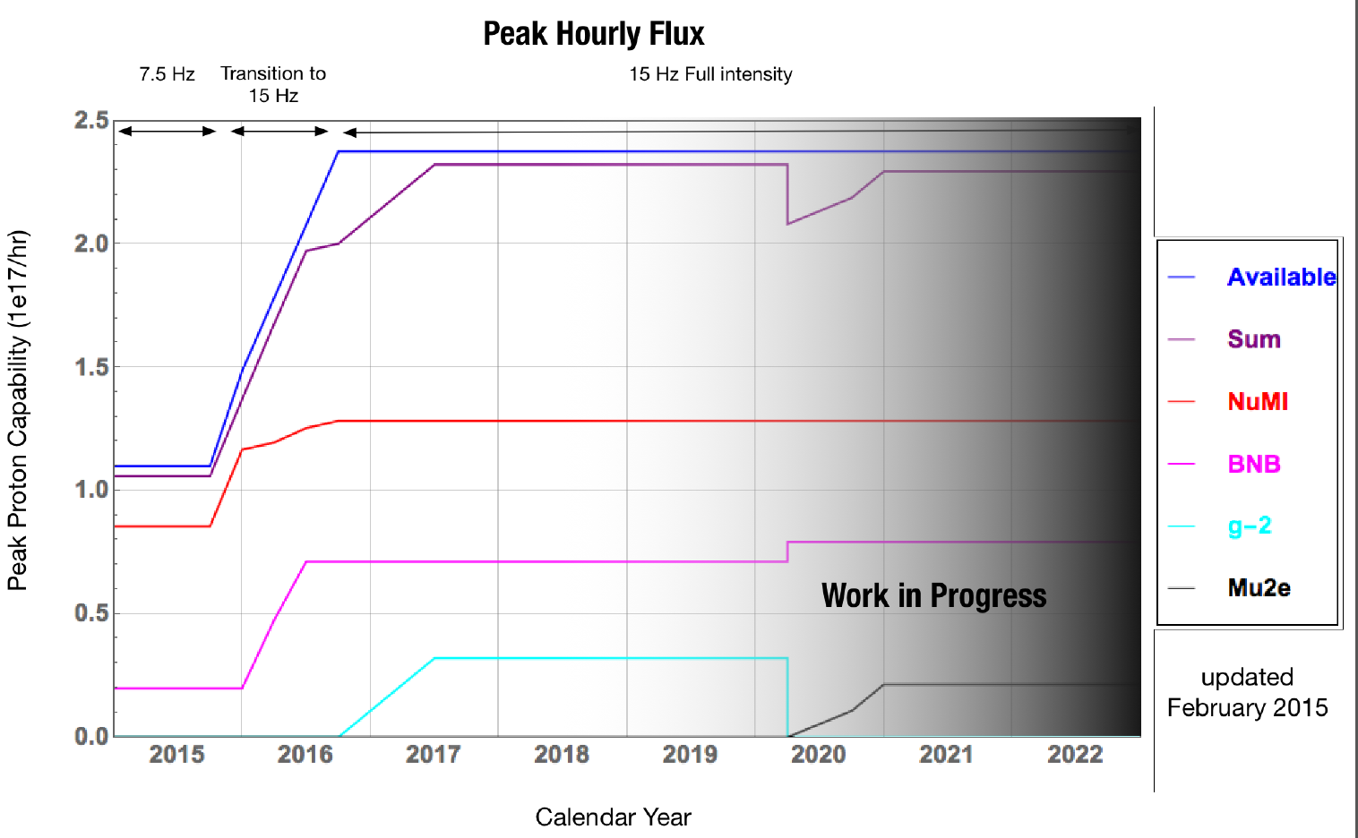
Planned Booster Peak Flux and Users
~PIP end
NOW
Preparing for PIP II
Flux Ramp Up
Summer shutdown

Slide 4
PIP Booster parameter table
Parameter | PIP NOW | PIP Completed
Beam energy cycle | .4 GeV to 8 GeV | .4 GeV to 8 GeV
Average extraction intensity (NOvA) | 4.3E12 protons/pulse | 4.3E12 protons/pulse
Flux Limit | Shielding assessment | Local loss points will be the control limit
Bunches removed (Linac or Booster) | 2 | 3
Efficiency @ 4.5E12 ppp | 92 – 93% | 95%
Booster repetition rate | 15 Hz | 15 Hz
MI/Recycler batches | 10 every 1.33 sec | 12 every 1.33 sec
NOvA beam power | 550 kW | 700 kW
Rate availability for other users | ~ 6.75 Hz | ~ 6 Hz
Booster flux capability | ~1.9E17 protons/h | ~ 2.3E17 protons/h
Longitudinal energy spread | < 4MeV | < 6 MeV
Transverse emittances (4.3E12) | < 13 – 14 pi-mm-mrad | < 14 p-mm-mrad
Booster uptime | >93% (2 month period) | > 85%

Slide 5
PIP II Booster
PIP II will generate > 50% higher flux than the planned PIP operations
PIP flux FY17: 2.3e17 pph
PIP-II flux: 3.5e17pph (15Hz)
PIP-II flux: 4.6E17pph (20Hz)
Notes:
The total flux increase is closer to 2 because of increased rep rate.

Slide 6
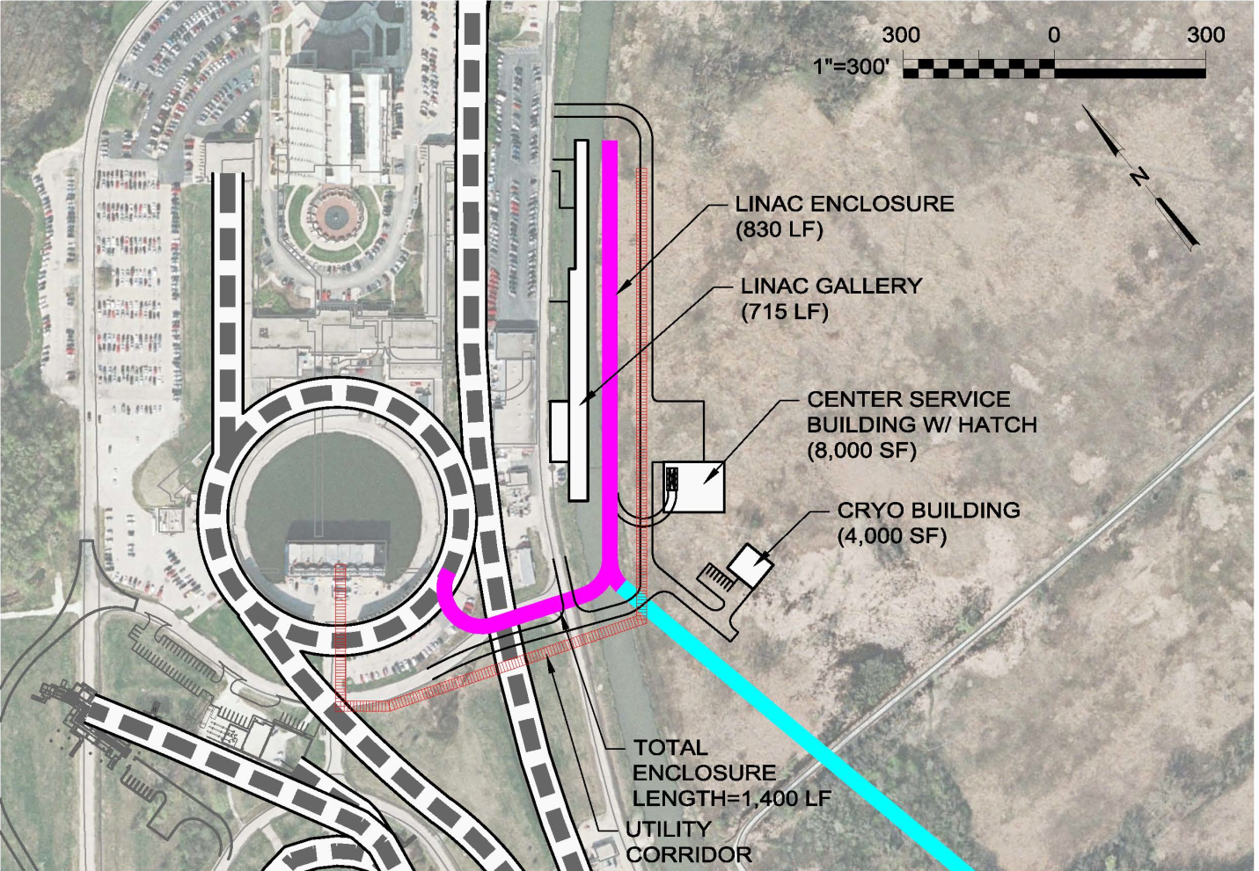
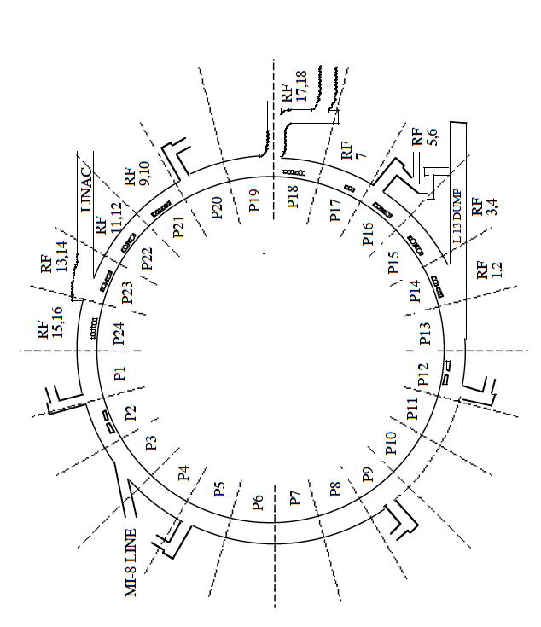
PIP II injection point into Booster - reminder
Present injection point at L1
New injection point at L11

Slide 7
PIP II required R&D: Areas of progress under PIP
  New injection point at L11
    New injection girder
    Space charge mitigation: painting
    New stripping foil system
    H⁰ , H⁻ absorber
  RF Cavity investigation/design/construction
  RF capture
    capture scheme: Direct injection into buckets preferred (adiabatic: 2nd choice)
    2nd harmonic cavities (considered but probably unnecessary)
  Transition crossing
    RF focusing method
    Beam/RF simulations (V. Lebedev – for PIP II)
    RF focus free method (flattening of RF amplitude)
      2nd or 3rd harmonic cavities. (can also be used in RF focusing method)
    γ_{t} jump system (not likely)
      requires resurrection/rebuild of old system
Notes:
Adiabatic bunching has a problem due to much smaller slip factor and higher energy

Slide 8
R&D Overview (cont’d)
Damper upgrades and collimation system
  Longitudinal quadrupole damping when going through transition
  Longitudinal coupled bunch mode damping at high field
  Transverse dampers for coupled bunch modes
Evaluation of present collimation system w.r.t. expected PIP II
Beam quality at extraction
  Emittances determined by Recycler admittances
20 Hz operations and components
  GMPS
  Pulsed systems
  Controls
Notes:
Improved stability for injection energy is required for the longitudinal painting

Slide 9
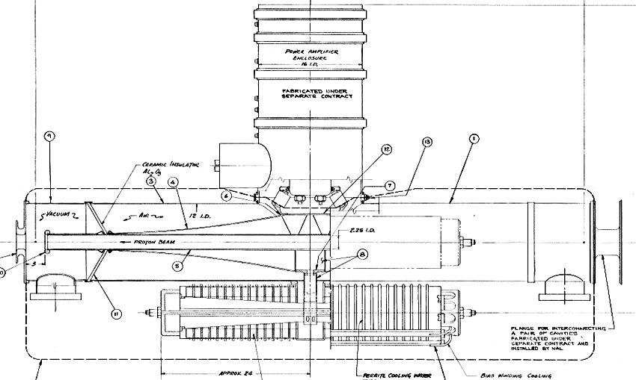
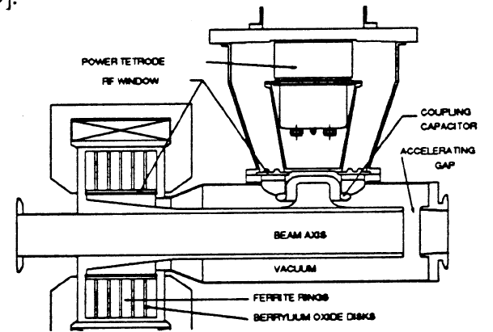

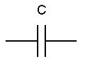
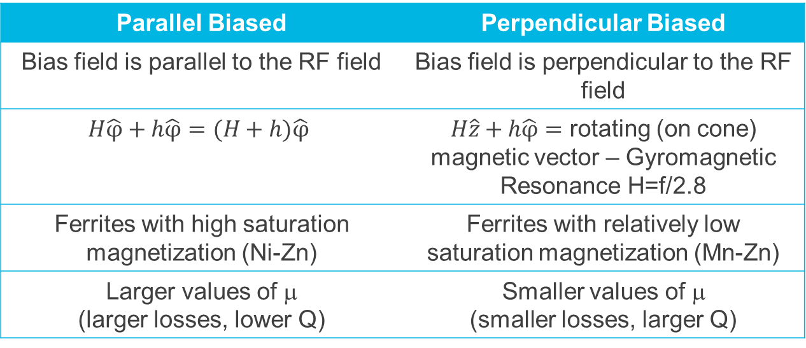
Tunable Booster cavities – two options being studied
h
H
H
h
Parallel Biased | Perpendicular Biased
Bias field is parallel to the RF field | Bias field is perpendicular to the RF field
$$H\hat{φ}+h\hat{φ}=(H+h)\hat{φ}$$ | $H\hat{z}+h\hat{φ}=$ rotating (on cone) magnetic vector – Gyromagnetic Resonance H=f/2.8
Ferrites with high saturation magnetization (Ni-Zn) | Ferrites with relatively low saturation magnetization (Mn-Zn)
Larger values of μ (larger losses, lower Q) | Smaller values of μ (smaller losses, larger Q)

Slide 10
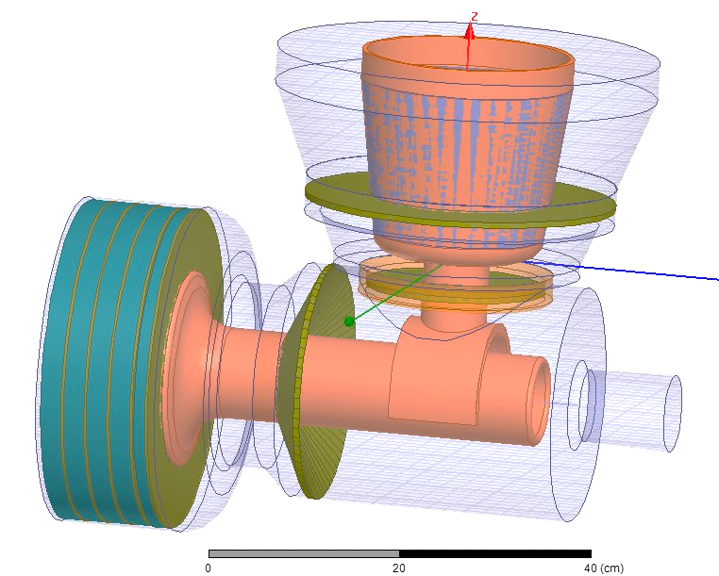
Perpendicular biased cavities (part of PIP – PIP II possibilities)
Simulations of use at injection/transition for PIP I is underway.
Standard Booster PA
The goal is 100 kV gap for a cavity that is about half the length of present Booster/MI cavity.
Garnet Rings
Vacuum Windows
Ferrites with relatively low saturation magnetization
(Mn-Zn)
Smaller values of μ
(smaller losses, larger Q)
Small space required but high gradient
Cooling is difficult
Vacuum windows location
3.25 aperture
Area of localized heating
G. Romanov, CY Tan, Ding Sun, Kevin Duel, Robyn Madrak, Mohamed Awida, Iouri Terechkine
Notes:
Tunability range need to be mentioned

Slide 11
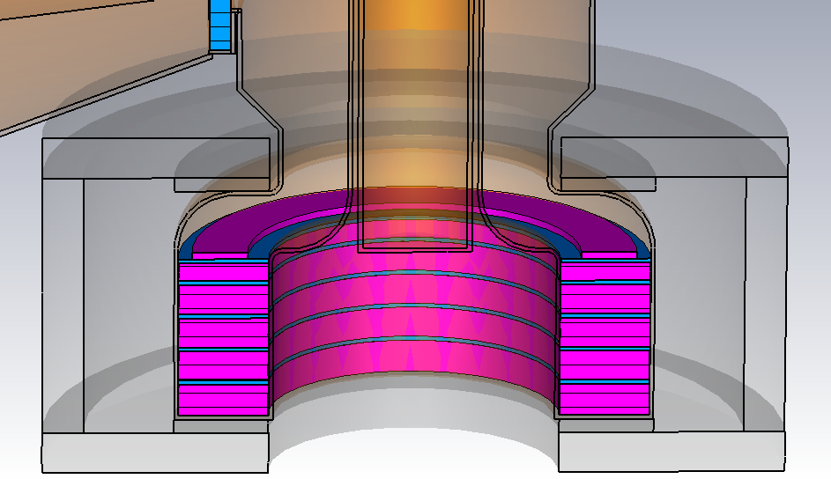
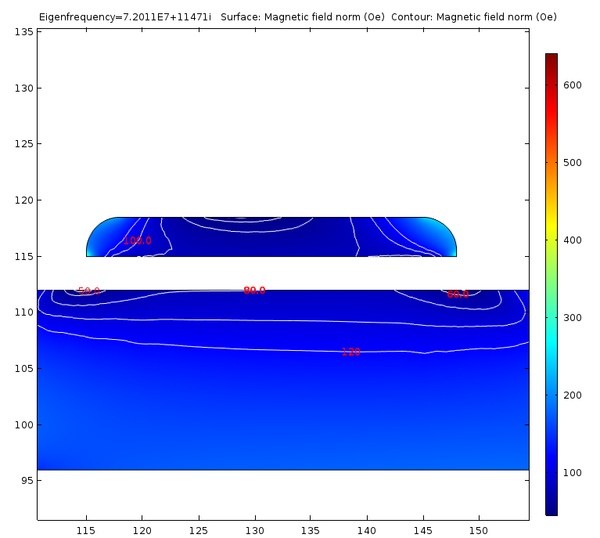
Second Harmonic (perpendicular) continued
H_{min} has increased from ~33 Oe to ~50 Oe
Material of shim – Al800
Thickness – 3.5 mm
Inner radius – 115 mm
Outer radius – 148 mm
Fillet radii – 2.5 mm
Ferrite disks:
Upper 16 mm
Others 21 mm
Total length 100 mm

Slide 12
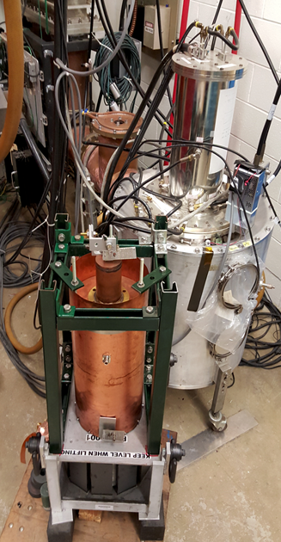
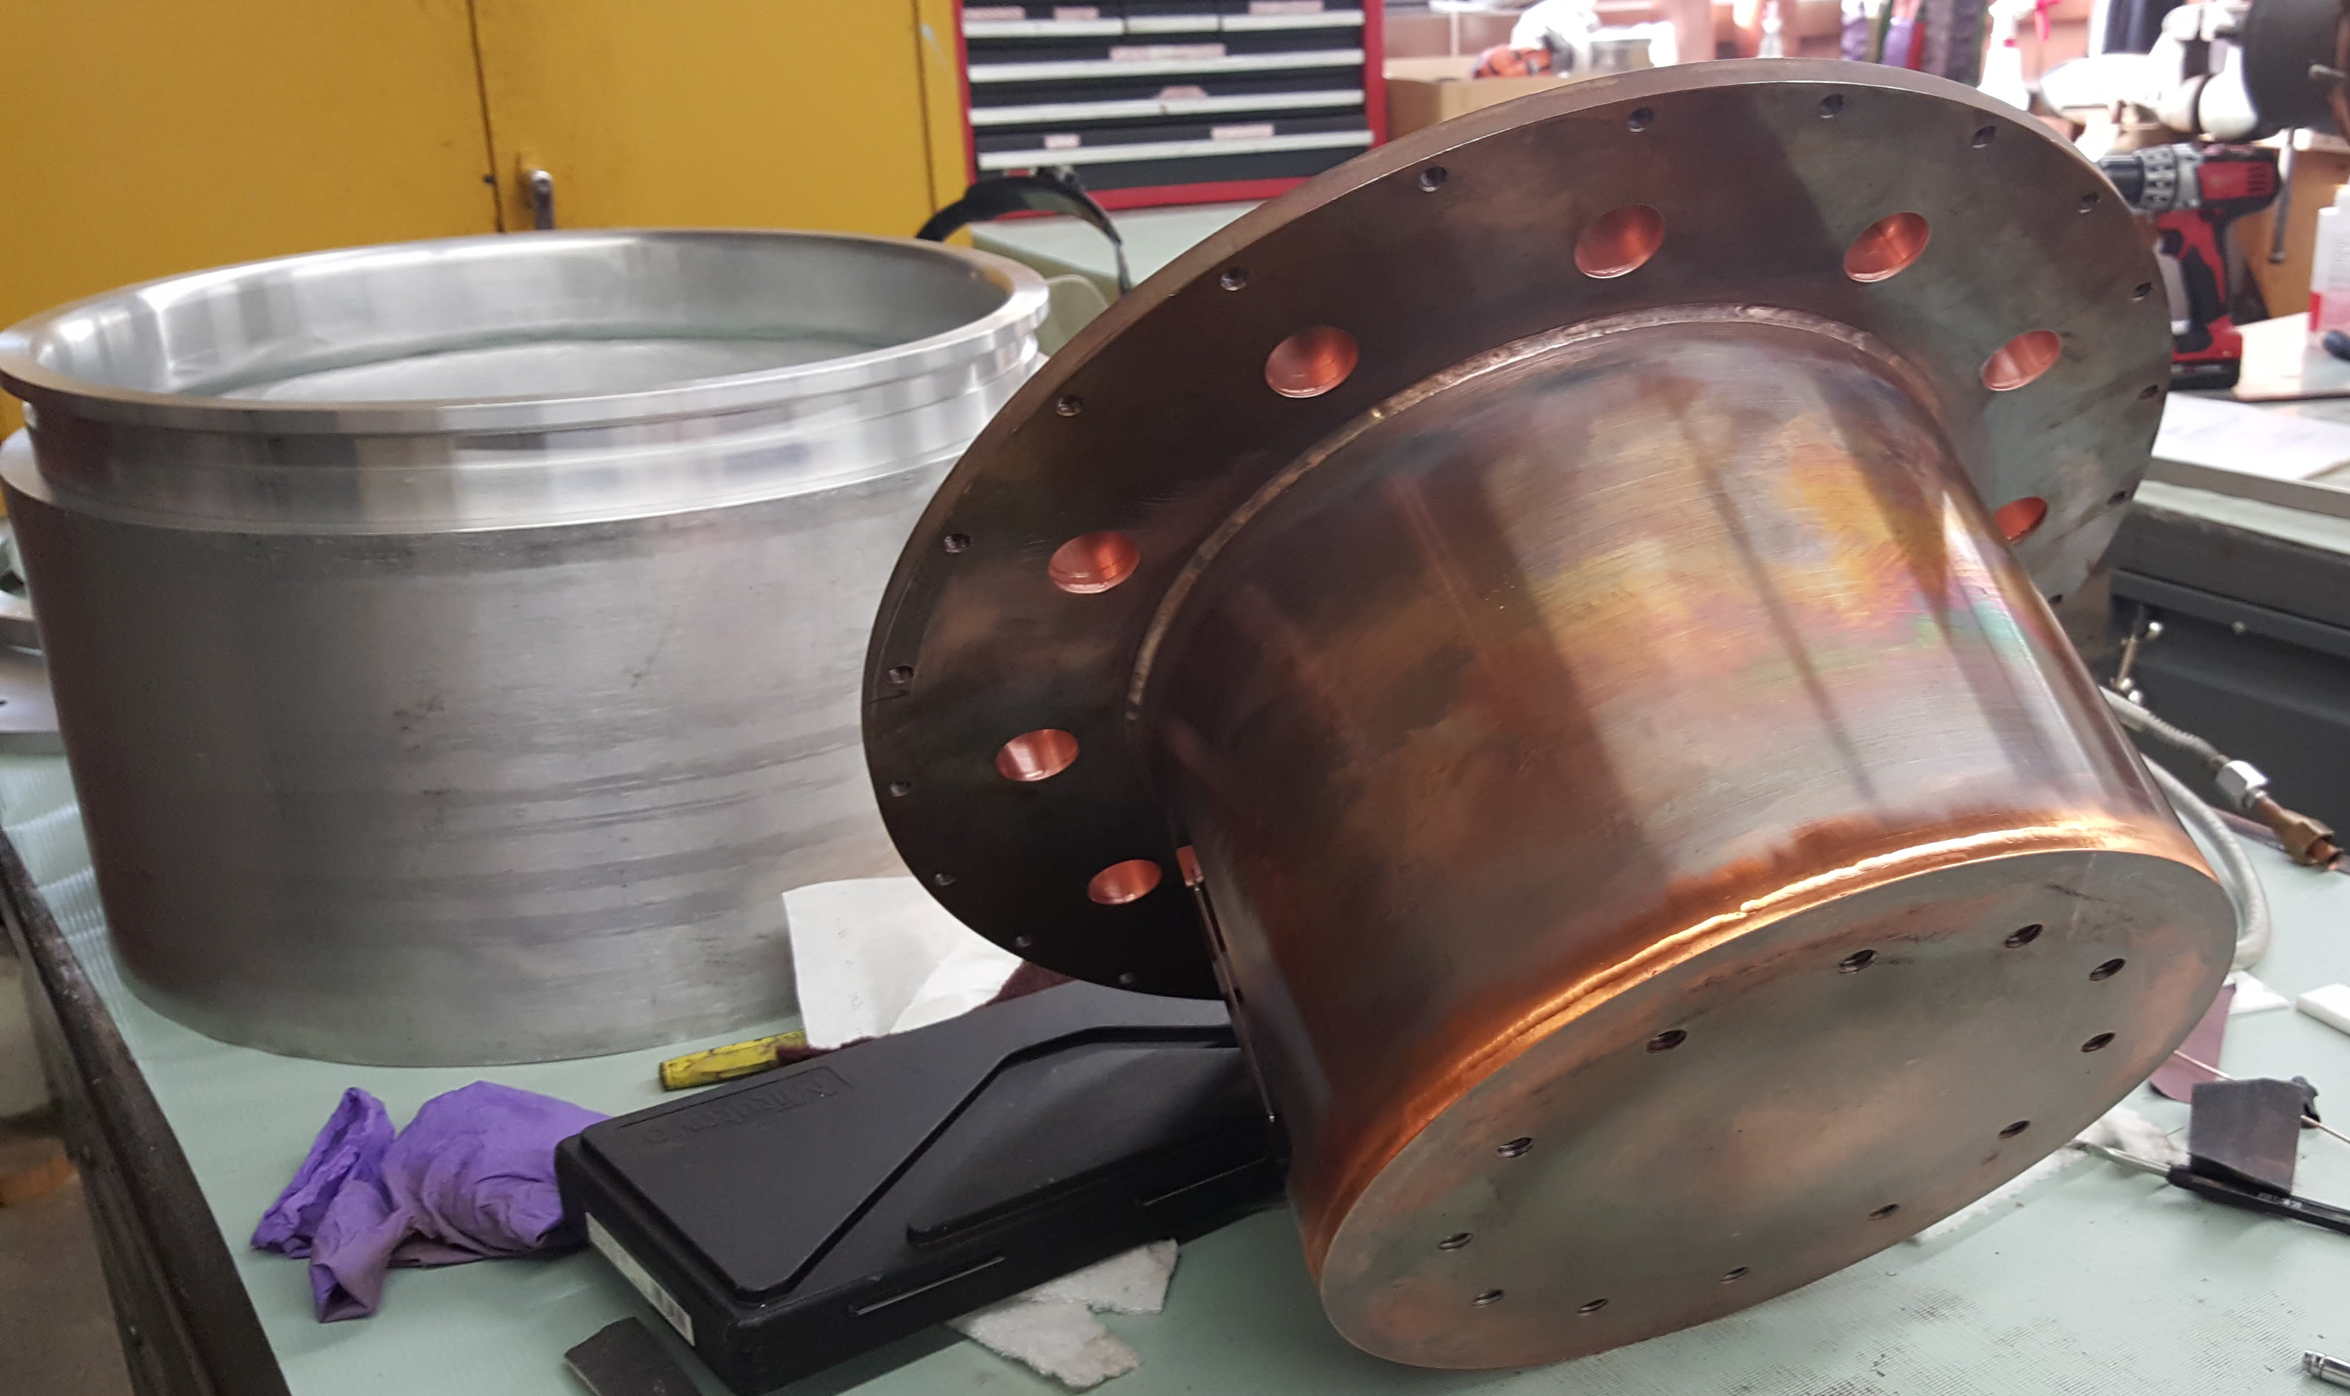
Perpendicular Harmonic Continued
Status & Plans:
Building PA test cavity – verify range/power of PA
Ordering Garnet material to make two rings
discussing assembly process with vendor
Discussing with vendor – window options
Finalize solenoid design
Plan is to start to build cavity this FY
Cavity to test ferrite
Anode and cathode resonator (PA testing)

Slide 13
Possible use of perpendicular design for fundamental use
1000 mm
82.5 mm
346 mm
Design features:-
–High R/Q (geometry is optimized to have R/Q>=50 over the frequency range)
–Relatively large bore (3.25”)
–Short length (1 m long)
–Using available Ferrite rings, similar to the ones used for the 2ndharmonic cavity (each is 1” thick, 13.6” diameter)
–Dielectric loading is used at the ferrite interface to concentrate the fields at the coupling region in order to achieve the desired sweep range (sweep range 36.6 MHz to 53.7 MHz; more than needed)
–Facilitate cooling of the ferrites by thermal paths through copper (cooling channels) and dielectric washers
–60 kV gap voltage
–Simple Vacuum window

Slide 14
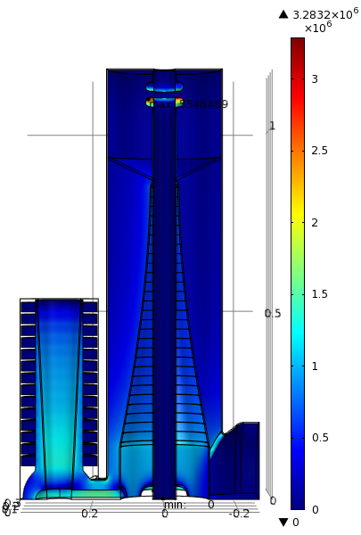
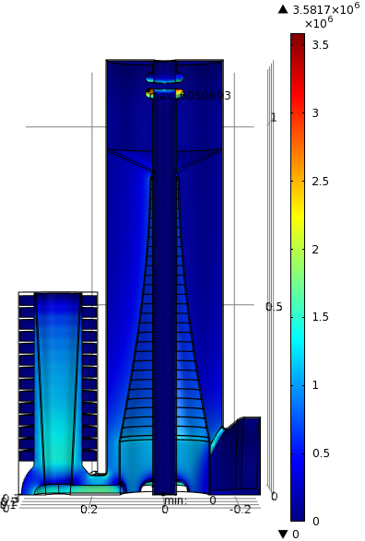
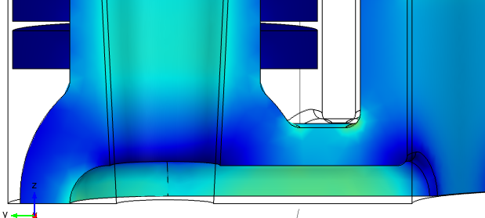
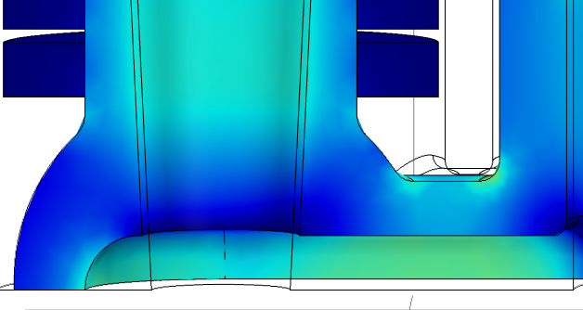
Standard Booster cavity modeling/mods – nearly complete
Electric Field for 55kV
Electric Field for 60 kV
Ferrites with high saturation magnetization (Ni-Zn)
Larger values of μ (larger losses, lower Q)
Known technology and operations
Relatively limited by the heating in the ferrites
Large size
Low gradient
Thermal/mods testing about done then
decide on cavity
manufacturing (soon)!
3.3 MV/m
3.6 MV/m
1.85 MV/m
1.7 MV/m

Slide 15
Injection / Capture Studies
Effort to optimize the process for multi-turn injection
Long duration – depending upon # of turns – ~40 us
  Will work towards 60 us load times for studies
Foil crossing – losses – tails/emittances
Longitudinal control
Capture losses – make the process more adiabatic
Optimize capture to 15 Hz ramp of the Booster gradient magnets
  The PIP II injection process will be much longer but the similarities and questions can be clarified.

Slide 16
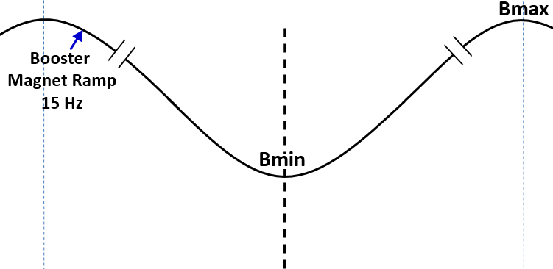
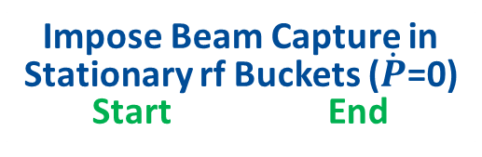
Schematic of the Early Injection with a pseudo front-porch
Impose Beam Capture in
Stationary rf Buckets ($\dot{P}$=0)
Start End
Begin Inj.
Simulations have been conducted under varieties of beam conditions from injection to extraction.
Change in
Es <0.24MeV
≈ 40μs
injection
Beam Acceleration using
37-52 MHz RF system
175μs
capture for >260μs (no debunching)
1/15Hz ≈ 0.0666 s
Energy Acceptance > 4MeV
Beam ΔE ≈ 1.3MeV
f_{sy} = 8kHz-27kHz @ Vrf=0.035-0.4MV

Slide 17
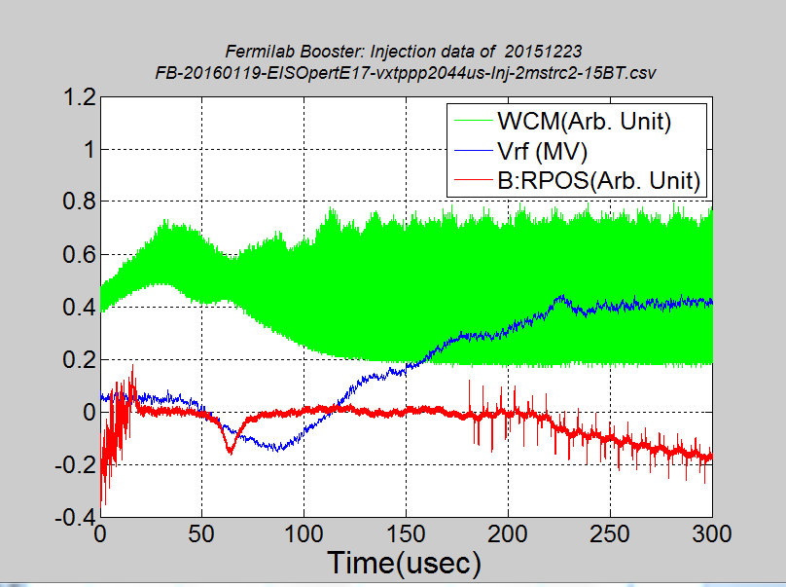
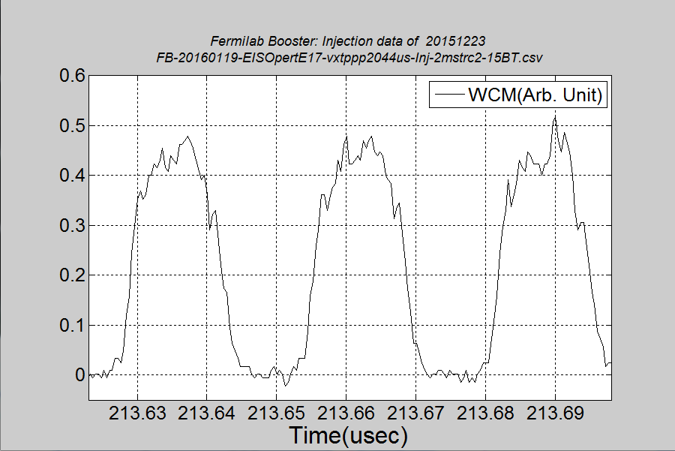
EIS Beam Data and some Analysis (Injection)
15BT Beam; 4.9E12ppb
Testing up to 5.5E12 ppb underway – will go as high as 6.5E12 for tests!
Summary: Reduction in required RF voltage and lower longitudinal emittances. Still working on improving beam capture/losses.
170µs
19.2 ns
B:VXTPPP
B:VAPLON
LE = ~0.05eVs
Notes:
I am not sure what you want to state here. I would expect a voltage increase.

Slide 18
Stripping foil studies
Investigation of various density/composite foils
  Losses
  Lifetime
  Efficiency
Foils tested include Diamond/Carbon, some double borated, and from three different vendors.
  369 ug/cm2
  411 ug/cm2
  420 ug/cm2
  339 ug/cm2
  500 ug/cm2

Slide 19
Foil studies continued
Summary of results:
Lifetime at 15 Hz seems to be reduced for some types
Lower density foils seem to reduce losses at tight transverse apertures
  Likely due to foil scattering creating tails
Lower stripping efficiencies
  Higher H- loss
  Higher neutral loss
  Thinking about solution(s) to shielding the above losses

Slide 20
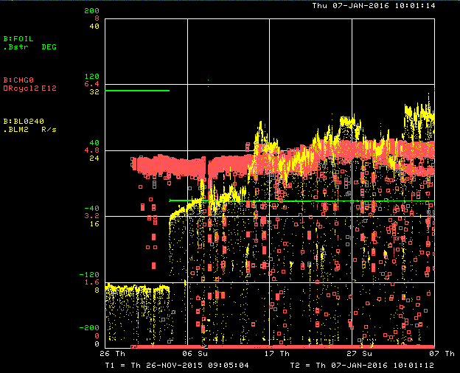
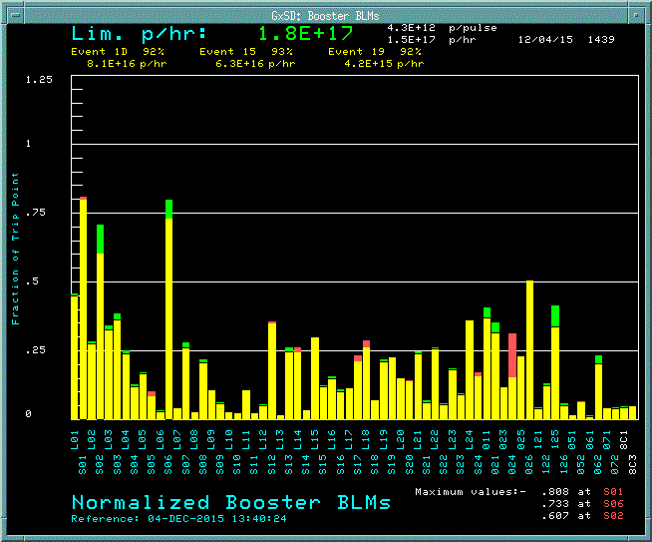
Foil study results
Losses reduced at transverse restricted areas for lower density foils….will go to lower density to map out parameter space
Beam loss monitor at H- location -
Higher H- loss as foil deteriorates

Slide 21
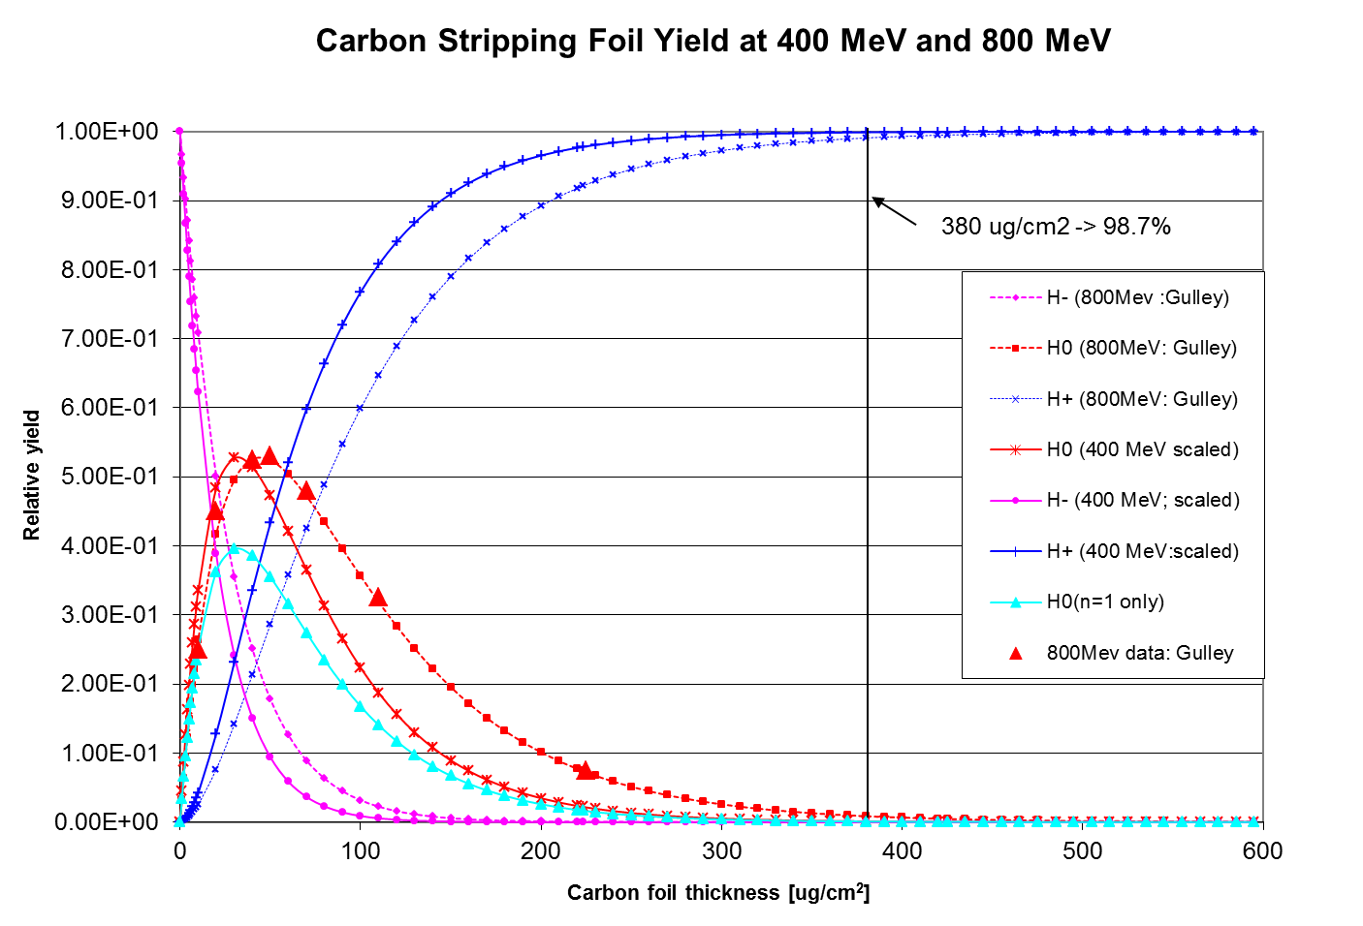
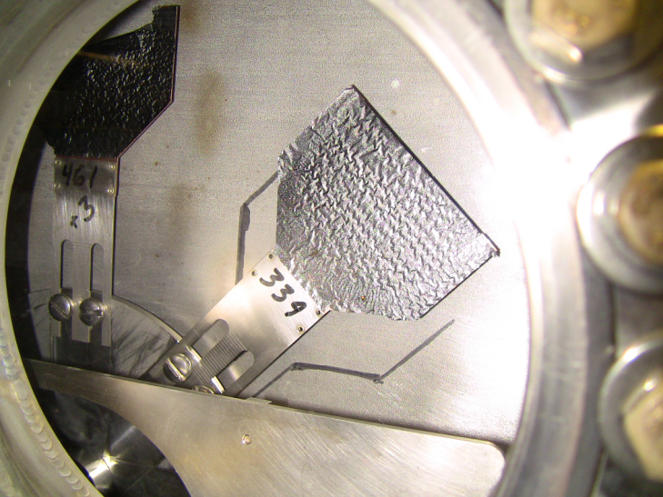
Injection Girder – Foil (PIP II numbers)
For a std. foil thickness 380 ug/cm² (1.15 mm)
400 MeV -> 99.9% efficiency to protons
800 MeV -> 99.1% efficiency to protons
To match 400 MeV efficiency at 800 MeV foil thickness needs to increase to ~ 545 ug/cm²
present foil holder
present foil
At 800 MeV with 7E12 injected at 15 Hz
Injection power increases to ~ 13 kW
For a 0.1% loss -> 13 Watts on downstream gradient magnet
Need to provide injection absorber
The space is very tight making an effective design difficult!

Slide 22
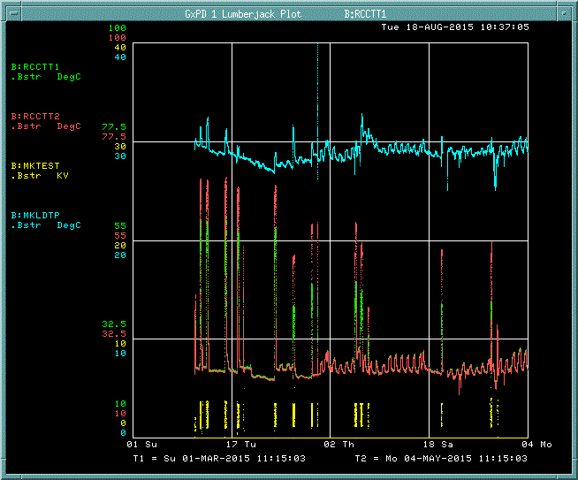
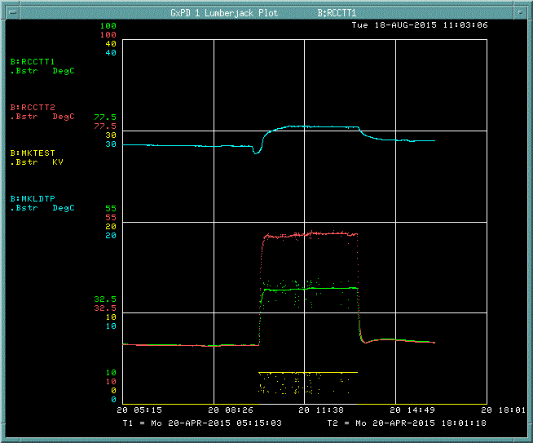
Booster Extraction Resonant Charging System Temperatures
Enhanced Cooling
Chassis modification
For cooler running at
20Hz.
15Hz
20Hz Running
20Hz
Internal RCC chassis Resistor Temp
PS HV on

Slide 23
20 Hz testing of pulsed systems
Testing and modifications of two pulsed systems
  Kickers
  ORBMP (3 element pulsed injection bump)
Both systems experienced high temps in the PS systems when run at 15 Hz
Solutions were developed that improved both systems
  Kickers PS improvements were demonstrated to allow operations at 20 Hz
  ORBMP could only be tested at 15 Hz

Slide 24
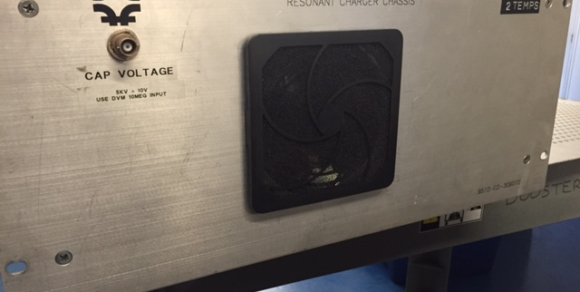
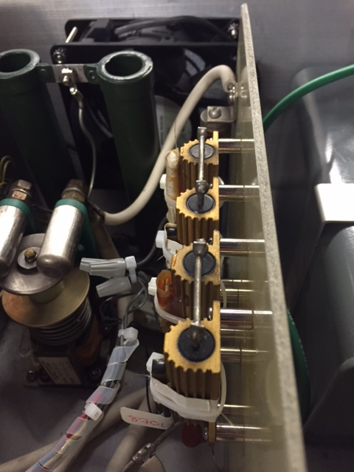
Kicker Power Supply Upgrades
Larger Fan
Enhanced Cooling Chassis modification
For cooler running at
20Hz.
Resistor Stand-offs

Slide 25
Beam Physics for Booster - examples
PIP goal of 2.3E17 pph has been driving our studies but PIP II benefits from the effort.
  Exploring the limitations and finding the optimal operating point
    Optics corrections (CY Tan, K. Seiya)
      Lots of new software
      A greatly improved lattice
      Mapping out higher order terms in the Booster gradient magnets
    Orbit and Tune control (A. Waller, K. Seiya)
      Software
      Tune optimization
    Dampers (N. Eddy, B. Pellico….)
      Limitations
      Growth rates
      Software
    Collimators (V. Kapin, R. Tesarek, T Sullivan)
      New primaries collimators – better suited for 400 MeV
      Improved analysis – use of MARS and MADX
      New diagnostics – fast
Notes:
“Beta corrections “ -> “optics corrections”

Slide 26
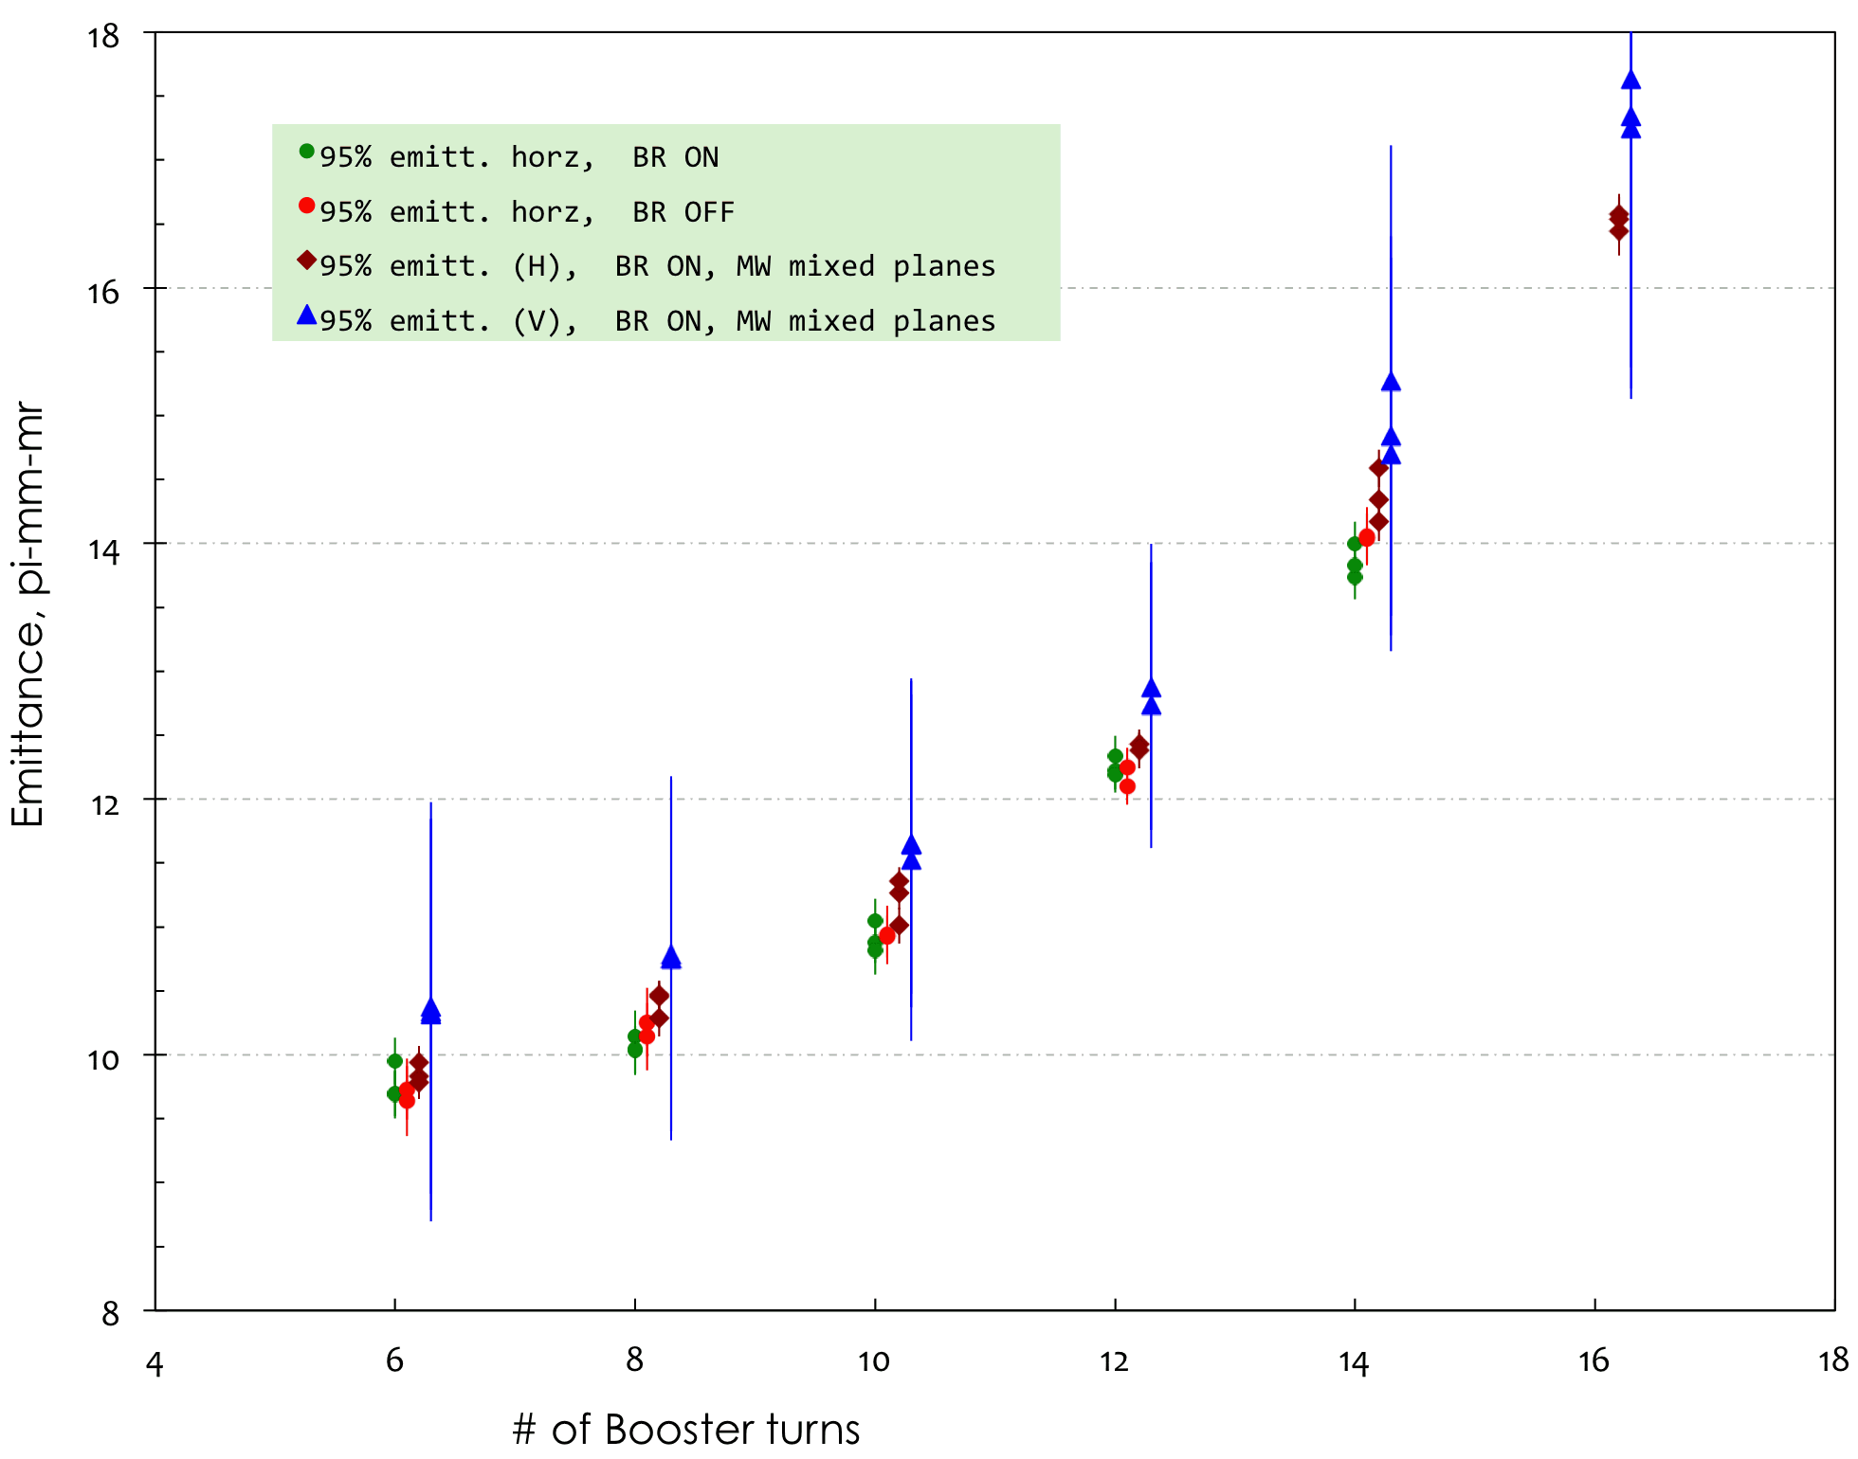
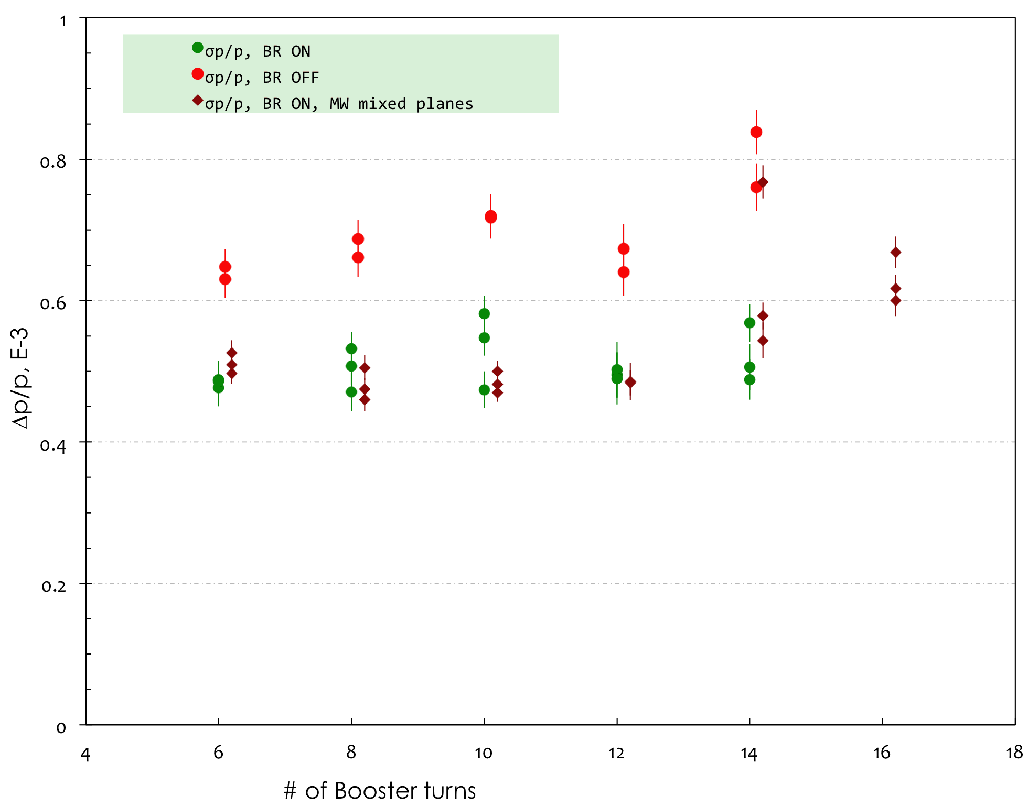
Beam physics Exploring emittance growth verses intensity
Emittance growth vs intensity
5.25E12 ppp
Longitudinal growth vs intensity
Higher intensity difficult – since not
part of normal operations it does
not get tuned on. Lots of parameters
need to be adjusted – takes time.

Slide 27
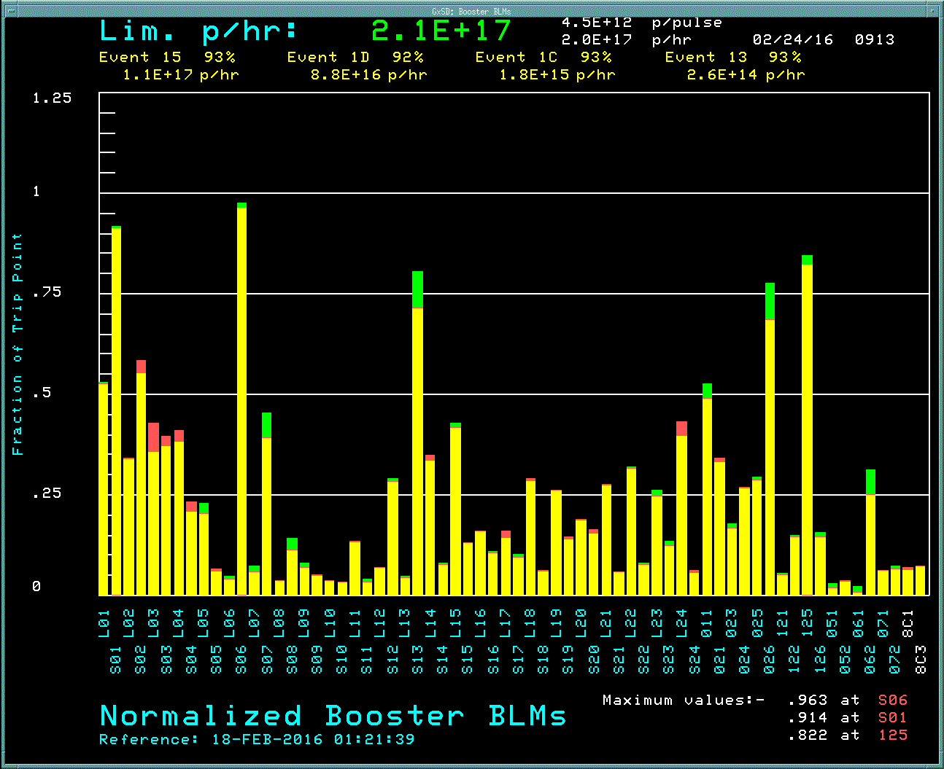
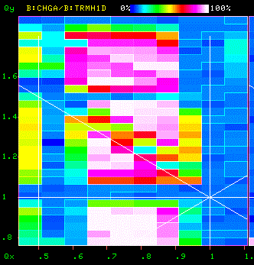
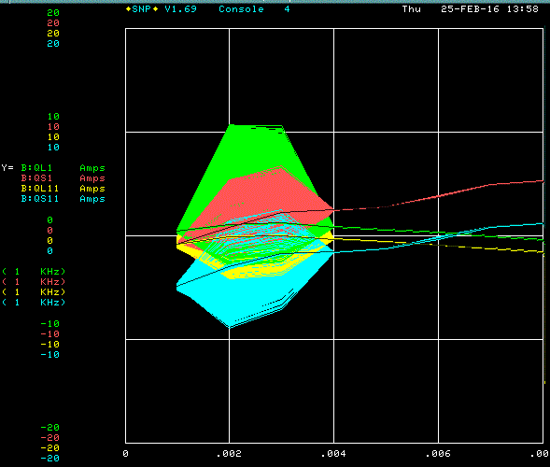
Increasing Booster intensity – operating point adjustments
What will it take to increase beam by 50%
Tune scans

Slide 28
Conclusion
While we wait for a funding to directly address items required for Booster PIP II operations, work is progressing under PIP and operations. Significant progress has been made in higher flux operations that directly impact PIP II plans and will help clarify additional work/studies as we transition from PIP to PIP II.
The transition will include items in the PIP II list above as well as the continuation of Booster beam physics work under PIP.
Glass half full: With present loss points while operating at 2E17 pph and peak intensities of ~ 5E12 has given us confidence in higher rate/intensity operations.
We will continue to identify issues and test solutions at as high intensity as operational limits allow.

Slide 29
Xtra slides
Slides from last year

Slide 30
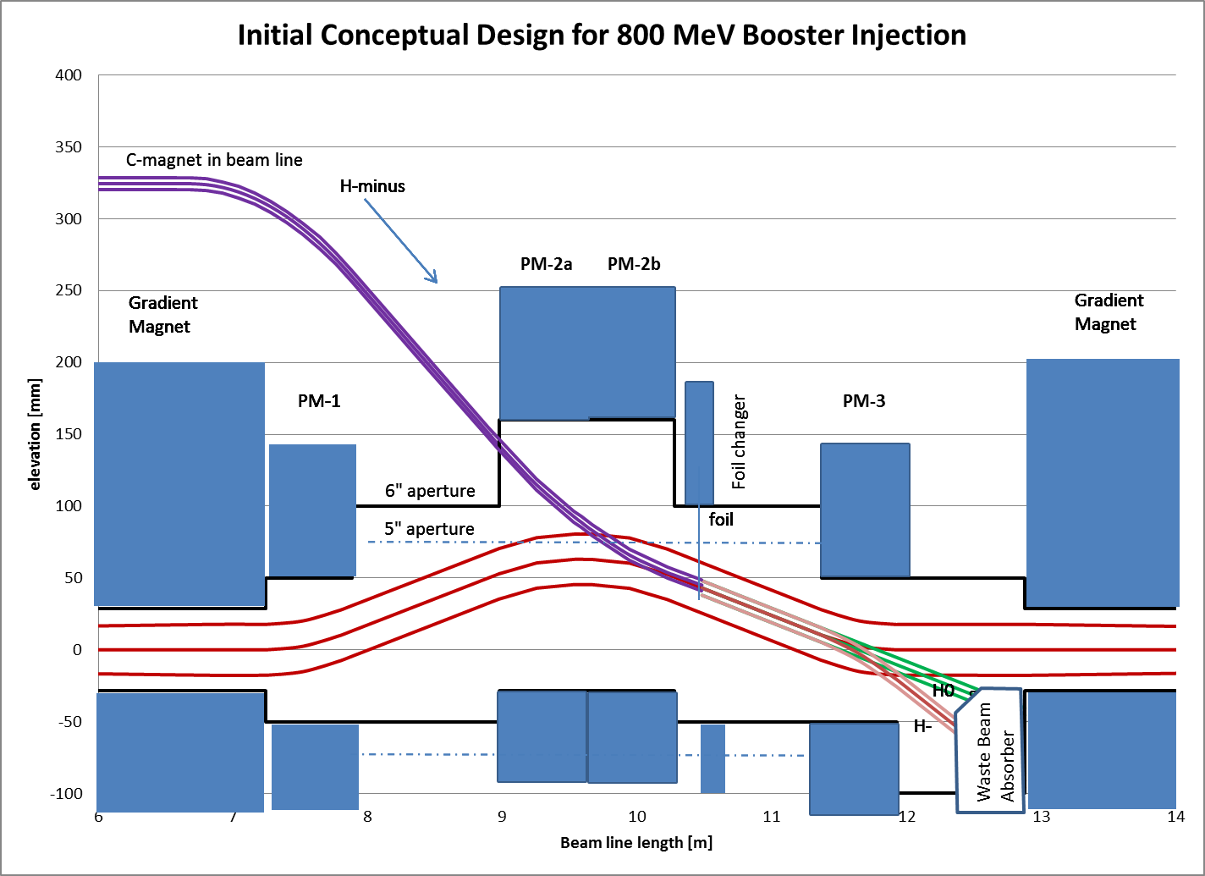
Vertical Injection Concept
Using a three-bump chicane within the unmodified length of the long straight section

Slide 31
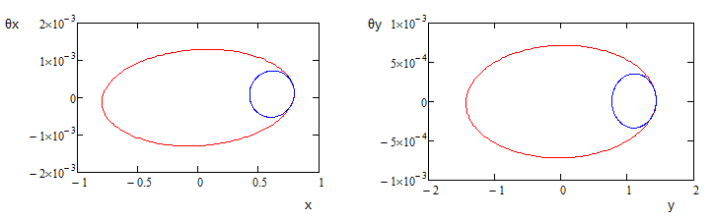
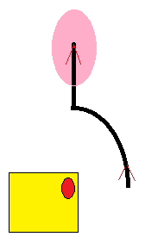
Injection painting* for space charge mitigation
Blue: injected beam (1.8 mm-mr 95% normalized emittance)
Red: phase space after painting (16 mm-mr 95% normalized emittance)
Yellow square is the injection foil,
Red ellipse is the injected linac beam stays at a fixed position on the foil
Black line indicates motion of the circulating closed orbit by H&V painting
magnets in ring
painting in H (~5.3 mm) & V (~9.5 mm), then vertically removed from foil.
*Results of a preliminary simulation - RDR

Slide 32
New injection girder
Beam can enter either horizontally or vertically
A new 3 bump system that can take 800 MeV beam (2x stronger)
Beam painting to mitigate space charge effects because of longer injection time (0.6 ms)
Carbon foil for stripping (presently 15 turns vs 315 turns for PIPII)
  Lifetime effects
New beam absorber for H⁰ and H⁻
  Build inside a gradient magnet
  Design new stronger and shorter gradient magnets to make space for an absorber (preferred)

Slide 33
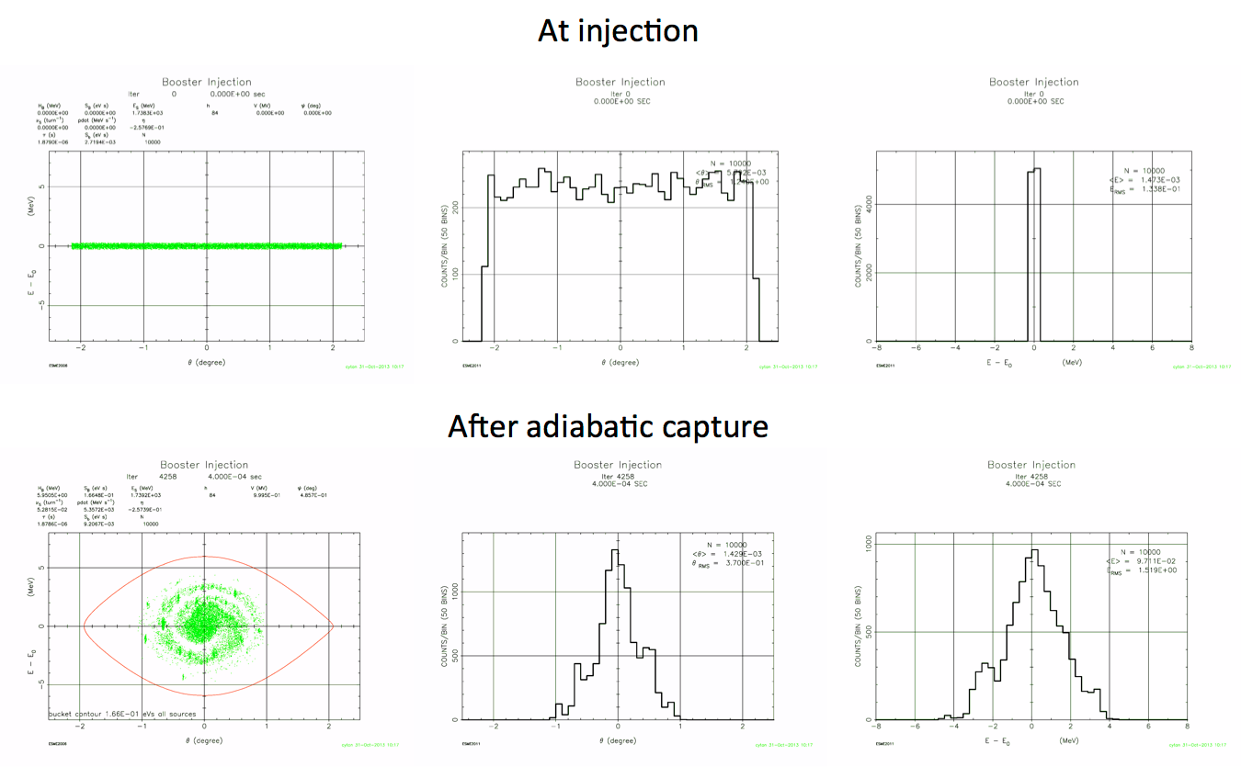
Capture (adiabatic at 800 MeV)
0.6 ms injection time
0.4 ms adiabatic ramp to full voltage (1 MV)

Slide 34
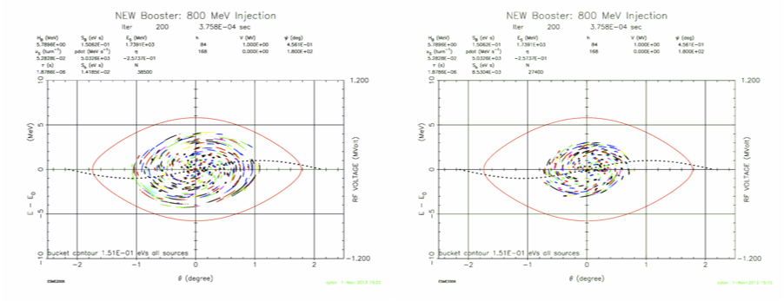
Capture (bucket to bucket injection)
Chopping 180 deg
Chopping 120 deg
0.6 ms injection time
Chopping is required to get the correct bunch pattern into the bucket
Linac 2 mA beam current for 0.6 ms provides 7.5e12 particles
May need flattened front porch for injection
Using Linac energy control vs. Booster ramp control needs to be studied

Slide 35
Booster RF – present RF cavity and options being discussed
Issues
Present cavities
will work over frequency range but reliability is a concern
  Modeling cavity properties
    Thermal issues
    Voltage breakdown
    Mechanical construction
  Rebuilt to operate at 15 Hz
  much of cavity remains original
have become increasing activated
have apertures that are similar to magnet – leaving no overhead for errors
New Cavity Discussion
  Two options:
  To be designed for present & PIP II Booster parameters
      Frequency sweep
      Beam power
      Transition and bunch rotation
  Design to meet the higher flux PIP II and future stages
      Wait till FNAL HEP/accelerator plan develops
        Design to be compatible with a new RCS (after PIP II)

Slide 36
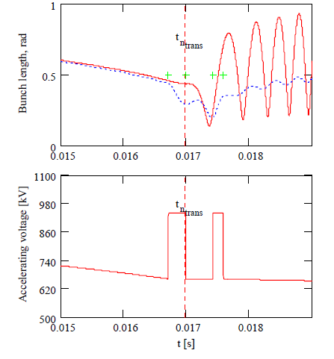
Transition Crossing
Transition crossing at 4.2 GeV
More RF for focusing during transition
~25% more RF implies 3 – 4 more RF cavities using present design (22 – 23 cavities)
Example shown here is the compensation of the effect of space charge that is defocusing before transition & focusing after transition
Increase RF voltage before transition
Increase RF voltage again to damp out quadrupole oscillation
Using quadrupole damper effectively also requires RF overhead

Slide 37
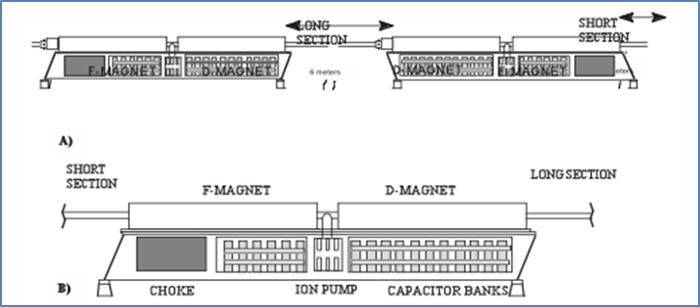
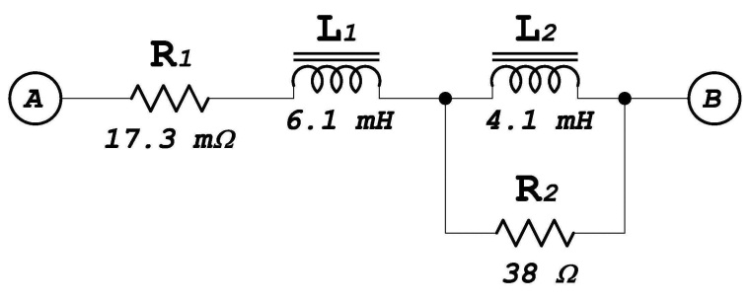
20 Hz operations
Booster magnet system
  Booster is a 15 Hz resonance synchrotron
Pulsed devices
  Injection bump system (above)
  Extraction systems
    Kickers
    Septas
    Correctors
Controls
  Lab built around 15 Hz clock system

Slide 38
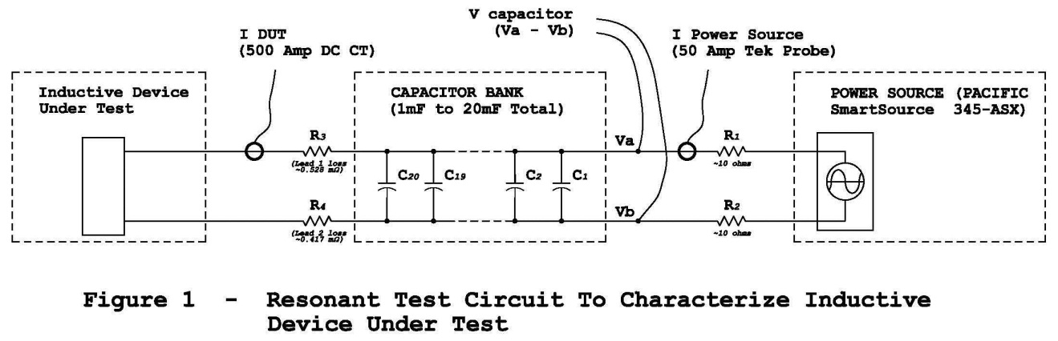
Booster Magnets - 20 Hz
We have looked at Booster 20 Hz operations several times….most recently by AD/EE support (George Krafczyk)
  ‘Measurements were performed on both a Booster gradient magnet and a Booster choke with the intent to compare the 15 Hz losses with the 20 Hz losses for a proposed Booster upgrade.’
  This analysis suggests that running the booster at 20 Hz with a current equal to the present 15 Hz Booster will require about 3.9% more power. Capacitor voltage will increase by about 32% and the resonant capacitor at each “Girder” must decrease from ~8.33 mF to ~4.69 mF. This also carries the implication that the RMS current per µF will also increase as well.

