Slide 1
Superconducting RF: LB650 and HB 650 Status
Tom Nicol
PIP-II Machine Advisory Committee Meeting
15-17 March 2016

Slide 2
Linac map

Slide 3
General cryomodule parameters

Slide 4
Cryomodule heat loads in CW

Slide 5
Overview of 650 MHz related activities
Low beta cavities
Fermilab – RF and end group design
VECC – Bare and dressed cavity mechanical design and fabrication
High beta (0.92) cavities
Fermilab – RF and bare and dressed mechanical design
RRCAT – Bare and dressed cavity fabrication
High beta (0.90) cavities (beta 0.90 is an earlier design, superseded by 0.92 – both will be used in the first high beta cryomodule)
Fermilab – Bare and dressed cavity design and fabrication
High beta cryomodule
Fermilab and RRCAT – Complete cryomodule design
There is no current effort on LB650 cryomodule design
Tuner design and fabrication
Fermilab – Prototype tuner design and fabrication
Input coupler design and fabrication
Fermilab – Prototype coupler design and fabrication

Slide 6
LB650 cavity milestones
Low beta 0.61 cavities
Deliverable | Responsible | Date
Fabricate 1-cell bare cavity | VECC | Complete
Process and test 1-cell bare cavity | VECC and Fermilab | April 30, 2016
Cavity RF and end group design | Fermilab | February 29, 2016
Mechanical design of 5-cell cavity | VECC | June 30, 2016
Final design review of 5-cell cavity | VECC | August 31, 2016
Helium vessel and tuner interface design | VECC | September 30, 2016
Fabricate 1st 5-cell bare cavity | VECC | November 15, 2017
Process and VTS test 1st 5-cell bare cavity | VECC | March 30, 2018
Fabricate 1st 5-cell dressed cavity | VECC | September 30, 2018
Test 1st 5-cell dressed cavity | Fermilab | December 31, 2018
Fabricate 2nd 5-cell bare cavity | VECC | March 31, 2018
Process and VTS test 2nd 5-cell bare cavity | VECC | September 30, 2018
Fabricate 2nd 5-cell dressed cavity | VECC | March 31, 2019
Test 2nd 5-cell dressed cavity | Fermilab | May 31, 2019
Primary deliverables

Slide 7
HB650 (0.92) cavity and cryomodule milestones
High beta 0.92 cavities
Deliverable | Responsible | Date
Cavity RF, end group, and mechanical design | Fermilab | Complete
Helium vessel and tuner interface design | Fermilab | June 30, 2016
Fabricate 1st 5-cell bare cavity | RRCAT | November 15, 2016
Process and VTS test 1st 5-cell bare cavity | RRCAT | May 15, 2017
Fabricate 1st 5-cell dressed cavity | RRCAT | December 15, 2017
Test 1st 5-cell dressed cavity | RRCAT and Fermilab | April 30, 2018
Fabricate, process, VTS, dress, high power test 1 cavity | RRCAT | September 30, 2018
Fabricate, process, VTS, dress, high power test 2 cavities | RRCAT | December 30, 2018
Fabricate 4 dressed cavities | RRCAT | December 31, 2017
Fabricate 4 tuner assemblies | RRCAT | March 31, 2018
High beta 0.92 cryomodules
Deliverable | Responsible | Date
Cryomodule design | RRCAT and Fermilab | July 31, 2017
Helium vessel and tuner interface design | Fermilab | June 30, 2016
Primary deliverables

Slide 8
HB650 (0.90) cavity and ancillaries milestones
High beta 0.90 cavities
Deliverable | Responsible | Date
Cavity RF, end group, and mechanical design | Fermilab | Complete
Fabricate 4 bare cavities | Fermilab and AES | Compete
Fabricate 5 bare cavities | Fermilab and Pavac | April 30, 2016
Helium vessel and tuner interface design | Fermilab | May 30, 2016
Process first 4 cavities | ANL and AES | June 30, 2016
Fabricate 1st 5-cell dressed cavity | Fermilab | September 30, 2016
Ancillaries
Deliverable | Responsible | Date
Design prototype tuner for beta 0.61, 0.90, 0.92 | Fermilab | March 31, 2016
Fabricate prototype tuner | Fermilab | September 30, 2016
Design input coupler for beta 0.61, 0.90, 0.92 | Fermilab | September 30, 2016
Primary deliverables

Slide 9
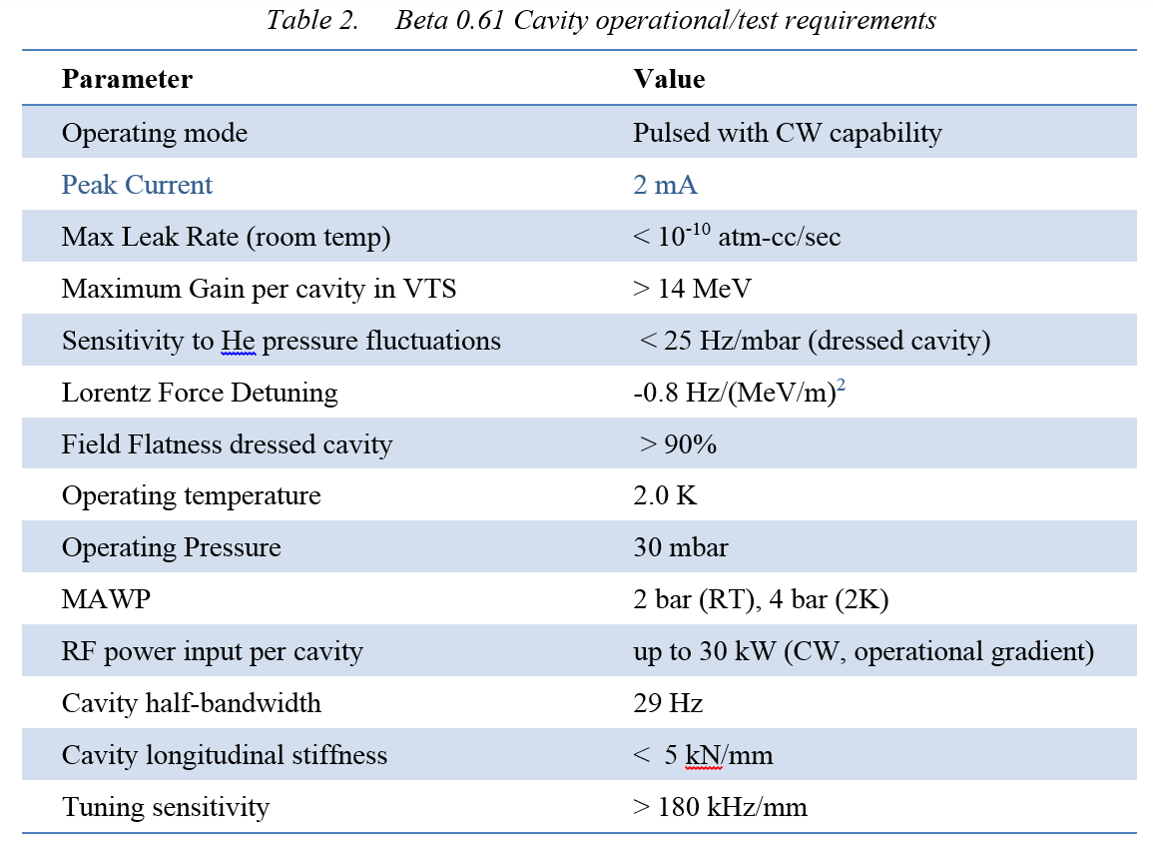
Performance parameters from the FRS (ED0001834)
Operational requirements from the FRS (ED0001834)

Slide 10
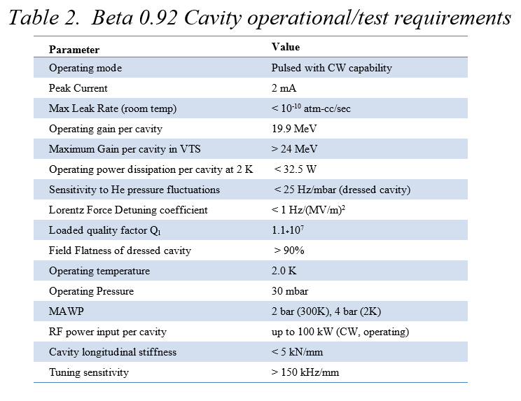
Performance parameters from FRS (ED0001321)
Operational requirements from FRS (ED0001321)

Slide 11
Low and high-β cryomodule general requirements
Low-β FRS: ED0001830
General
 | Physical beam aperture, mm | 83
 | Overall length (flange-to-flange), m | 3.9
 | Overall width, m | ≤1.6
 | Beamline height from the floor, m | 1.3
 | Cryomodule height (from floor), m | ≤2.00
 | Ceiling height in the tunnel, m | 3.20
 | Max allowed heat load to 70 K, W | 100
 | Max allowed heat load to 5 K, W | 15
 | Max allowed heat load to 2 K, W | 100
 | Maximum number of lifetime thermal cycles | 50
 | Intermediate thermal shield temperature, K | 45-80
 | Thermal intercept temperatures, K | 5 and 45-80
 | Cryo-system pressure stability at 2 K (RMS), mbar | ~0.1
 | Environmental contribution to internal field | <0.1 mG
 | Transverse cavity alignment error, mm RMS | <0.5
 | Angular cavity alignment error, mrad RMS | ≤5
Cavities
 | Number, total per cryomodule | 3
 | Frequency, MHz | 650
 | β geometric | 0.61
 | Operating temperature, K | 2
 | Operating mode | CW and pulsed (0-100%)
 | Operating energy gain, MV/m | 17.7
 | Coupler power rating (TW, full reflection), kW | 120
High-β FRS: ED0001322
General
 | Physical beam aperture, mm | 118
 | Overall length (flange-to-flange), m | 9.5
 | Overall width, m | ≤1.6
 | Beamline height from the floor, m | 1.3
 | Cryomodule height (from floor), m | ≤2.00
 | Ceiling height in the tunnel, m | 3.20
 | Max allowed heat load to 70 K, W | 300
 | Max allowed heat load to 5 K, W | 25
 | Max allowed heat load to 2 K, W | 220
 | Maximum number of lifetime thermal cycles | 50
 | Intermediate thermal shield temperature, K | 45-80
 | Thermal intercept temperatures, K | 5 and 45-80
 | Cryo system pressure stability at 2 K (RMS), mbar | ≤0.1
 | Environmental contribution to internal field | 10 mG
 | Transverse cavity alignment error, mm RMS | <0.5
 | Angular cavity alignment error, mrad RMS | ≤1
Cavities
 | Number, total per cryomodule | 6
 | Frequency, MHz | 650
 | β geometric | 0.92
 | Operating temperature, K | 2
 | Operating mode | Pulsed and CW
 | Operating energy gain, MV/m | 17.7
 | Maximum cavity heat load to 2 K, W (each) | 30
Tables from FRS

Slide 12
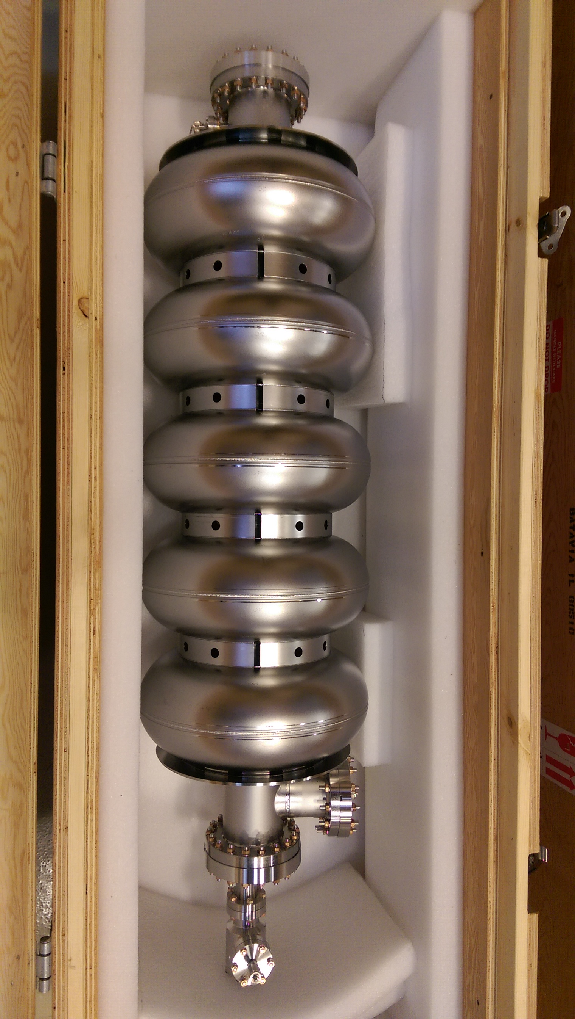
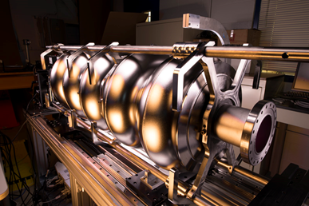
650 MHz Multi-cell Photos
Optical Inspection of 5-cell B=0.9 650 MHz cavity
Four beta 0.9 cavities have been received from AES and are being prepared for processing
5-cell B=0.9 650 MHz cavity prepared for vertical testing.
Notes:
You should note who the vendor is on this.

Slide 13
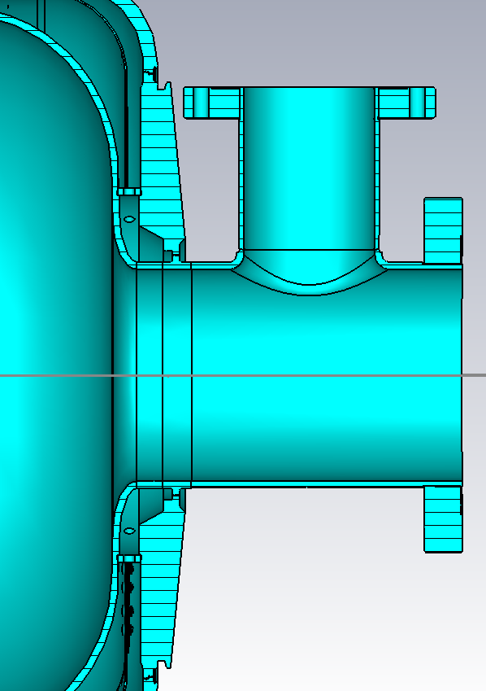
Low beta 650 MHz cavity end group
Power coupler end group design details developed at Fermilab and made available to VECC for low beta cavity design
FPC end group
Ø=72.9 mm
L=160 mm
L=98 mm
Ø=118 mm
Lbeam_Pipe=183 mm

Slide 14
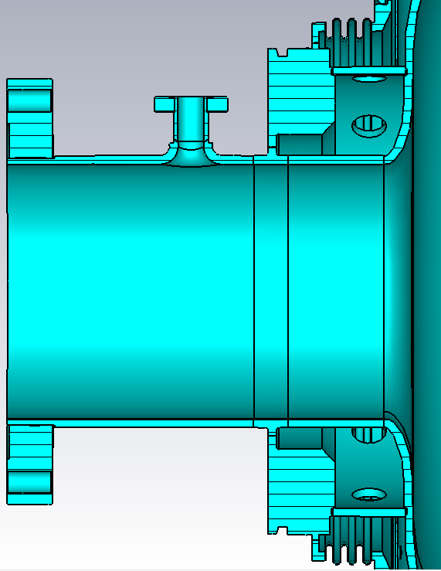
Low beta 650 MHz cavity end group
Field probe and tuner end group
Tuner end group design details developed at Fermilab and made available to VECC for low beta cavity design
Ø=12 mm
L=89.5mm
L=91 mm
L=176 mm
Ø=118 mm

Slide 15
High beta 650 MHz dressed cavity
Beta 0.92 dressed cavity and tuner being developed at Fermilab
When completed, final design will be made available to RRCAT
Power coupler port
Tuner
Helium vessel and pipe connections are compatible with HTS-2

Slide 16
High beta 650 MHz dressed cavity
Analysis work is ongoing to determine the effectiveness of an internal magnetic shield
Internal magnetic shield

Slide 17
High beta 650 MHz cryomodule
High beta cryomodule being developed jointly between Fermilab and RRCAT
Heat exchanger and relief line
Valves and transfer line connections
Tuner access ports
The design being developed will house both beta 0.90 and 0.92 dressed cavities

Slide 18
High beta 650 MHz cryomodule
Vacuum relief
Beam gate valve
Input coupler ports
Instrumentation ports

Slide 19
Lab 2 cleanroom
Lab 2 in the Fermilab village is being converted to cleanroom, HPR, and cryomodule assembly space for both SSR and 650 MHz cavity activities

Slide 20
Summary
Low beta cavities
RF and end group designs have been made available to VECC
High beta (0.92) cavities
Mechanical bare cavity design drawings have been made available to RRCAT
Detailed design work has started at RRCAT
Helium vessel and integration design is in-process at Fermilab
High beta (0.90) cavities
Four bare cavities are in-house and Fermilab and are being processed
Five more are in-process at Pavac
Helium vessel and integration design is in-process at Fermilab
High beta cryomodule
Detailed design work is in-process at Fermilab and RRCAT, loosely divided between cavity string and cold mass (Fermilab) and vacuum vessel and thermal shield (RRCAT)
Tuner design and fabrication
Prototype design and analysis is in-process at Fermilab (Fermilab and RRCAT engineers)
Goal is to have a common tuner design for all low and high beta cavities
Input coupler design and fabrication
Previous coupler work needs to be restarted at Fermilab
Goal is to have a common coupler design for all low and high beta cavities

