Slide 1
Superconducting RF:
Resonance Control
Presented by Yuriy Pischalnikov
for W. Schappert, Y.Pischalnikov, J.Holzbauer
PIP-II Machine Advisory Committee
15 March 2016

Slide 2
SRF Cavity Detuning
SRF cavity cells often formed from thin (2-4mm) sheets of pure niobium to allow them to be cooled below superconducting transition temperature
  Thin walls make cavities susceptible to detuning from vibration
  Detuned cavities require more RF power to maintain accelerating gradient
  Providing sufficient RF reserve power to overcome cavity detuning increases both capital and operational cost of machine
Controlling cavity detuning critical for current generation of machines, (LCLS-II, PIP-II, ERLs, etc.) that employ very narrow bandwidth cavities
  For machines with very narrow bandwidth cavities, e.g. ERLs, detuning can be the major cost driver for the entire machine

Slide 3
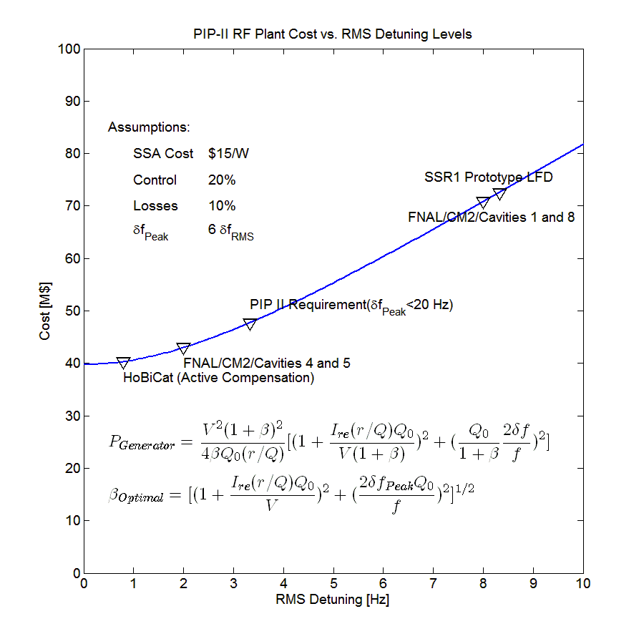
Cost of Cavity Detuning
Detuned cavities require more RF power to maintain constant gradient
PEAK detuning drives the RF costs
    Beam will be lost if RF reserve is insufficient to overcome PEAK detuning
  Providing sufficient reserve increases both the capital cost of the RF plant and the operating cost of the machine

Slide 4
Challenge of Detuning Control
Maury Tigner ERL2015
https://indico.bnl.gov/getFile.py/access?contribId=1&sessionId=2&resId=0&materialId=slides&confId=909

Slide 5
Controlling Cavity Detuning
Cavities may be detuned by either deterministic sources or non-deterministic sources
  Deterministic sources include
    Radiation pressure on cavity walls (Lorentz Force)
  Non-deterministic sources include
    Cavity vibrations driven by external noise sources
    Helium pressure fluctuations
Cavity detuning can be controlled using either passive or active measures
  Passive measures include
    Suppressing external vibration sources
    Reducing cavity sensitivity to sources of detuning, e.g. df/dP, LFD,…
  Active measures include
    Sensing cavity detuning in real-time and using piezo or other actuators to actively cancel detuning
      Deterministic sources may be cancelled using feed-forward
      Non-deterministic sources require feed-back

Slide 6
Detuning in the PIP-II Cavities
PIP-II design calls for narrow bandwidth (f1/2 ≅30 Hz) cavities operating in pulsed mode
  Narrow bandwidth makes cavities susceptible to vibration induced detuning
  Pulsed mode LFD can excite vibrations
PEAK detuning of PIP-II cavities must be limited to 20 Hz or less
  PIP-II cavities will require active detuning compensation of both LFD and microphonics during routine operation
    Will require combination of
      best LFD compensation achieved to date
      AND best active microphonics compensation achieved to date
      AND 24/7 operation over hundreds of cavities for several tens of years
No examples of large machines that require active detuning control during routine operation currently exist
 | N | f | Q₀ | r/Q | E | L _{Effective} | Voltage | Current | Control | Losses | P_{Beam}
 |  | MHz | 10⁹ | Ω | MV/m | m | MV | mA | % | % | kW
HWR | 8 | 162.5 | 5.0 | 275 | 9.7 | 0.21 | 2.01 | 2 | 20 | 10 | 4.02
SSR1 | 16 | 325 | 6.0 | 242 | 10.0 | 0.21 | 2.05 | 2 | 20 | 10 | 4.10
SSR2 | 35 | 325 | 8.0 | 296 | 11.4 | 0.44 | 4.99 | 2 | 20 | 10 | 9.99
LB650 | 33 | 650 | 15.0 | 375 | 15.9 | 0.75 | 11.86 | 2 | 20 | 10 | 23.72
HB650 | 24 | 650 | 20.0 | 609 | 17.8 | 1.12 | 19.92 | 2 | 20 | 10 | 39.84

Slide 7
Detuning Control Program for PIP-II (March 2015)
Demonstrate CW Microphonics Compensation
Demonstration of feasibility is current focus
Focus must shift at some point to engineering a robust integrated electro-mechanical control system
Reliable operation can only be ensured by extensive program of testing of both components and integrated system
Demonstrate Pulsed LFD Compensation
Prototype Integrated Electro-mechanical Controller Development
System Engineering
System Validation and Testing

Slide 8
Conclusions (March 2015)
Controlling cavity detuning will be critical for successful operation of PIP-II because of narrow cavity bandwidths (f1/2~ 30 Hz)
  Narrow bandwidths would be challenging even with CW operation alone
  Pulsed mode operation brings significant additional complications
All possible passive measures must be exploited but active control will still be required
  Will require both best LFD and best microphonics compensation achieved to date operating reliably over many cavities and many years
    Early test results provide reason for CAUTIOUS optimism
  There are no existing examples of large machines that require active control of detuning during routine operation
  Cross-disciplinary challenges may be more difficult to solve than technical challenges (which are still considerable)
    Minimizing cavity detuning requires optimization of entire machine
    Will require active coordination across divisions and across disciplines

Slide 9
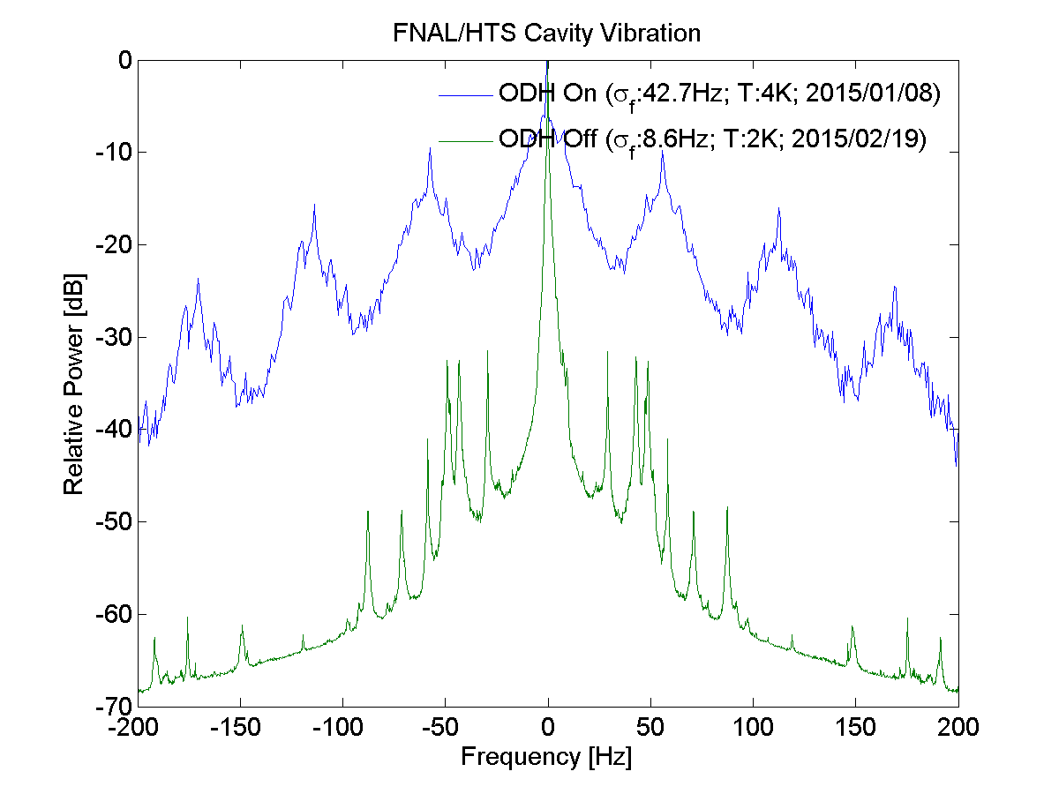
Cross-disciplinary Challenges (March 2015)
Minimizing cavity detuning requires careful optimization across entire machine
  Cavity design, cryomodule design, RF plant, cryogenic system design, civil engineering
    Cross-disciplinary challenges may be more daunting than technical challenges
Large potential costs if any aspect ignored
  Small design changes may have large impact on cavity detuning
  Cost of fixing microphonics afterwards could be very high
Some structure within PIP-II organization will be required to coordinate effort amongst groups and disciplines
  Education and communication
  Vibration related reviews

Slide 10
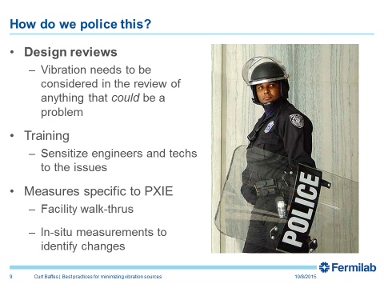
Progress on Passive Measures
PIXIE Best Practices Document (Curtis Baffes)
Vibration Testing Plan for LCLS-II Prototype Cryomodule
(J. Holzbauer)
  Based on JLab experience
  Dry run for PIP-II

Slide 11
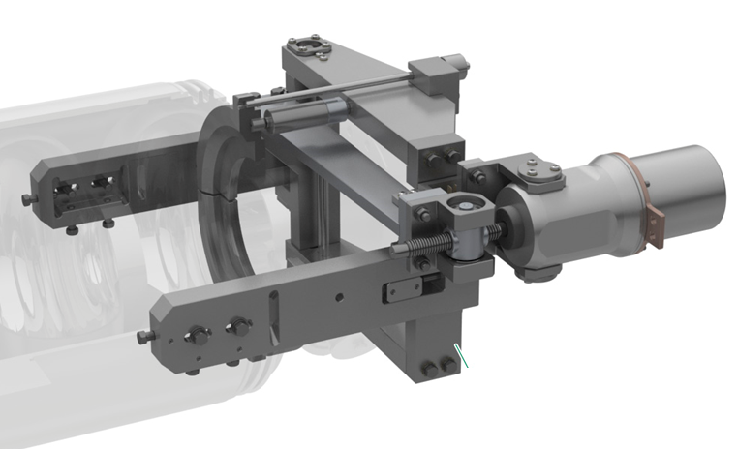
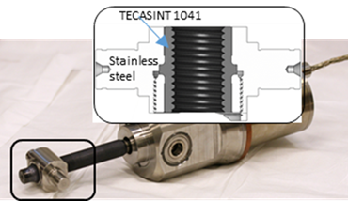
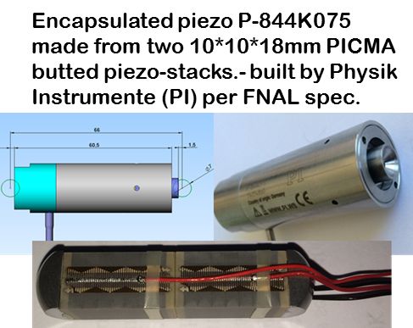
Tuner reliability
(R&D program in collaboration with Phytron and PI (Physics Instrumente) to develop reliable active components for the tuner)
RELIABILITY OF THE LCLS II SRF CAVITY TUNER
Yu.Pischalnikov, et al. SRF 2015
Electromechanical Actuator (LVA 52-LCLS II-UHVC-X1):
- Phytron stepper motor
- Planetary gear box (1:50)
- M12X1 spindle made form titanium
- Traveling nut made from SS with TECASINT-1041
Actuator tested for 30lifetimes of LCLS II
(600year operation)

Slide 12
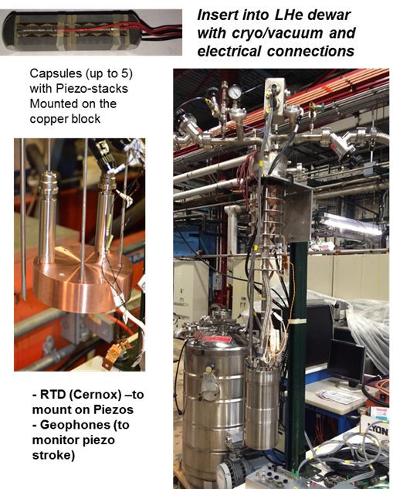
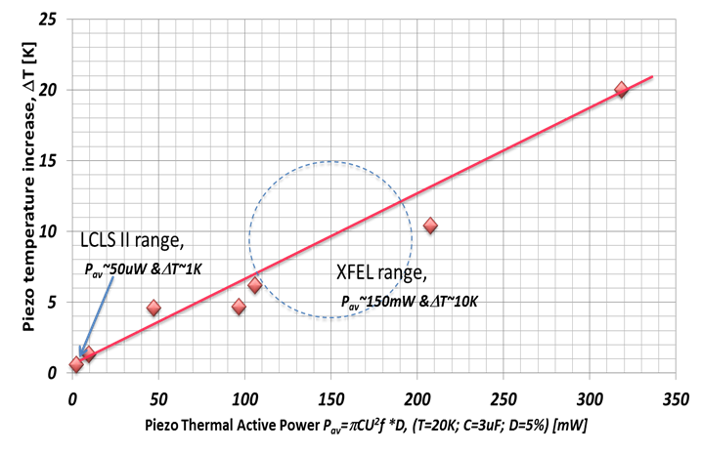

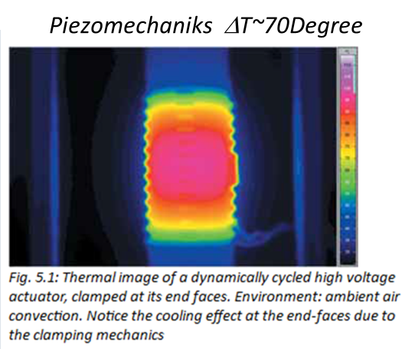
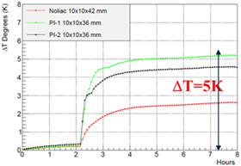
High reliability of tuner components (piezo-actuator)
Accelerated Piezo Lifetime test at FNAL
Designated facility at FNAL to test piezo at the CM environment (insulated vacuum and LHe)
LCLS II Tuner piezo-stacks run for 2.5*10¹⁰ pulses (or 125% of LCLS II expected lifetime) without any degradation or overheating

Slide 13
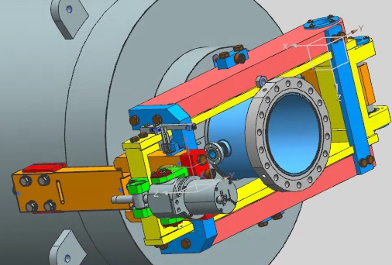
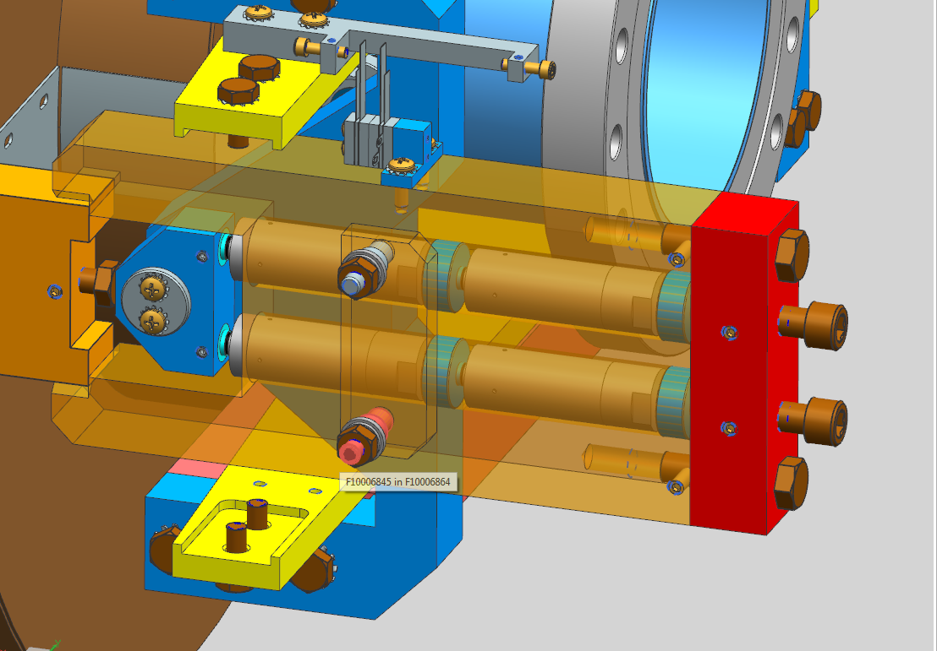
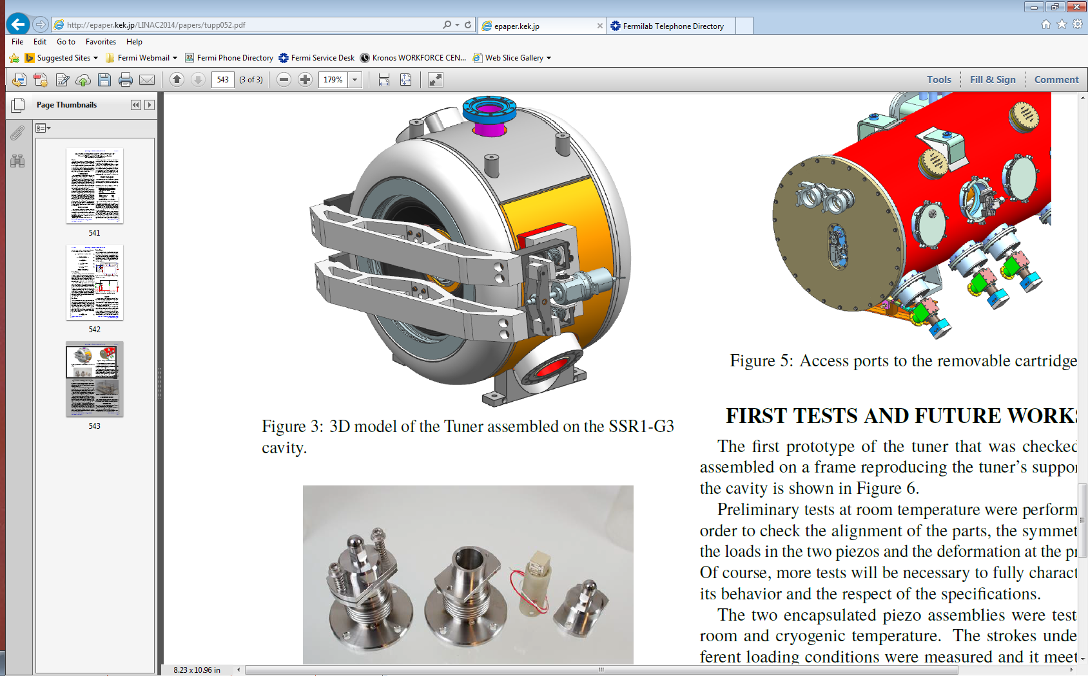

SRF Cavities Tuners for PIP II
650MHz tuner designed with active components developed for LCLS II (electromechanical actuator/Phytron & piezo-capsule /PI)
325MHz tuner designed much early… Phytron actuator included in design.. But Piezo-capsule (PI) was not available yet… Several cold tests of 325MHz cavity/tuner with Noliac piezo illustrated low reliability of selected piezo tuner. At this moment modification is under way to replace Noliac to PI capsulated piezo (LCLS II solution)

Slide 14
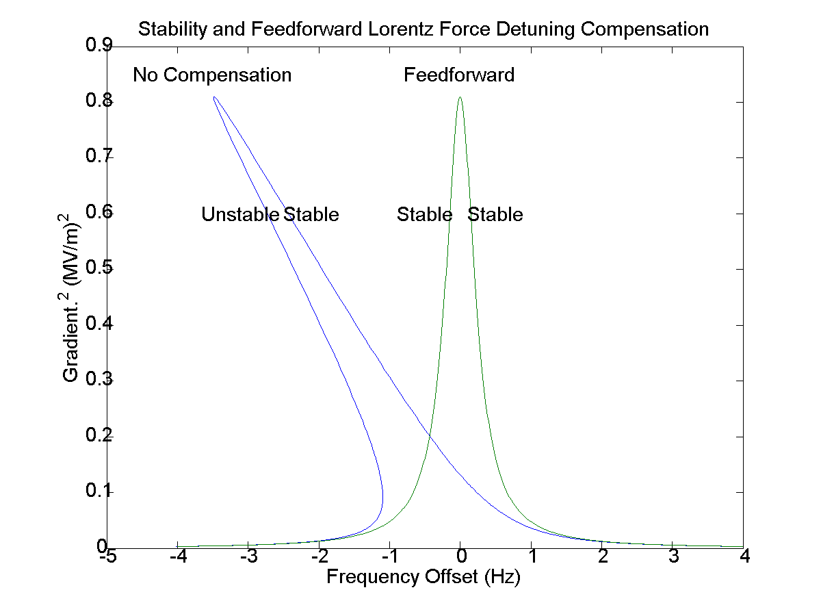
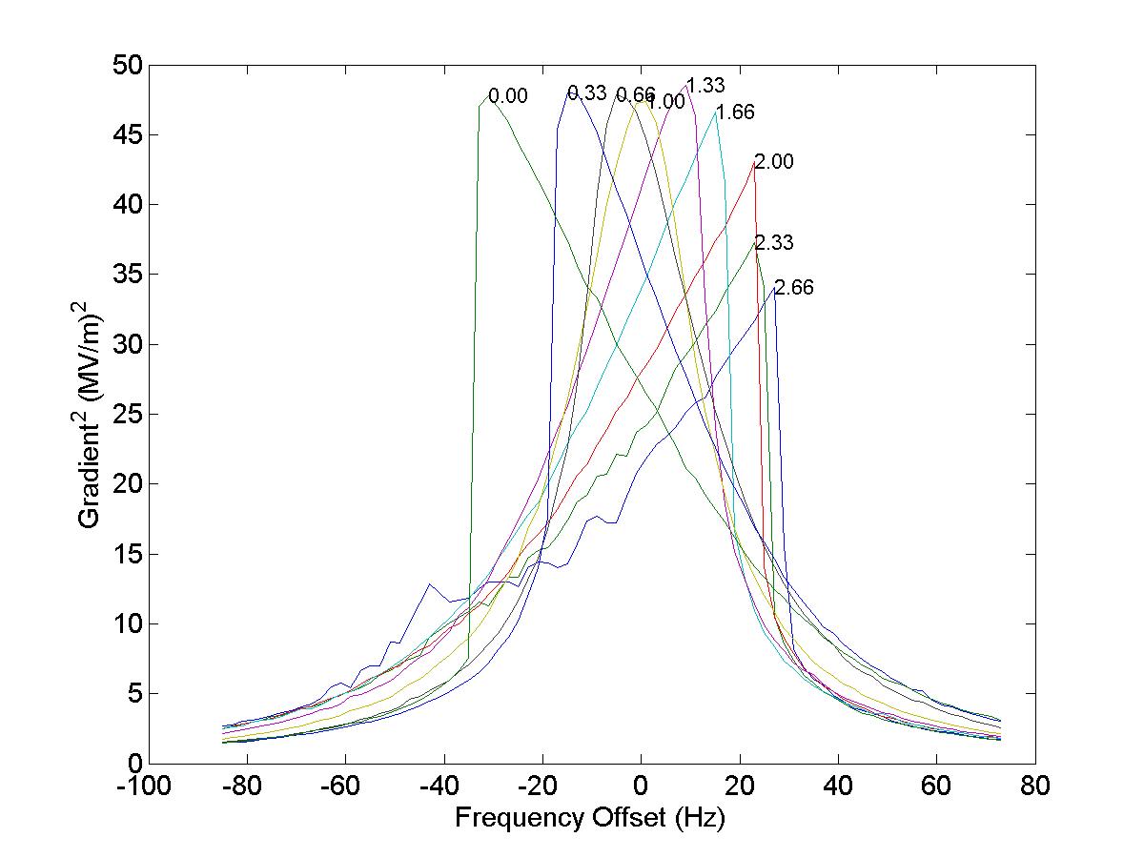
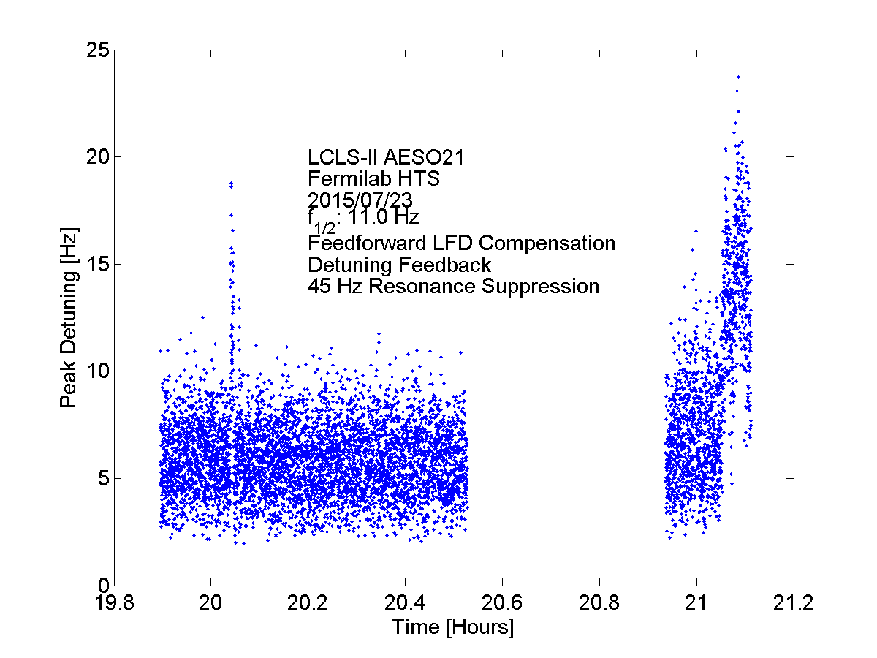
Progress on Active Measures
PIP-II and LCLS-II CW tests
Feed-forward compensation of Ponderomotive instability demonstrated
  Previously demonstrated at Cornell
    https://www.classe.cornell.edu/rsrc/Home/Research/ERL/ErlPubs2009/Fast.pdf
Better understanding of cavity behavior
Progress limited by cold-cavity access

Slide 15
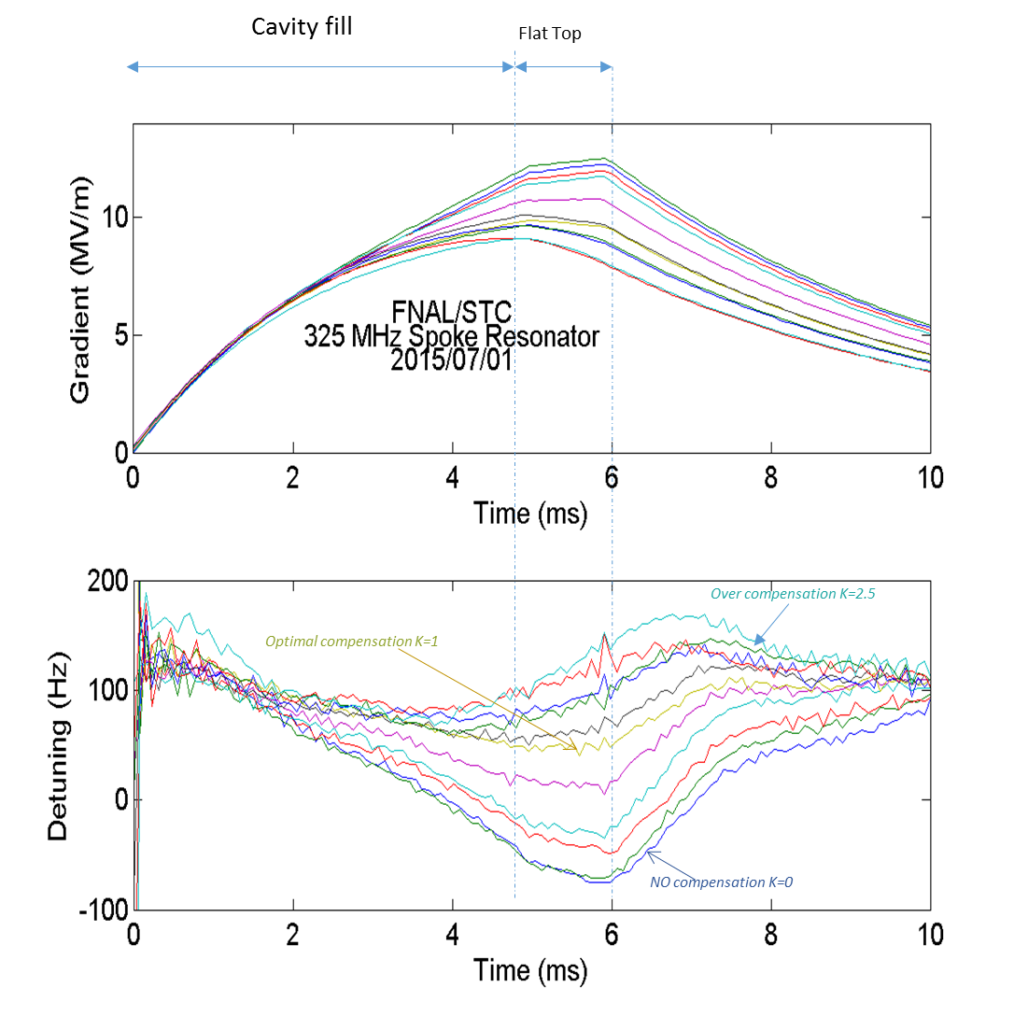
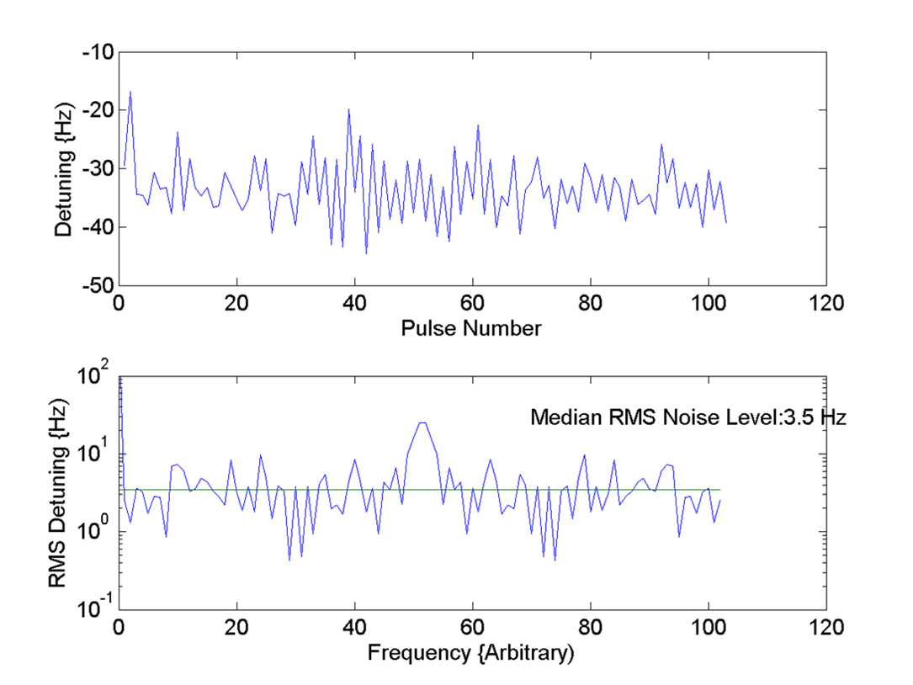
Compensation of the Lorentz Force Detuning in Pulsed SSR1 (325MHz) cavity (STC/FNAL)
Feed-forward LFD compensation proportional to Eacc ²
Pulse-to-pulse variation is more problematic
RMS pulse to pulse detuning approximately 10 Hz
(with PIP II target ~3.5Hz)
Mean detuning during flattop shows systematic effects
- Compensation possible if source can be identified
Residual non-deterministic detuning likely 4 Hz or less
- It is already close to the PIP-II target
Improvements likely
- Effective feedback not operational during this test

Slide 16
Integrated Electro-Mechanical Controller (March 2015)
  Measure SSR1 mechanical transfer functions
  Detuning response to mechanical and LFD excitations as a function of frequency
Extract low order approximation to transfer mechanical functions
  Minimal State Space Realization (MSSR) algorithm of Kalman and Ho
Construct optimal coupled electro-mechanical filters and controllers from low-order transfer functions
  Kalman filter
  Linear Quadratic Gaussian Regulator
    Recursive, weighted, least-squares fit at each point in time minimizes quadratic cost function that depends on transfer-functions and noise covariance

Slide 17
System Engineering for PIP-II (March 2015)
Detuning control crosses boundaries between divisions and between disciplines
  Robust system is required for machine operation
Focus must shift need to shift towards engineering high-reliability system
  Integration of algorithms with LLRF control system
  Will require extensive testing of all hardware, firmware, software
Cryogenic
Fluctuations
External
Vibrations
Compensation Algorithms
RF Signals
Piezo
Tuner

Slide 18
Looking Forward (March 2015)
Upcoming tests of SSR1 offer opportunity to
  Finalize CW algorithms
  Investigate pulsed mode operation
  Measure expected RF and performance parameters
Focus must then shift to integration of algorithms into an integrated electro-mechanical control system
  Will require close collaboration between TD/RC and AD/LLRF groups
Robust system will require careful system engineering and extensive testing of all hardware, firmware and software
Need to arrive at consensus on mechanism(s) within PIP-II organization to coordinate detuning control efforts

Slide 19
Conclusions
Some encouraging progress on passive measures
  Best practices (Curtis Baffes)
  LCLS-II Prototype Cryomodule Vibration Testing
  More to be done
Some progress on active measures
  Better understanding of cavity behavior based on tests conducted over last year
  Well defined program
  Still more to be done
    Progress limited by cold cavity access

