Slide 1
Effect of Interstitial Impurities on the Field Dependent Microwaves Surface Resistance of Niobium
Martina Martinello
New Perspective, Fermilab
14th July 2016

Slide 2
Outline
Introduction
BCS Surface Resistance
Trapped Flux Sensitivity
Q-factors vs Mean free path
Best Surface Treatment
Conclusions

Slide 3
SRF Cavities Figure of Merits
SRF Cavities Figure of Merits
Q-factor ($Q_{0}$):
$$Q_{0}=\frac{G}{R_{s}}=\frac{ω_{0}U}{P_{d}}$$
High $Q_{0}$ → lower power consumption
Accelerating field ($E_{acc}$):
Determine the energy transferred to charged particles
High $E_{acc}$ → lower accelerator length
Standard ILC cavity
High Q at large gradient may reduce both capital and operational costs of accelerators

Slide 4
Experimental procedure
Large variety of 1.3 GHz single cavities with different surface treatments:
standard Nb treatments: 120 C baking, electro-polishing (EP)
different N-doping treatments
Surface resistance contributions analysis for each cavity
Mean free path determination for each cavity

Slide 5
BCS Surface Resistance
$$R_{S} \left( 2 K,B_{Trap} \right)={R_{BCS} \left( 2 K \right)+R}_{0}+R_{Fl} ( B_{Trap},l )$$
R_{BCS} defines by Mattis and Bardeen and based on the Bardeen-Cooper-Schrieffer theory of superconductivity:
$$R_{BCS}=A{(λ_{L},l,∆,ξ_{0},f_{0},T_{c})e}^{−\frac{∆}{k_{B}T}}$$
Depends on material parameters: $λ_{L},l,∆,ξ_{0},f_{0},T_{c}$
Theoretical minimum of R_{BCS} vs $l$ around $ξ_{0}/2$
$$R_{S} \left( 2 K,B_{Trap} \right)={R_{BCS} \left( 2 K \right)+R}_{0}+R_{Fl} ( B_{Trap},l )$$
$$R_{S} \left( 1.5 K,B_{Trap} \right) \sim R_{0}+R_{Fl} ( B_{Trap},l )$$
$$R_{BCS}=R_{S}\left(2 K\right)−R_{S}\left(1.5 K\right)$$

Slide 6
Residual Resistance
$$R_{S} \left( 2 K,B_{Trap} \right)={R_{BCS} \left( 2 K \right)+R}_{0}+R_{Fl} ( B_{Trap},l )$$
Residual resistance is mainly due to defects, precipitates and so on…
Depends on both bulk and surface treatments
It is known that with 120C bake treatment it increases of about 2 nm
$$R_{S} \left( 1.5 K,B_{Trap} \right) \sim R_{0}+R_{Fl} ( B_{Trap},l )$$
$$R_{0}=R_{S}\left(1.5 K,B_{Trap}=0\right)$$

Slide 7
Trapped Flux Surface Resistance
$$R_{S} \left( 2 K,B_{Trap} \right)={R_{BCS} \left( 2 K \right)+R}_{0}+R_{Fl} ( B_{Trap},l )$$
R_{Fl} defines the dissipation due to trapped flux during the SC transition:
$$R_{S} \left( 1.5 K,B_{Trap} \right) \sim R_{0}+R_{Fl} ( B_{Trap},l )$$
$$R_{Fl}=R_{S}\left(1.5 K,B_{Trap}\right)−R_{0}$$

Slide 8
Mean Free Path Calculation
Measurements of frequency vs T close to Tc
The interpolation is done using Halbritter SRIMP code. The parameters of the interpolation are:
London penetration depth: $λ_{L}$ → fixed $λ_{L}=39nm$
Critical temperature: $T_{c}$ → fixed
Intrinsic coherent length: $ξ_{0}$ → fixed $ξ_{0}=38nm$
Mean free path (m.f.p.): $l$
Energy gap: $Δ/{k_{B}T_{c}}$
Penetration depth at f₀ : $λ_{0}$
Residual resistance: $R_{0}$

Slide 9
Outline
Introduction
BCS Surface Resistance
Trapped Flux Sensitivity
Q-factors vs Mean free path
Best Surface Treatment
Conclusions

Slide 10
BCS vs mfp
N-doping allows to tune the mean free path and reaching the theoretical minimum of R_{BCS} vs mean free path
Different theoretical curves for standard Nb cavities and N-doped cavities
→ Mean free path is not the only parameter changing with N-doping
→ N-doped cavities may have larger $Δ/{{kT}_{c}}$ than standard Nb cavities

Slide 11
Outline
Introduction
BCS Surface Resistance
Trapped Flux Sensitivity
Q-factors vs Mean free path
Best Surface Treatment
Conclusions

Slide 12
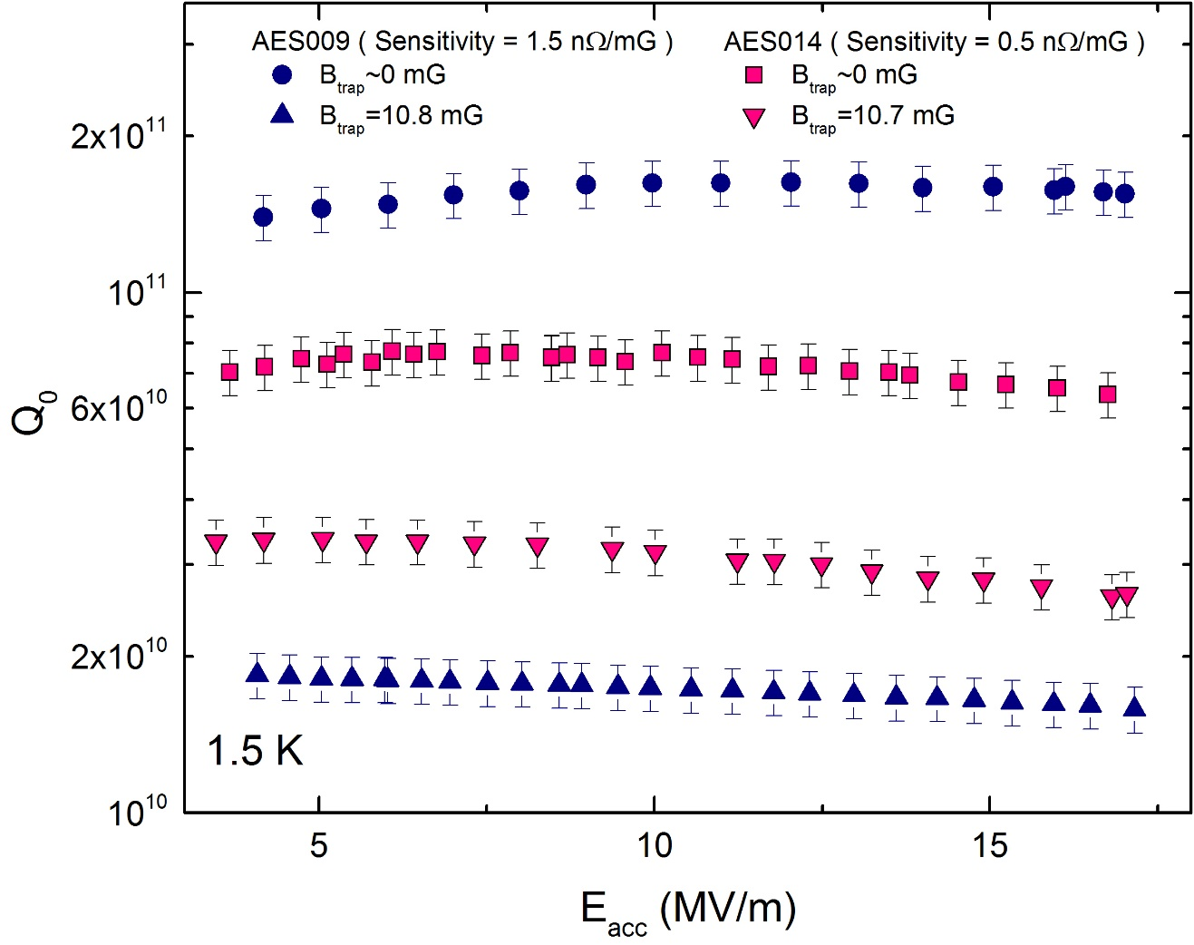
Trapped Flux Sensitivity
How much the cavity dissipated per amount of trapped flux:
$$Sensitivity(l)=\frac{R_{FL}}{B_{Trap}}$$

Slide 13
Sensitivity vs mean free path
2/6 N-doping

Slide 14
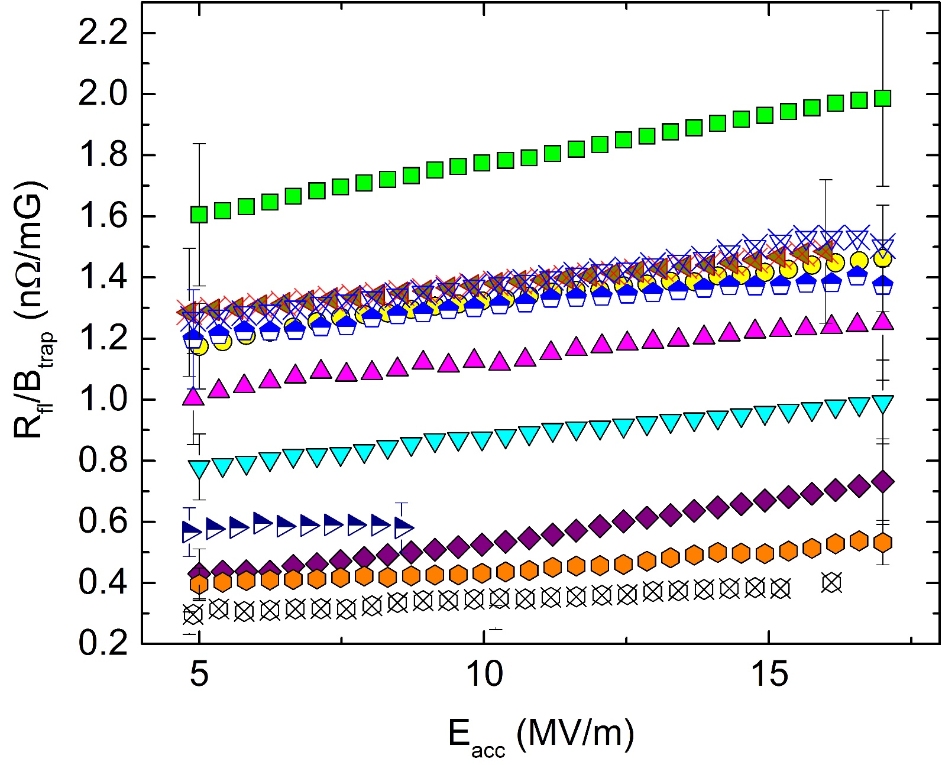
Trapped Flux Sensitivity Field Dependence

Slide 15
Outline
Introduction
BCS Surface Resistance
Trapped Flux Sensitivity
Q-factors vs Mean free path
Best Surface Treatment
Conclusions

Slide 16
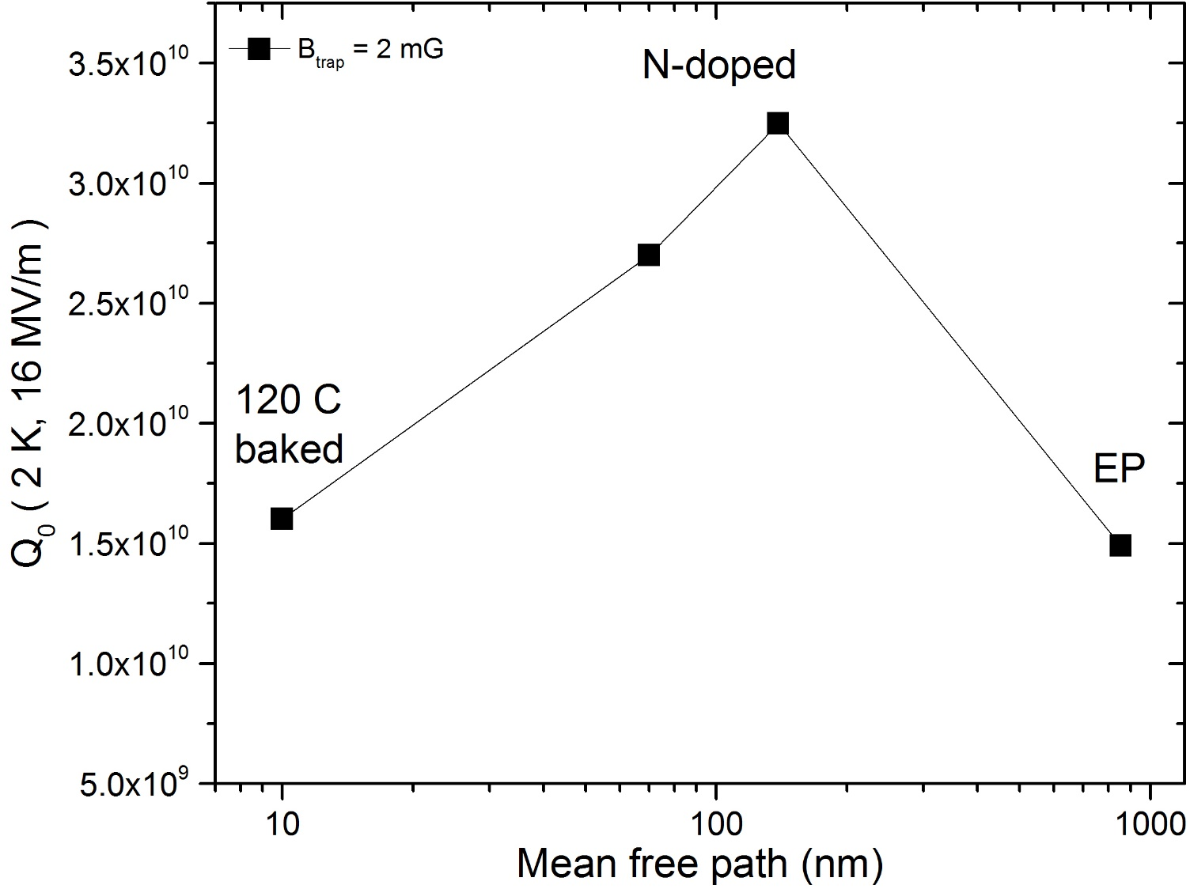
Q-factor vs mfp
Adding together all the $R_{S}$ contributions, it is possible to predict the Q-factor as function of mean free path for different amount of trapped flux

Slide 17
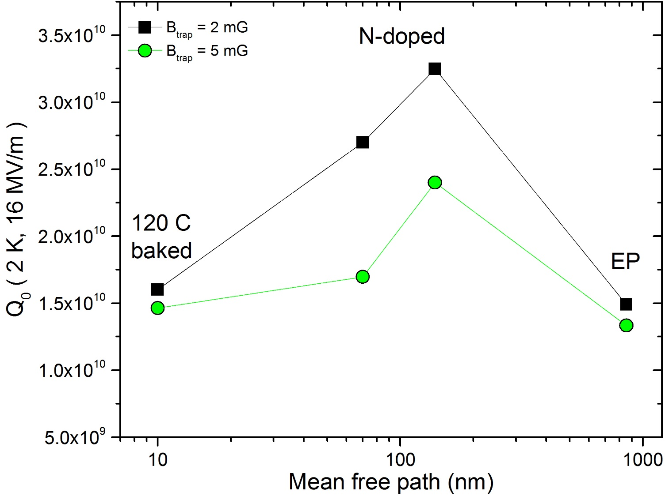
Q-factor vs mfp
Adding together all the $R_{S}$ contributions, it is possible to predict the Q-factor as function of mean free path for different amount of trapped flux

Slide 18
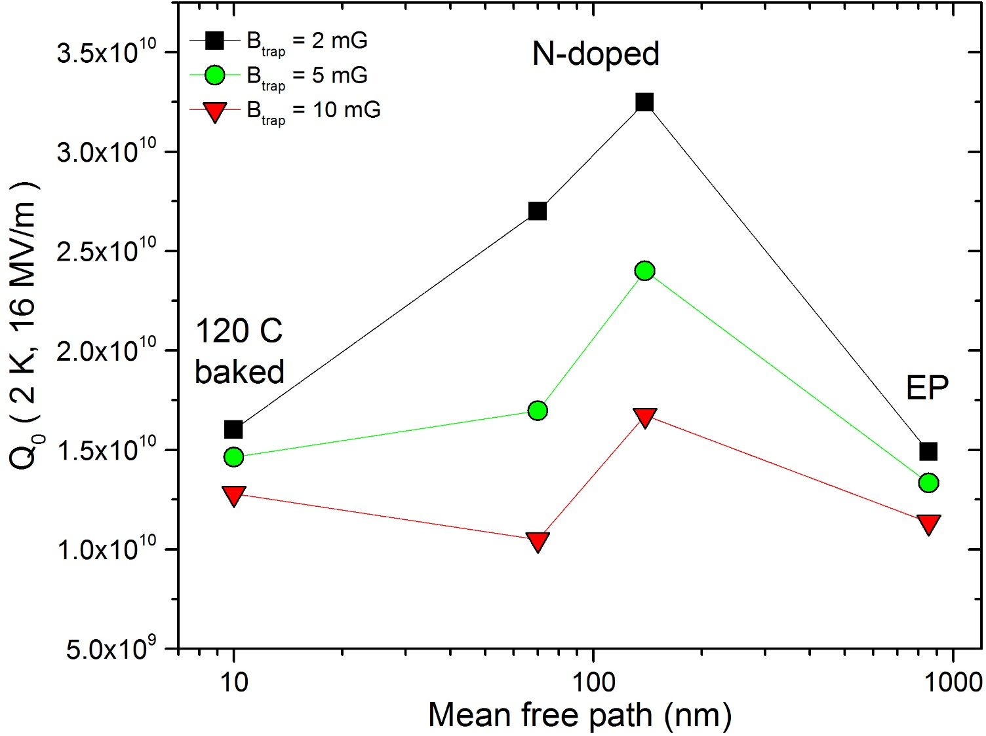
Q-factor vs mfp
Adding together all the $R_{S}$ contributions, it is possible to predict the Q-factor as function of mean free path for different amount of trapped flux

Slide 19
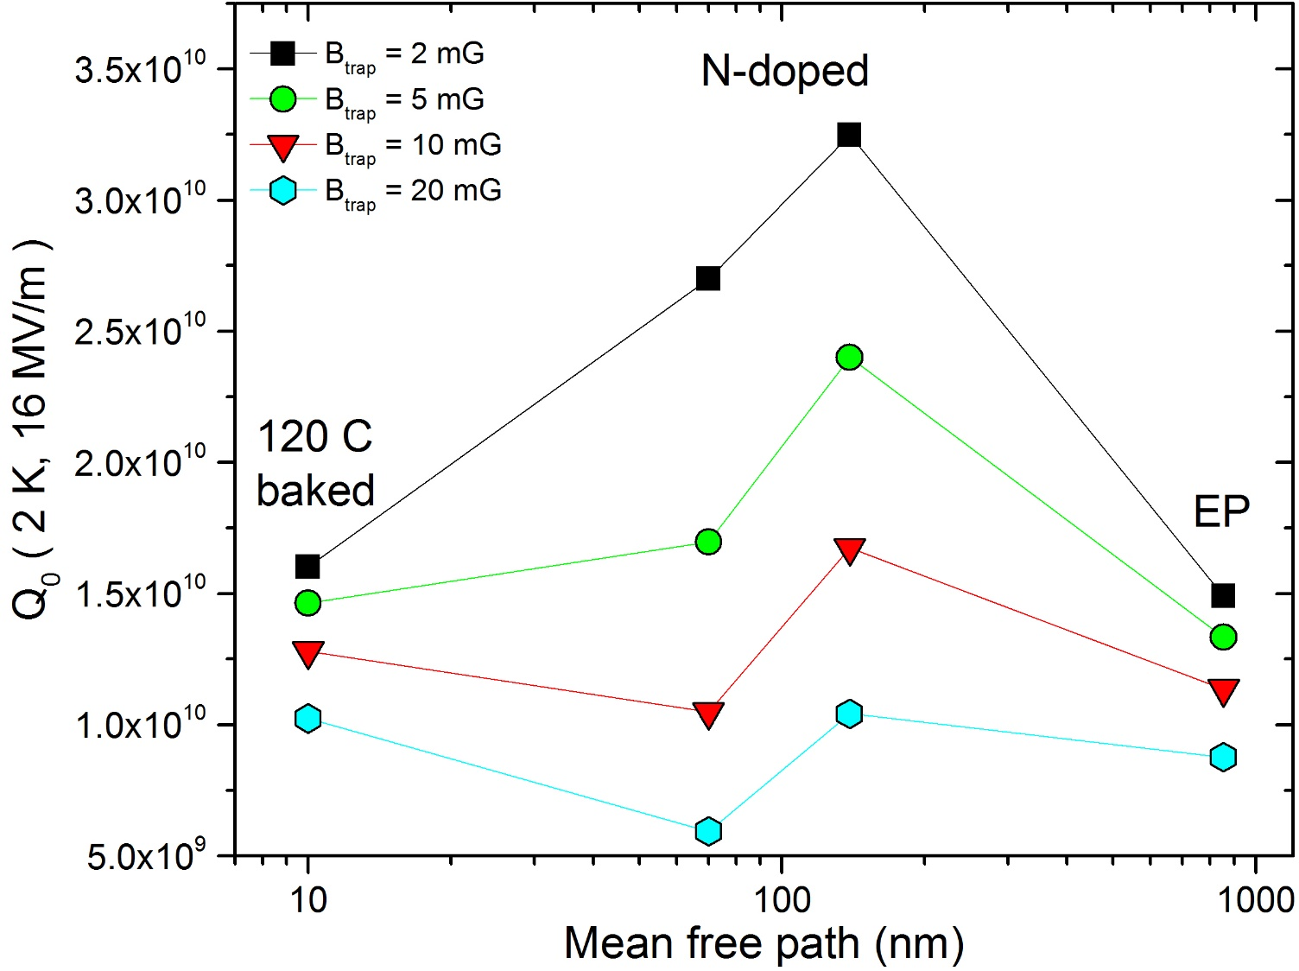
Q-factor vs mfp
Adding together all the $R_{S}$ contributions, it is possible to predict the Q-factor as function of mean free path for different amount of trapped flux

Slide 20
Outline
Introduction
BCS Surface Resistance
Trapped Flux Sensitivity
Q-factors vs Mean free path
Best Surface Treatment
Conclusions

Slide 21
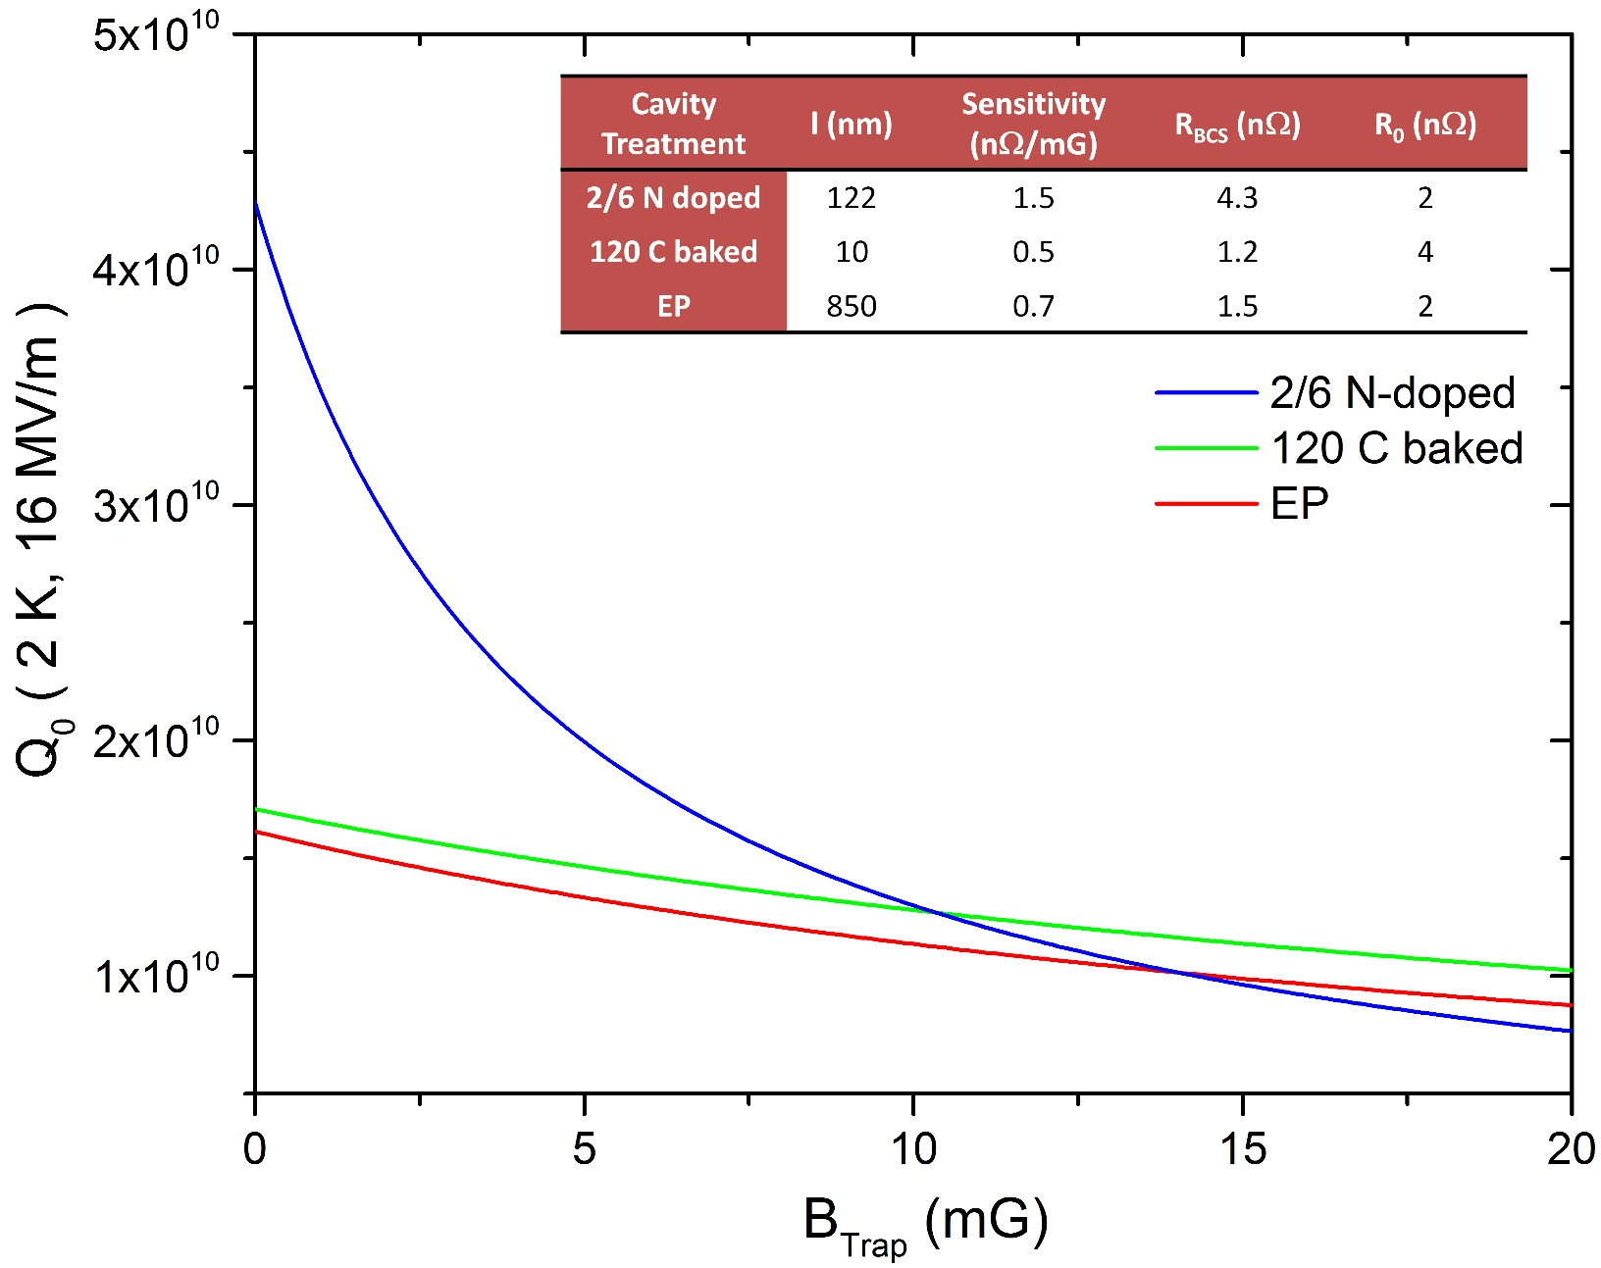
Q-factor vs Trapped Flux for different surface treatments
12
15

Slide 22
Outline
Introduction
BCS Surface Resistance
Trapped Flux Sensitivity
Q-factors vs Mean free path
Best Surface Treatment
Conclusions

Slide 23
Conclusions
N-doped cavities are closed to both minimum of BCS and maximum of sensitivity
Light N-doping allows lower sensitivity and still low BCS
The 2/6 N-doping recipe gives the highest Q-factor at 2 K and 16 MV/m as long as the trapped field is less than 10 mG
Further optimization still possible towards even lighter N-doping

Slide 24
Thank you for your attention

Slide 25
Back up Slides

Slide 26
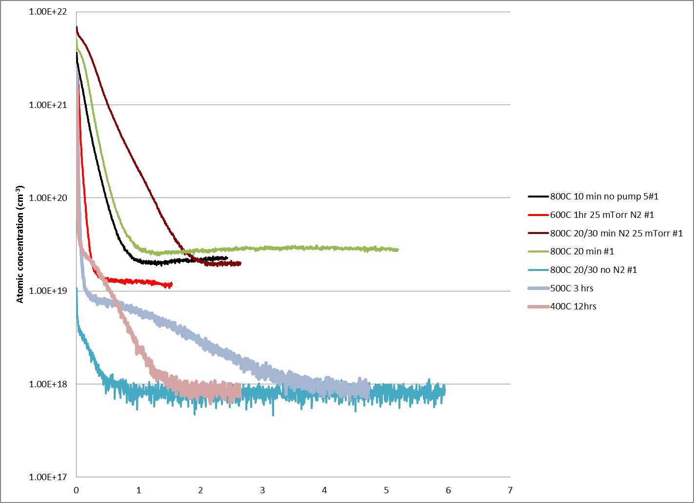
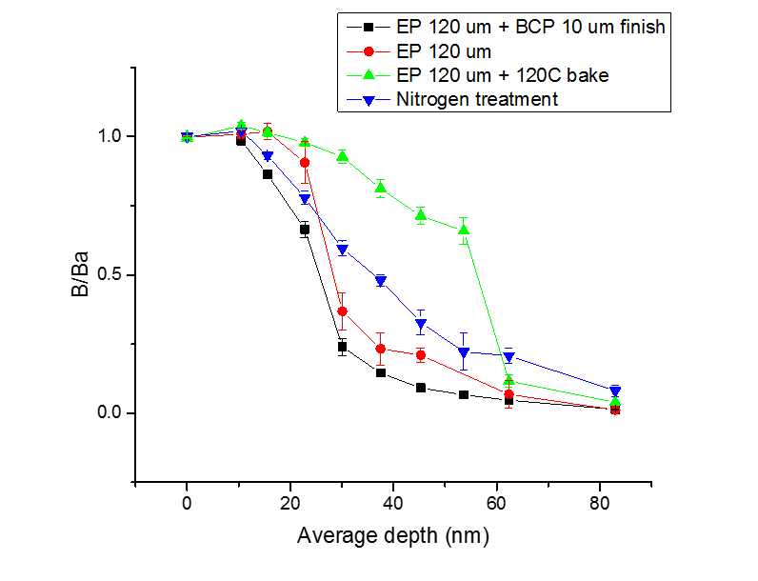
N-doping effect on mean free path
Nitrides
Interstitial nitrogen in Nb
LE-μSR measurements (Ba=25mT)
~15 nm - no screening
Doped
N-doped: mfp~40 nm
Atomic concentration (cm⁻³)
120C bake: mfp~2-16 nm
Non-doped
EP: mfp > 400 nm
Depth (μm)
N-doping modify the mean free path ($\sim 100$ ppm of interstitial N)

Slide 27
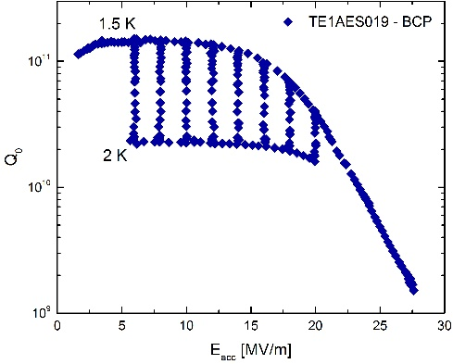
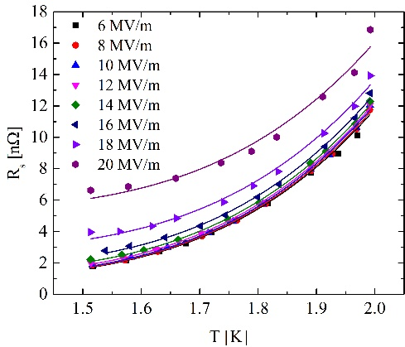
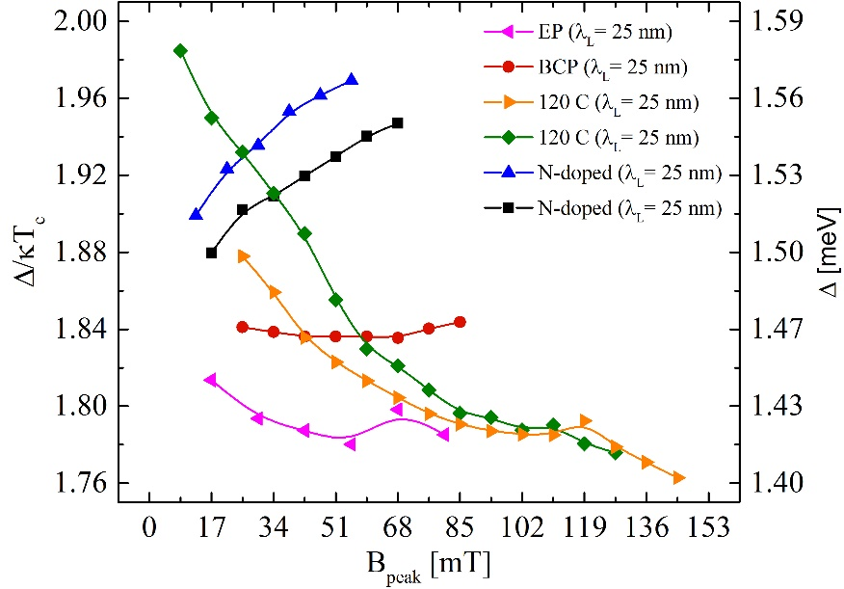
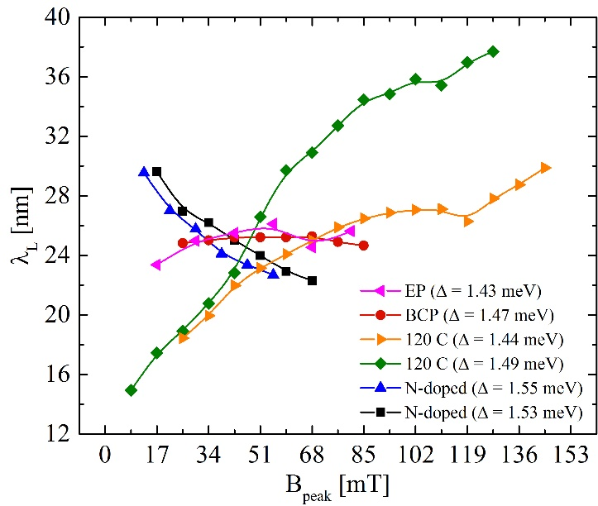
Insight on the Anti-Q-Slope
Fit of R_{s} vs T at different field levels using BCS theory (with SRIMP¹):
$$R_{BCS}=A{(λ_{L},l,∆,ξ_{0},f_{0},T_{c})e}^{−\frac{∆}{k_{B}T}}$$
With BCS theory we cannot discriminate which parameters is changing with the field:

Slide 28
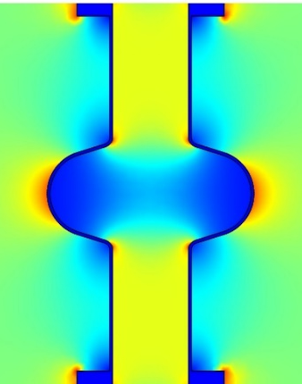
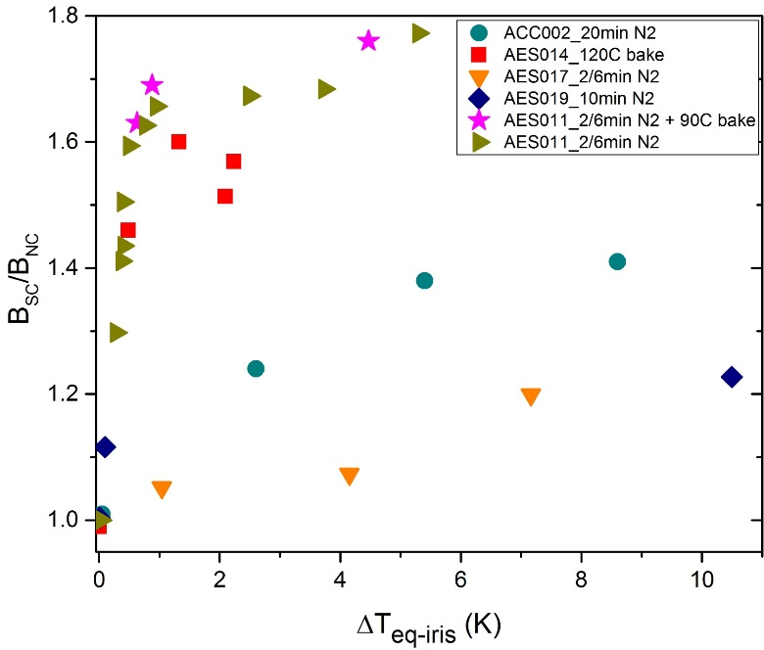
Flux Trapping during Cooldown
Simulation with perfect diamagnetic ($μ≅0$) walls:
2
The amount of trapped magnetic flux depends on:
external magnetic field ($B_{ext}$)
flux expulsion (${B_{SC}}/{B_{NC}}$)
No trapped flux when:
$B_{Ext}\sim 0$ mG
or
$B_{SC}/B_{NC}\sim 1.8$ @ the equator
1.5
@ equator:
$$1≤{B_{SC}}/{B_{NC}≤1.8}$$
1
0.5
0
Magnetic flux fully expelled
Magnetic flux fully trapped

