Slide 1
An OSC Experiment in IOTA at Fermilab
Northern Illinois University
Matthew Andorf On the Behalf of the Optical Stochastic Cooling group

Slide 2
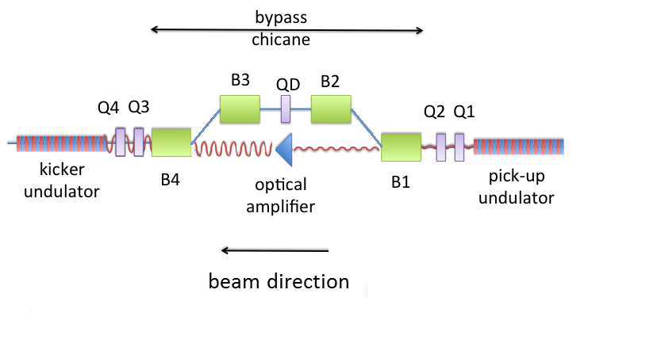
Introduction: 100 MeV Optical Stochastic Cooling (OSC) electron experiment is planned for IOTA. Particle cooling is needed to increase luminosity and combat beam degradation of hadron colliders however proof of principle experiment is easier with electrons.
Briefly: In OSC cooling is achieved through a coherent interaction between a particles motion in the ‘kicker’ undulator with radiation created in the ‘pick-up’ undulator.
The experiment will proceed in two phases: i) A passive test.
ii) An active test based on Cr:ZnSe amplifier.

Slide 3
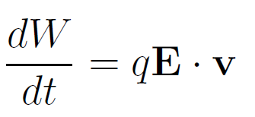
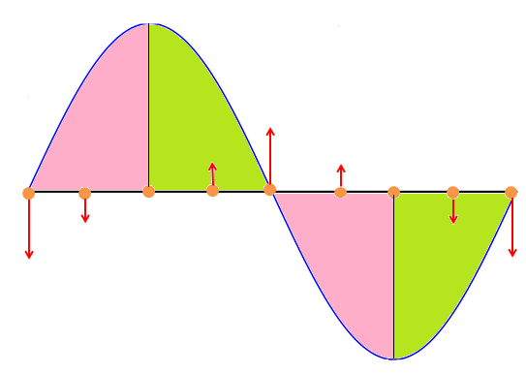
Undulator radiation and particle beam interaction
A charged particle passing through an undulator will oscillate transversely and radiate.
If this transverse motion is superimposed with a light wave an energy transfer can take place. However the wave must have the right wavelength and polarization. Using two identical undulators guarantees the proper wavelength and polarization.
In the particles rest frame the light wave “slips” past the particle one wavelength per one period of oscillation. Hence a coherent energy transfer. Here we have a coherent interaction but no energy transfer.
So how does this lead to cooling?

Slide 4
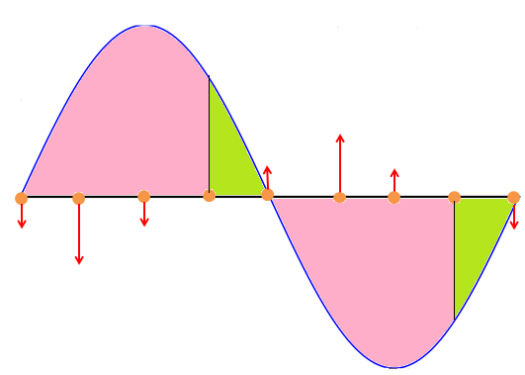
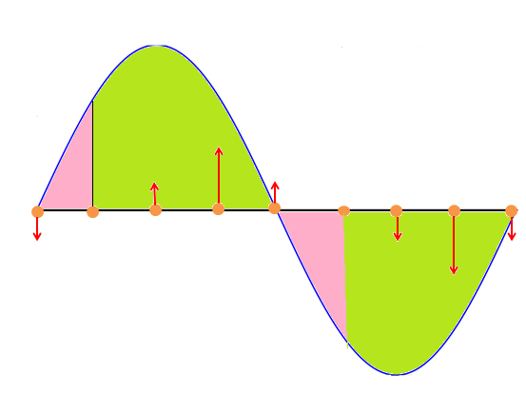
Undulator radiation and particle beam interaction:
It is the relative phase between particle oscillation and the electric field that determine energy loss or gain in comparison to the reference particle receiving no kick.
A bunch contains ~10⁶ electrons for the demonstration of IOTA and this technique is being developed to cool high luminosity beams with many orders of magnitude more particles.
how can an individual particle phase be linked to its energy deviation and wont other nearby particles spoil the cooling?
First note that each particle radiates a pulse much shorter then the bunch length. In IOTA’s case Δt~ 40 fs and the bunch is ~10 cm long. This means particular particle “sees “ the radiation of only the nearest 120 or so particles. Furthermore from turn to turn the phase of the other nearby particles are random and average to nearly zero.
This is why bandwidth is so important for stochastic cooling.

Slide 5
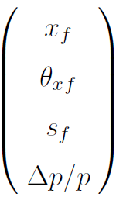
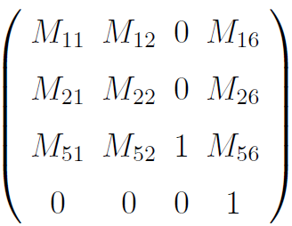
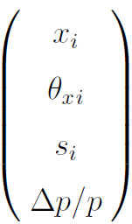
OSC bypass chicane
The relative energy transfer is given as A particle passing through the chicane has its coordinates transformed as:
- Horizontal position
- Horizontal angle
- Longitudinal position
- Relative momentum
Or
Keeping linear terms we obtain

Slide 6
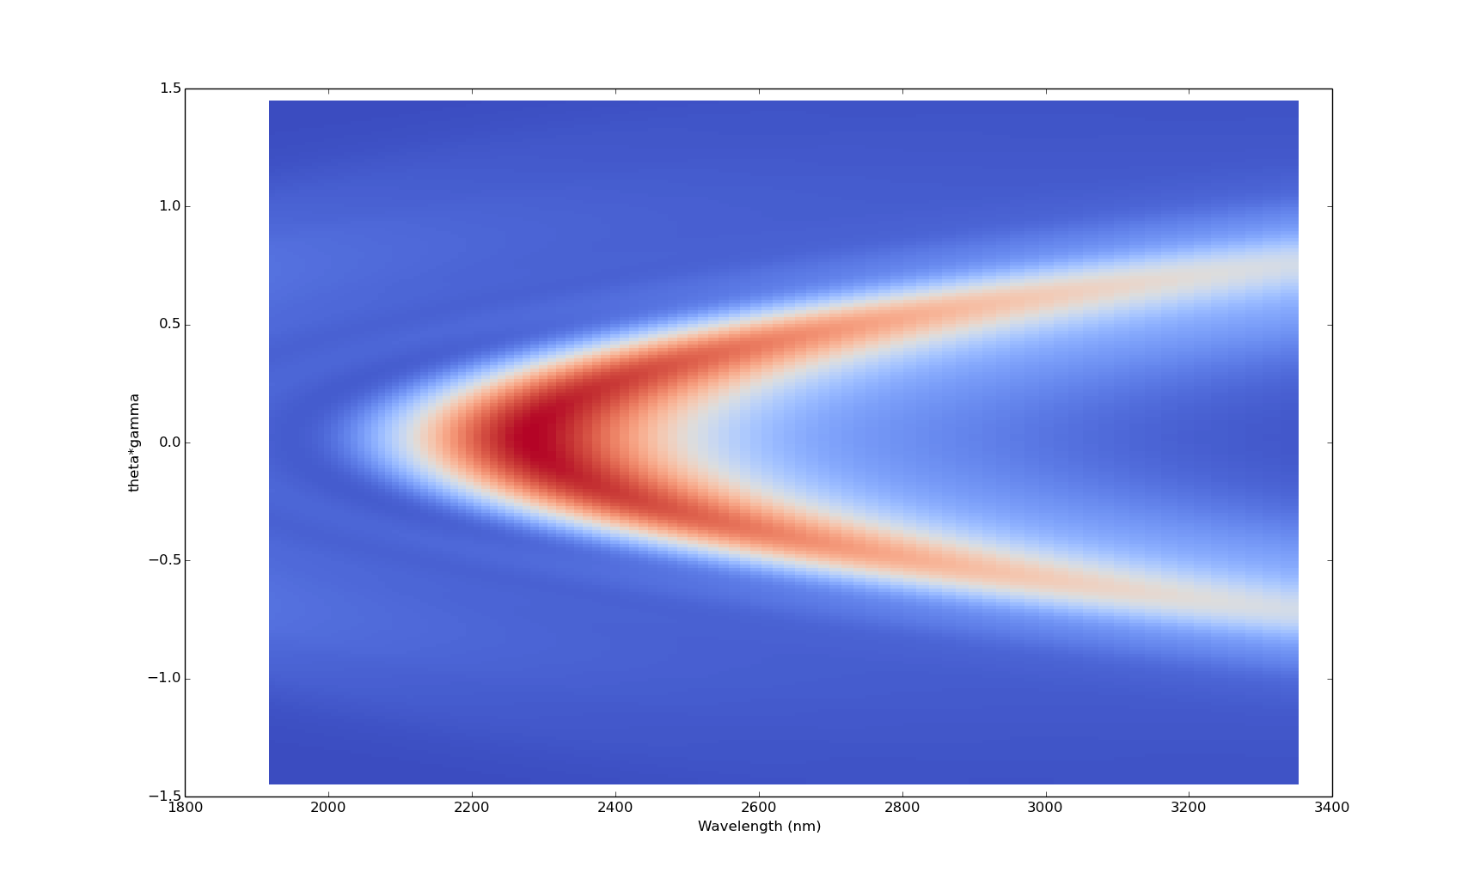
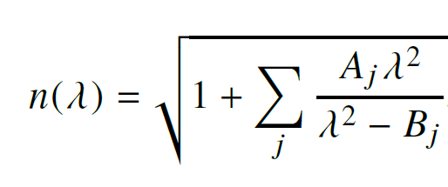
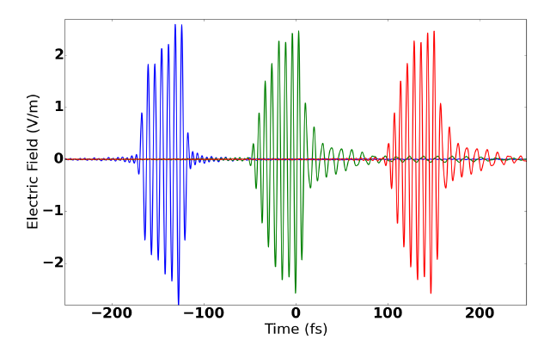
Light Optics for Passive case of OSC
Synchrotron radiation modeled using Synchrotron Radiation Workshop a code typically used for X-ray beam lines.
We augmented the code to account for first and second order dispersion (GVD) in the lens for real glasses using Sellmeier’s formula
To verify our code accounts for GVD correctly we pass radiation through 5 mm of BaF₂ glass. The effect can be computed analytically . Computation of the correlation function quantifies agreement ( >0.999 )

Slide 7
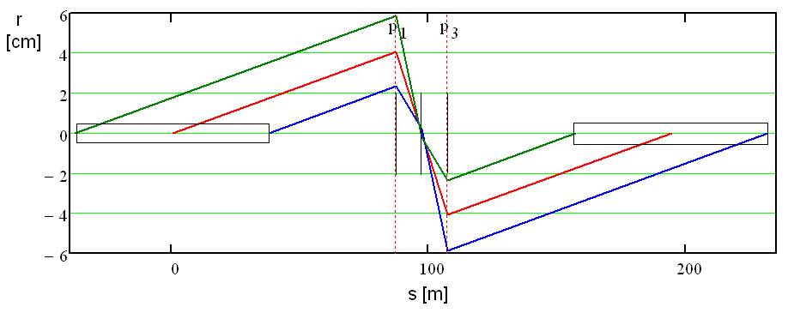
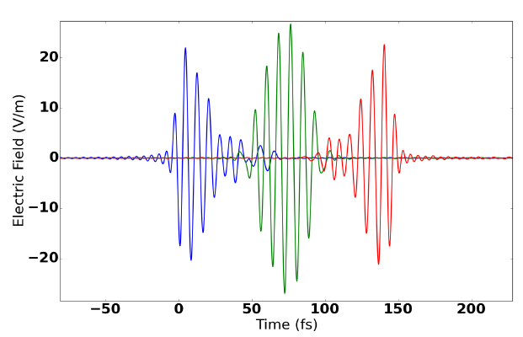
Light Optics for Passive case of OSC
Focusing optics between undulators designed to have +/- Identity matrix to eliminate depth of field effects.
Negative case is closer match to beam optics transfer. Mitigates transverse separation of radiation and particle for particles with large betatron motion.
Computing real/imaginary components of the electric field of a single electron allows for construction of the time field at a specific location. Plot on the right shows field at front, center, back of kicker. Dispersions not accounted.

Slide 8
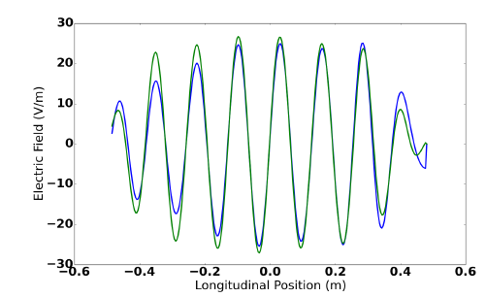
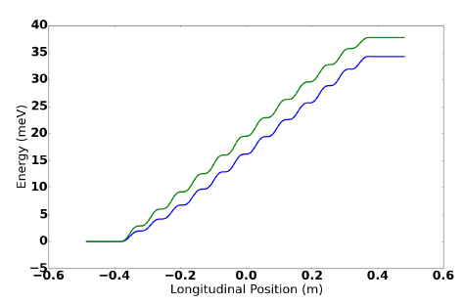
Computation of the kick amplitude
The E-field seen by the electron in the kicker is computed by accounting for slippage that occurs between the co-propagating light pulse and the electron.
The kick amplitude is found to be 38 meV for an ideal lens, and 34 meV for a real lens. Analytic theory for small undulator with K<<1 and single lens at ‘infinity’ gives 37 meV.
Twice the energy loss for a single undulator
Accounts finite aperture.

Slide 9
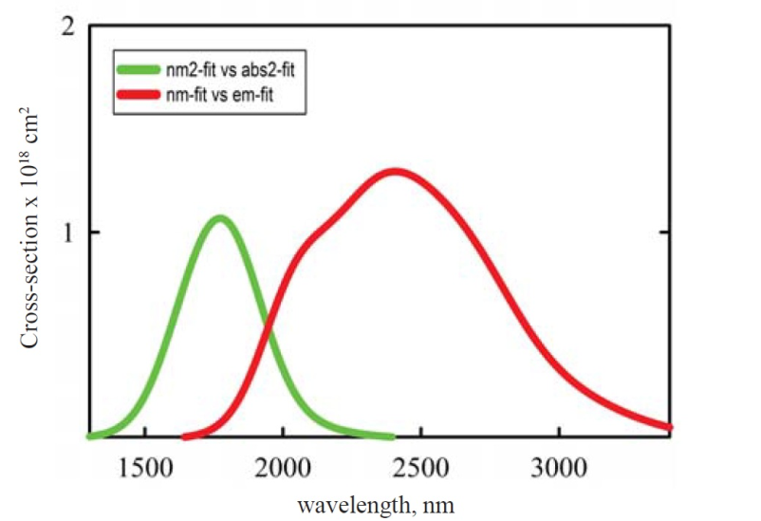
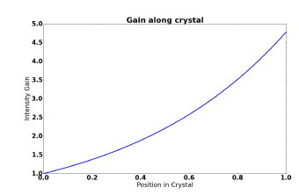
Single Pass Amplifier for OSC at IOTA
Basic Characteristics
IPG photonics
-Cr:ZnSe solid state lasing gain medium.
-Bandwidth FWHM 2.2-2.9 µm.
-1 mm length (~1.44 mm delay) .
-CW pumping at 1.93 µm with ~100 kW/cm²
Pump wavelength chosen because
i) High power (50-100 W) commercially available Thulium pump. ii) Reduction in heat deposited in crystal over shorter wavelengths .
Gain
Combination of short crystal length, small signal intensity and depleted ground state gives rise to exponential signal growth through the crystal.
Total gain in power, G= 5

Slide 10
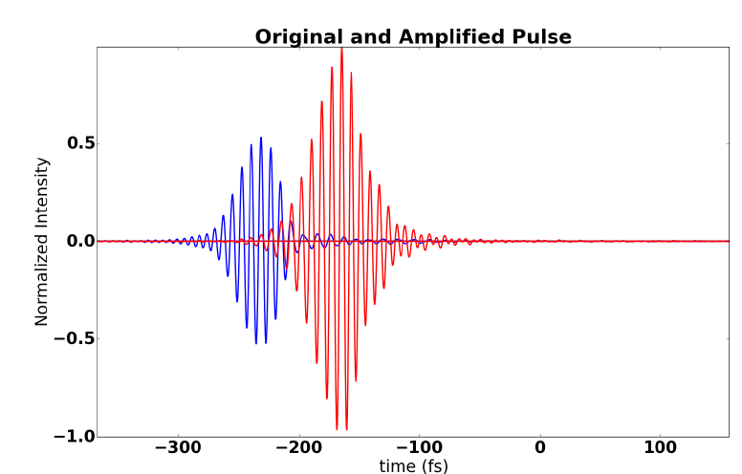
Single Pass Amplifier for OSC at IOTA
The broadband pulse is modified in 3 ways while passing through the amplifier
Group Velocity Dispersion (GVD) from the host medium lengthens the pulse and introduces energy chirp, β=2πn/λ.
Gain narrowing (pulse broadening) from finite amplifier bandwidth.
Phase distortions from amplification.
Lengthening through GVD has largest effect, works to reduce field amplitude.
Correlation function multiplied by gain estimates total increase in kick
Amplifier increases damping rates by a factor of 2

