Slide 1





SeaQuest in 10 mins
Arun Tadepalli
Rutgers University
(on behalf of the SeaQuest E906 collaboration)

Slide 2
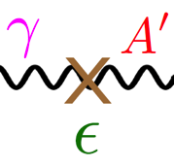

Outline of the talk/ Energy budget of the Universe
Dark energy
68.3%
4.9%
26.8%
Standard model matter
Dark matter
Nucleons and Nuclear structure
Dark forces & Hidden sector
Issues in Nuclear structure
Dark photons
Spectrometer
Current status & results

Slide 3
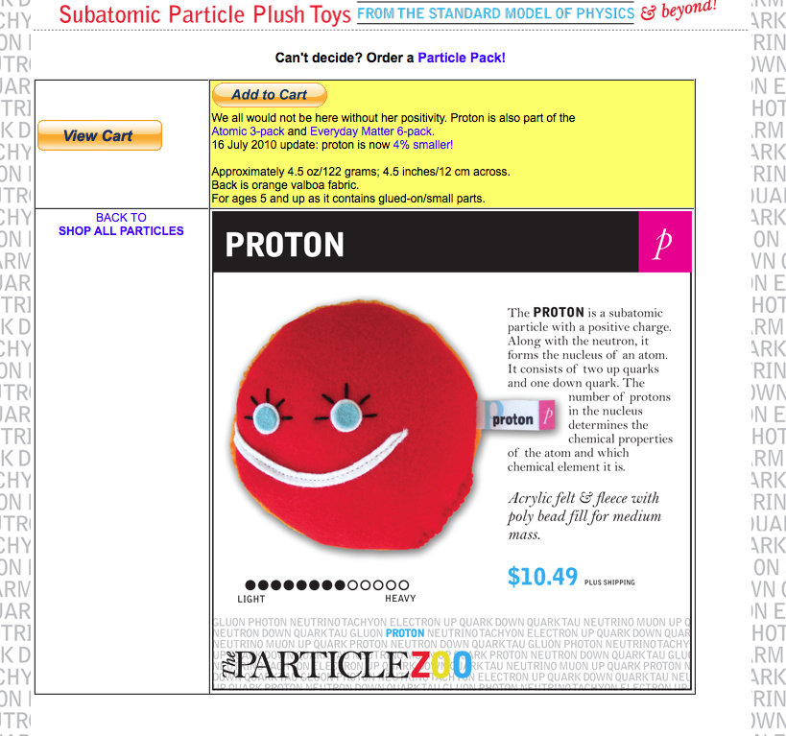
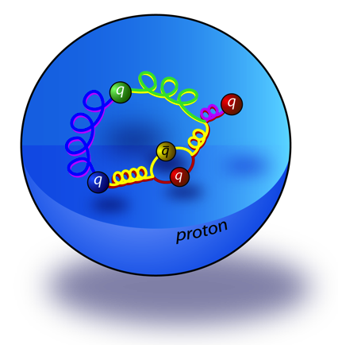

Goal: Study Proton structure
Proton is a dynamical QCD system made up of:
  Quarks
    Valence quarks
    Sea quarks
  Gluons
NUCLEONS ALSO AVAILABLE ON PARTICLEZOO.NET FOR $10.49!!

Slide 4
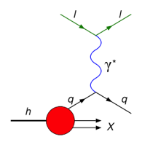
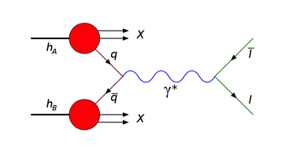
Processes used in probing the Nucleus
space
space
time
time
DEEP INELASTIC SCATTERING
Lepton scatters from hadron
Exchange of virtual photon
Higher states of the hadron
Doesn’t differentiate between quark and antiquark
DRELL YAN PROCESS
Quark from hadron annihilates with antiquark from another hadron
Virtual photon is created
Decays into a lepton + antilepton
Unique sensitivity to the anti-quark distributions
Unique sensitivity to antiquark distributions!

Slide 5
Leading Order Drell Yan cross-section formula
*Ignoring higher order processes in α_{s}
space
time
Drell-Yan cross section
Charge weighted summation over all quark flavors
Fine structure constant
PDF of a quark of flavor i in the beam
Center of mass energy squared
momentum fraction of quark in the beam
PDF of anti quarks of flavor i in the target
momentum fraction of antiquark in the target

Slide 6
Leading Order Drell Yan cross-section
*Ignoring higher order processes in α_{s}
space
time
Acceptance of the spectrometer can be chosen to study antiquark distributions
Term negligible compared to the first term

Slide 7

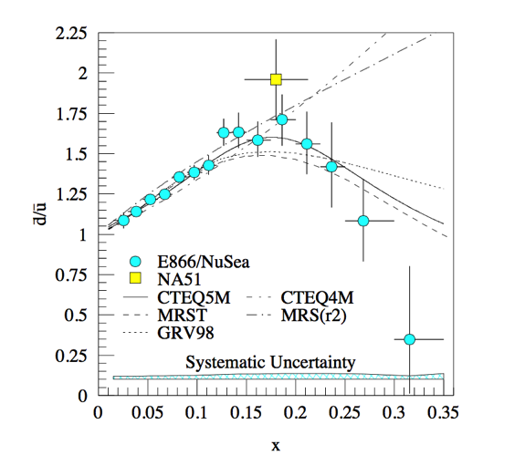
SeaQuest physics goals
What is the origin of the nucleon sea?
What about TMDs?
Do we know what causes EMC effect?
Do partons lose energy in cold nuclear matter?
Did you just say dark photons??
Is J/ψ and ψ’ suppression in cold nuclear matter the same?
What happens to the dbar/ubar ratio at x_{bj} ≈ 0.3?

Slide 8
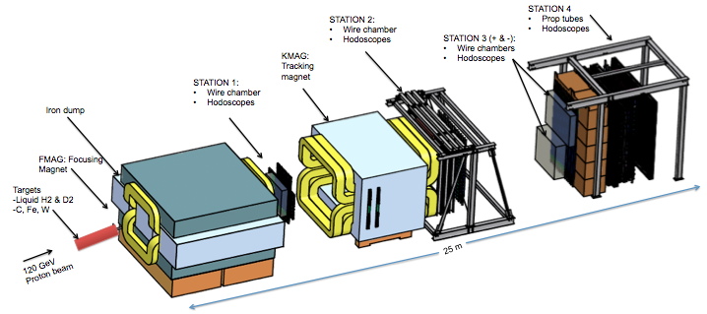
The SeaQuest Spectrometer
3500 wires
550 prop tubes
350 hodo paddles

Slide 9
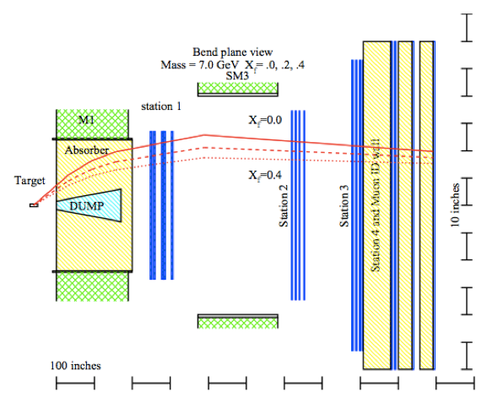
hit
Accept this path
hit

Slide 10
hit
Reject this path
hit

Slide 11
hit
Signal is a coincidence of μ⁺ & μ⁻ paths
hit

Slide 12


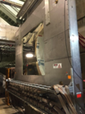

Timeline of SeaQuest
March 2012
I
REST
Nov 2013
REST
Nov 2014
REST
II
III
IV & V
VI?
Main injector upgrades
Stable operation of all detector sub systems
Dark photon road sets included into the trigger system
New St3- installed
Improved duty factor
Continue data taking
Installation of new St 1 drift chamber
Scheduled accelerator maintenance
Commissioning run
All detector subsystems work
Issues and upgrades addressed

Slide 13

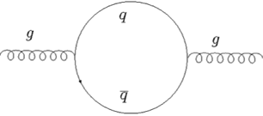
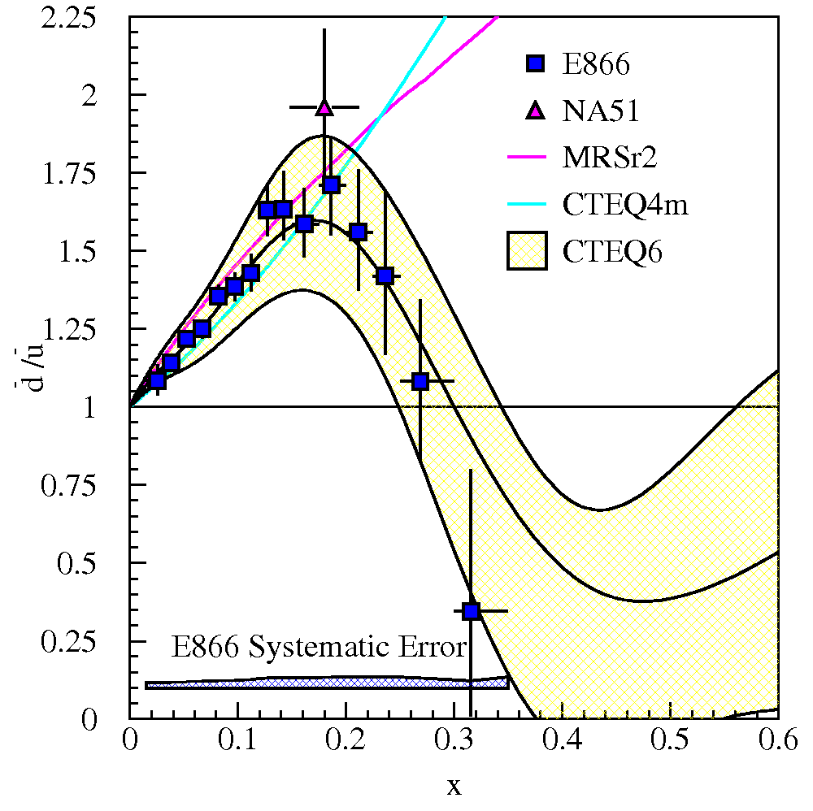
Light antiquark flavor asymmetry
Initially assumed a flavor symmetric sea as:
  Gluons don’t couple to flavor
  Masses of u and d quarks are small and similar
Gottfried integral violated
  NMC (1991):
  NA51 (1994):
  NuSea/E866 (1998):
gluon splits
quark antiquark pair
recombine into gluon

Slide 14
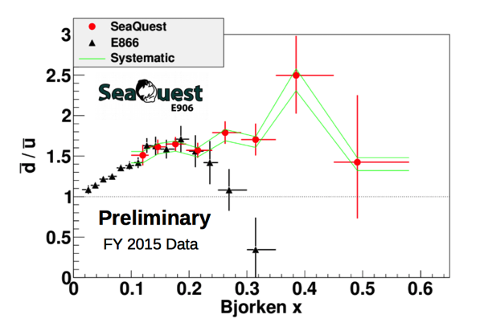
Preliminary results
B.Kerns APS, 2016
Excellent agreement in 0.1 < x < 0.25
Interesting difference between E866 is seen in the high-x region and is under investigation
THANKS TO THE DBAR/UBAR ANALYSIS TEAM!!

Slide 15
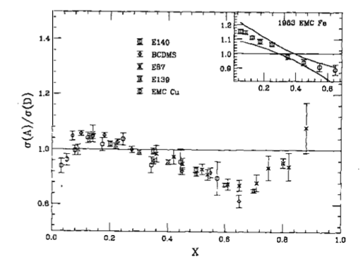
EMC effect in Deep Inelastic Scattering
Quark distributions in the nuclei differ from quark distributions in the nucleon
In 1983, the EMC collaboration found per nucleon structure functions F₂ (x,Q²) in heavy nuclei different from deuterium
Exact physics reason for EMC effect still being debated
D.F.Geesaman, K.Saito, & A.W.Thomas, Annu.Rev. Nucl. Part. Sci. 45, 337 (1995)
Shadowing region 0 < x < 0.06
Anti-shadowing region 0.06 < x < 0.3
EMC region 0.3 < x < 0.8
Fermi motion region 0.8 < x < 1

Slide 16
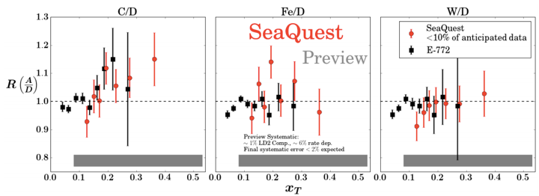
Preview results
THANKS TO THE NUCLEAR DEPENDENCE ANALYSIS TEAM!!
Ratios of Drell-Yan cross sections for C/D, Fe/D, W/D shown
Contains < 10% of expected statistics
Already competitive with existing data

Slide 17
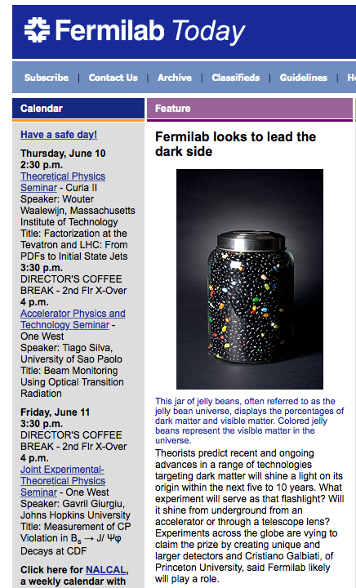
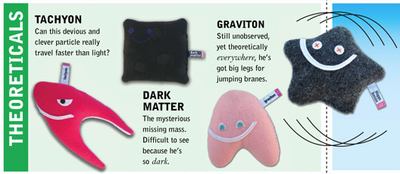
What’s the matter?
Dark matter is:
one of the greatest unsolved mysteries of modern physics
a central element for cosmology and astronomy
about 27% of the energy density of the Universe
Dark energy
68.3%
DARM MATTER ALSO AVAILABLE ON PARTICLEZOO.NET FOR $10.49!!
26.8%
4.9%
Dark matter
Ordinary matter

Slide 18
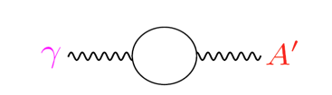
Dark sector and Standard model coupling
Standard Model
Quarks, leptons
g W Z γ
Hidden Sector
dark matter
A’
Dark sector could interact with the standard model sector via a hidden gauge boson (A’ or “dark photon” or “para photon” or “hidden photon”)
Dark photons can provide a portal into the dark sector
Dark photons could couple to standard model matter with α’ = αε²
A’ produced via a loop mechanism
B. Holdom, PLB 166 (1986) 196
J. D. Bjorken et al, PRD 80 (2009) 075018

Slide 19
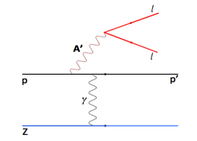
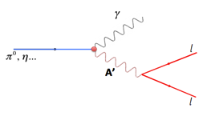
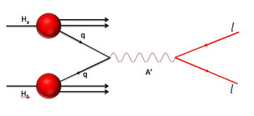
Possible A’ production mechanisms
Proton Bremsstrahlung
η … decay
Dark Drell-Yan process

Slide 20
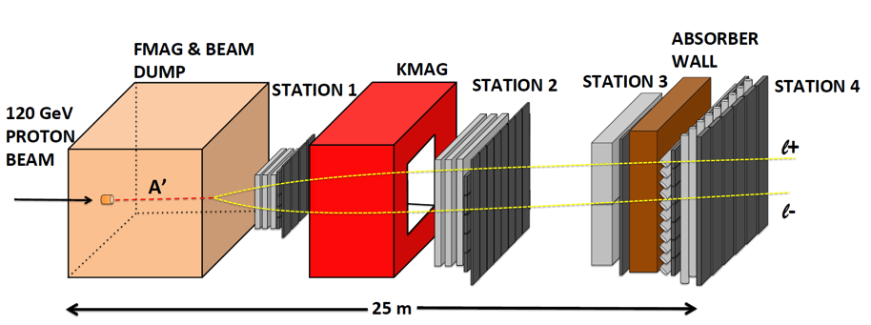
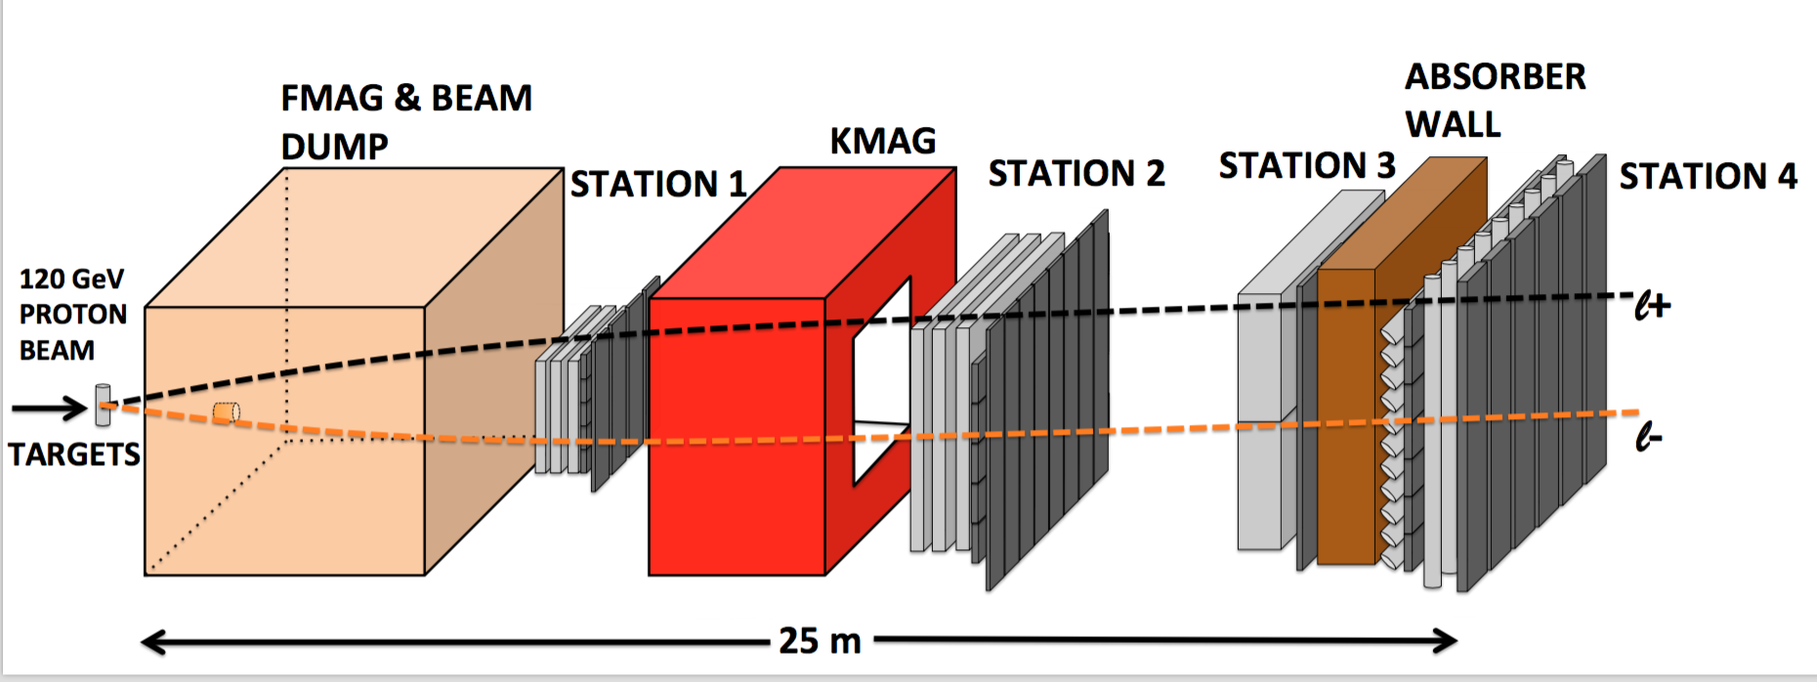
CARTOON OF A DARK PHOTON EVENT
CARTOON OF A DRELL-YAN PROCESS EVENT

Slide 21
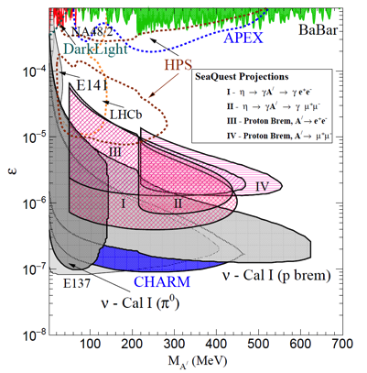
SeaQuest projections
S. Gardner, R. J. Holt, A. Tadepalli, arXiv 1509.00050
J. D. Bjorken et al, PRD 80 (2009) 075018
E₀ = energy of the A’
N_{eff} = no. of available decay products
l₀ = distance that A’ travels before decaying
ε = coupling constant between standard model and dark sector
m_{A’} = mass of A’
preliminary
2E12 ppp
200 days
10 event contours

Slide 22
Summary and outlook
Nucleons are dynamical quantum systems
Drell-Yan process has unique sensitivity to the antiquark distributions
SeaQuest experiment addresses issues in nucleon and nuclear structure and the dark sector
The experiment will extend the measurements to a higher x with greater statistical precision compared to previous Drell-Yan experiments and perhaps gain a portal into the dark sector
Data taking in progress and preview results presented
Exciting times ahead!!
ANALYSIS IN PROGRESS
PARTON ENERGY LOSS IN COLD NUCLEAR MATTER
J/ΨAND Ψ’ SUPPRESSION IN P-A COLLISIONS
ANGULAR DISTRIBUTIONS IN DRELL-YAN DIMUONS
-SEE BRYAN RAMSON’S TALK

Slide 23

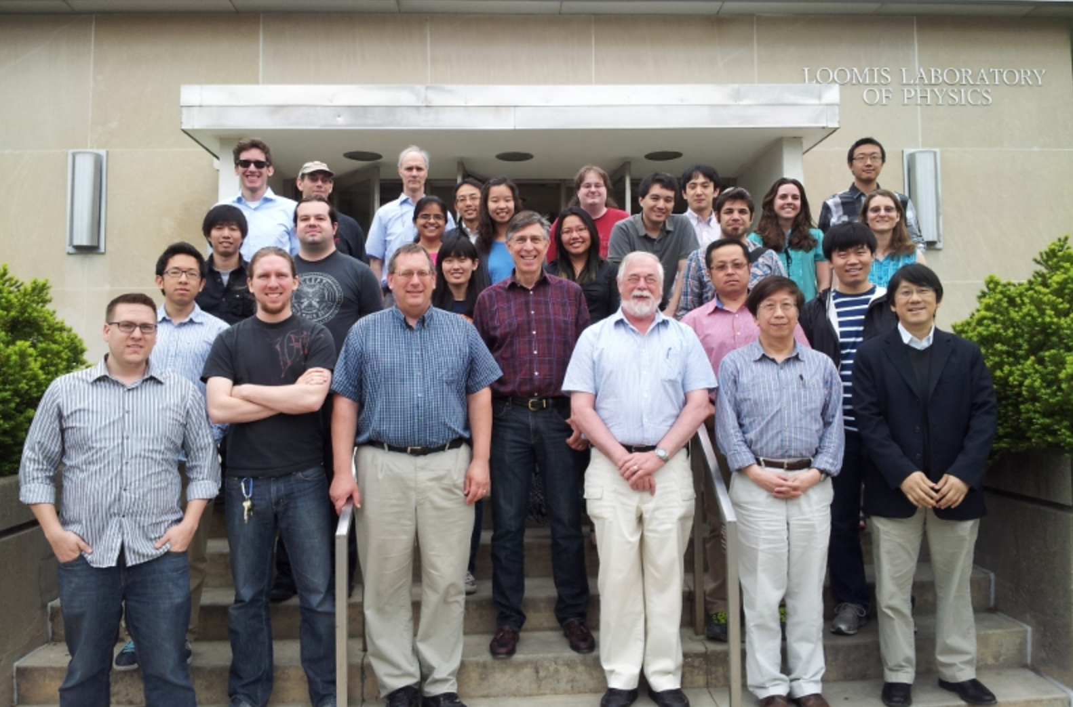
Nucleon Sea Times
East or West, SeaQuest is the best
- Since 1802
Fermilab makes history by finding dark photons!
This could be Fermilab!
Nucleon Sea Times congratulates Prof. Ron Gilman from the department of Physics and Astronomy at Rutgers University for finding the missing link between the dark sector and the standard model sector.
Overwhelming evidence for dark matter has been observed through its gravitational interactions by many detailed studies around the world. SeaQuest took advantage of η decay and proton bremsstrahlung process to search for dark photons.

Slide 24
QUESTIONS?

Slide 25
J/Ψ and Ψ’ suppression in p-A collisions at SeaQuest
E866:
  Presented “new” data for the suppression of Ψ’ and J/Ψ vs x_{F} and Pt ranges
  Suppression has strong x_{F} and Pt dependence
  Suppression higher for Ψ’ compared to J/Ψ near x = 0
SeaQuest will be able to tell what the suppression is when there is no QGP assumed. This could be crucial input for RHIC physics
nucleus
nucleus
J/Ψ
protons
D mesons

Slide 26
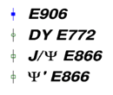
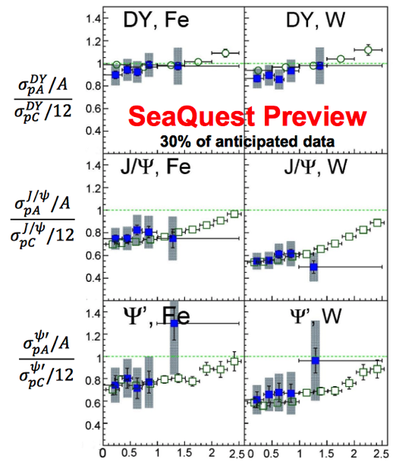
Preview results
Compared to J/Y and Y’
there is no strong suppression in DY.
The level of pT suppression of DY is similar in E906.
Those are both expected since there is 𝑝𝐴
no final-state interaction and only one common production mechanism for DY.
There are no significant difference in the observed strong suppression of J/Y and Y’ with beam energy 800 GeV (E772 and E866) and 120 GeV (E906).
pT (GeV)

Slide 27
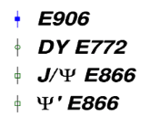
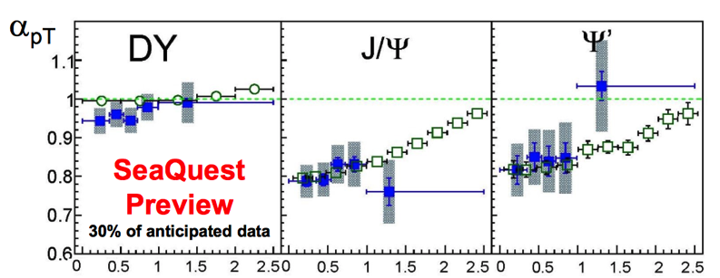
Preview results
Within errors, the nuclear suppression is the same for J/Ψ and Ψ’. This is interesting as the radii of J/Ψ and Ψ’ differ by almost a factor of 2 in potential models.

Slide 28
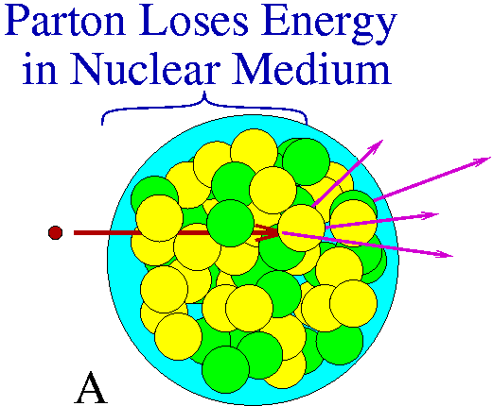
Parton energy loss in cold nuclear matter
QCD partons (are thought to) lose energy while decelerating in a strongly interacting medium
Drell Yan process is an ideal tool to study the interactions of fast partons traversing cold nuclei
The dilepton pair doesn’t interact strongly with the nuclear medium
Significant implications for physics of relativistic heavy ion collisions (RHIC)
q, g

Slide 29



Models from E772 data analysis
M.A. Vasiliev et. al. Phys. Rev. Lett. 83, 2304-2307
First model: Gavin and Milana
  Δx₁ ≈ 0.4 % / fm and k₁ has Q² dependence
Second model: Brodsky and Hoyer
  Energy loss should be ≤ 0.5 GeV/fm
Third model: Baier et. al.(formulation of model 2 extended)
Definitions:
Δx₁ - the average change in the incident-parton momentum fraction
S - square of the nucleon-nucleon center of mass energy
A - nucleon mass

Slide 30
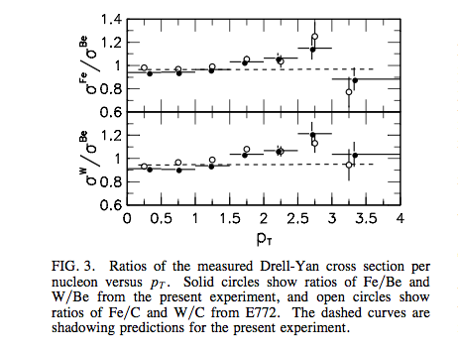
Cross-section ratios vs Pt in E866
Measured ratio of Drell-Yan cross section vs Pt for Fe to Be and W to Be
Plot:
  Solid circles - ratio of Fe/Be and W/Be
  Open circles - ratio of Fe/Be and W/Be from E772
  Dashed curves - shadowing predictions
Data shows a clear Pt dependence
Slight reduction in cross-section for low Pt and increase at high Pt attributed to multiple scattering
Phys. Rev. Lett. 83, 2304-2307

Slide 31
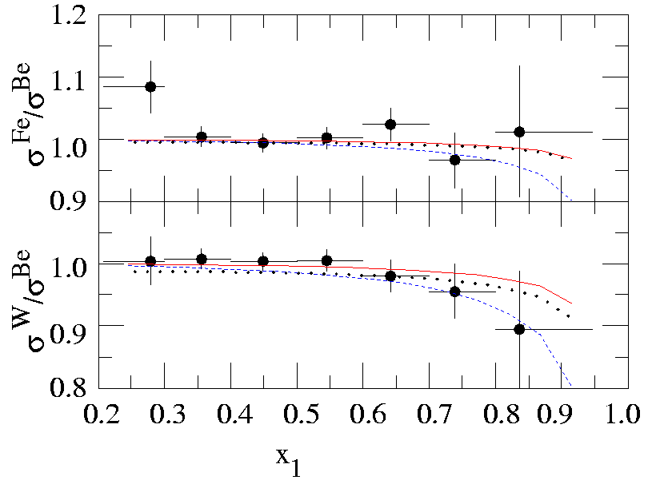
Cross-section ratios vs x₁ in E866
Solid curves – best fit using Gavin Milana model
  energy loss < 0.14%/fm
Brodsky and Hoyer model (not shown)
  Energy lost at constant rate < 0.44 GeV/fm
Dotted curves are 1σ upper limits from Baier et. al. model
    k2 < 0.75 GeV²/fm
    k₃ < 0.1 GeV²/fm
    Δx₁ < 0.046 GeV/ fm² x L² (L – propagation length in the nucleus)
Phys. Rev. Lett. 83, 2304-2307

Slide 32
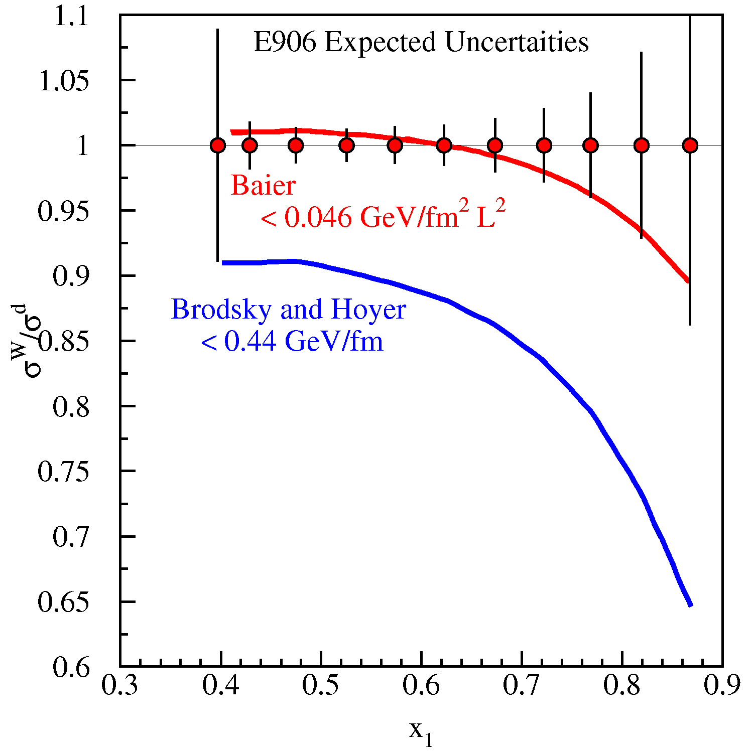
Parton energy loss in CNM
Energy loss scales as 1/s
  Larger at 120 GeV
Ability to distinguish between different models
Actual measurements than upper limits
E906 expected uncertainties
Shadowing region removed

Slide 33
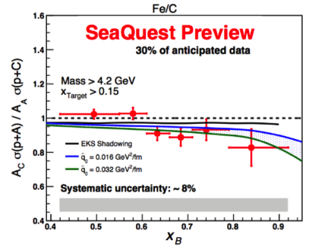
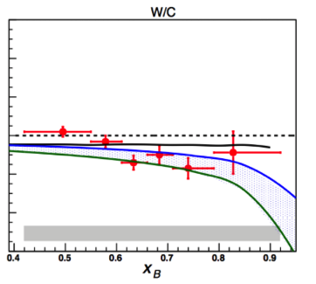
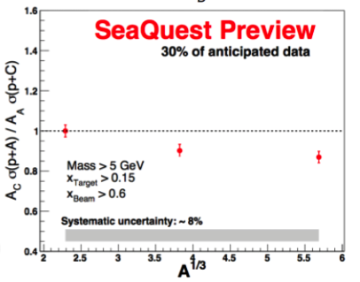
Preview results
Negative slope observed in both p+Fe and p+W results
Work on minimizing systematic uncertainty in progress
More data being taken on nuclear targets!

Slide 34
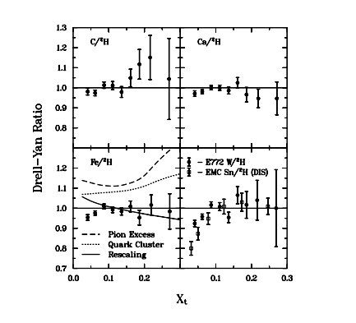
EMC effect in Drell Yan process
E772 data
Little nuclear dependence in the shadowing region
EMC effect in Drell-Yan process limited by statistical uncertainty
Significant drop not observed in anti-shadowing region like in DIS but limited by statistical uncertainty
D.F.Geesaman, K.Saito, and A.W.Thomas, Annu.Rev. Nucl. Part. Sci. 45, 337 (1995).
More precise measurements needed in the anti-shadowing region

Slide 35
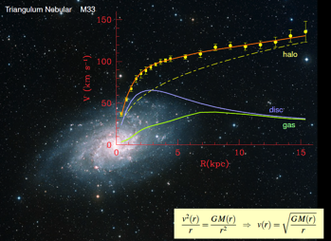
Evidence for Dark matter
F. Zwicky, ApJ 86 (1937) 217, V. Rubin et al, ApJ 238 (1980) 471
Indirect:
  Rotation curves of galaxies
  Gravitational lensing
  Surveys of cosmic microwave background
  Positron excess in the universe
  Gamma ray excess from the galactic center
  …
Direct:
  …
Dark matter interpretations of astrophysical anomalies
Indicates that dark matter couples to ordinary matter more than gravitationally

