Slide 1
Higgs Physics – Lecture 1
Jim Olsen
Princeton University
11th Hadron Collider Physics School
Fermilab
August 18, 2016

Slide 2
Outline
Lecture 1
Introduction
Brief history of Higgs searches
Discovery of “a Higgs boson”
Characterization of H(125) with Run 1 data
Lecture 2
Searching for non-SM behavior of H(125)
Search for exotic Higgs bosons
Run 2 results
Future prospects

Slide 3
Why do we need any Higgs bosons?

Slide 4
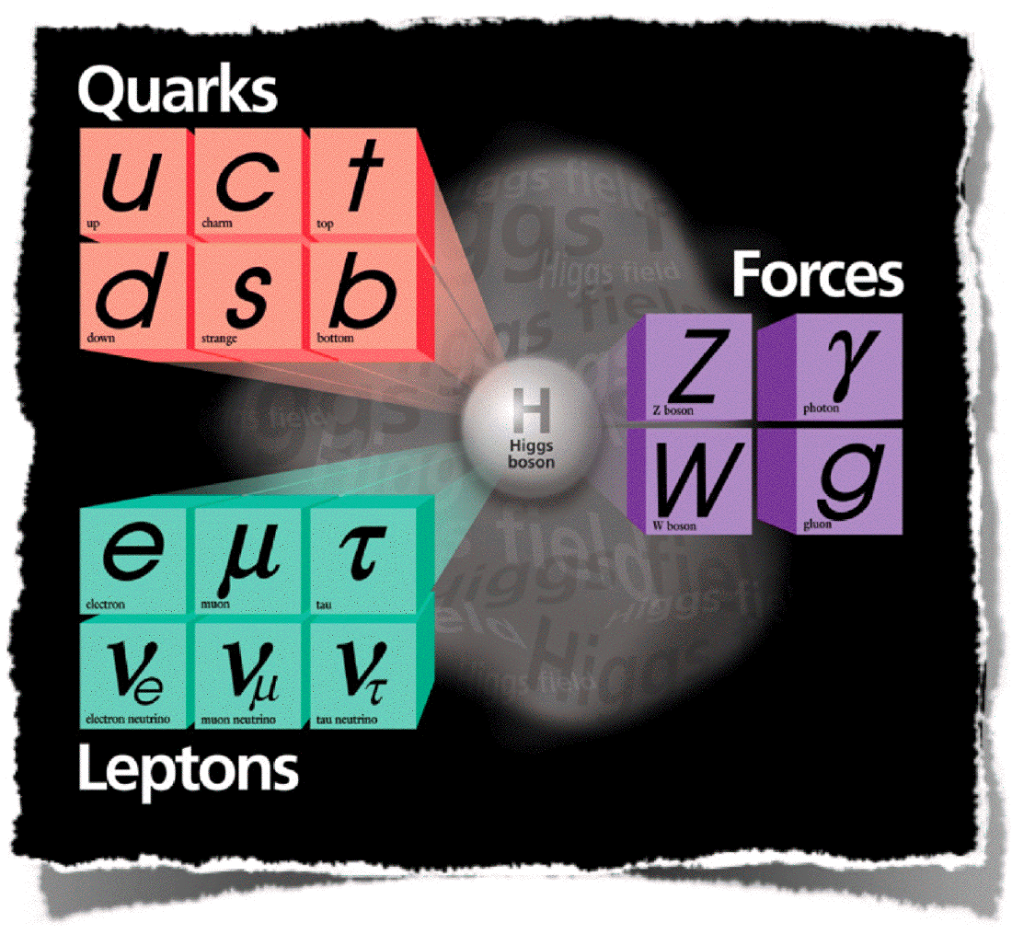
One field to rule them all…
Standard Model
Fundamental matter: quarks and leptons
Symmetries: U(1)_{Y}, SU(2)_{L}, SU(3)_{C}
Local gauge invariance: gauge bosons (force carriers)
Higgs field: spontaneous EWK symmetry breaking and the Higgs boson

Slide 5
What’s the problem?
Dirac Lagrangian:
Free fermions
Gauge interaction
Free gauge bosons
$$e^{−}$$
$$γ$$
$$γ$$
$$e^{−}$$
“Local gauge invariance”: should be invariant under ,
but is not gauge invariant → need !
So it works for EM and QCD, but W and Z bosons are massive (~100 GeV). Need a mechanism to give mass to the W and Z.

Slide 6
The Higgs* Mechanism
Introduce a complex scalar field φ and a massless gauge boson $A^{μ}$:
“vev”
Gauge invariance:
Expand around minimum:
Gauge boson mass!
Mass of a real scalar particle: Higgs boson!
* actually, the Nambu-Goldstone-Anderson-Englert-Brout-Higgs-Guralnik-Hagen-Kibble mechanism

Slide 7
Properties of “the SM Higgs boson”
A single elementary scalar particle ( $J^{P}=0^{+}$), quantum of the field that gives mass to the W and Z (plus quarks and leptons)
Mass:
Because λ is not predicted, the Higgs boson mass m_{H} is a free parameter in the Standard Model
Interaction: couples to particles according to their mass, including self-coupling (H* → HH)
Here, g and g/ are the SU(2) and U(1) gauge couplings

Slide 8
Fermion Masses
The mass term $mψ\overline{ψ}$ in the Dirac Langrangian is not gauge invariant under SU(2)_{L} x U(1)_{Y} transformations. One can make it gauge invariant either by setting m = 0 (i.e., getting rid of it by making all fermions massless), or by using the so-called Yukawa interaction between fermions and the Higgs field*:
And after spontaneous symmetry breaking, setting φ = v + H, we obtain:
Where the first term gives the fermion masses, $m_{f}=\frac{g_{f}v}{\sqrt{2}}$, and the second term describes the interaction of fermions with the Higgs field.
*as in nuclear physics, where the scalar pion field mediates strong interactions between nucleons.

Slide 9
Connection to Flavor Physics
The previous slide glosses over important details of the Yukawa interaction. Unpacking it one step further we have more generally:
Here, Y_{ij} are the Yukawa couplings between the Higgs field and the fermion flavor eigenstates.
To get to the mass eigenstates we need to apply a rotation:
The rotation matrices V that take us from flavor to mass eigenstates are essentially the CKM matrix:

Slide 10
Is this the only possibility? NO!
Additional Higgs fields, e.g. from Supersymmetry, that help solve the hierarchy problem
New strong interactions at the TeV scale that break electroweak symmetry dynamically
Other Higgsless models tend to be ruled out by the observation of a Higgs boson ;-)
But, for example, still possible to consider the observed particle as a Goldstone boson of the spontaneous breaking of scale invariance at some large scale.

Slide 11
A brief history of Higgs searches…

Slide 12
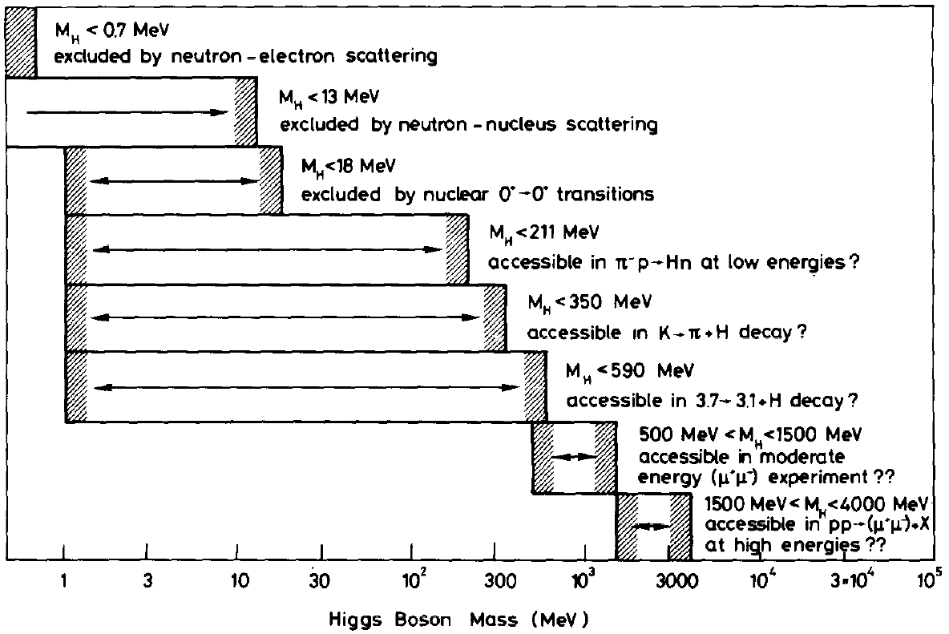
Higgs Hunting: 1975
Ellis, Gaillard, and Nanopoulos, Nucl. Phys. B106, 292
125 GeV

Slide 13
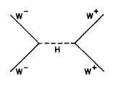
Bounds on the SM Higgs Mass: ~1980
and A. Linde, JETP Lett. 23 (1976) 64
Requiring $V\left(v\right)<V\left(0\right)$ gives:
$$m_{H}>{\left[\frac{3\left(2m_{W}^{2}+m_{Z}^{4}\right)−4\sum{m_{l}^{4}−12\sum{m_{q}^{4}}}}{16π^{2}}\right]}^{\frac{1}{2}}>7 \text{GeV}$$
By 1980 we knew the Higgs mass was 7 < m_{H} < 1000 GeV

Slide 14
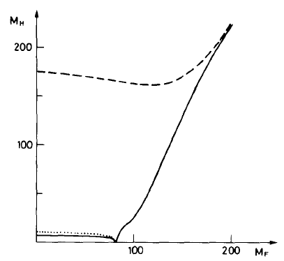
The Role of the Top Quark
The SM Higgs boson couples to fermions according to their mass, $m_{f}$ :
The top quark was discovered at Fermilab in 1995 with a mass near 173 GeV, clearly indicating it’s strong coupling to the Higgs field
This result ushered in the modern era of Higgs searches at LEP and FNAL
Cabibbo, Maiani, Parisi, Petronzio, Nucl. Phys. B158 (1979) 295

Slide 15
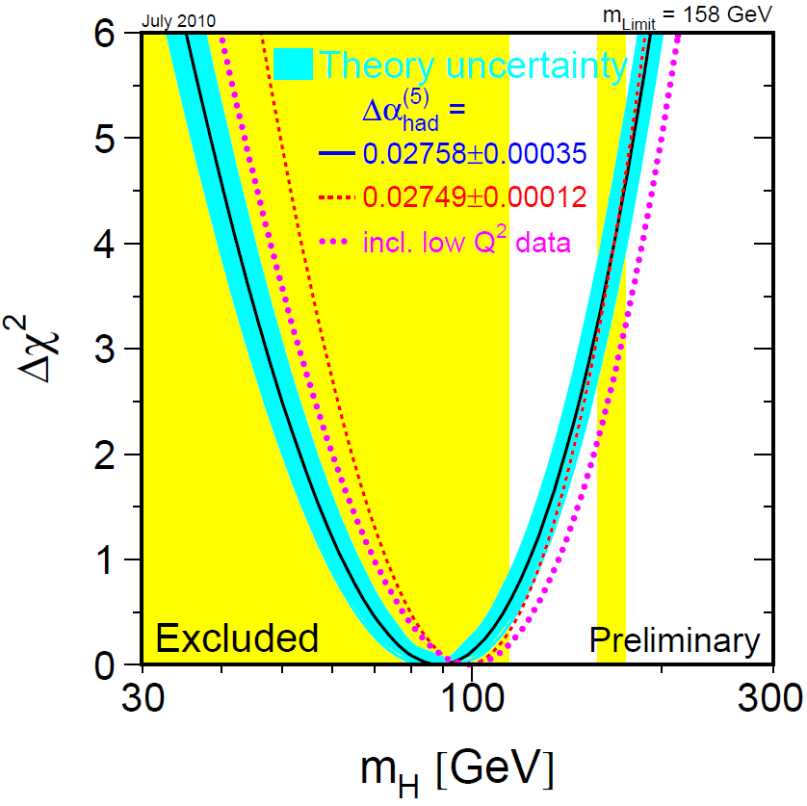
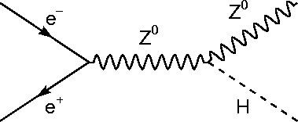
LEP Legacy
Search strategy:
Produced via Higgs-strahlung
Decaying to $b\overline{b}$ or $τ\overline{τ}$
$m_{H}>114.4$ GeV

Slide 16
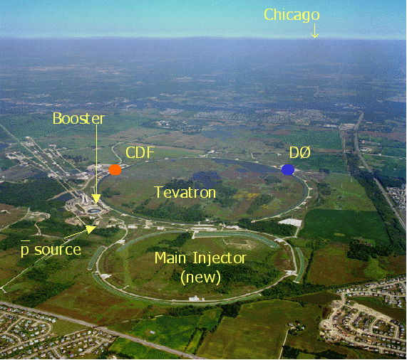
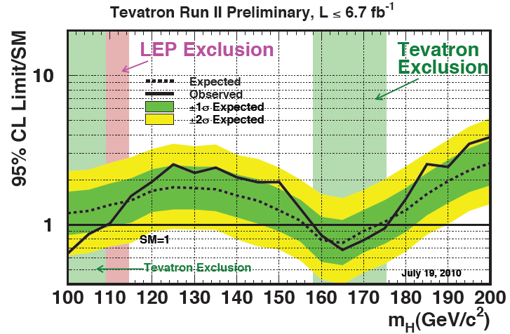
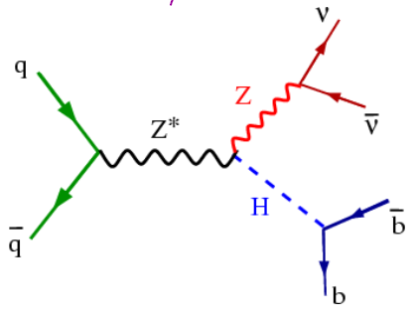
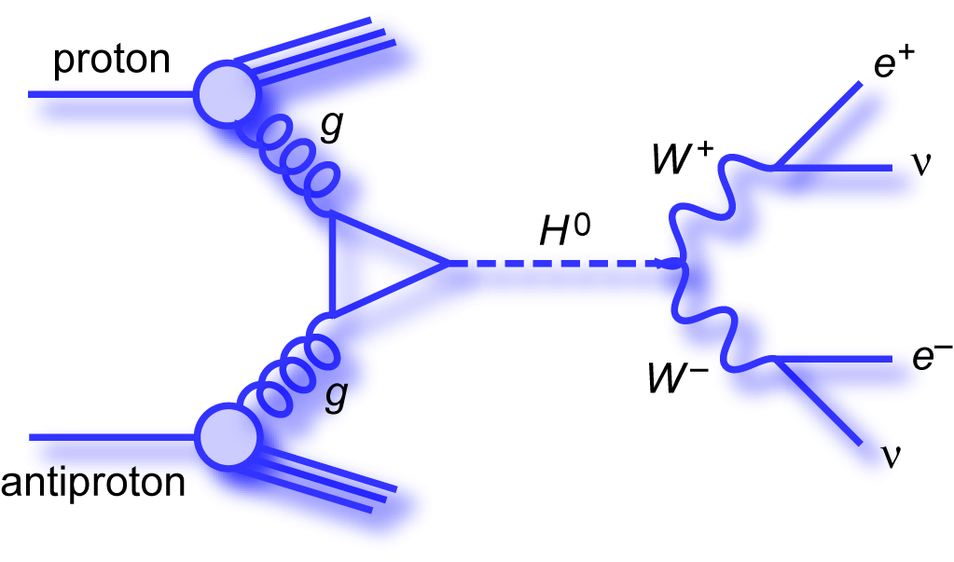
Searching at the Tevatron ($≤$ 2010)
Operating at FNAL from 1985 - 2011
$p\overline{p}$ collider with $\sqrt{s}$ up to 1.96 TeV
Discovery of the top quark
Measurements of $m_{t}$ and $m_{W}$
Search for the Higgs boson
$$m_{H}<158 or>175 GeV$$

Slide 17
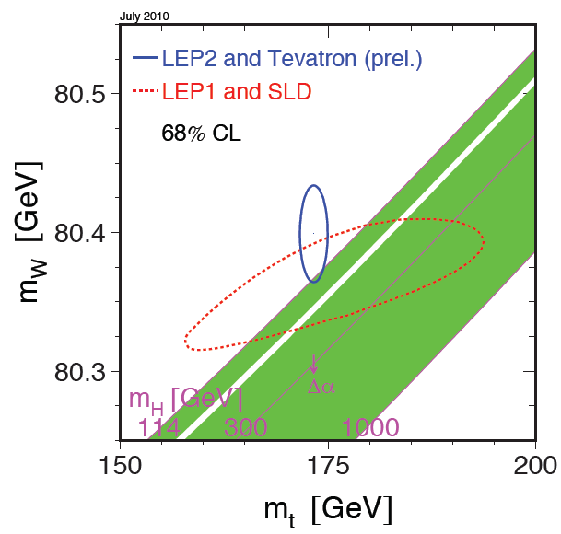
At the dawn of the LHC era

Slide 18
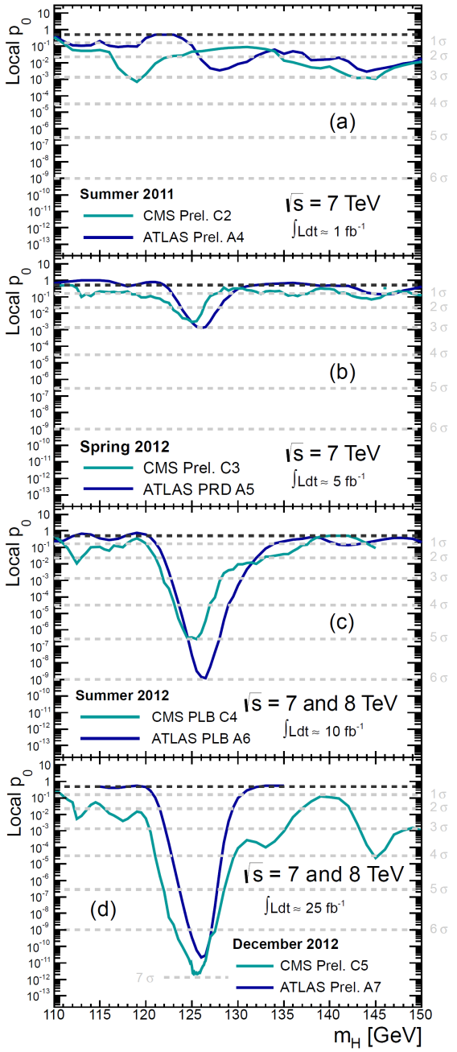
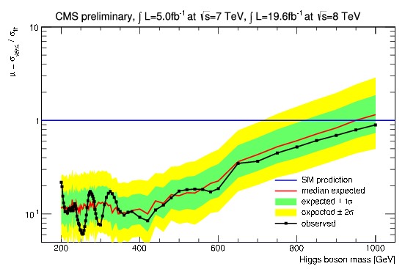
Evolution of Higgs Discovery @ LHC
From the PDG:
http://pdg.lbl.gov/2015/reviews/rpp2015-rev-higgs-boson.pdf
Summer 2011: drops in the bucket
End of 2011: tantalizing hint, the trail begins
Summer 2012: discovery! 5σ from both experiments
End of 2012: confirmation! Measurement era begins
…and we did not find a SM-like Higgs boson anywhere else:
SM

Slide 19
Finding “a Higgs boson”

Slide 20
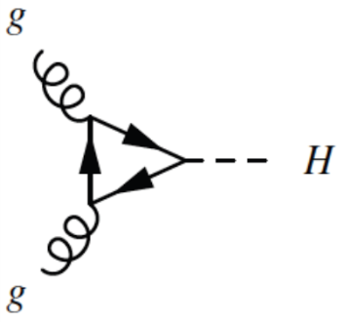
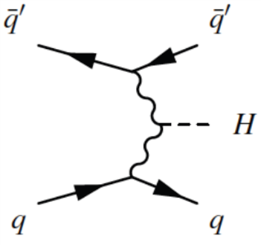
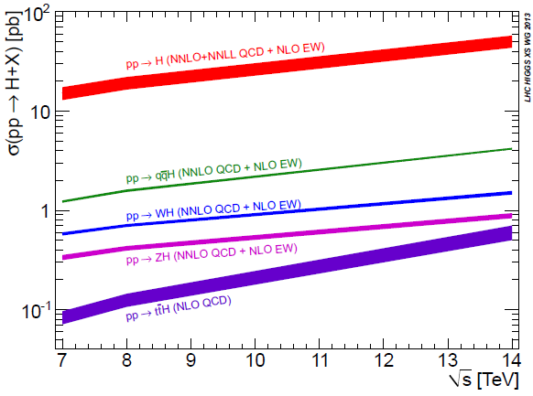
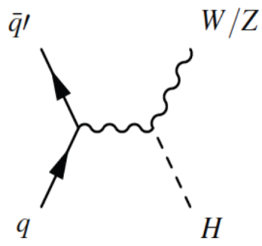
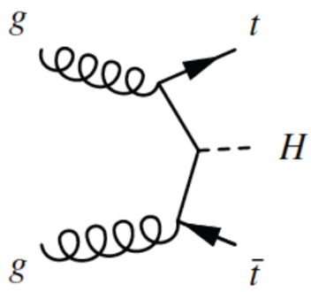
SM Higgs Production at the LHC
Gluon Fusion
Vector-Boson Fusion
Higgs-strahlung
Top Fusion ($\text{t}\overline{\text{t}}$H)
LHC in 2012 at (the old) record luminosity (7 x 10³³ cm⁻²s⁻¹) and energy (8 TeV) was producing SM Higgs bosons (M_{H} = 125 GeV) at a rate $\sim 750$/hr

Slide 21
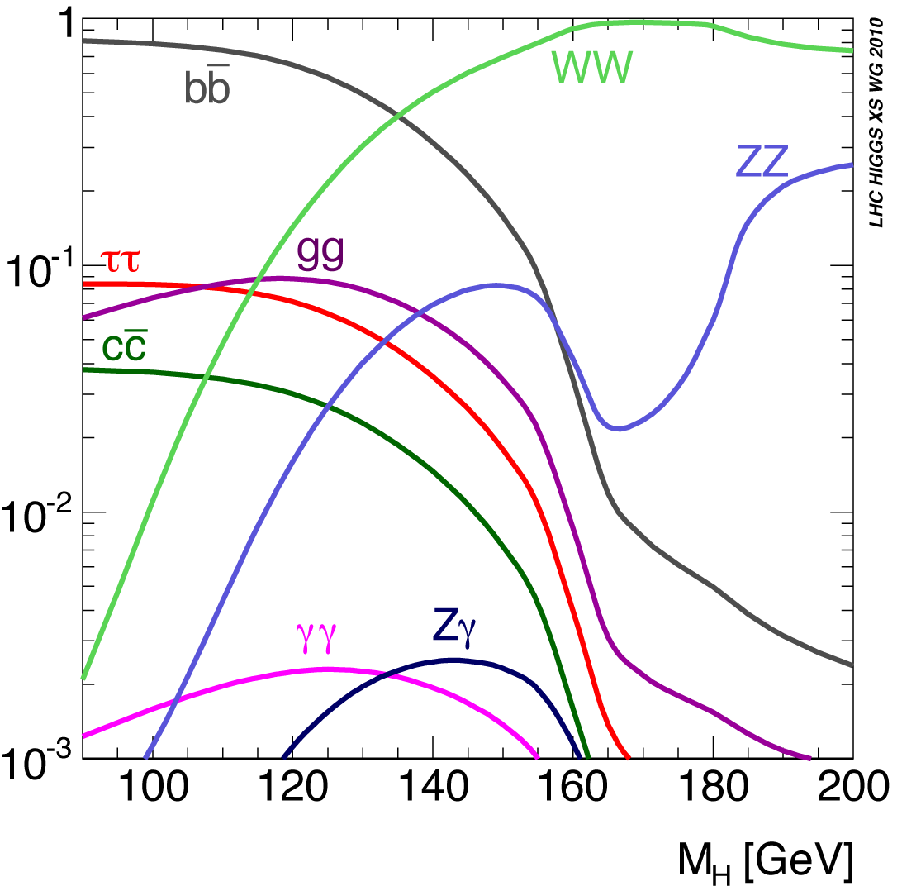
Decay of the Higgs Boson
BF (%) for m_{H} = 125.09 GeV
58.1%
21.5%
6.3%
2.6%
0.2%
Cross sections are large
Fermion decays (bb+ττ) are accessible
Natural width is negligible
Fortuitous! Only region in m_{H} where

Slide 22
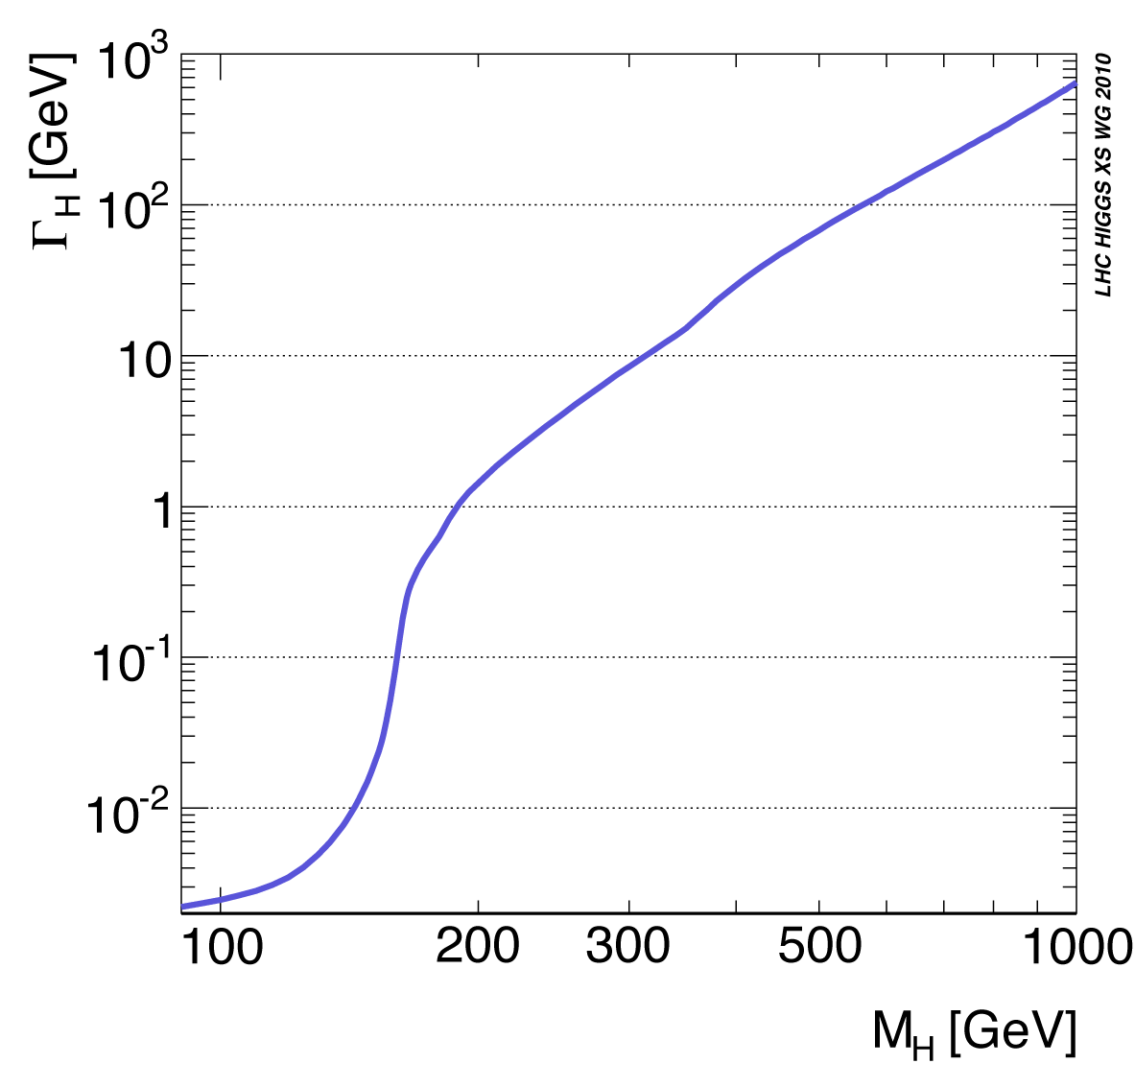
Natural Width of the Higgs Boson
@Low mass
Narrow!
Observed width dominated by detector resolution
@High mass
Higgs becomes a broad resonance dominated by natural width
Theory input is critical
Det. Res. = 10-20%
($\text{b}\overline{\text{b}}$, ττ, WW)
Det. Res. = 1-2%
(γγ, ZZ)

Slide 23
SM Higgs Analyses @ LHC
ττ
WW
Three main classes of SM analysis:
20%
1) High sensitivity, high resolution
bb
10%
γγ, ZZ
Detector Mass Resolution
2) High sensitivity, low resolution
WW
γγ
3) Low sensitivity, low resolution
1%
ΖΖ
ττ, bb
Sensitivity
Need multi-purpose detectors like ATLAS and CMS to find the Higgs boson at the LHC!

Slide 24
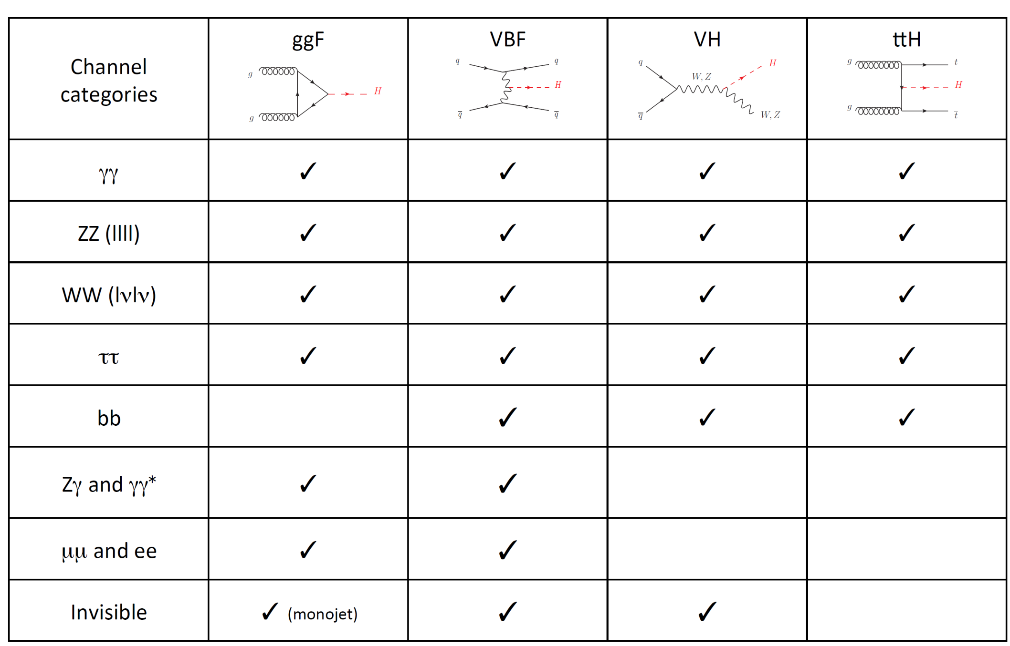
Overview of SM Higgs Searches
M. Kado

Slide 25
General Comments on SM Higgs Searches
Blind analysis methods are used in ~all Higgs searches at ATLAS/CMS.
We searched explicitly for the SM Higgs boson: most analyses use unique properties of the SM Higgs boson to optimize their search sensitivity relative to known SM backgrounds.
This means that analyses are model dependent (i.e., the SM!) to varying degrees, and the significance of an observed excess is within the context of a search for the SM Higgs boson.
However, it does not mean that a 5σ signal proves that what we have seen is the SM Higgs boson (more on that later).
N.B. : due to historical agreement (included in the Magna Carta), we quote ‘signal strength’ (μ) relative to SM:
$$μ≡{σ×\text{BF}}/{σ_{\text{SM}}×{\text{BF}}_{\text{SM}}}$$

Slide 26
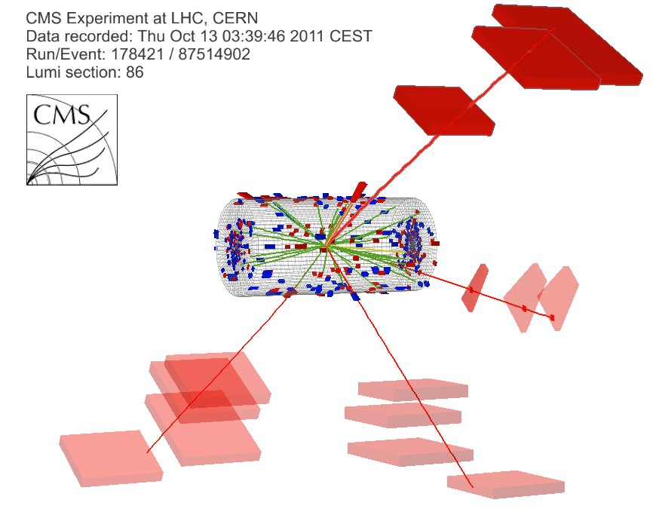
Overview of H → ZZ* → 4ℓ (ℓ=e,μ)
Advantages
Very clean channel
Excellent mass resolution
Readily available trigger
Challenges
High S/B, but very low S for Higgs masses near 125 GeV
Must maintain high lepton trigger and reco efficiencies
Four muon (+ 1 photon) event from 7 TeV dataset. mass of 4μ + γ = 126.1 GeV
μ⁻(Z₁) p_{T} : 28 GeV
γ(Z₁) E_{T} : 8 GeV
μ⁺(Z₂) p_{T} : 6 GeV
μ⁺(Z₁) p_{T} : 67 GeV
μ⁻(Z₂) p_{T} : 14 GeV

Slide 27
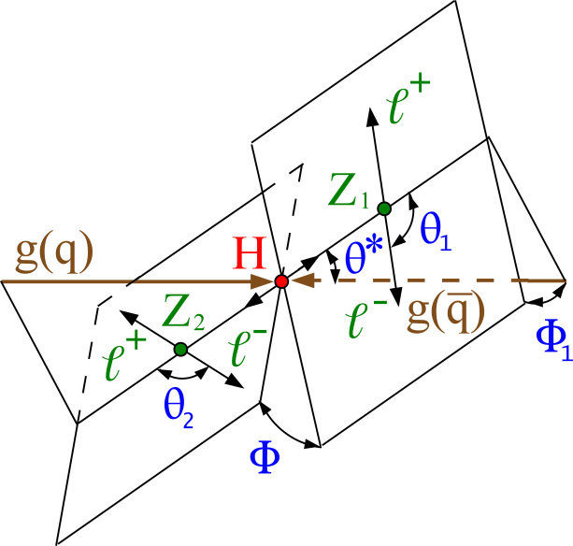
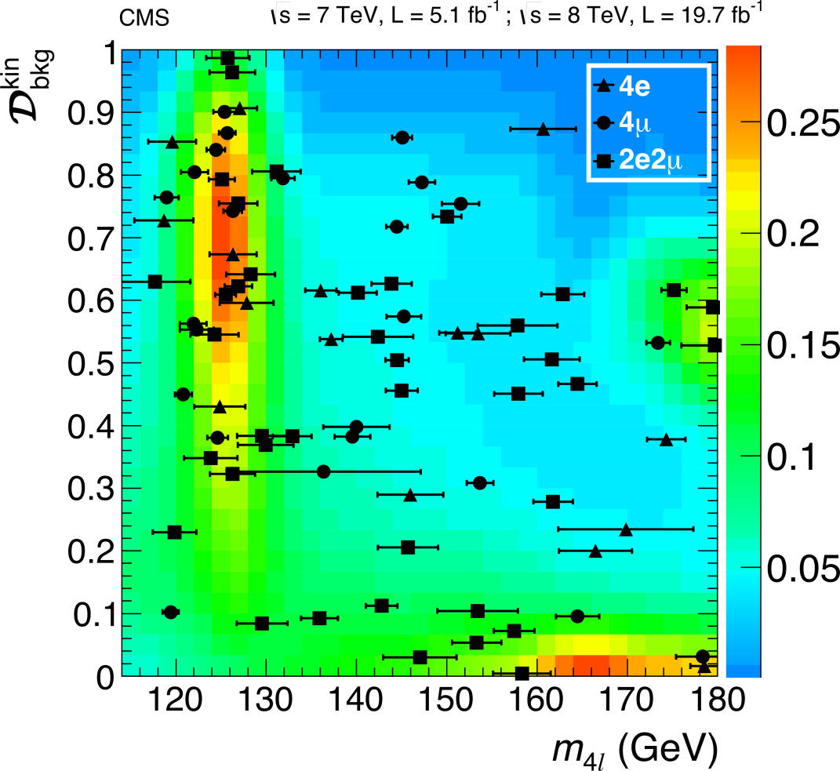
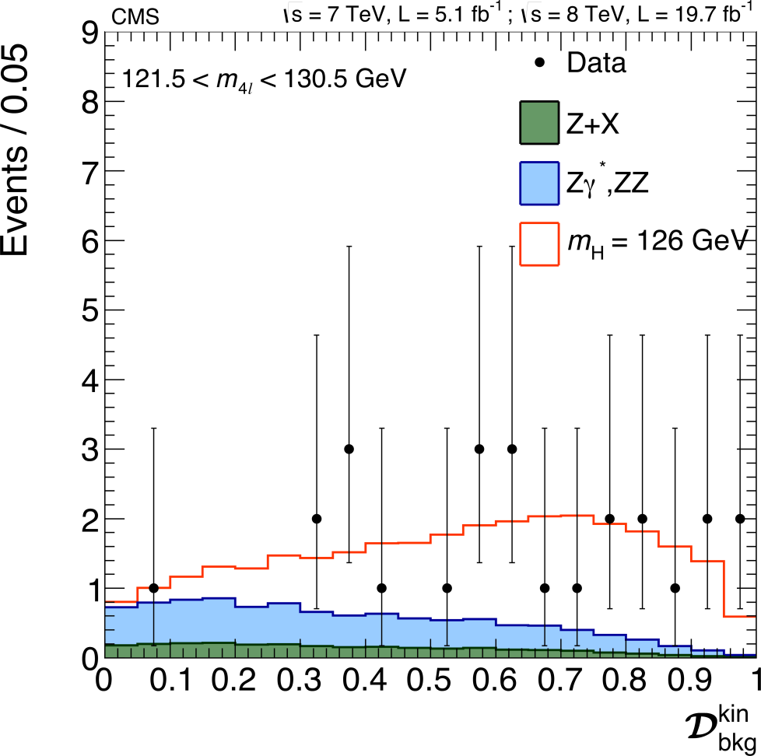
Decay Kinematics
Fully exploit the expected angular distribution to separate Higgs signal from SM backgrounds
Signal region

Slide 28
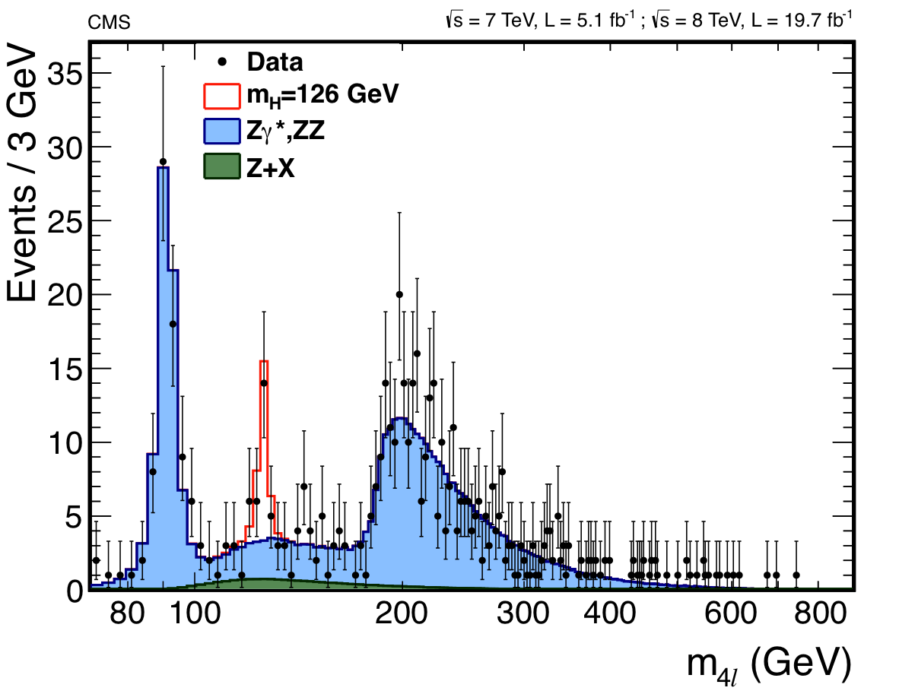
Golden Channel: H → ZZ* → 4ℓ
Z → 4ℓ
> 6σ observation
pp → ZZ
Higgs Boson

Slide 29
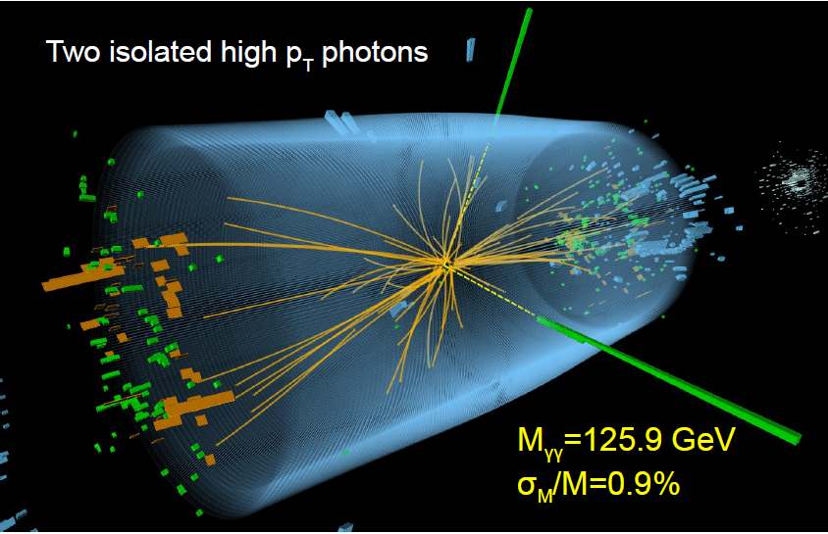
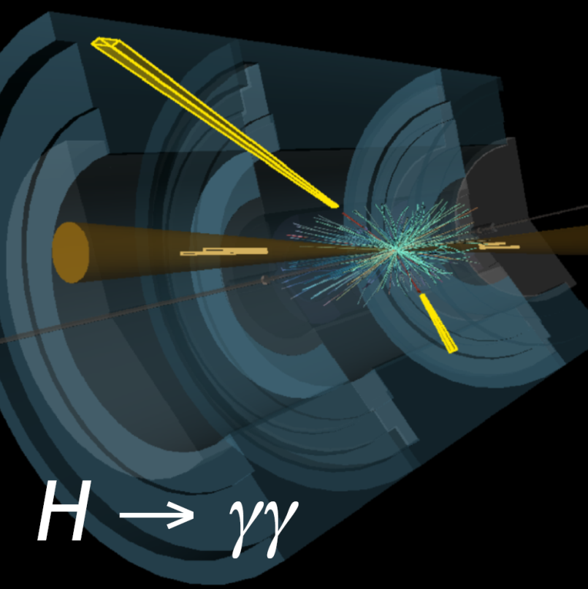
Overview of H → γγ
Experimental signature
Narrow (1-2%) diphoton resonance
Hard diphoton p_{T} spectrum
Isolated photons
VBF: spectacular diphoton+dijet
Analysis strategy
Photon energy scale from Z → ee
Separate categories for inclusive, VBF, VH, ttH production; and photon quality
Fit of narrow peak over smoothly falling background (obtained from data)

Slide 30
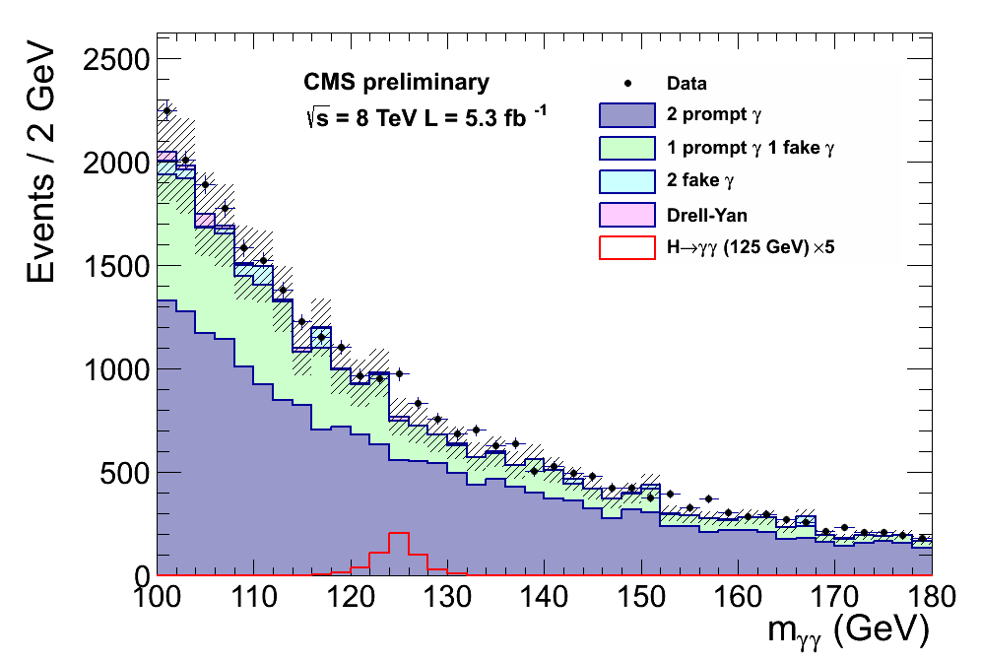
Diphoton Backgrounds
For illustration only

Slide 31
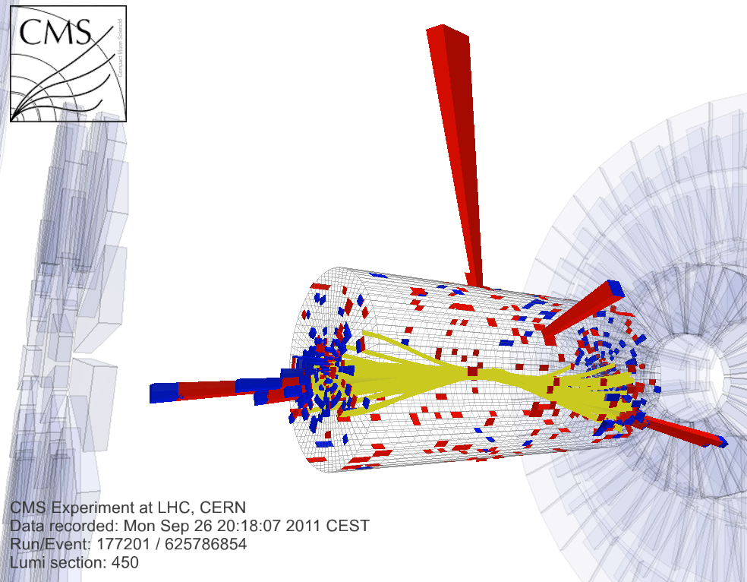
VBF Category
Select events with VBF topology
Two isolated photons + 2 forward jets
Jets have large pT and mass, and are separated by a large distance in η
Large S/B, but small S

Slide 32
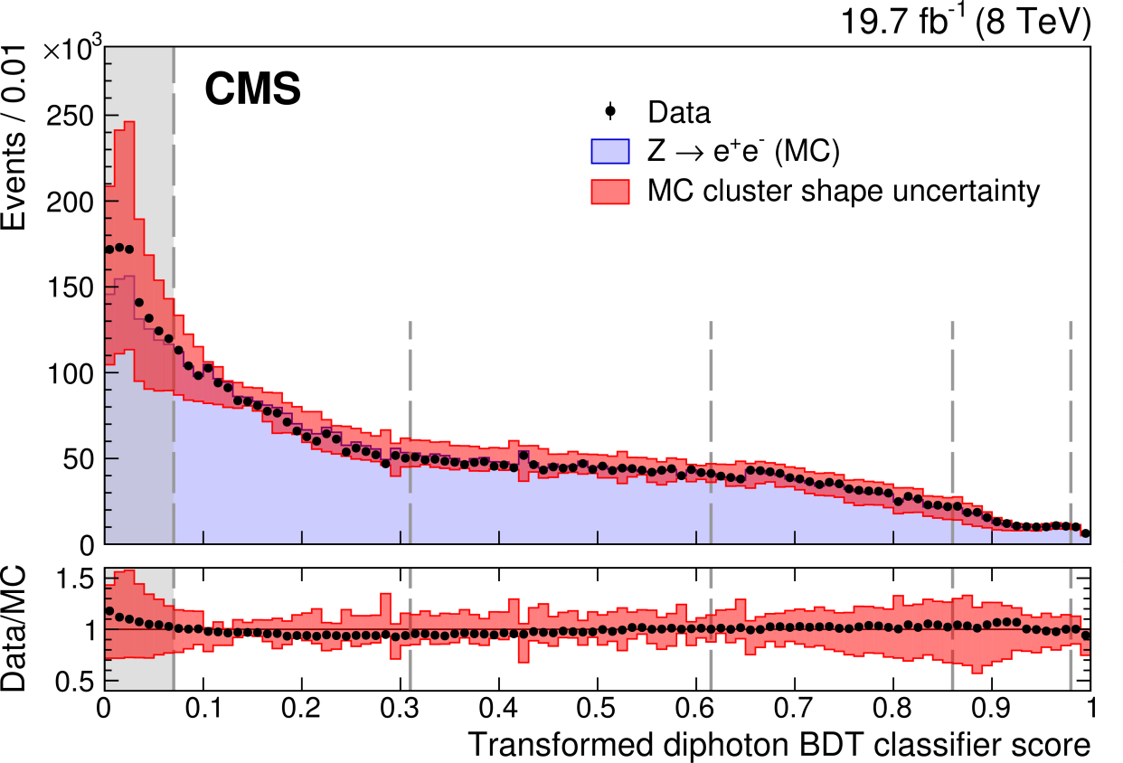
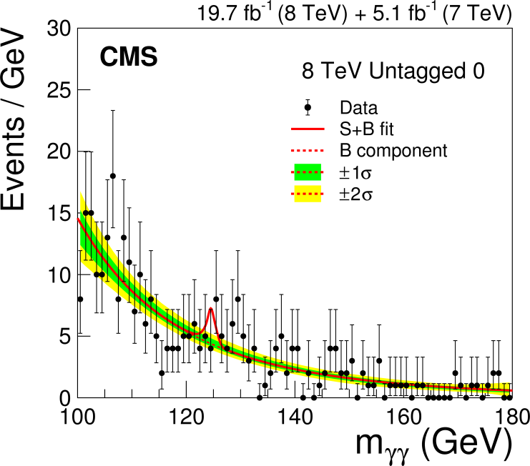
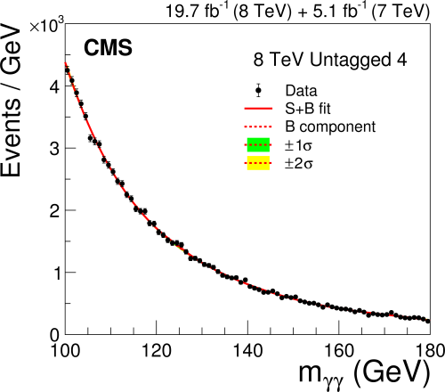
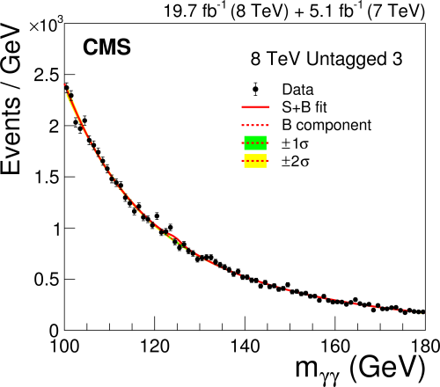
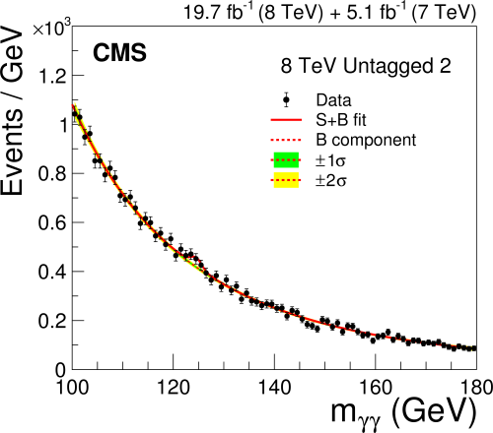
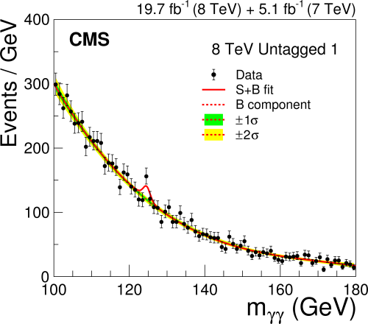
Example: MVA Categories
BDT based on photon ID, diphoton mass resolution and diphoton kinematics, within production cats

Slide 33
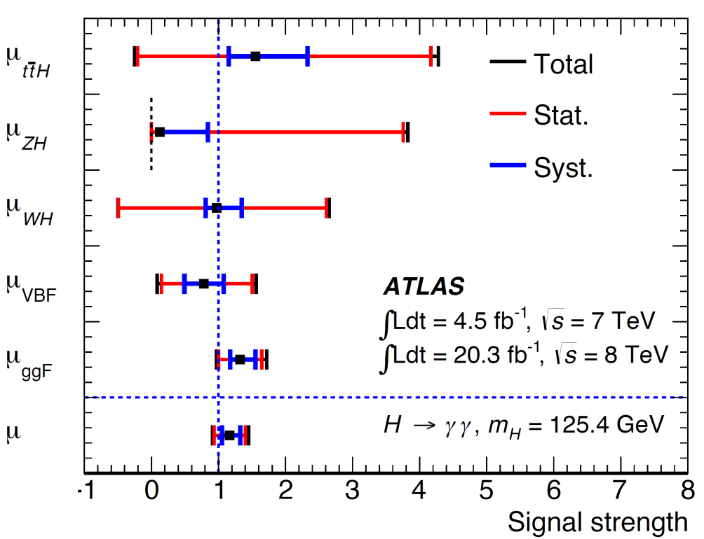
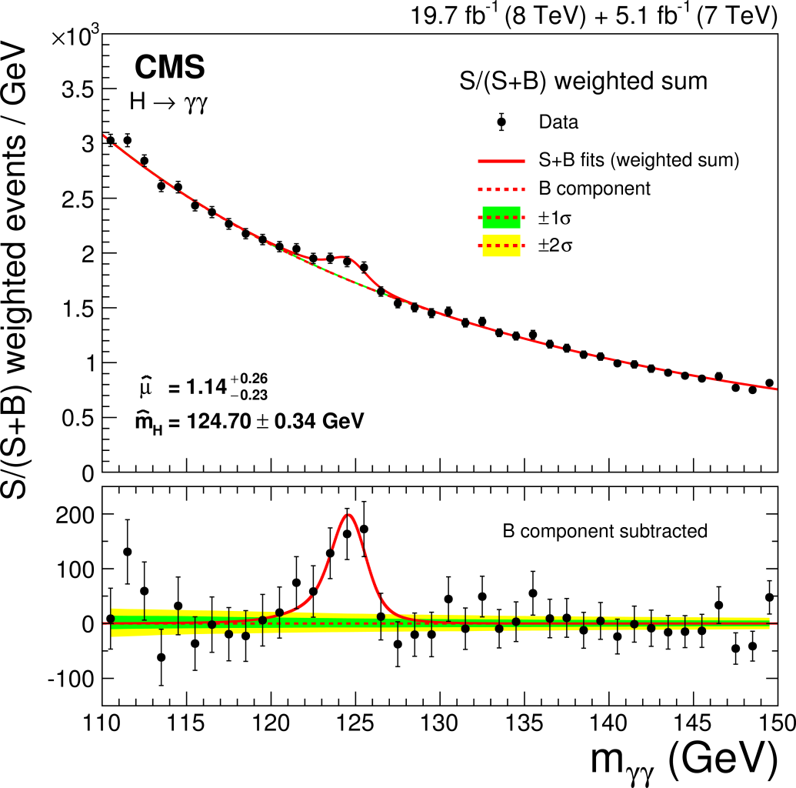
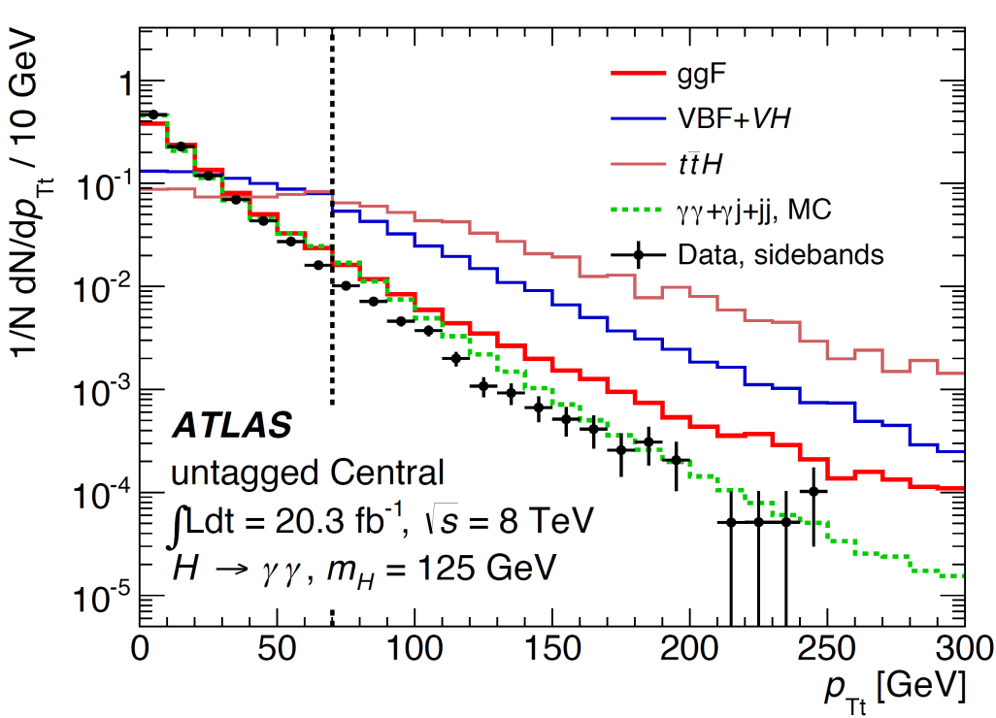
H → γγ observation
Both experiments see ≥ 5σ
Measurements of differential distributions useful in evaluating agreement with higher-order theory calculations

Slide 34
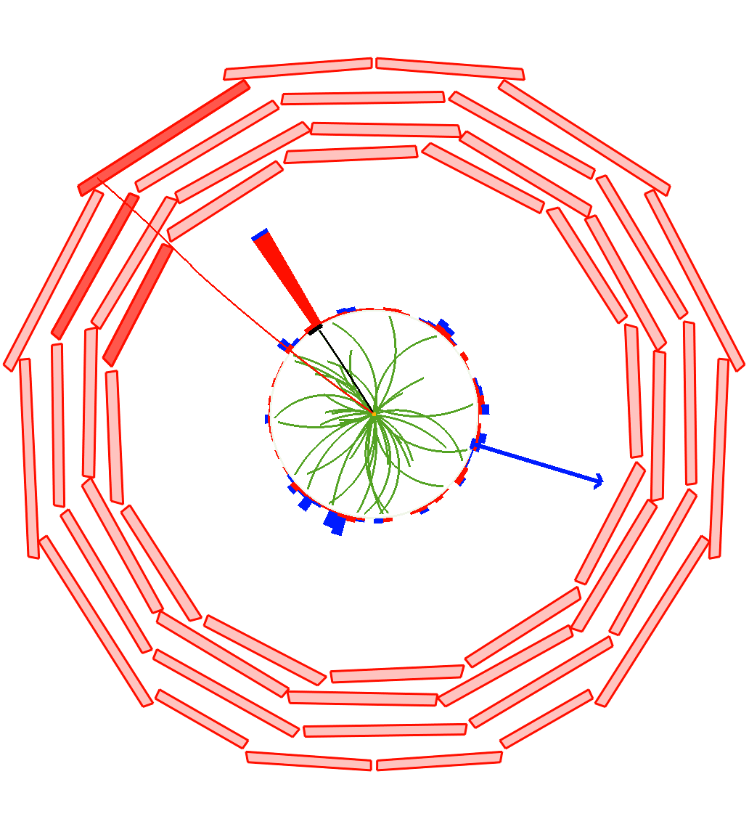
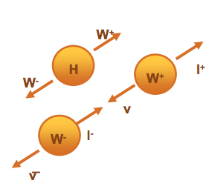
Overview of H → WW*→2ℓ2ν
High sensitivity, low resolution
2nd largest σ x BF
Charged leptons for trigger
Controllable backgrounds
Kinematic handles
μ P_{T}
32 GeV
e P_{T}
34 GeV
Spin-0 Higgs + V-A weak int. = small angle between ℓ’s, and ν’s
MET
47 GeV
Primary drawback is no sharp mass peak (20% resolution in M_{T})

Slide 35
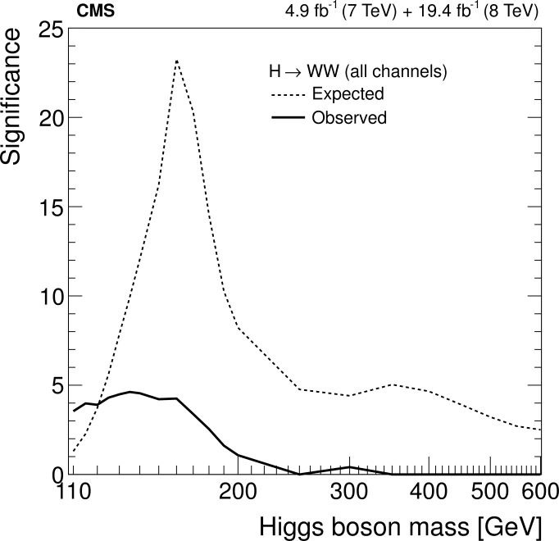
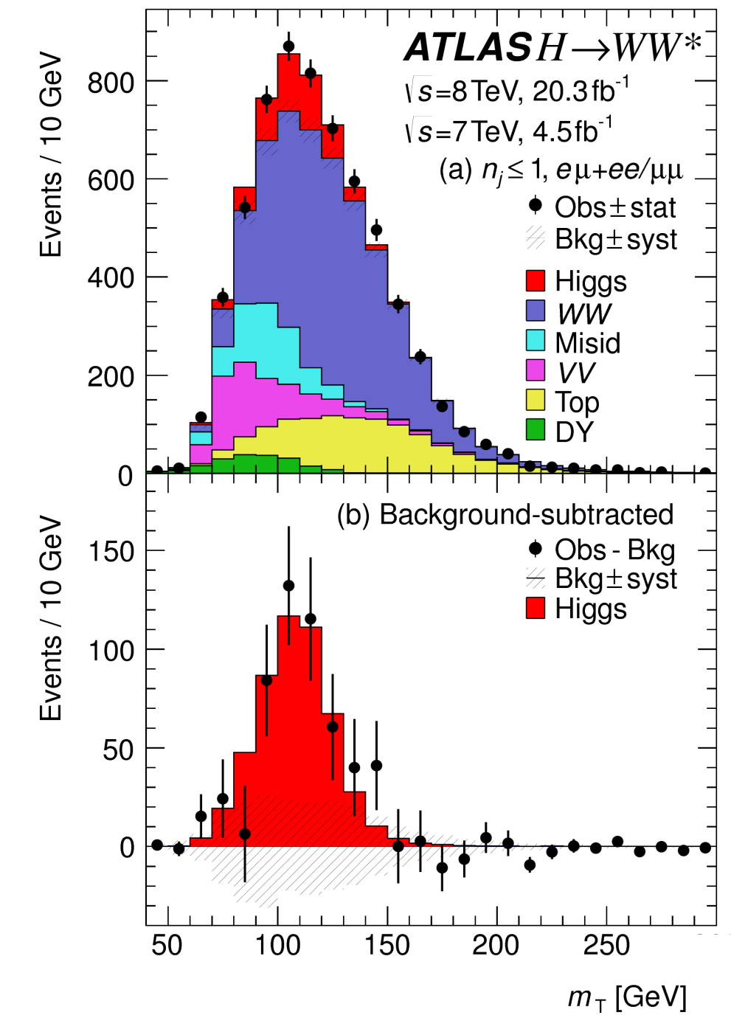
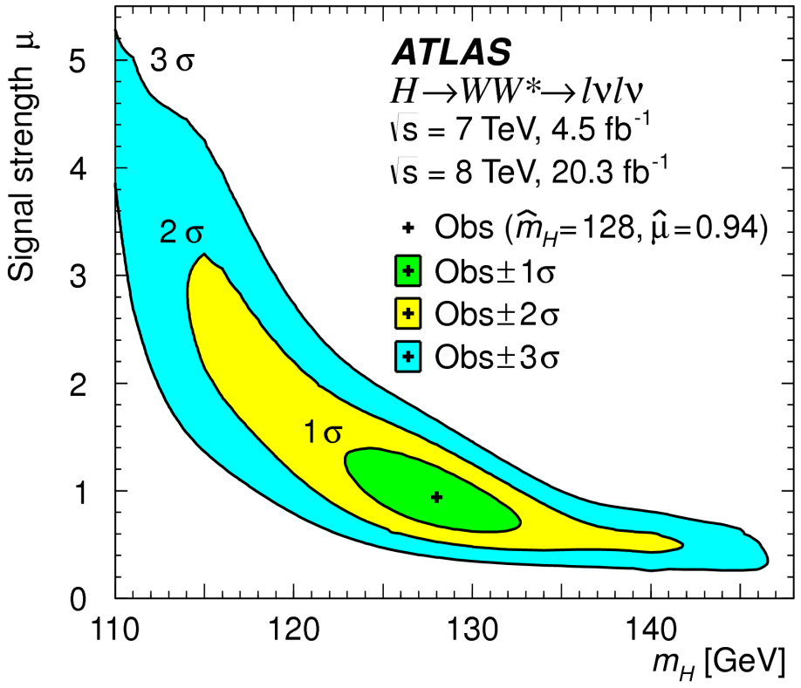
Observation of H → WW

Slide 36
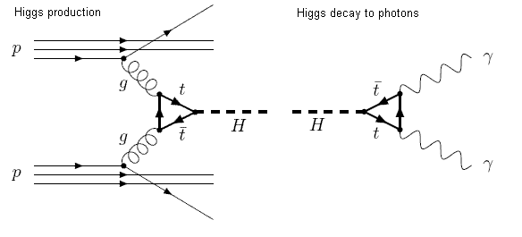
Does it H(125) couple to fermions?
$$W$$
$$W$$
In the context of the SM Higgs boson phenomenology, we already have strong indirect evidence for a coupling to the top quark via the loop in the dominant production mechanism.

Slide 37
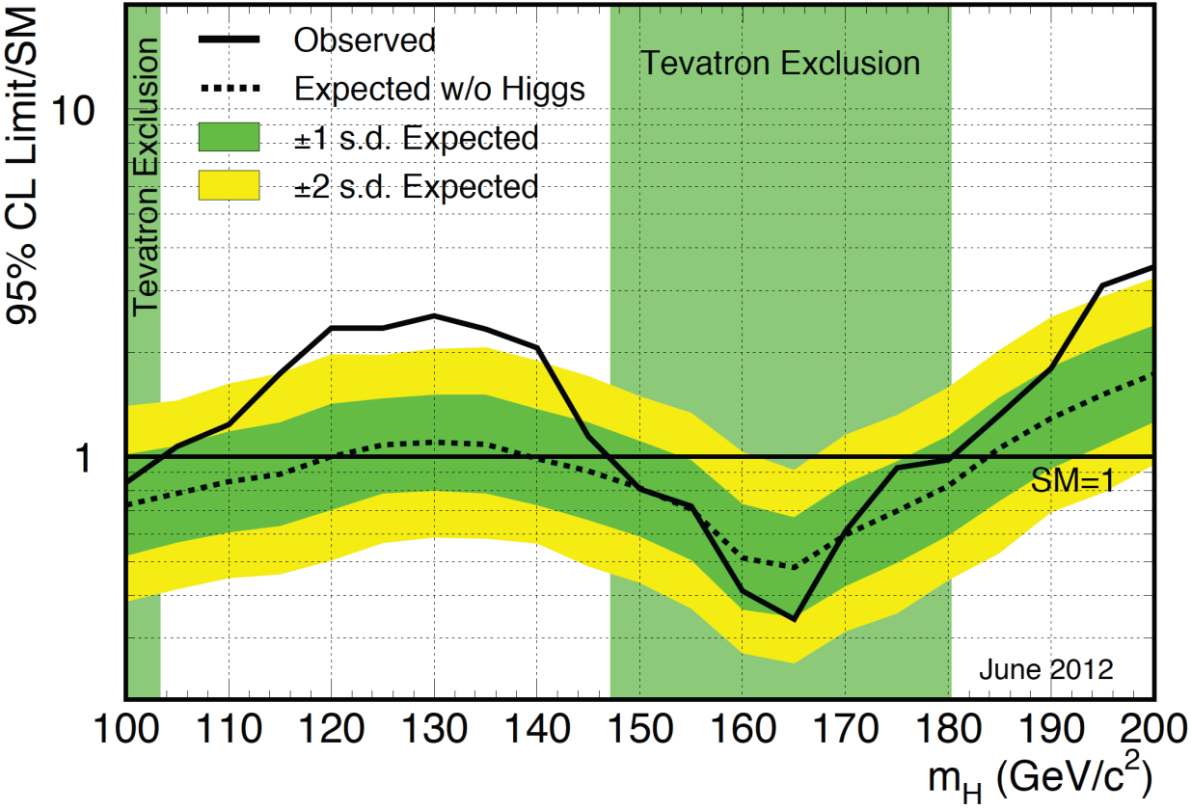
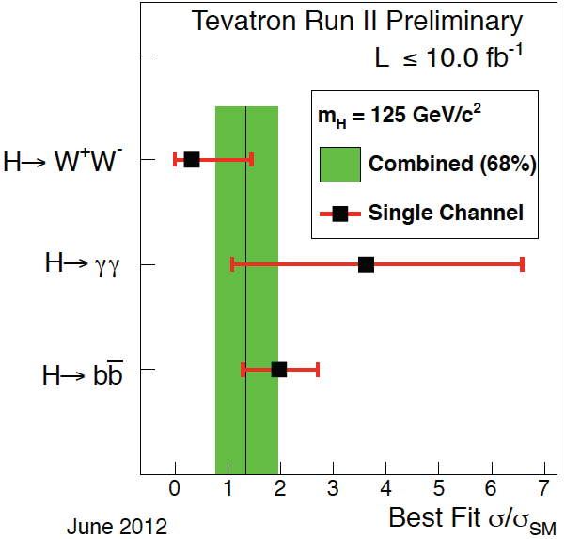
Does it decay to fermions?
2.5σ (Global)
2.9σ (bb)
Hints of H → bb at the Tevatron

Slide 38
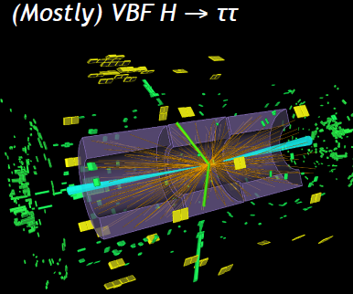
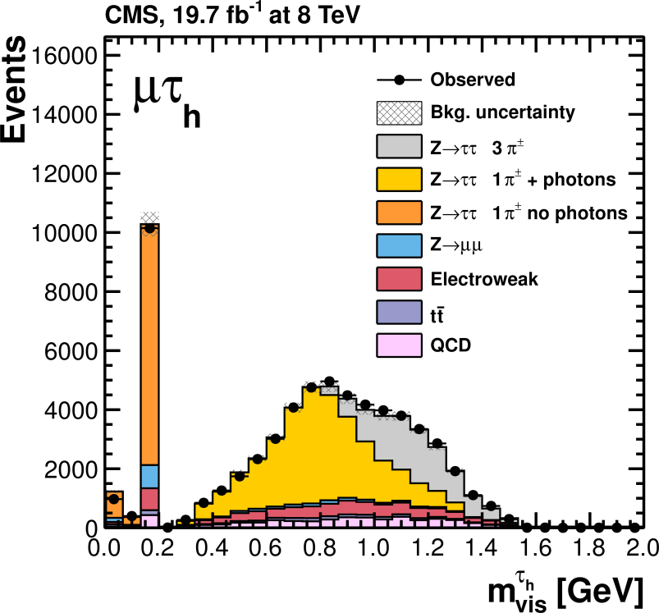
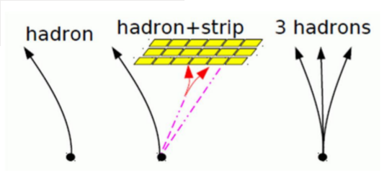
Overview of H → ττ
Example in ATLAS: VBF H → ττ
Importance of H → ττ:
Only currently active probe of lepton coupling
Complementarity with H → bb in down-type fermion couplings
Largest σ x Br for SM mH < 130 GeV
Sensitivity to BSM models
Main challenges
Tau reconstruction, large backgrounds
CMS:
τ reconstruction in Run 1
π±
ρ±→π±π⁰
a₁→π±π⁰π⁰
a₁→π±π∓π±

Slide 39
Observation of H → ττ @ LHC
CMS @ 3σ and ATLAS @ 4.5σ, combination over 5σ
First direct observation of H(125) coupling to fermions

Slide 40
H → $\text{b}\overline{\text{b}}$ @ LHC
Inclusive search swamped by QCD
In 2008 it was proposed to search in boosted VH topology:
V mostly kills QCD and provides an efficient trigger
Boosting (> 200 GeV) suppresses V+jets and makes Z(νν)H visible
Substructure facilitates boost
B/S ~ 10⁹
LHC vs. Tevatron:
Signal increases ~5x
Gluon-initiated bkg increases > 20x
Still challenging at LHC, but more cross section to burn → boost!

Slide 41
H → bb @ LHC
Not there yet: CMS @ 2.1σ, ATLAS @ 1.4σ

Slide 42
Search for ttH production
Top is the heaviest fermion
Strong coupling to Higgs
But ${2m}_{t}≫m_{H}$, only sensitive to coupling in production (ttH, tHq, tH)
Critical channel
Only access to real tops coupling to Higgs
One of the highest priorities in Higgs physics for Run 2 @ 13 TeV
Strategy
Combine the five main H decay modes in three categories: bb, γγ, and multilepton (WW, ZZ, ττ)
All production channels probed: lepton+jets, dilepton, and even all-hadronic (ATLAS)
Topology and extensive b-jet identification techniques are exploited by both experiments

Slide 43
Hints of ttH @ LHC
CMS excess is 2σ from SM expectation, mostly concentrated in dilepton category
ATLAS also sees μ > 1, but more consistent with SM
This production channel is under intense scrutiny in Run 2, more in tomorrow’s lecture

Slide 44
Rare, Very Rare, and Ultra Rare Decays
2 x 10⁻⁴
μμ
Accessing Higgs couplings to light fermions via direct and radiative decays:
H → $\text{f}\overline{\text{f}}$
H → γ (γ*, Z*) → γ$\text{f}\overline{\text{f}}$
2-3 x 10⁻⁶
J/ψ γ, φγ
5 x 10⁻⁹
ee
2-6 x 10⁻¹⁰
ϒ(ns)γ

Slide 45
Higgs decaying to Zγ
Connected via SU(2) to the other diboson channels, but directly sensitive to loop diagrams differently from γγ
New BSM particles in the loops could enhance the predicted BF
Deviations from SM expectations in γγ and Zγ useful to study BSM
Limits are ~10x the SM expectation, thus ruling out models that predict deviations at this level due to additional BSM particles in the loops

Slide 46
Higgs → μμ or ee?
If this is the SM Higgs boson, coupling to leptons should go like $g∝ m_{l}$
μμ/ee decays should be highly suppressed relative to ττ
This is what is observed at CMS and ATLAS
Would have seen μμ/ee by now → clearly H(125) is not flavor-universal!
H → μμ
H → ee

Slide 47
H → (J/ψ, ϒ, φ) γ
Very/ultra rare decays of H(125) can be used to study alternative interpretations via the Higgs coupling to u, d, s, c, b quarks
Current limits range from 5-10000 x SM prediction, HL-LHC will help here!
m_{ll} < 20 GeV

Slide 48
Is it “The SM Higgs Boson”?
When a new particle is discovered, the first step is to measure its properties with the highest possible precision
Mass (is it one state, or multiple states?)
Quantum numbers: spin, parity, charge conjugation
Signal strength (cross section times branching fraction)
Total width (lifetime)
If this is the SM Higgs boson it is a J^{PC} = 0⁺⁺ fundamental particle that couples to the gauge bosons and fermions according to their mass via a single vacuum expectation value
Any deviation from this expectation is a sign of New Physics

Slide 49
Characterization of the New Boson
Combined ATLAS + CMS signal strength
Combined ATLAS + CMS mass
Spin, parity, and CP
Natural width

Slide 50
Signal strength by decay channel
Both experiments are consistent with the SM expectation, combination improves overall sensitivity by expected amount. Only significant outlier is ttH production (2σ from SM)

Slide 51
Significance (σ) by production and decay channels at or below ‘observation’ level
Three secondary production channels (VBF, VH, ttH) all have significances above 3σ, although ttH is a bit ‘hotter’ than expected. Confirming ttH, and observing bb decays, are top priorities for Run 2,

Slide 52
Higgs Combined Mass: overview
Use high-resolution channels only: ZZ and γγ
CMS uses same analysis for mass and signal strength measurements
ATLAS modified analysis targeting reduced systematic uncertainty on m_{H}
Signal/bkg interference is neglected
Few 10s of MeV shift in γγ, much smaller in ZZ
Common mass and 3 signal strength parameters
H → γγ: μ_{ggF+ttH} , μ_{VBF+VH}
H → ZZ: μ_{ZZ}
Reduces model dependence of mass measurement
Fit to ATLAS+CMS datasets maximizing profile likelihood ratio:
∼300 floating parameters including mass, signal strength and nuisance parameters describing systematic uncertainties

Slide 53
LHC Higgs Mass Combination
Some tension between ATLAS and CMS, but not much (10% compatibility)
Allowing signal strengths to vary by experiment shifts m_{H} up by only 50 MeV

Slide 54
Systematic Uncertainties
Relative weights →
Uncertainties on γ, electron, and muon energy/momentum scale dominate (± 0.11 GeV), all experimental uncertainties (except lumi) taken to be uncorrelated
Theory uncertainties are 100% correlated

Slide 55
Spin-Parity Overview
Use bosonic channels: ZZ, γγ, WW
Discovery channels with higher stats and/or better S/B
ZZ: best S/B and full access to angular information, but lowest statistics
γγ: large stats but few handles
WW: large stats and angular information, but not fully reconstructed
Analyses have evolved substantially since 2012
From basic hypothesis testing of 0⁺ vs. spin 1 or 2 to detailed and comprehensive analysis of anomalous spin 0 couplings
Much is already known about the spin and parity of H(125), future direction will focus on precision tests of its scalar nature

Slide 56
Spin and parity: example
pseudoscalar
scalar
Data
In each final state one constructs probability density functions, in one or more variables, to distinguish the SM Higgs (0⁺) from other hypotheses

Slide 57
CMS Spin-Parity Summary
How to read:
Orange = likelihood for SM
Blue = likelihood for alt hypothesis
Black dot = data
SM Wins!!!

Slide 58
ATLAS Spin-Parity Summary
All spin 2 hypotheses rejected at 99.9% C.L. or more
Spin 0,1 hypothesis rejected at 99.7% C.L.

Slide 59
Can we measure Γ_{H} ?
Det. Res. = 10-20%
($\text{b}\overline{\text{b}}$, ττ, WW)
Det. Res. = 1-2%
(γγ, ZZ)
Natural width @ 125 GeV is only a 4.2 MeV
Similar measurement from ATLAS

Slide 60
Higgs width from off-shell production
On peak:
Off peak:
Higgs width from comparison of on-/off-peak production rate

Slide 61
Analysis Overview
Define:
r = 1
Perform shape analysis in m_{4l} to extract relative yield in on-/off-peak regions. Analysis also performed in 2l2ν channel.
r = 25

Slide 62
Constraints on Higgs width
CMS: Γ_{H} < 22 MeV (95% C.L.)
ATLAS: Γ_{H} < 23 MeV (@95% C.L.)
Now talking about MeV instead of GeV!

Slide 63
Lecture 1 Summary
The SM includes a mechanism to break electroweak symmetry and give mass to the W and Z, and the fermions
In 2012, ATLAS and CMS discovered a new particle with a mass near 125 GeV decaying to bosons (γγ, ZZ, WW)
All measurements from Run 1 indicate that this new particle, H(125), has properties consistent with the SM Higgs boson
Consistent mass between ATLAS and CMS (only one particle)
Signal strength consistent with expectations
Spin and parity consistent with 0⁺
Observation of direct decay to fermions
Natural width consistent with being $≪$ m_{H}
In Lecture 2 we will test the SM even more, and take a first look at the Higgs boson in 13 TeV proton-proton collisions

