Slide 1
The SENSE Project
How to build an ENOS application
John MacAuley
macauley@es.net

Slide 2
Application Architecture
Web Container (Jetty)
Web Management Console
Servlet Container
Jersey Client
JAX-RS Connector
OSGi Runtime API
OSGi Srvc Registry
Application
OSGi Shell
ENOS Services
Service specific API
Topology Service
Multipoint VPN Service
Monitoring Service
Policy Services
OSCARS
TP Driver
ScienceDMZ
TP Driver
ODL
Srvc Driver
OSCARS
Srvc Driver
perfSONAR
Driver
MonALISA
Driver
AuthN Services
Netshell Kernel
Netshell API
Interactive Shell
Messaging/Events
logging
Scheduler
Users
ACL
Resources
Persistence
OSGi
SSHD
Java
Python

Slide 3
Why OSGi as a runtime?
A dynamic module system for Java - modules can be loaded, unloaded, and upgraded on a running system
Provides a service-oriented, component-based environment for developers
Offers standardized ways to manage the software lifecycle of an application
Runtime supports a standard set of application design patterns with built in framework features
Used in projects such as Eclipse, IBM Webshpere, ODL, ONOS, and many more

Slide 4
Apache Karaf
ENOS utilizes the Apache Karaf OSGi implementation aligning with ODL and ONOS
http://karaf.apache.org/

Slide 5
OSGi Framework Layering
Service Model
Provides a publish/find/bind service model to decouple bundles
Manages the life cycle of a bundle in the framework without requiring the VM to be restarted
Creates the concept of a module (aka. Bundles)
OSGi Minimum Execution Environment (JavaSE)
Lifecycle
Module
Execution Environment

Slide 6
OSGi Modules
Unit of deployment is the bundle i.e., a JAR with extra metadata
￼￼￼￼Separate class loader per bundle
Independent namespaces
Class sharing at the Java package level
Multiple version support (i.e. side-by-side versions)
Explicit code boundaries and dependencies (i.e. package imports and exports)
Support for various sharing policies (i.e. arbitrary version range support)
Arbitrary import/export package (influence package selection)
Sophisticated class space consistency model to ensure code constraints are not violated

Slide 7
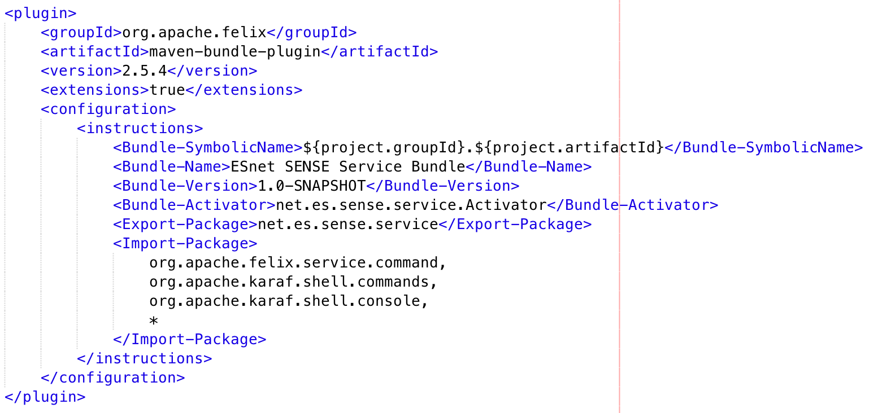
Maven support for OSGi
Maven supports generation of OSGi compliant bundles (JAR file) through the org.apache.felix.maven-bundle-plugin

Slide 8
Features repository
A simple and flexible way to provision applications
A feature describes an application as:
a name
a version
an optional description (eventually with a long description)
a set of bundles
optionally a set configurations or configuration files
optionally a set of dependency features
When you install a feature, Apache Karaf installs all resources described in the feature
Automatically resolves and installs all bundles, configurations, and dependency features described in the feature

Slide 9
Features repository
features.xml file is added to maven repository along with the JAR bundles and is used to aid in automatic feature and dependency discovery
karaf@root()> feature:repo-add mvn:net.es/sense-service/1.0-SNAPSHOT/xml/features
Adding feature url mvn:net.es/sense-service/1.0-SNAPSHOT/xml/features
karaf@root()> feature:install sense-service
SENSE service: started
karaf@root()>

Slide 10
Application Lifecycle
Start
install
Installed
Starting
start
Resolved
Active
stop
uninstall
Stopping
End
Uninstalled

Slide 11
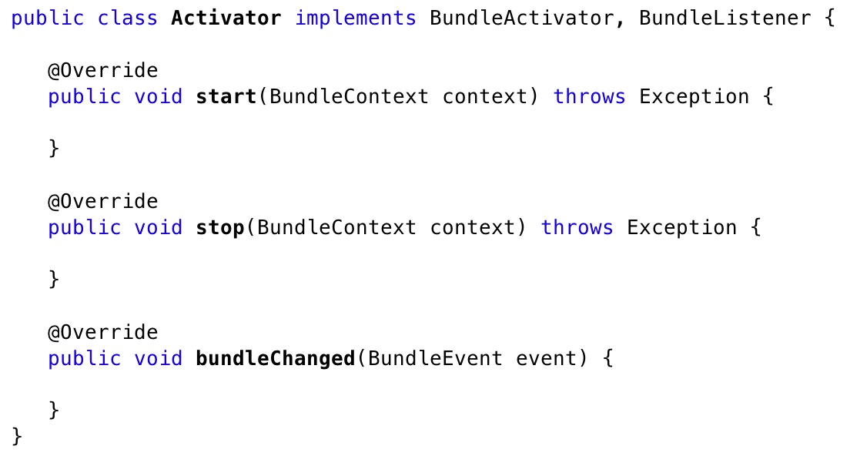
Participating in the lifecycle
OSGi allows an application to provide hooks into the lifecycle state machine through the use of an activator

Slide 12
Why do I care?
Perform application initialization (start) and cleanup (stop)
Register public interfaces (start) and unregister interfaces (stop) with the OSGi Service Registry
Lookup service interface for needed dependencies (start) and free reference to interface (stop)
Determine status of other bundles through API or via events through listener

Slide 13
Inversion of Control and Annotations
Inject lifecycle events, register services, or inject references to services into your existing code without having to interact directly with the OSGi framework
Use the OSGi Declarative Services or iPOJO to inject through XML descriptors (inversion of control) or annotations
SpringDM provides a Spring IoC compliant framework for OSGi

Slide 14
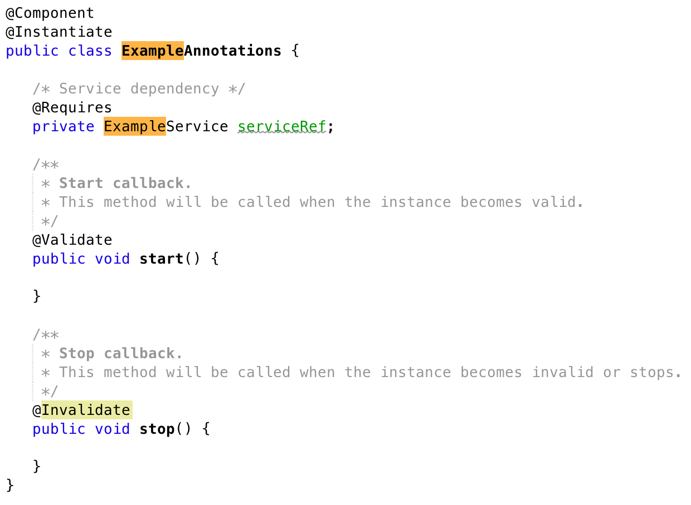
Annotations

Slide 15
The Service Registry
The OSGi framework promotes a service oriented interaction pattern among bundles to decouple dependencies
Service Registry
publish
find
Service Provider
Service Requester
interact

Slide 16
Manipulating the Service Registry
// Add topology service to OSGi service registry.
BundleContext context = getBundleContext();
ESnetTopologyIf topologyService = new ESnetTopology();
ServiceRegistration registration = context.registerService(ESnetTopologyIf.class.getName(), topologyService, null);
// Lookup topology service in OSGi service registry.
BundleContext context = getBundleContext();
ServiceReference ref = context.getServiceReference(ESnetTopologyIf.class.getName());
ESnetTopologyIf topologyService = (ESnetTopologyIf) context.getService(ref);

Slide 17
JAX-RS Auto-wiring
The OSGi JAX-RS Connector connects Jersey and OSGi at the service level
OSGi services can be published as RESTful web services by simply registering them as OSGi services
When the connector discovers a service that is annotated with the JAX-RS annotations @Path/@Provider it automatically hooks these services into Jersey and the OSGi HTTPService
REST services can also be directly consumed as OSGi services
To configure, specify the jax-rs-connector bundle, making sure the system scr and http bundles have been installed:
karaf@root()> feature:install scr http
karaf@root()> feature:install webconsole
karaf@root()> feature:repo-add mvn:com.eclipsesource.jaxrs/features/5.3/xml/features
Adding feature url mvn:com.eclipsesource.jaxrs/features/5.3/xml/features
karaf@root()> feature:install jax-rs-connector
karaf@root()> feature:install jax-rs-provider-moxy
karaf@root()>

Slide 18
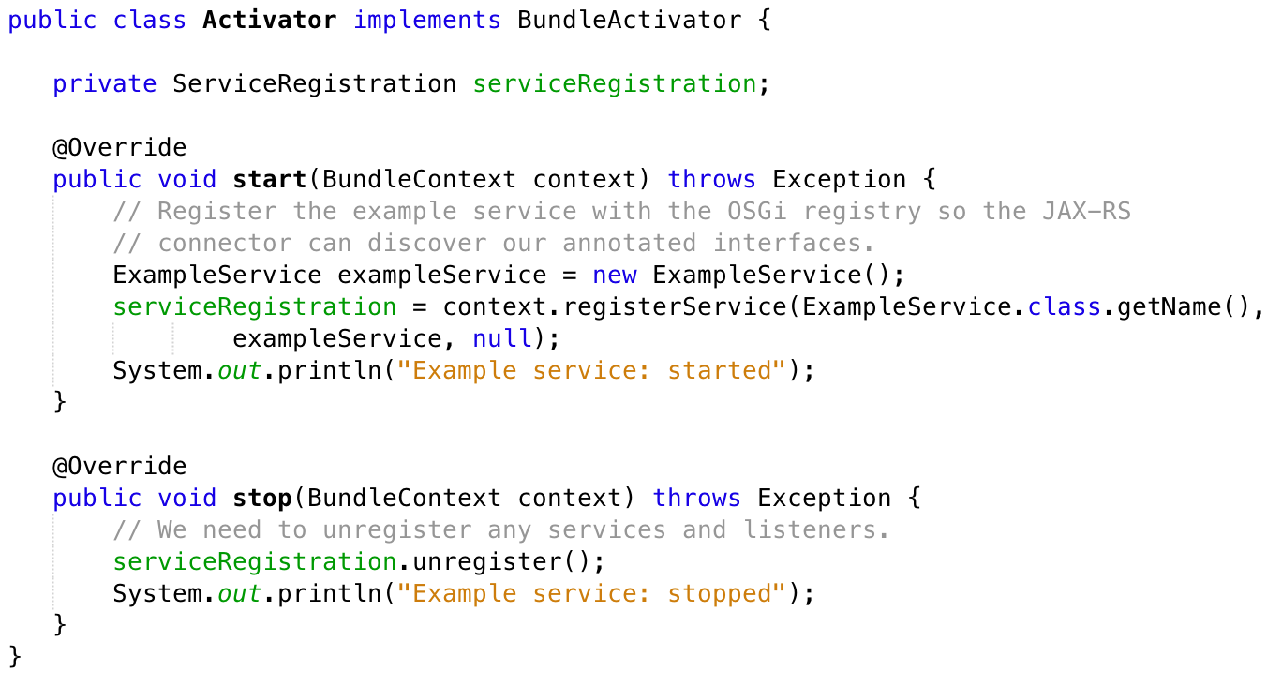
Register your web service
Either register the JAX-RS service directly with the OSGI Service Registry, or use one of the OSGi Declarative Services frameworks to annotate the service

Slide 19
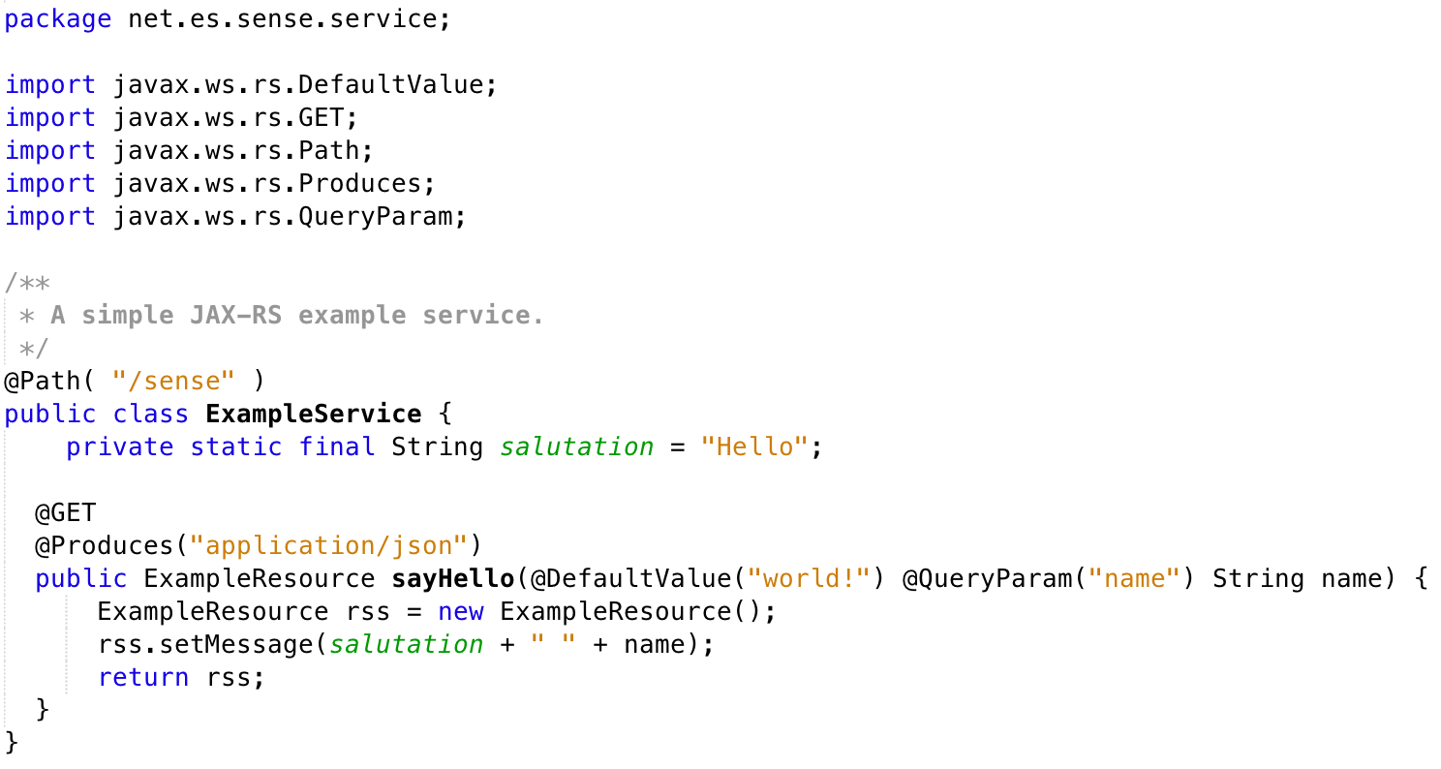
RESTful Services using JAX-RS
http://localhost:8181/services/sense?name=SENSE%20Project!
{
"message": "Hello SENSE Project!”
}

Slide 20
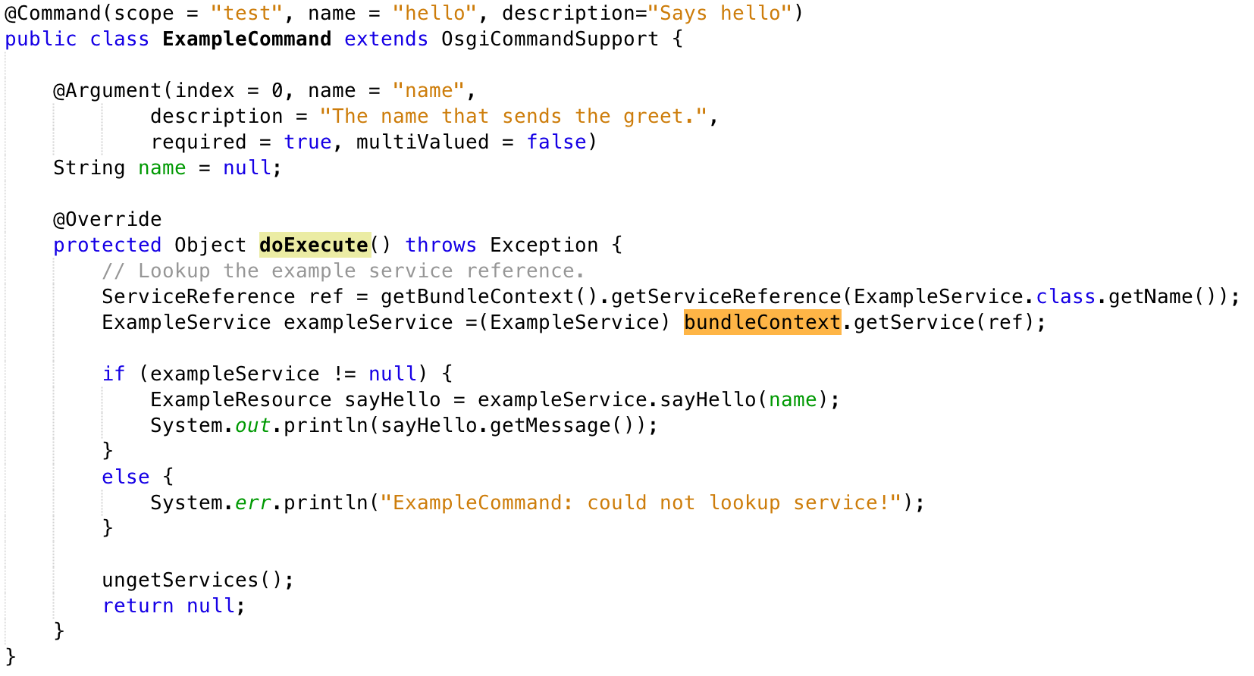
Extending the Karaf shell

Slide 21
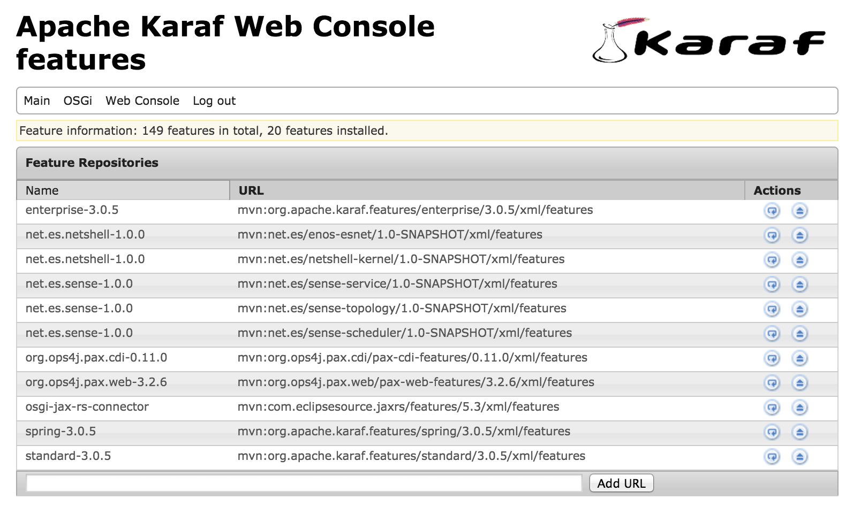
Karaf Web Console
http://localhost:8181/system/console

Slide 22
Starting minimum runtime
Download and install Apache karaf
Download and build Netshell
https://github.com/esnet/netshell
Download and build ENOS
https://github.com/esnet/enos
Configure the Netshell runtime
ReadMe @ https://github.com/esnet/enos
Start karaf

Slide 23
Starting minimum runtime
Load Web components into Karaf:
karaf@root()> feature:install scr http
karaf@root()> feature:install webconsole
karaf@root()> feature:repo-add mvn:com.eclipsesource.jaxrs/features/5.3/xml/features
karaf@root()> feature:install jax-rs-connector
karaf@root()> feature:install jax-rs-provider-moxy
Load Netshell and ENOS features from local maven repo into karaf:
karaf@root()> feature:repo-add mvn:net.es/netshell-kernel/1.0-SNAPSHOT/xml/features
karaf@root()> feature:install netshell-kernel
karaf@root()> feature:install netshell-python
karaf@root()> feature:repo-add mvn:net.es/enos-esnet/1.0-SNAPSHOT/xml/features
karaf@root()> feature:install enos-esnet

Slide 24
Topics to complete
Minimum configuration to get started (i.e. I don’t need ODL)
Authentication and authorization for application web services within SENSE and ENOS
Defining and interacting with application specific ACLs
Netshell users and how they apply to applications
Data persistence

