Slide 1
SENSE Kick-Off Meeting

Slide 2
What Problem(s) are We Solving
Multi-domain network service automation
Mix of manual provisioning and automation today
No service consistency across domains
No service visibility across domains
Expression and application of individual domain policies
Narrower focus: Science DMZ to Science DMZ
Ability for science workflows to drive service provisioning
Networks don’t provide application consumable interfaces
Programming APIs usually not intuitive and require detailed network knowledge, some not pre-known
Three science application use-cases

Slide 3
What Problem(s) are We Solving
Multi-domain information exchange for service provisioning and troubleshooting
Data APIs across domains for applications, users, network administrators
Performance, service statistics, topology, capability etc.
Exchange of ‘scoped’ and authorized information
Aligned with security policies @ the end-site

Slide 4
Core idea
End-to-end, multi-domain provisioning automation and resource orchestration

Slide 5
SENSE scoped definitions
End-to-End (network point of view)
DTN NIC to DTN NIC, across Science DMZ, WAN(s), Open exchange points (ideally)
Multi-domain
Multiple administrative domains, independent policies and AUP
Different users?
Provisioning automation
Bring-up and management of services without interrupt-driven human involvement
Does not have any implications on duration of service
Resource orchestration
Allocation and reservation of resources including compute, storage and network
Network resources may include bandwidth, path, VLAN, QoS etc.

Slide 6
Current State of SDN - Gaps
Inter-domain SDN undefined, and not focus of open-source or commercial efforts
No organized R&E efforts either, though on many roadmaps
Describing resources are not done in a standard, consistent manner
Minimal ethernet topology discovery by controllers, represented in proprietary JSON formats
Multi-domain admission control and Authz
No clear way to specify AA, policies, and enforce them across domains
A ‘usable’ multi-domain testbed

Slide 7
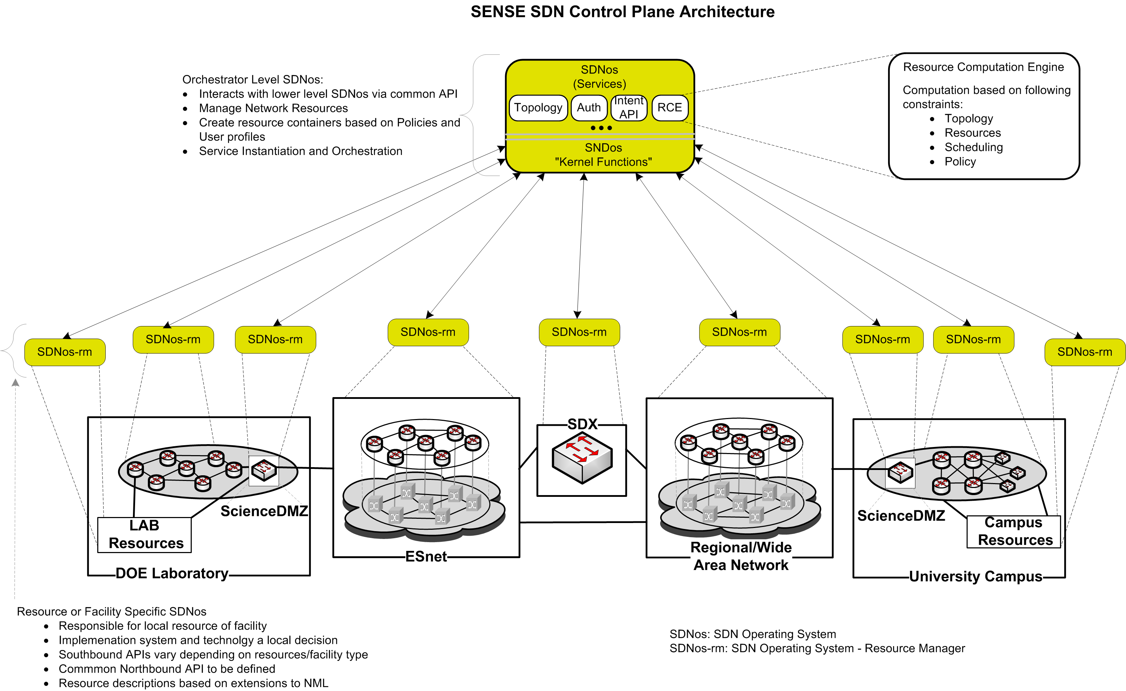
SENSE SDN Control Plane Architecture for End-to-End Orchestration
Orchestrator Role
Resource Manager Role
Defines Service Perimeter/Boundary

Slide 8
SENSE Requirements for an SDN OS
Communication and coordination between the control planes at different sites, as well as the wide area network(s) connecting them.
Security mechanisms to protect the integrity and availability of network, compute, and storage resources. These mechanisms need to protect against both accidental and deliberate forms of misbehavior.
Abstractions of resource state and metadata that may have different representations (or, to a certain extent, different data models) across the various domains.
An easy way of expressing local resource control policies and running them within the network.

Slide 9
SENSE OS (SENOS) Architecture
Service functions provide the intelligence to interpret or render a user’s intent, enforce policies, and coordinate workflows.
Service functions are hierarchical in nature, with atomic services being a discrete set of services that can be composed to build a more complex, custom service.
User Services (Application Containers)
Intent API
Intent API
Multi-Point VPN Service
Big Science Service
Service
Functions
System Services
API
API
API
API
API
API
Resource Topology Service
Resource Computation Service
Policy Service
NE Driver (OpenFlow)
Service
ScienceDMZ Driver
Service
Monitoring Service
SENOS Intelligent Service Functions
SENOS Core Functions
Core
Functions
Generic API
SSHD
Python
Messages
Persistent State
Thread
ACL
Users
Resources
Roles
Separation of kernel (privileged) and multi-user (unprivileged) execution space
Supports the concept of resources and allows the owners of resources to specify how those resources may be used, via access control lists.
A set of generic object definitions for commonly-used objects in SDN programs, such as network nodes, ports, and links.
An inter-process message-passing facility for communication between SENOS instances.

Slide 10
SENOS Intelligent Service Functions (1/2)
Resource Information Service (RIS)
Harvest and normalizes resource topology
Enforces policy views of topology
Resource Computation Service (RCS)
Multi-Constrain Multi Resource computation (from RAINS)
Add support for SENSE requirements
Next-Generation Science DMZ and site resources
Flow management, flow termination, and site services integration functions
Interaction with SENOS Policy Service

Slide 11
SENOS Intelligent Service Functions (2/2)
Intent and Rendering
Intent APIs expose very high-level service abstractions that focuses on the ‘what’ the application wants to accomplish and not on the ‘how’
Renderer implements the business logic for the service
Authorization
Policy enforcement
Computation to determine a next set of tasks
Creation of subordinate (lower-layer) intents, if any
Directly performing a set of actions
Returning request status
Multi-Point VPN Service will be the first network service prototyped for the SENSE project

Slide 12
End-Site Orchestration
Two main ideas
Flow management @ Science DMZ
DTN Autoconfig
Flow management
Route to right flows to the right DTNs, vlan or mor granular flow identification using OF
Support multi-science Science DMZ, with resource allocation and traffic steering
Allow addition of NFV services like Caching, and flow service chaining

Slide 13
End-Site Orchestration (contd.)
DTN Autoconfig
Systems configuration to ensure data transfer application can connect @ Layer 3 and/or Layer 2
Includes, VLAN configuration on the NIC
Private or public IP address configuration of L2 or L3 VPNs
Other configuration like TCP window size, might be a stretch
Creating VMs or containers with right data-movement software for multi-science DTNs
More ideas?
OVS configuration and QoS configuration
Flow steering and ACLs to connect to the internal file system over different NICs

Slide 14
WAN / Regional / Exchange Network Orchestration
Leverage past experience with dynamic point-to-point circuit services to develop multi-point offering
Network Element (NE) Control
SENOS NE Driver for southbound communication (i.e. OpenFlow, NetConf/YANG, P4, CLI, etc)

Slide 15
SENSE End-to-End Orchestration
Three Science Use-cases
LHC CMS use-case
NERSC Burst Buffer use-case
Superfacility use-case

Slide 16
Instrumentation / Monitoring / Measurements
Feedback to the user / application is critical, but must be in the context of the request, e.g. feedback for a service request should in terms of the service parameters and not low level technology specifics (unless they are part of the service parameters)
Exchange of information between (service) domains for operational support needs to be investigated to understand the level of abstraction (or lack thereof) needed to maintain a domain’s information exchange policy, but still provide useful data
Data mined will be used for system modeling and machine learning to perform capacity predictions and develop strategies for negotiating resources
This task will collaboratively lead by the SDN NGenIA project

Slide 17
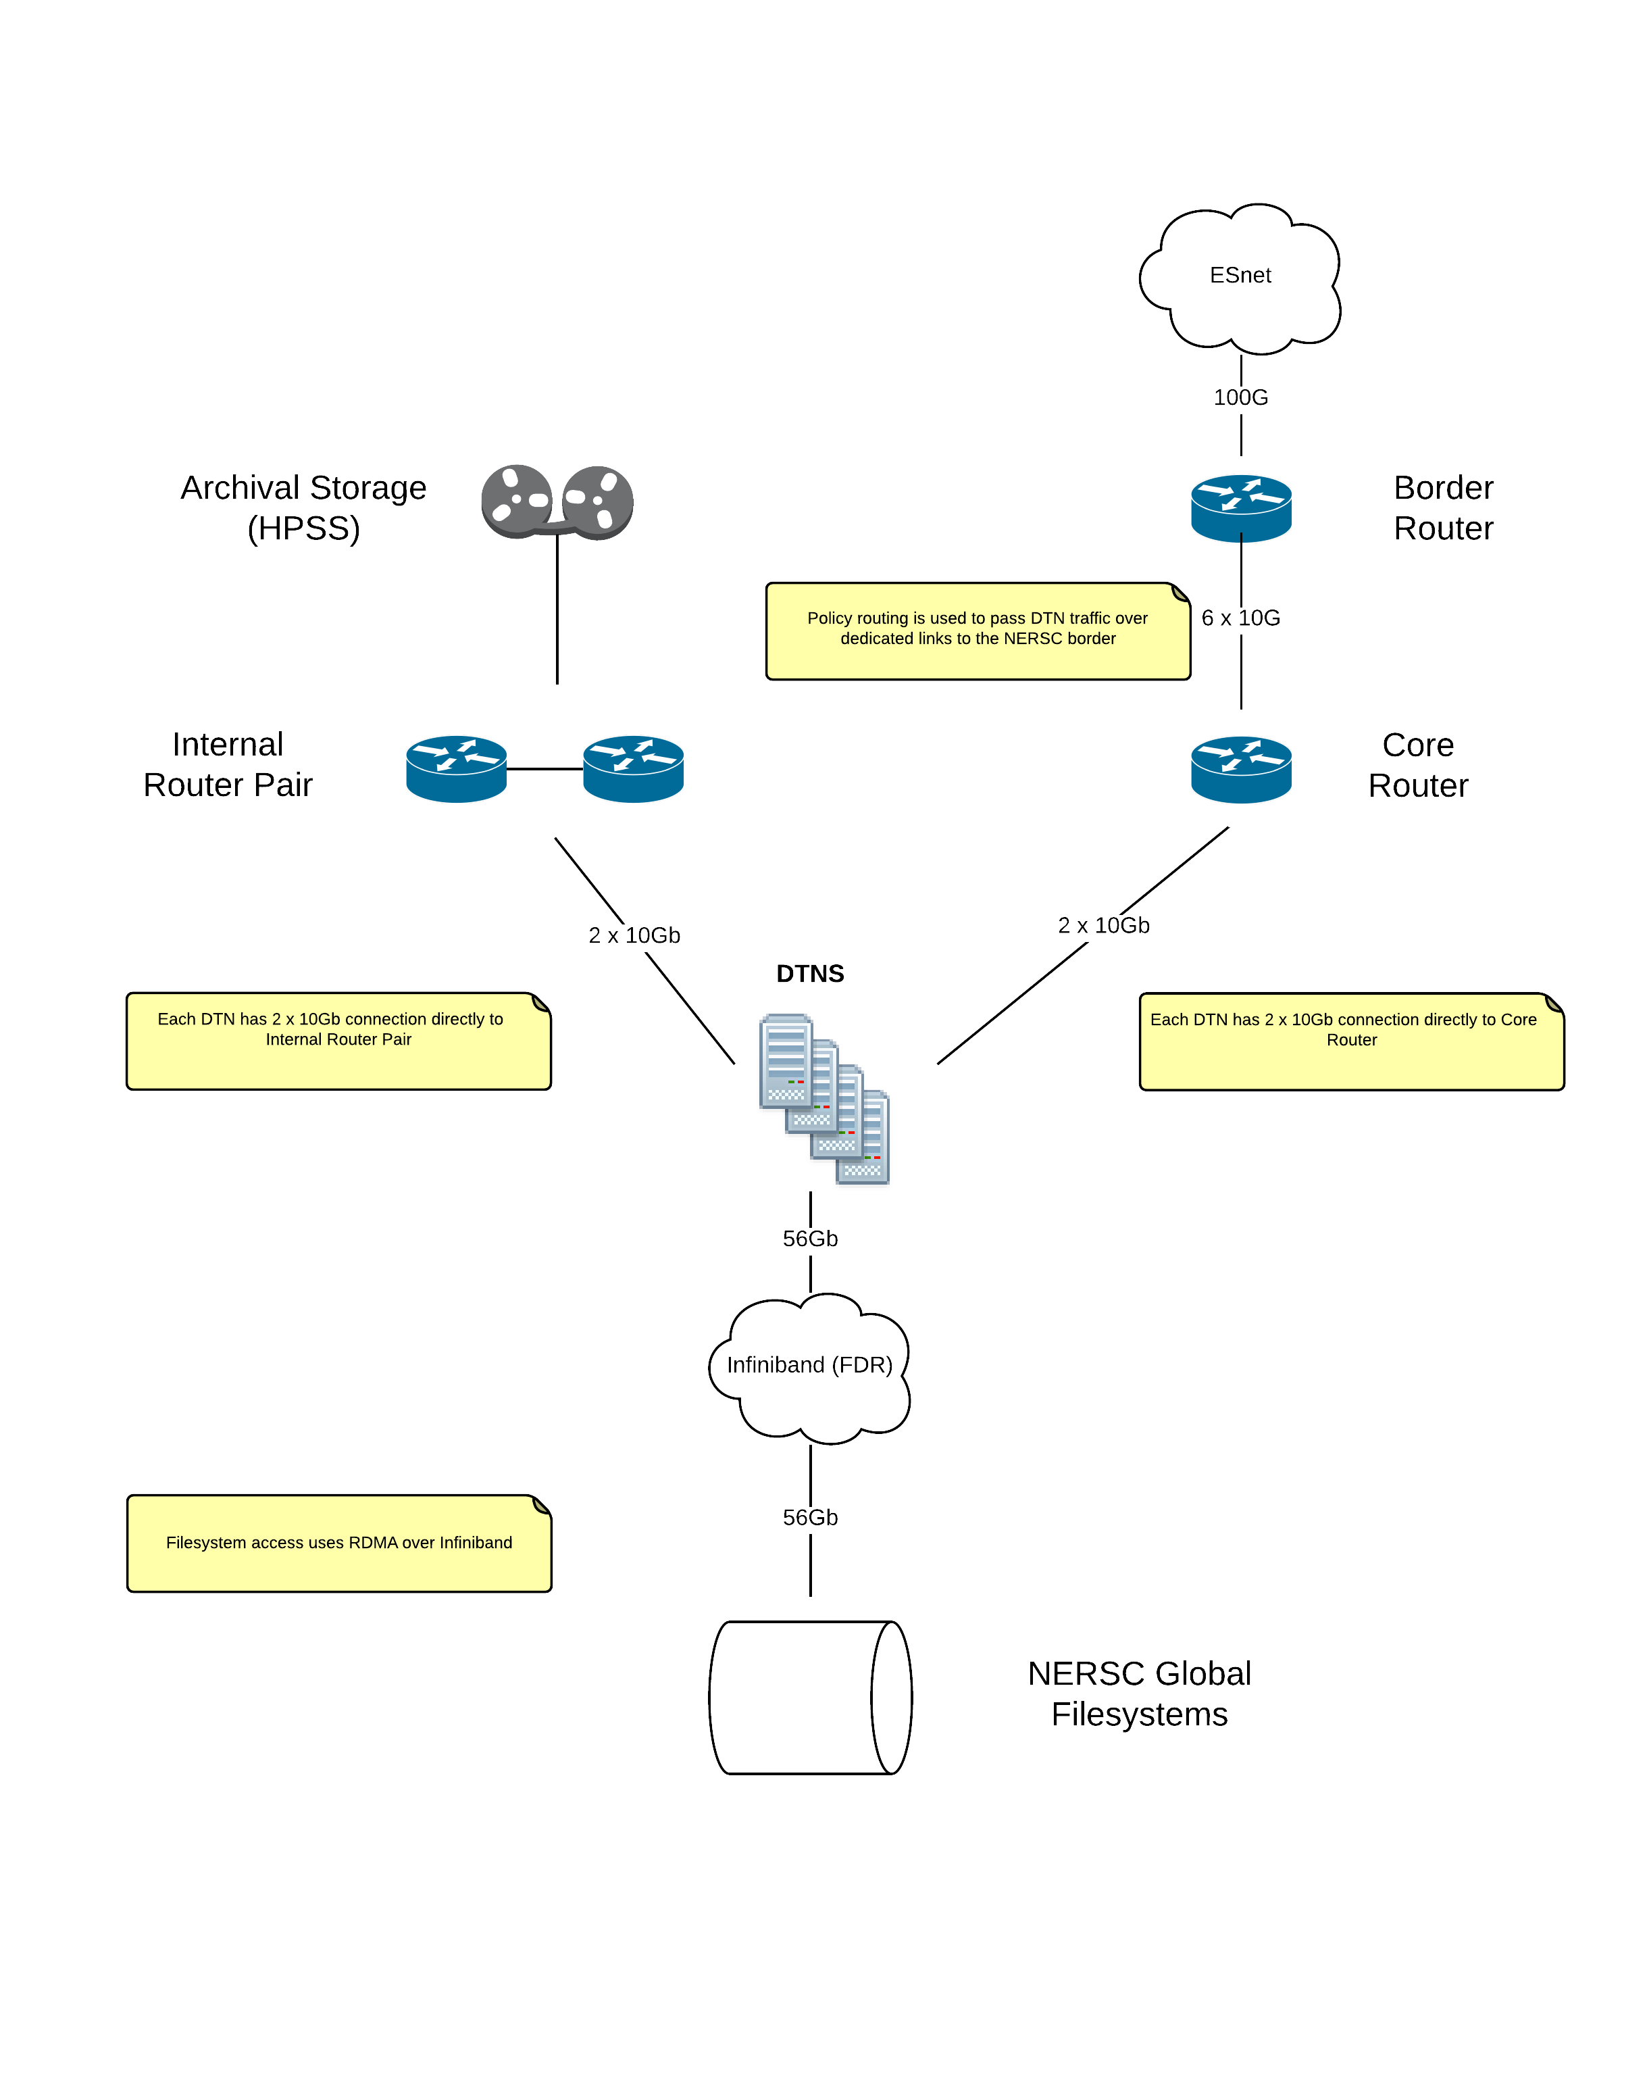
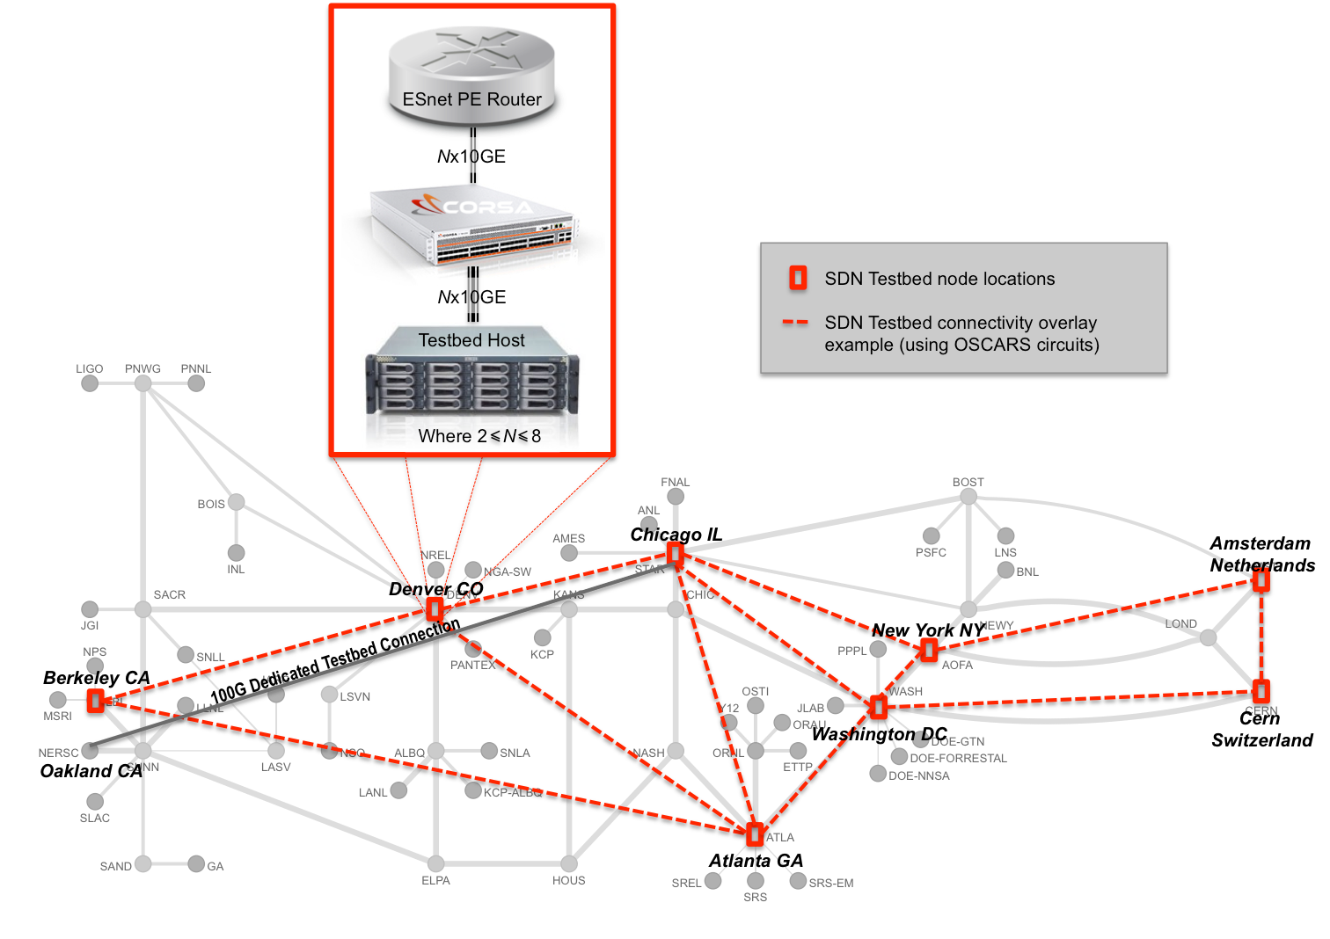
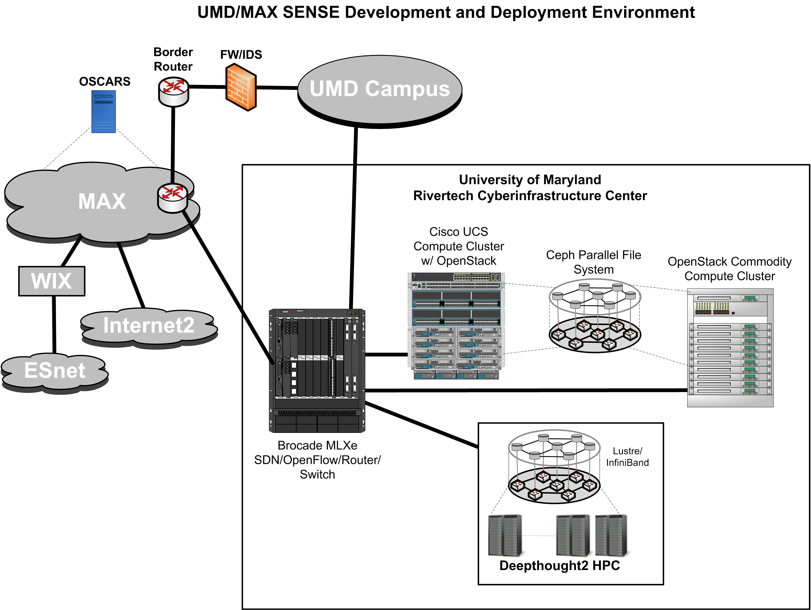
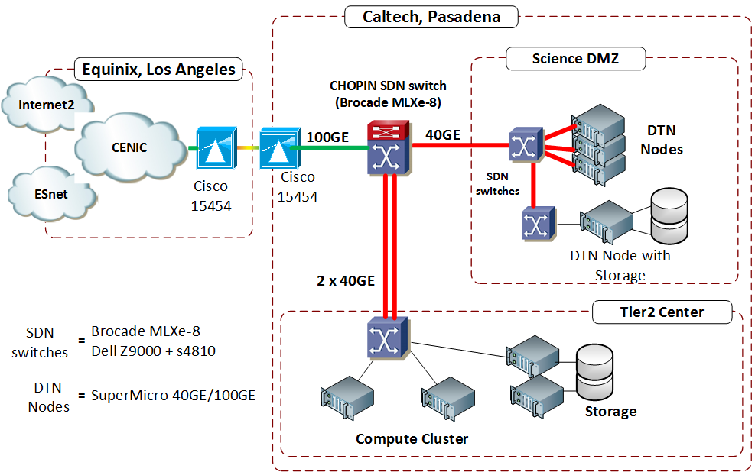
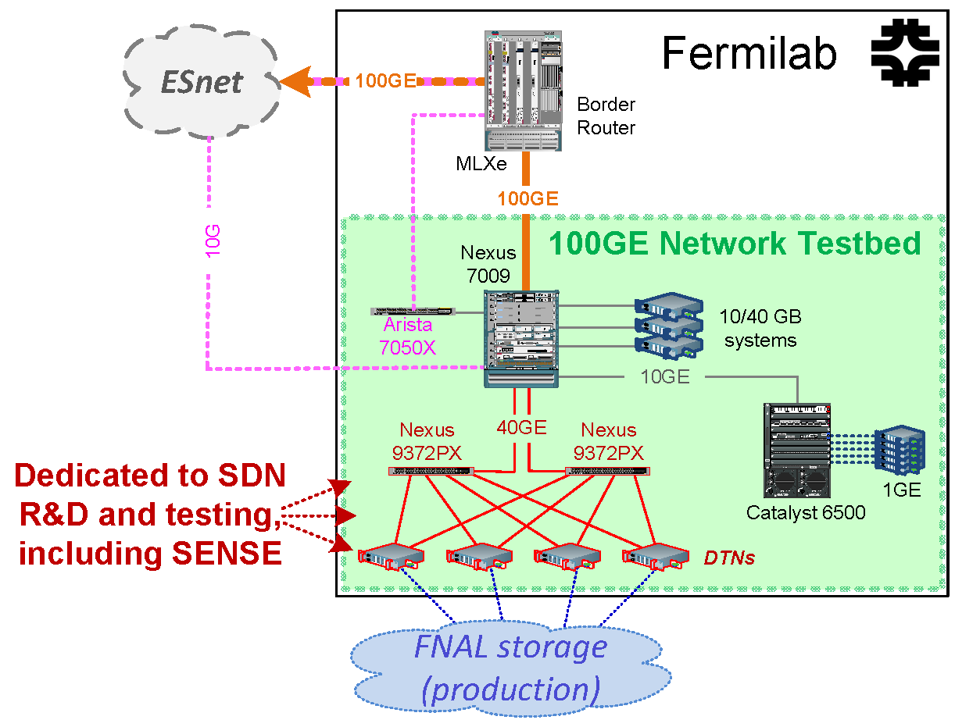
End-to-End SENSE Testbed
Network,
Storage
Network,
Compute
Network,
Compute,
Storage
Network,
Compute,
Storage
Network,
Storage

Slide 18
SENSE Deliverables Year 1 (1/2)
3.1.2.1 Resource Information Service
Develop SENOS Resource Information Service module that is compatible with MRML [ESnet – 2Q2016 Final]
3.1.2.2 Resource Computation Service
RCS Architecture and design document [UMD – 2Q2016 Final]
Base RCS SENOS (Resource Computation) Service module implementation [UMD – 4Q2016 Final]
3.1.2.3.1 Multi-Point VPN Service
SENOS Layer 2 (Multi-Domain) Multi-Point Service design document [ESnet – 2Q2016 Final]
SENOS Layer 2 (Multi-Domain) Multi-Point Service module implementation [ESnet – 4Q2016 Update]
3.2.3.1 DTN Auto Configuration
End-System / DTN Auto Configuration Agent requirements and design document [NERSC – 2Q2016 Final]
End-System / DTN Auto Configuration Agent implementation and SENOS-RM integration [CalTech – 4Q2016 Update]
3.2.4 Next Generation Science DMZ
NGScience DMZ architecture and design document [FNAL – 4Q2016 Final]
NGScience DMZ SENOS-RM Base Implementation which provides resource representation to higher level SENOS-O [UMD – 4Q2016 Update]

Slide 19
SENSE Deliverables Year 1 (2/2)
3.3.1 Network Intent API and Rendering
SENOS OpenFlow NE Driver Service module design document [ESnet – 3Q2016 Final]
SENOS OpenFlow NE Driver Service module implementation [ESnet – 4Q2016 Final]
3.4.1 Global Resource Modeling
Document describing service level abstraction for each resource domain [ESnet – 3Q2016 Final]
Resource modeling exercise for each SENOS- RM domain and SENOS-O instance [All– 4Q2016 Final]
3.4.2 Science Workflow Intent Rendering
LHC CMS workflow use case and requirements document [FNAL– 2Q2016 Final]
Superfacility workflow use case and requirements document [ANL– 2Q2016 Final]
KBase workflow use case and requirements document [NERSC– 3Q2016 Final]
SENOS Big Science Workflow Service module design document [ESnet – 4Q2016 Final]
SENOS Big Science Workflow Service module implementation [ESnet – 4Q2016 Initial]
3.5.1 Feedback across the Intent Based Interface
Requirements document for coherent end-to-end monitoring, measurement, and management of SENOS services [CalTech – 3Q2016 Final]
Architecture and design document for coherent end-to-end monitoring, measurement, and management of SENOS services [CalTech – 4Q2016 Initial]

Slide 20
Management Plan discussion
Monthly PI meetings: Chin
Progress, issues
½ hr
Quarterly Progress reports in bullets
Internal, but can be shared to DOE program manager

Slide 21
Areas of research, and leads
Roles and responsibility
Software:
Processes, release mechanism, etc.
Deployment:
Deployment of SDN testbed, architecture, timeline
Science Use-cases & demos:
Coordination of science use-cases, demos etc.
Multi-domain orchestration:
Resource models, design, AA, etc.
Policies and End-Site Orchestration:
Site policies, ScienceDMZ automation, end-host automation requirements
Overall Project Management:
Work with Thomas, deliverables tracking, reports etc.

