Slide 1

End-Site Orchestration
With Open vSwitch (OVS)
R. Voicu, A. Mughal,
J. Balcas, H. Newman
for the Caltech Team

Slide 2
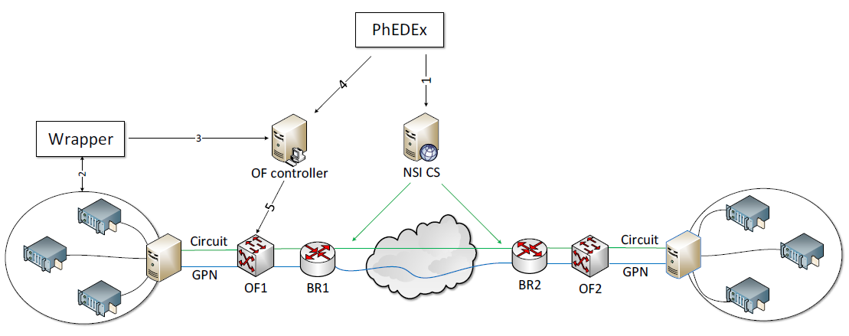
Site Orchestration: Prerequisites
The Caltech team’s earlier work, in OLIMPS and the DYNES and ANSE NSF projects with dynamic circuits, integrated with the CMS PhEDEx and ASO applications used a so-called “FDTAgent” to couple the data transfer nodes (DTNs) at the end-sites running Caltech’s FDT as the high throughput data transfer application
The agent (1) requests the circuit, (2) waits for an answer, (3) configures both end-hosts if the circuit provisioning succeeds,
and (4) modifies the local end-host routing including creating VLAN interfaces to use the new circuit. Integrated with PhEDEx
We generalized this to multiple circuits and paths with an OF controller in 2013-15
We clearly needed to move to standard methods of site/regional/wide area integration

Slide 3
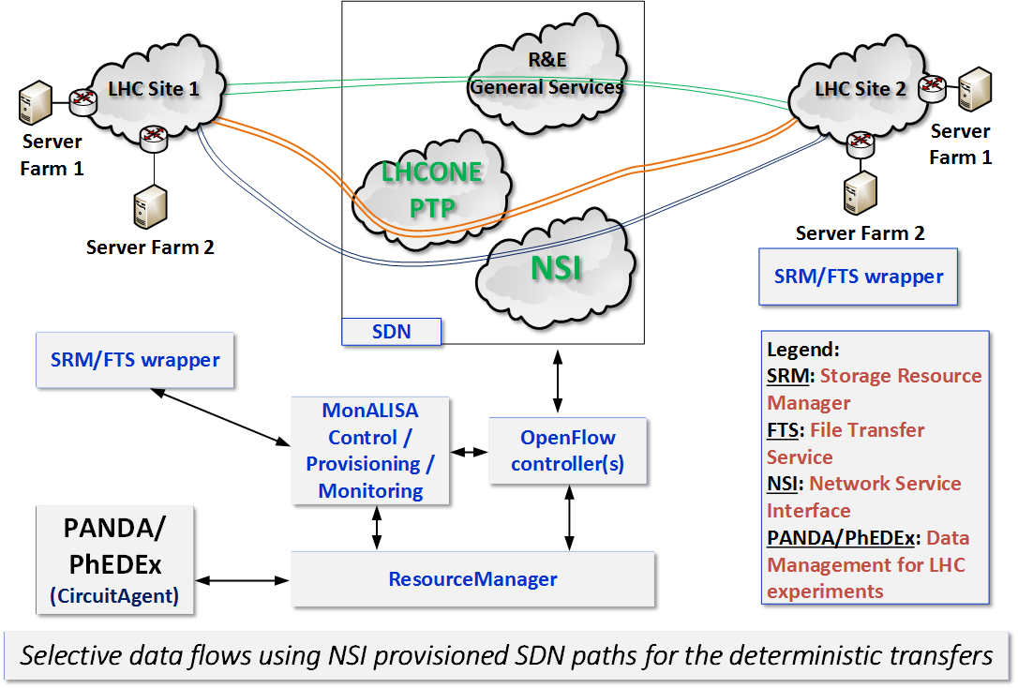
Caltech from ANSE to SDN-NGenIA: Dynamic Circuits
with Software-defined path building and load balancing
Dynamic circuits used to create network paths with reserved bandwidth
OF Flow-matching is
done on specific subnets
to route only the desired data packets to the circuits
Caltech’s controller is used
to select paths for the circuits, based on available capacity, load-balancing, etc.
Controller also can be used
to load-balance and/or
moderate flows over
multiple non-circuit paths
In SDN-NGenIA we need to generalize this, and move to
production ready tools

Slide 4
Site Orchestration: Prerequisites
In seeking standard methods of site orchestration, including solving the campus QoS problem in a generally applicable, transfer-protocol independent way, we decided to use Open vSwitch (OVS)
OVS is designed to enable network automation via programmatic interfaces, especially for virtualized environments.
It supports standard, well-established protocols for internal management: Security, monitoring, automated control
Huge performance improvements in recent versions (2.x+) made OVS appealing.
  Caltech’s tests showed ~no penalty in performance compared with bare metal
No special requirements: OVS is
Included in the standard Linux releases.
www.openvswitch.org
Seamless migration: OVS can run on part of a cluster The deployment path can thus be gradual, with no impact on production
  IP reachability and per-formance are the same
  with or without OVS

Slide 5
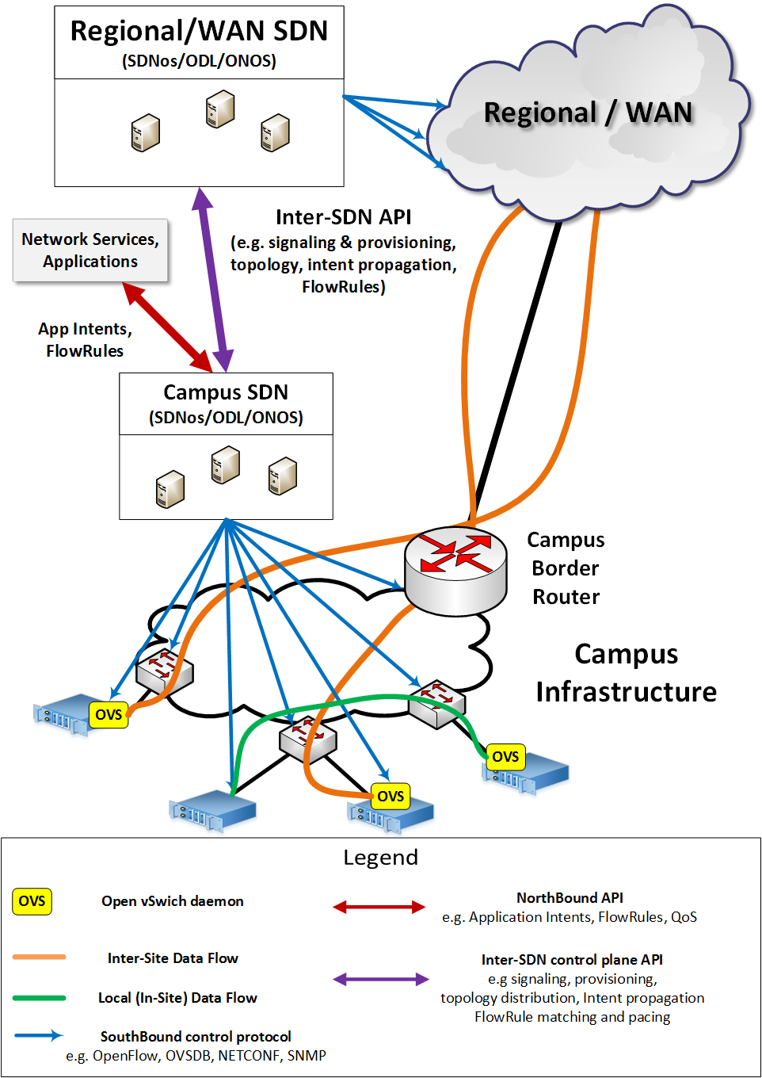
OVS Benefits: Managing Site Interactions Locally, with Regional and Wide Area Networks
Provides SDN-orchestrated configuration for data flows all the way to end-host,
which can be orchestrated from the local/campus SDN controller or brought down from the Regional/WAN controller
Provides QoS and traffic shaping right at the end-point of a data transfer
  QoS via OVS is protocol agnostic: one can use TCP (GridFTP, FDT) or UDP
  Under the hood, OVS uses the TC (Traffic control) part of iproute2 to configure and control the Linux kernel network scheduler
  Helps to achieve better throughput
  by moderating and stabilizing data flows; e.g. in cases where the upstream switches
  have limited buffer memory
Monitoring is done with standard sFlow and/or NetFlow protocols
Traffic mirroring: Taps
and/or mirroring are required at some sites

Slide 6
OVS Benefits (2)
SDN-based configuration of the end-host
  OVS is SDN Controller agnostic: will work with any SDN controller which supports OpenFlow and/or OVSDB
      The Open vSwitch Database Management Protocol:
      RFC 7047
  OVS extends SDN capabilities all the way to the end-host: provides a unified configuration based on the same SDN approach for both the network infrastructure and the end-host
Highly dynamic and flexible security policies
  Makes it possible to replace the standard (iptables)
  end-host firewall configuration with a more dynamic,
  flexible approach via the local controller.
  Security control may be unified inside a
  “centralized” SDN controller where needed

Slide 7
OVS Open vSwitch
Performance Tests
We compared the performance of
hardware “bare metal” versus OVS
in two cases:
  A bridged network:
  The physical interface becomes
  a port in the OVS switch
  Dynamic bandwidth adjustment
  Through policy at the site egress

Slide 8
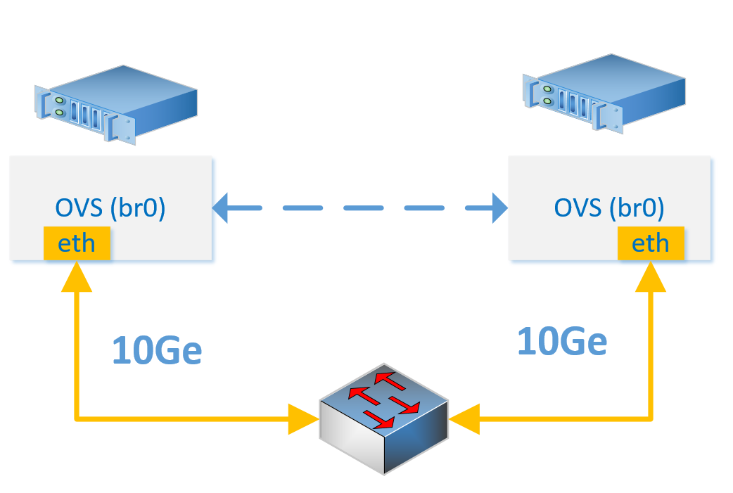
10GE Performance Tests
Two SandyBridge machines
10GE Mellanox cards (“back-to-back”)
Stock SLC 6.x kernel – Mid2015
Connected via a Dell Z9000

Slide 9
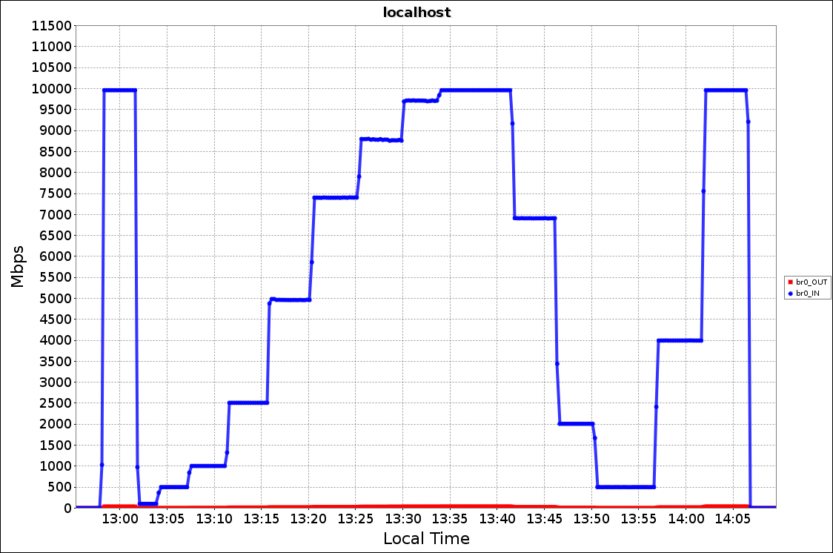
OVS Dynamic bandwidth adjustment Egress rate-limit 10GE LAN tests
10Gbps
NO policy
9Gbps
11Gbps
policy
10Gbps
NO policy
10Gbps
policy
7Gbps
5Gbps
500Mbps
7.5Gbps
4Gbps
1Gbps
0.5 Gbps
2.5Gbps
Smooth
Stable Flows at any rate
up to line rate

Slide 10
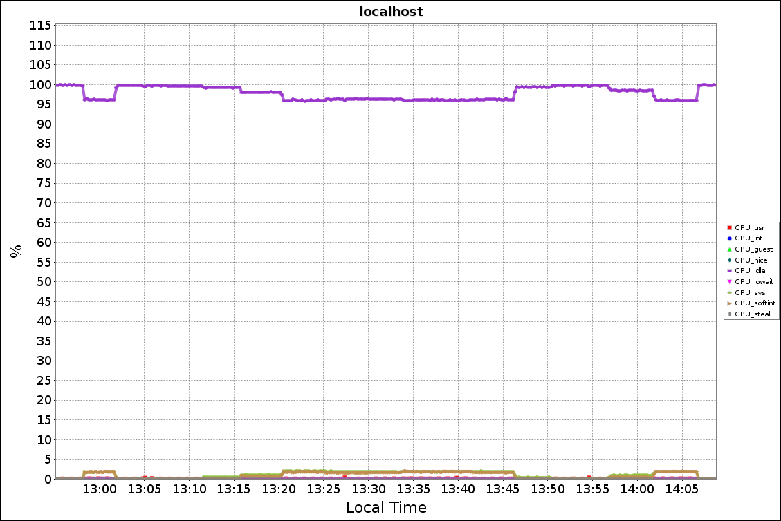
OVS 10G LAN tests
CPU Utilization
10 Gbps
NO policy
11 Gbps
policy
10 Gbps
NO policy
5 Gbps
Available CPU
2.5 Gbps
7.5 Gbps
10 Gbps
policy
4 Gbps
  Almost the same CPU Usage
  With and without an egress limiting policy in place

Slide 11
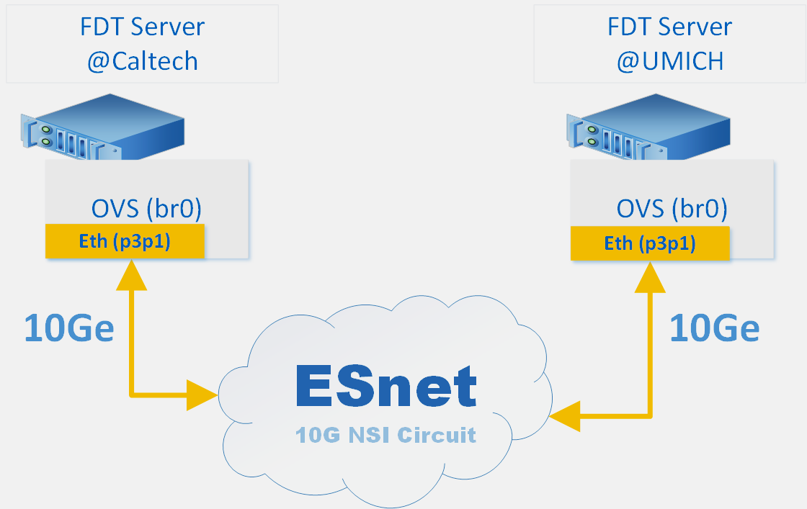
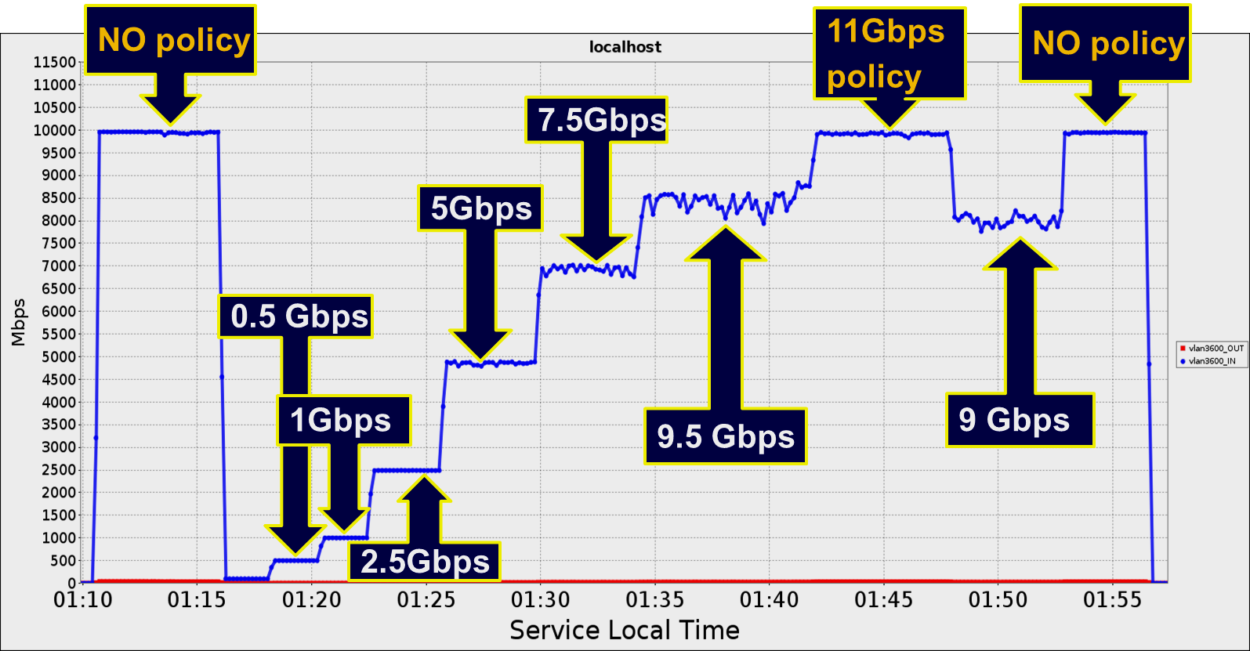
10G WAN Tests: Over an NSI Circuit
OVS 2.4 with stock kernel Centos6
10G NSI circuit from
Caltech to Umich (~60 ms RTT)
Very stable up to 7.5 Gbps
Shaping still good (± 2%)
above 8 Gbps

Slide 12
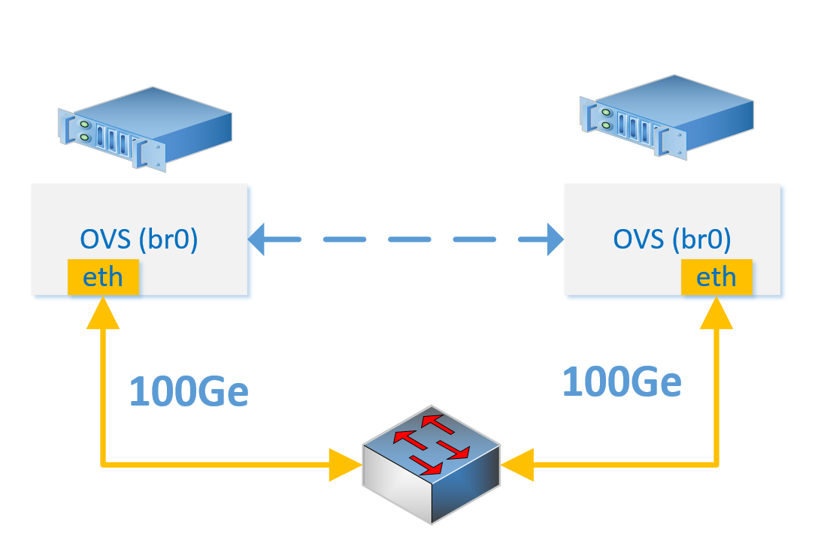
100GE Performance Tests (Feb. 2016)
100GE Mellanox NICs; Haswell Machines; Z9100 Switch
Kernel 4.x(4.4.1) EPEL CentOS 7 (Feb 2016)
Up to date kernel needed for > 35 Gbps
OVS 2.4 (also via standard EPEL)

Slide 13
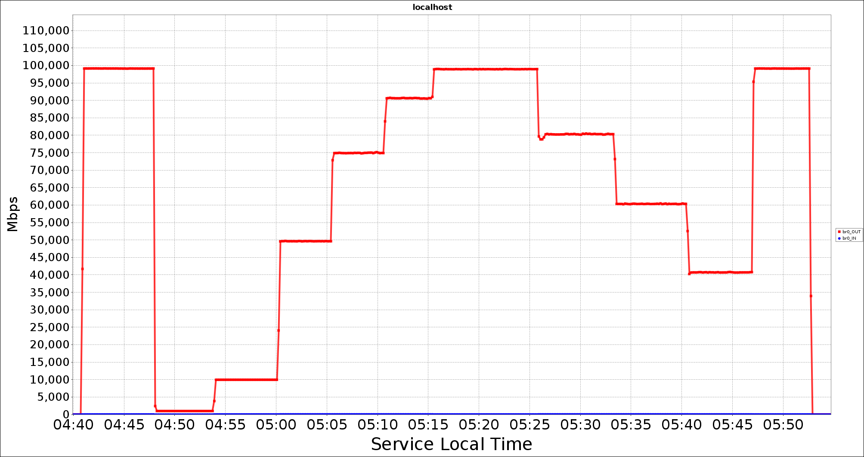
OVS Dynamic bandwidth adjustment Egress rate-limit 100G tests
100 Gbps
NO policy
110 Gbps
policy
100 Gbps
NO policy
50 Gbps
80 Gbps
90 Gbps
60 Gbps
10 Gbps
75 Gbps
Smooth
Stable Flows at any rate
up to line rate
40 Gbps
1 Gbps

Slide 14
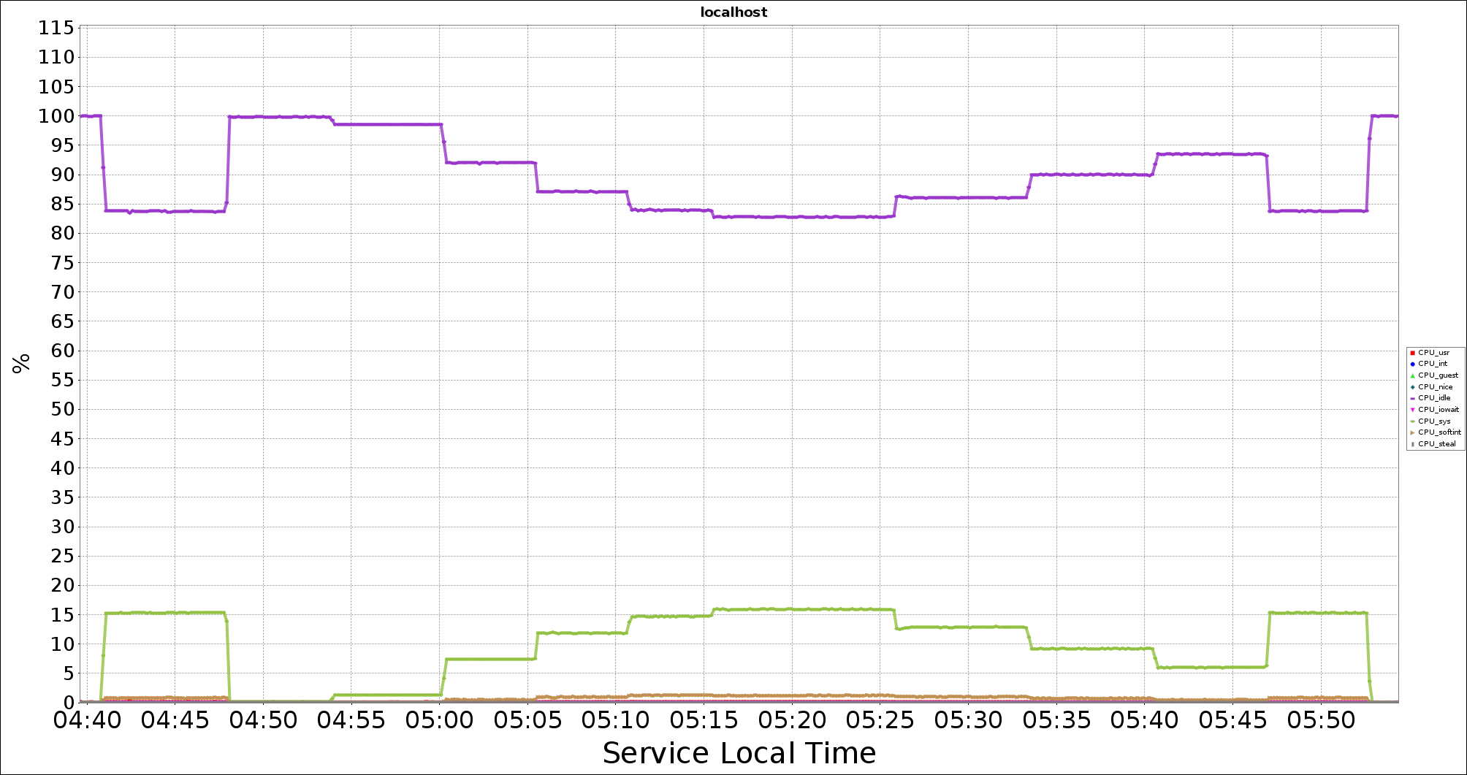
100GE OVS Performance Tests
CPU Utilization
100Gbps
NO policy
100Gbps
NO policy
Available CPU
110Gbps
policy
40Gbps
90Gbps
80Gbps
10Gbps
50Gbps
CPU Usage:
Penalty for using policy 1% or less
1Gbps
CPU Used: System

Slide 15
Notes on 100GE Performance Tests
The default kernel and iproute packages in Centos 7 are not suitable for 100GE rates
      Although they work fine up to nearly 40GE rates
Both the kernel and user-space utilities in
older kernels suffer from the use of 32-bit rate limit counters, which gives a maximum
rate limit of ~35 Gbps (34.360 Gbits/s)
Newer kernels are required (>=3.13):
these are available via the “standard”
EPEL repositories
Newer `tc` (Traffic Control) utility is also needed
  This is part of the `iproute2` package

Slide 16
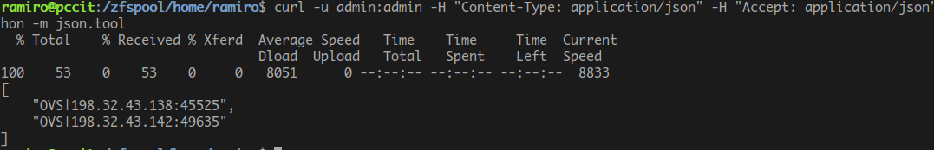
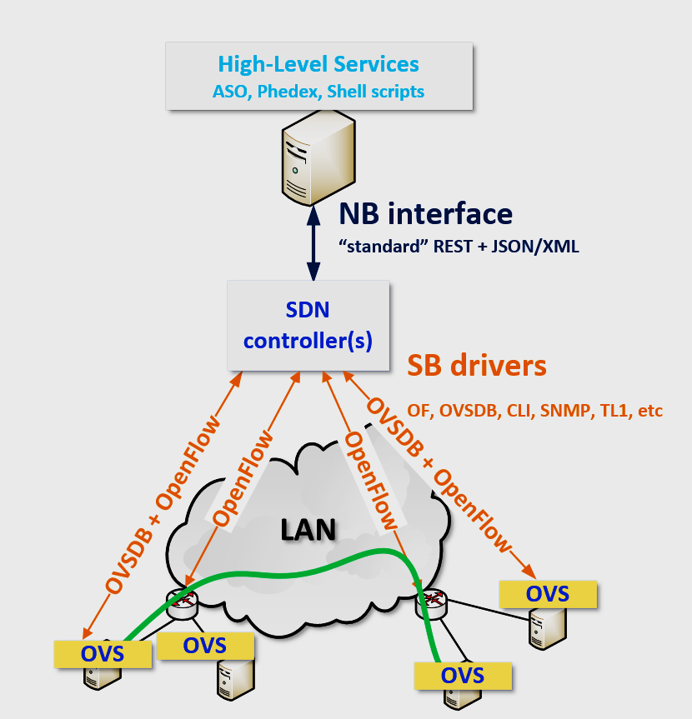
End-Site Orchestration – Site example
Northbound interaction with SDN OS
End-hosts automatic discovery: the SDN controlling infrastructure becomes a distributed LS (Lookup Service)
Automatic identification of data flows between pairs of hosts (IPs) which helps with flow steering
The HL services/applications manage the OVS instances via “standard” RESTful NB APIs. The SB protocols + drivers: handled by the SDN controller
Fast prototyping using scripts and/or Python as NB clients

Slide 17
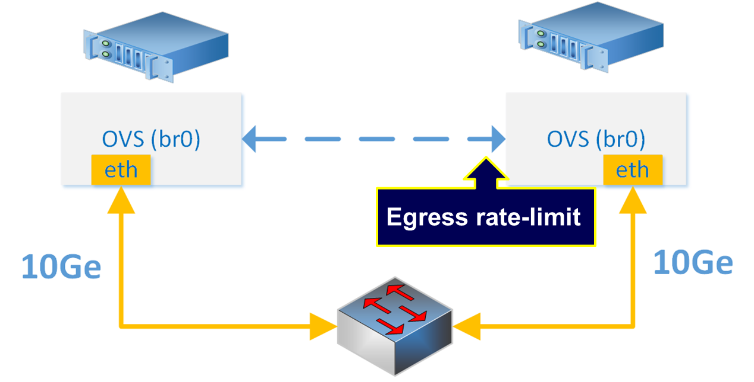
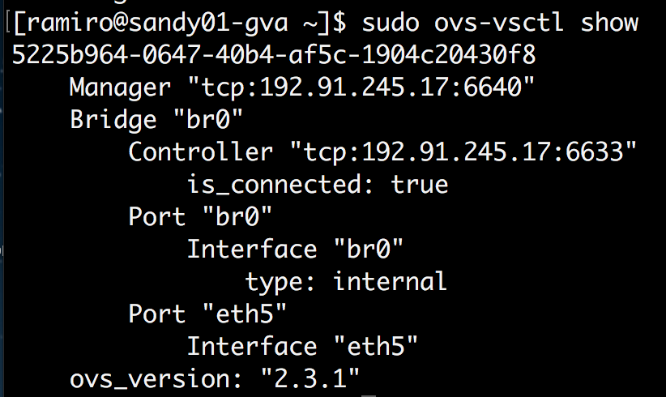

End-Site Orchestration – Site example
Southbound interaction with SDN OS
OVSDB – Open vSwitch Database Management (RFC7047)
Used to create the virtual bridges
Virtual bridges can use standard OF to speak with the controller
Normal routing if the controller is down
OVSDB + OpenFlow
OVSDB
OpenFlow
ODL Controller

Slide 18
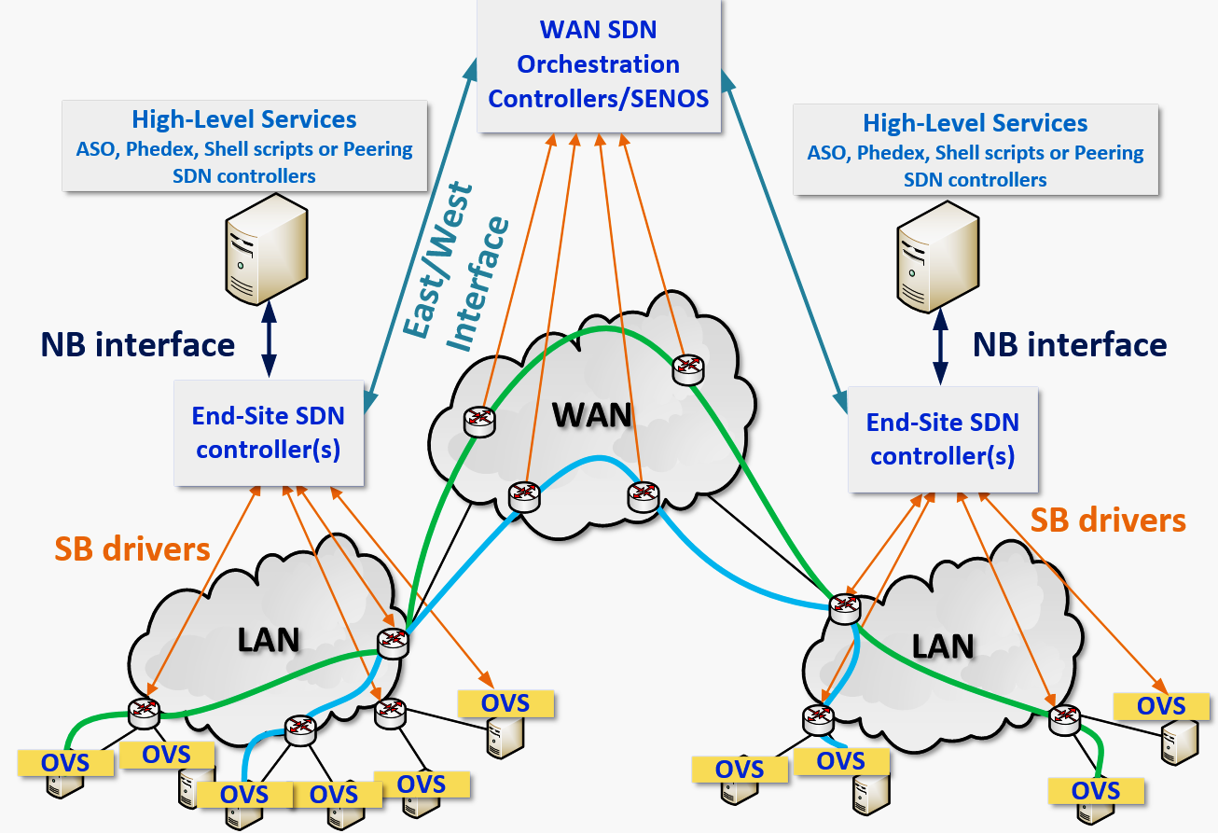
End-Site Orchestration Inter-Site Example Multiple Host Groups, Paths, Policies

Slide 19
A Few Notes on OVS
As soon as OVS starts (e.g. during OS boot)
it will connect to the configured end-site controller
Both major SDN controllers ONOS and ODL support OVSDB
The SDN controller can “speak” both OVSDB and OpenFlow to the OVS instance
OVS offers the means to identify different data flows in a standard approach for SDN since OVS uses OpenFlow
Both sFlow/NetFlow and OF can be used for data flow monitoring
OVS also helps in cases where the network infrastructure
at the end-site only partly supports, or does not support OF
OVS can also be used to extend VLANs all the way to the end-host if data flows over VLAN-based “circuits”

Slide 20
Argonne Mira/Cooley
Moving Towards LCFs as a Grid Resource
Mira @ Argonne:
  48 racks PowerPC 1600Mhz
  786,432 processors, and 768 terabytes, 1GByte/core
  Torus network – each node connected with 9 neighbors
Cooley @ Argonne:
  Two 2.4 GHz Intel Haswell E5-2620 v3 processors per node (6 cores per CPU, 12 cores total)
  126 compute nodes
  GPUs: One NVIDIA Tesla K80 (with two GPUs) per node
  384GB RAM per node, 24 GB GPU RAM per node (12 GB per GPU)

Slide 21
Argonne Mira/Cooley Data Flow
Moving Towards Data Intensive LCFs
Supports GridFTP doors, which can be accessed from any GridFTP-enabled end-point – e.g. LHC site
The DTN nodes mount the shared file system (GPFS)
The FS is seen by both Mira and Cooley
FDT can be installed in user space
Overarching requirement in the system design is to make Mira/Cooley appear as a Grid resource (Opportunistic site)
An added field of development for site orchestration using OVS and SDN, targeting the GridFTP doors, then state of the art DTNs

