Slide 1
Indian Institutions and Fermilab Collaboration
Design Status of 650 MHz Low Beta (0.61) Cavity
(using new FRS)
Sumit Som
Sub-Project Coordinator
&
Sudeshna Seth, Pranab Bhattacharyya, Aditya Mandal, Sundeep Ghosh,
Surajit Ghosh, Anjan Duttagupta
VECC, Kolkata
Ready Talk Presentation at IIFC meeting on 24-Feb-2016

Slide 2
OUTLINE
EM design of 5-cell LB650 cavity (using new FRS)
3D Multipacting Study
Study of Lorentz Force Detuning (LFD)
Study of Pressure sensitivity under external helium pressure
Structural Analysis of the cavity
Summary

Slide 3
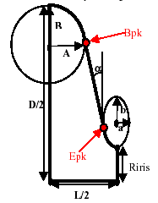
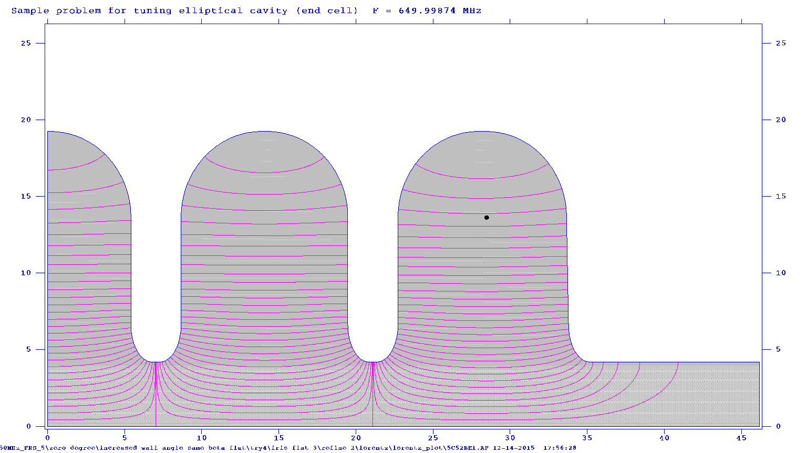
EM Design for 5-cell LB650 Cavity
(with Geometric β=0.61)
(using new FRS released in Sep-2015)
Half-cell dimensions | Inner cell (mm) | End cell (mm)
D | 384.84 | 384.84
R_{iris} | 42 | 42
L/2 | 70.335 | 70.335
A | 52.14 | 52.14
B | 56 | 56
a | 13.73 | 13.83
b | 24.5 | 24.7
α | 0⁰ | 1⁰
Equator flat | 1.905 | 3.07
Iris Flat | 2.565
RF Parameters | Superfish simulation Result
E_{p}/E_{a} | 2.32 (≤39.25 MV/m at specified energy gain at optimal β ) FNAL FRS: ≤ 40 MV/m (at optimal β)
B_{p}/E_{a} | 4.2544 (≤ 71.98 mT at specified energy gain at optimal β ) FNAL FRS: ≤ 72 mT (at optimal β)
R/Q | 373 Ω
π-mode:649.9987MHz
Field Flatness: 96%

Slide 4
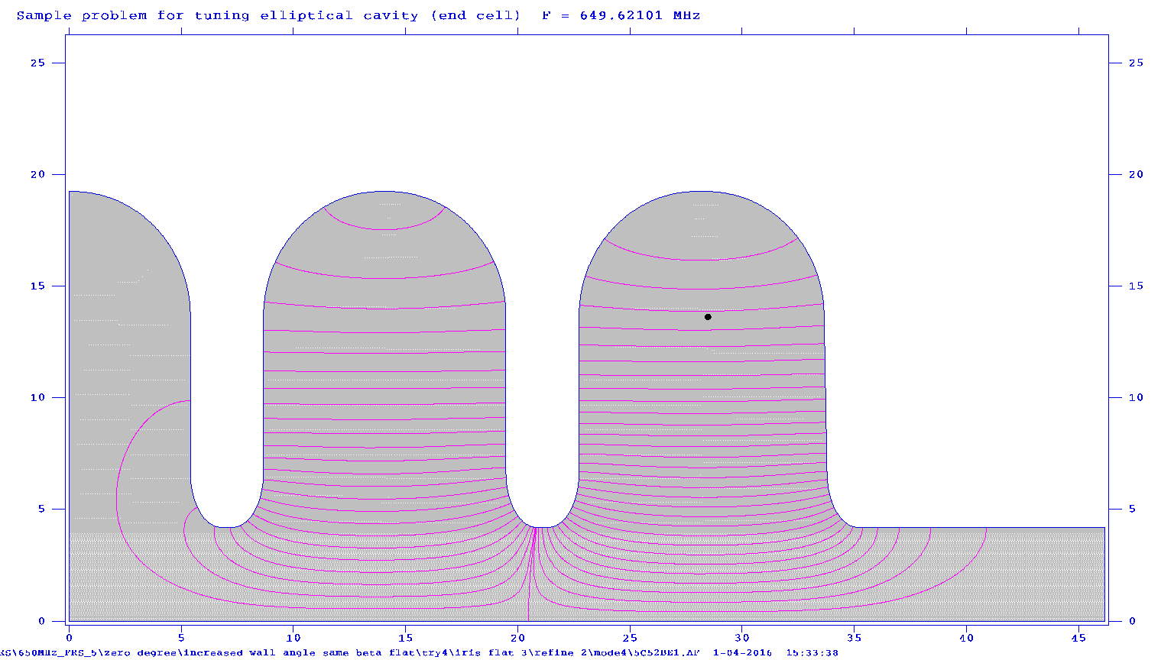
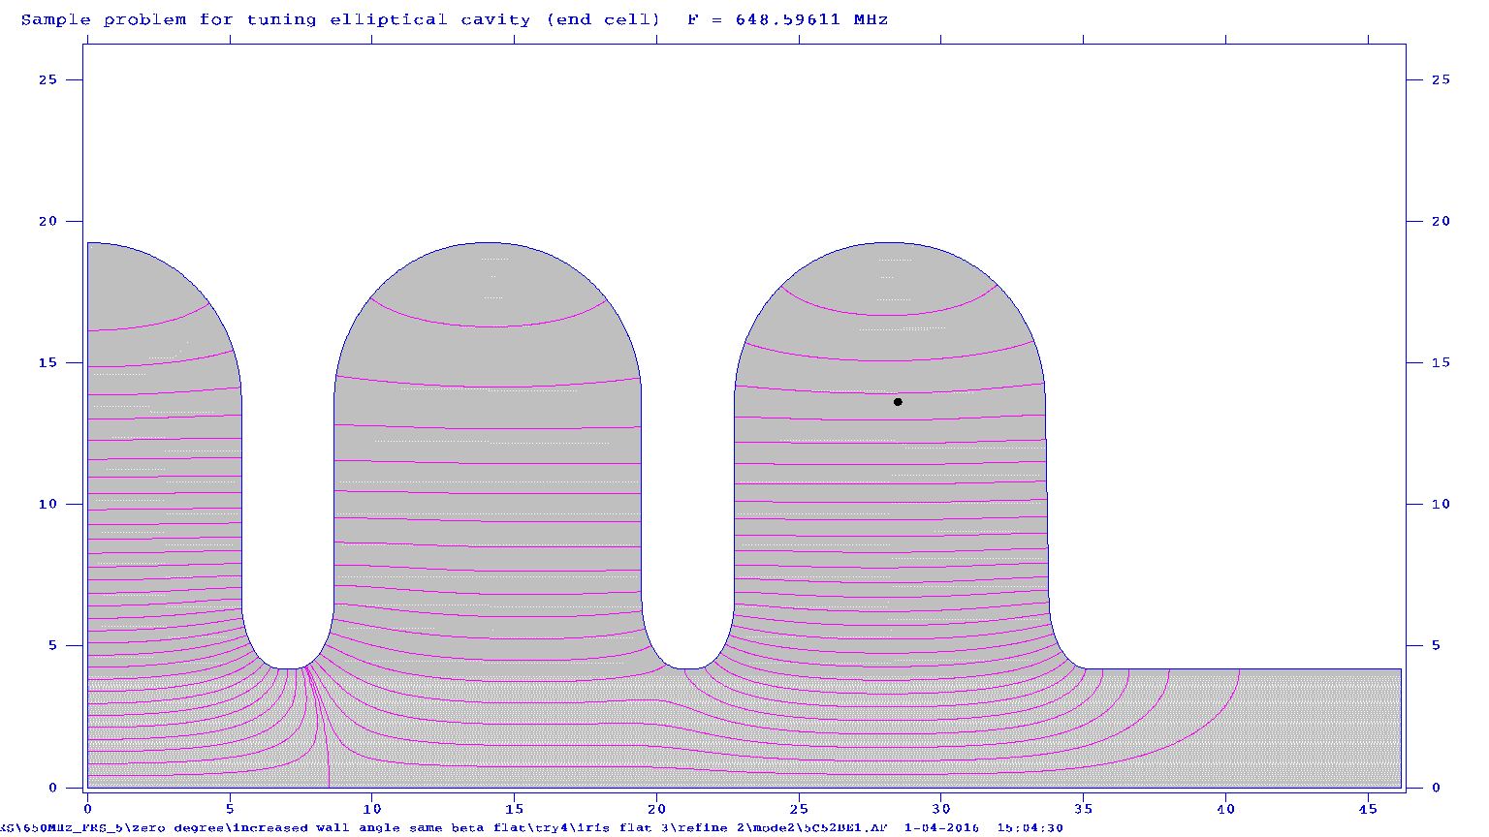
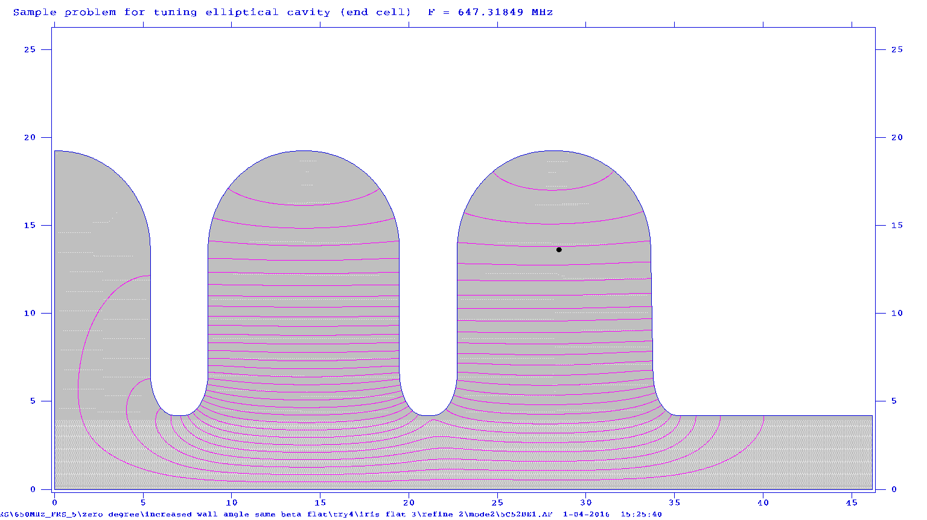
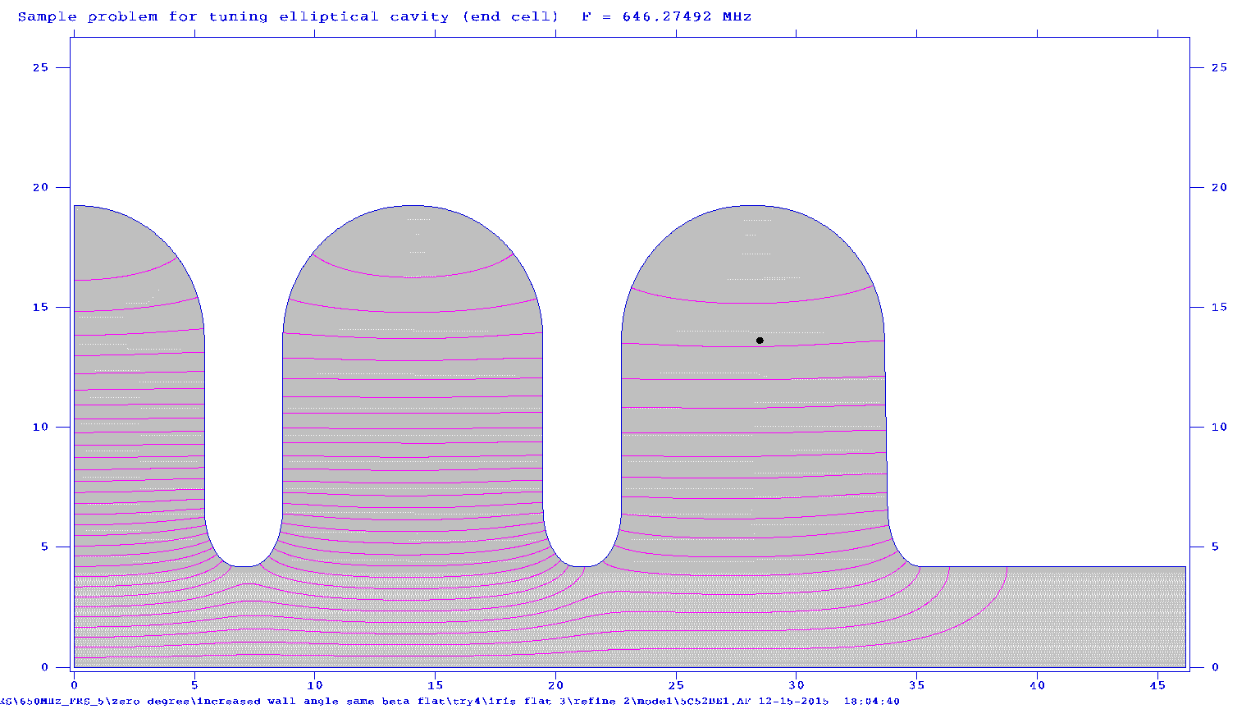
EM Design of LB650 (Geometric Beta=0.61) as per FRS
4π/5 mode:649.62MHz
3π/5 mode:648.596MHz
2π/5 mode:647.318MHz
π/5 mode:646.275MHz
Electric field lines for other four fundamental modes of elliptical shape
5-cell cavity ( ¼ geometry shown )

Slide 5
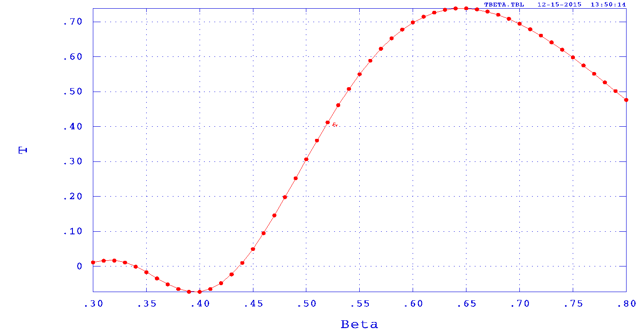
EM Design of LB650 (Geometric β=0.61) as per FRS
Transit Time Factor Vs. Beta (optimal β=0.65)

Slide 6
EM Design of LB650 (Geometric β=0.61) as per FRS
Comparison between Superfish and CST Microwave studio
RF Parameters | Superfish | CST Microwave Studio | FRS
Frequency of π-mode | 649.9987 MHz | 650.055MHz
Frequency of π/5 -mode | 646.275MHz | 646.29MHz
Ep/Ea | 2.32 ( 39.25 MV/m at specified energy gain at optimal beta) | 2.477 ( 41.91 MV/m at specified energy gain at optimal beta) | < 40 MV/m at specified energy gain of 11.9 Mev(Ea=16.919MV/m) at optimal beta(0.65)
Bp/Ea | 4.2544 ( 71.98 mT at specified energy gain at optimal beta) | 4.587 ( 77.6 mT at specified energy gain at optimal beta) | <72mT at Specified energy gain of 11.9 Mev(Ea=16.919MV/m) at optimal beta(0.65)
R/Q | 373 ohm(optimal beta) | 381.89(optimal beta)
Regarding the Surface electric and magnetic field, result from 2-D Code is more reliable, we consider the data from Superfish code as our design value. A mesh convergence study is recommended, if one has to rely on surface fields from 3D codes.

Slide 7
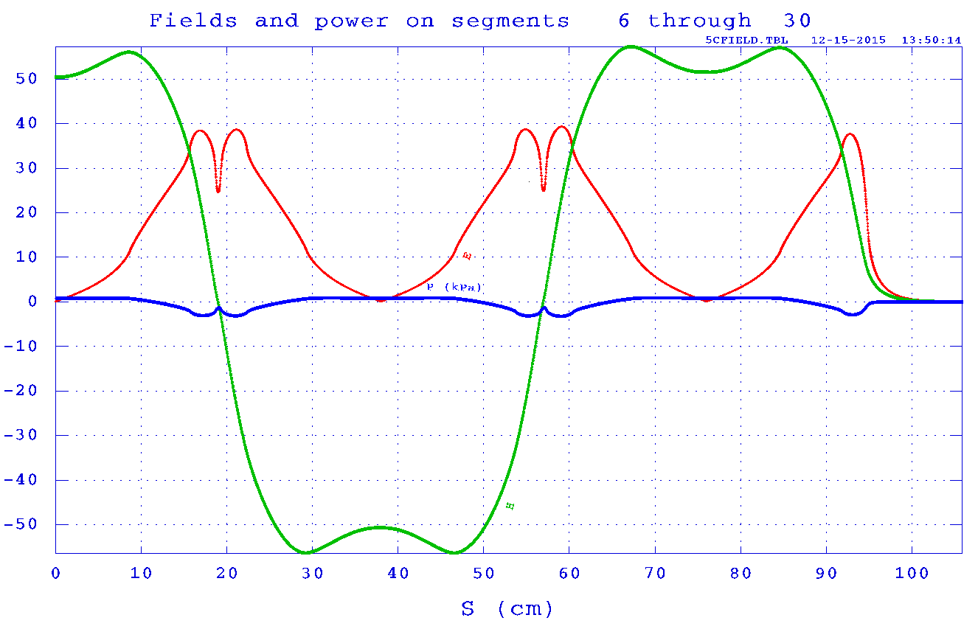
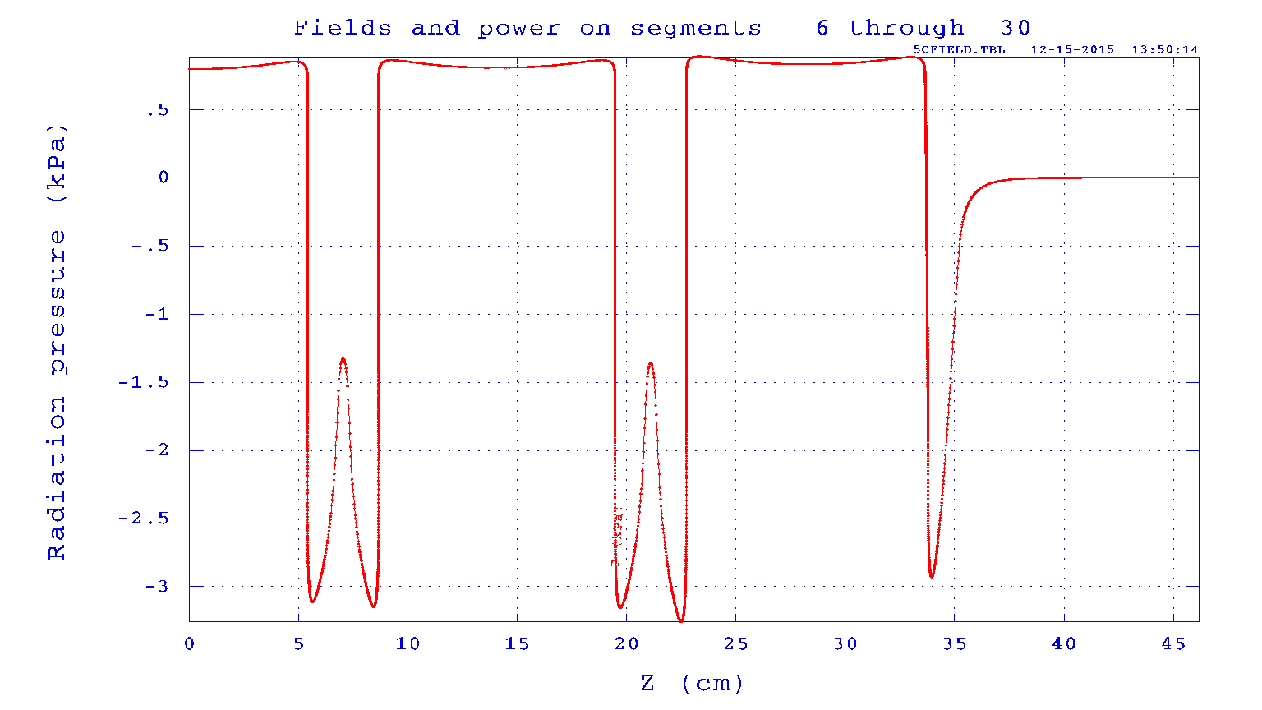
EM Design of LB650 (Geometric β=0.61) as per FRS
Lorentz force at specified energy gain 11.9 Mev at optimal β (0.65) by Superfish
Maximum radiation pressure (Lorentz Force) is 3.25 kPa at iris region and
0.9 kPa at equator region.

Slide 8
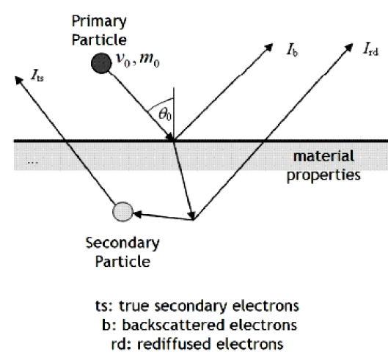
Multipacting simulation using 3D CST Particle Studio
Furman Model of Secondary Electron emission (consisting of three types of scattering particles ) has been taken into account in CST code.
Secondary emission:
A primary particle hitting a metal
surface can cause the emission of
so-called secondary particles.
  Depends on kinetic energy and material properties
  Self consistent model according to Furman.
[M.A. Furman, M.T.F. Pivi, “Simulation of secondary electron emission based on a phenomenological probabilistic model”,
LBNL-52807, SLAC-PUB-9912]
  Statistical behaviour.

Slide 9
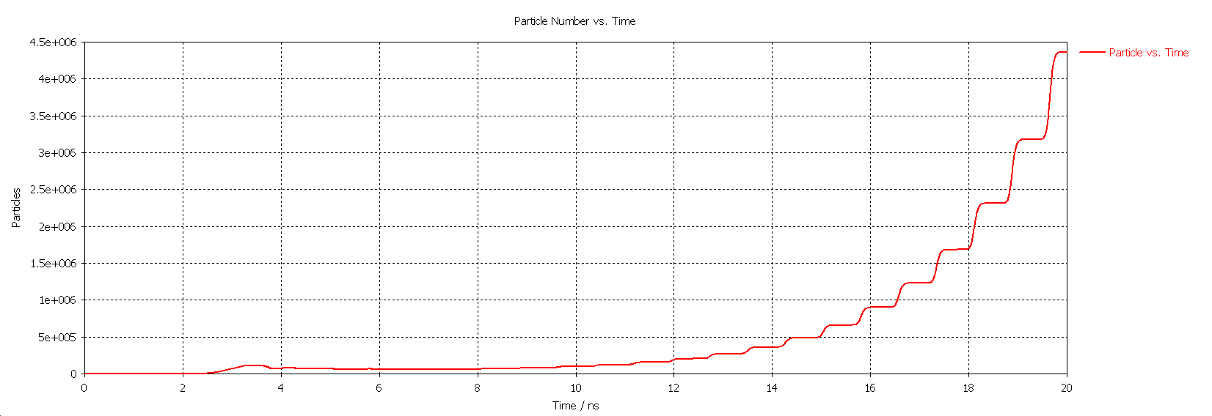
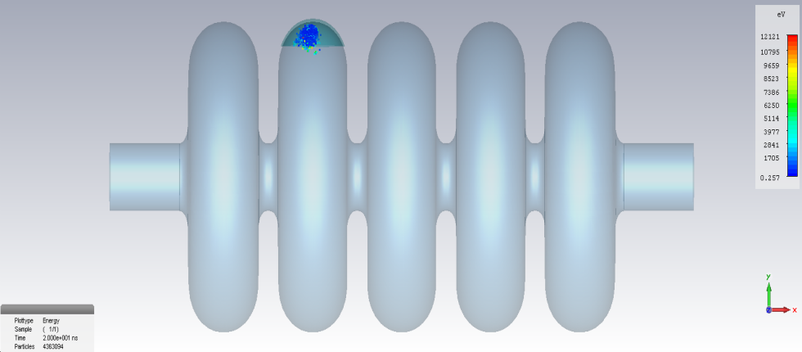
Multipacting simulation results for 650MHz, β=0.61 SRF Cavity
using 3D CST Particle Studio
30 mm. of equator region has been simulated.
Multipacting Analysis has been carried out for both mid-cell and end-cell.
Multipacting has been found up to 4 MV/m.
Multipacting rate is very high in the region of 3.5MV/m.
At 4 MV/m, increase in partcle due to multipacting is very low.
Particle vs. time (ns) at 3.5 MV/m (mid-cell)
Particles after 20ns at 3.5 MV/m (mid-cell)

Slide 10
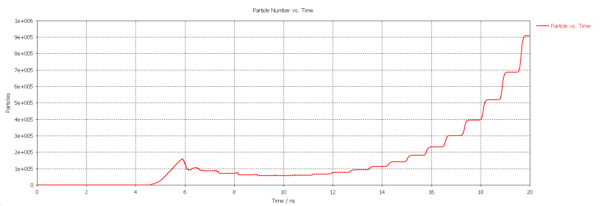
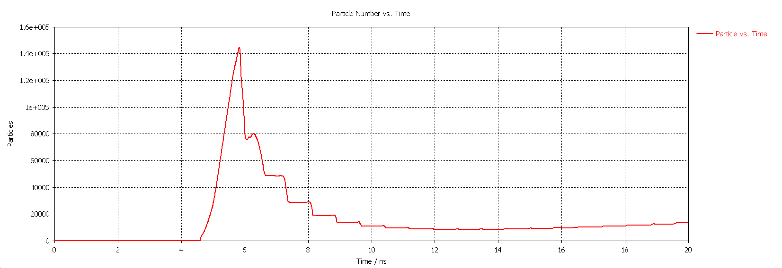
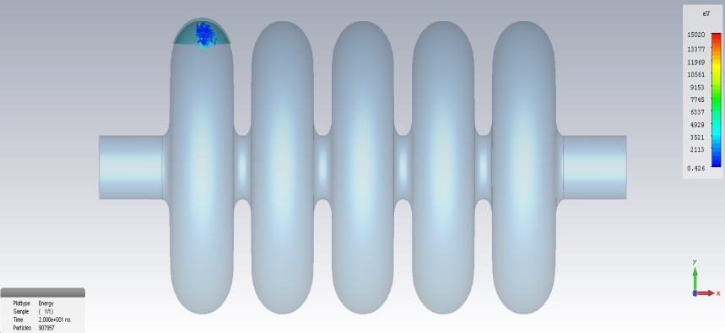
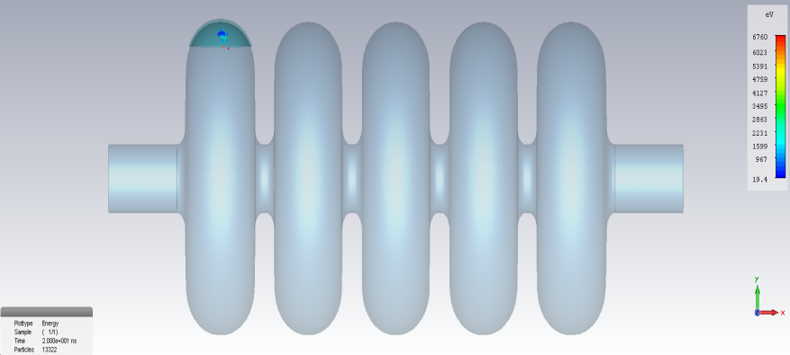
Multipacting simulation data for 650MHz, β=.61Cavity using CST Particle Studio
Particle vs. time (ns) at 3.5 MV/m (end cell)
Particle vs. time (ns) at 4MV/m (end cell)
Particle after 20ns at 3.5 MV/m(end cell)
Particle after 20ns at 4 MV/m(end cell)

Slide 11
Dimensions of 650 MHz, 5-cell, β=0.61, Niobium Cavity
Dimensional Parameters | COLD Dimension (inside) (as designed) (mm.) | COLD Dimension Pre- BCP treatment of 250 μm (mm.) | WARM Dimension Inside (for fabrication) (mm.)
Equator radius | 192.42 | 192.17 | 192.4429
Iris radius | 42 | 41.75 | 41.80929
A | 52.14 | 51.89 | 51.96368
B | 56 | 55.75 | 55.82917
a | 13.728 | 13.978 | 13.99785
b | 24.51 | 24.76 | 24.79516
Equator flat | 1.905 | 1.905 | 1.907705
Iris flat | 2.565 | 2.565 | 2.568642
a (for end cell) | 13.83 | 14.08 | 14.09999
b (for end cell) | 24.696 | 24.946 | 24.98142
Equator flat (end cell) | 3.07 | 3.07 | 3.074359
Iris flat (end cell) | -- | -- | --
Half cell length (L/2) | 70.335 | 70.335 | 70.43488

Slide 12
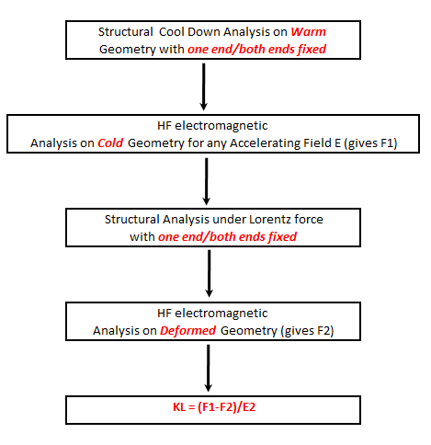
Study of Lorentz Force Detuning Coefficient of SRF Cavity using ANSYS
Steps carried out in ANSYS
It was studied under 2 extreme structural boundary conditions:
With one fixed and one end free
With both ends fixed
Note:
The actual boundary condition will be in between the above two cases.
In actual case, helium vessel with tuning system and bellows have to be considered with the bare cavity

Slide 13
Case 1: LFD with one end fixed
(without any stiffener ring)
E (MV/m) | E*E | F1 (Hz) | F2 (Hz) | F2-F1 (Hz) | KL Hz/(MV/m)²
5 | 25 | 649957057 | 649954848 | −2209 | −88.36
10 | 100 | 649957057 | 649948221 | −8836 | −88.36
16.919 | 286.25 | 649957057 | 649931759 | −25298 | −88.3765

Slide 14
Case 2: LFD with both ends fixed without any stiffener ring
E (MV/m) | E*E | F1 (Hz) | F2 (Hz) | F2-F1 | KL Hz/(MV/m)²
5 | 25 | 650288721 | 650288675 | −46 | −1.84
10 | 100 | 650288721 | 650288534 | −187 | −1.87
16.919 | 286.25 | 650288721 | 650288186 | −535 | −1.868979

Slide 15
Effect of stiffener rings on LFD with both ends fixed
Stiffner Radius (mm) | F1 (Hz) After cool down | F2 (Hz) After cool down | F_shift (Hz) (F2 – F1) | KL Hz/(Mv/m)² (for 16.919 MV/m)
No stiffner | 650288721 | 650288186 | −535 | −1.868978912
50 | 650297123 | 650296775 | −348 | −1.215709647
60 | 650308784 | 650308557 | −227 | −0.793006006
65 | 650313178 | 650312960 | −218 | −0.761565239
70 | 650316758 | 650316523 | −235 | −0.820953354
80 | 650321555 | 650321235 | −320 | −1.117893929
90 | 650325777 | 650325319 | −458 | −1.599985685
100 | 650332166 | 650331532 | −634 | −2.214827346
110 | 650342756 | 650341922 | −834 | −2.913511052
122 | 650357286 | 650356238 | −1048 | −3.661102616
FRS: KL= −0.8 Hz/(MV/m)²

Slide 16
Study of pressure sensitivity of SRF cavity under external liquid helium pressure
ONE END FIXED
Helium Pressure (mbar) | F1 (Hz) | F2 (Hz) | F1-F2 | dF/P (Hz/mbar)
25 | 649957057 | 649908150 | 48907 | 1956.28
30 | 649957057 | 649898365 | 58692 | 1956.4
35 | 649957057 | 649888579 | 68478 | 1956.52
BOTH ENDS FIXED
Helium Pressure (mbar) | F1 (Hz) | F2 (Hz) | F1-F2 | dF/P (Hz/mbar)
25 | 650288721 | 650287049 | 1672 | 66.88
30 | 650288721 | 650286714 | 2007 | 66.9
35 | 650288721 | 650286380 | 2341 | 66.89

Slide 17
Effect of stiffener rings on pressure sensitivity
(with both ends fixed)
Stiffner Radius (mm) | F1 (Hz) After cool down | F2 (Hz) External Helium Pressure 30 mbar | F_shift (Hz) due to Helium Pressure | Pressure Sensitivity (dF/P)
No stiffner | 650288721 | 650286714 | 2007 | 66.9
50 | 650297123 | 650295952 | 1171 | 39.03333333
60 | 650308784 | 650308415 | 369 | 12.3
65 | 650313178 | 650313034 | 144 | 4.8
70 | 650316758 | 650316765 | -7 | 0.233333333
80 | 650321555 | 650321762 | -207 | 6.9
90 | 650325777 | 650326157 | -380 | 12.66666667
100 | 650332166 | 650332700 | -534 | 17.8
FRS: dF/P= < 25 Hz/mbar
(For dressed cavity)

Slide 18
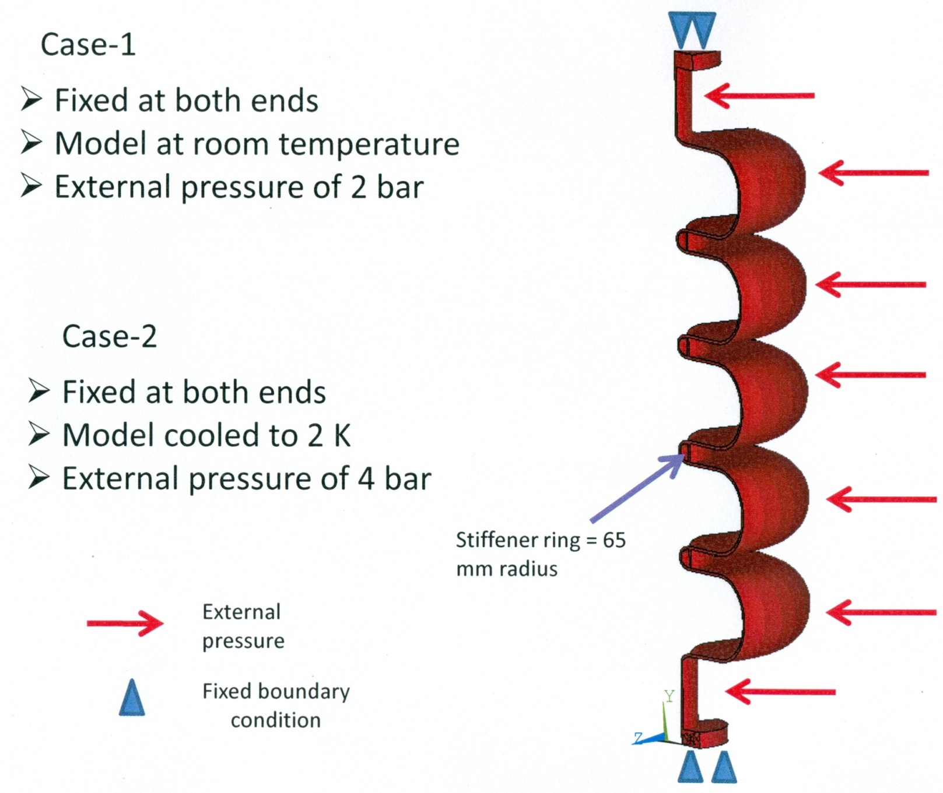
Structural analysis of stiffened SRF cavity with both ends fixed

Slide 19
Case 1: Contour plot of total deformation
Undeformed shape
Displacement is in meter

Slide 20
Case 1: Stress categorization plot on path-1
Stress Intensity (SINT) is in Pascal
Path-1
Observed:
Pm = 6.47 Mpa < Sm = 33 Mpa
Pm + Pb = 8.92 Mpa < 1.5Sm = 49.5 Mpa
Safe

Slide 21
Case 1: Stress categorization plot on path-2
Stress Intensity (SINT) is in Pascal
Path-2
Observed:
Pm = 13.39 Mpa < Sm = 33 Mpa
Pm + Pb = 13.45 Mpa < 1.5Sm = 49.5 Mpa
Safe

Slide 22
Case 1: Stress categorization plot on path-3
Stress Intensity (SINT) is in Pascal
Path-3
Observed:
Pm = 13.37 Mpa < Sm = 33 Mpa
Pm + Pb = 13.46 Mpa < 1.5Sm = 49.5 Mpa
Safe

Slide 23
Case 1: Stress categorization plot on path-4
Stress Intensity (SINT) is in Pascal
Path-4
Observed:
Pm = 5.49 Mpa < Sm = 33 Mpa
Pm + Pb = 7.51 Mpa < 1.5Sm = 49.5 Mpa
Safe

Slide 24
Case 1: Stress categorization plot on path-5
Stress Intensity (SINT) is in Pascal
Path-5
Observed:
Pm = 29.06 Mpa < Sm = 33 Mpa
Pm + Pb = 43.97 Mpa < 1.5Sm = 49.5 Mpa
Safe

Slide 25
Case 2: Contour plot of total deformation
At 300 K
Displacement is in meter

Slide 26
Case 2: Stress categorization plot on path-1
Stress Intensity (SINT) is in Pascal
Path-1
Observed:
Pm = 11.96 Mpa < Sm = 103 Mpa
Pm + Pb + Q = 16.13 Mpa < 3Sm = 309 Mpa
Safe

Slide 27
Case 2: Stress categorization plot on path-2
Stress Intensity (SINT) is in Pascal
Path-2
Observed:
Pm = 28.16 Mpa < Sm = 109 Mpa
Pm + Pb + Q = 29.06 Mpa < 3Sm = 309 Mpa
Safe

Slide 28
Case 2: Stress categorization plot on path-3
Stress Intensity (SINT) is in Pascal
Path-3
Observed:
Pm = 28.28 Mpa < Sm = 103 Mpa
Pm + Pb + Q= 29.26 Mpa < 3Sm = 309 Mpa
Safe

Slide 29
Case 2: Stress categorization plot on path-4
Stress Intensity (SINT) is in Pascal
Path-4
Observed:
Pm = 11.55 Mpa < Sm = 103 Mpa
Pm + Pb + Q = 15.64 Mpa < 3Sm = 309 Mpa
Safe

Slide 30
Case 2: Stress categorization plot on path-5
Stress Intensity (SINT) is in Pascal
Path-5
Observed:
Pm = 64.8 Mpa < Sm = 103 Mpa
Pm + Pb + Q = 104.9 Mpa < 3Sm = 309 Mpa
Safe

Slide 31
SUMMARY
5-cell LB650 cavity design carried out, using new FRS.
The necessary parameters are well within the prescribed limits .
3D Multipacting done. It is probable below 4 MV/m; Beyond 4 MV/m multipacting probability diminishes.
Study of Lorentz Force Detuning (LFD) carried out (for bare cavity)
With stiffener ring , KL=-0.76 Hz/(MV/m)²
[ As per FRS, KL=-0.8Hz/(MV/m)² ]
Study of pressure sensitivity under external liquid helium pressure carried out (for bare cavity).
With Stiffener ring, dF/P=4.8 Hz/mbar.
[ As per FRS, dF/P < 25Hz for dressed cavity]
Structural analysis of the cavity carried out.
With Stiffener rings, all Stresses are well with in the limits.
Further study is in progress for finalizing the design.

