Slide 1
Discussion input for future ROOT functionality/features.
Peter van Gemmeren, Marcin Nowak for the ATLAS I/O team

Slide 2
Interface separation of ROOT I/O
Dynamic structure creation to minimize ROOT branch count

Slide 3
Event Data Streaming
ATLAS is developing Shared Reader/Writer framework for AthenaMP (and others):
Worker nodes will not access ROOT file directly.
Avoid having multiple worker read (and decompress) same data (because their events are in the same ROOT cluster).
Save memory (e.g. TTreeCache).
Has to work with fine granularity dispatching (EventServer).
Single events for Simulation

Slide 4
Prototype Implementation
The (Gaudi-style/ROOT independent) ConversionSvc is configured so that when object is requested from worker’s store, it sends a message to a Shared Reader.
The Shared Reader uses its ConversionSvc to read the object (via POOL/APR and ROOT) and sends it back via shared memory to the worker.

Slide 5
Okay
Read
Worker
Shared Memory
Reader
ROOT
Request object via Token
Object
Object
TBranch
Copy Object out Shared Memory:
De-serialize
Copy Object to Shared Memory:
Serialize
ROOT Reading:
Disk I/O
De-compress
De-serialize
Serialization Service:
(e.g.) ROOT
branch->SetAddress()
branch->GetEntry()

Slide 6
Better
Read
Worker
Shared Memory
Reader
ROOT
Request object via Token
Object
Object
TBranch
Copy Object out Shared Memory:
De-serialize
Copy Object to Shared Memory:
Serialize
ROOT Reading:
Disk I/O
De-compress
De-serialize
Serialization Service:
(e.g.) ROOT
branch->SetAddress()
branch->GetEntry()
branch->SetBufferAddress ()
branch->GetEntry()

Slide 7
Please Consider
We would like the ROOT team to consider:
Provide an interface (similar to SetBufferAddress()) set allows client to read Branch entry w/o de-serialization.
This should work for all ROOT data
Similarly on write, SetBufferAddress() should allow giving serialized data object to ROOT to collect, compress and write.

Slide 8
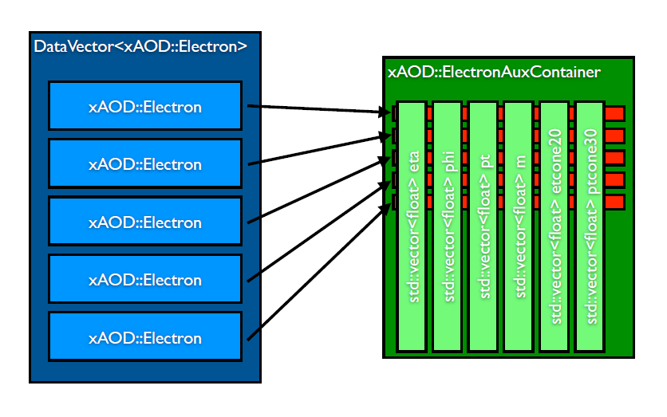
Run 2 ATLAS EDM - xAOD
For Run2 ATLAS is using a new EDM based on the concept of dynamic data structure – xAOD
An xAOD type can have a fixed set of static attributes and a random set of dynamic attributes
Dynamic attributes can be added at any stage of program execution and removed when writing data to file
Data payload changes between event processing stages while the class type remains the same
Memory
TFile
C++
TBranches

Slide 9
xAOD: TBranches and Memory
Only dynamic attributes can be dropped between processing stages
All attributes that we suspect could be dropped need to be dynamic
Every dynamic attribute adds one TBranch
ATLAS ESD files can have ~10K branches
An open TFile allocates a buffer for each branch
Buffer size in memory is multiplied by the compression ration
We use a lot of memory

Slide 10
Packing Dynamic Attributes
Combining dynamic attributes into a single structure would significantly reduce the number of branches
The exact shape of the structure is known only at runtime, when writing data
Cannot prepare a dictionary beforehand
ROOT offers 2 ways to define a new class „on the fly”:
gSystem->CompileMacro(„filename”)
Builds and loads a shared library with the class definition
Needs to explicitly include all necessary header files
Attributes can be of any type!
(somewhat slow and less elegant solution)
gInterpreter->Declare(„C++ class definition”)
Fast, knows all types internally
But does not produce a TClass with complete reflection information – necessary to use StreamerInfo to query about data members

Slide 11
Using Dynamic Structures
Declaration
Inspecting xAOD dynamic attributes and preparing a string declaration
Creation
With TClass::New()
Filling
A little of void* pointer acrobatics to set all structure members to point to the original xAOD storage vectors
Data members’ offsets seem to follow standard C structure rules (offset 0, 8, 16, ..)
struct xAODtypename_dynamic {
// xAOD (Aux) storage vector type attribute name
std::vector<int> *int_attr_name = 0;
std::vector<AnyType> *anytype_attr_name = 0; };

Slide 12
Dynamic Structures – I/O
Writing
Regular TBranch::SetAddress() and Fill()
Works as long as all members of the structure have dictionaries
Explicit ROOT error if not (good!)
Reading
ROOT creates the object ( GetEntry() )
Attributes can be inspected using StreamerInfo
Data members’ offsets are completely different than when writing!
No idea how to ask ROOT to read directly into xAOD storage (which we do when working with single branches)
Currently using a hack to swap std::vector content

Slide 13
Topics for Discussion
We are aware we are doing I/O for interpreted types
Simple tests are working – more testing needed
Reading/merging files with different „versions” of the dynamic structures
How to best copy/move the vector payload when reading
How to handle new dynamic attributes added after the structure was defined

