Slide 1
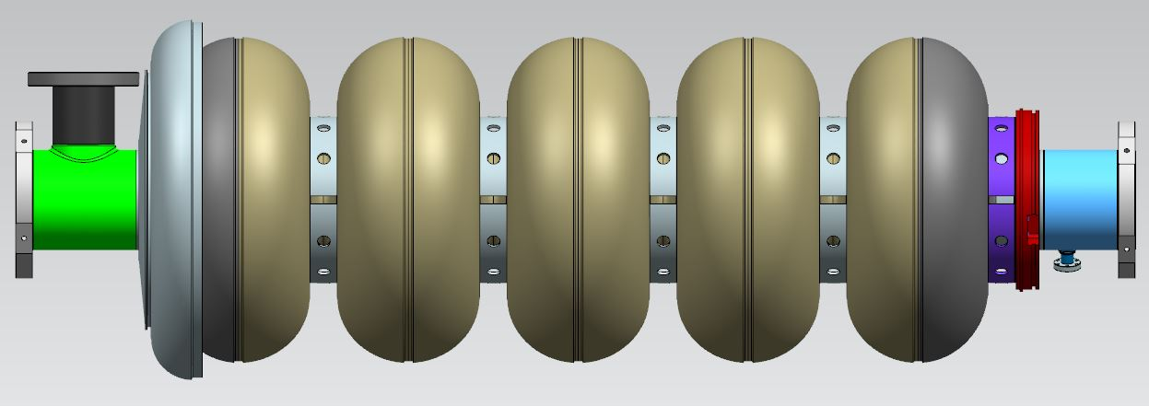
Design Process of the 650 MHz β=0.92 Cavity
Chuck Grimm
March 2, 2016

Slide 2
Design Process of the 650 MHz β=0.92 Cavity
Starting Point:
End and Mid Half-Cell RF Volume Shapes are Developed
Work Performed by the RF Engineering Group
Developed for Cold Operation (2K)
Numbers Converted to Room Temperature (300K)
RF Volume Geometry Goes to Engineering for Cell Development
Numbers are Used to Develop 2-Dimensional RF Curves in the CAD System
Curves are Revolved with a 4mm Thickness to Produce Half-Cells
Once the 3-Dimensional Cell is Developed Weld Preps are Added

Slide 3
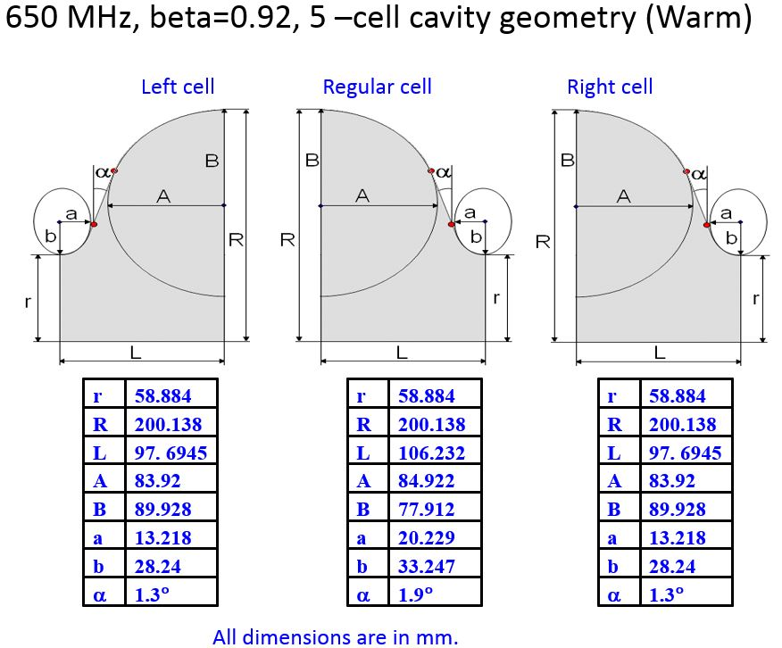
Design Process of the 650 MHz β=0.92 Cavity

Slide 4
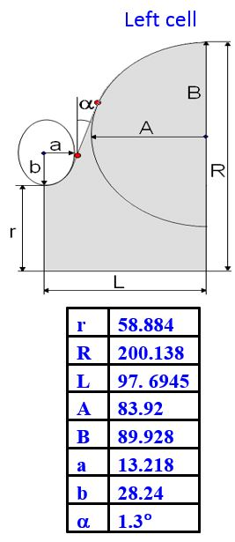
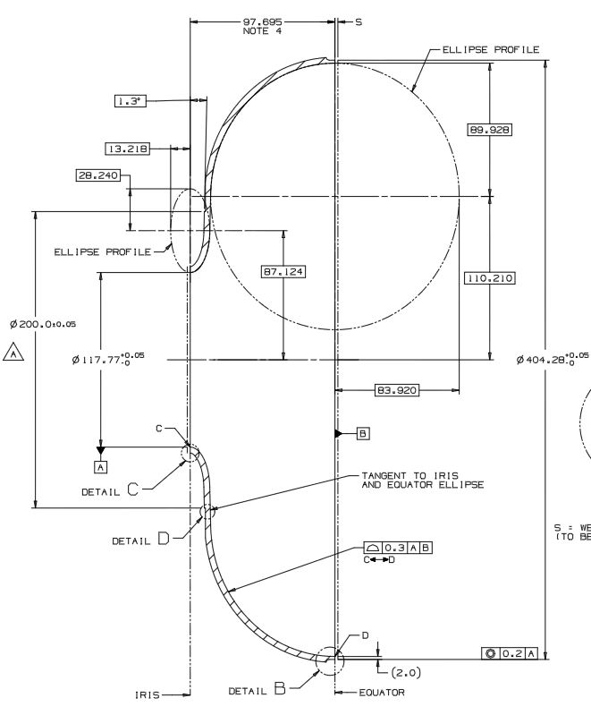
Design Process of the 650 MHz β=0.92 Cavity
58.884*2= 117.77

Slide 5
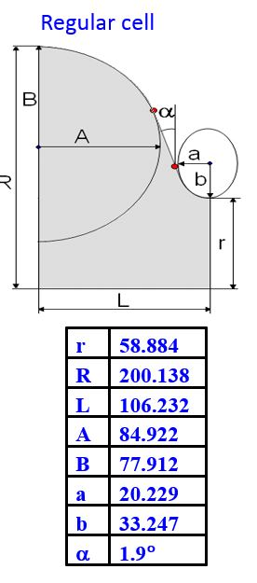
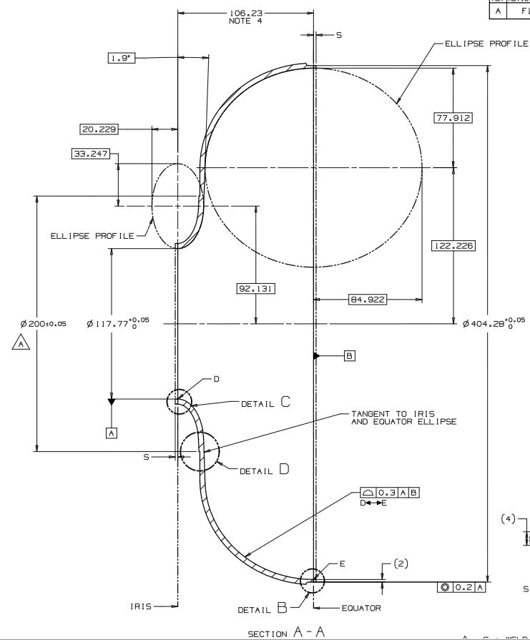
Design Process of the 650 MHz β=0.92 Cavity
58.884*2= 117.77

Slide 6
Design Process of the 650 MHz β=0.92 Cavity
Dumbbell and Barbell Assembly:
Dumbbells are Developed
Created by Joining Mid-Cells at the Iris Region
Position a Stiffening Ring at an Approximate Location
Barbell is Developed
Created by Joining Dumbbells at the Equator Region
This is Done Three Times to Create the Finished Assembly
Cavity Barbell Assembly is Complete

Slide 7
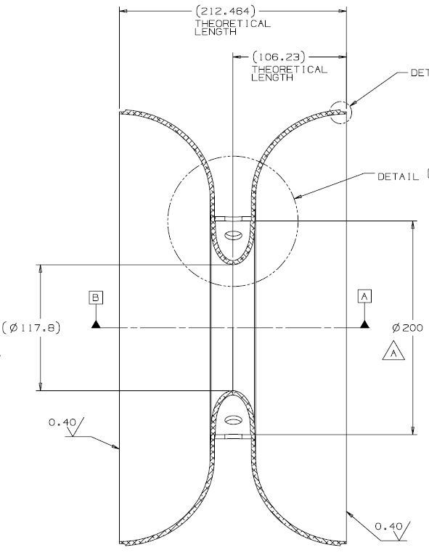
Design Process of the 650 MHz β=0.92 Cavity
Dumbbell Assembly:

Slide 8
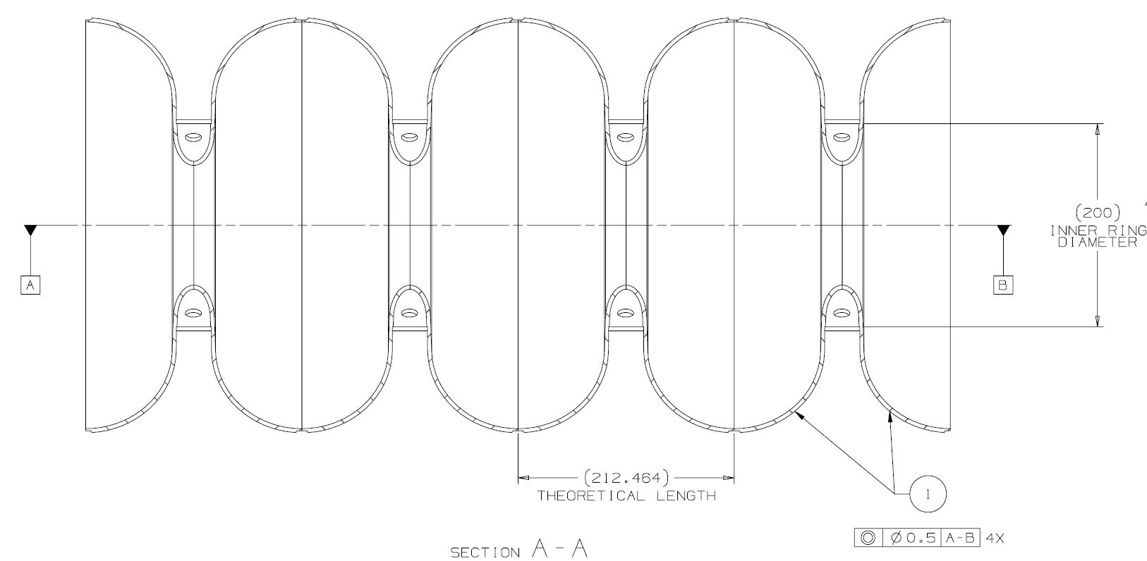
Design Process of the 650 MHz β=0.92 Cavity
Barbell Assembly:

Slide 9
Design Process of the 650 MHz β=0.92 Cavity
Endgroups:
Main Coupler (MC) Endgroup is Developed
Created by Joining End-Cell, Beam Tube, Beam Flange
Coupler Port Location Determined by Power Coupler Group
Coupler Port Flange Location Determined by Power Coupler Group
Field Probe (FP) Endgroup is Developed
Created by Joining End-Cell, Beam Tube, Beam Flange
Field Pick-Up Port Location Determined by RF Group
Field Pick-Up Flange Location Determined by RF Group

Slide 10
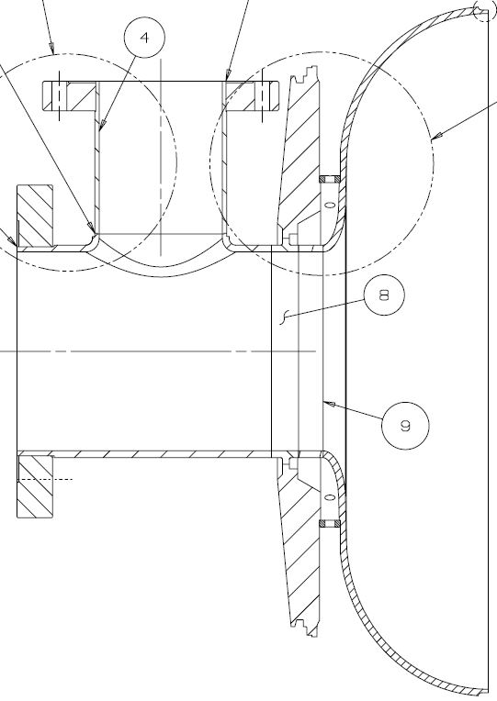
Design Process of the 650 MHz β=0.92 Cavity
MC Endgroup Considerations:
Weld Sequence
Weld Thickness
Material Conservation

Slide 11
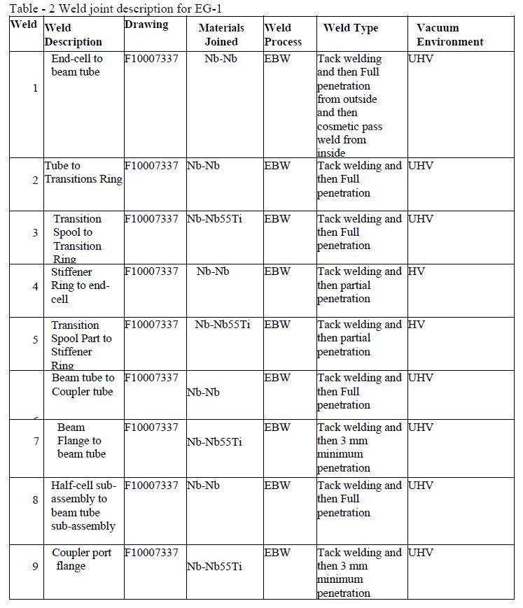
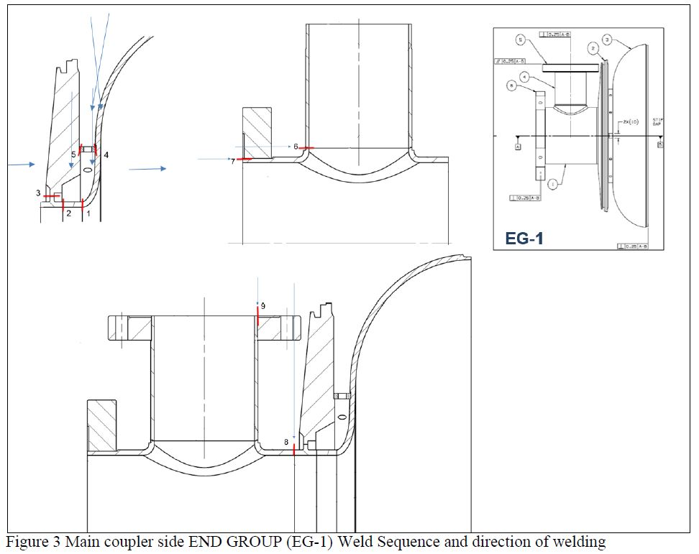
Design Process of the 650 MHz β=0.92 Cavity
MC Endgroup Considerations:
Weld Sequence

Slide 12
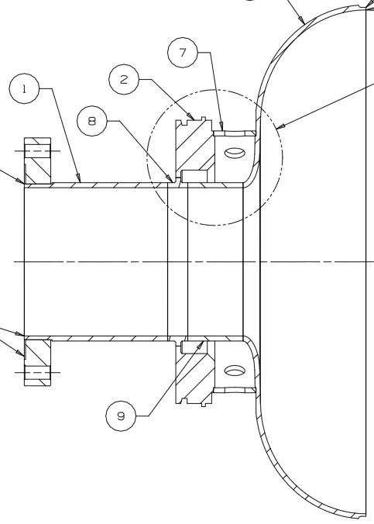
Design Process of the 650 MHz β=0.92 Cavity
FP Endgroup Considerations:
Weld Sequence
Weld Thickness
Material Conservation

Slide 13
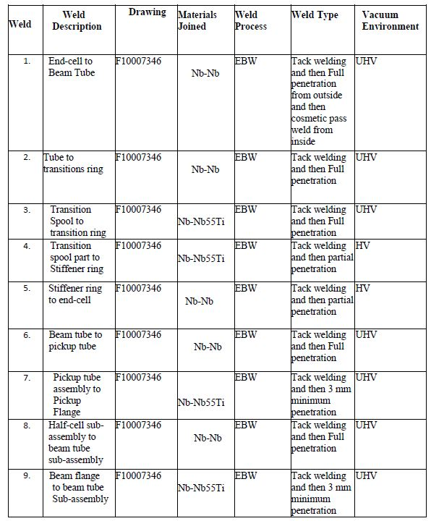
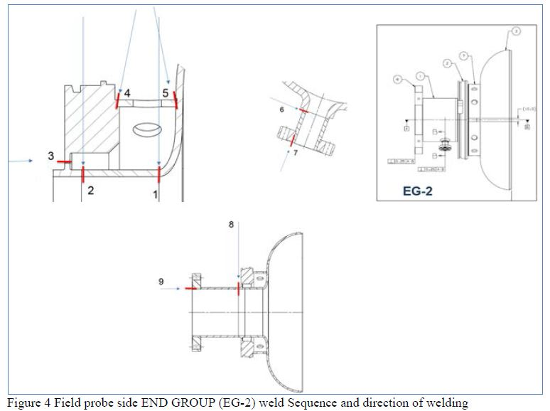
Design Process of the 650 MHz β=0.92 Cavity
FP Endgroup Considerations:
Weld Sequence

Slide 14
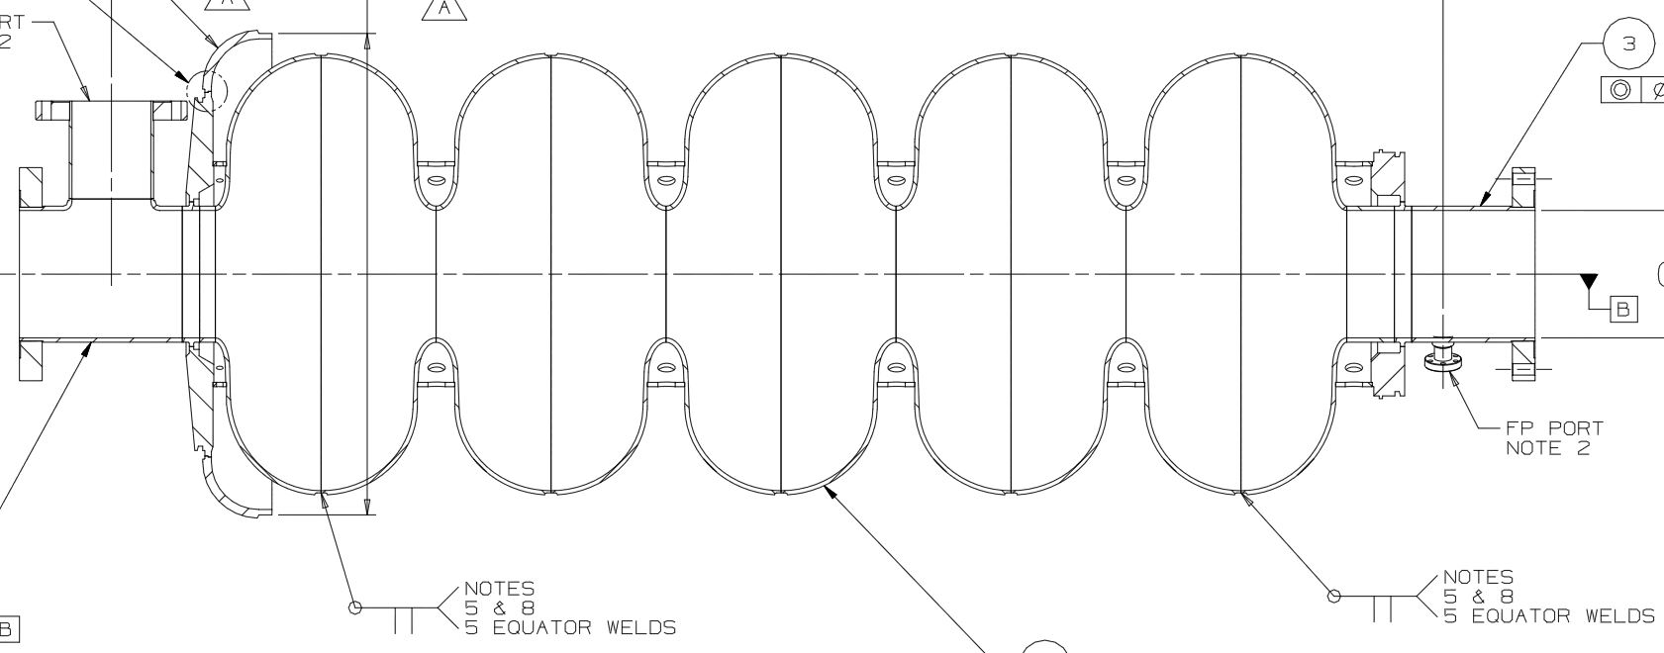
Design Process of the 650 MHz β=0.92 Cavity
Final Cavity Assembly:
Endgroups Welded to Barbell Assembly
Joined at the Equators

Slide 15
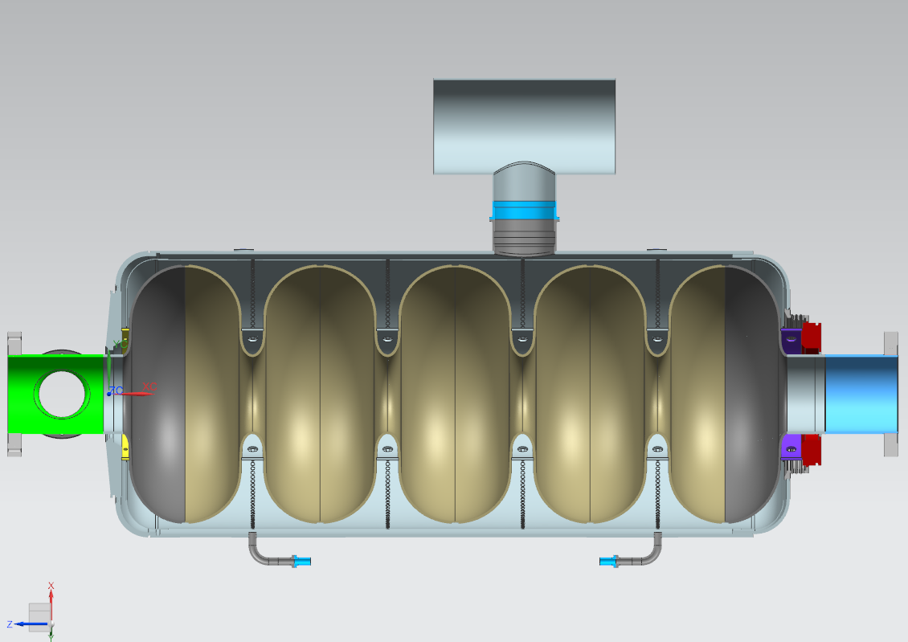
Design Process of the 650 MHz β=0.92 Cavity
Dressed Cavity Configuration:
Needed for RF and Mechanical Analysis
Once the preliminary 3-D model is complete it is stored in Team Center and used for the various analysis performed. The 3-D model is updated accordingly to align with the Functional Requirement Specification (FRS) and Pressure Vessel Safety. The FRS is also stored in Team Center.

Slide 16
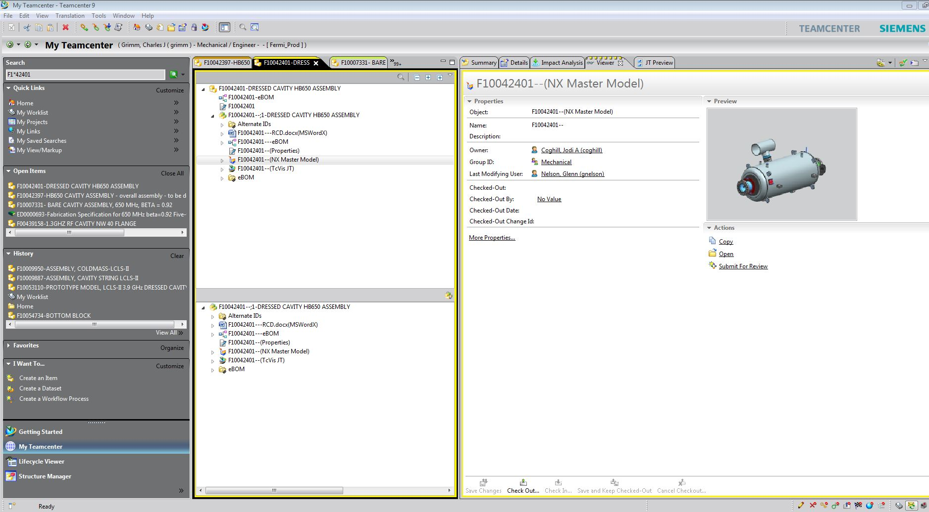
Design Process of the 650 MHz β=0.92 Cavity

Slide 17
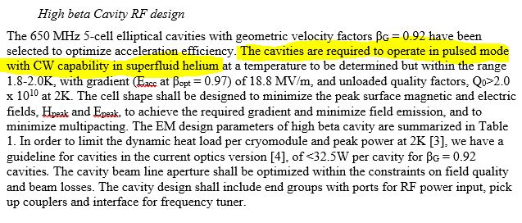
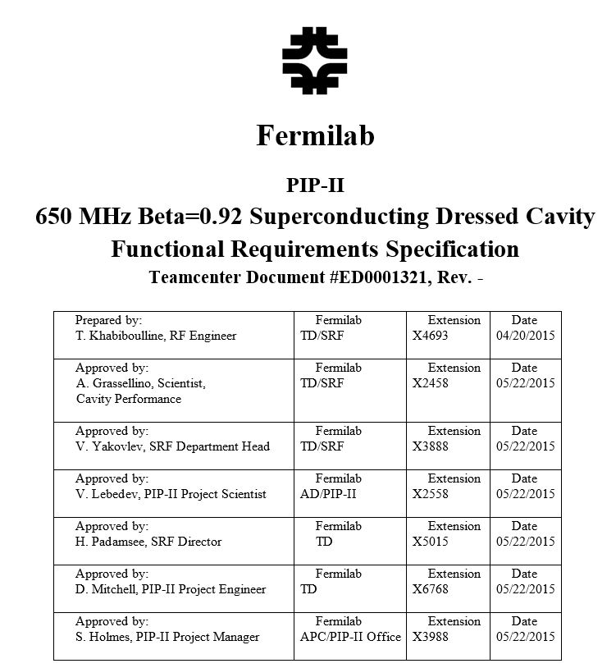
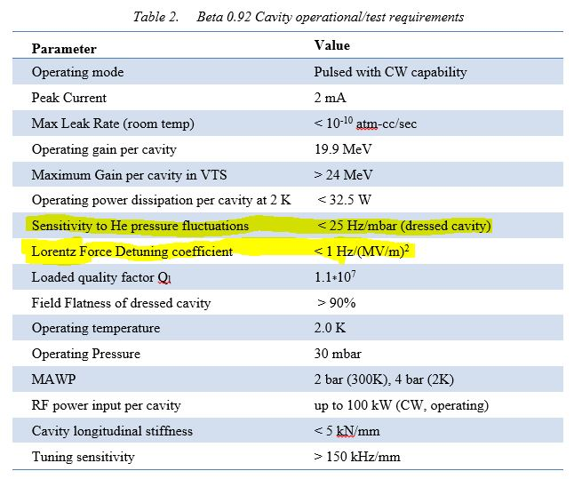
Design Process of the 650 MHz β=0.92 Cavity

Slide 18
Design Process of the 650 MHz β=0.92 Cavity
RF and Mechanical Analysis: (The Helium Vessel Plays an Important Role)
Determine Optimal Stiffening Ring Radial Locations
Helium Vessel Bellow Radius
Niobium/Titanium Spool Transition Thickness
Helium Vessel Titanium Transition Ring Thickness
Pressure Loads
Gravity Load
Cool-Down to 2K
Tuner Extension of 2 mm
Hydrostatic Pressure Due to Helium Weigh
Elastic Stress Analysis
Buckling Analysis

Slide 19
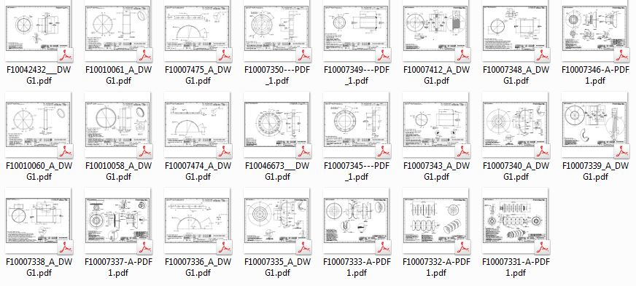
Design Process of the 650 MHz β=0.92 Cavity
Final Stages:
Develop Drawing Package Based on Final Model
Complete – Released in Team Center
Final Design Review for Bare Cavity
Complete
Final Design Review for Dressed Cavity
Preliminary Stage – Maybe Rolled in with CM Review?

Slide 20
Design Process of the 650 MHz β=0.92 Cavity
Thank You!

