Slide 1
Mu2e Accelerator Design Review Recommendations
Mu2e Accelerator Management Team
Mu2e Director’s Review
20 April 2016

Slide 2
Resonant Extraction Review
August 25-27, 2015

Slide 3
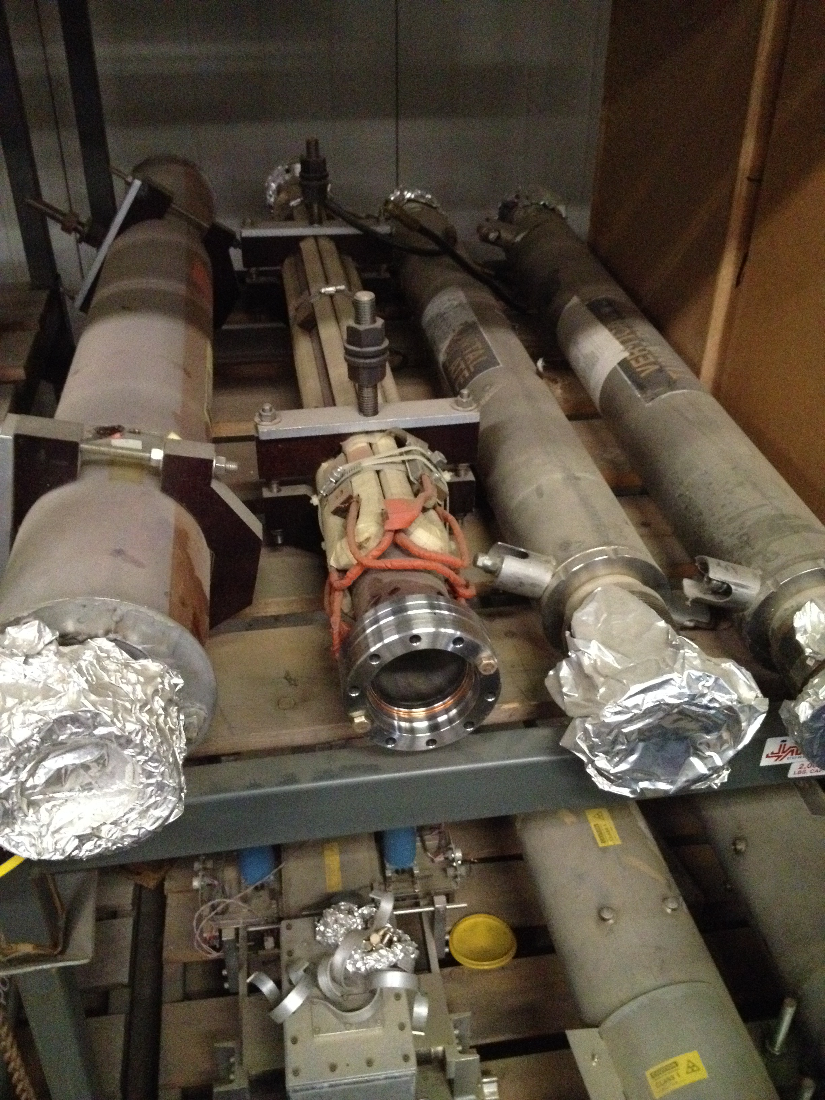
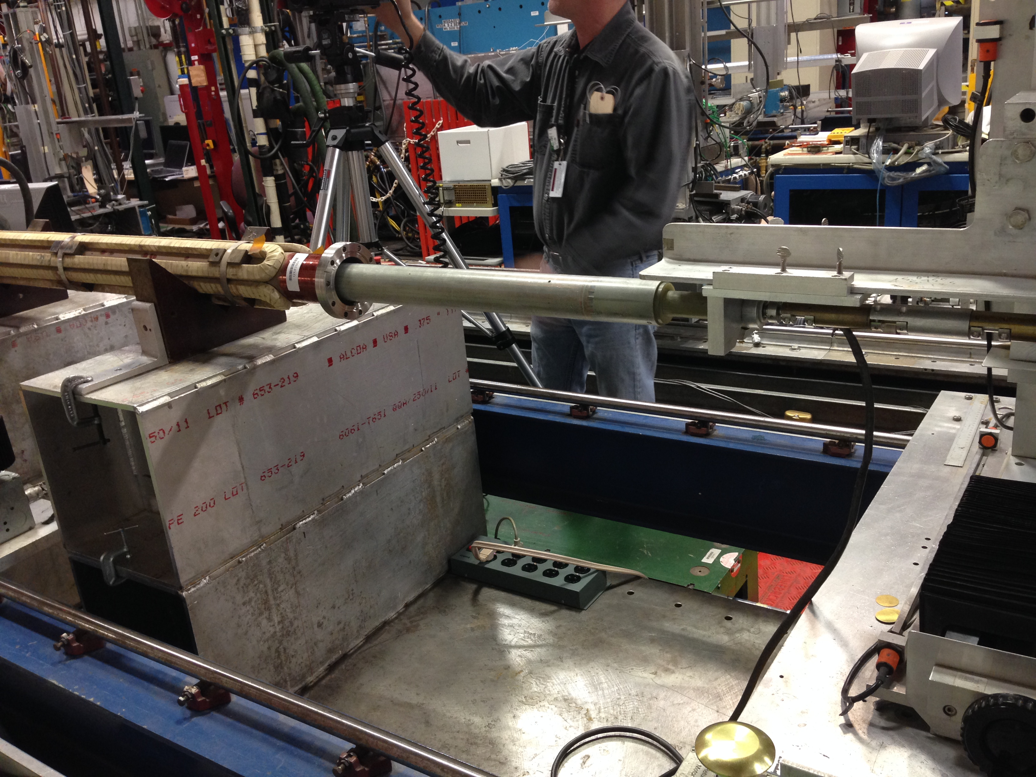
Independent Technical Design Review Recommendations - 1
Include the spill correction system on the risk list. Develop the backup option to the technical design level.
Conventional system for the fast ripple regulation is the Quadrupole eXtraction Regulation (QXR) “Bucker”
Easy to add to the regulation logic
The technical solution is to piggy-back on the on-going air core ceramic pipe QXR magnet fabrication for Main Injector
We are carrying out magnet measurements at MTF on the old QXRT magnets with SS pipe.
At D0 storage
At MTF stand

Slide 4
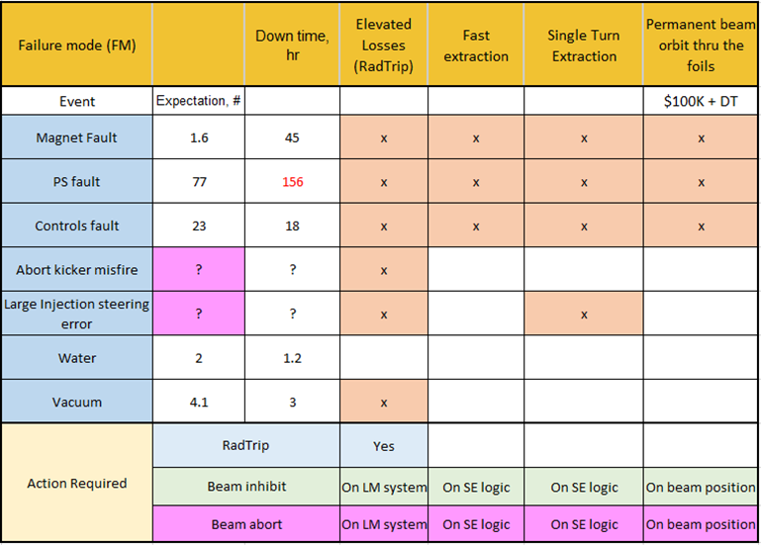
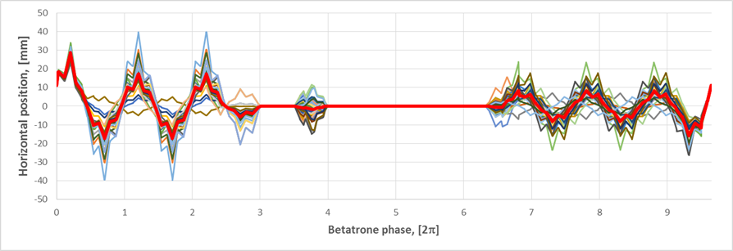
Independent Technical Design Review Recommendations - 2
A more comprehensive analysis of beam faults and their detection needs to be done, with a focus on building a realistic fault matrix.
Preliminary FMEA has been performed using projections from the MI downtime data
Comprehensive fault matrix has been built
Analysis is published in the Mu2e-docdb-7301
SVD solution space for the accidental “channeling mode”
Accelerator fault matrix

Slide 5
Independent Technical Design Review Recommendations - 3
Simulations need to have a better model of the apertures and an improved model to anticipate operational conditions.
Agreed
We’ve lost support of the Synergia simulation group
Working on developing pyOrbit tracking simulations

Slide 6
Independent Technical Design Review Recommendations - 4
Complete the design of the FSP ESS before CD-3 review.
We have completed development of the Full Scale ESS prototype solid model in NX based on a single spring retraction concept. Now working on preparations for its fabrication.

Slide 7
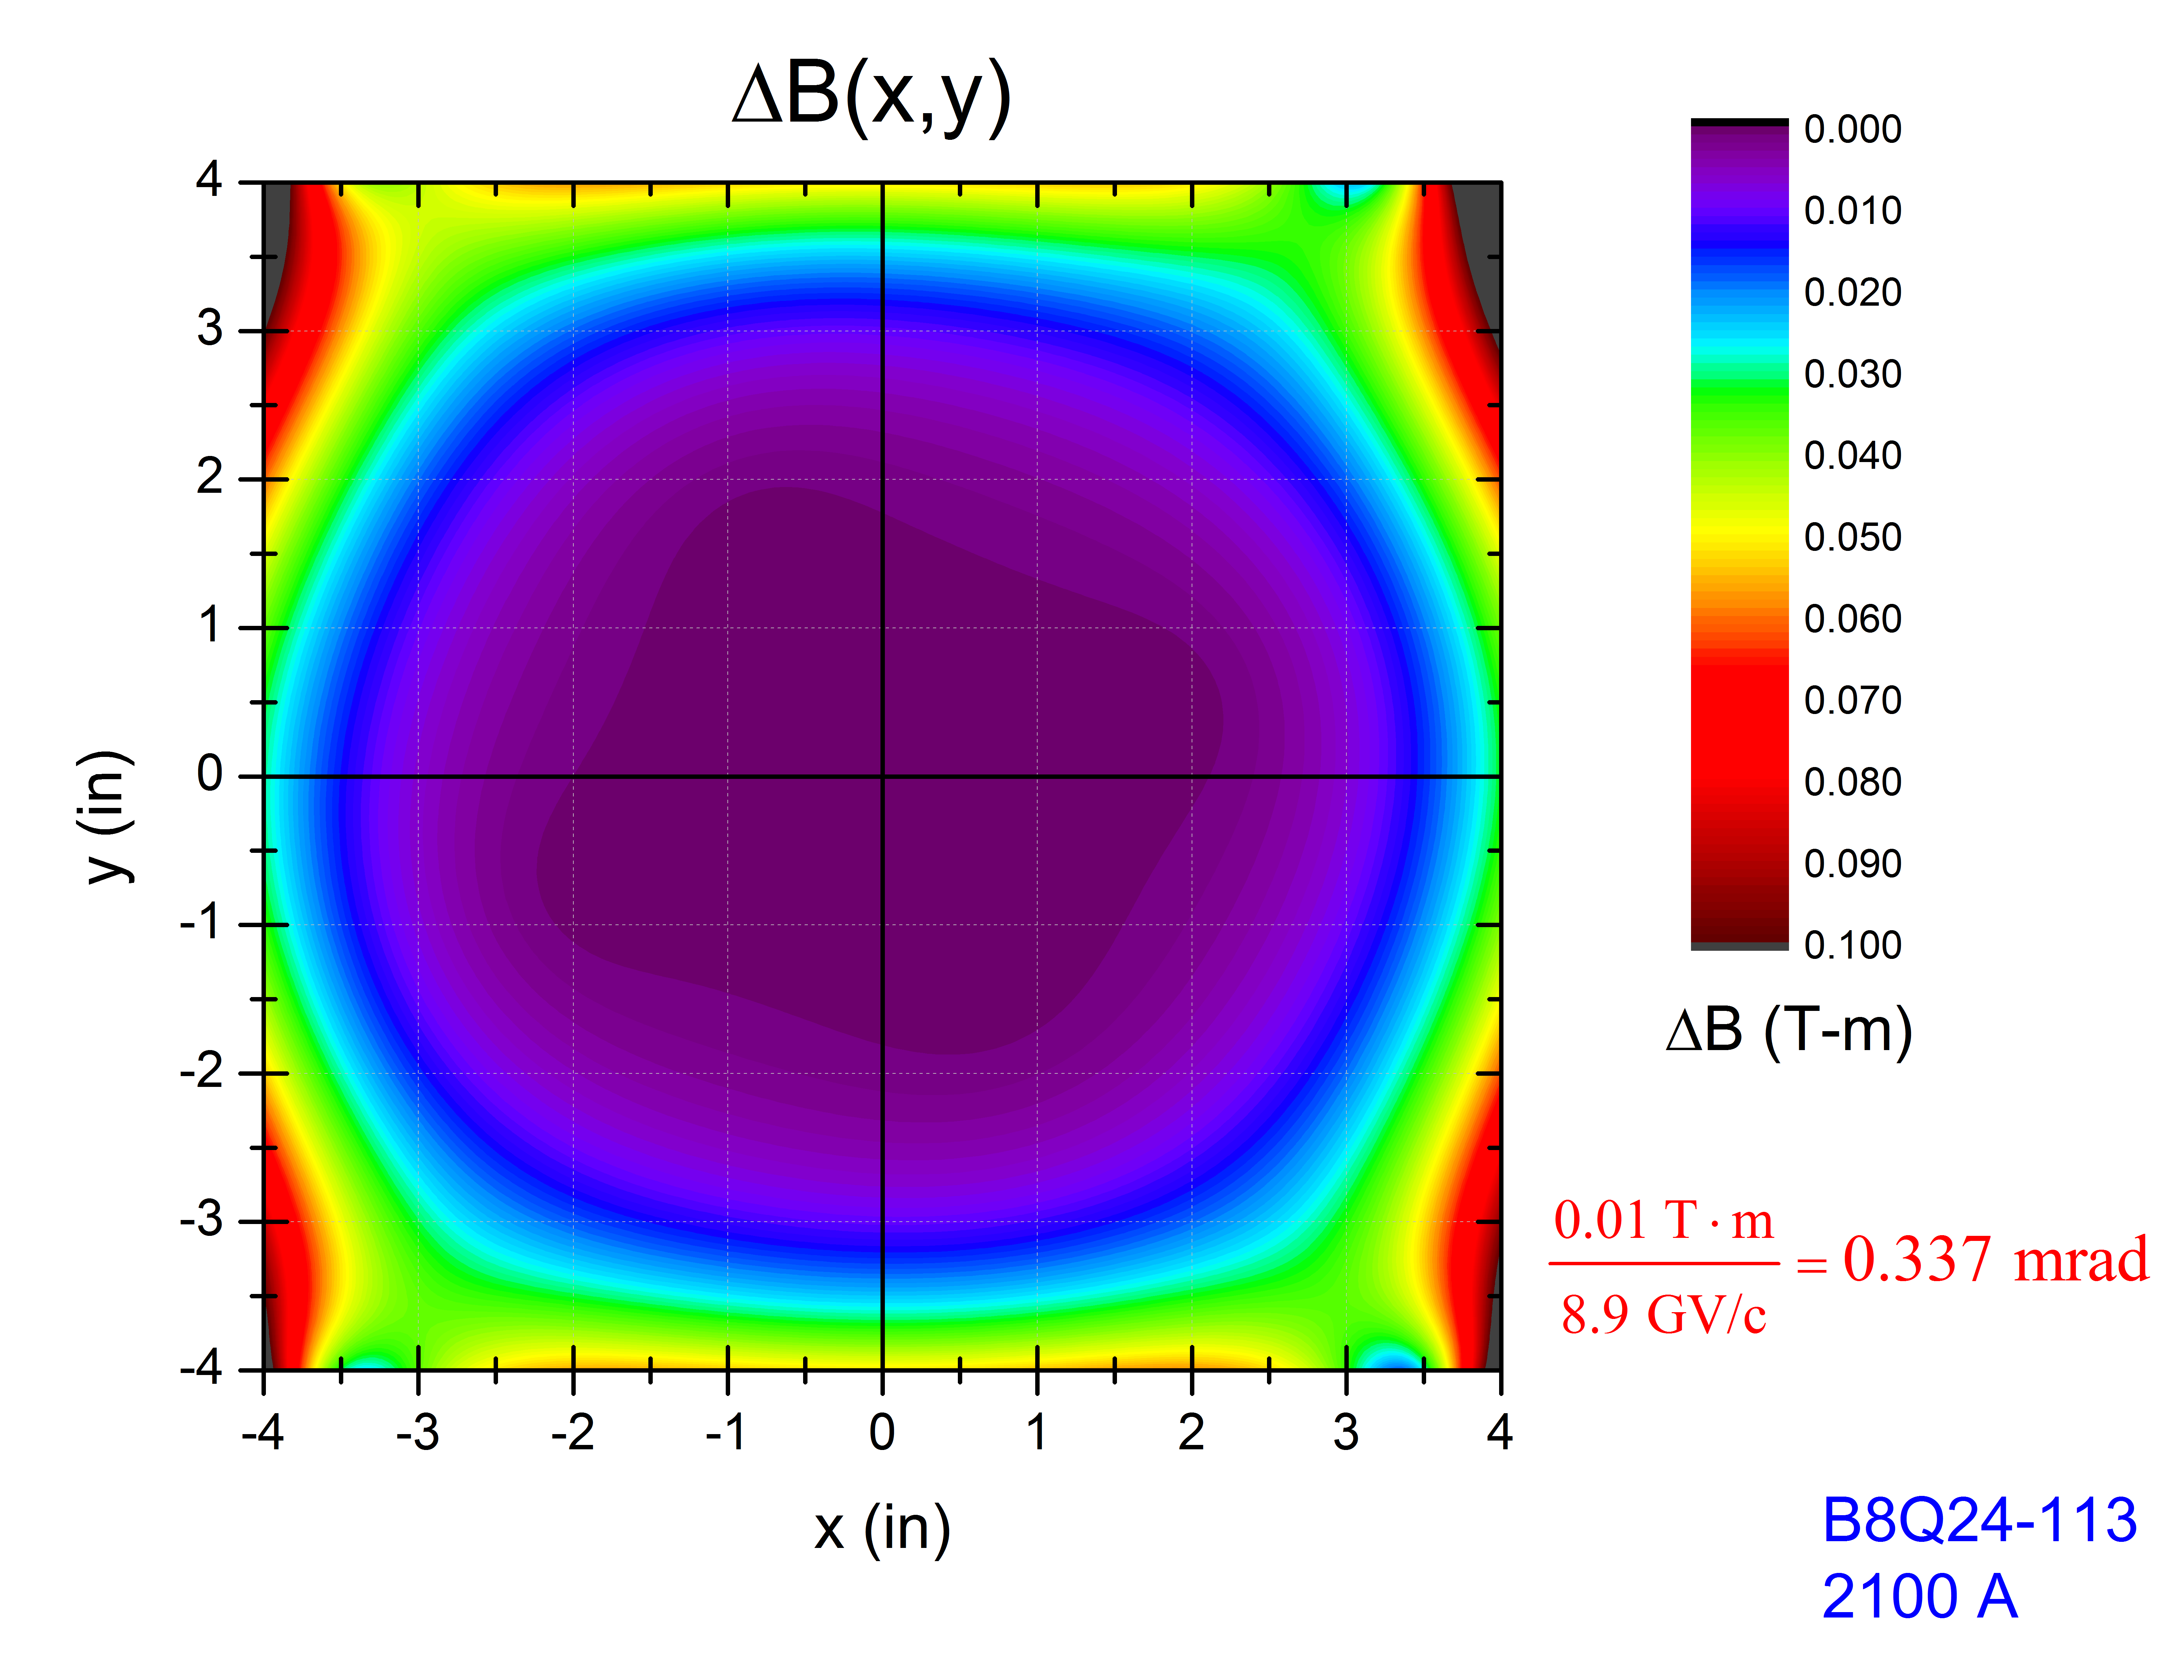
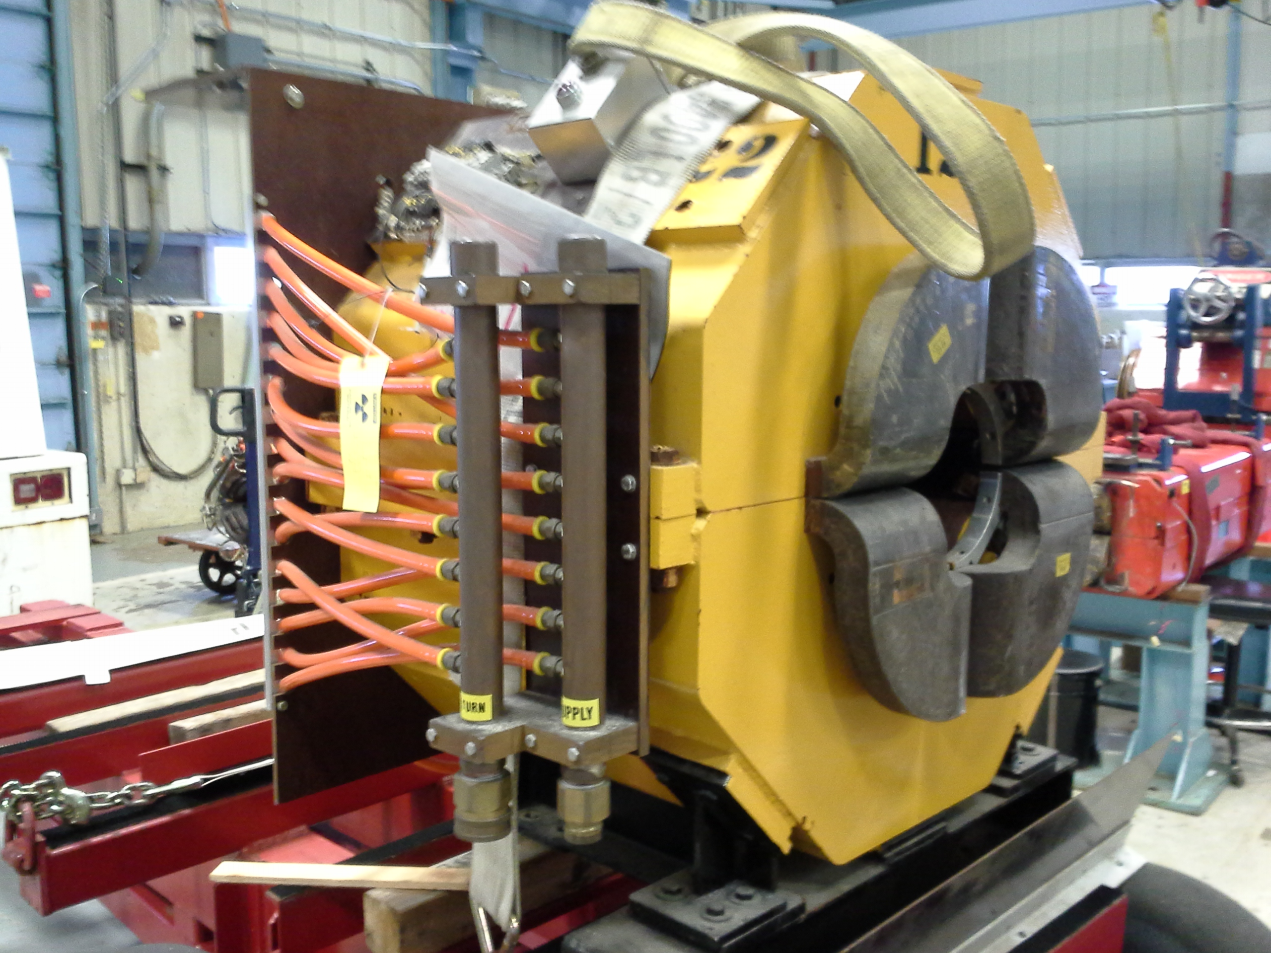
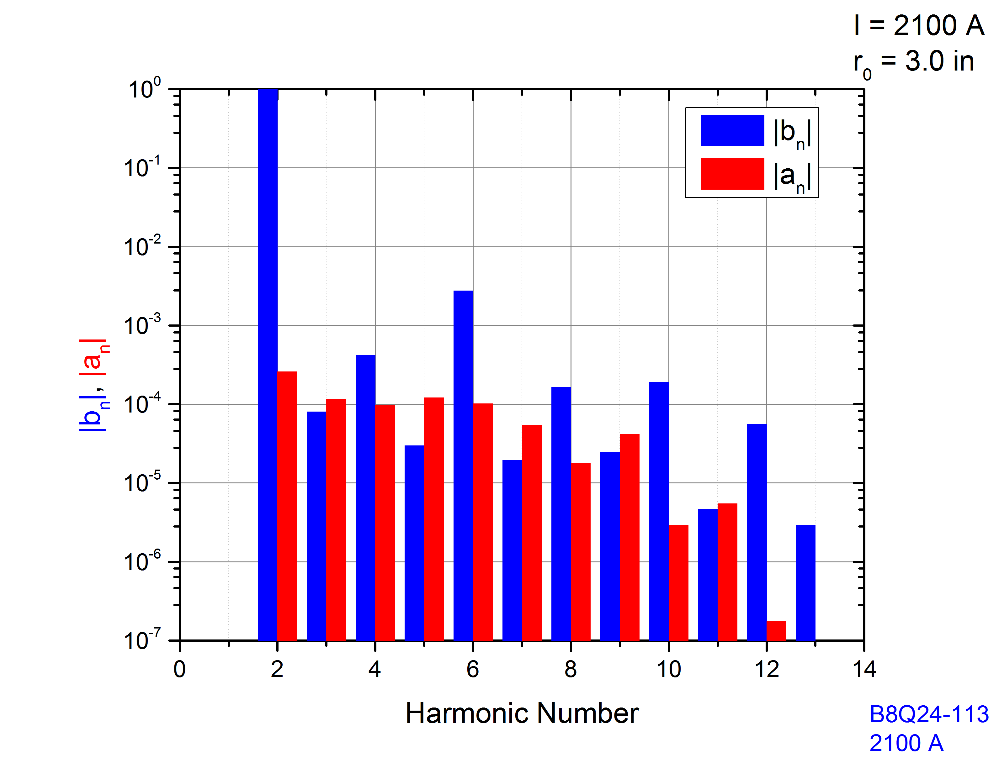
Independent Technical Design Review Recommendations - 5
The impact of poor field quality needs to be quantified.
The large aperture 8Q24 quad will be used in place of Q205 in the Delivery Ring
Effect of parasitic harmonics:
Distortions in the extracted beam phase space start to appear when harmonics are 1000 larger than measured
Magnet measurement data analysis performed by S.Werkema
x1000

Slide 8
Independent Technical Design Review Recommendations - 6
If found necessary, correct the field quality of the magnets to meet requirements.
2. A more comprehensive analysis of beam faults and their detection needs to be done, with a focus on building a realistic fault matrix.
Found not necessary

Slide 9
Independent Technical Design Review Recommendations - 7
Power supply ripple measurements need to be made to better determine the RFKO kicker strength, prior to construction.
Agreed. Will do the field ripple measurements when magnets are powered.

Slide 10
Beamline, Instrumentation & Controls Review
October 6-7, 2015

Slide 11
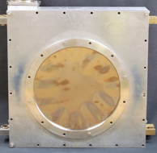
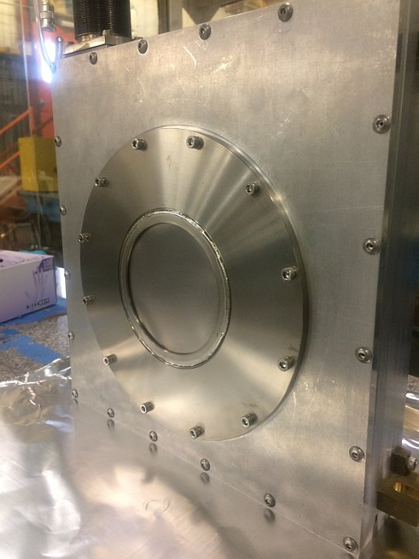
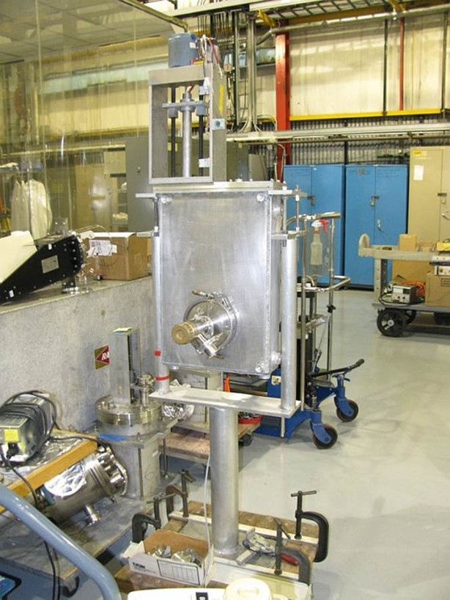
Independent Design Review
Beamline Design Review – Controls and Instrumentation
Date: Oct 6-7, 2015
Reviewers: Robert Webber, Paul Derwent
Comments
Instrumentation: The concern over the as-yet unproven vacuum window design is appropriate, but not a major issue for meeting project technical or schedule demands. The expectation is that a prototype will be ready for testing within a few weeks. There is adequate float in the Mu2e schedule should problems be discovered and the g-2 project needs a solution for this same design much sooner than Mu2e. The risk associated with deleterious effects on instrumentation of the production solenoid magnetic field is appropriately recognized and the need to resolve the concern is understood.
Old Design
New Design
A prototype ion chamber using the new vacuum window design was built and passed a two-stage vacuum certification test.
Beam studies are planned to test profile monitors in the production solenoid magnetic field (see next slide).
Vacuum Certified

Slide 12
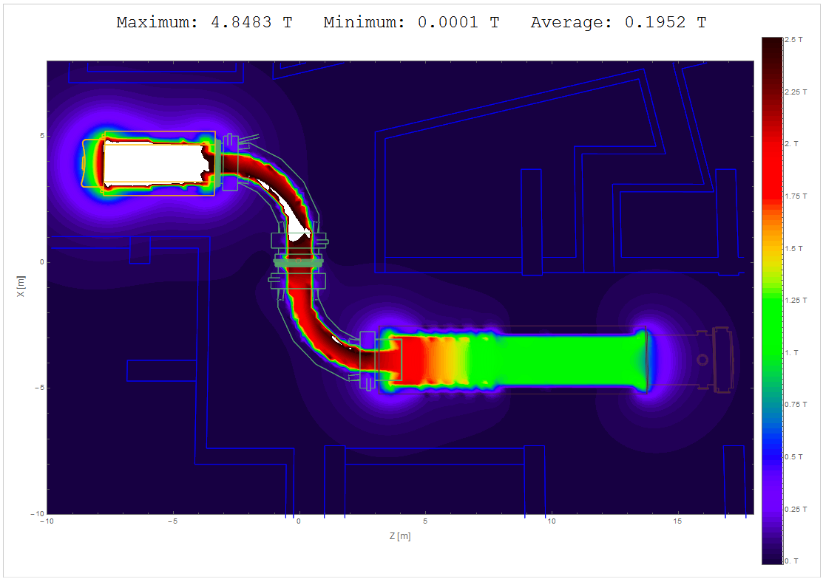
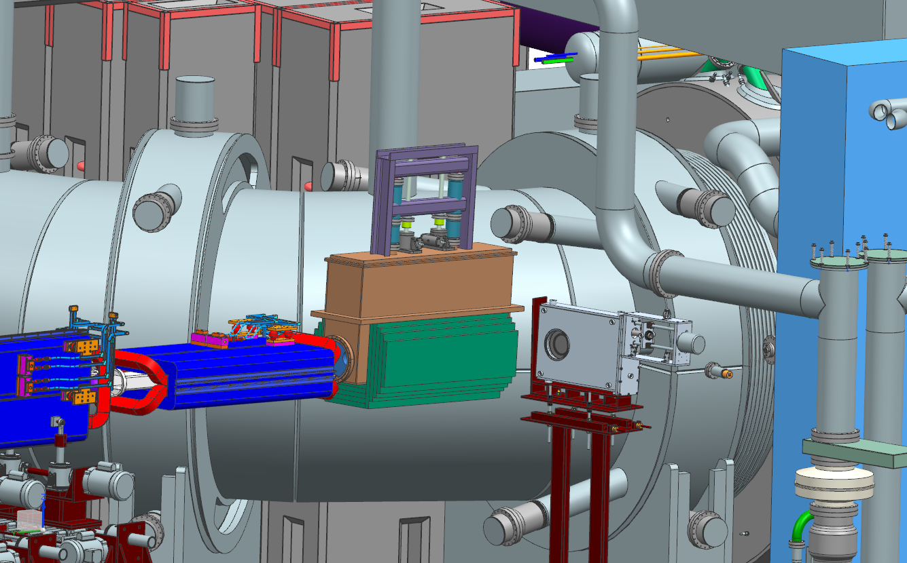
Design Review Comments & Recommendations
Beamline Design Review – Controls and Instrumentation
Date: Oct 6-7, 2015
Reviewers: Robert Webber, Paul Derwent
Recommendations
Pursue a location and test the remaining questions about the performance of the profile monitors in the fringe field of the production solenoid.
Various options were explored for testing a profile monitor in a 1.2Kg magnetic field. There are planned studies using MICE solenoid in the MTA beam line. We have added resources to the design scope in BCR029 to extend the MTA studies to include putting a multiwire in the beamline in the field of their solenoid. Instrumentation will locate and modify a spare multiwire for this test.
PreTarget MW:
1.2Kg magnetic field

Slide 13
Independent Design Review
An independent, external design review of the External Beamline and Controls & Instrumentation was held on Oct 6-7, 2015.
The review committee consisted of experts in accelerators systems, optics, mechanical engineering, controls and instrumentation
  Paul Derwent – FNAL (Chair)
  Herman Cease – ANL
  Giulio Stancari – FNAL
  Alexander Valishev – FNAL
  Robert Webber – Retired FNAL/ MSU
  Al Zeller – MSU (FRIB)
Review Proceedings can be found at https://indico.fnal.gov/conferenceDisplay.py?confId=10361
Final review report (Mu2e-doc-6239)

Slide 14
Design Review Charge Questions
Is the technical design of the Mu2e beamline, controls and instrumentation technically sound? Have all the principal issues been appropriately evaluated, simulation, and calculated? Are all these issues properly addressed in the design? Yes
What are the technical risks of the design? Have all of the technical risks been accounted for? Have these risks been properly evaluated and have mitigation plans in place? Yes
Is the technical design of the Mu2e beamlines, controls and instrumentation on track to satisfy the requirements for the DOE CD3 review in early CY 2016? Yes

Slide 15
Design Review Comments & Recommendations
Beamline Design Review – Optics & Lattice
Date: Oct 6-7, 2015
Reviewers: Alexander Valishev, Giulio Stancari
Recommendations
Perform error analysis of the beam line optics including the full set of imperfection: magnet tilts, field calibrations and if practical, higher order field effects in the Delivery ring extraction and final focus sections.
Do a beginning-to-end integrated calculation, including the effect of Production Solenoid on the optics of the final focus and beam transport.
Work is in progress with completion in June 2016
Eliana Gianfelice-Wendt
Status – In Progress
The solenoid field from the production solenoid transport matrix have been incorporated into MADX. Currently, performance testing the transverse and longitudinal parts for confidence and accuracy.
Eliana Gianfelice-Wendt
Status – In Progress

Slide 16
Design Review Comments & Recommendations
Beamline Design Review – Technical Components
Date: Oct 6-7, 2015
Reviewers: Al Zeller, Herman Cease
Recommendations
Recheck the radiation transport calculation to ensure the final focus elements do not require radiation resistant coils.
Verify that activation of the LCW flowing through the HRS will not introduce radioactive contamination issues when that water is mixed with the general LCW system. In particular, the LCW is also used to cool the SCR power supplies not in the tunnel.
Residual dose rates for the PS and RHR floor are calculated in Mu2e-doc-5572. Estimates of 1.5 Rad/hr are calculated for the PC (protection collimator) downstream of the last M4 beamline dipole magnet HT943. Integrated dose for 10 years at the PC would be 131k Rad/10 years. This is a very conservation estimate for HT943. Radiation tolerance for this CDA dipole is much greater.
T. Leveling, D. Still
Status - Complete
MARS simulations for the production of Tritium in the cooling water and HRS have performed and documented in Mu2e-doc-3000. The document concludes that tritium would build up in the HRS water system to the level <<< 1μCi/cc after 3 years of continuous running. These levels do not pose concern for water circulating through the LCW return.
Deshpande, T. Leveling, D. Still
Status - Complete

Slide 17
Design Review Comments & Recommendations
Beamline Design Review – Technical Components
Date: Oct 6-7, 2015
Reviewers: Al Zeller, Herman Cease
Recommendations:
Prepare a justification of the vacuum requirements that can be presented at the CD3 review.
Vacuum specification for the beamline is 1.0x10⁻⁷ Torr. Calculations estimated that there are no emittance growth issues for the range of vacuum pressures proposed for the beamline. There are no issues for single or multiple scattering at these pressures with or without the insertion of scattering material from instrumentation(mainly multiwire foil). However, scattering in residual gas for extinction is much more delicate. Estimates for the beamline vacuum pressure based on extinction beam have been estimated that a vacuum pressure better than 1.0x10⁻⁴ Torr is needed. 1.0x10⁻⁷ Torr is consistent for reusing much of the antiproton vacuum hardware. Also, estimates for
V. Nageslav, E. Prebys, D. Still
Status - Complete
Comments:
Using an existing SDC dipoles instead of new construction (of MCD dipole) is worthwhile exploring further.
  Agree and will use SDC.
Develop a more detailed installation plan prior to the CD-3 review would be beneficial.
  Agree and have implemented and processed a BCR for detailed schedule changes.
Continue work on reducing the ± 0.8° requirements for target scans, as this will alleviate some problems with bellows and other components.
  Requirement has changed to ± 0.15° removing need for movable devices and challenges to bellows and instrumentation.

Slide 18
Design Review Comments & Recommendations
Beamline Design Review – Risk & Management
Date: Oct 6-7, 2015
Reviewers: Al Zeller, Paul Derwent
Recommendations
Retain in the risk register all risks identified in the Technical Design Report or address as retired. This ensures that none of them slip through the cracks.
Some risks in the TDR are not viewed as risks and are not tracked in the risk register. Risk register is complete and up to date.
Dean Still
Status - Complete

Slide 19
Radiation Safety Review
October 20, 2015

Slide 20
Recommendations and status
    4 – update documentation: Preliminary Shielding Assessment
    6 – calculations: input checks, repeat calculations by alternate methods
    3 – ODH related
    2 –consultation: receive advice from AD ES&H department

Slide 21
Accelerator Radiation Safety Improvements Independent Technical Design Review |  | Tuesday, October 20, 2015
# | Recommendations | Actions/Response | Responsible Parties | Status
1 | Recommend that as new shielding analysis is completed, that those documents be added to the applicable PSA document database entry for inclusion in the final shielding assessment. | The additional simulations found necessary during construction and any new shielding analysis work will be added to the applicable PSA document database entry. | Radiation Safety Improvements Level 3 manager | In Progress
2 | To facilitate the final Shielding Assessment (SA) Review, Safety Assessment Document development, and Accelerator Readiness Review processes, it is recommended that the Mu2e Shielding Assessments cover the entire assessment boundary of their primary and secondary beam from the AP1/MI line extraction critical devices in F sector through the experimental hall. | We will plan to proceed along these lines when the final shielding assessment is eventually written. | Muon Department | In Progress
3 | The final SA should cover or list all the penetrations within the assessments boundaries. The PSA appears to be missing the penetrations from the enclosure to the AP-10, 30, and 50 service buildings and the site riser penetrations. | The service building penetrations are meant to be covered by the following statement in which worst cases beam losses were created to measure the response of chipmunks through shielding above the loss point and simultaneously at nearby penetrations:“Two specific penetration/shield measurements were made and documented for the 2000 pbar shielding assessment at AP30 and AP50. In both cases, the effective dose rate through the shield was higher than that measured at the exits of penetrations." Delivery Ring site riser penetrations were filled with polyethylene beads during the 1991 shielding assessment. These points will be reported in the Final Shielding Assessment. | Muon Department | In Progress
4 | Beams Doc 4611 and Beams Doc 4513 sections 2.2.7 to 2.2.9, are practically identical sections, word for word. Clearly this is a style comment, however even with this now known, the number for the exhaust fan changes from 800 to 900 respectfully. Recommend that the fan speed be defined and consistently used within the final SA and associated supporting analysis documents. | Air parameters for the mu2e target station and M4 beam line are still under development. We will report the complete picture of the entire air flow scheme in the Final Shielding Assessment. | Integration Manager, Project Mechanical Engineer, Radiation Safety Improvements L3 manager, Muon Department | In Progress
5 | Beams Doc 4494-v7 is the justification for the critical devices that clearly describes the lack of primary transportation of protons. However it doesn’t analyze where the lost beam would go, and the areas affected, such as prompt dose rates into the MC-1 since its occupancy status is unclear. Recommend updating the analysis with the effects of the beam loss in the critical device. | The present plan is that all muon campus beam lines will be equipped with TLMs. The requirements for critical device justification is that no primary beam transport will be possible. The devices described in 4494-v7 meet this requirement. The total loss of 8 GeV primary proton beam due to the beam inhibiting action of a critical device will rapidly produce a TLM excessive charge trip to inhibit beam. The entry controls required for access to the MC-1 service building during beam transmission to the M4 line remain to be determined. An analysis of the M5 line shield will be required for the muon campus final shielding assessment for mu2e operation. In this final assessment, the entry controls, interlocked detector settings, and radiological postings will be defined to establish access conditions for the MC-1 experimental area. The goal is to permit access to the MC-1 service building while 8 GeV beam is delivered to the mu2e experiment. | Muon Department | In Progress

Slide 22
Accelerator Radiation Safety Improvements Independent Technical Design Review |  | Tuesday, October 20, 2015
# | Recommendations | Actions/Response | Responsible Parties | Status
6 | Beams Doc 4513 Section 2.2.1, 40 mrem/hr is high for a DC rate of beam loss. This section calls out that the building will be posted as a Radiation Area. The parking lot dose rates are also noted as several mrem/hr and additional shielding or fencing could be used if necessary. Recommend initiating discussions with relevant stakeholders and the AD Operational RSO to determine the access limits and operational effects. | The simulation work for this area needs to be repeated since the extraction system and related component designs have been modified. In the next simulation, the prototype extraction system design will be modeled and the concrete building panels and “steel windows” will be included for a more accurate simulation. A third simulation effort will be required when the final extraction system design will be completed. It will be timely to act on the committee’s recommendation upon completion of the simulation work. Additional scope was added in BCR 26 to complete this work | Radiation Safety Improvements Level 3 manager, ADRSO | In Progress
7 | Recommend the ODH analysis calculations be completed, identify the location of air isolation curtain locations, and how the air isolation curtains affect the movement of radioactivated air. | This work is in progress. The ODH configuration for beam on operations will be different than during the commissioning phase when radioactivated air will not be produced. The designation of ODH areas for the Project phase will differ from those during the operations phase. | Integration Manager, Project Mechanical Engineer, Radiation Safety Improvements L3 manager | In Progress
8 | Recommend identifying which organization, AD or PPD, is responsible for enclosure oxygen monitoring. | This work is in progress. Some progress has been made. The responsibility for ODH will be divided between PPD and AD. | PPD/AD Department Heads | In Progress
9 | Recommend either AD or PPD be responsible for all tunnel oxygen monitoring. | This work is in progress. This recommendation has been considered and rejected. All parties now agree that landlord divisions must be responsible for their areas | PPD/AD Department Heads | In Progress
10 | Recommend initiating discussions with the AD Operational RSO to determine where operational airborne activation monitoring will be needed and where that scope fits into the overall project structure. | These discussions have taken place. The BOE for air monitoring has been modified to add an air monitor for the PS room in addition to one located at the air emissions stack exhaust. | Radiation Safety Improvements L3 Manager, ADRSO | In Progress

Slide 23
Accelerator Radiation Safety Improvements Independent Technical Design Review |  | Tuesday, October 20, 2015
# | Recommendations | Actions/Response | Responsible Parties | Status
11 | Groundwater and surface water was covered in section 2.2.7 and 2.2.8, with a reference to document Mu2e Doc 1553. However this document did not cover the AP-30 extraction region where a known loss point occurs. In addition this document, 1553, reflects earlier versions of MARS and earlier versions of the construction design of the facility. Recommend updating both the MARS model to the current civil design and adding the MI-30 extraction region the groundwater and surface water activation analysis. | This work will be completed in conjunction with the work described in Recommendaiton 6. | Radiation Safety Improvements L3 Manager | In Progress
12 | In the FESS review of the proposed in tunnel shielding for the MI-30 resonant extraction region, Mu2e-doc-6152_ADMSD14-001_FESS_Review.pdf, the reviewer "TL" stated "I have not performed a numerical check but a detail check should be made. The bearing on the concrete slab shall be limited to 1400 psi." It is recommended that this detailed check be performed and documented. | This calculation will be made and the result will be included in Mu2e-doc-6152 | Cory Crowley | In Progress
13 | It is mandatory that prompt dose and air activation MARS simulations are always done down to thermal neutron energy of 1.e-12 GeV. The committee has checked this for a few cases, but recommends to be sure that this is always the case. | A checklist will be made of simulation work presented to the review committee. The input files for the simulations will be checked to verify the correct settings were made to account for low energy neutrons (ENRG 5=1.0E-12). Additional scope was added in BCR 26 to complete this work | Radiation Safety Improvements L3 Manager, with independent checker | In Progress

Slide 24
Accelerator Radiation Safety Improvements Independent Technical Design Review |  | Tuesday, October 20, 2015
# | Recommendations | Actions/Response | Responsible Parties | Status
14 | It is mandatory that all calculations in the categories presented at the Review are done with one of the two variance-reduction techniques in the MARS code: (1) A track-length probability scoring mode, INDX 6=T, or (2) Multi-stage method. Each of these has its own pros and cons. The first one is more appropriate for thick shielding of complex geometry, provides accurate estimate of statistical errors, is easy to use, but can be more CPU-time consuming. The second one requires less CPU time, but more human efforts with calculation of correct statistical errors being a non-trivial task. At high statistics, both methods converge to the same result. All the results presented at the Review are obtained with the second method that is quite acceptable for the configurations and shielding thicknesses considered in the project. The committee recommends to run MARS with the first method for one of the cases with thickest shielding to check for the consistency of the results and statistical errors. | This additional work will be undertaken when time permits. Additional scope was added in BCR 26 to complete this work | Radiation Safety Improvements L3 Manager | In Progress
15 | An advanced module newly developed for very detailed air activation calculations will be available in the next release of the MARS15 code in November. It is recommended to redo with the new version one of the typical simulations presented at the Review to see a possible difference in the results and rescale the earlier data if needed. | The PS room air activation simulation will be undertaken using the MARS advanced module when time permits. Additional scope was added in BCR 26 to complete this work | Radiation Safety Improvements L3 Manager | In Progress

Slide 25
Extinction and Extinction Monitoring Review
November 2-3, 2015

Slide 26
Extinction Technical Review
The Extinction and Extinction Monitoring Technical Review was held in November, 2015*. Reviewers:
  Ed Blucher, U of Chicago (chair): Extinction Monitoring
  Stefano Redaelli, CERN: Collimation and Extinction technique
  Mark Jaski, ANL: Magnet design
From the final report:
  The reviewers were impressed by the quality of the presentations and by the amount of work performed. The speakers presented their results in a clear and complete way.
  The reviewers agree that the proposed extinction solution seems adequate to fulfill the design specification. However, there are some comments and suggested checks.
*Mu2e-Doc-6356 (includes link to Indico Page)

Slide 27
Extinction Review Recommendations
The committee recommends building a 1 m, 18 mm gap prototype magnet.
  This activity was originally planned as part of production, but because the gap was increased from 12 to 18 mm, the committee felt it was important to build the prototype prior to full production
  The design of the prototype vessel is now complete, and it will be built and tested prior to production.
The committee recommends the early development of a commissioning plan for the full extinction and monitoring system
  We have written a commissioning document (Mu2e-DOC-7290)
  We will continue to refine this and coordinate it with the rest of the beam line commissioning

Slide 28
Extinction Recommendations (cont’d)
It is therefore recommended to setup simulations with realistic errors and estimate better the impact on extinction efficiency from over-populated longitudinal tails, or outof-bucket particles, in the DR.
  These studies are ongoing, with the goal of finalizing the tolerances for the beam line optics and collimator position accuracy.

Slide 29
Target, Target Handling, and HRS Review
November 18, 2015

Slide 30
Design Review Comments & Recommendations
Target, Remote Handling, and HRS Design Review
Date: Nov 18, 2015
Reviewers: John Anderson, Franz Gallmeier, Mike Dayton, Van Graves, Jim Hylen, Bob Zwaska
Recommendations
HRS stagnant water next to the welds in the maximum radiation area may accelerate corrosion in the welded areas, leading to a leak into the vacuum space. This risk needs to be evaluated.
The solenoid design needs to be reviewed to assure it can support the weight of the HRS during installation.
Mu2e Document 6258
A fluid simulation was performed which indicates the maximum dwell time of water in the HRS is only a few hours under very conservative assumptions so the level of stagnacy is minimum(Mu2e Document 6409). Fermilab welding experts were also consulted on quality control of the welding. The conclusion was given the thickness of the stainless steel tank, quality control of welds and water flow that a leak due to corrosion should not occur.
The stress due to the weight of the HRS on the PS bore tube has been calculated to exceed the allowable stress by the PS contractor (General Atomics). The high stress in current models is under the arc bearing attached to the HRS. Fermilab has performed an independent finite element analysis with a modified arc being. Increasing the size of the arc bearing results in an allowable stress (Mu2e Document 7288). This design change has been sent to GA for their re-analysis.

Slide 31
Target, Remote Handling, and HRS Design Review Recommendations (continued)
Further develop all the remote handling room monorail operations. Using a standard hoist with no hook rotate feature will significantly affect operations along with the design of the lifting fixtures and components being lifted
Remote handling system Instrumentation and Controls design, including the operator control station, should be considered in the near term to better understand ramifications on the hardware design. Considerations should include feedback sensor requirements.
Consider remote viewing needs. The single borescope on the remote handling system may not be adequate for totally remote operations. Additional cameras on the remote handling system will likely be required. All this may dictate a more sophisticated viewing station.
We had considered previously the possibility of using two trolleys on the overhead rail with all payloads lifted by two separate cables (thus preventing free rotation). We will continue looking into this option, as well as the possibility of using a low-profile hook rotate feature on a single trolley.
Most of the motion control sensor requirements have been identified – all pneumatic motions to have end-of-stroke sensors at both ends of travel, all servo axes to have a home position sensor plus hard stops and limit switches at both ends of travel, servo motors to utilize closed loop position-feedback with a resolver mounted to the back of the motor, torqueing of the window bolts to be controlled using a servo motor and torque transducer, plus LVDT bolt position feedback. That being said, we do intend to bring a motion controls engineer onto our RH project team in the near future.
The borescope is not intended to be the only camera for the RH system, although it may have been the only one mentioned in the presentations. We are planning to have several cameras, although exactly how many and where is still TBD. At minimum, there will be: (a) the borescope on the target module EOAT, (b) at least one other camera mounted further back on the target module, likely of the zoom/pan/tilt variety, (c) a camera mounted to the X/Y/Z stage of the window module for looking at the target soon after the window is removed, (d) at least one other camera mounted further back on the window module, also of the zoom/pan/tilt variety, (e) at least one zoom/pan/tilt camera mounted in the RH room near the doorway for watching the RH module operation from the side, (f) more cameras possible. The number of viewing screens at the operator’s workstation will be one per camera being used.
Ryan will address these responses in the next talk

Slide 32
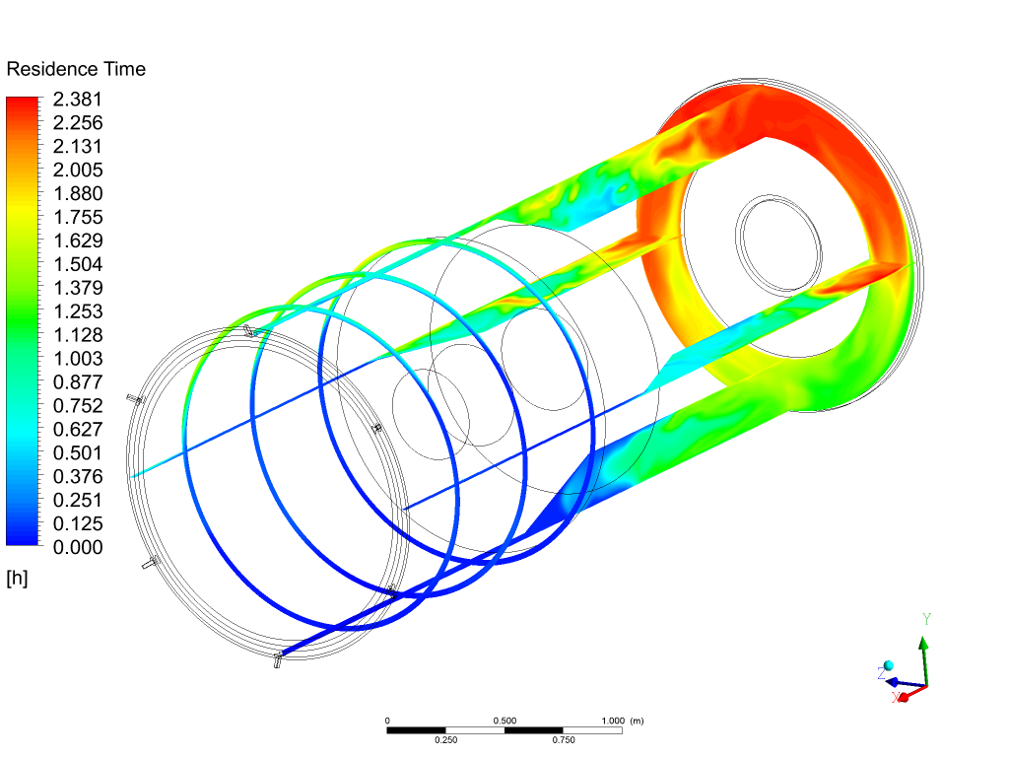
HRS Water Residence Time – Main Water Volumes
(With heat load, which assists by buoyant mixing)
HRS Thermal Fluid Simulation
Erik Voirin, Zhijing Tang
Mu2e Doc. 6409
Dec 2015
(hours)
Flow in Bronze Gaps Also
Estimated with Purge Time of ~ 8hrs
See Document for details

Slide 33
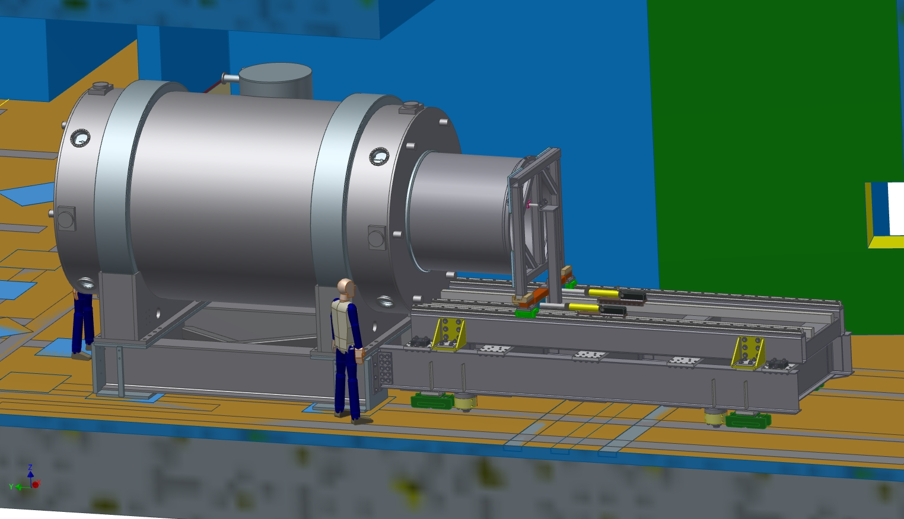
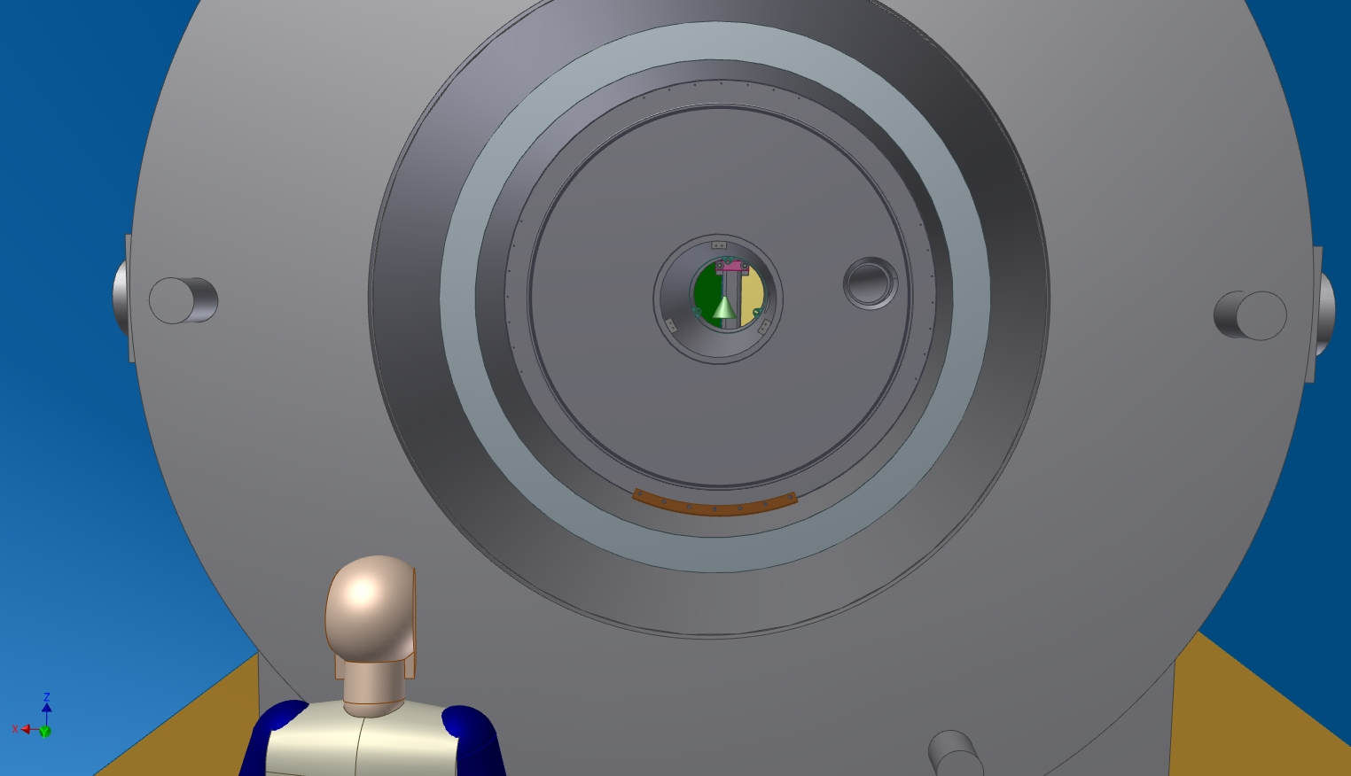
Stress on PS cryostat during HRS installation
Slides from L. Bartoszek
Tech. Design Review
https://indico.fnal.gov/conferenceOtherViews.py?view=standard&confId=10650
arc bearing
120 degree
supporting
arc bearing
Max von Mises Stress for 44 mm Wide Bearing is
136 MPa (19.7 ksi)
PS contractor General Atomics
found stress > 20 ksi (code req.)
too high on PS vacuum vessel
shell
45 degree
supporting
arc bearing
opposite end
of HRS from
insertion
fixture

Slide 34
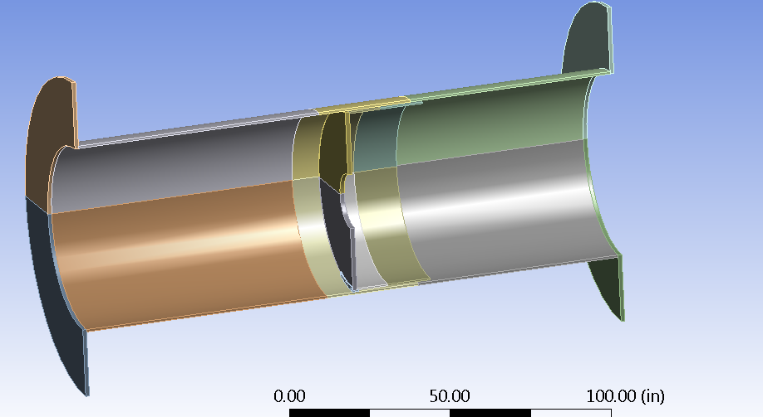
HRS Load on PS
PS Inner Bore Subject to HRS Load
Ang Lee,Mu2e Doc. 7288, April 2016
After GA analysis, meetings with Tom Page, Larry Bartoszek, and Ang Lee resulted in a new
analysis with a modified design for HRS arc bearing
Case Arc angle of the bearing plate | Maximum stress of PS inner bore _ transport position (ksi)
45 degree | 42
90 degree | 23.5
120 degree | 16.4
150 degree | 10.6
Maximum Stress when HRS
at middle transport postion
1) It seems that the increase the arc length of the bearing plate can effectively reduce the stress of the PS inner bore. GA (ref_1) uses 20 ksi as the allowable stress for the inner bore.
2) The middle transport position is the worst case.
3) The bearing plate has a high stress concentration (singularity) at its edge due to 90 degree sharp angle. If a corner radii or round edge is given, the stress can be reduced significantly.

Slide 35
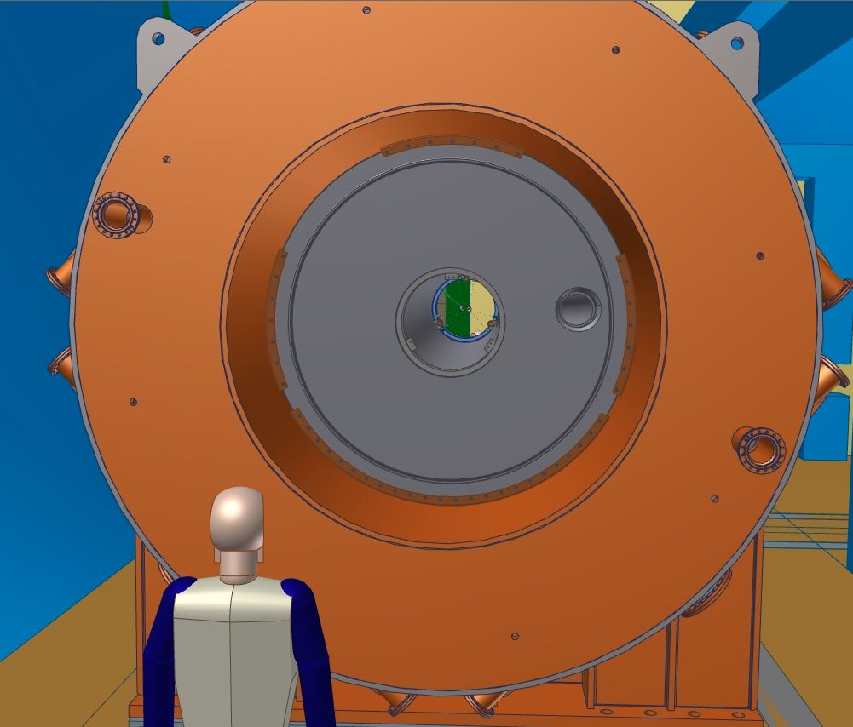
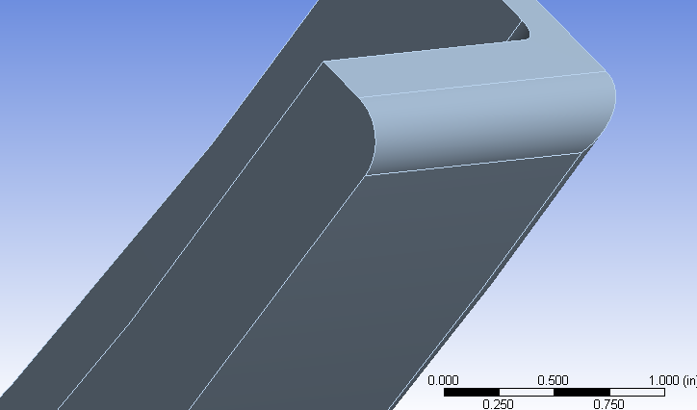
Modified HRS arc bearing design
arc bearing
120 degree
supporting
arc bearing
120 degree
supporting
arc bearing
Rounded edges
supporting
arc bearing
Max von Mises Stress for 44 mm Wide Bearing is
136 MPa (19.7 ksi)
Expect some more improvement
with rounded edges
45 -> 120 degree
42 ksi -> 16 ksi
rounded edge
supporting
arc bearing

Slide 36
Delivery Ring RF Review
November 19, 2015

Slide 37
Independent Design Review
An Independent Design Review of the Mu2e Delivery Ring RF was held on November 19, 2015.
The review committee consisted of experts in accelerator systems.
  Craig Drennan - Fermilab Booster
  David Peterson - former Fermilab Antiproton Source
Review Proceedings can be found at:
  https://indico.fnal.gov/conferenceDisplay.py?confId=10838
Final Review Report (Mu2e-doc-6861)

Slide 38
Independent Design Review
Recommendation 1a : The final base timeline, as well as any alternate timelines must be specified, worked into the LLRF system design and documented for the CD-3c review.
Response : Beams-doc-4854 was written and submitted to Program Planning. The final base timeline will be decided by program planning. The LLRF Mu2e-doc-1776 covers all that is known at this point in time.
Status : In Progress

Slide 39
Independent Design Review
Recommendation 1b : Additional simulations should be performed to include the phase and energy variations. Simulations using the Recycler Ring model should be performed with the inclusion of the cavity impedances. The effects of the Higher-Order Modes of the cavities should be investigated. The documentation of the simulations needs to be updated for the CD-3c review.
Response : Steve Werkema has completed the ESME simulations. A formal document will be ready for the DOE CD-3c review.
Status : In Progress

Slide 40
Independent Design Review
Recommendation 1c : The beam studies that the experiment and the Accelerator Division would like to be capable of performing must be specified and the final configuration of the LLRF system must be determined and reviewed. Considerations for beam study modes must also include radiation shielding limits..
Response : Necessary beam studies for the transition to operations (WBS – Delivery Ring RF Studies & Tuning) will be carried out when they have been determined. Recommendations will be implemented at the time of studies.
Status : Closed

Slide 41
Independent Design Review
Recommendation 2c : The risk that the final system design will not have the flexibility to implement the accelerator beam studies desired. Recommendations are found elsewhere in this reviewers’ response.
Response : The Accelerator Division Low Level RF Department has investigated this and a formal response will be posted in the document database. The formal response is located in Mu2e-doc-7176
Status : Closed

Slide 42
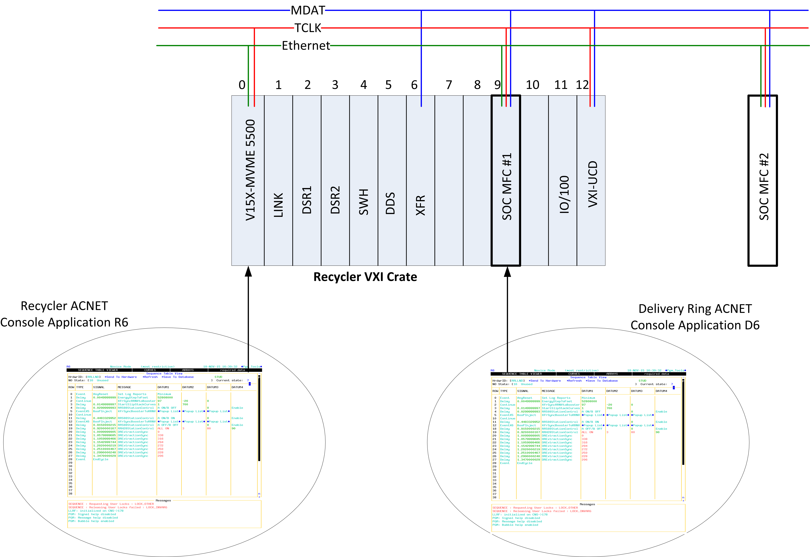
Independent Design Review
Independent Control of Delivery Ring LLRF
Slide from
Mu2e-doc-7176

Slide 43
Independent Design Review
Recommendation 2d : Recommendations are found elsewhere in this reviewers’ response.
Response : Recommendation (2d) will be closed once recommendations 1a, 1b, 1c, and 2c have been closed. Nearly complete (as of 4/7/16)

Slide 44
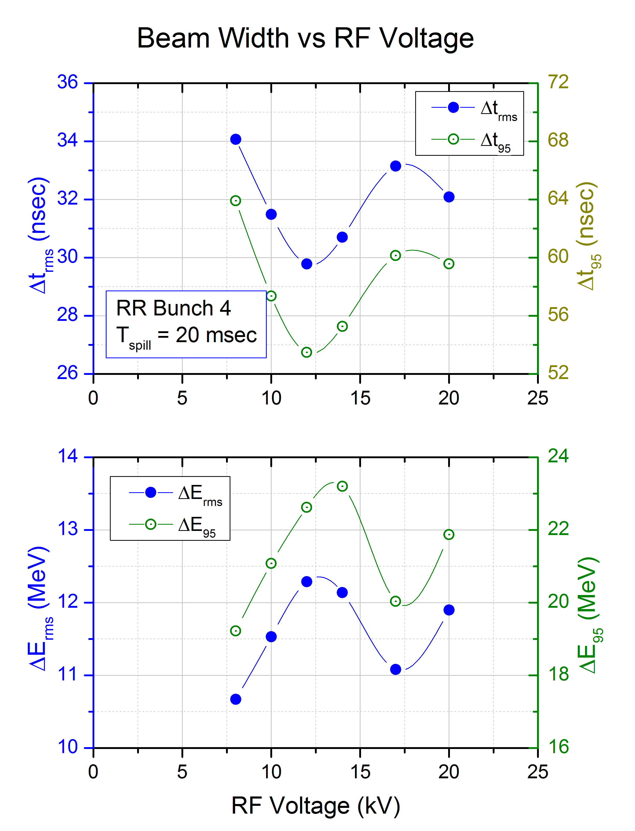
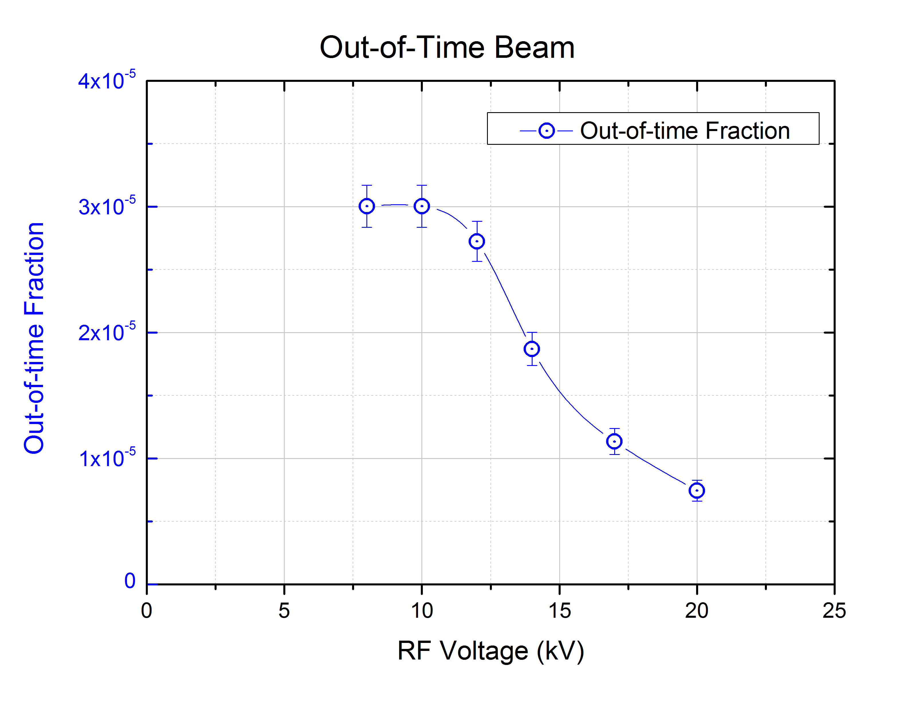
Delivery Ring RF Voltage Studies
Nominal V_{rf} = 10 kV
Extinction improves with increasing voltage and does not degrade when voltage is decreased to 8 kV

Slide 45
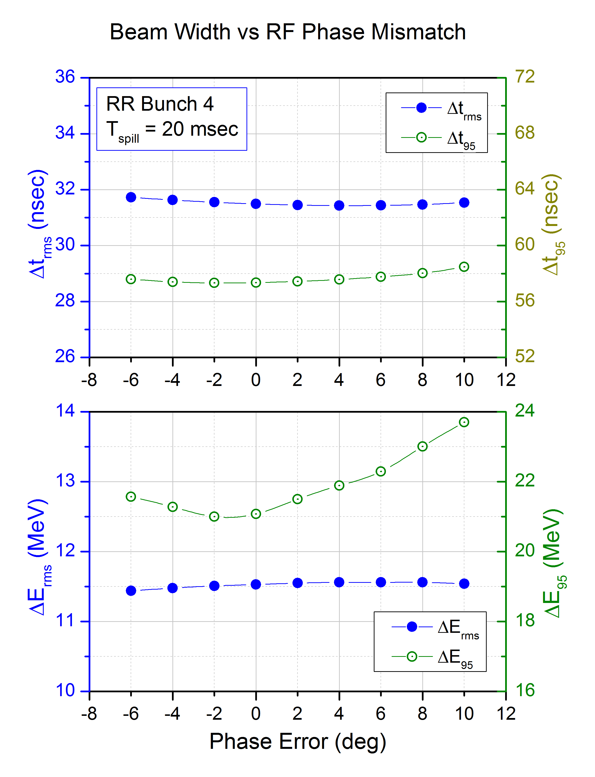
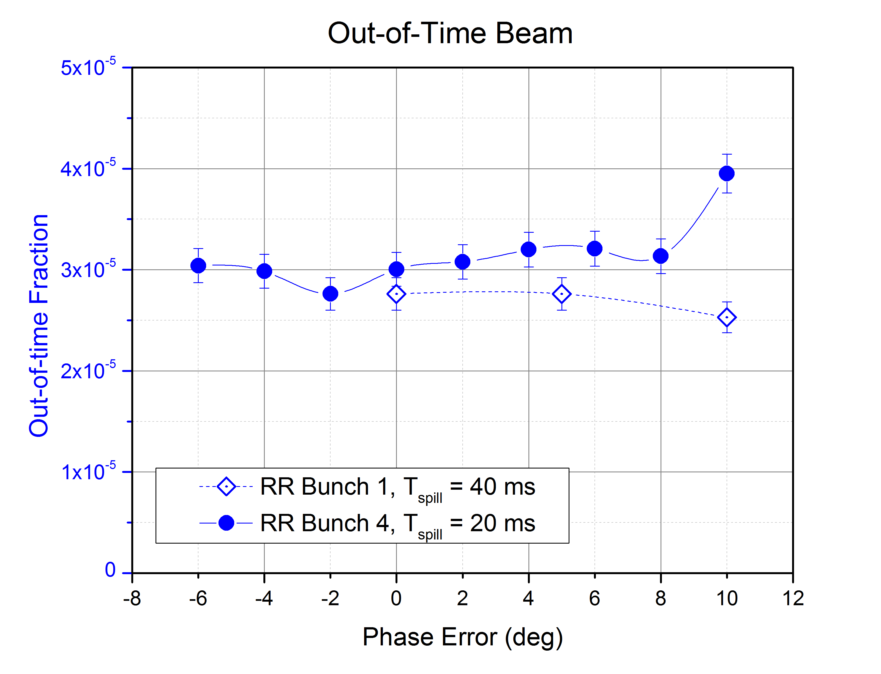
RR-DR Phase Mismatch Study
Phase mismatch of less than 10° does not appreciably degrade extinction.
Beam energy and time widths are not appreciably affected by mismatch of less than 10°

Slide 46
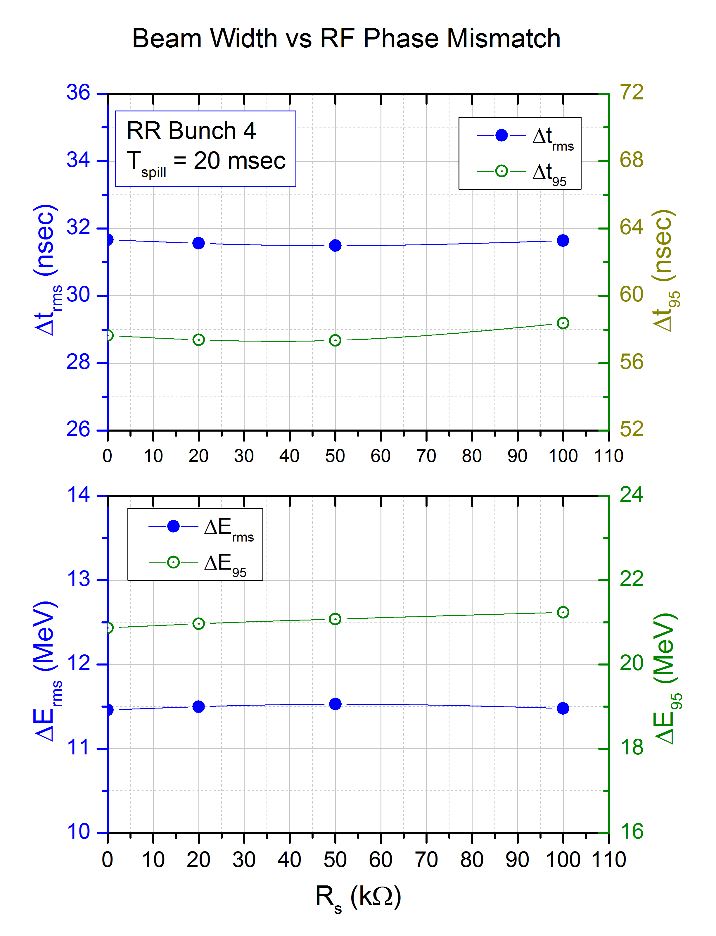
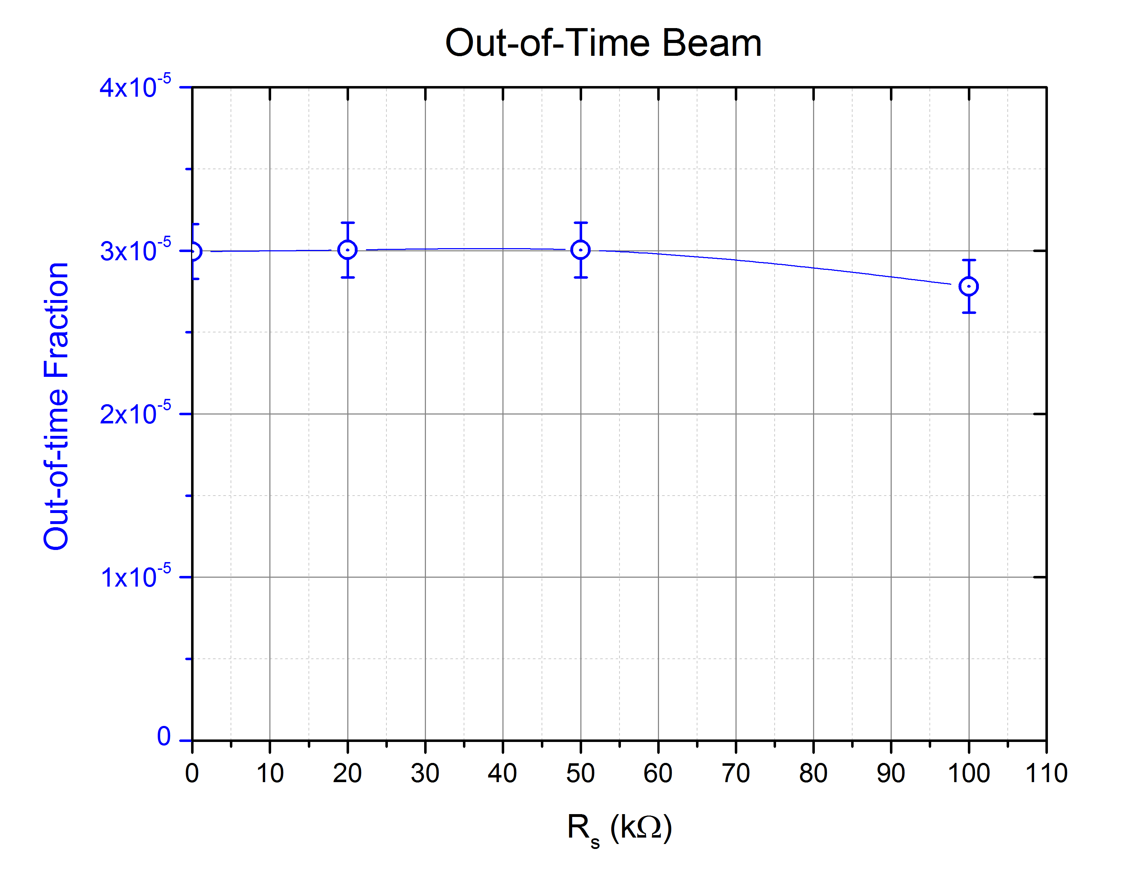
Delivery Ring RF Impedance Study
Measured cavity impedance = 54 kΩ
Performance does not depend on impedance less than 100 kΩ

Slide 47
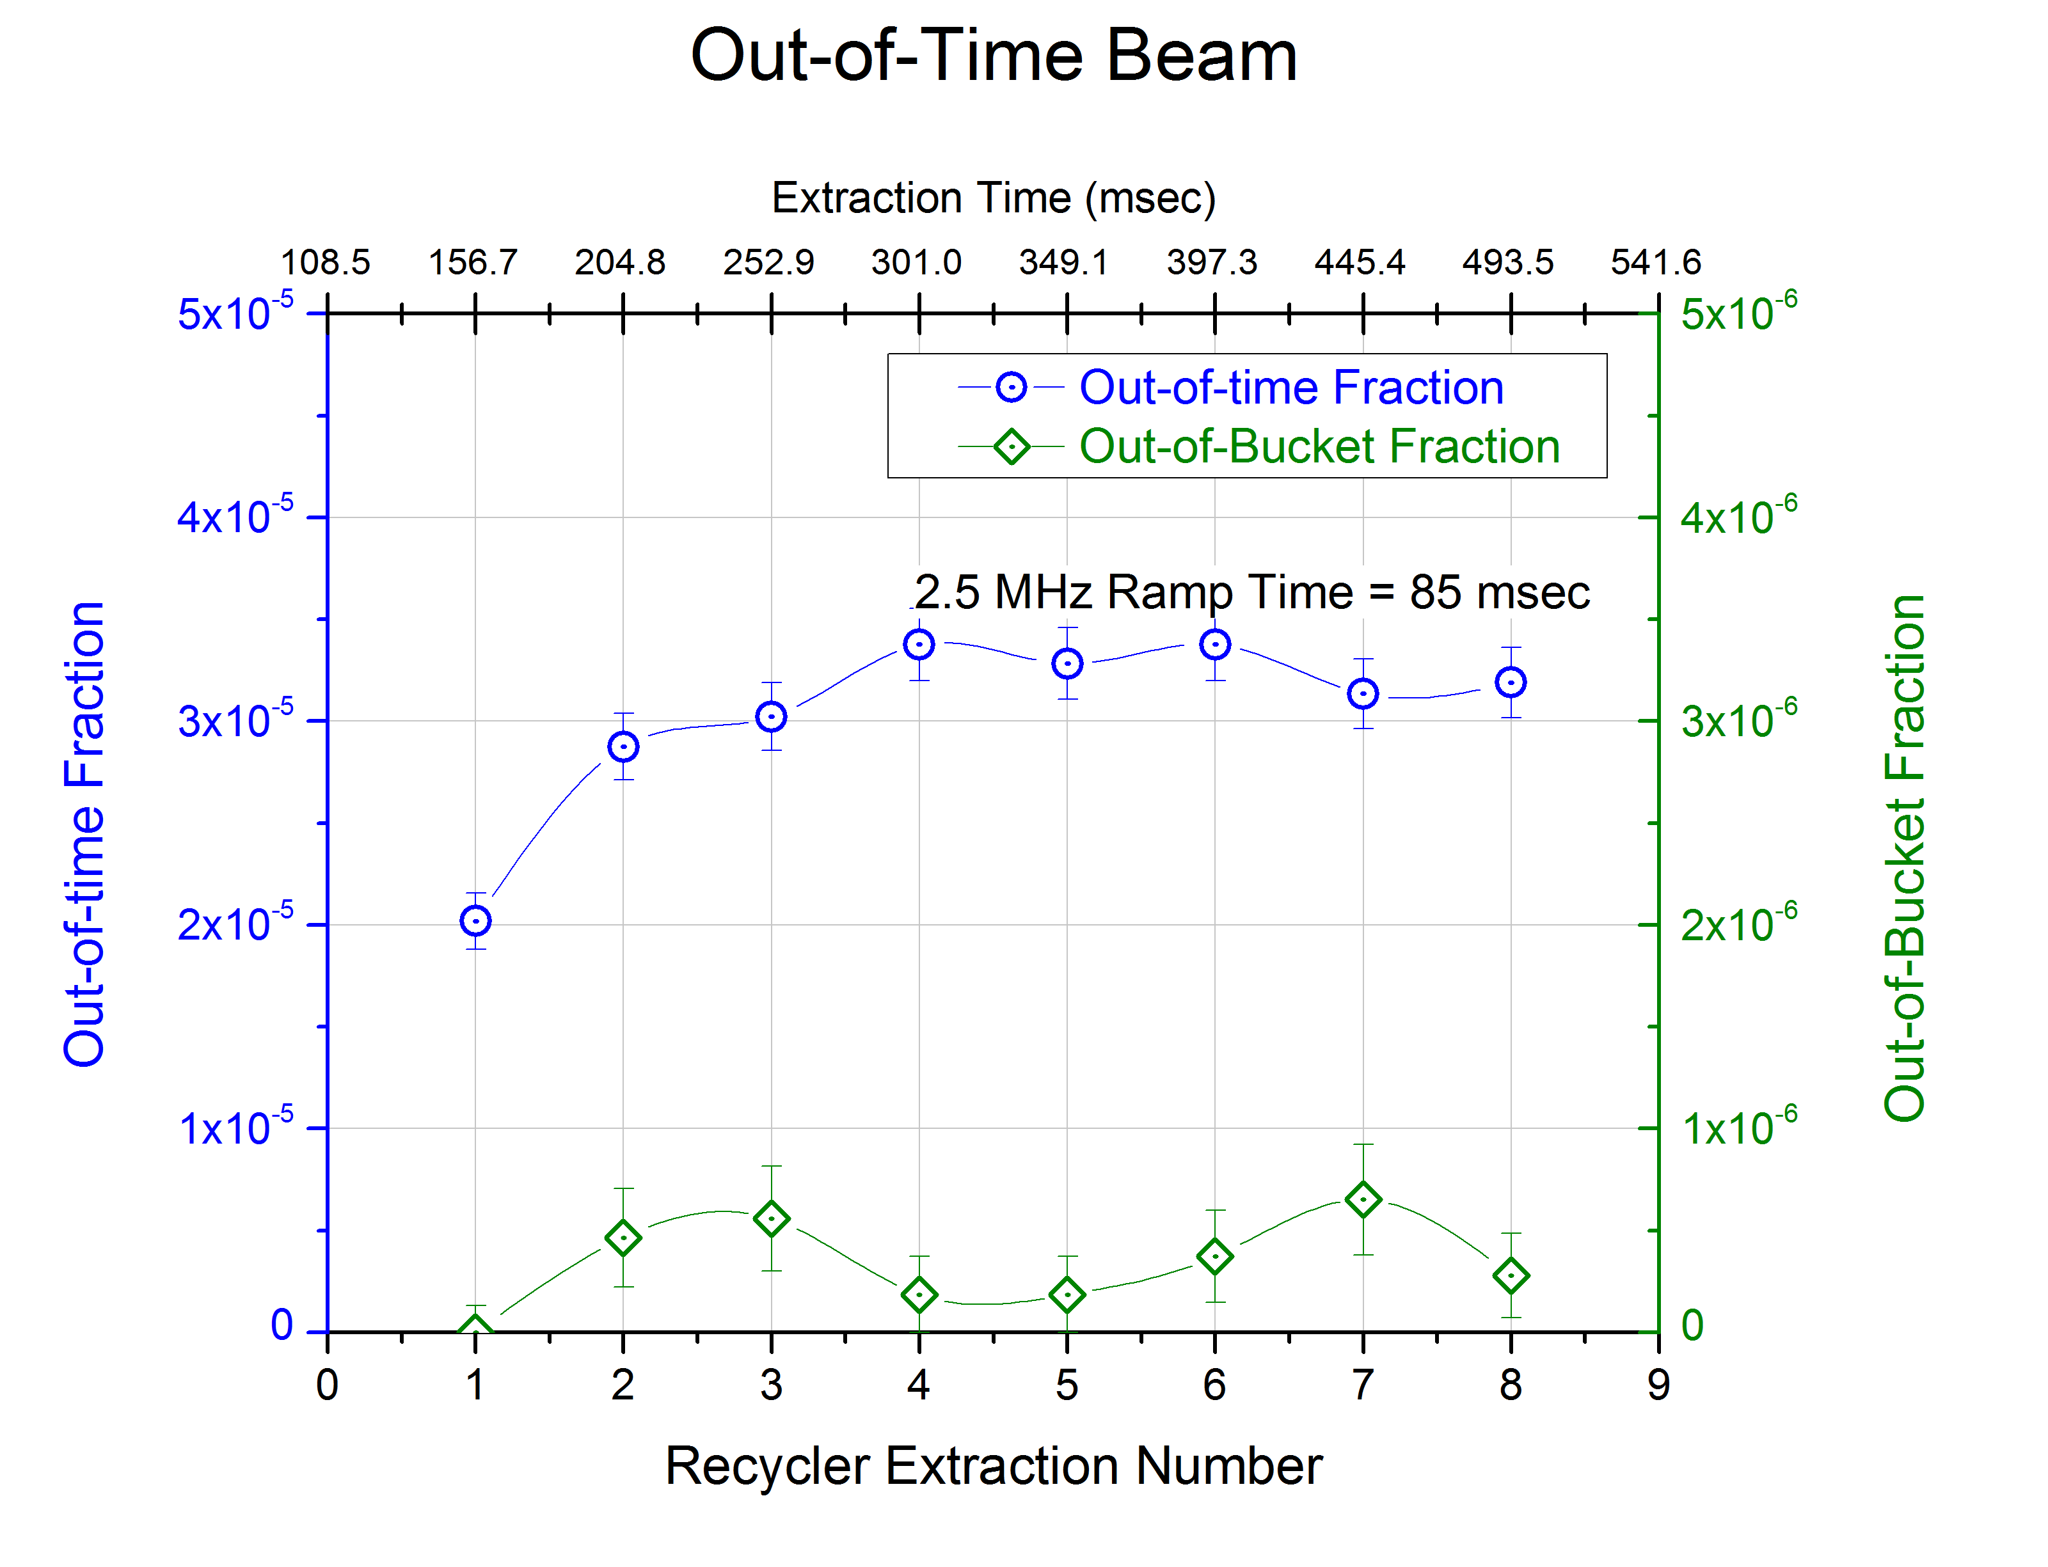
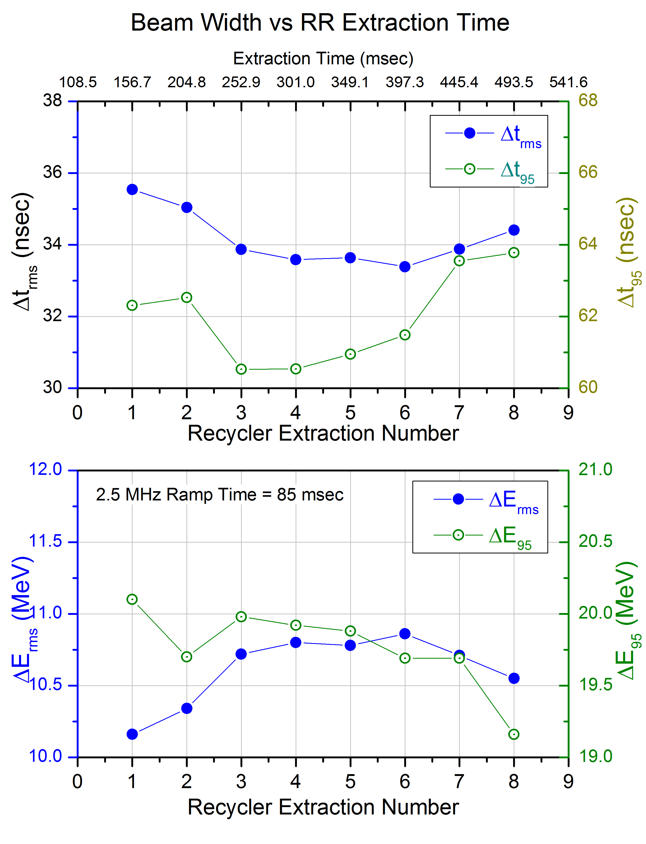
Recycler RF
After the first RR – DR transfer, the amount of out-of-time beam is independent of extraction time.

Slide 48
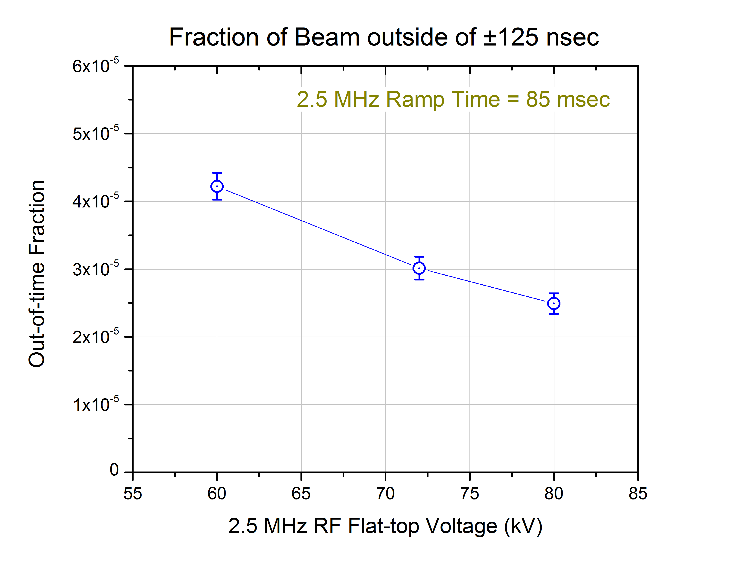
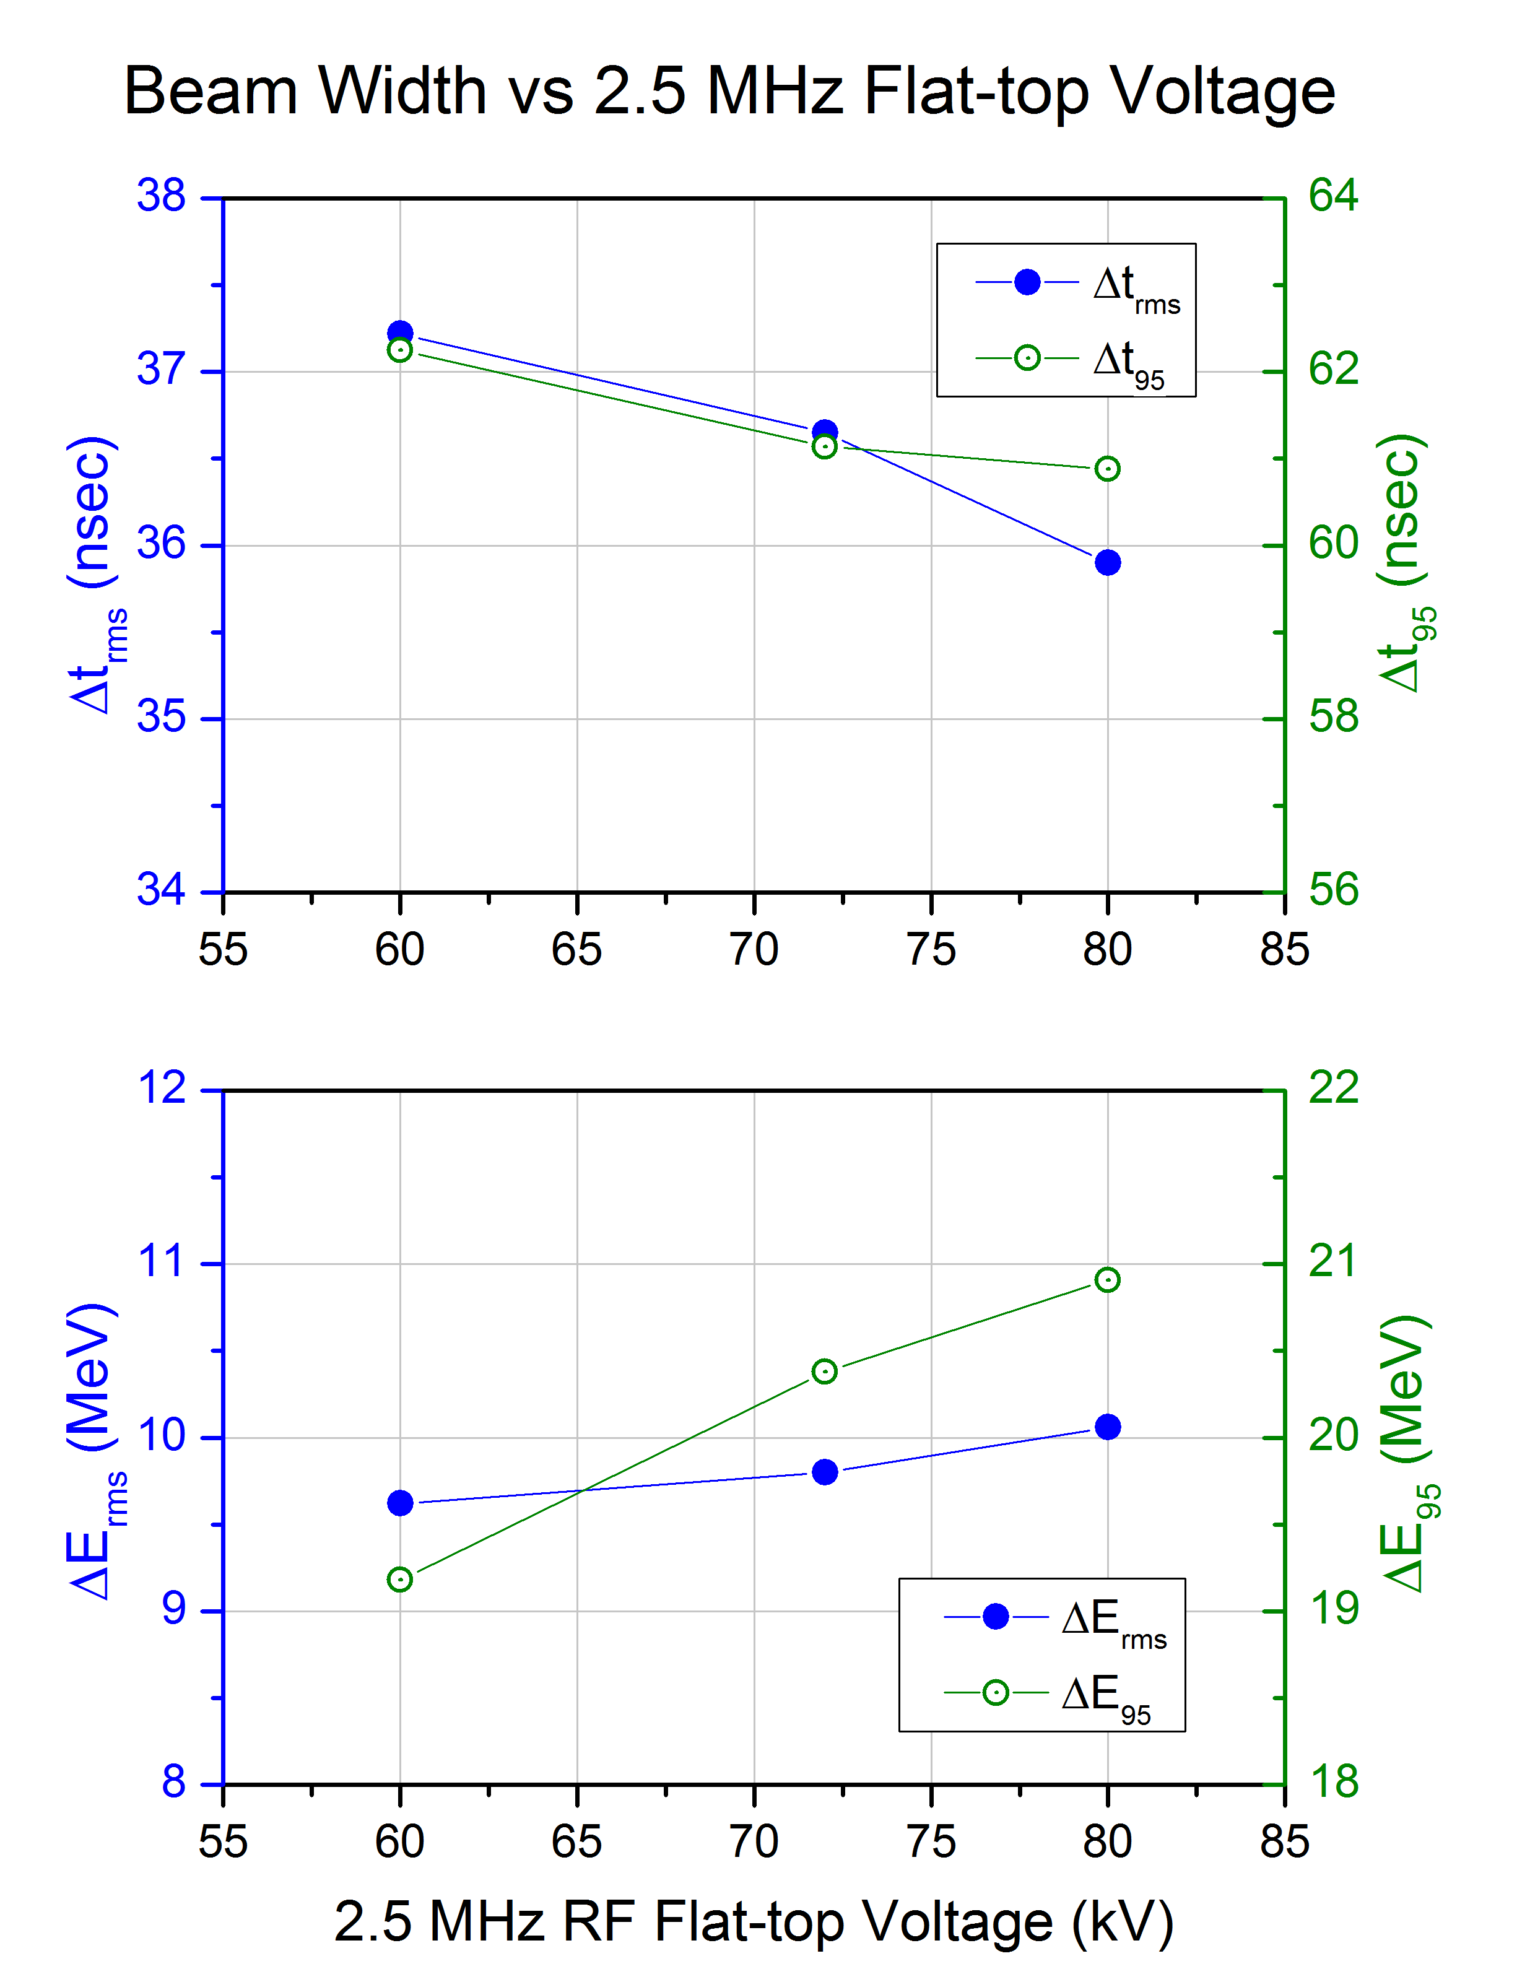
RR 2.5 MHz Voltage study
Nominal RR V_{rf} = 80 kV
More voltage is better.

Slide 49
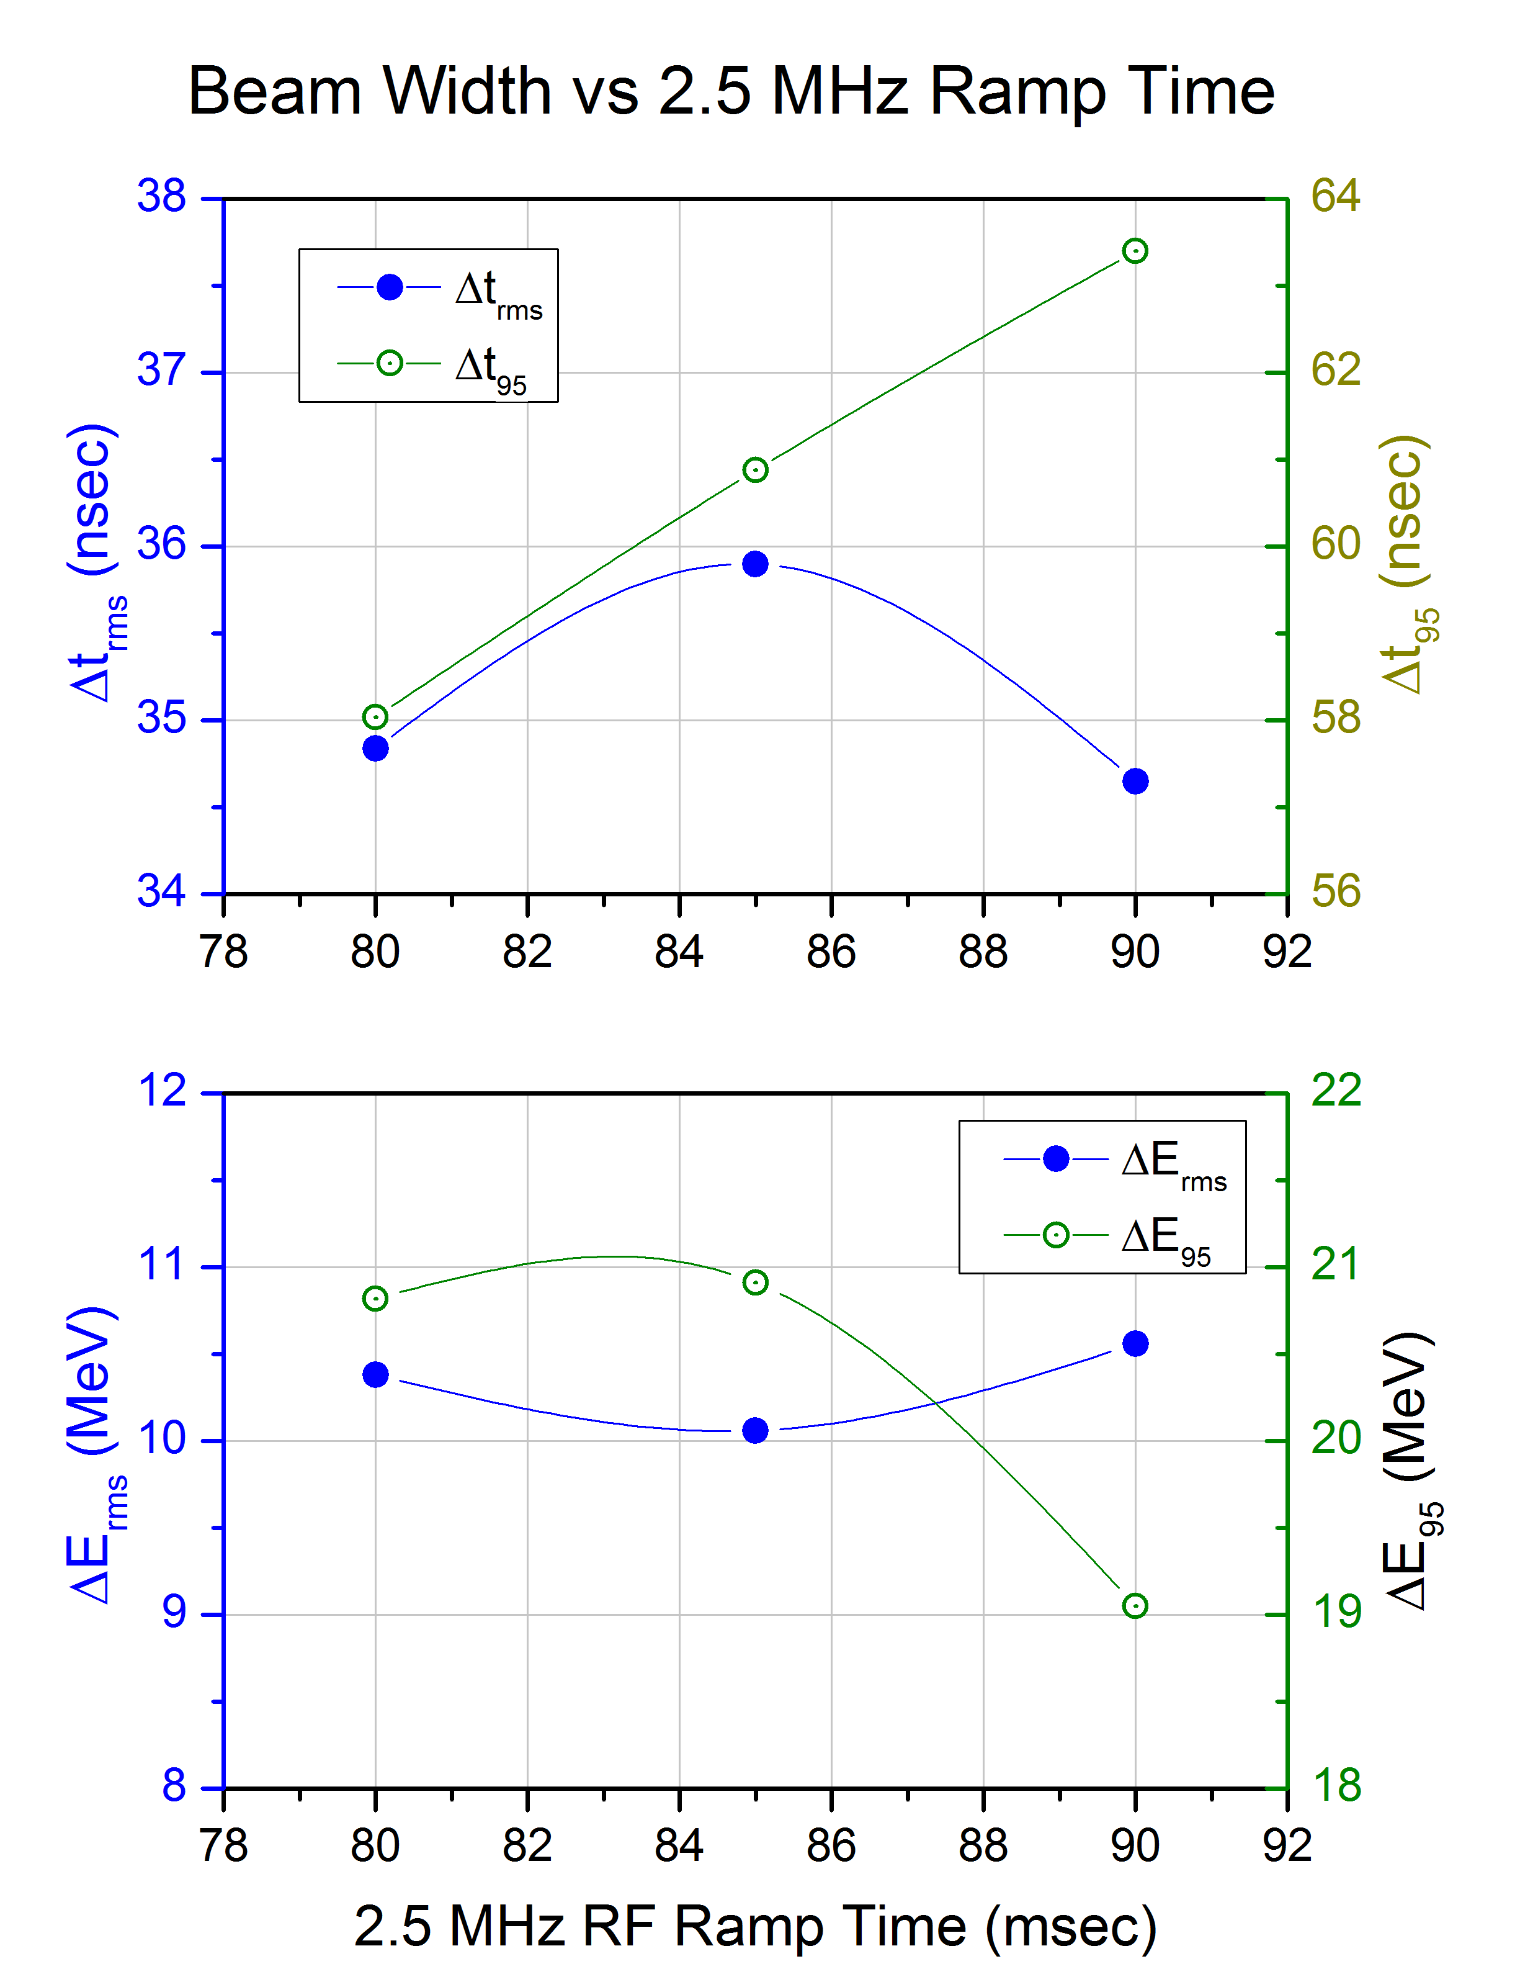
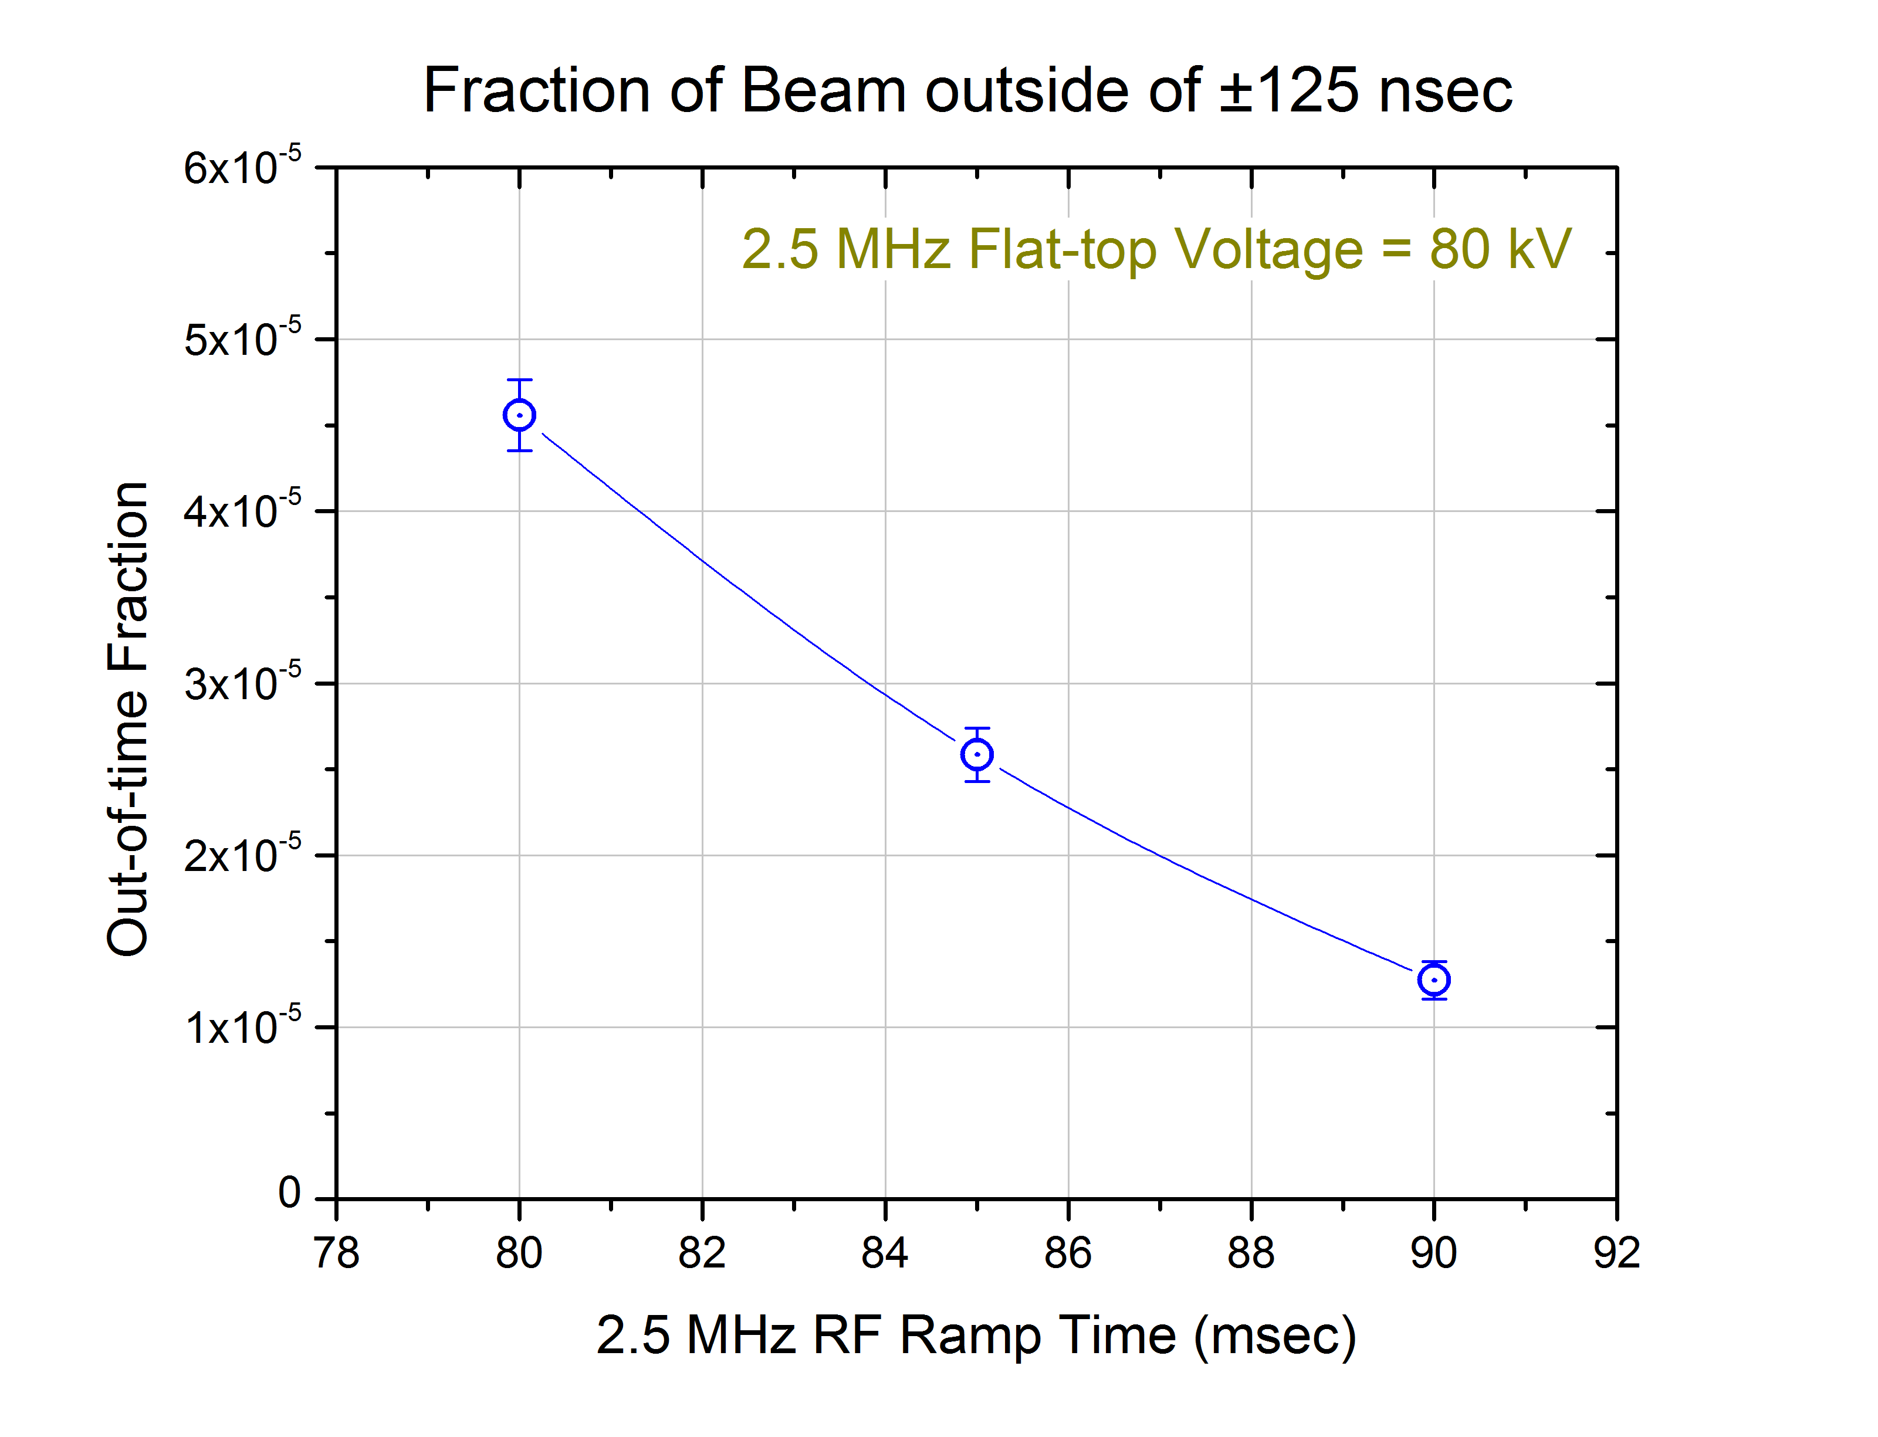
RR Voltage Ramp time study
Nominal voltage ramp time = 85 msec.
Longer (more adiabatic) ramps are better.

