Slide 1
Systematic errors in nucleon decay limits
Maury Goodman
Lisa Lin

Slide 2
Question
Should nucleon decay limits be degraded by systematic errors in nuclear efficiencies?

Slide 3
Mission of Goodman-Lin Study
to identify those modes (vis-à-vis water counters) for which a high resolution liquid Argon detector has a possible competitive advantage.
Note and spreadsheet updated in docdb-679
http://docs.dunescience.org:8080/cgi-bin/ShowDocument?docid=679
http://docs.dunescience.org:440/cgi-bin/ShowDocument?docid=679

Slide 4
January Example
Sample Mode n→ e⁺ρ⁻
Final state has one e⁺, two γ, one π⁻.
Best limit is from IMB, τ/B > 0.22 10³³ yr.
We estimate ε_{recon}×ε_{nuc =} 0.95 × 0.29.
Dune Sensitivity estimate is:
τ/B > 1.6 (16) 10³³ yr in 40 (400) kt-y

Slide 5
2 modes for which IMB has better limit than Super-K:
n →e⁺ρ⁻ , Super-K 0.07e33y, IMB 0.22 10³³y
n →μ⁺ρ⁻, Super-K 0.036e33y, IMB 0.23 10³³y
(This μ is below Cherenkov threshold)
Super-K has much larger exposure and the issue is not background. It is “systematic errors”.

Slide 6
Super-K limit, w/o systematic errors.
n →e⁺ρ⁻
ε = 1.8/1.6% (SK1/SK2)
N = 1/0
τ/B > 0.18 10³³y
Quoted τ/B > 0.0710³³y
n →μ⁺ρ⁻
ε = 1.1/0.9
N = 0/9
τ/B > 0.16 10³³y
Quoted τ/B > 0.036 10³³y

Slide 7
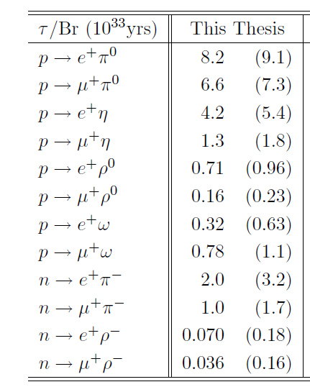
With (and without) systematic errors for all modes in Nishino’s thesis. PDG used values with systematic errors.

Slide 8
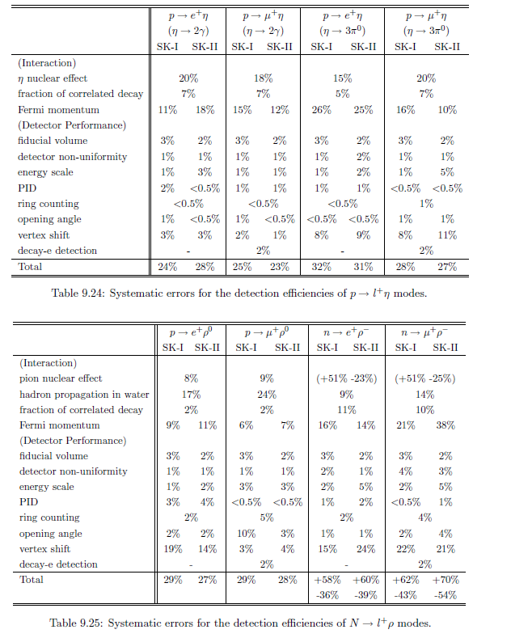
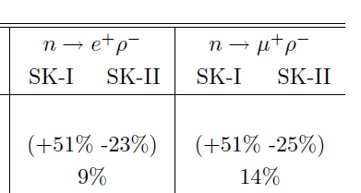
Super-K systematic errors

Slide 9
Discussion
In comparing a limit with a theoretical exact prediction, you would want to include systematic errors in evaluating disagreement
In comparing two experiments, it seems less clear to me. You especially don’t want to include them for one and not the other.
Our document doesn’t include them for DUNE.

