Slide 1
DAQ Data Handling Designs for Proto-DUNE
M. Potekhin, B. Viren, S. Fuess,
O. Gutsche, R. Illingworth, M. Mengel, A. Norman

Slide 2
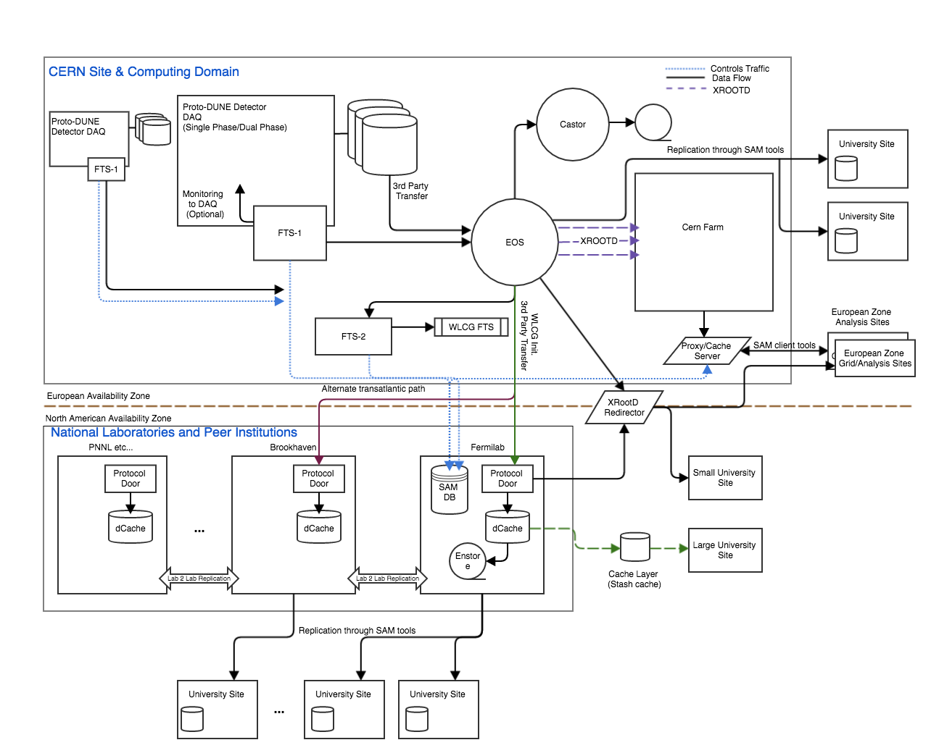
General Topology

Slide 3
Requirements & Specifications
Draft Document Link:
https://docs.google.com/document/d/1zLleejBRQH3OenrXoVkwJNT6CnN2NoLAEhXDTJ5jHGc/edit?usp=sharing
Details all aspects of the topology diagram as well as most interface specifications
Most of the work based on data handling for NOvA, MicroBooNE, 35T with specific consideration for how to integrate with CERN computing environment.

