Slide 1
Mechanical Analysis of Coil E2
Reported by P. Wanderer, BNL
Analysis by H. Witte and A. Marone, BNL
MICE-US meeting
March 25, 2016

Slide 2
MICE Spectrometer

Slide 3
Aims of Study
Understand training behaviour
Quenches triggered mostly by E2
Mechanism?
After training spectrometer is ok
Thermal cycling requires re-training
Fix?

Slide 4
Spectrometer Training
 | Margin
E2 | 0.7
SS | 0.78
E1 | 0.7

Slide 5
Model
NbTi: Orthotropic material properties
E_{1/2}=100/50 GPa
From:
Mechanical properties of epoxy impregnated superconducting solenoids. DOI: 10.1109/20.511486
Also: DOI:10.1016/0010-4361(78)90587-6
Al-6061T6
Isotropic elastic
FEA model
Contact elements between bobbin & coils (0.2 friction)
M1
M2
E1
C
E2
Good field region

Slide 6
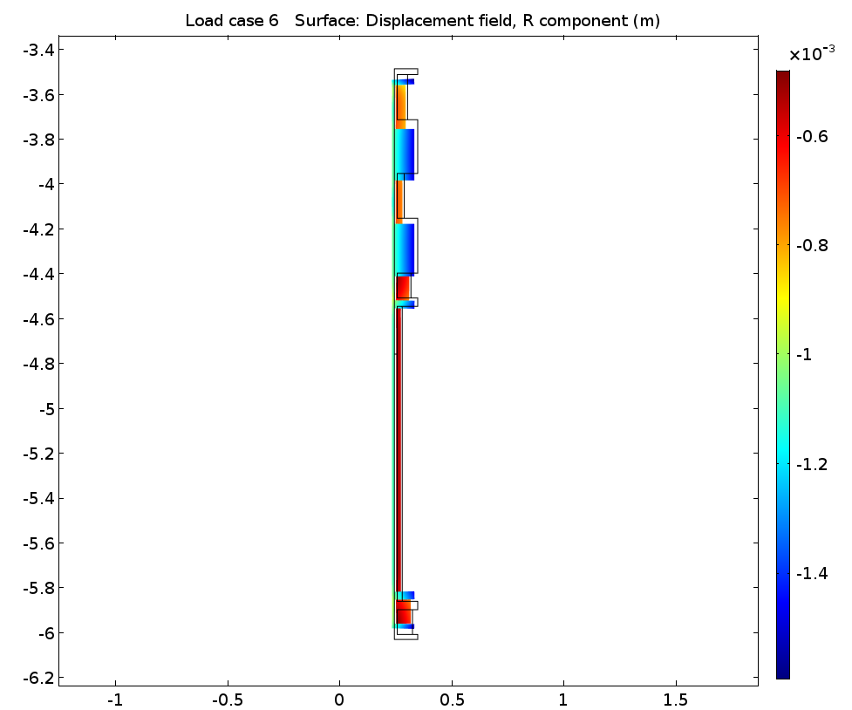
Model
Winding tension + Cooldown + EM force
Quasi-static
Transient

Slide 7
E2 After Cooldown
Aluminum mandrel shrinks more than NbTi solenoid
Axial shrinkage leads to coil being clamped in place
Partially detached axially
Radially detached from bobbin
x, y axes in meters
Axis in color: δr, m
E2 at room temp.
Radius (m)

Slide 8
Forces on E2
Solenoidal forces
Axial compression
Radial expansion
Additional axial force towards Centre Coil
Fringe field effect from C
Coil shrinks longitudinally and is pressed against C coil
Bobbin acts as clamp

Slide 9
Load Cycles (~during training)
0→25%
0→40%
0→60%
0→80%
0→100%
x, y axes in m
E2 at room temp.

Slide 10
Radial Displacement
100%
E2
80%
60%
40%
25%
All slides:
Displacements have been amplified for better visibility.
Non-zero slope of straight line indicates “training”

Slide 11
Radial Displacement
After mechanical cycling
After Cooldown
E2

Slide 12
Warming Up + Cooldown
Radial displacement (amplified) vs axial position, before and after cycling (note two line colors).
293K→4.2K, energization→293K
4.2K→energiz., 293K→4.2K
Conclusion: cycle to 293K brings magnet to pre-training state.

Slide 13
Comparison: E1
E1
Straight line has no slope.

Slide 14
Preliminary Analysis of M.I.C.E. Solenoid Coils
Marone
March 23, 2016

Slide 15
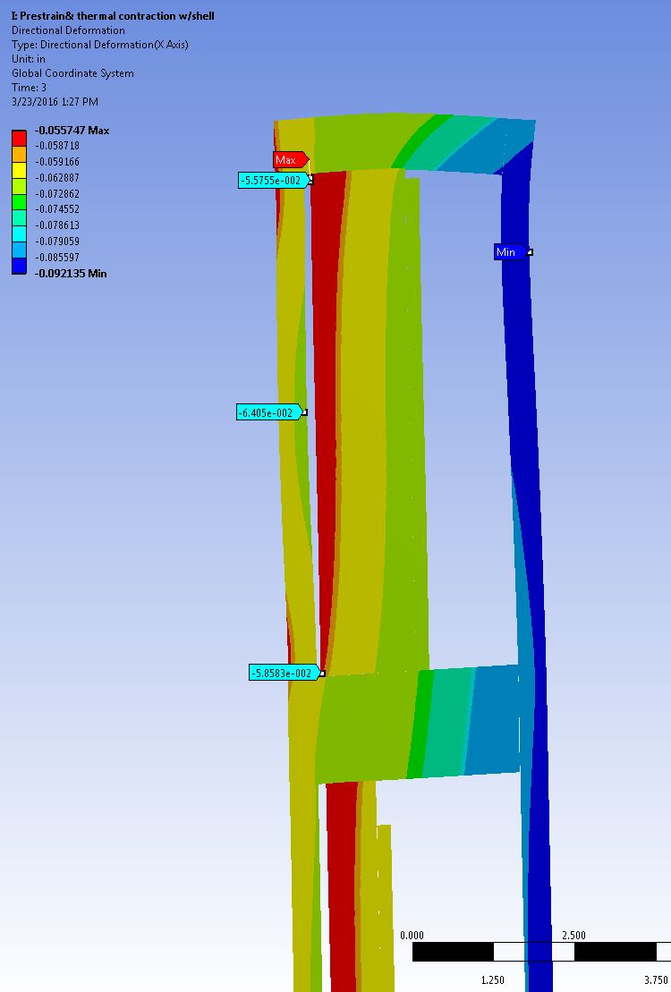
Model Run With/Without ½” Aluminum Outer Sleeve Pre-stress and Thermal Contraction
Coil bends in reverse direction about 75μm.
Conclusion: aluminum sleeve important
No sleeve

Slide 16
Model Run With ½” Aluminum Outer Sleeve, With / Without magnetic forces
B~4T
Δr ~ 300μm
B=0
Δr ~75μm
Conclusion: cycling produces significant deflections, even with sleeve

Slide 17
Comparison & Summary
Comparison of model inputs
Remark: models still under development, will converge
Summary for E2
Both models show significant deflections of the end flange due to thermal contraction
Models established a mechanism for training, repeatable training and reset of training due to thermal cycle
Mechanical changes are essential to eliminate this problem
 | friction | sleeve | Coil design | B | Thermal Contr. | other
Witte | Y | N | Wang | ~5.6T | Y | TBD
Marone | N | Y | Gupta | ~4.0T | Y | TBD

Slide 18
BACKUP

Slide 19
Two Cycles – Same Current
0%
25%
0%
25%
0%

Slide 20
Steel Bobbin

Slide 21
Summary
Understand training behavior
Mandrel acts as clamp
Quenches triggered mostly by E2
E2 is held weakly on one side
Forces push E2 out of clamp
After training spectrometer is ok
Same load does not seem to produce slippage
Thermal cycling requires re-training
Room temperature: “reset”
Fix?

