Slide 1
325 MHz – FY17 Budget Request
Leonardo Ristori (325 MHz Task Manager)
PIP-II Budget Retreat
26 April, 2016

Slide 2
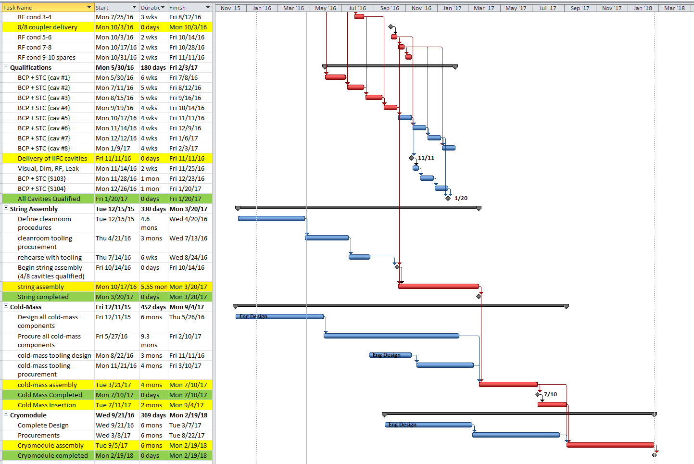
PIP-II 325 MHz – SSR1 Cryomodule Schedule (Apr 2016)
Cavity Qualifications
String
Assembly
Cold Mass
Assembly & Insert
Cryomodule
Assembly

Slide 3
PIP-II 325 MHz – FY17 GOALS
Complete 2nd half of qualifications Oct 2016 – Mar 2017
Cavities 5-8 of 8 (including IIFC cavities)
String Assembly Oct 2016 - Mar 2017
String Assembly will start early with 4 cavities in hand
Cold Mass Assembly & Insertion Apr 2017 – Sep 2017
Cryomodule Assembly & Completion Oct 2017 – Feb 2018
IIFC & Project Management Goals (ongoing):
Assist Indians with IIFC deliverables – 325 MHz magnets
Support Conceptual Design Report (CDR) and Resource Loaded Schedule (RLS) for all elements of 325 MHz program
Assist Indians with IIFC deliverables – SSR-2

Slide 4
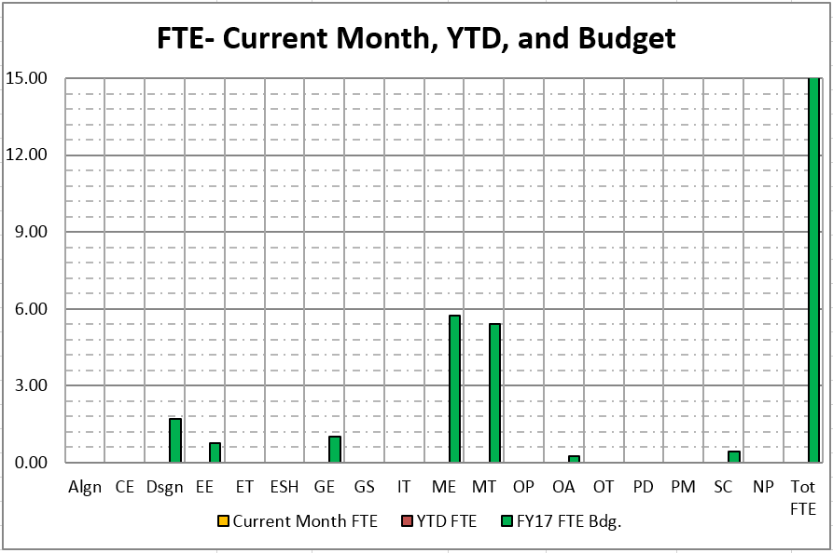
PIP-II 325 MHz – Resources Required to Meet Initial Goals
OHAP Category | FY17 FTE Bdg.
Alignment | -
Civil Engineer | -
Design | 1.70
Electrical Engineer | 0.75
Electrical Technician | -
ESH | -
Guest Engineer | 1.00
Guest Scientist | -
Intern | -
Information Technology | -
Mechanical Engineer | 5.75
Mechanical Technician | 5.40
Operations | -
Other Administration | 0.25
Other Technical | -
Postdoctoral Res Assoc | -
Procurement | -
Project Management | -
Scientist | 0.45
Not Provided | -
Total | 15.30
~10 FTE current effort
+5 FTE request unidentified
(2 Techs, 2 Eng, 0.5 Des, 0.25 Admin)

Slide 5
Remaining purchases for FY16 (Apr-Sep 2016)
BONUS SLIDE!
Tuners (x 10) = $200K
Current Leads (x 4) = $120K
String Hardware (seals, screws) = $10K
String Tooling (Clean Room) = $30K
HPR System for Lab2 = $100K
Extra HPR tooling for Lab2 = $10K
Thermal Shields = $50K
String lifting fixture = $20K
Total $540K vs ~$600K left in budget as of 4/26/16

Slide 6
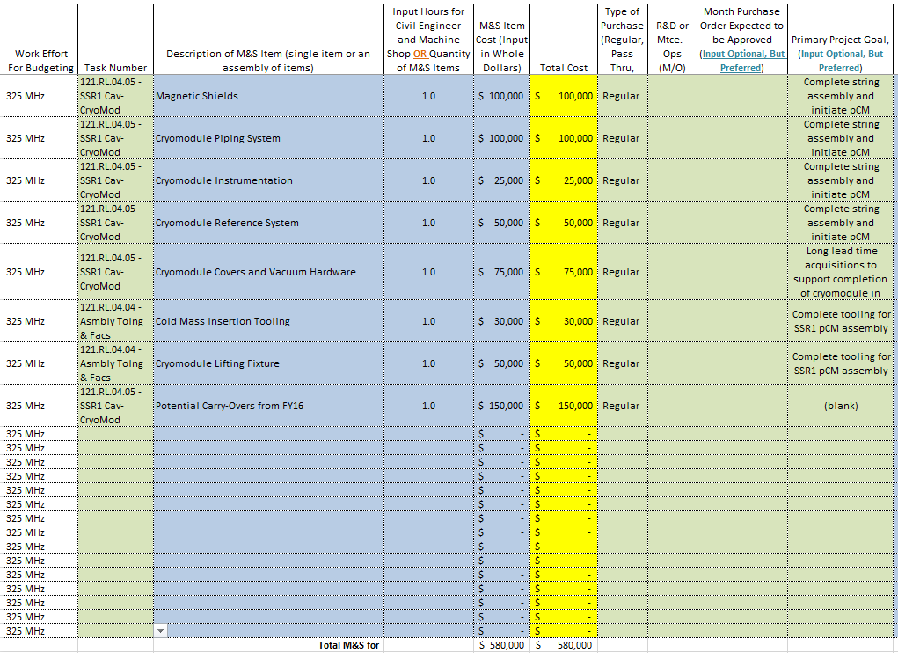
PIP-II 325 MHz – FY17 Materials & Services
Tot. Request $430K
~ ½ of FY16 M&S
($150K is Carry Over)

Slide 7
PIP-II 325 MHz – Achievable Goals at Initial Target
Comparison of Initial Target vs Request for:
325 MHz
 |  | ($000)
Category | FTE | SWF Cost | M&S Cost | Tot. Directs
Original Target | 13.50 | $ 1,871.1 | $ 400.0 | $ 2,271.1
Current Request | 15.30 | $ 1,796.6 | $ 580.0 | $ 2,376.6
(Over)/Under Target | (1.80) | $ 74.5 | $ (180.0) | $ (105.5)
Note: Preliminarty allocated cost per FTE is an average of $138.6K/FTE
Includes $150K Carryover !
M&S FY17 request is ~ ½ of FY16
FTE FY17 request is (again) 15 FTE
All goals could be achieved with a FY17 budget = original target!
Extremely challenging to secure additional (qualified) FTEs, must start now, and with full support of PIP-II management

Slide 8
Impact of reduced effort (high level of uncertainty)
Difficult to quantify schedule delays caused by reduced effort in cryomodule design, procurement and assembly
We are not in production mode
FTE target has been ~15FTE for last 2 years vs.10-12 actual
10 FTE → constant schedule delays (see last 2 years plans vs. advancements)
Best guess at this moment:
Effort of ~10FTE will delay cryomodule completion by at least 1.5 years beyond original target of 2/2018 → 8/2019 !!
NOTE: Emergence of schedule conflicts with 650 MHz effort
CRITICAL to secure now and train ENG & Tech DEPENDABLE resources for the next 2 years (2-3 FTE)

