Slide 1
Status Update: Nonlinear Optics Experiments at UMER
Kiersten Ruisard,
Timothy Koeth, Brian Beaudoin, Irving Haber, David Matthew, Heidi Baumgartner

Slide 2
Outline
Overview: UMER and Nonlinear Optics
Nonlinear Experiments at UMER
Single Channel
Octupole Design and Measurement
Preliminary Experiments
N4 lattice
Tune scan with octupoles
Ring Improvement
Beam steering
Re-anchoring and realignment

Slide 3
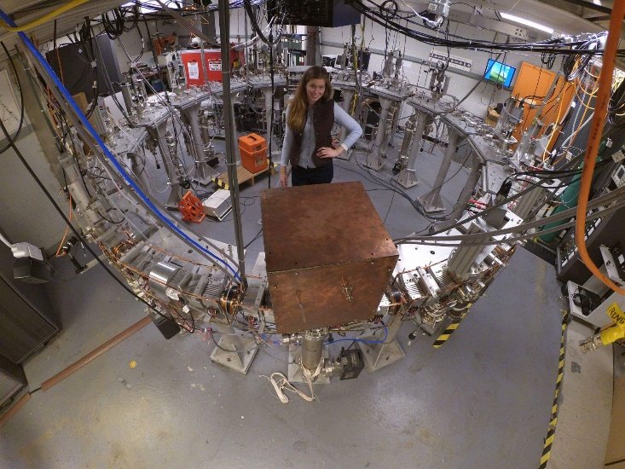
UMER Overview
System Parameters
Beam Length 20-140ns
Circulation Time 197ns
Circumference 11.5 m
Beam energy 10 keV
Beam current 0.6 - 100mA
Beam radius 0.25 - 10mm
Tune ν_{x}~ ν_{y}~ 6.6
= 0.85 – 0.14
We (typically) operate in high intensity, “extreme” space charge regime!
Notes:
Tune vy=vy=6.6, pulse length 15-145 ns,

Slide 4
UMER as a testbed for nonlinear optics
Pros
Existing facility
Intuition about operation
Well benchmarked codes (WARP)
Variable intensity
Flexible lattice
Low-cost upgrade to nonlinear lattice
Cons
Not designed as precision machine
Not designed for non-fodo lattice
Dense lattice with limited space
Need to share with other experiments with AG lattice
Too much intensity?

Slide 5
Experimental Program
β_{x}= β_{y}
1 0
-k 1
Nonlinear Insert
Octupole strength
T-insert
Pulsed Injector
Notes:
Many alternate lattices possible
Dr. Santiago Bernal has developed alternate lattice strategies for the ring.
----- Meeting Notes (7/19/13 12:02) -----
symmetry problem nbd.
flexible lattice
more room with alt lattice., more symmetry

Slide 6
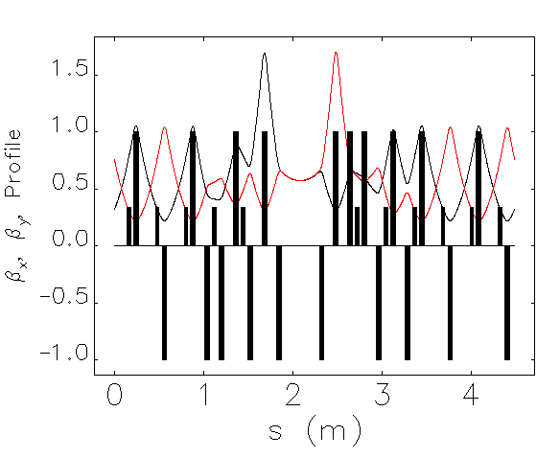
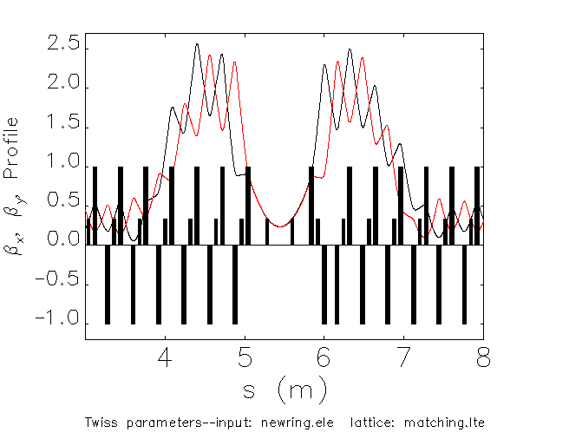
Experimental Program
Matching Sections
Octupole Channel
$$ΔΨ_{channel}=0.09∗2π$$
$$ΔΨ_{oct}=0.28∗2π$$
Notes:
Max tune spread about half delta nu

Slide 7
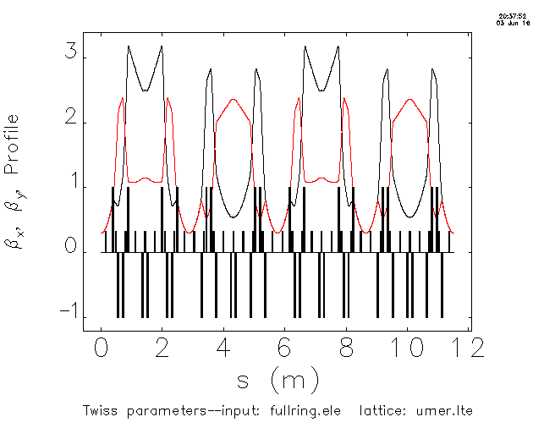
Experimental Program
Octupole Channel
(20 deg)
$$ΔΨ_{channel}=0.23∗2π$$
Ring divided into 4 sections of phase advance π
Families of 5 quadrupoles

Slide 8
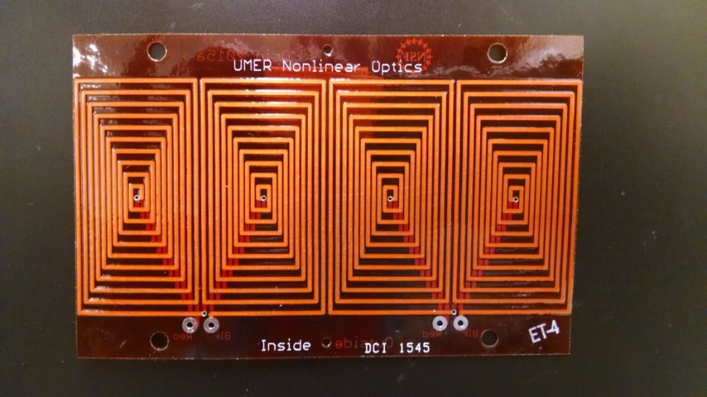
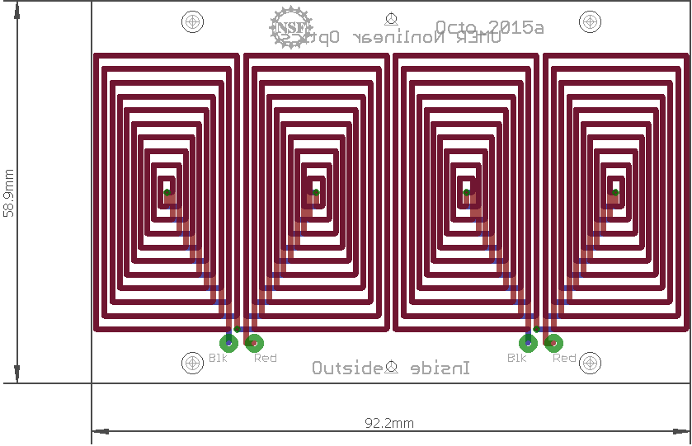
PC Octupole Magnets: Design
David Matthew

Slide 9
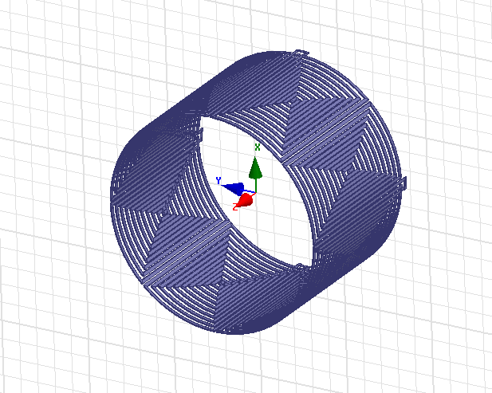
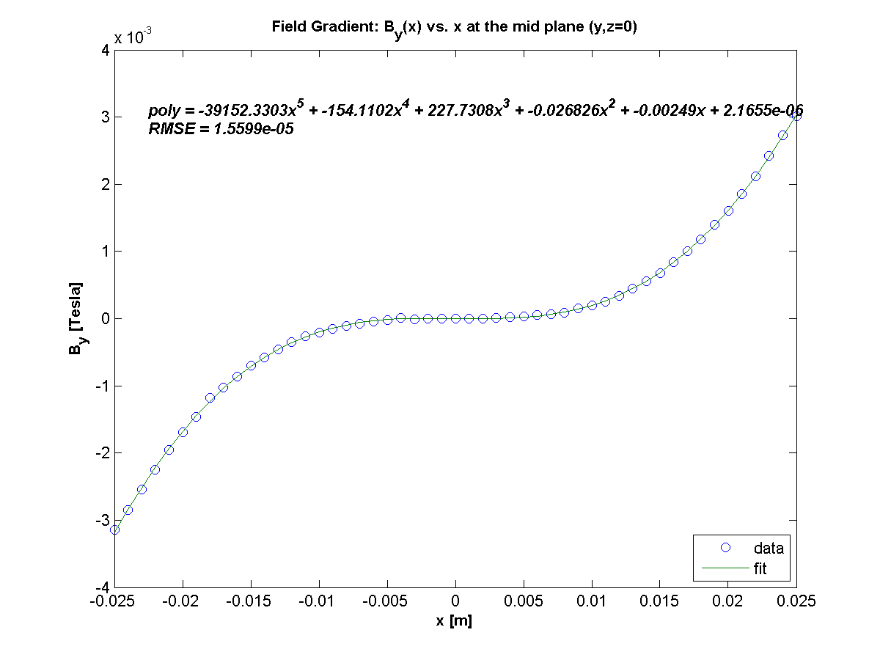
PC Octupole Magnets: Characterization
David Matthew
Expect 75 T/m³/A based on Maxwell simulation

Slide 10
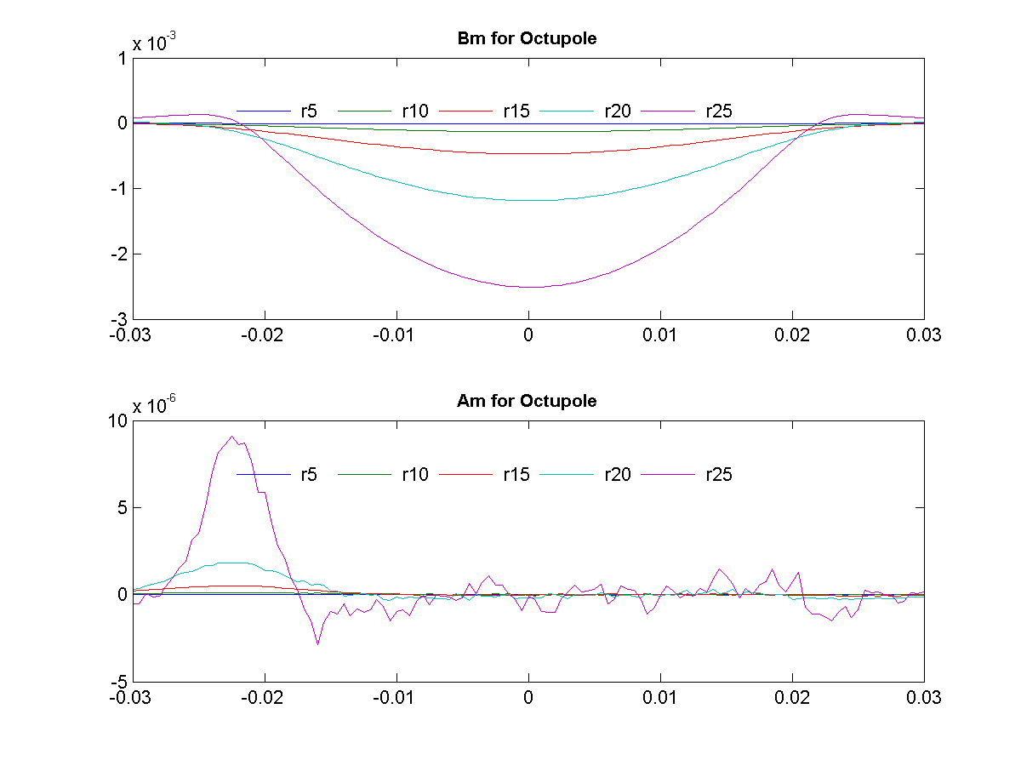
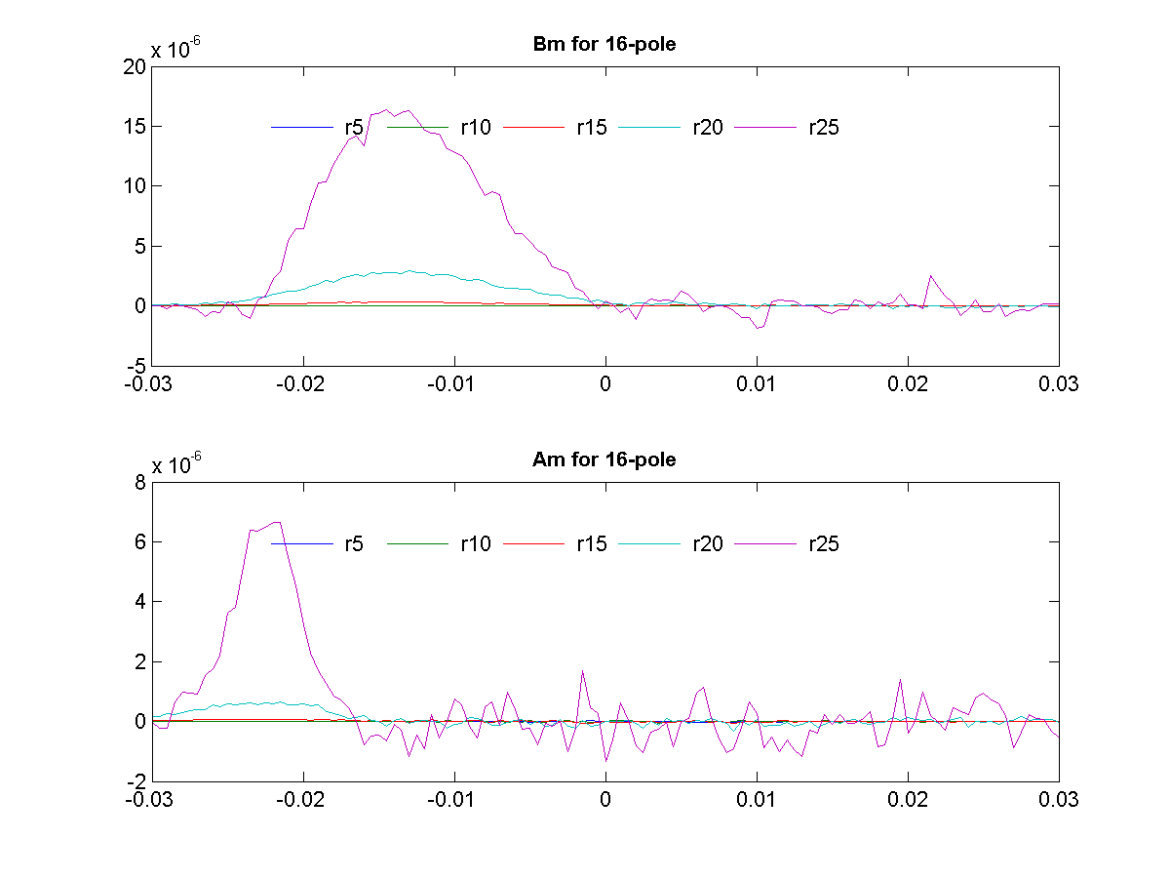
PC Octupole Magnets: Characterization
David Matthew
Octupole
16-pole
Skew Octupole
Skew 16-pole

Slide 11
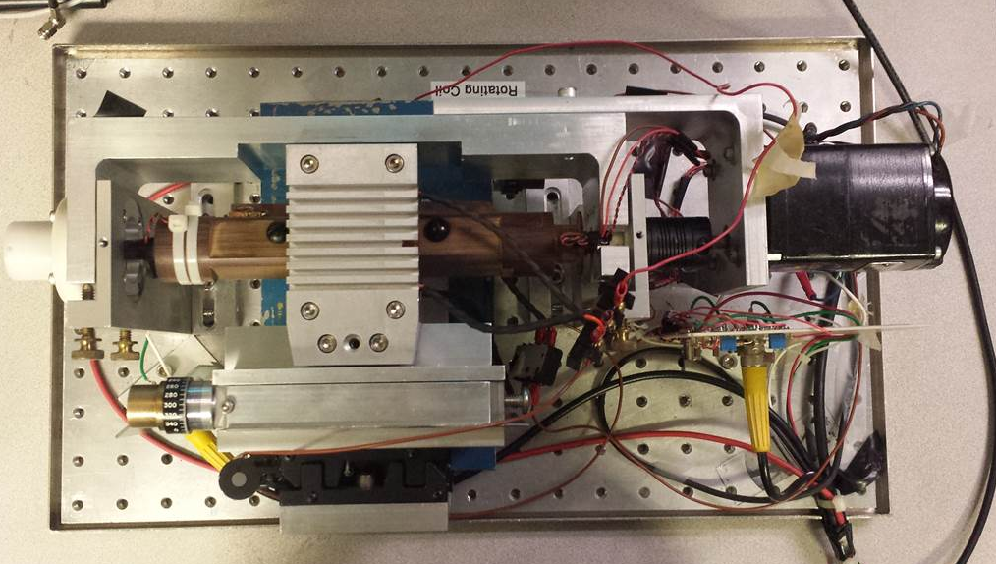
PC Octupole Magnets: Characterization
David Matthew
Scope Data
Rotating coil apparatus
EMF
Magnet housing
Coil
Motor
Oct
Sext
Quad
Dipole
12-pole
10-pole
16-pole

Slide 12
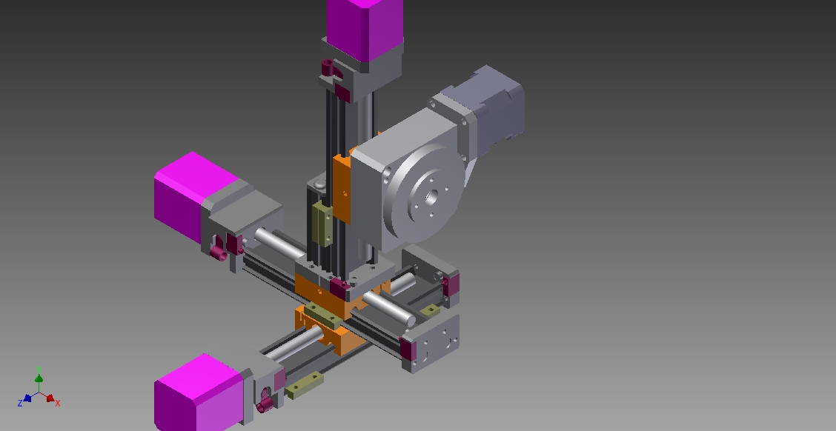
PC Octupole Magnets: Characterization
Heidi Baumgartner
3+1D Gauss Probe Stage

Slide 13
N4 Lattice
$$β_{x}≈β_{y}$$
1 0
-k 1
4 Octupoles equally distributed
Octupole strength
T-insert
$$ΔΨ_{oct}≈0.14∗2π$$
Alternative Lattice: remove every other quadrupole
π phase advance between sections

Slide 14
N4 lattice: operating point
$$ν_{x}$$
$$ν_{y}$$
π phase advance between sections
$$I_{focus}≈0.98 A$$
$$I_{defocus}≈0.99 A$$

Slide 15
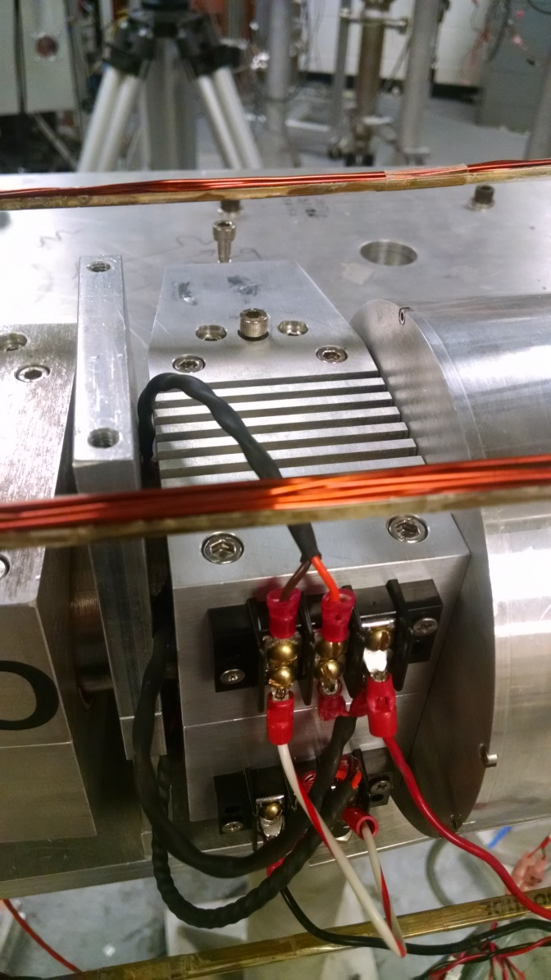
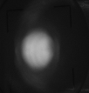
PC Octupole Magnets: Installation
First turn beam image, varying octupole current (bipolar)

Slide 16
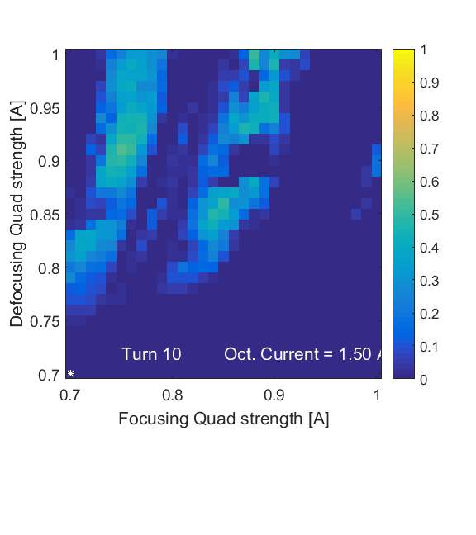
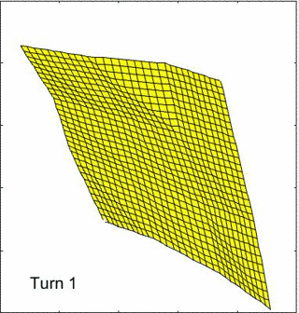
Tune Scan – Alternative Lattice
4.5
4
3.5
3
2.5
2
2 2.5 3 3.5 4 4.5
Nominal Operating Point

Slide 17
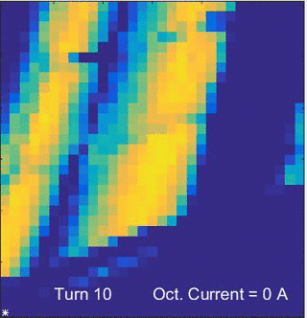
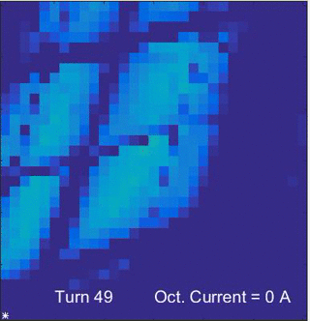
Preliminary Experiments
Nominal Operating Point
Desired Operating Point (near π phase advance)
Notes:
Steering: horz rms 2 mm, max 5 mm
Vert: rms 2.5, max 1 cm

Slide 18
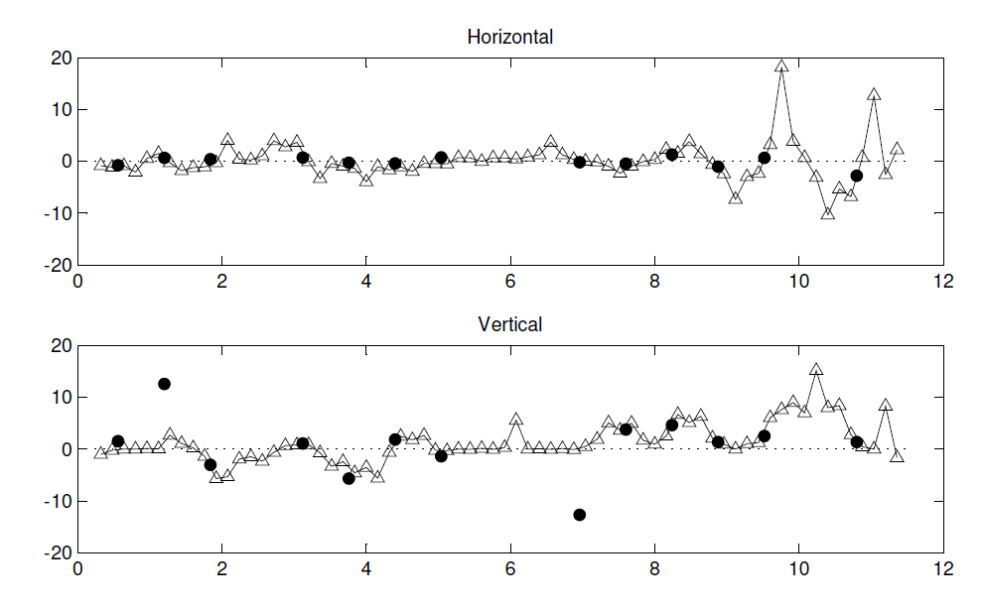
Ring Improvement: Steering
BPM
Quadrupole
Q69
Δx (mm)
*
Q65
bad BPM
*
Δy (mm)
*
bad BPM
S (meters)

Slide 19
Ring Improvement: Steering
BPM
Quadrupole
*
Note new scale (2x smaller)
Horizontal, MAX: 3 mm, RMS: 0.8 mm
20
10
0
-10
-20
Same scale as prev. slide
Vertical: MAX: 10 mm, RMS: 3 mm
Δy (mm)
Additional vertical correctors necessary
Notes:
Multi-turn (first 4 turns):
MAX delta X 2 mm
MAX delta Y up to 1 cm
For Alt Lattice: Steering: horz rms 2 mm, max 5 mm
Vert: rms 2.5, max 1 cm

Slide 20
UMER Realignment
Credits:
Heidi Baumgartner (producer)
Dave Sutter
Eric Montgomery
Brian Beaudoin
Santiago Bernal
Tim Koeth
Rami Kishek
Irving Haber
Dave Matthew
Ana
Matt Teperman
Kiersten Ruisard
https://youtu.be/EZcCYs80T8k
Notes:
Tolerances from Dave?
Prev. movement of 2-4 mm on vacuum break, 20 lbs of inward force. Expected .5-1 mm, hopefully less.

Slide 21
Conclusion
Octupoles tested and installed on ring for very preliminary testing
Ring fastened to floor and re-aligned, pump-down imminent
Focus for this summer:
Recommissioning of the beam
Simulation program to catch up to experimental
Quantify conservation of Hamiltonian/ tune spread
Characterization of octupoles
Mechanical framework for single-channel experiment on 20-degree section
N4 lattice tests at improved operating point
New mount for multi-octupole magnet

