Slide 1
Commissioning and Plans of the IOTA Electron Injector
Dan Broemmelsiek
FAST/IOTA Scientific Program Meeting
13 June 2016

Slide 2
Acknowledgements
J. Ruan, D. Crawford, A. Warner, D. Edstrom, J. Thangaraj, J. Santucci, K. Carlson, W. Johnson, G. Stancari, Elvin Harms, A. Romanov, C. Baffes, et al (FNAL)
P. Piot, A. Green, A. Halavanau, D. Mihalcea, et al (NIU)

Slide 3
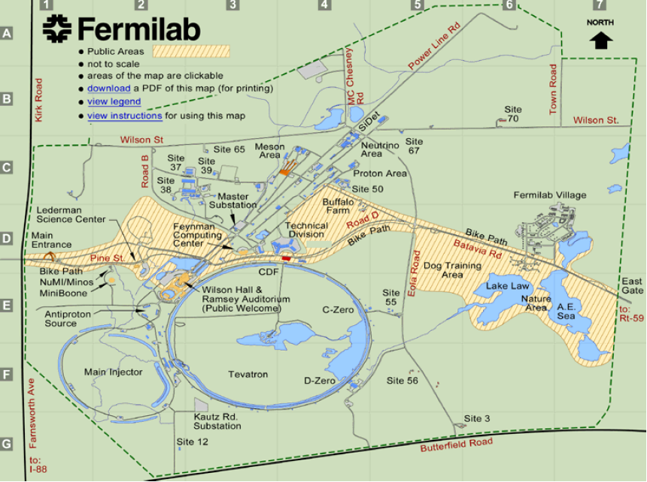
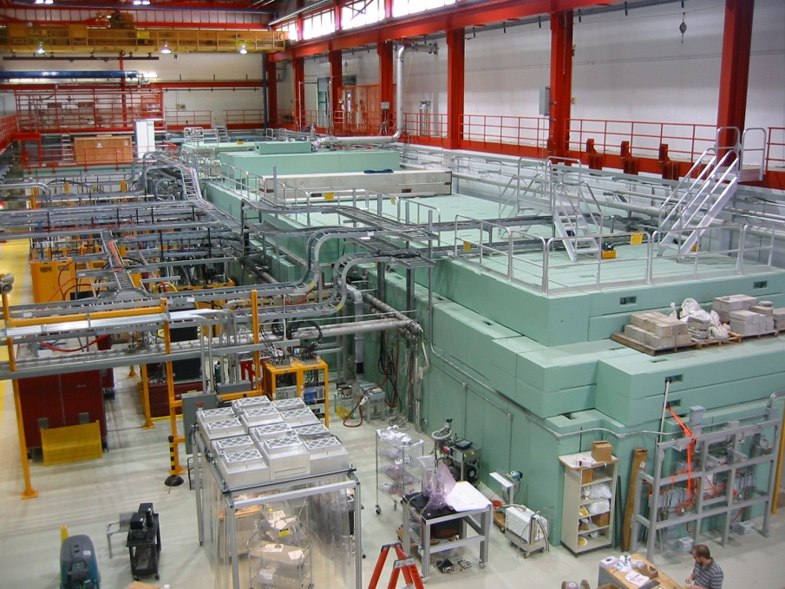
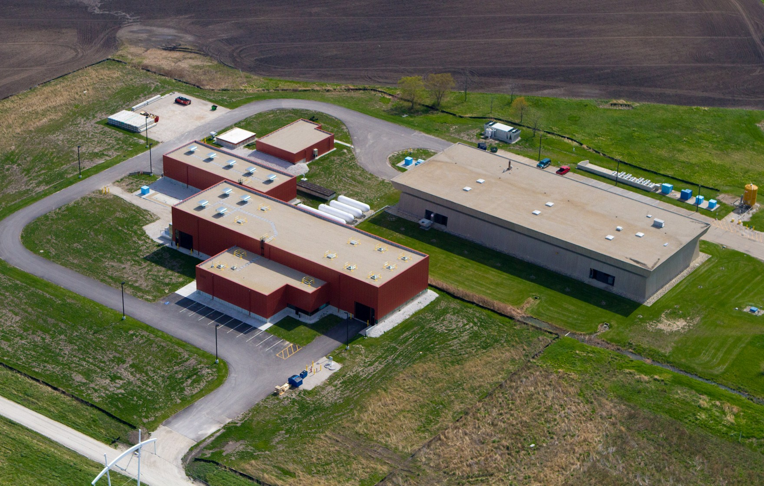
Location
FAST
Aerial view courtesy T. Nicol

Slide 4
Electron Injector
Parameter | Value | Unit
Bunch charge | 0.02 – 3.2 | nC
Bunch train duration | 1 | ms
Bunch frequency within train | 3 | MHz
Number of bunches/train | 1 – 3000
Bunch train frequency | 1 – 5 | Hz

Slide 5
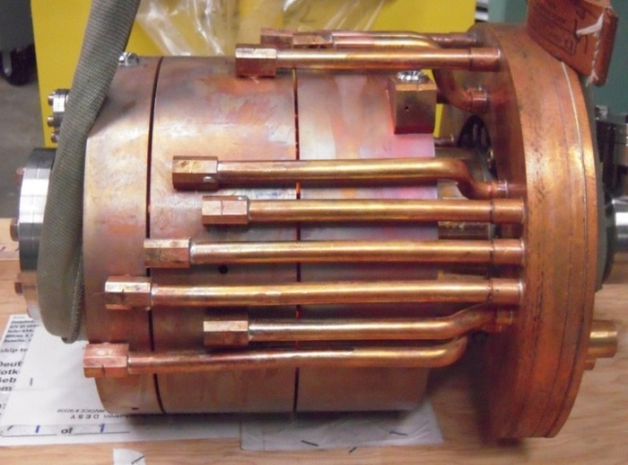
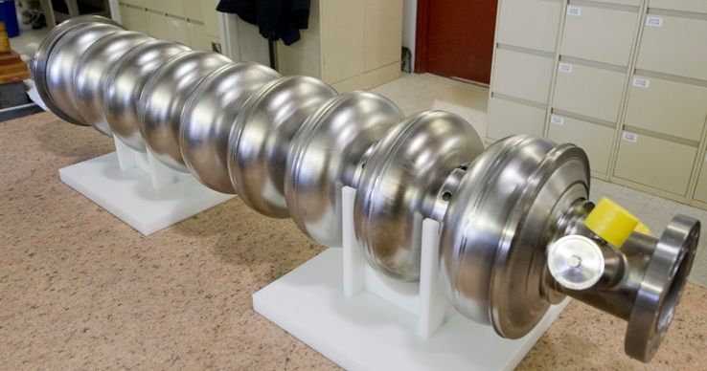
Gun and Capture Cavities
1.3 GHz, normal conducting, 1.5 cell RF electron gun
Cs₂Te photocathode excited by 254 nm uv laser
Gun 42 MV/m, ~4.5 MeV electrons
Two 1.3 GHz 9-cell SRF cavities
CC1 at 27.5 MV/m
CC2 at 17 MV/m
Parameter scaling, spectrometer based beam energy > 50 MeV

Slide 6
Current Performance – Downtime Sources
System | Down | Downtime
Diag/Inst | 02 Jun 2016 10:22 | 1.217 | Camera captures not returning through image tool
Diag/Inst | 02 Jun 2016 14:54 | 0.350 | Camera captures not returning through image tool
Miscellaneous | 02 Jun 2016 15:15 | 0.250 | Cleaning up files after camera issue
Diag/Inst | 03 Jun 2016 12:10 | 0.000 | Camera server not returning images to Image Tool
Diag/Inst | 04 Jun 2016 11:53 | 0.167 | Camera servers frequently reporting back with errors
Diag/Inst | 06 Jun 2016 10:29 | 0.383 | Toroid baseline subtraction off on reboot
Diag/Inst | 06 Jun 2016 10:52 | 0.000 | Camera Servers unable to capture images
Miscellaneous | 08 Jun 2016 11:13 | 0.017 | MPS trip on un-used channel (33)
Water | 11 Jun 2016 13:46 | 0.117 | NGA trip on Polyscience closed loop chiller system

Slide 7
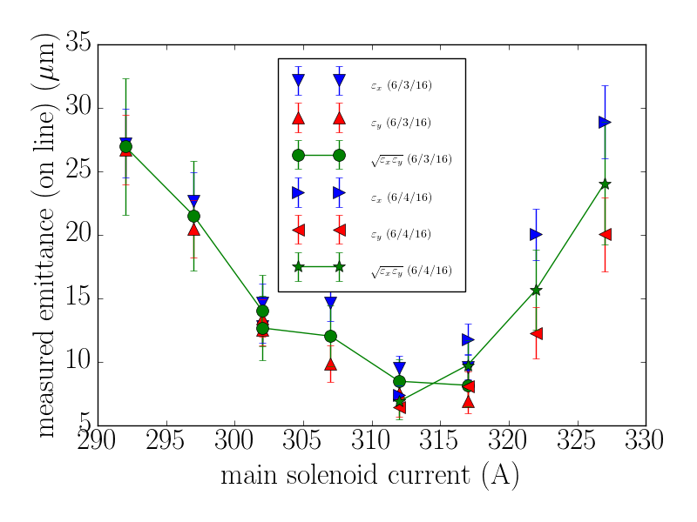
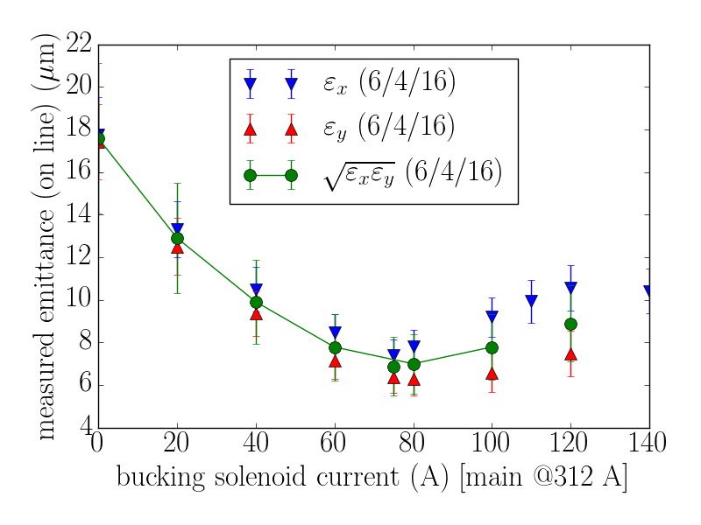
Current Performance - Emittances
Quad scan emittance measurements
Scan main gun solenoid with bucking solenoid tracking for zero-field @ cathode condition
For best emittance found, scan bucking solenoid to optimize emittance again.

Slide 8
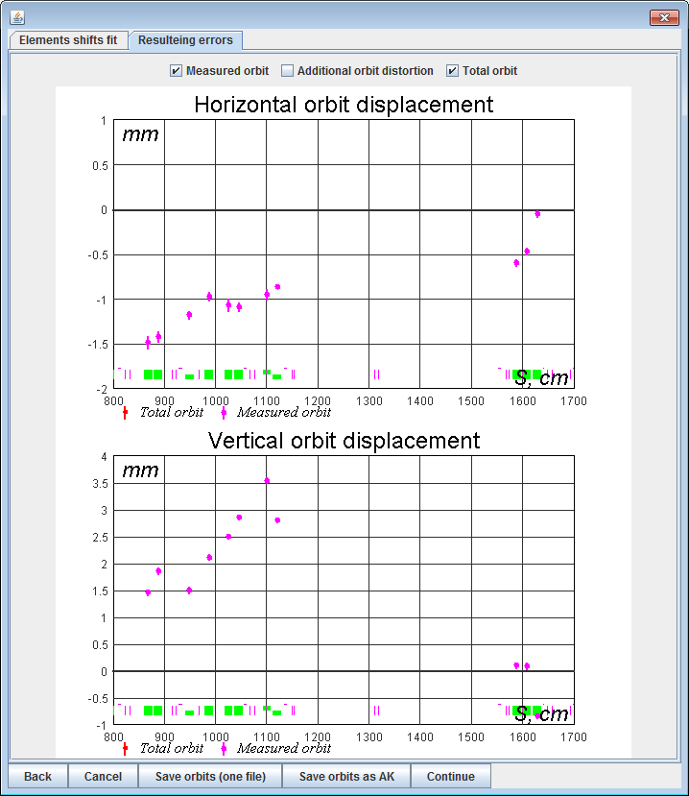
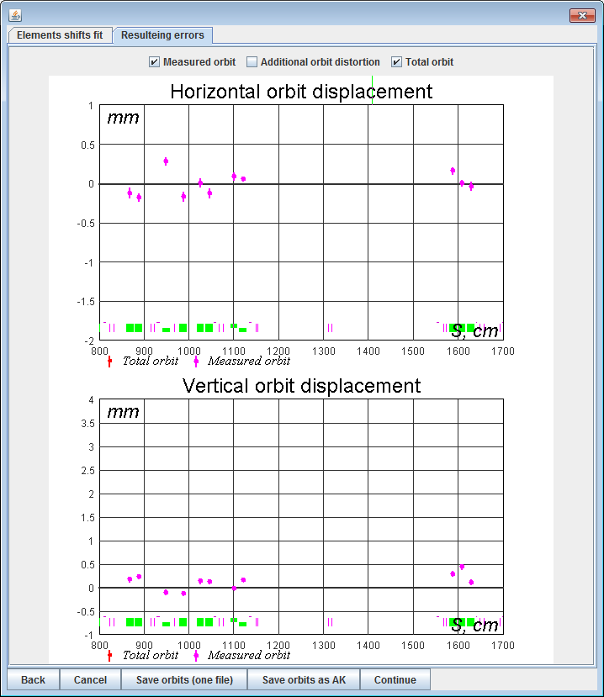
Trajectory Alignment
Before
After

Slide 9
Lattice Measurement
Use measured Twiss parameters and propagated beta functions
Predicted sizes are in qualitative agreement with measured ones.

Slide 10
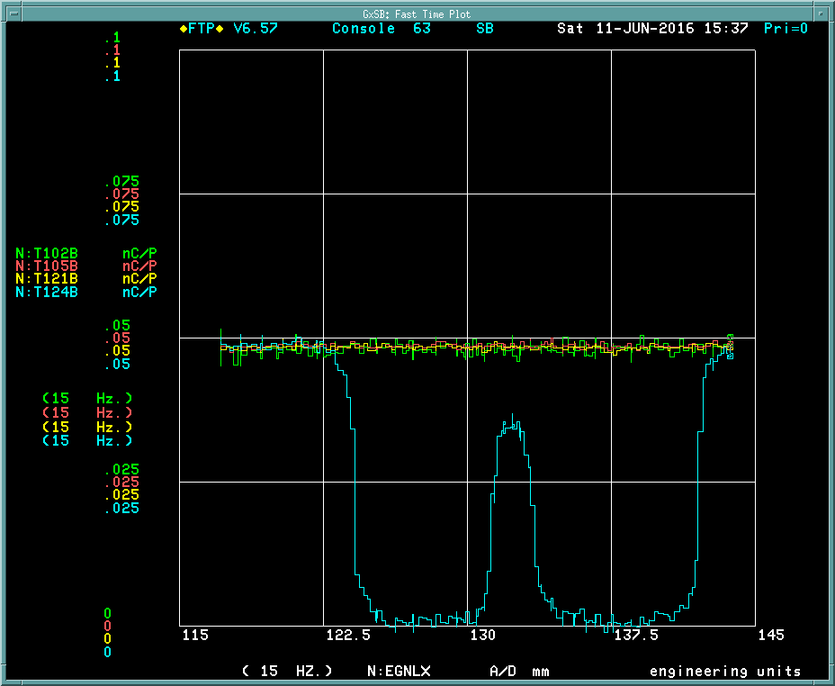
Goniometer
Nearly 100% transmission through goniometer open aperture. Intensity vs. position shows the location of the crystal.

Slide 11
Experimental Program
SRF Transfer Matrix Measurements
X – ray generation via crystal channeling
Continue to improve instrumentation and methods

Slide 12
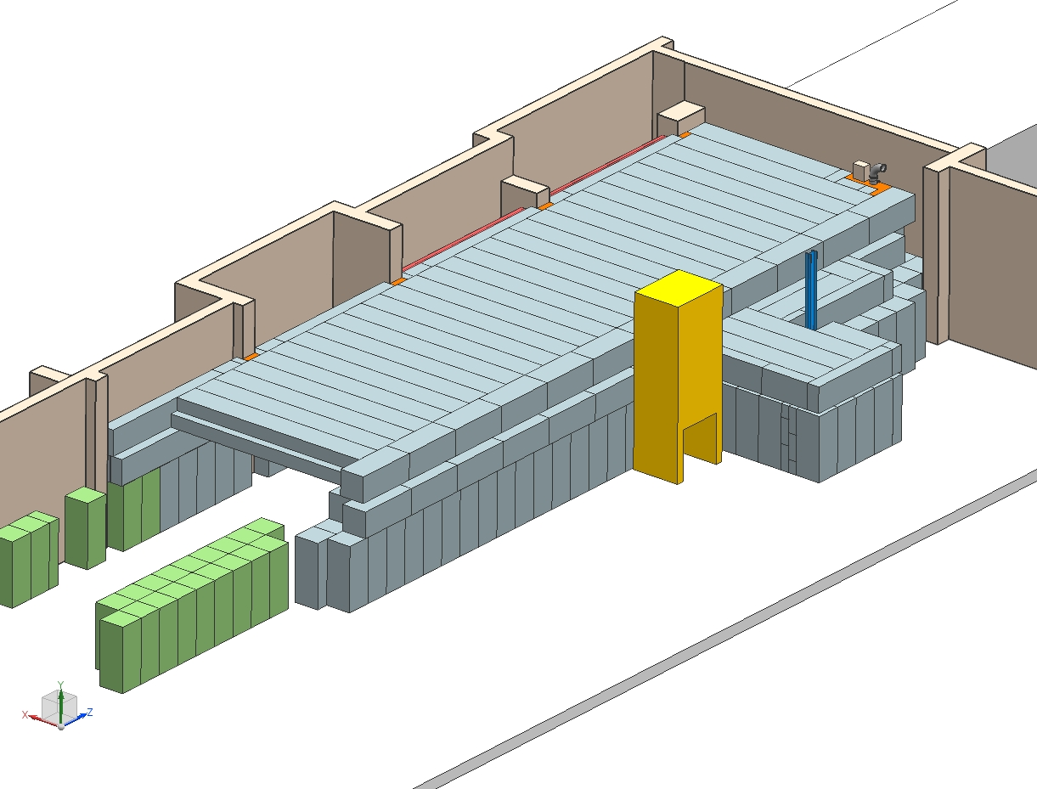
Continue Work towards 300 MeV Operations
Extend shielding to tunnel extension
Final designs completed - procurement initiated
Continuing vacuum system parts certification

