Slide 1
Status of the Integrable Optics Test Accelerator
Alexander Valishev
FAST/IOTA Scientific Program Meeting
14 June 2016

Slide 2
Acknowledgments
V.Bocean, D.Broemmelsiek, A.Burov, K.Carlson, A.Didenko, N.Eddy, V.Kashikhin, V.Lebedev, J.Leibfritz, M.McGee, S.Nagaitsev, L.Nobrega, H.Piekarz, E.Prebys, A.Romanov, G.Romanov, V.Shiltsev, G.Stancari, J.Thangaraj, R.Thurman-Keup, A.Valishev, S.Wesseln, D.Wolff (FNAL)
S.Chattopadhyay, P.Piot, Y.M.Shin (NIU)
D.Shatilov (BINP)
G.Kafka (IIT)
S.Danilov (ORNL),
S.Antipov (U of Chicago)
J.Cary (Tech-X)
D.Bruhwiler, N.Cook, S.Webb (RadiaSoft)
F.O’Shea, A.Murokh (RadiaBeam)
R.Kishek, K.Ruisard (UMD)

Slide 3
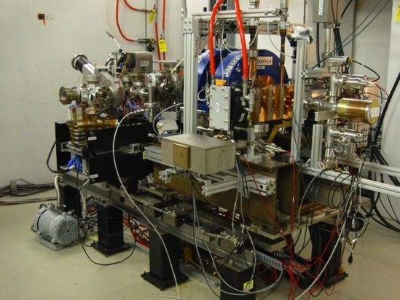
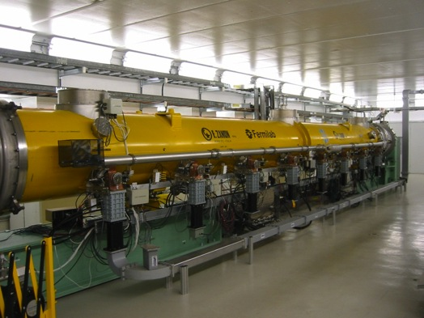
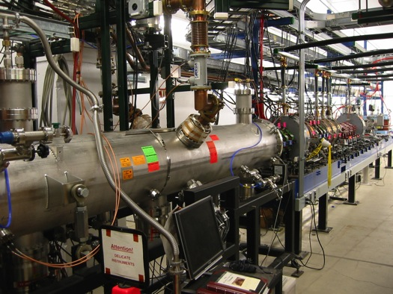
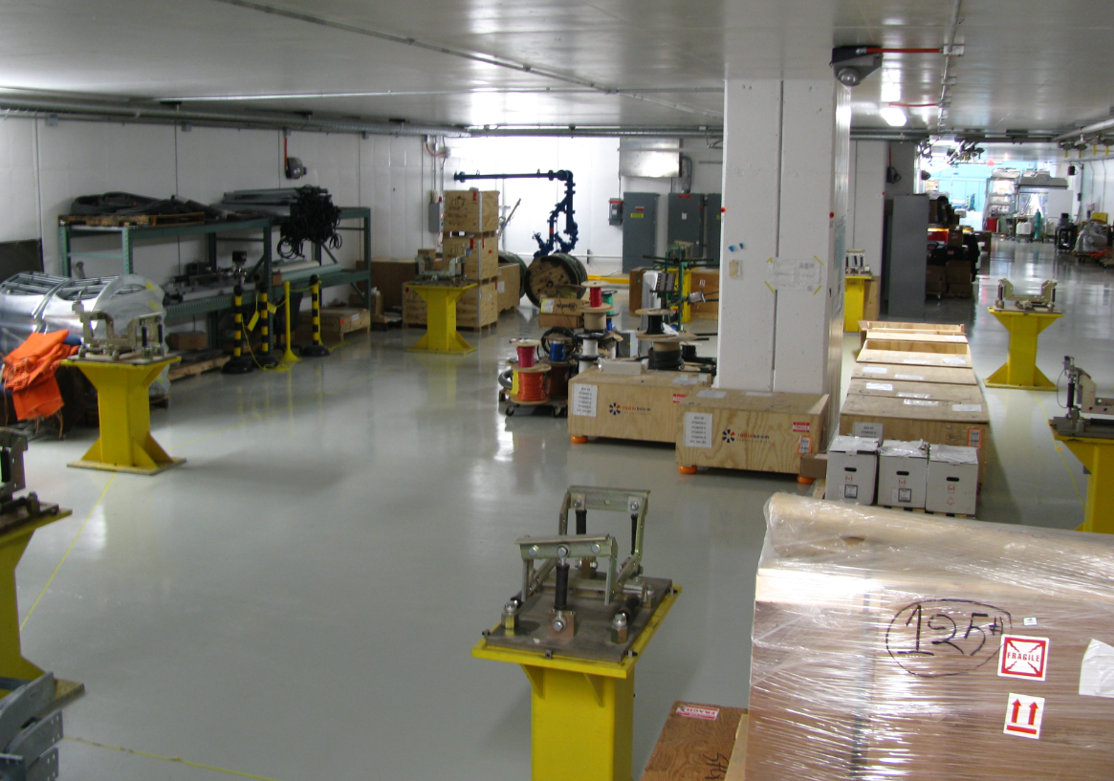
FAST
Need accelerator R&D beam facilities !

Slide 4
Integrable Optics Test Accelerator
Unique features:
  Can operate with either electrons or protons (up to 150 MeV/c momentum)
  Large aperture
  Significant flexibility of the lattice A.Romanov’s talk
  Precise control of the optics quality and stability
  Set up for very high intensity operation (with protons)
Based on conventional technology (magnets, RF)
Cost-effective solution
  Balance between low energy (low cost) and research potential

Slide 5
IOTA Physics Drivers
Nonlinear Integrable Optics – Experimental demonstration of NIO lattice in a practical accelerator
Space Charge Compensation – Suppression of SC-related effects in high intensity circular accelerators
  Nonlinear Integrable Optics – D.Bruhwiler, C.Mitchell’s talk
  Electron lenses – G.Stancari’s talk
  Electron columns – C.S.Park’s talk
  Circular betatron modes
Beam collimation – Technology development for hollow electron beam collimation
Optical Stochastic Cooling – Proof-of-principle – V.Lebedev’s talk
Electron Cooling – Advanced techniques
Laser-Plasma Accelerator – Demonstration of injection - A.Mikhailichenko’s talk
Quantum Physics – R.Dixon’s talk

Slide 6
IOTA Parameters
Nominal kinetic energy | e⁻: 150 MeV, p+: 2.5 MeV
Nominal intensity | e⁻: 1×10⁹, p+: 1×10¹¹
Circumference | 40 m
Bending dipole field | 0.7 T
Beam pipe aperture | 50 mm dia.
Maximum b-function (x,y) | 12, 5 m
Momentum compaction | 0.02 ÷ 0.1
Betatron tune (integer) | 3 ÷ 5
Natural chromaticity | -5 ÷ -10
Transverse emittance r.m.s. | e⁻: 0.04 μm, p+: 2μm
SR damping time | 0.6s (5×10⁶ turns)
RF V,f,q | e⁻: 1 kV, 30 MHz, 4
Synchrotron tune | e⁻: 0.002 ÷ 0.005
Bunch length, momentum spread | e⁻: 12 cm, 1.4×10⁻⁴
Beam lifetime | e⁻: 1 hour, p+: 1 min

Slide 7
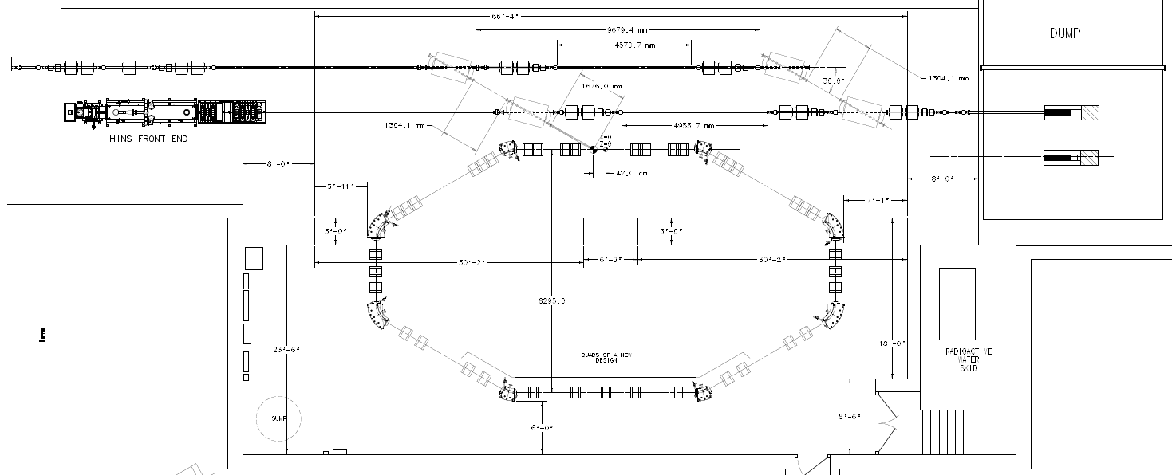
IOTA Ring
e- beam line
p beam line
2.5 MeV RFQ

Slide 8
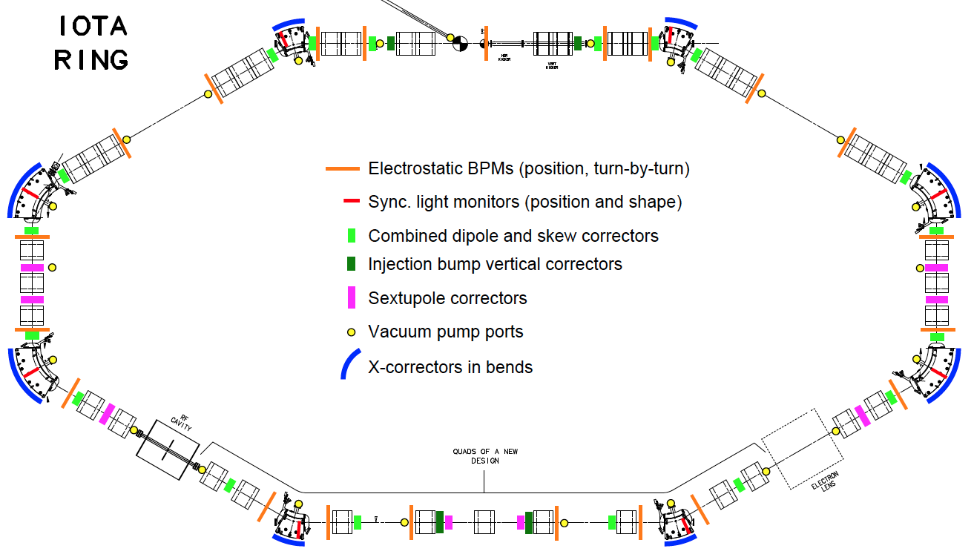
IOTA Layout

Slide 9
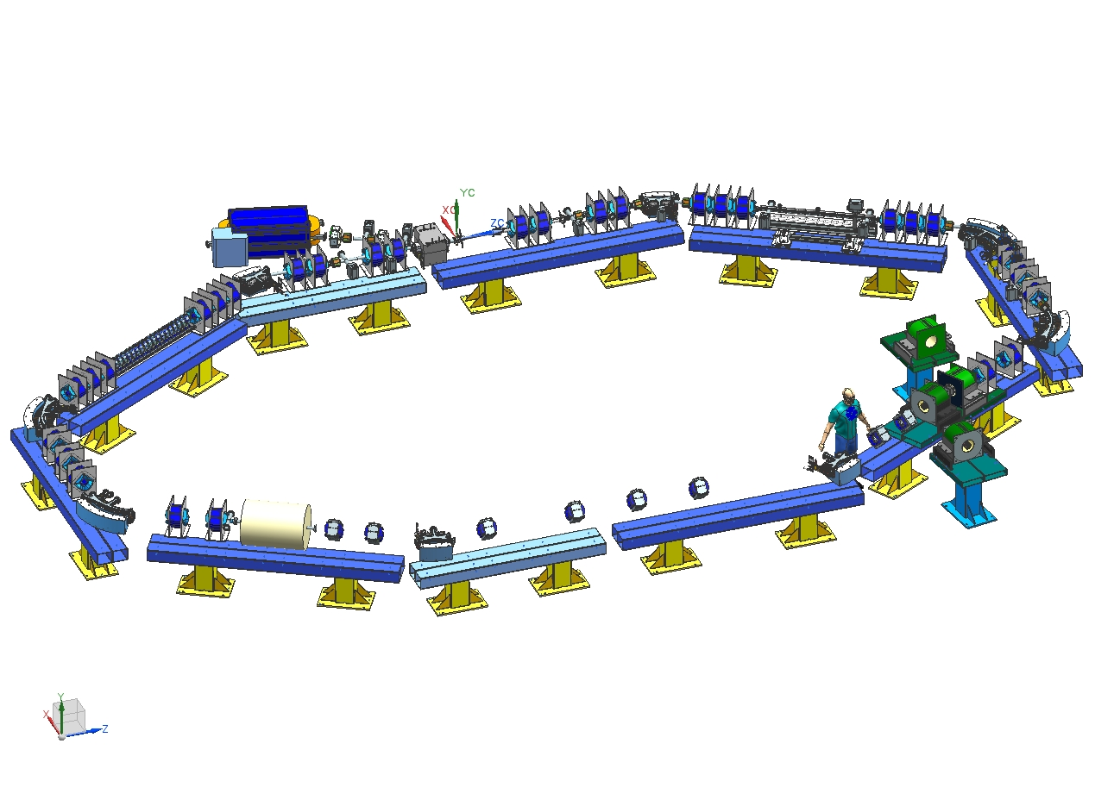
IOTA Layout

Slide 10
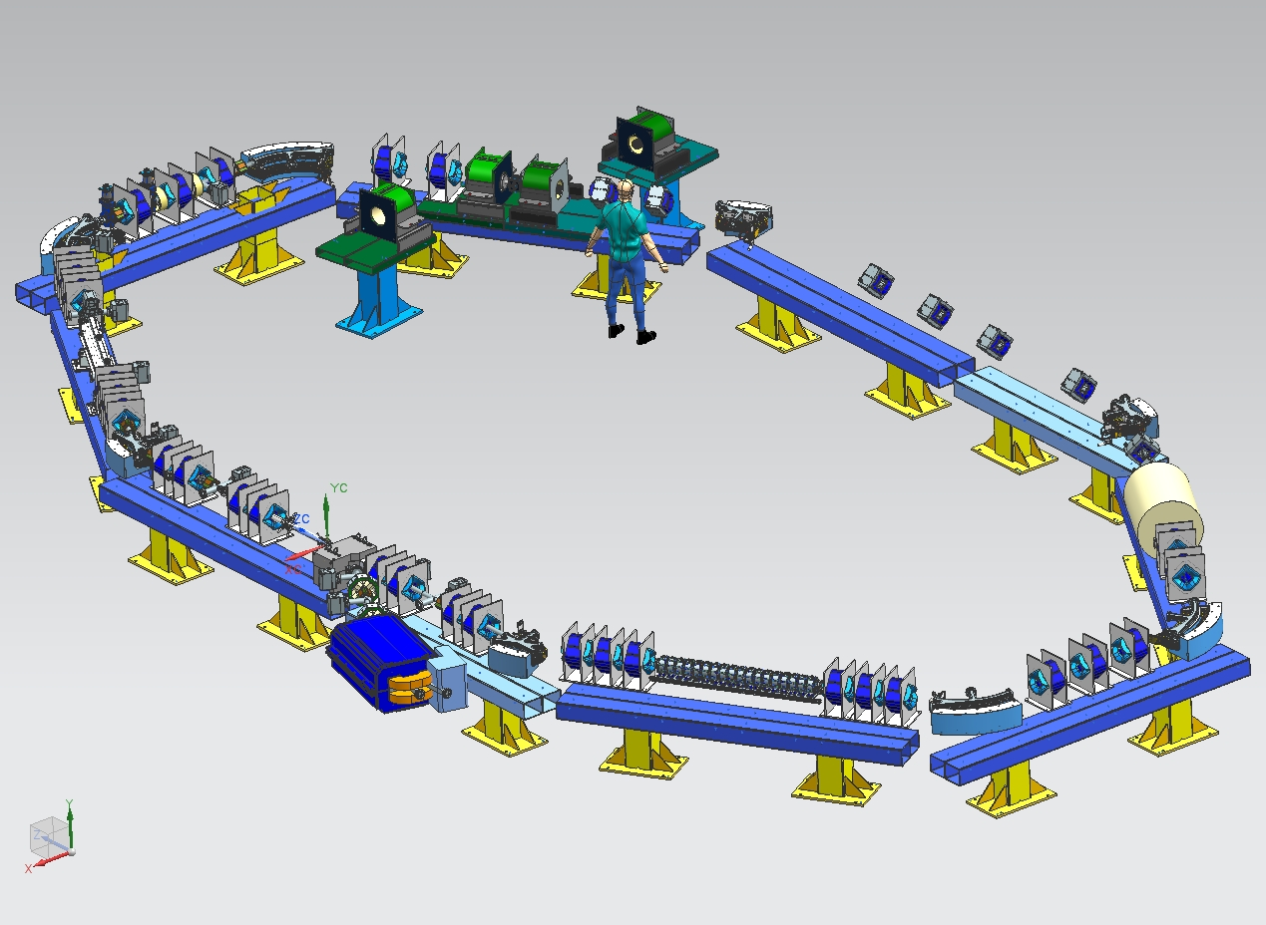
IOTA Layout

Slide 11
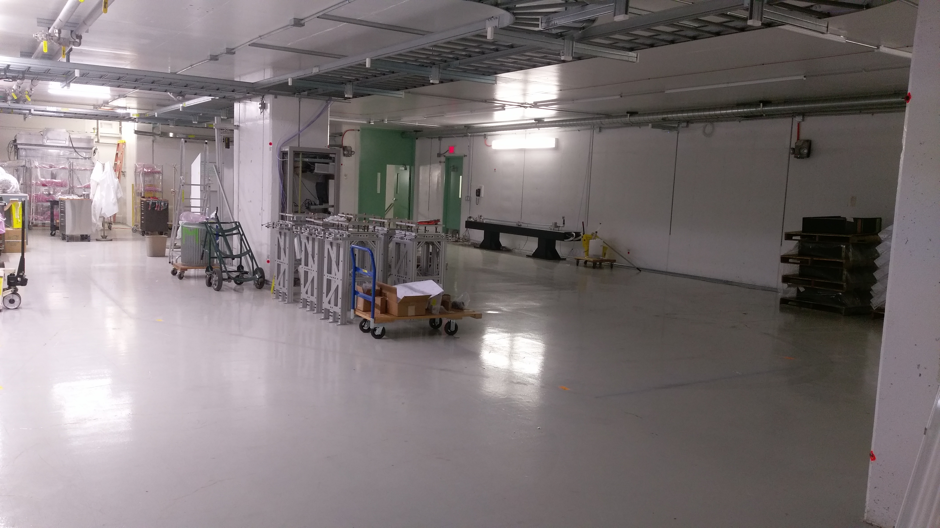
Hall cleaned, cable trays installed.

Slide 12
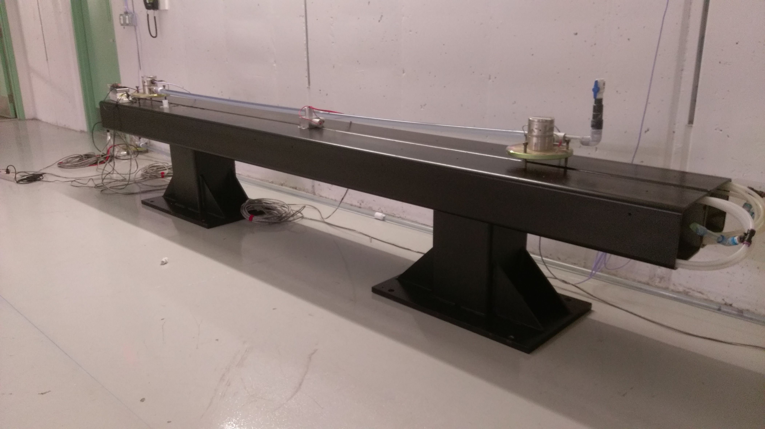
Floor girder. 3 ready, 7 to be delivered this summer.
Magnets stands designed, to be manufactured this year

Slide 13
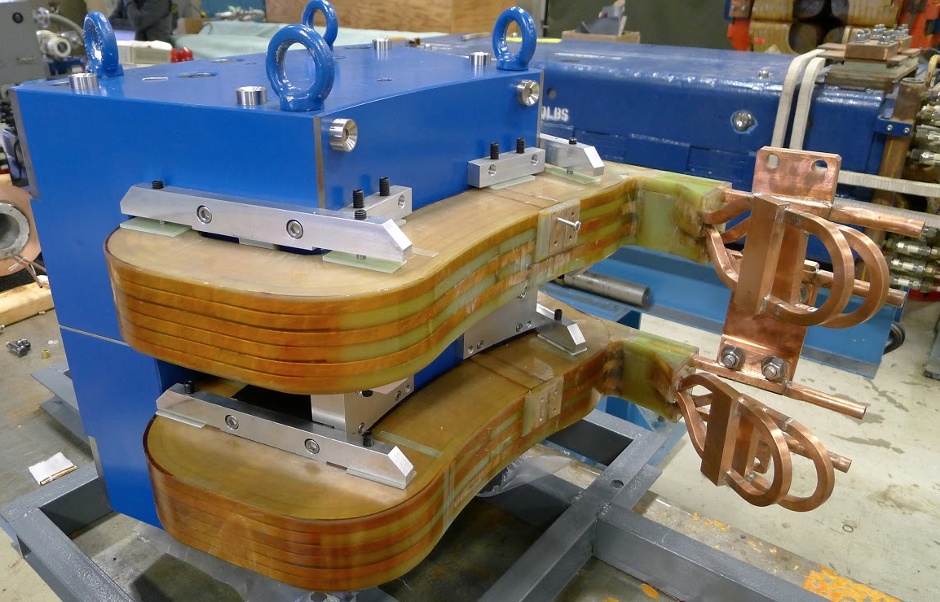
30-deg. dipole (2015). Remaining 9 to be shipped in June.

Slide 14
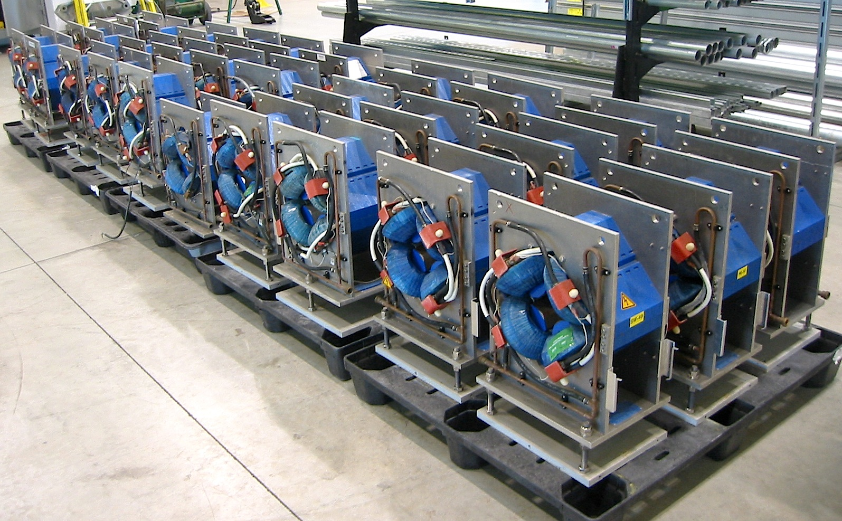
‘Dubna’ quadrupoles (32) – 30 refurbished

Slide 15
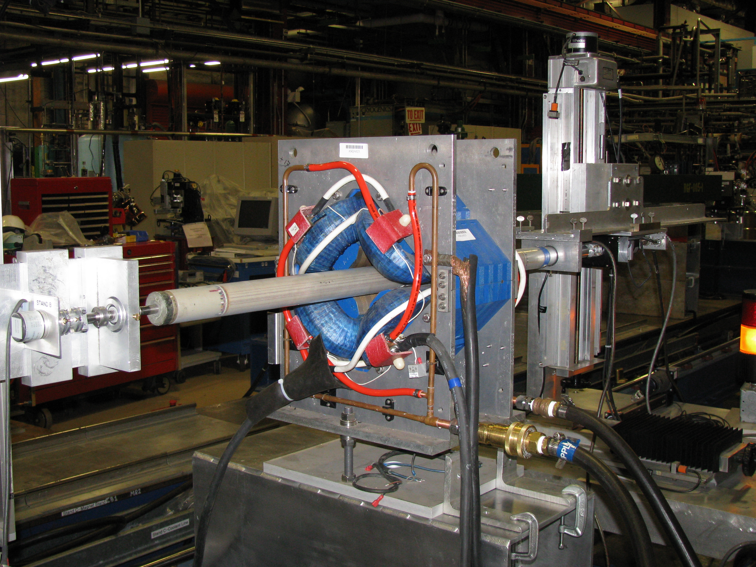
20 quadrupoles referenced and multipole harmonics measured

Slide 16
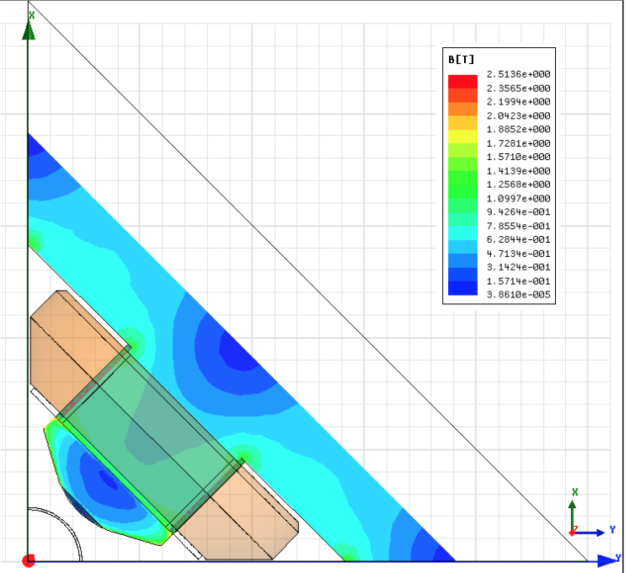
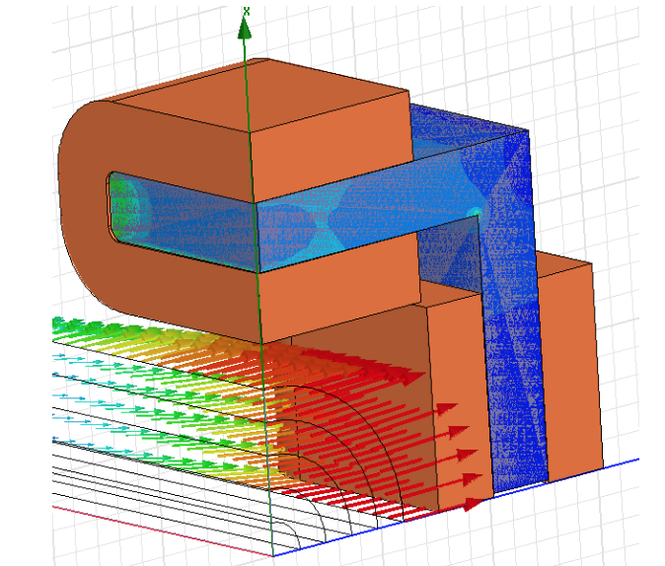
Additional quadrupoles and correctors ordered,
to be delivered this year.

Slide 17
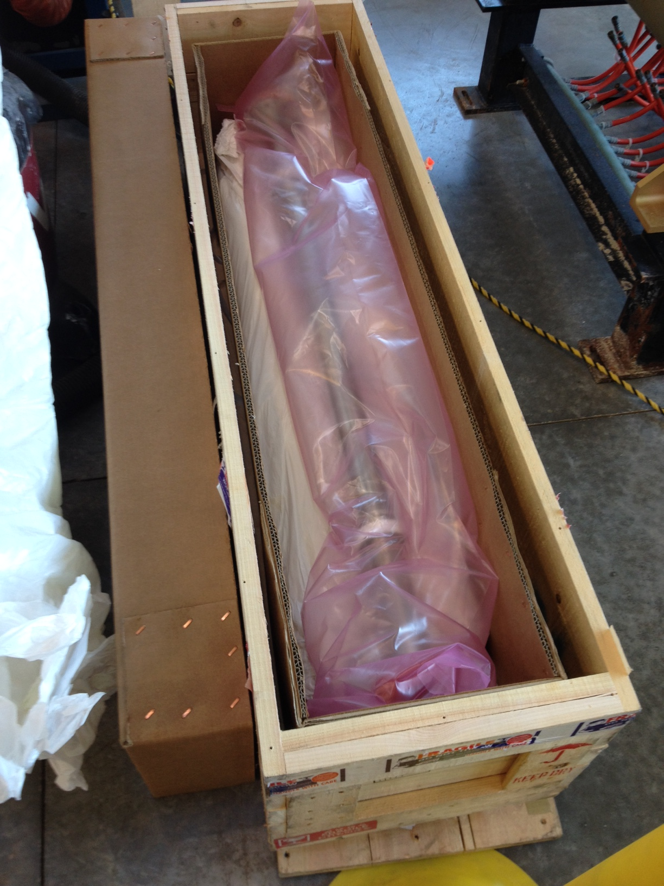
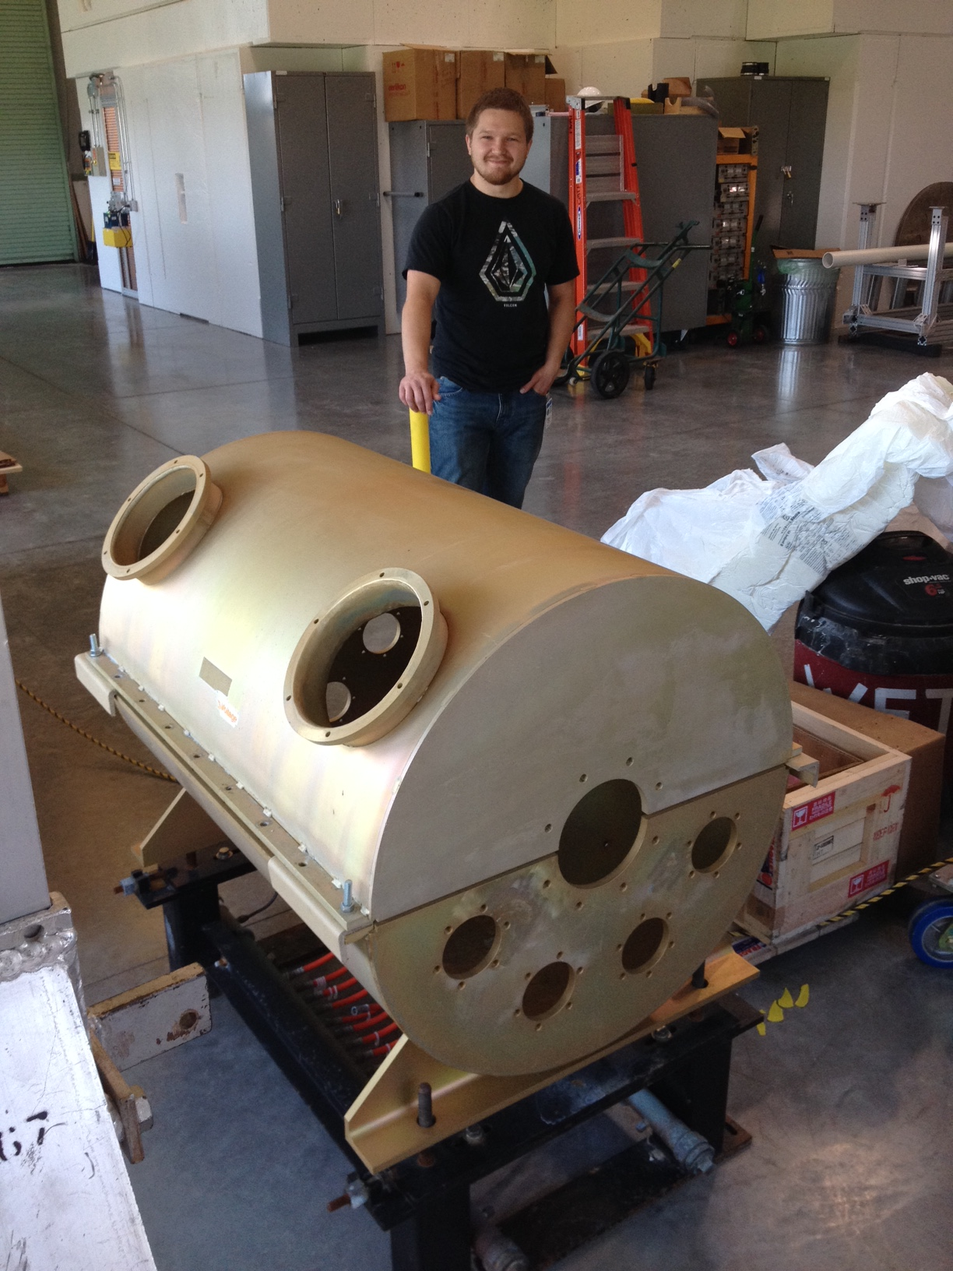
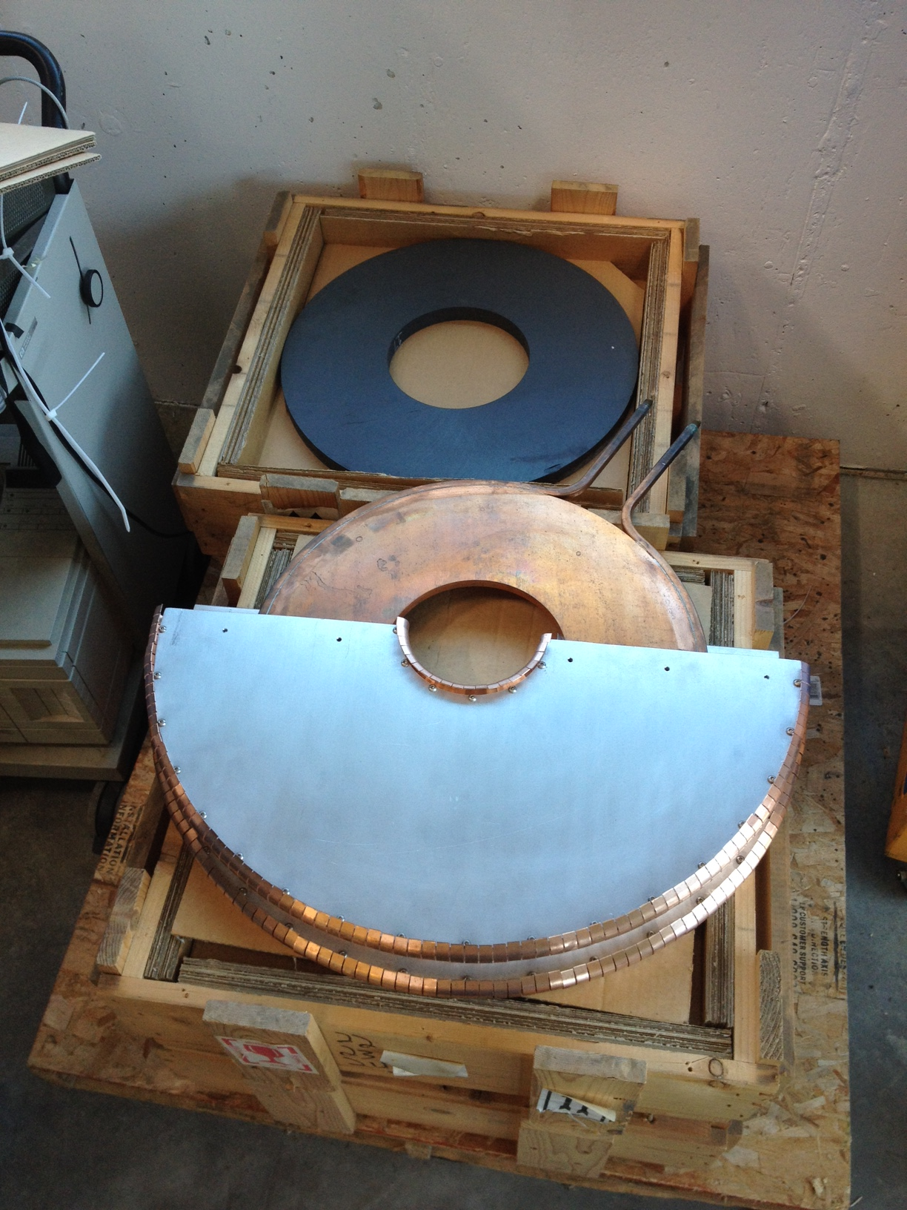
Double ceramic chamber received
Pbar RF cavity refurbished
Ferrite rings tested

Slide 18
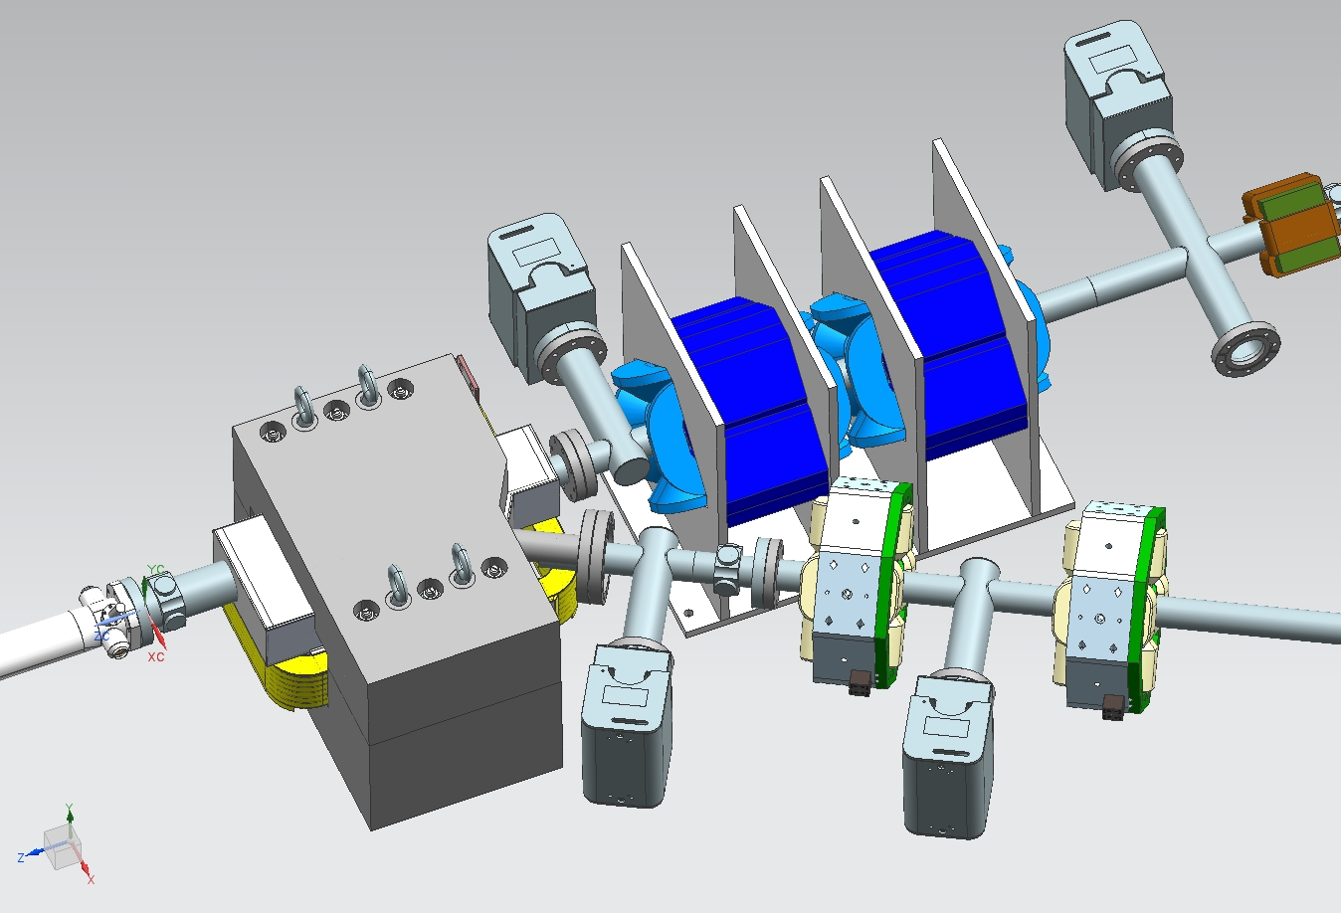
IOTA Injection Lambertson – Design complete, drafting and fabrication in progress
  Kicker designed, manufacturing in progress.
  Pulse generator is reused from Tevatron, tested.
IOTA injection Lambertson

Slide 19
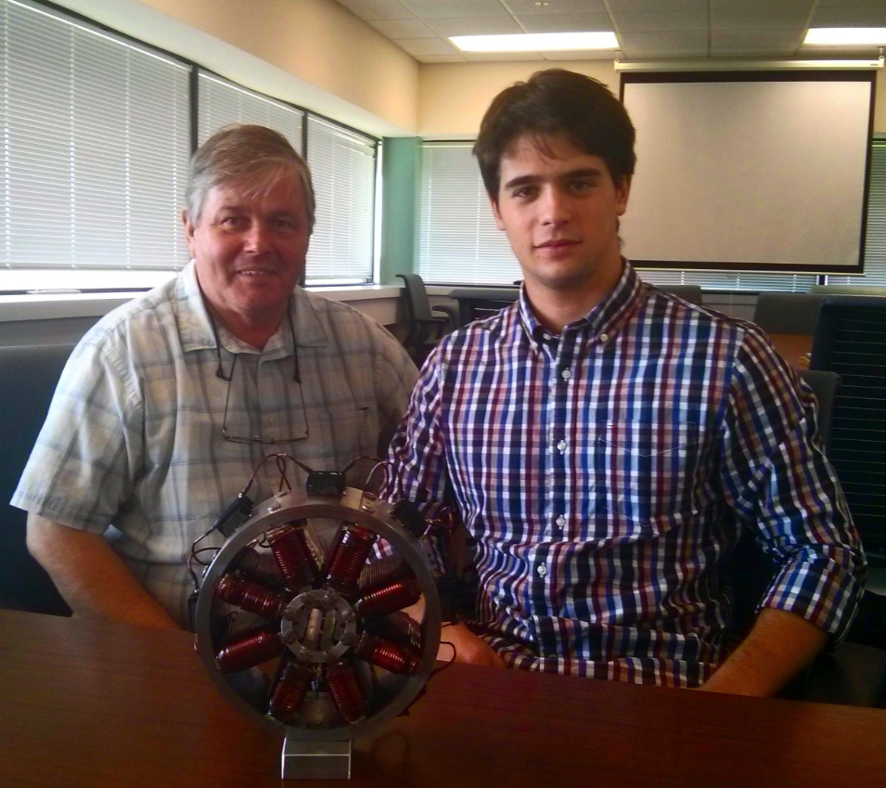
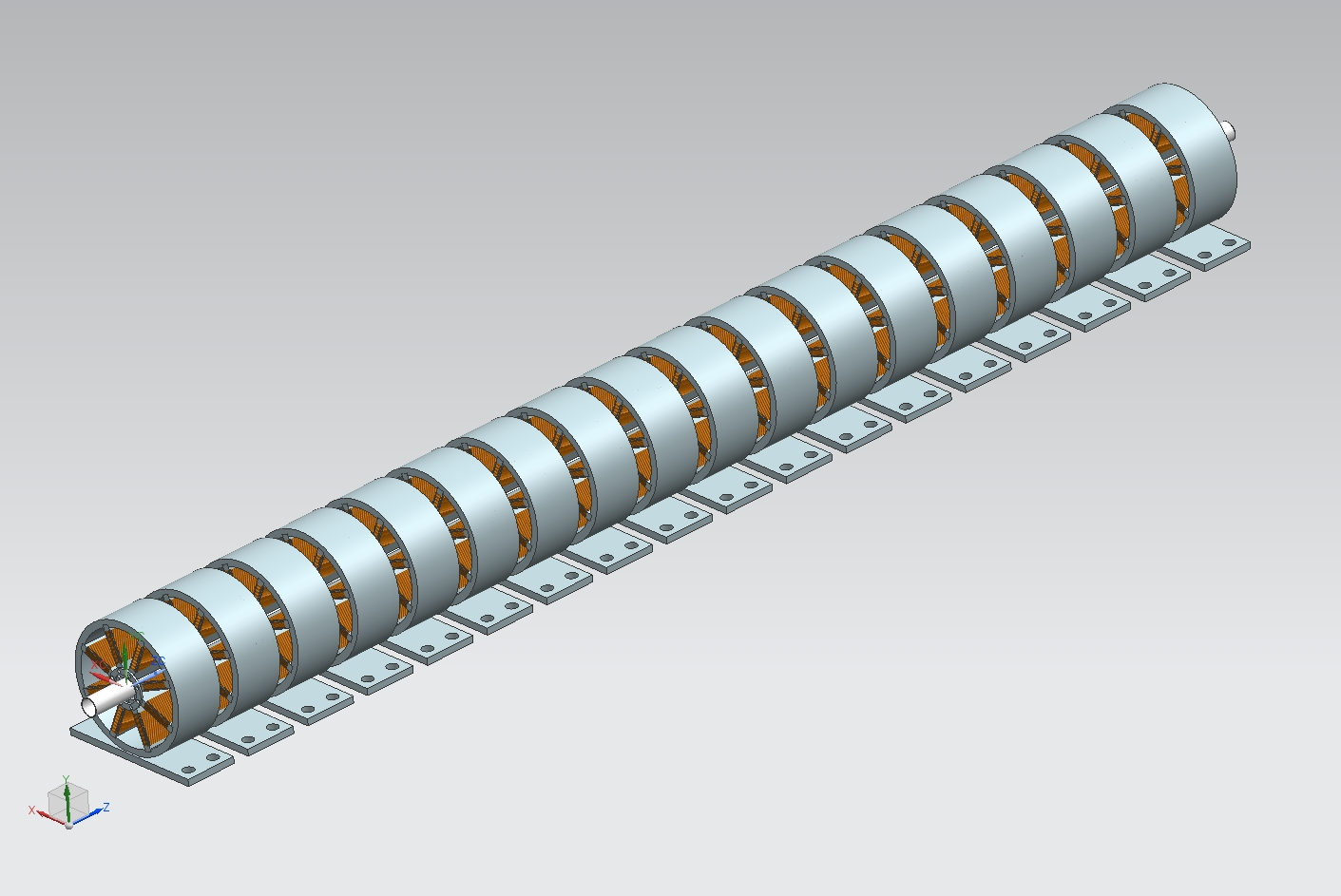
Octupoles for Quasi-Integrable System
K.Carlsson, R.Castellotti
Summer engineering internship project. Prototype built in 2015,
All parts fabricated. Magnets will be assembled in 2016

Slide 20
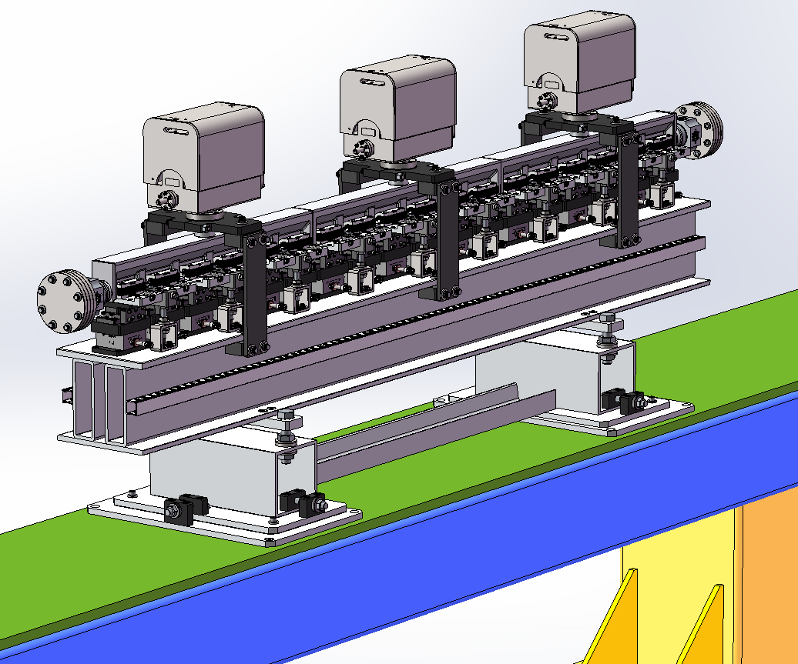
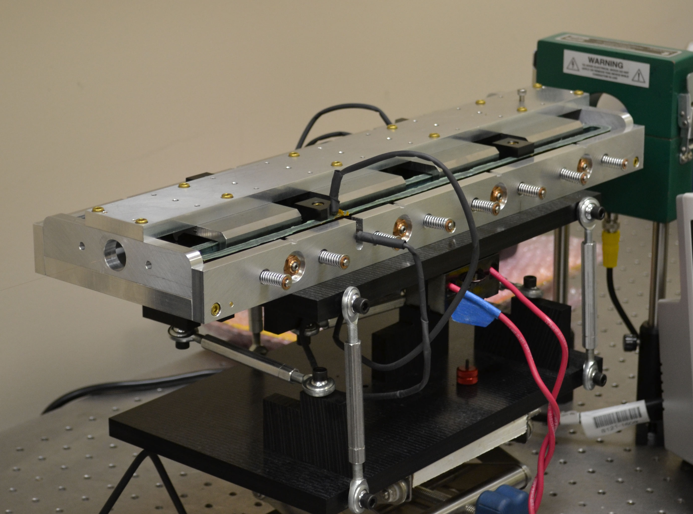
Nonlinear Magnet
Design by RadiaBeam Technologies (Phase I and II SBIR)
Short prototype built in Phase I
1.8-m long magnet to be delivered in 2016

Slide 21
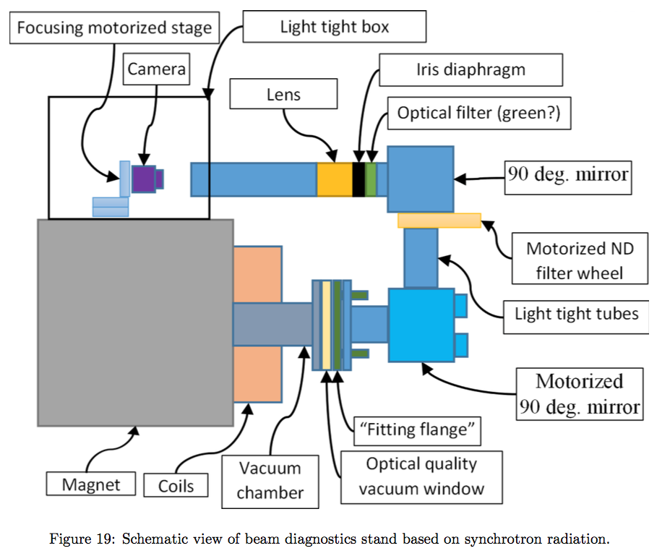
Synchrotron Light Based Diagnostics – 2016 internship project
Components procured
Prototype to be assembled
this summer

Slide 22
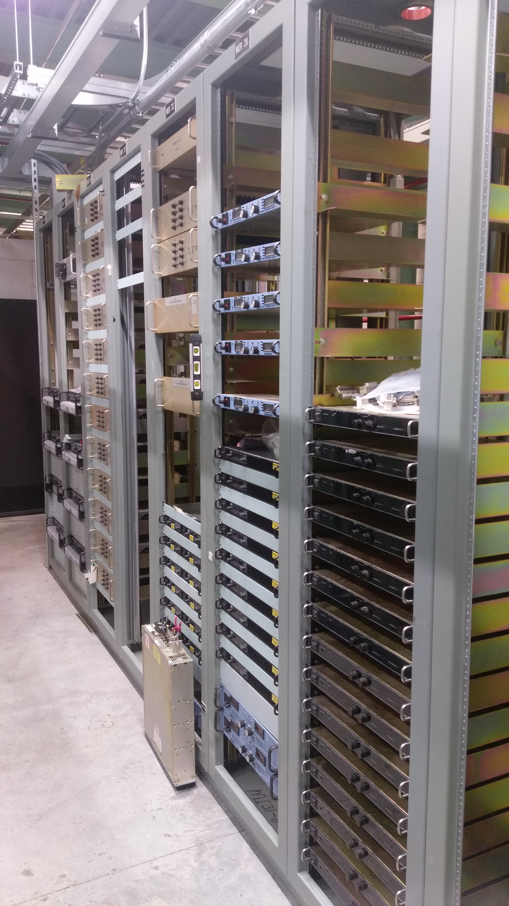
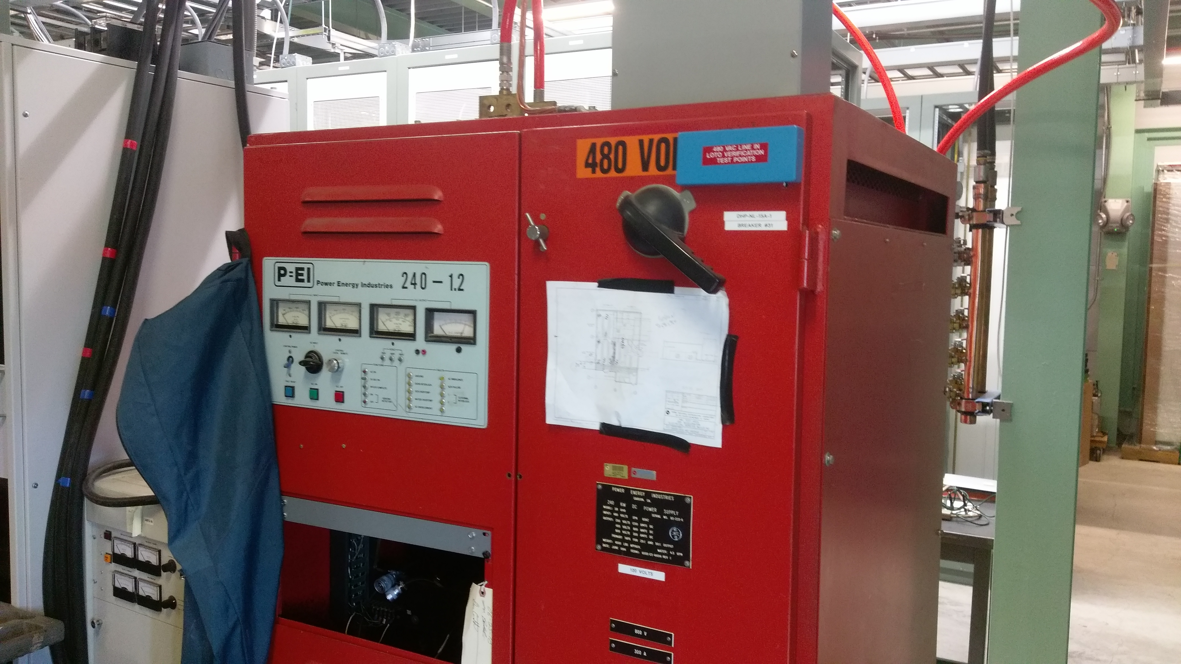
IOTA Systems
Power supplies purchased, installed. Cable pulls in progress.
Vacuum system:
  Dipole alum. chambers manufactured.
  Vacuum pumps and gauges purchased.

Slide 23
IOTA Staging – Phase I
Phase I will concentrate on the academic aspect of single-particle motion stability using e- beams
  Achieve large nonlinear tune shift/spread without degradation of dynamic aperture by “painting” the accelerator aperture with a “pencil” beam
  Suppress strong lattice resonances = cross the integer resonance by part of the beam without intensity loss
  Investigate stability of nonlinear systems to perturbations, develop practical designs of nonlinear magnets
  The measure of success will be the achievement of high nonlinear tune shift = 0.25
Notes:
color pencil beam

Slide 24
IOTA Staging – Phase I
The magnet quality, optics stability, instrumentation system and optics measurement techniques must be of highest standards in order to meet the requirements for integrable optics
  1% or better measurement and control of β-function, and 0.001 or better control of betatron phase
This is why Phase I needs pencil e⁻ beams as such optics parameters are not immediately reachable in a small ring operating with protons

Slide 25
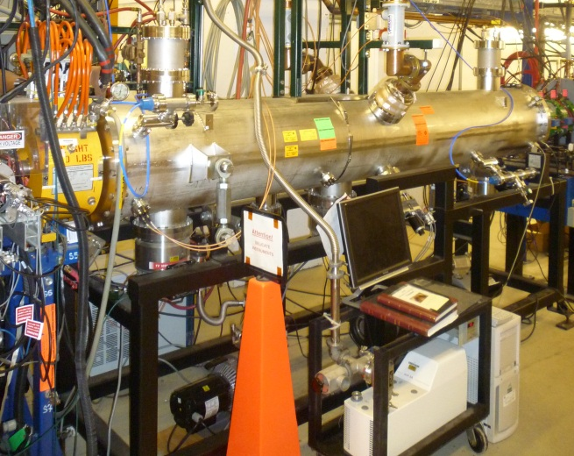
IOTA Staging – Phase II
After the IOTA commissioning with e-, we will move the existing 2.5 MeV proton/H- RFQ to FAST to inject protons into the IOTA ring.
Allows tests of Integrable Optics with protons and realistic space charge beam dynamics studies
Allows space charge compensation experiments
ΔQ_{SC} =0.5 for one-turn injection
*multi-turn injection possible
2.5 MeV RFQ
Notes:
multi-tun injection possible

Slide 26
Resources
Construction / Instruments
FAST/IOTA Department in Accelerator Division
  17 people (8 FTE on FAST)
Support Depts. in AD and TD
  1.6 FTE on FAST
GARD M&S
In-kind contributions
  JINR Dubna quadrupoles
  MIT/Bates support stands
Fermilab LDRD (PI Chattopadhyay)
NIU (PI Chattopadhyay)
SBIR Phase II RadiaBeam Technologies
  nonlinear magnet

Slide 27
Summary
First IOTA experiments on nonlinear integrable optics with e- is in good shape
  Simulations done
  Nonlinear magnets on track
IOTA construction plans for completion in FY17
IOTA needs resources in FY16-17 to accomplish the goals
  Lab priorities and availability of engineering/mechanical labor may impact schedule
  Required extra engineering support ~1 FTE (mix of EE and Mechanical) for 3 years

Slide 28
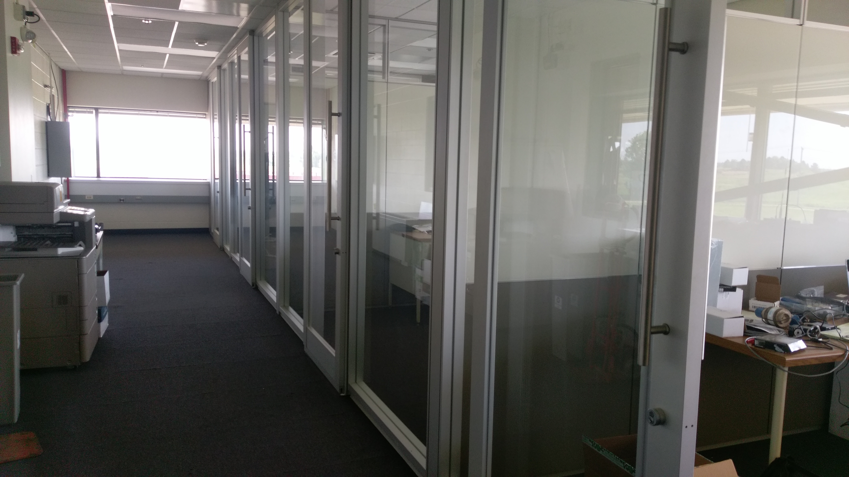
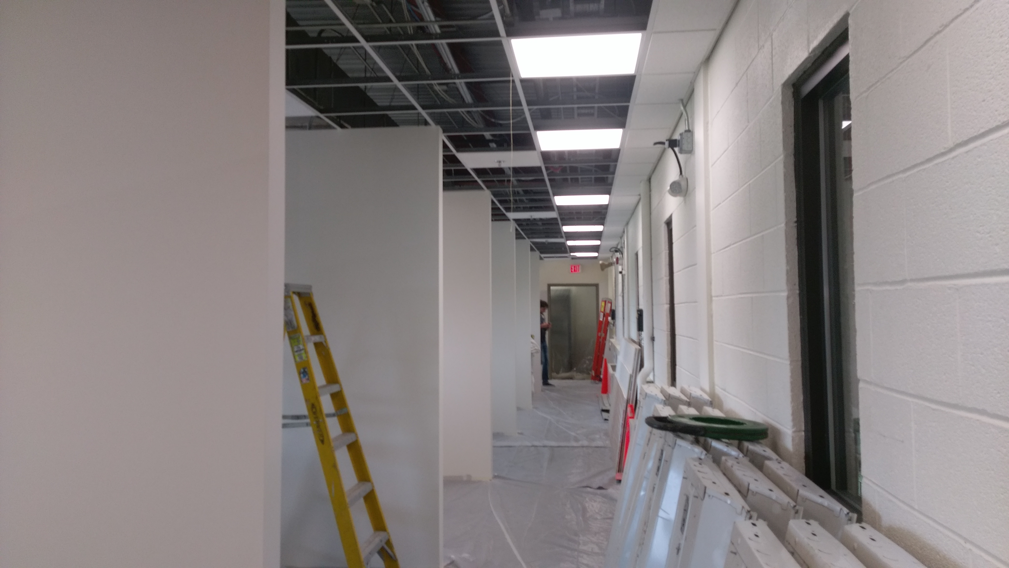
FAST/IOTA Dept. moves to FAST

