Slide 1
Simulation of Space Charge Compensation Using e-Columns at IOTA
Chong Shik Park and Jayakar Thangaraj
June 14, 2016
Thanks to Giulio Stancari, Vladimir Shiltsev, and Moses Chung
2016 FAST-IOTA Scientific meeting

Slide 2
Space Charge (SC) – Crucial Challenge at High Intensity
Intensity Frontier presents an important fundamental challenge – Space Charge Effects
SC
ACCELERATE COMPENSATE CONTROL
- Space Charge Tune Shift
$\sim γ^{−3}$
- Cons: expensive LINACs
- Add opposite charges
- Create a neutral plasma
- Integrable Lattice
- Scrapping
- SC Compensation w/ solenoid in RF Photoinjector

Slide 3
Space Charge (SC) – Compensation
Two ways of compensation
Co-propagating beam of opposite charge (e-lens)
Robust, precise control of transverse profile of the e-beam
Experimentally mature Swiss knife (many actual and potential benefits)
Passive compensation proton beam (e-columns)
Self-ignition: Use protons to ionize the vacuum and to generate electrons
Electrons are approximately rest longitudinally compared to co-moving electrons in e-lens
Trap/Match/Control the electrons and their profile – solenoid and electrodes
Remove $H_{2}^{+}$ ions (edge electrodes)
Challenges: Many physical processes
Our initial approach: Simulation – to understand the precise parameter range for the magnetic field, voltages, etc.

Slide 4
Shiltsev (2007)* – Proposed the Experimental Setup
[Courtesy of N. Chauvin, ICIS'11]
* V. Shiltsev et al. The Use of Ionization Electron Columns for Space‐Charge Compensation in High Intensity Proton Accelerators AIP Conf. Proc. 1086, 649 (2009)

Slide 5
Historical Success, Challenges, and Specific Requirements
Several experimental attempts have been made
Linacs:
In linear machines, successfully applied to transport high-current low energy proton and $H^{−}$ beam (gas focusing), Gabor lens, etc.
Solenoid based compensation in RF photoinjectors. Now a standard in x-ray FELs
Circular machines
Novosibirsk PSR ~ 10 SC limit! G. I. Dimov, V. E. Chupriyanov (1984)
Conditions: few mTorr, H₂ gas, 1 MeV proton, 100 turns, 6.8 m
Cons: e-p instabilities a major obstacle
Our Strategies
- Strong magnetic field stabilizes the e-column, prevents e-p instabilities
- Match the transverse profile
- Local compensation for an overall ring effect. Control

Slide 6
e-Column: HIGH concentration over small fraction of the ring
Assuming full compensation on average
No relativistic cancellation for the electrons as they are stationary
If we only use a fraction of the ring then, “denser column”
η: degree of local space charge compensation
C: circumference of the ring
N_{e}, N_{p}: total number of electrons and protons
N_{ec} : number of electron columns
L_{ec:} length of electron columns
λ_{e}, λ_{p}: average line charge density of electrons and protons

Slide 7
History of the Simulations on the Concept e-lens & e-column
Y. Alexahin & V. Kapin (2007) showed promising results using e-lens concept for space charge compensation in FNAL Booster.
M. Chung (2014) used WARP-3D to test the idea of e-column at IOTA Ring.
Conclusion: over-compensations were observed. Too much electron accumulations.
Our Features in WARP-3D Simulations:
2.5 MeV protons injected to ionize residual gas
1 m long electron column
Dynamics of electrons and ions in E and B fields
Primary proton beam considered as stable.
Control B, gas pressure, voltages on electrodes, and geometry of the e-column
WARP-3D simulations were done on the Fermilab Wilson Cluster, on-site superb support from the Fermilab Scientific Computing Division.

Slide 8
Some practical numbers and limits
Proton beam potential at the center is given by
If e-column length is 1 m and the circumference is ~ 40 m, we get about 150 V for full space charge compensation. Our study is limited to 1 m channel only. No ring is considered
Larmor radius (for 100 eV, 0.1 T) < 0.5 mm,
<< proton beam radius
Our goal has three fold
- Match transversely [ ‘resistive’ solenoid field and electrodes]
- Compensate longitudinally [electrodes]
- Neutralize quickly i.e. neutralization time should not be too long (revolution time is ~ 1.8 us)

Slide 9
WARP 3D Simulation Parameters
Beam parameters:
Beam species | Proton
Beam energy | 2.5 MeV
Average beam current | 8 mA
RMS beam size | 5.5 mm
Beam distribution | -Uniform in longitudinal direction -Gaussian in transverse direction (for initial test)
Apparatus parameters:
Length | 1 m
Electrode size | 0.1 m
Wall radius | 25 mm
Solenoid field | 0 ~ 0.2 T
Bias voltage | 0 ~ -200 V
Gas parameters:
Main gas species | H₂
Pressure | 10⁻³ Torr (for initial test)
Neutralization time | 0.86 μs
Processes considered
Numerical parameters:
Particle injection/step | 100 (~7500)
Time step (< 2π/ω_{ce}) | 15 psec
Boundary conditions | Absorbing boundaries for particles

Slide 10
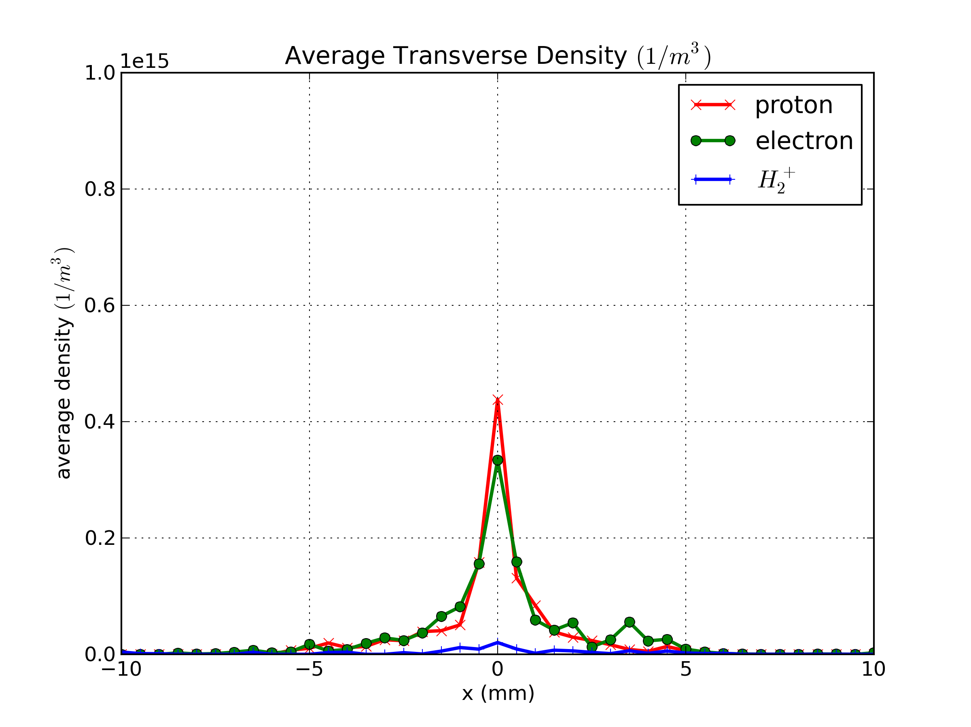
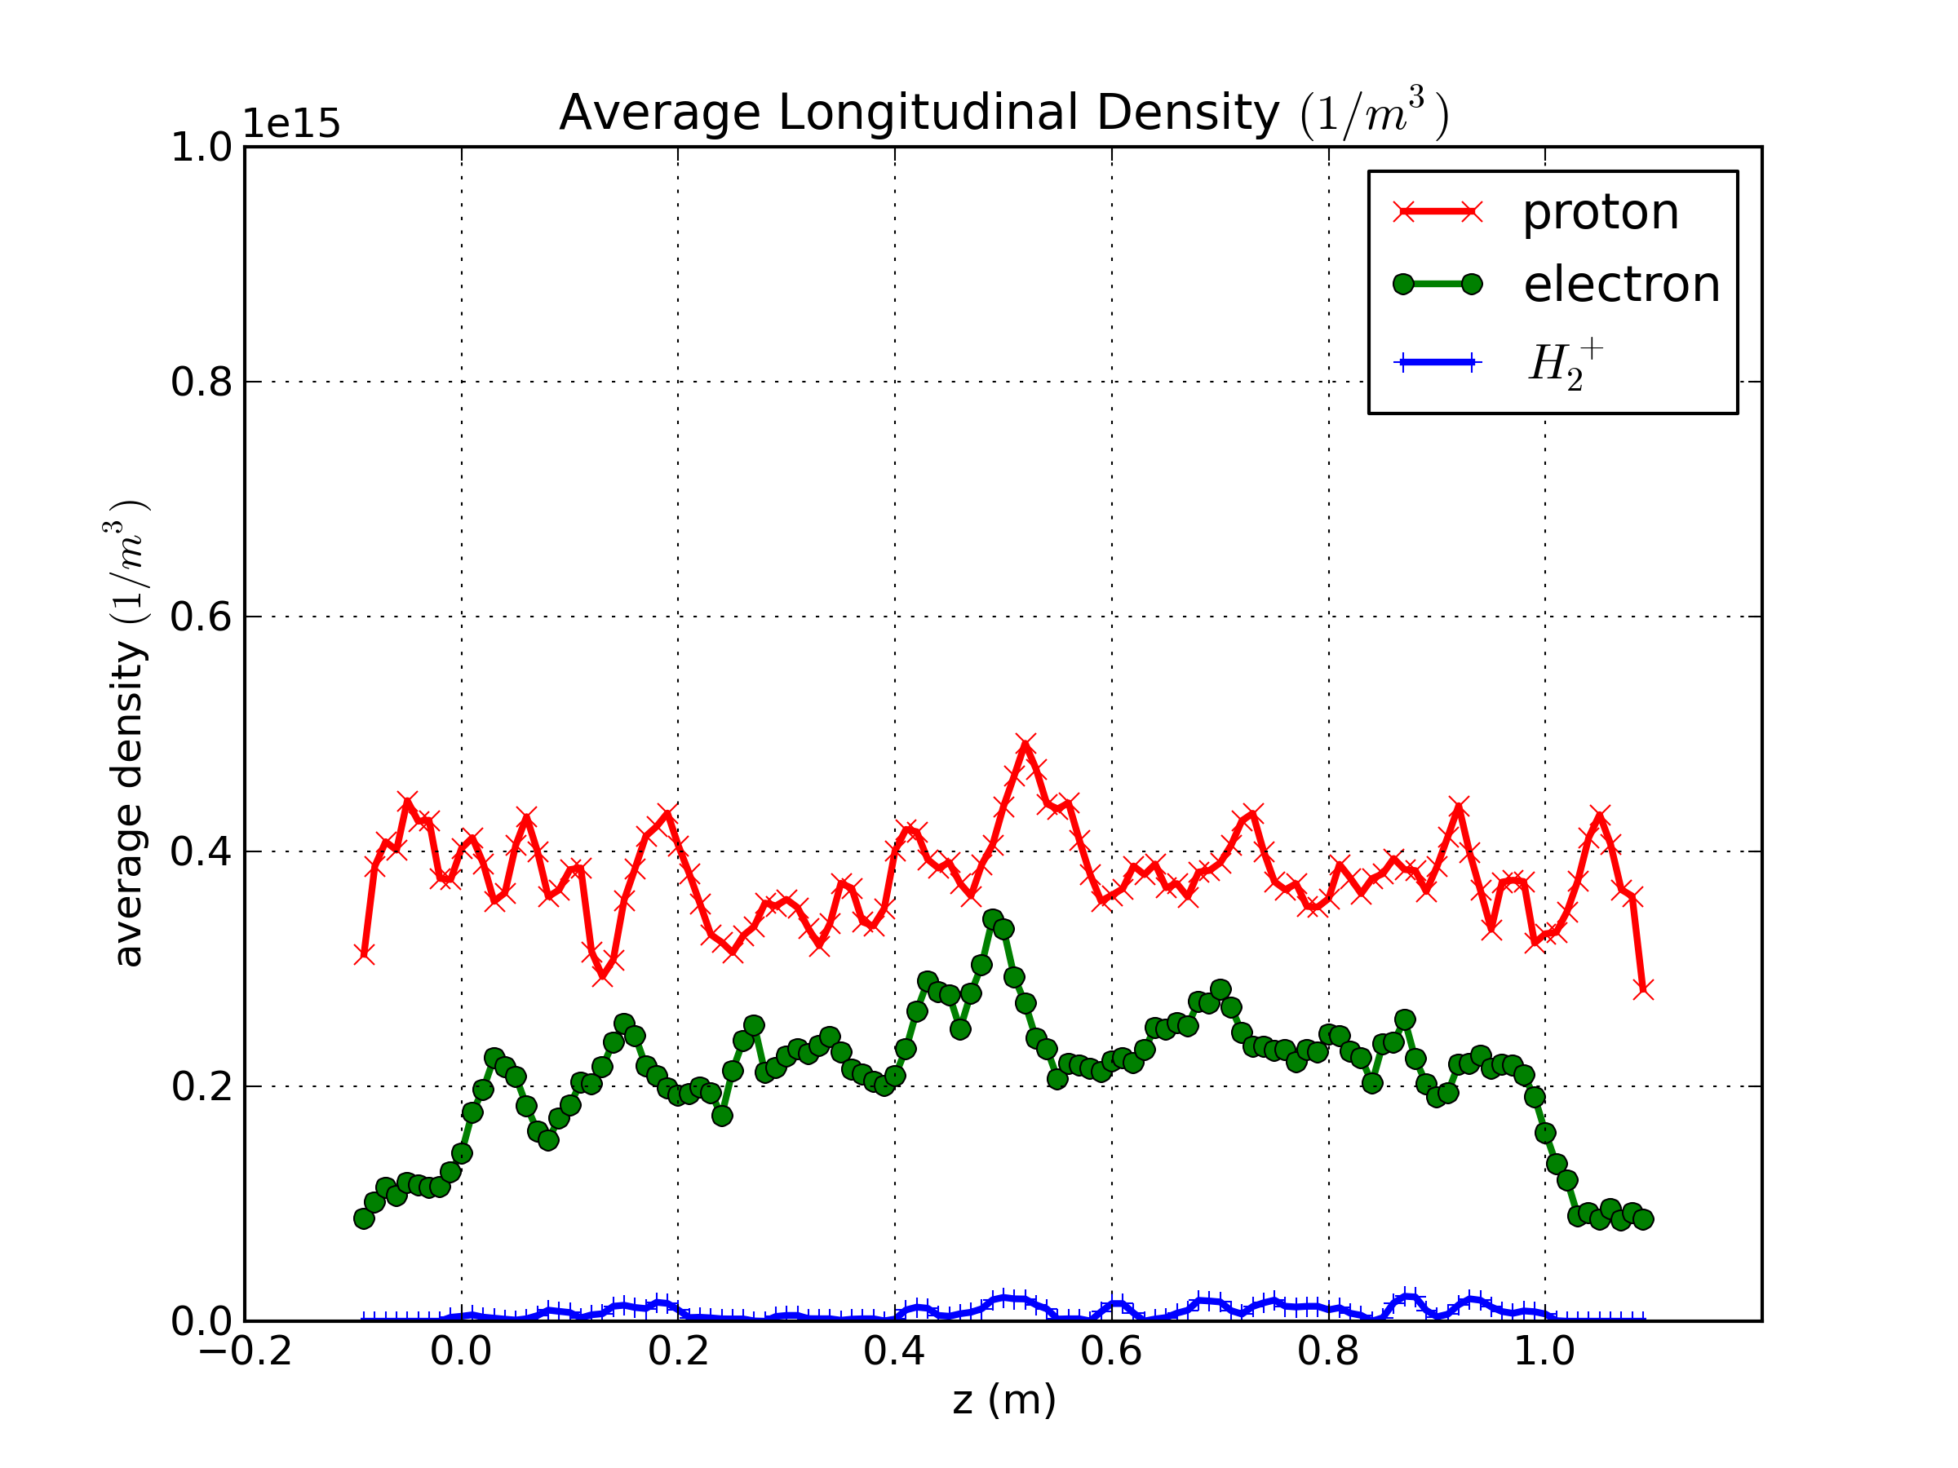
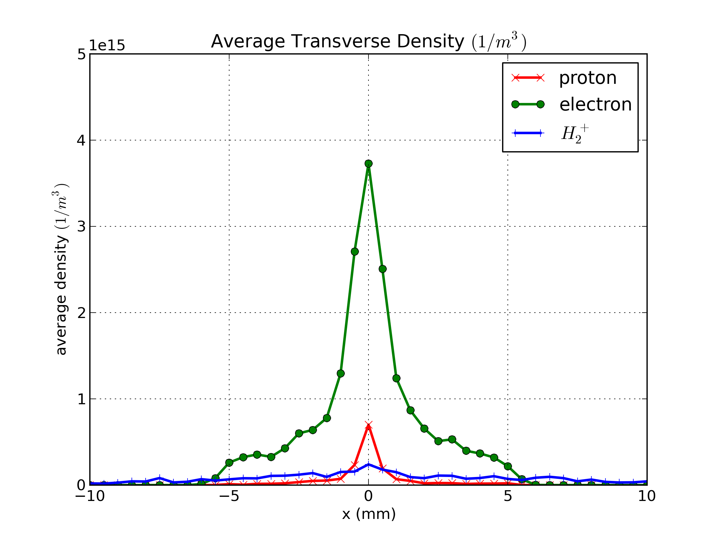
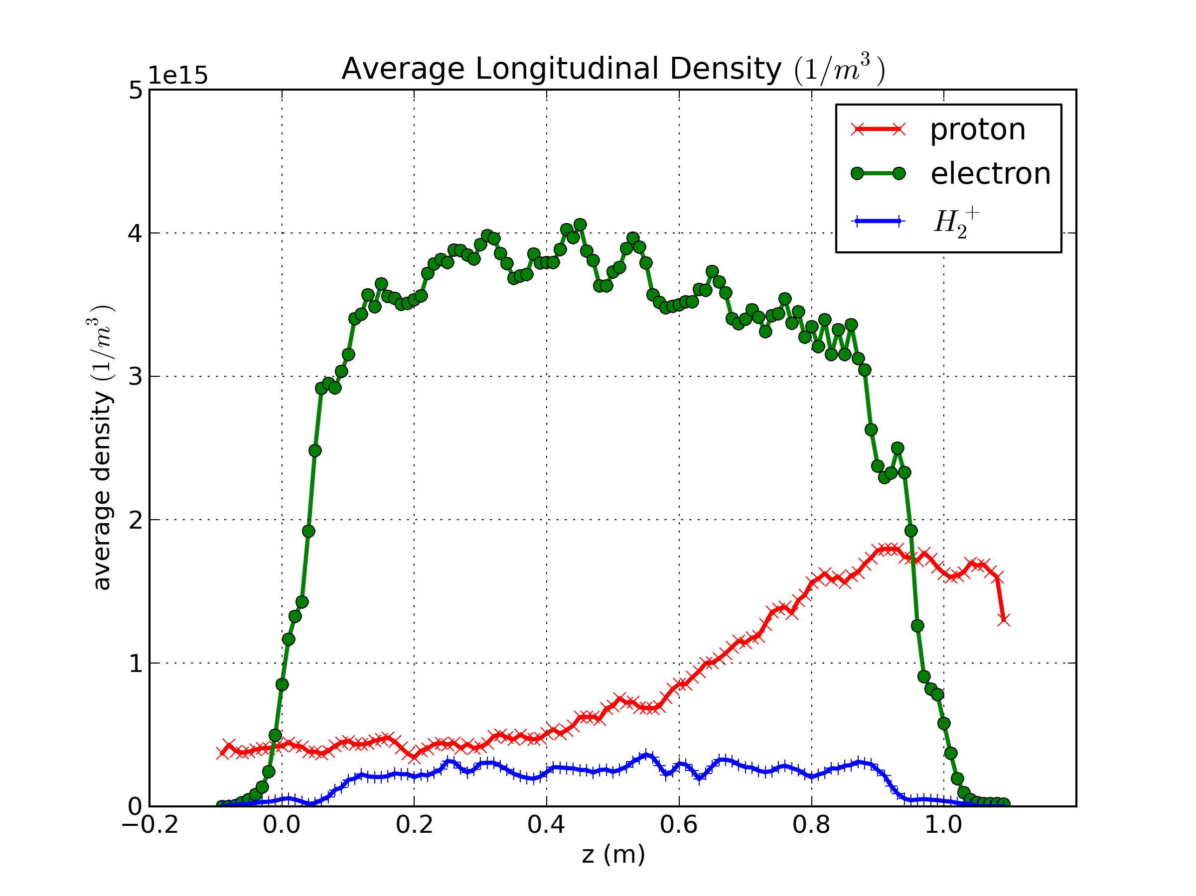
Under Compensation or Over Compensation
B = 0.0 T
V = 0.0 V
Transverse Density Profile
Longitudinal Density Profile
B = 0.1 T
V = -200.0 V

Slide 11
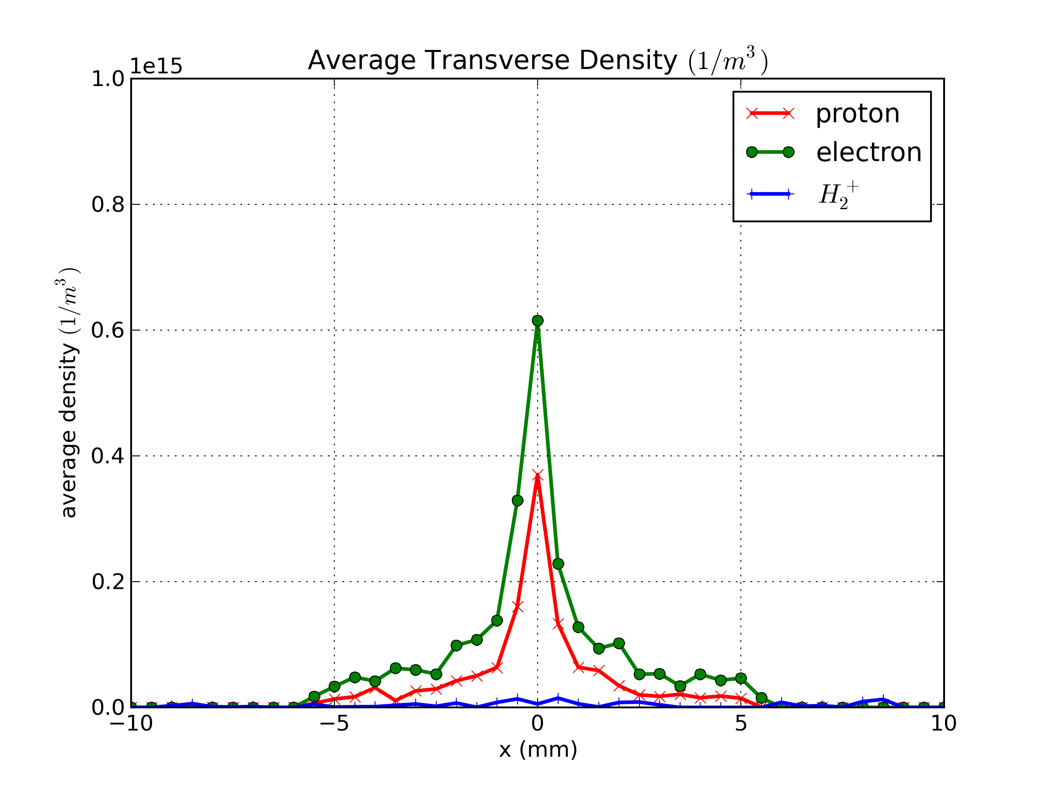
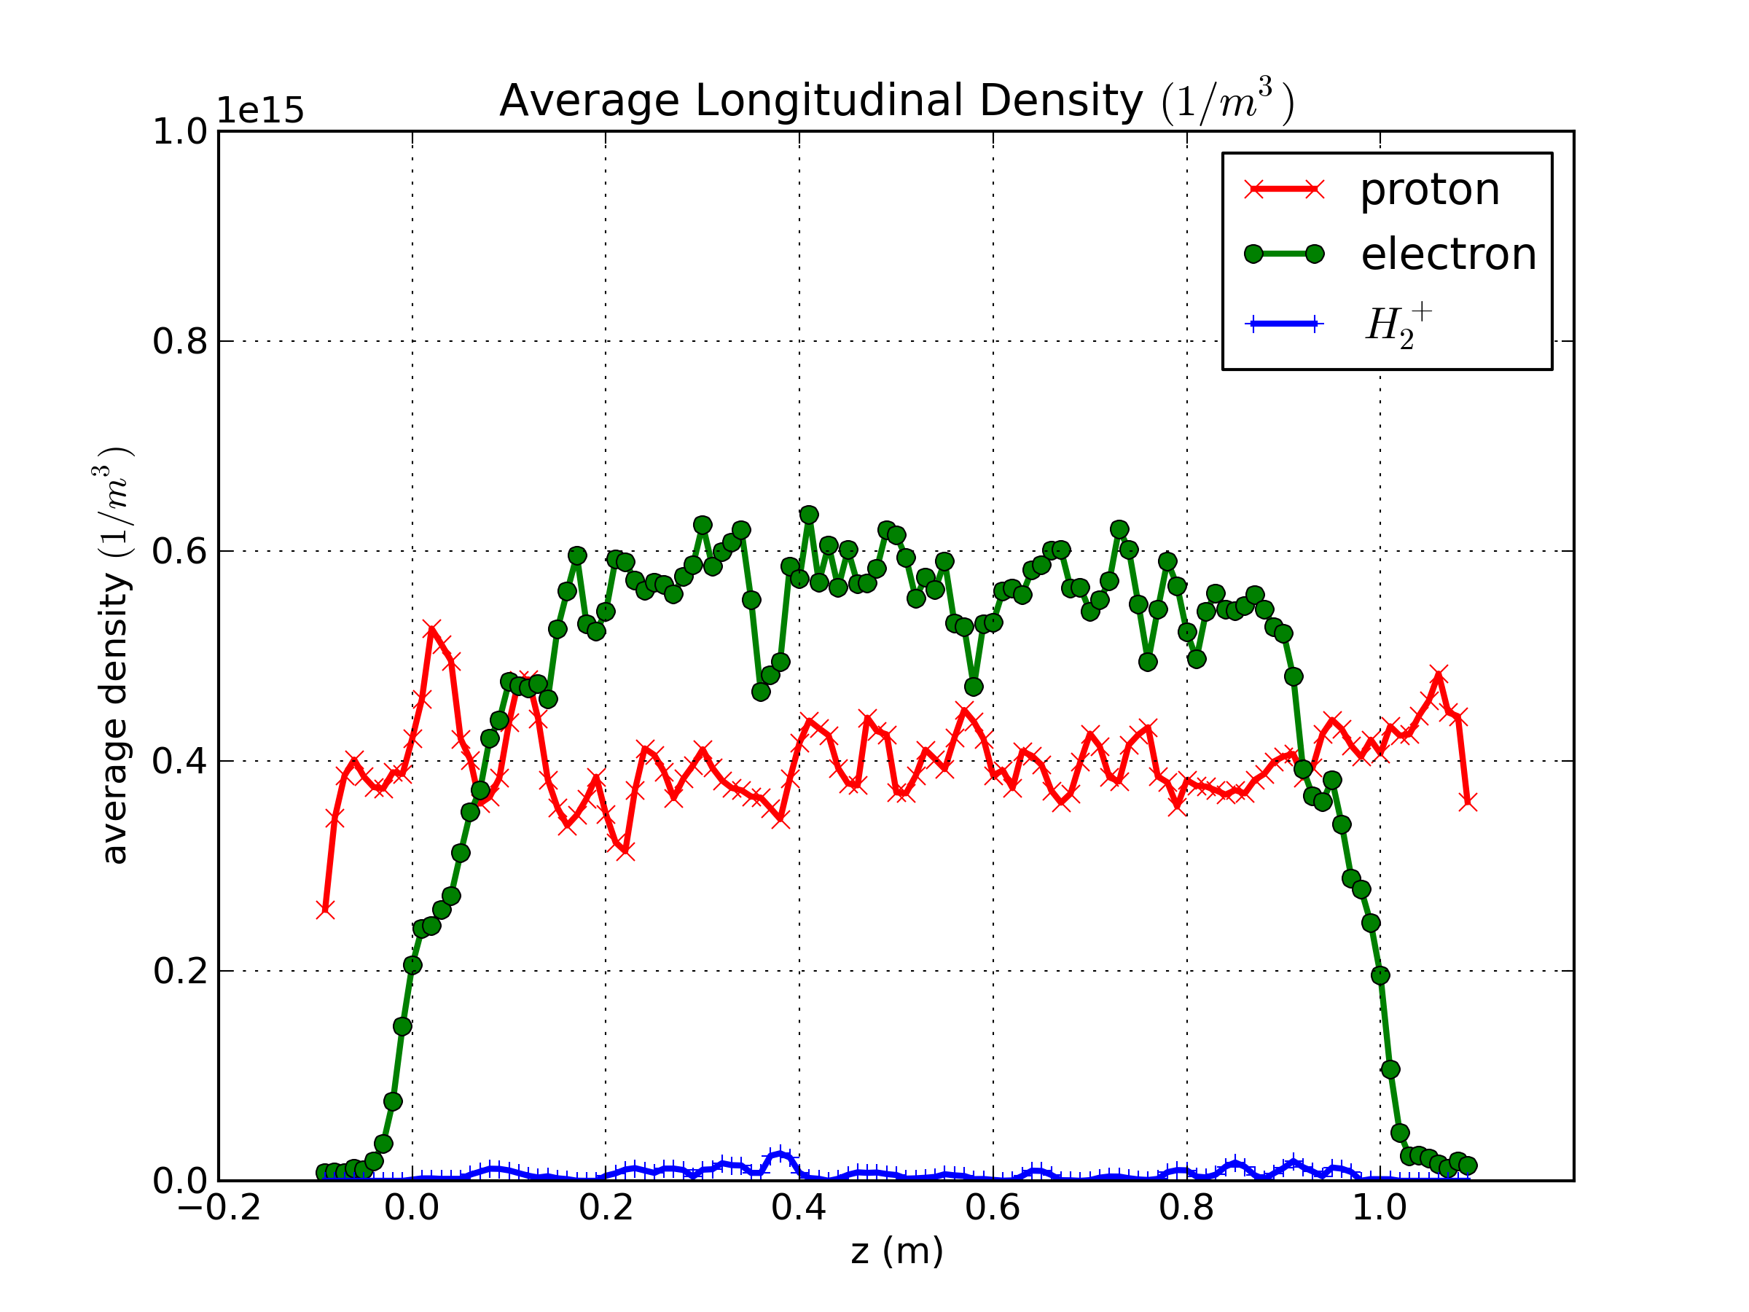
Current Best Compensation-Matched Results
Transverse Density Profile
Longitudinal Density Profile
Lower the Electrode Voltages
B = 0.1 T and V = -10 V

Slide 12
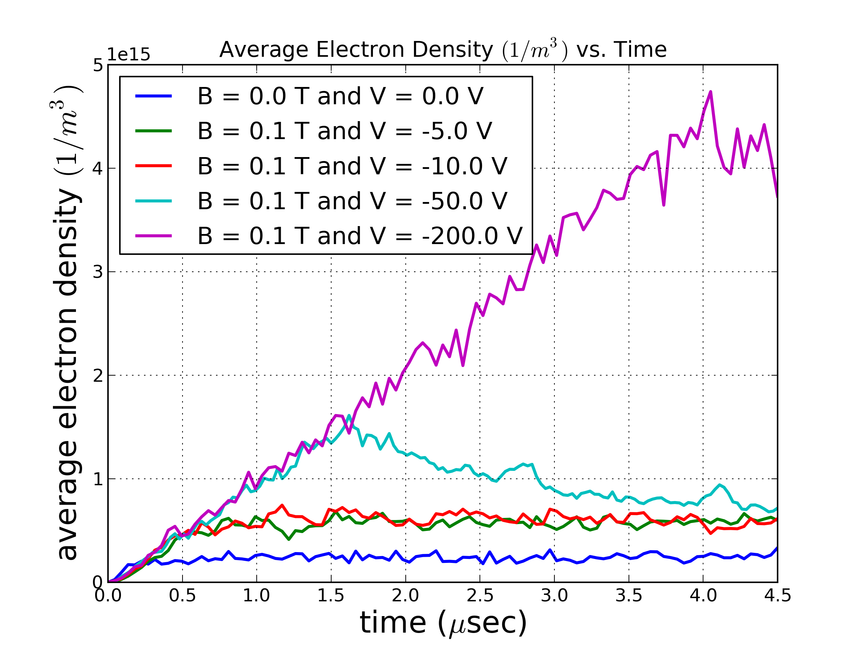
Neutralization Time for Various Parameters

Slide 13
Current Best Compensation-Matched Results (Cont’d)

Slide 14
Summary
SC compensation has been observed in e-column with properly matched longitudinal and transverse distribution.
Fast Neutralization has also been observed with lower solenoid fields and biased voltages for e-column simulations
WARP-3D simulations of SC processes in the e-column show that a parameter set of 0.1 T and 10 V leads to stable/matched accumulation of electrons for single pass.
NEXT STEP: Practical issues such as ring dynamics of the primary proton beam with external focusing and multiple passes thru the e-column must be done.
SC compensation physics program with BOTH e-lenses and e-columns are planned at the IOTA ring.
Collaborators in theory/simulation/experiment are Welcome!

