Slide 1
Gamma Ray Production via Inverse Compton Scattering with 300 MeV Electrons
Daniel Mihalcea
Northern Illinois University
FAST/IOTA Workshop, June 14, 2016

Slide 2
Goal & Key Objectives
  use a conventional superconducting radiofrequency (SRF) linear accelerator which readily produce high-repetition rate bunch (FAST facility suitable for this purpose),
  develop a recirculation optical cavity to collide the electron bunches and laser pulses at high rep. rates
    upgrade the laser currently available,
    design and install a suitable interaction region.
  Combine SRF linac with optimized optical cavity to produce high-flux γ rays (we anticipate close to Watt level average power i.e. about 10¹¹ 1 MeV photons/second)

Slide 3



Team members
Alex Murokh (chief scientist at Radiabeam)
Bryce Jacobson (scientist at Radiabeam)
Philippe Piot (NIU faculty + Fermilab Scientist)
Daniel Mihalcea (research scientist)
Andrei Khizhanok (ME student advisor Jenn-Terng Gau)
Aleksei Halavanau (Physics student)
Jinhao Ruan (laser scientist at Fermilab)

Slide 4
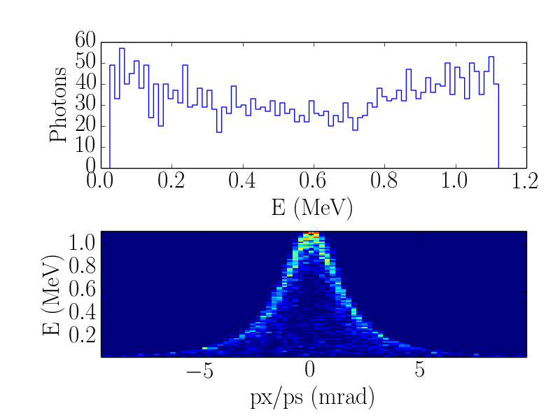
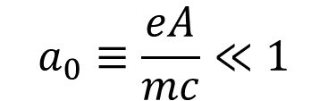
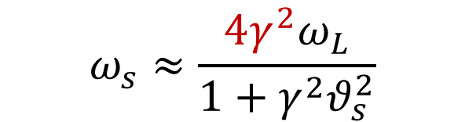
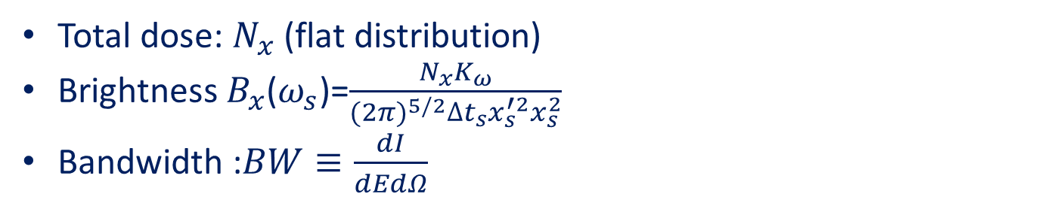
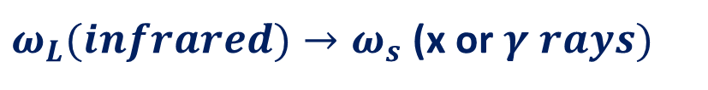

Theoretical background
$$ω_{s}≈\frac{4γ^{2}ω_{L}}{1+γ^{2}θ_{s}^{2}}$$
IR laser
$$a_{0}≡\frac{eA}{mc}≪1$$
e⁻ bunch
IP
The upshift factor:$4γ^{2}$
ϒ- ray
$ω_{L}(infrared)→ω_{s}$ (x or $γ rays)$
Scattered radiation main parameters:
Total dose: $N_{x}$ (flat distribution)
Brightness $B_{x}$($ω_{s}$)=$\frac{N_{x}K_{ω}}{({2π)}^{5/2}∆t_{s}x_{s}^{′2}x_{s}^{2}}$
Bandwidth :$BW≡\frac{dI}{dEdΩ}$

Slide 5
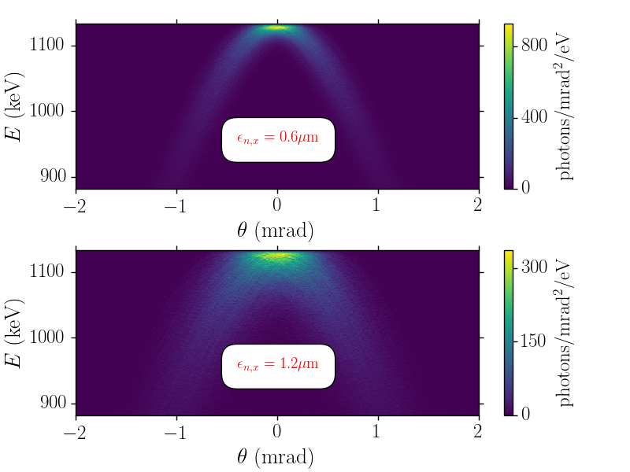





Theoretical background (2)
W. Brown and F. Hartemann, AIP, 737, 839(2004)
Scaling relations:
Critical input parameters:
$$N_{x}≈\frac{N_{e}N_{γ}σ_{T}}{2π\left(x_{e}^{2}+x_{L}^{2}\right)}$$
e⁻ beam energy ($γ$)
e⁻ transverse emittance ($ε_{nx}$)
e⁻ microbunch charge (N_{e})
e⁻ transverse size (x_{e})
$$B_{x}≈\frac{K_{λ_{s}}σ_{T}}{{(2π)}^{7/2}}\frac{N_{γ}}{x_{L}^{2}}γ^{2}\frac{N_{e}}{∆t_{e}ε_{nx}^{2}}$$
IR intensity ($N_{γ}$)
IR focus (x_{L})
$$BW≈{\left(\frac{ε_{nx}}{σ_{x}}\right)}^{2}$$

Slide 6
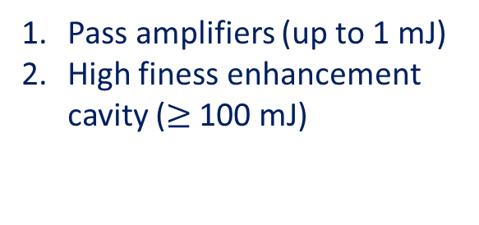
FAST facility
Biggest challenges:
Increase laser bunch energy to Joule level
Pass amplifiers (up to 1 mJ)
High finess enhancement cavity ($≥$100 mJ)
Synchronize e⁻ and laser beams
(B. Jacobson talk)

Slide 7
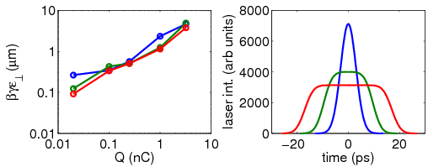
FAST facility (2)
e⁻ bunch duration : 3 ps (same for the laser)
Estimated energy spread: 0.1% at 250 MeV.
Maximum Q/microbunch = 3.2 nC
Q correlated with transverse emittance
FAST 3000 bunches
F. Hartemann et al. PRSTAB 8, 100702 (2005)
FAST 1 bunch

Slide 8
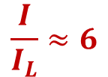
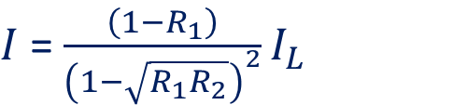
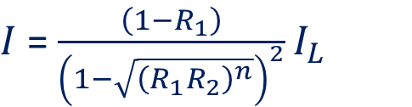



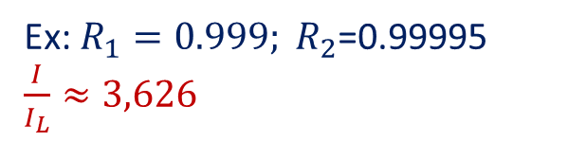
Enhancement Cavity
Simplest geometry: 2 mirrors
Amplitudes from consecutive laser pulses add up coherently if:
$2×L=\frac{c}{f_{L}}$
IR
( = 100 meters)
Mode shape matching
Maintain resonance with a feedback system
L
Steady state intensity I:
$$L→L/n$$
$I$ = $\frac{\left(1−R_{1}\right)}{{\left(1−\sqrt{R_{1}R_{2}}\right)}^{2}}I_{L}$
$$L= \frac{c}{2nf_{L}}$$
$I$ = $\frac{\left(1−R_{1}\right)}{{\left(1−\sqrt{{\left(R_{1}R_{2}\right)}^{n}}\right)}^{2}}I_{L}$
Ex: $R_{1}=0.999; R_{2}$=0.99995 $\frac{I}{I_{L}}≈3,626$
$$\frac{I}{I_{L}}≈6$$
L = 2 m and n =25

Slide 9
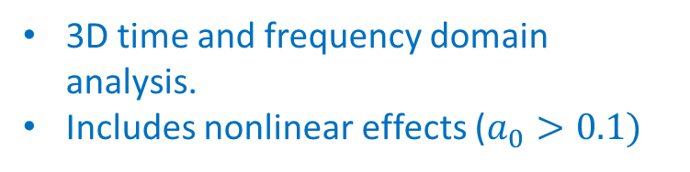
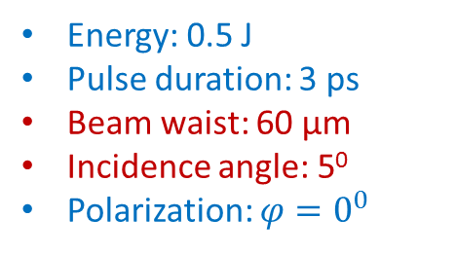
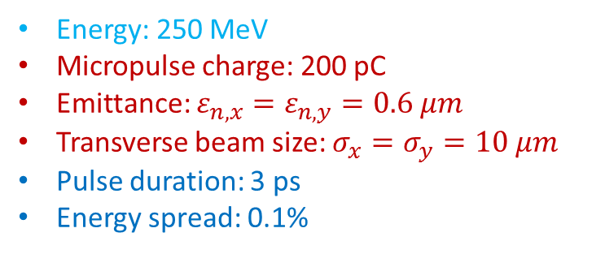
ICS Simulations
W. Brown and F. Hartemann, PRSTAB, 7, 060703 (2004)
C++ code to implement relativistic Thompson backscattering
3D time and frequency domain analysis.
Includes nonlinear effects ($a_{0}>0.1)$
http://www-acc-theory.kek.jp/members/cain/
Electron beam:
Laser beam:
Fortran code to implement fully QED Klein-Nishima formula for ultra-relativistic Compton scattering
Energy: 250 MeV
Micropulse charge: 200 pC
Emittance: $ε_{n,x}=ε_{n,y}=0.6 μm$
Transverse beam size: $σ_{x}=σ_{y}=10 μm$
Pulse duration: 3 ps
Energy spread: 0.1%
Energy: 0.5 J
Pulse duration: 3 ps
Beam waist: 60 µm
Incidence angle: 5⁰
Polarization: $φ=0^{0}$

Slide 10
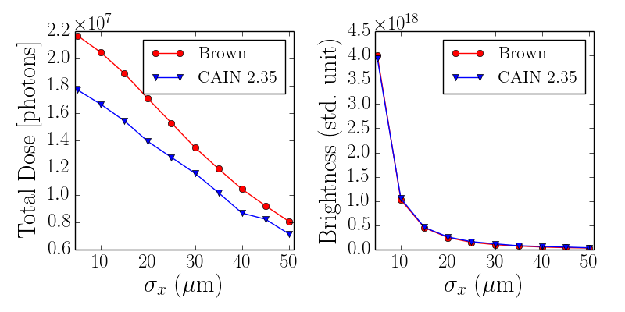
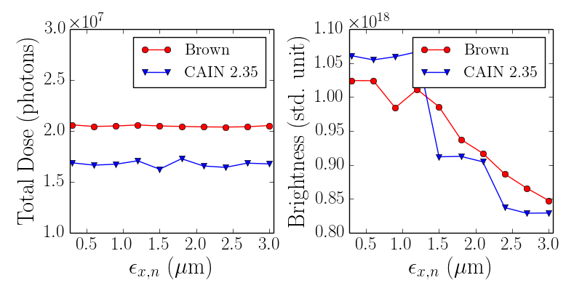
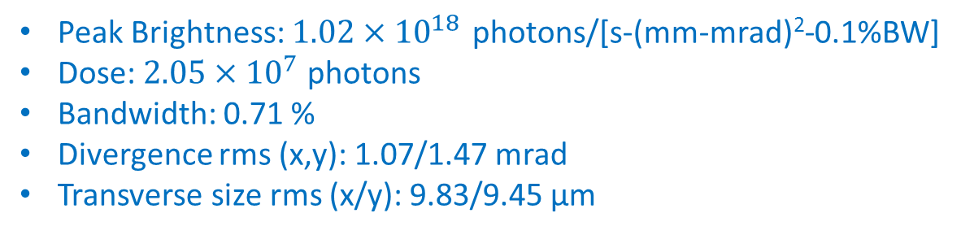
ICS Simulations (2)
For “standard conditions”:
Peak Brightness: $1.02×{10}^{18 }$photons/[s-(mm-mrad)²-0.1%BW]
Dose: $2.05×{10}^{7}$ photons
Bandwidth: 0.71 %
Divergence rms (x,y): 1.07/1.47 mrad
Transverse size rms (x/y): 9.83/9.45 µm

Slide 11
Conclusions:
1 MeV gamma-rays can be produced at FAST (after upgrade!) through ICS.
Bandwidth can be kept below 1% due to sub-micron beam e⁻ emittance.
Peak brightness can exceed 10²¹ photons/[s-(mm-mrad)²-0.1%BW] provided laser pulse energy is at Joule level.
About 2x10⁵ photons/micropulse can be generated at 1 MeV.

