Slide 1
Documenting LArSoft for Ease of Use and Learning LArSoft Workshop June 22, 2016 Katherine Lato

Slide 2
LArSoft Documentation
LArSoft Doxsvn – Comments in the code in a format that enables Doxygen to interpret them. Have template - Code Documentation Guidelines.
LArSoft wiki – (Redmine) covers everything from getting started to details on code and releases
http://larsoft.org/ - one-stop spot with links to other things (and useful things there as well)
larforum.org – forum hosted by the University of Manchester to discuss LArTPC software – slides from Andrzej Szelc
Too much? Too little? About right?

Slide 3
LArSoft wiki (Redmine)
Quick Links – to experiment-specific information on getting started.
Introduction to LArSoft
LArSoft is both a project/collaboration and a body of code.
Using LArSoft
This covers the preliminaries needed to get started, where to find releases, using LArSoft with your experiment and where to find the software.
Developing With LArSoft
Developing LArSoft code itself. Using LArSoft to write experiment-specific code against an existing LArSoft release.
CI results display page
Getting LArSoft
Local installation of LArSoft, and builds.
LArSoft Internals
Topics of interest to people supporting LArSoft.
Miscellaneous Links
Information that may be of historical interest, or that is under development.
Have a page you’d like updated soon?
Email klato@fnal.gov

Slide 4
Larsoft.org
http://larsoft.org/ - general documentation, not code or release specific, good place to start
Concepts in LArSoft – big picture understanding of LArSoft design and structure
http://larsoft.org/list/ - list of algorithms
http://larsoft.org/notes/ - news of interest
Meetings, upcoming activities, etc.

Slide 5
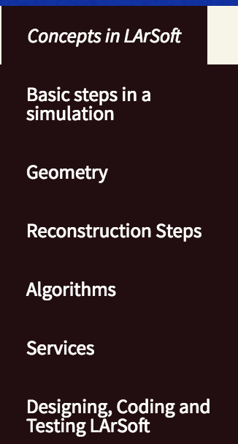
Larsoft.org
Help LArSoft users understand the big picture of what is going on within the code.
not specific code examples
lay the foundation for conceptual understanding.
Any suggestions for other pages?
Anywhere on the site?

Slide 6
LArSoft Notes (Newsletters)
Available at http://larsoft.org/notes/
If you’d like to write an article,
Please let me know.

Slide 7
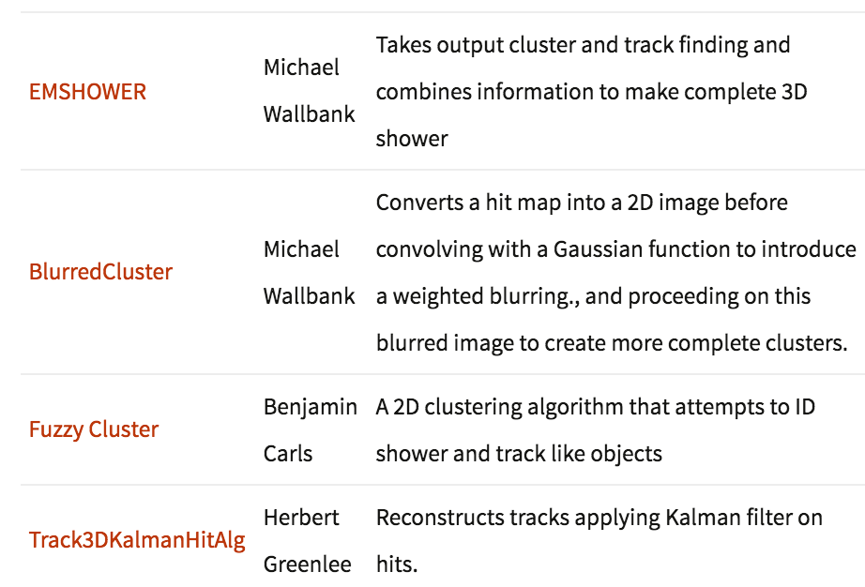
Documenting Algorithms
http://larsoft.org/list/ - Documentation about algorithms.
https://larsoft.org/add/ - Can add information to the database without being a WordPress user.

Slide 8
Contributor Accounting and Attribution Discussion (page 1 of 2)
The Implementation Plan
“By the beginning of FY17 SCD will implement a means for tracking and reporting
contributions to LArSoft. This information will be kept in a code repository and available
publicly. Sufficient information will be maintained to allow members of the Coordination
and Steering Groups to provide recommendations based on the contributions made.”
Current Situation
The list of algorithms and owners is a component of this – http://larsoft.org/list/
Includes fields for code analyzed and improved code released. (Can sort on different fields.)
Questions?
Notes:
Plan: Search

Slide 9
Contributor Accounting and Attribution Discussion (page 2 of 2)
Future Plans
Have a list of publications and reports with attributions perhaps using - Fermilab Technical Notes – http://techpubs.fnal.gov/
Search DocDBs for each experiment to look for ones that should be common. Experiments need to:
Grant permission to search
Be willing to have the document also appear or be linked from a common LArSoft document repository.
Notes:
Plan: Search

Slide 10
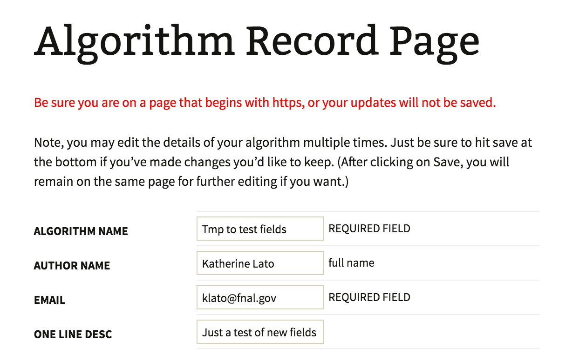
Documenting Algorithms – https://larsoft.org/add

Slide 11
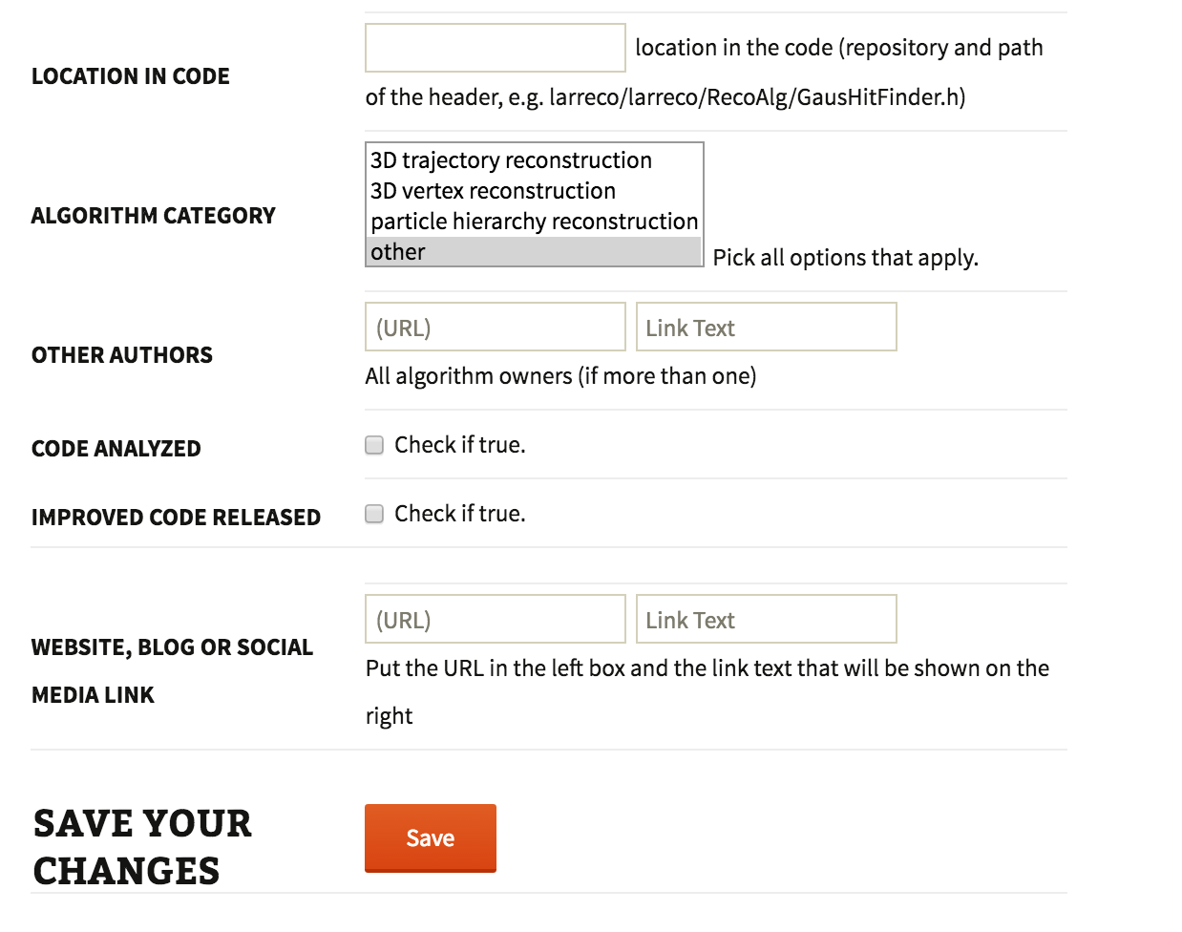
Documenting Algorithms
Want to try this?
Attend small group discussion led by Katherine Lato this afternoon.

Slide 12
Documenting an Algorithm: Putting it all together
http://larsoft.org/list – high level view of the algorithm
Technical note
could be an internal (to LArSoft community) note, or
published paper like in http://techpubs.fnal.gov/ or elsewhere
Comments in the header and in the implementation code should be in a format that enables Doxygen to interpret them. Also describe important parts in the code.
See LArSoft wiki (Redmine) page Code Documentation guidelines for suggested template to follow.
Don’t forget in-line comments in the code for maintainability.
Questions?

Slide 13
LArFORUM www.larforum.org

Slide 14
LArFORUM www.larforum.org
A forum provides a compromise between a quick-response chat and archiving capabilities.
Currently hosted at University of Manchester
Started as MicroBooNE, evolved to all-LArSoft:
Experiment-specific sections (e.g. LarIAT) are also possible

Slide 15
LArFORUM www.larforum.org
Notifications through email (alerts, digests) and chat (jabber) settable by user.
Have set-up daily digests going to mailing lists (e.g. MicroBooNE, LArIAT) – let Andrzej know if you want one.
Both lead to quick responses from experts and other users.
Join and ask questions!

