Slide 1
Protons At FNAL
Chris Polly
3 May 2016

Slide 2
Fermilab accelerator complex (now-2025)
400 MeV Linac nearly continuously wraps beam around Booster
8 GeV Booster operates at 15 Hz maximum (PIP I Upgrade)
Recycler gymnastics used to slip-stack beam into MI, used for muon program when MI is ramping
120 GeV MI dedicated to NOvA
Beyond 2025, PIP II possibilities
Total power at each stage
- 80 kW at Booster output (12/20 to NuMI)
- 700 kW at Main Injector to NuMI

Slide 3
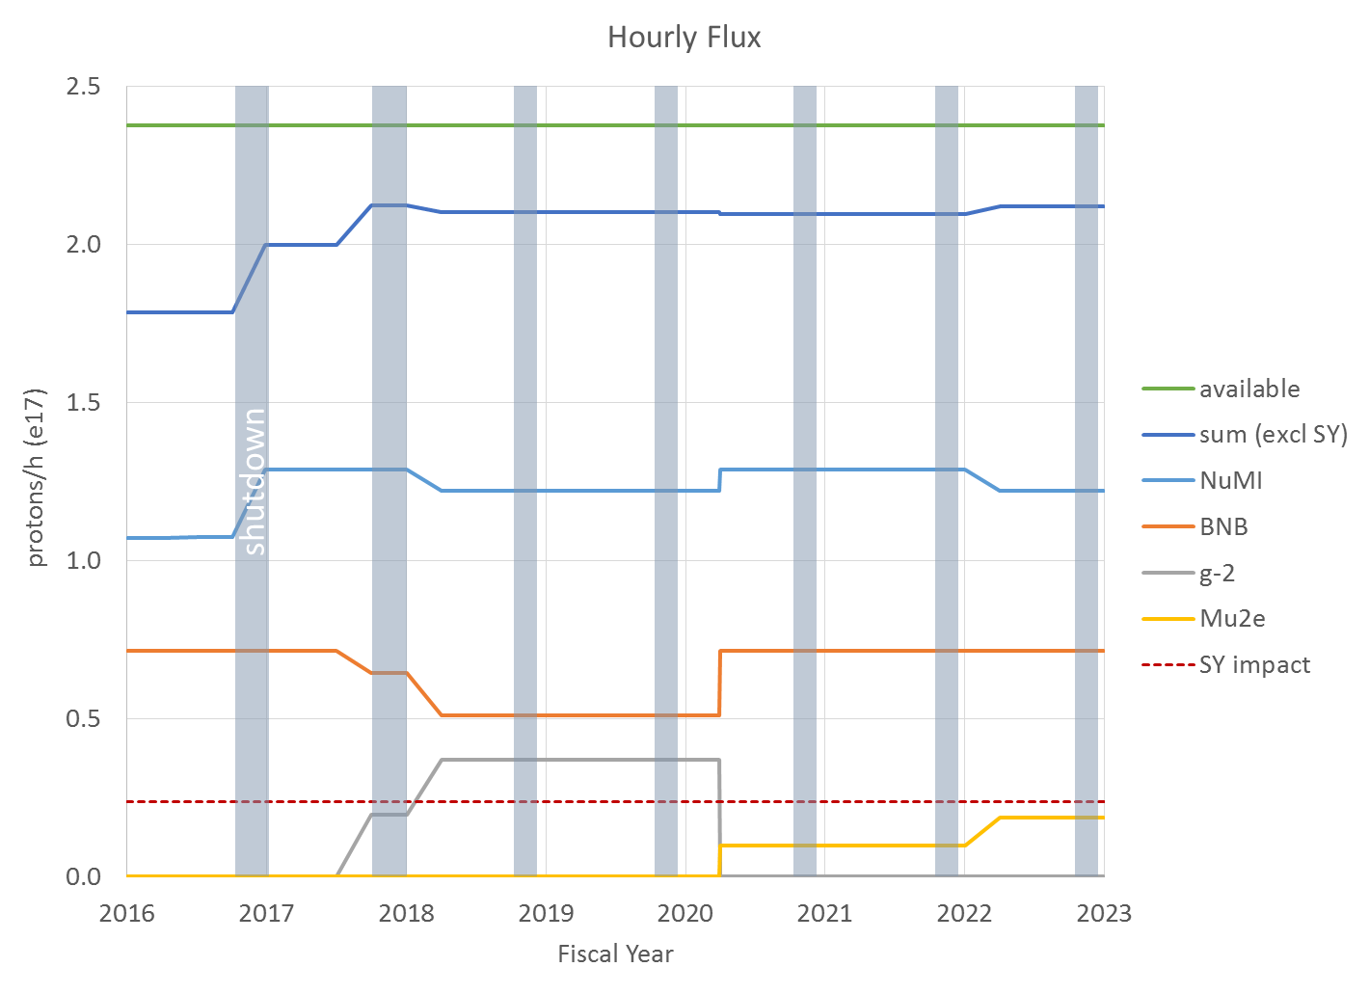
Fermilab proton plan (now-2023)
Does not take into account uptime efficiencies, etc
Typical >90% uptime during 9 mo/yr running
Does not include proposal to run μ- to g-2 starting in 2020
Assumes 4.4E12 ppp to BNB (last week 4.7E12)
Realistic to gain 10-20% more here over time
* Mary Convery 3 Mar 16 Proton PMG Meeting

Slide 4
Fermilab accelerator complex (now-2025)
Note: This is ‘available’ beam is complicated.
Only available during SY120 slow spill from MI, does away if SY120 is down
Can’t use MI, probably can’t use Recycler (must check)
Can use 8 GeV beam from Booster
SBN was looking at possibility of upgrading horn to use these protons
* Mary Convery 3 Mar 16 Proton PMG Meeting

Slide 5
Fermilab accelerator complex timeline
21 ticks, 12 batches to NOvA, 16 2.5-MHz bunches to g-2 every 1.40s
Timeline when g-2 begins operating next year
Stretching timeline to 1.4s from 1.33s
5% reduction in beam to NOvA and g-2 from original plan, but solves timing problem (takes 13 Recycler events to load 12 Booster batches, transfer, and reset)
BNB gets 1 more batch per 5% longer super-cycle
Every 1.4s the Booster goes through 21 acceleration cycles
12 injections into Recycler for NuMI, all 12 moved to MI and accelerated
9 Booster batches left over
4 injections into Recycler → cut into 1/4s and extracted to Muon Campus
5 extractions to the Booster Neutrino Beamline (BNB)

Slide 6
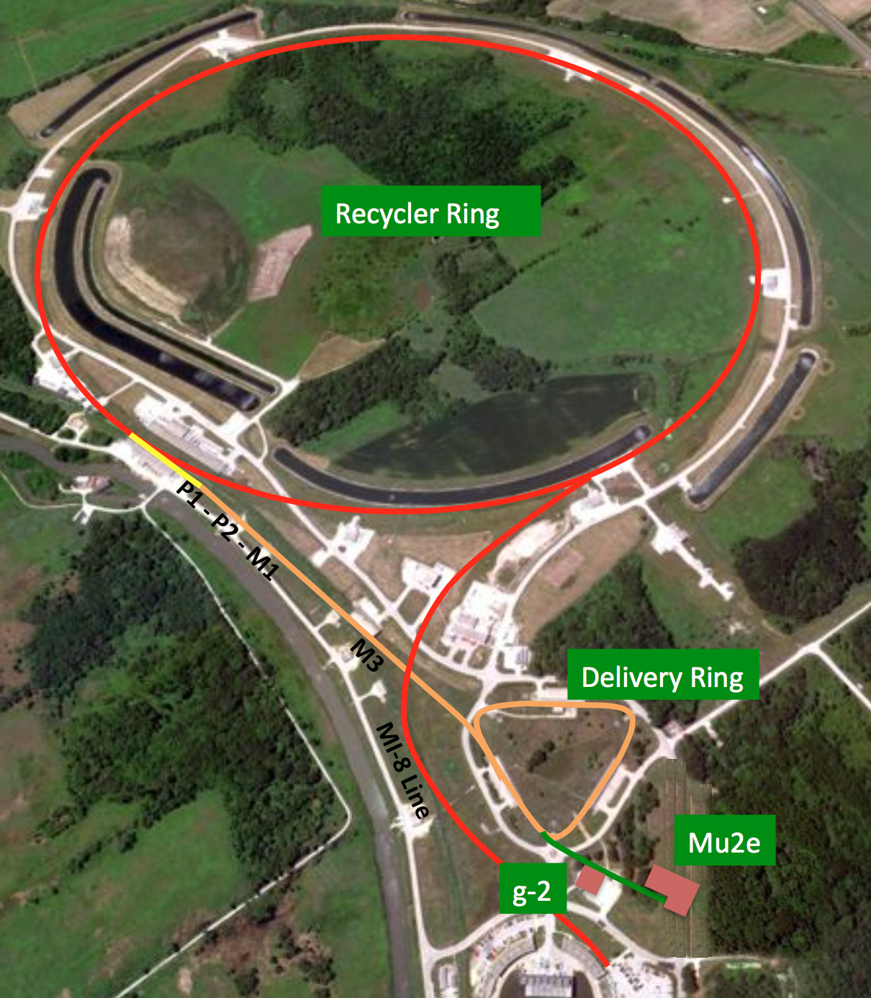
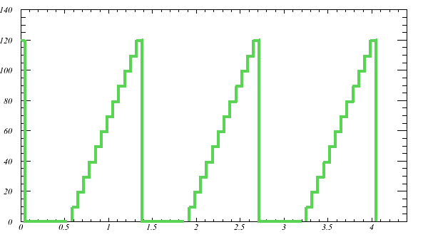
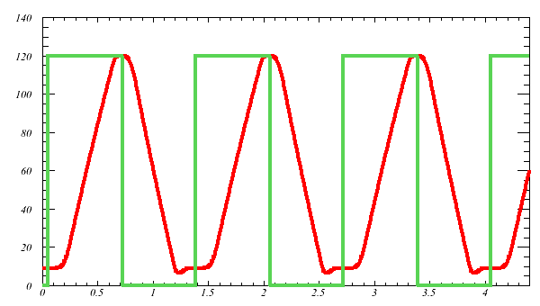
Beam During NOvA 700kW Operations
Recycler
Main Inj.
During NOVA ops, MI used 100% of time
10% of time, one Booster batch moved to MI and slow-spilled for 5 second
MI cycle time allows 7 non-NOvA Recycler events

Slide 7
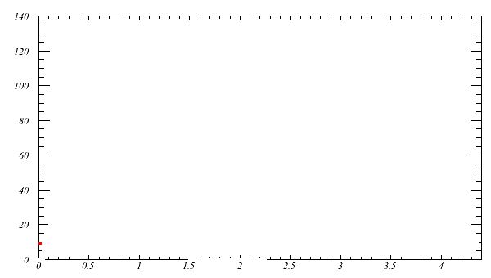
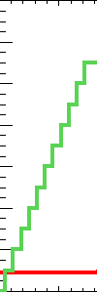
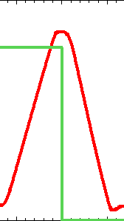
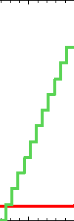
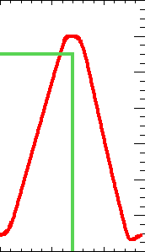
Beam During Muon g-2 Operations
Scale x 6
AP0
Muon g-2 uses rest of available Recycler time
Coalesces into 4 x 120 ns sub-bunches (90 ms)
Extract each sub-bunch with 10 ms spacing
Hit target at AP0
Secondary muon beam orbits Delivery Ring 4x before extraction to g-2 experiment

Slide 8
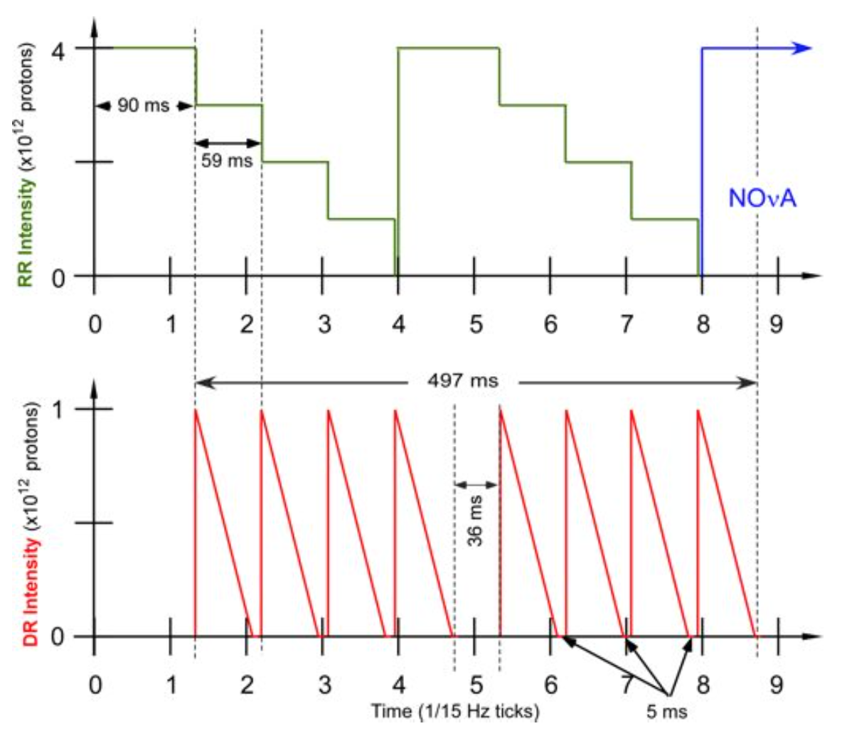
Beam During Mu2e Operations
Mu2e
Mu2e
Mu2e also uses rest of available Recycler time
Coalesces into 4 x 120 ns sub-bunches (90 ms)
Extract each sub-bunch with ~60 ms spacing
Bypasses AP0
Slow spills primary p beam out of Delivery Ring to target in Mu2e production solenoid

Slide 9
Program summary through 2023
NOvA (+SY120) uses 100% of MI
NOvA + Muon Program (Mu2e or Muon g-2) uses 100% of Recycler
Delivery Ring used as pre-injector for both experiment
Used to clean protons from tail of muon beam in g-2
Used to slow spill protons in Mu2e
Technically available 2/3s of time but only during time when rest of complex is not available
Left over Booster batches (5 in g-2 era, 7 in Mu2e) nominally go to SBN program
Proposals for new experiments either have to run parasitically off existing beams or stretch existing program

Slide 10
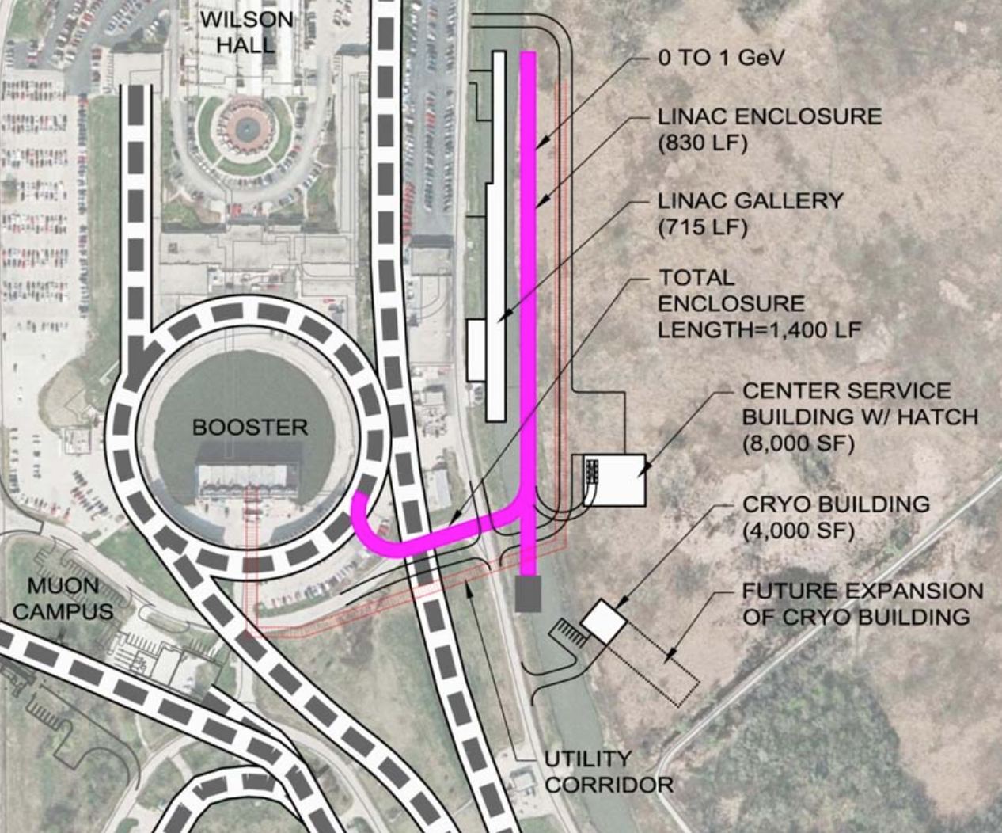
PIP-II era complex (2025-)
Replaces 400 MeV Linac with 800 MeV CW-capable
Runs in pulsed mode at < 10% of RF power to provide NuMI 1.2MW
Really only 1.1% of potential beam power goes into Booster
Can be upgraded to CW providing 1.6MW at 800 MeV
PIP-II White Paper

Slide 11
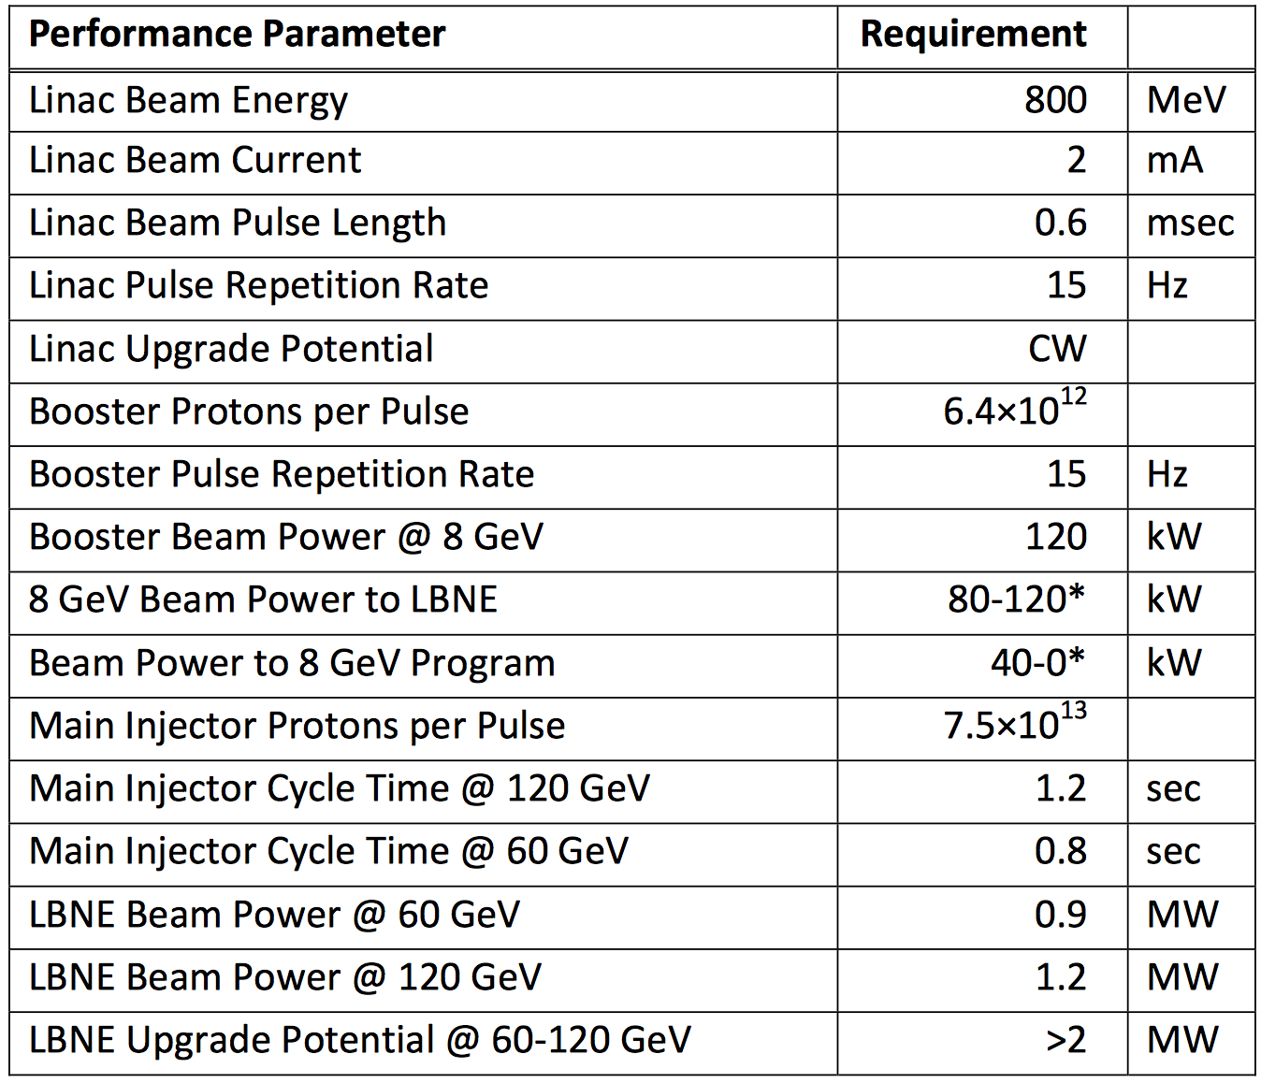
PIP-II era complex (2025-)
Beam power to LBNE depends
on ideal proton energy
50% more protons to 8 GeV
Booster program
Opportunity to upgrade to full CW capability → 1.6 MW with < 1.1% going to Booster/MI
PIP-II White Paper

Slide 12
PIP-II Beam Structures w/ CW upgrade
PIP-II initial RF at 162.5 MHz
< 50 ps (4 ps now?) wide pulse (FWHM) separated by 6.2ns
Native timing structure perfect for K⁰→π⁰νν
Cost drivers for upgrade
2K cryo plant
RF power
Need target hall

Slide 13
PIP-II Beam Structures
Getting a lower duty cycle is still possible, but requires scaling
down the beam power proportionately.

Slide 14
Muon beams around the world
Facility | Type | Proton Power | Proton Beam E | Power in Target | Muons/sec μ+ μ-
PSI | Cont. | 1.3 MW | 590 MeV | 150 kW | 10⁸ | 10⁷
PSI (HiMB) | Cont. | 1.3 MW | 590 MeV | 900 kW | 5x10¹⁰
TRIUMF | Cont. | 0.8 MW | 500 MeV | 70 kW | 10⁷ | 10⁶
MUSIC-Osaka | Cont. | 400 W | 392 MeV | 310 W | 3 x 10⁸ | 1x10⁸
RIKEN-RAL | Pulse | 0.2 MW | 800 MeV | 160 kW | 10⁶
J-PARC (MUSE) | Pulse | 1.0 MW | 3 GeV | 120kW? |  | 10¹⁰
J-PARC (COMET) | Pulse | 56 kW | 8 GeV | ~56 kW |  | 10¹¹
FERMI (g-2) | Pulse | 15 kW | 8 GeV | ~15 kW | 1 x 10⁷ | 4x10⁶
FERMI (Mu2e) | Pulse | 8 kW | 8 GeV | ~8 kW |  | 10¹⁰
FERMI (PIP-II) | Both** | 1.6 MW | 800 MeV | TBD | TBD | TBD
Conventional μSR facilities (PSI/TRIUMF/RAL) only use a fraction of beam power
Peak flux from surface μ+ (29 MeV, > 90 % polarization)
μ- from cloud muons (< 100 MeV, < 20% polarization)
Fluxes >10¹⁰ only achieved through superconducting π capture solenoid
MUSIC demonstrated at 0.4%, HiMB lower capture efficiency due to SINQ
Muon g-2 only decay-in-flight muon beam (highly polarized μ+/μ-)
Flux quoted for 2% dp/p in Delivery Ring, down two orders of magnitude

Slide 15
Conclusion
Fermilab is an amazingly versatile complex
Allows NOvA, Muon g-2/Mu2e, and SBN to run simultaneously
Takes < 2 days to switch from g-2 (3 Gev) to Mu2e (8 GeV) + time to tune up
Proton economics are very tight through 2023
Proposal have to be very competitive to stretch existing program (or be able to run parasitically)
Good chance AD will find ways to improve flux from baseline plan
Current experiments can soak up a lot of extra π-/μ- beam (- flux down by 2.7 relative to + charge)
Muon g-2 baseline plan (slide 3) does not include μ-
SBN could run anti-neutrinos for a long time to get stats (4-5 yrs)
PIP-II aiming for start in 2025
50% more beam at 8 GeV and 1.2 MW at 120 GeV
Major opportunity for right experiment to upgrade PIP-II to CW
Related upcoming talks
Diktys will talk more about muon production in Muon g-2
Erik will discuss some work on mSR at a CW PIP-II

