Slide 1
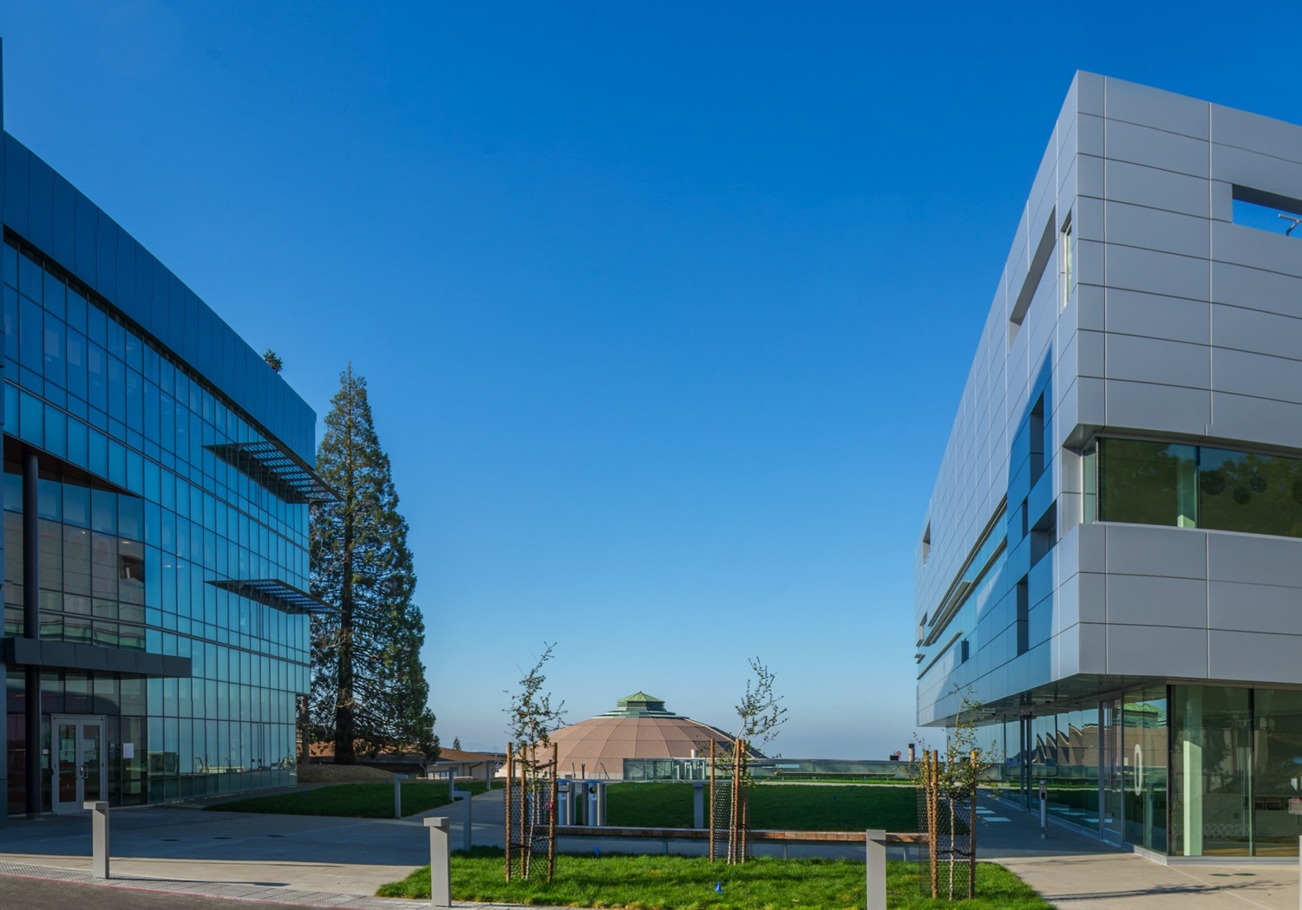
Lawrence Berkeley National Laboratory
Facilities Division
Stan Tuholski
Facilities Deputy Division Director
June 2016

Slide 2
Operations and Maintenance Electrical Incidents
From 2012-2014, LBNL recorded:
    5 electrical shocks
    3 instances of cutting a live wire
    5 instances of leaving live electrical panels or equipment open
2015-2016, LBNL recorded:
    2 electrical shocks (One was custodial employee unplugging refrigerator from a receptacle)
    0 instances of cutting a live wire
    0 instances of leaving live electrical panels or equipment open

Slide 3
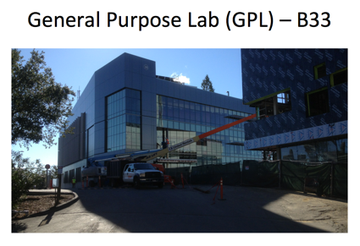
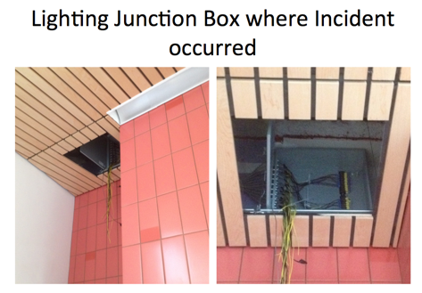
The event that shook us to our core….
  Apprentice electrician working on lighting circuit terminating wires in a junction box.
  Worker stripped incoming wire and prepared to crimp the end. While holding wire, worker reached for a metal ceiling rail for support and received the shock.
Notes:
Some details given –
Main points are that it was an apprentice working for a subcontractor on a construction job.
Several preliminary issues identified around how subs are performing LOTO.

Slide 4
What happened?
Issues:
Electrical Worker was on group LOTO (lockbox), but did not include this particular circuit
No pre-job briefing was performed for change in work scope
Did not perform zero energy check
Delayed reporting, delayed medical examination
Conditions:
Premature building energization
Less than adequate 70E implementation by subcontractor
Less than adequate assurance of 70E by LBNL
Not enough subcontractor QEW support for building energization
Unsafe approach to verification of zero energy

Slide 5


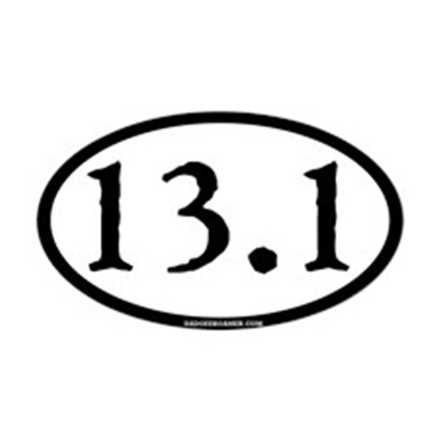
Electrical Safety Improvement Plan

Slide 6
ESIP Main Components
FOCUS
AREAS
IMPACTED DOCUMENTS
Qualified Electrical Workers (QEW)
Work Planning and Control
Safe Equipment and Installations
Authority Having Jurisdiction (AHJ)
Culture
Assurance
Supplier Selection
EH&S Manual Document PUB-3000
  Chapter 8, Electrical Safety
  Chapter 10, Construction Safety
Facilities
  Design & Construction Manual (DCM)
  Master Specifications
  Construction Details and Design Guidelines (CDDG)
  MRO Procedures

Slide 7
Introduction
Maintenance and Operations:
QEW
Vendor QEW
Remote racking
Switching
Breaker maintenance
Inspections
AHJ program
Project and Construction Management:
Subcontractor QEW
Inspections/NRTL
AHJ program
Energization
Conduit cutting

Slide 8
Maintenance, Repair, and Operations
QEW
Training/Practical
Non-Electrical Crafts
IAHJ
Validation
NRTL Review
Engineering
Inspection
Improved Design
Strengthened Specifications
Change Control
Vendors

Slide 9
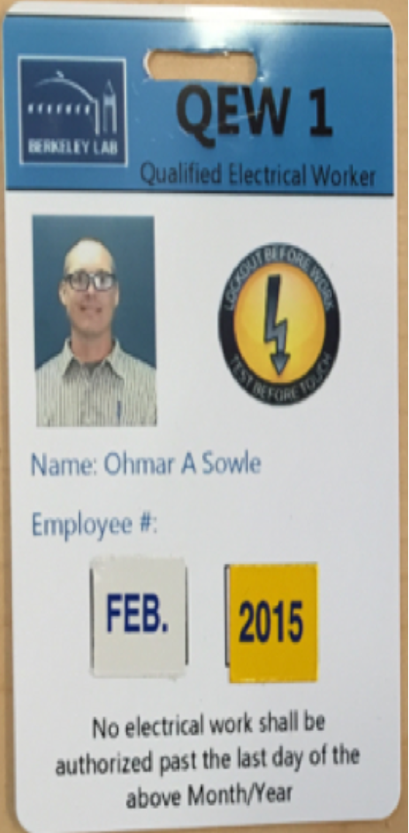
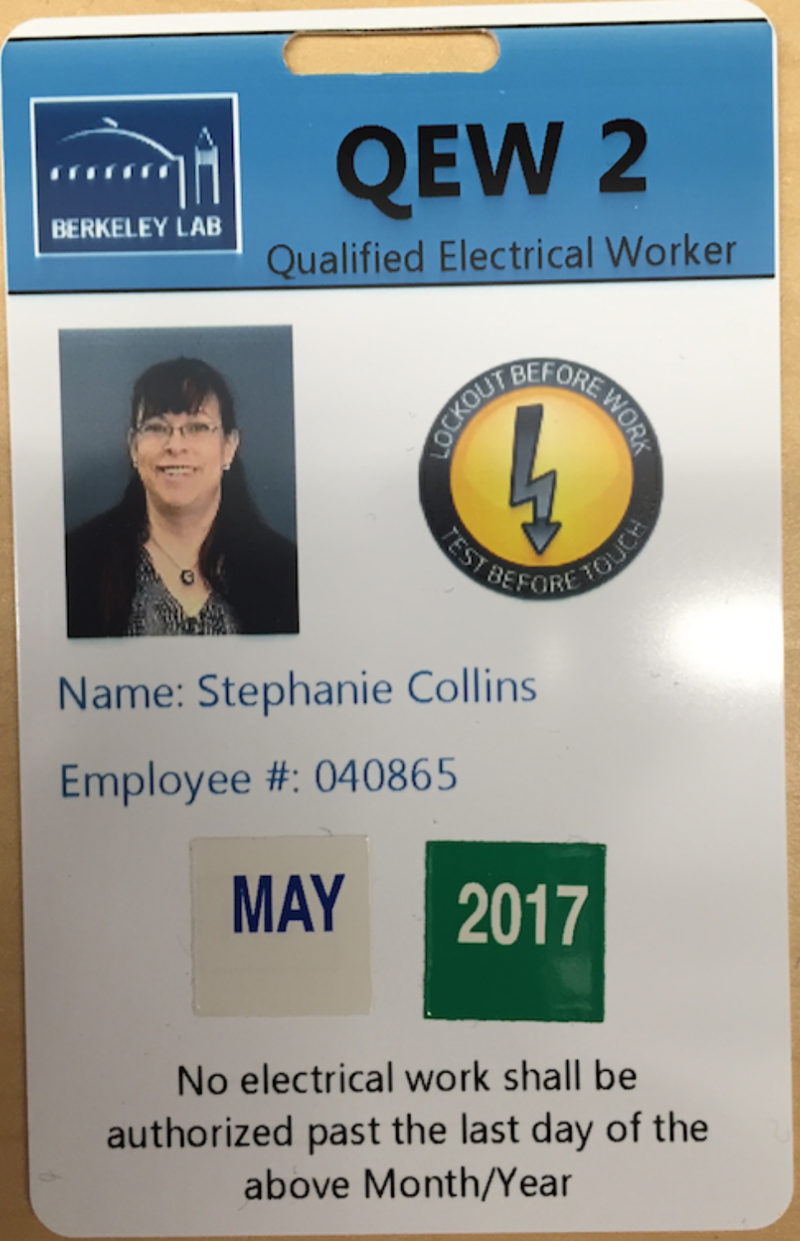
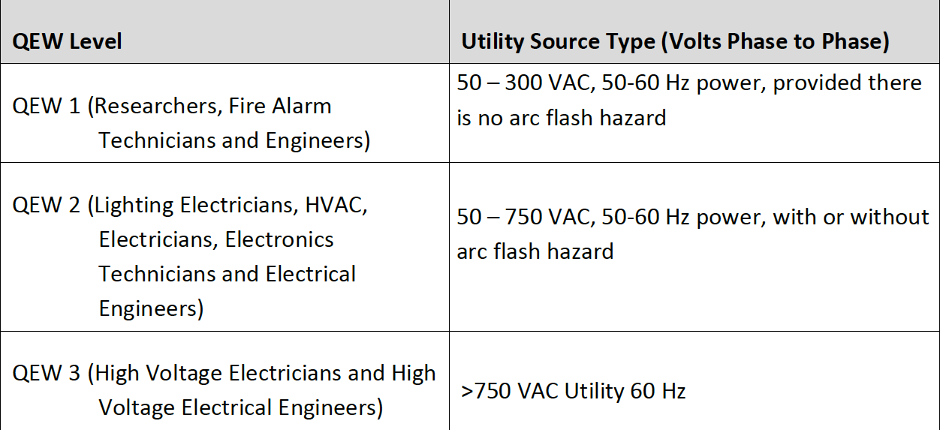
Who is a Qualified Electrical Worker (QEW)?
Blue:
LBNL Employee

Slide 10
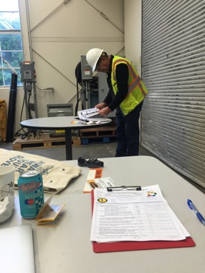
QEW Practical Certification
Passing the QEW Practical Demonstration is necessary to be approved for electrical work at LBNL.
This demonstration consists of the following types of knowledge:
  Arc-rated PPE inspection
  Voltage-rated glove inspection
  Meter inspection
  Knowledge of LBNL ESM requirements
  Knowledge of LBNL LOTO procedures
  Zero Voltage Verification
  and more…..

Slide 11
Use Remote Racking for >12 cal/cm²
Rackable breakers must be racked out for LOTO.
Racking of breakers presents a high risk of an arc flash.
Remote racking devices are required when greater than 12 cal/cm².
If not available contact Facilities ESO.

Slide 12
MCC Buckets may not be racked out energized >12 cal/cm²
Racking MCC buckets in or out creates a high risk of an arc flash
  Body position is compromised because the QEW is directly in the line of fire and up close
  Requires mechanical forcing of the apparatus
LOTO the MCC or submit request for EEWP.

Slide 13
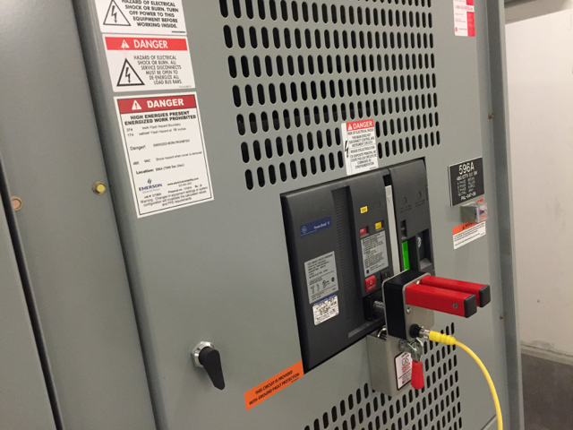
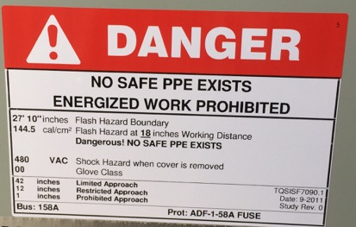
Use Remote Switching for >40 cal/cm²
Arc flash labels will say DANGER where arc flash energy is >40 cal/cm²
Ask for available remote switching devices

Slide 14

Maintenance and Operations
Discussion Points:
QEW/Vendor QEW
Remote racking
Switching
Breaker maintenance
Inspections
IAHJ/AHJ program
Energization
Conduit cutting

Slide 15
Design and Construction Management
Electrical Inspections
AHJ/Inspector Structure
Inspections
QEW
Employer Responsibilities
LBNL Program
Planning
QEW Certification Process
Lockout/Tagout
LOTO RI-First On
EVAP Process
Energization Planning
Unlisted Equipment

Slide 16
Contractor and Host Employer Responsibilities
Electrical Contractor Provides:
LBNL Provides:
Electrical Safety Program
Statement that you are a QEW per their program
Documented completion of NFPA 70E, First Aid, CPR and AED training, all must be current
Documentation of State of California Electrical Licensing
LOTO training
Orientation to LBNL Electrical Safety Program
Practical QEW Certification

Slide 17
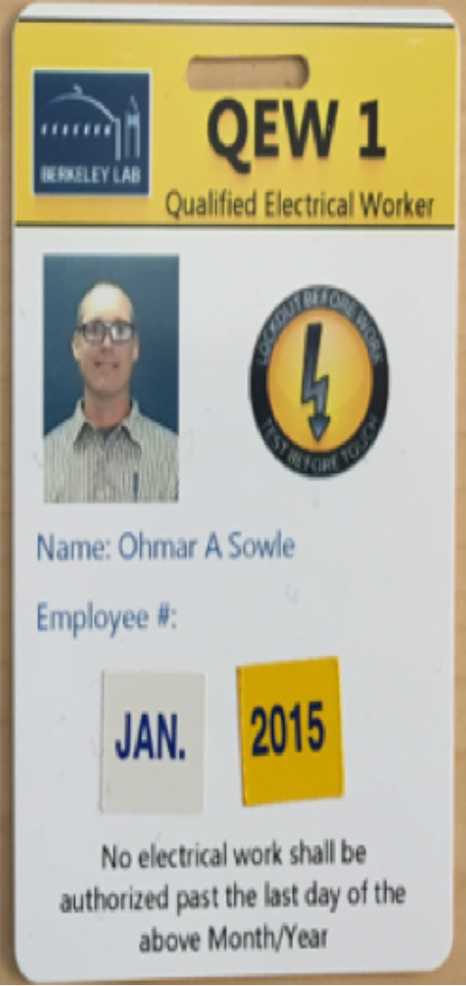
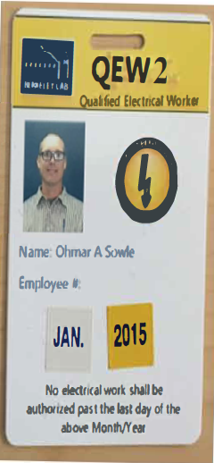
Sub-Contractor QEW
Yellow: Subcontractor
Coming Soon!

Slide 18
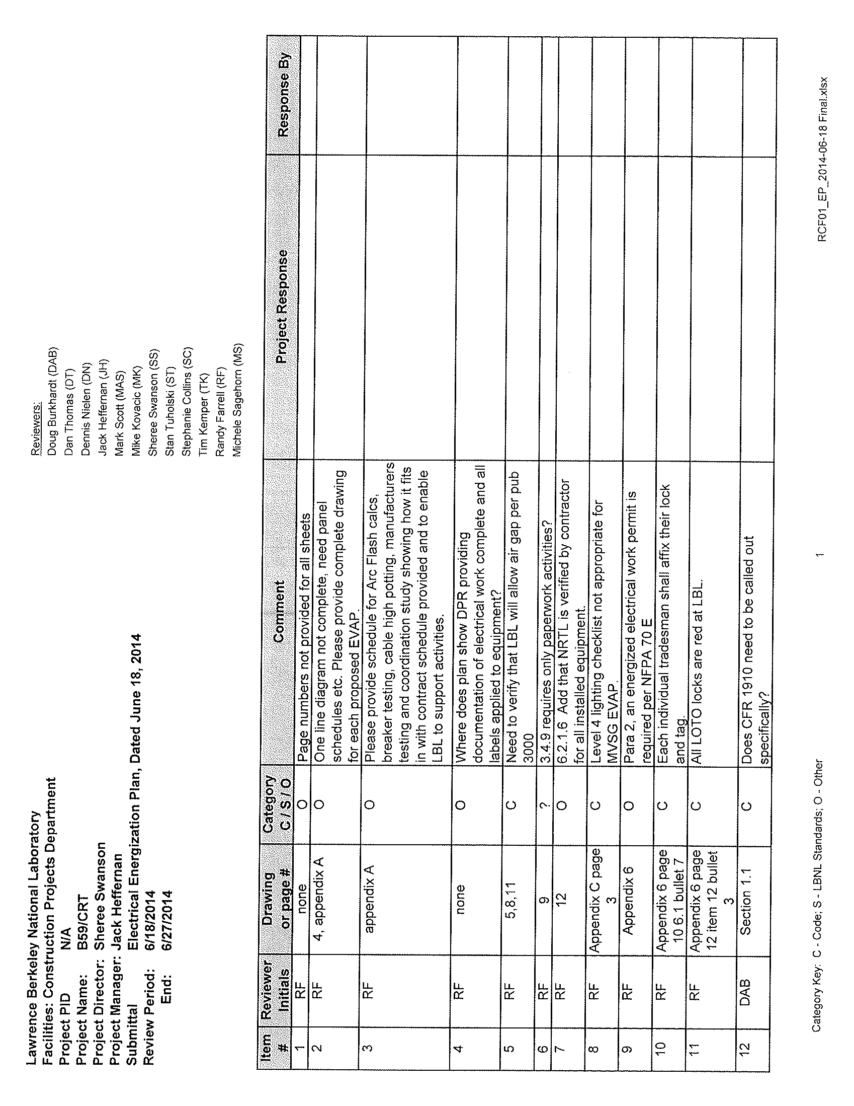
Electrical Energization Plan (EEP)
This is a documented agreement between LBNL, the GC and the EC on the conduct of operations and safety during the initial energization and through final commissioning of the Building.
Incorporates:
  Electrical Inspections and Test Reports
  QEW requirements
  LOTO requirements
  Energized work requirements

Slide 19
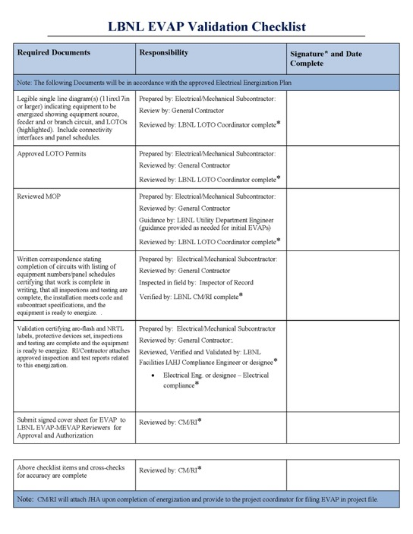
Energization Validation and Authorization Package
Every energization event is prepared and authorized with an EVAP.
First EVAP is the most critical
  QEW approvals
  Transition from Air Gap to LOTO control for the entire project

Slide 20
EVAP, M-EVAP (Subcontracted Work)
Includes:
Energization Plan
Work Certification
Inspection & Test reports
Method of Procedure (MOP) w/ single line dwg & panel schedule
Compliance Engineer Validation
Work Authorization – LOTO Permits
Subcontractor JHA
EVAP Checklist
IAHJ review
RI executes all EVAP activities
Completed EVAP is filed with Project Document Records
Notes:
NFPA 70 (Integrity of wiring, connections, examination by AHJ --- NRTL, lack of documented insulation tests (conductors and transformers, breaker tests or inspections, torque results). These can stop energization.
Lessons Learned: Working clearances, Dedicated space, ground conductor size, plug and cord connection for permanent fixed installed equipment, applicable ground and GFCI tests for temporary wiring, Non-NRTL equipment: Control enclosures (components listed, assembly not), NEMA enclosures suitable for environment, GFCI and multi-oulet raceways in vicinity of Eye Wash Showers, sinks.
NFPA 70 E – Arc-flash hazard – labeling, JHA document details, Vendor work – modifications to equipment – violates NRTL.
Code, Standards and Contract Documents - LBNL Specifications
Modifications as appropriate to existing circuits, instances of future work
Documentation to Engineering, Projects, Commissioning, Subcontractors, Procurement, MRO, Design Professional, Document Control
Integration and compliance with Electrical Safety Program
See Annex for more details of EVAP process

Slide 21
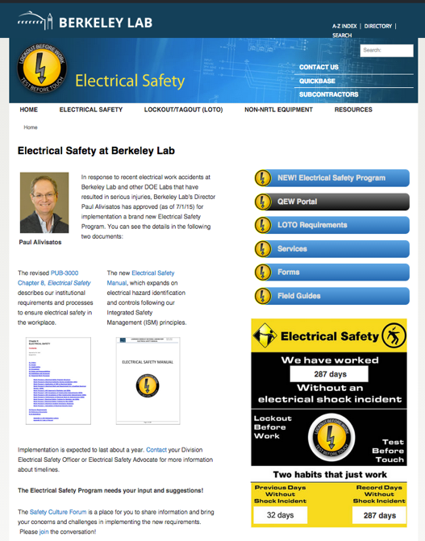
Electrical Safety Website
Primary information center for Electrical Safety at Berkeley Lab
http://electricalsafety.lbl.gov/
link for SUBCONTRACTORS

Slide 22
Project and Construction Management
Discussion Points:
Subcontractor QEW
Inspections/NRTL
AHJ program
Energization
Conduit cutting

Slide 23
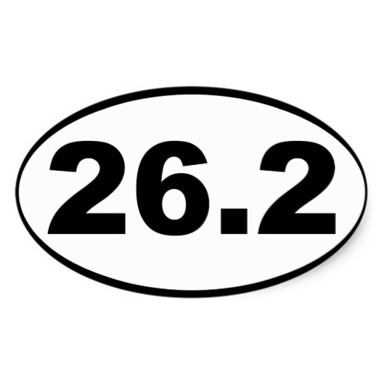
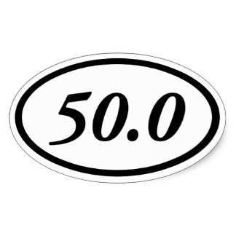

Near the Finish Line?

Slide 24
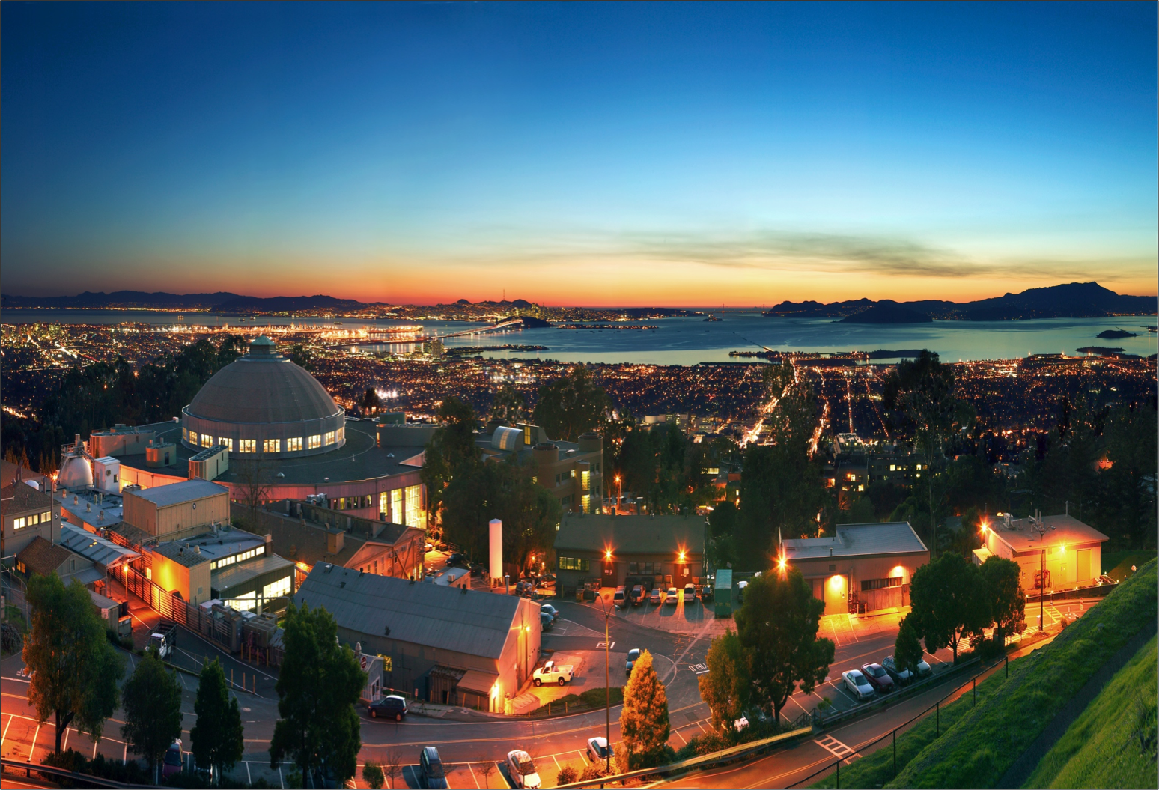
Thank You

