Slide 1
First Results on PIP-II B=0.9 650 MHz Multicell Cavity Processing and Testing
Allan Rowe (for 650 MHz Processing and Testing Team)
April 13th, 2016

Slide 2
Processing Plan
Bulk EP – 120 um
US degreasing + UPW rinse
HPR – cleanroom dry
800C bake w-N2 doping (2/6 recipe as used for LCLS-II)
RF tuning
Light EP (mistake made and 20 um removed instead of 5-10 um)
US degreasing + UPW rinse
HPR – standard rinse as for 1.3 GHz cycle
Evac, leak check
Test #1 – resulted in high FE

Slide 3
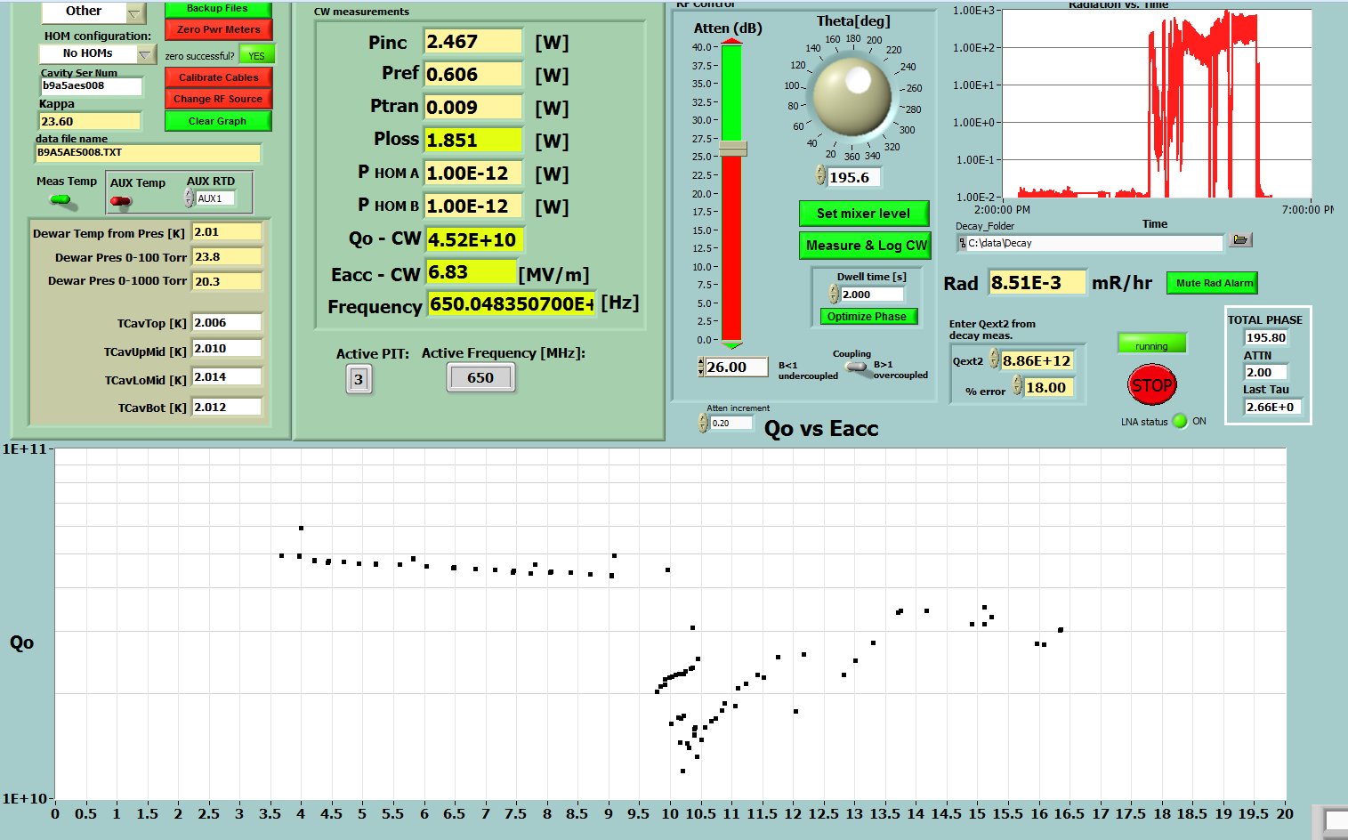
B9A-AES008 Test Results March 2, 2016
1R/hr
~10 MV/m Multipacting Barrier

Slide 4
Field Emission Mitigation Plan
Remove bottom flange only.
Double integrated rinse time.
Slow the HPR to ½ translation speed.
Top of beamtube not directly rinsed due to lack of HPR reach.
Cleanroom lifting height restrictions
Water retained in FPC port, difficult to remove with cavity rotation capability on HPR tool.
Dry 24 hours.
Re-assemble.
Evac, leak check.
Retest.

Slide 5
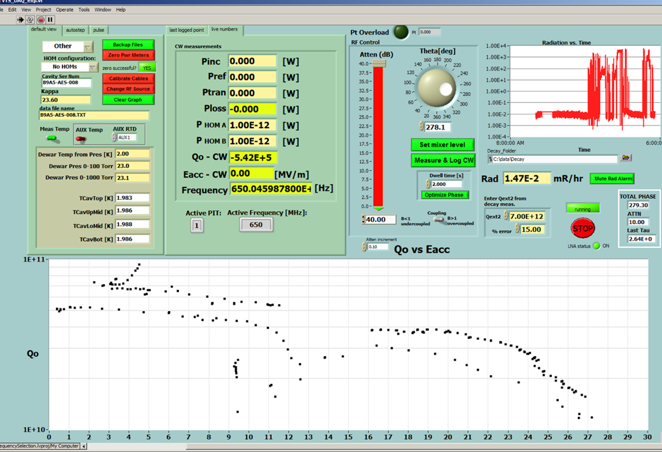
B9A-AES008 Test Results April 1, 2016
5R/hr
~ 10, 12-16 MV/m Multipacting Barriers

Slide 6
Next Steps -- Field Emission Mitigation Plan
Fully disassemble cavity
By hand, scrub the inside surfaces with soapy lint-free wipers
US degrease and UPW rinse
Install new HPR wand head that reaches 100% of top beamtube. Third nozzle installed.
½ speed rinse (translation, not rotation)
Dry 24 hours.
Re-assemble.
Evac, leak check.
Retest.
Test date TBD

Slide 7
Critical Team Members
Electropolishing @ ANL
Tom Reid, Ben Guilfoyle
Cleanroom work
Chris Baker, Brent Stone
Heat treatment
Margherita Merio
Tuning
Paolo Berutti, Mohamed Hasan, Timergali Khabiboulline
Testing
Dmitri Sergatskov, Alex Melnychuk
Reporting & Results
Anna Grassellino

