Slide 1

Project Plans and LMQXFA Requirements
Ruben Carcagno
LMQXF Cold Mass Assembly Review – April 25 2016

Slide 2
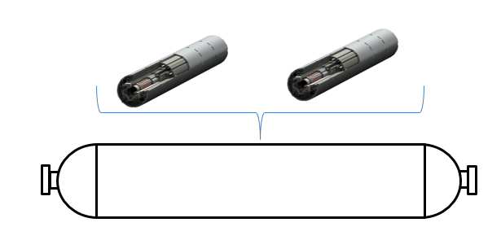
U.S. HL-LHC Accelerator Upgrade Project
Preliminary Focusing Magnets Scope
4 Cold Mass Assemblies for Q1, 4 Cold Mass Assemblies for Q3, and 2 Spare Cold Mass Assemblies
  The Q1 and Q3 Cold Mass Assemblies are expected to be identical
Cryostat excluded (part of CERN’s scope)
  But need one for testing the cold mass assembly!
Magnets (MQXFA)
Cold Mass Assembly (LMQXFA)
Liquid Helium Containment Vessel

Slide 3
Schedule
U.S. Deliverables must support LHC tunnel installation during CERN’s “Long Shutdown 3” (LS3) in 2024-2026
The last U.S. deliverable for tunnel installation must be at CERN by the end of CY2023 at the latest to give enough time for CERN to execute their scope prior to tunnel installation
  CERN scope: cryostat the U.S. cold mass assembly and test the final cryo-assembly before HL-LHC tunnel installation
Run 2
LS 2
PHASE 1
Run 4
Run 3
LS 3
Run 4
HL-LHC installation
LS 4
LS 5
LS 4
Run 5
LS 5

Slide 4
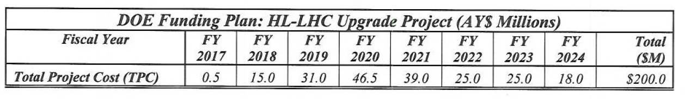
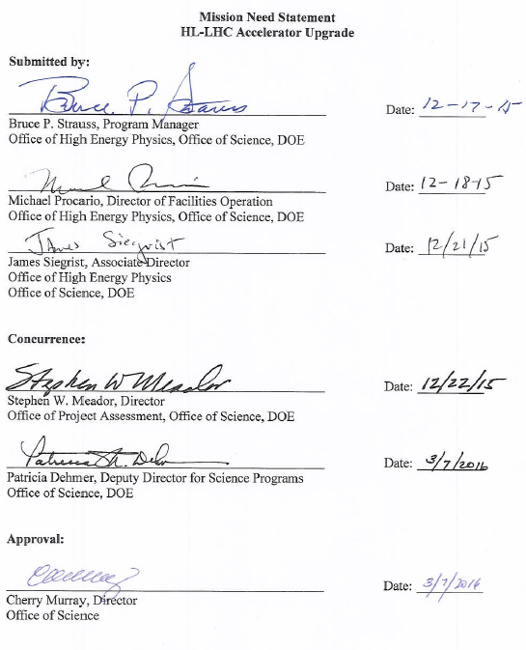
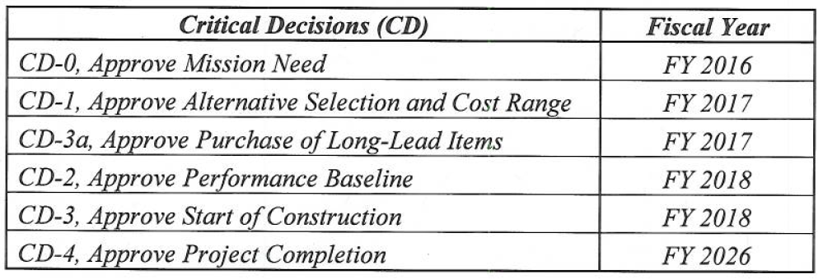
Funding Profile and CD Forecast
From approved “Mission Need Statement” for the HL-LHC Accelerator Upgrade:
The U.S. HL-LHC Accelerator Upgrade Project achieved CD-0 on April 13, 2016

Slide 5
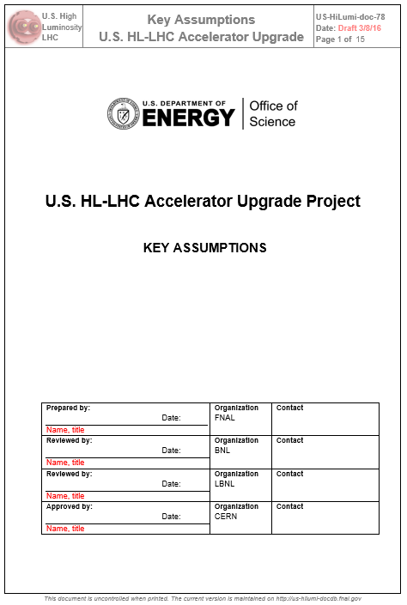
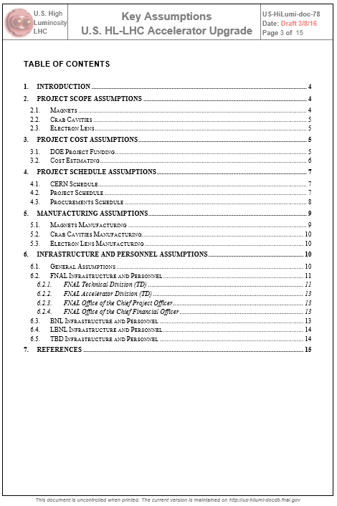
Preliminary Project Planning
Draft “Key Assumptions” Document available:
  https://us-hilumi-docdb.fnal.gov:440/cgi-bin/ShowDocument?docid=78

Slide 6
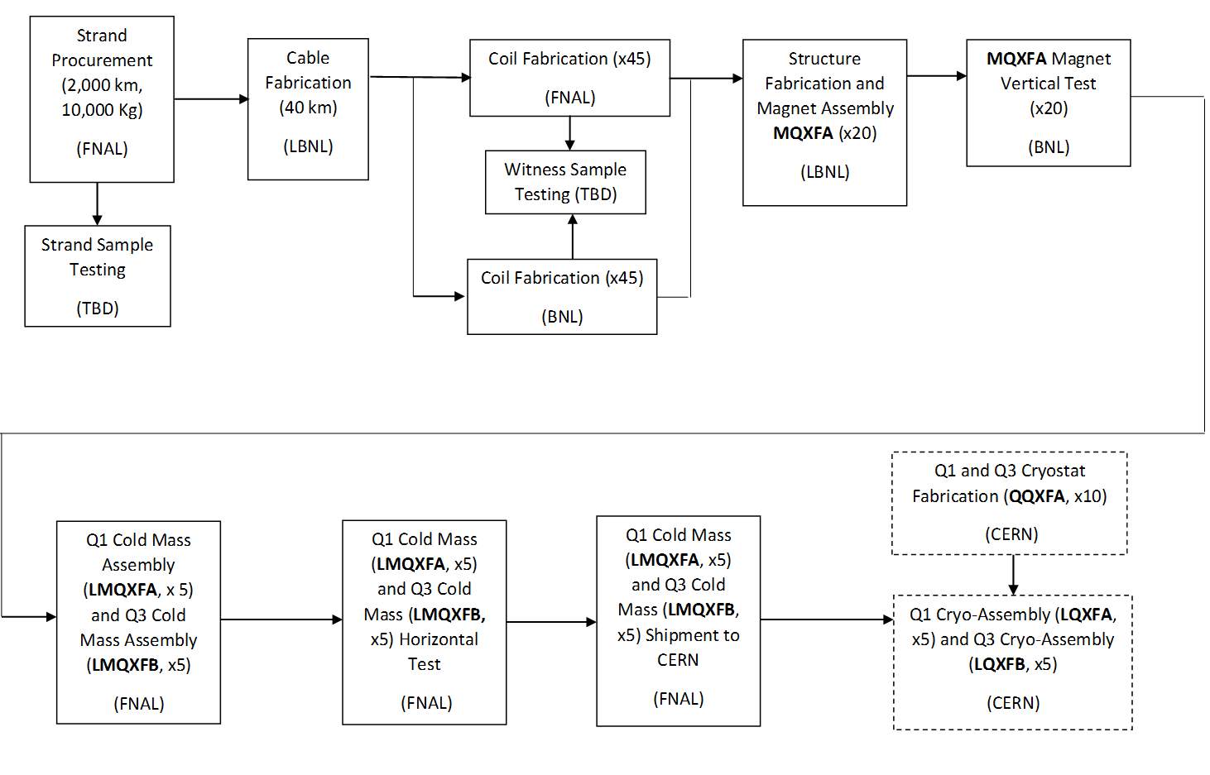
Preliminary Magnets Project Planning
Draft Magnets “Manufacturing Plan” in progress
    https://us-hilumi-docdb.fnal.gov:440/cgi-bin/ShowDocument?docid=52
High Level Manufacturing Flow Chart:

Slide 7
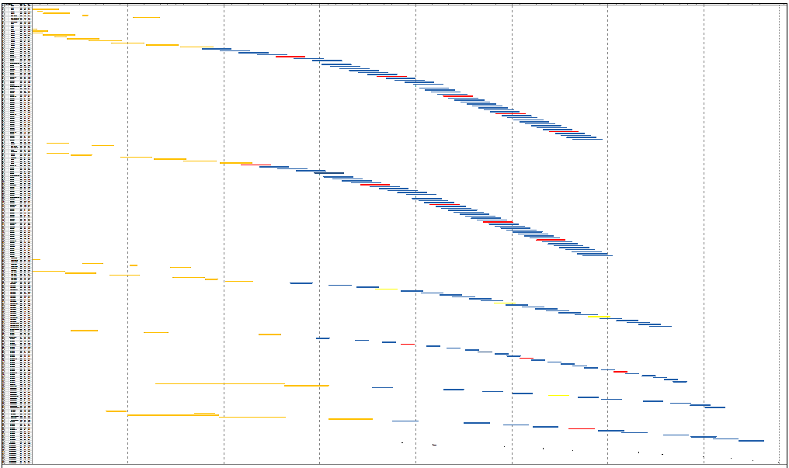
Preliminary Integrated Schedule
(includes LARP to Project transition)
FY17
FY18
FY19
FY20
FY21
FY22
FY23
FY24
FNAL Coils
LARP
Project
BNL Coils
LBNL Structure Assembly
BNL Vertical Test
FNAL Cold Mass Assembly*
FNAL Cold Mass Test*
Delivery to CERN
P
1
2
3
4
5
6
7
8
9
10
*Topics of this Conceptual Review

Slide 8
Preliminary Delivery Dates
Cold Mass Delivery to CERN | Delivery Date
Delivered LMQXFP (LARP) | 8/10/20
Delivered LMQXFA-1 | 1/1/21
Delivered LMQXFA-2 | 9/2/21
Delivered LMQXFA-3 | 1/14/22
Delivered LMQXFA-4 | 5/6/22
Delivered LMQXFA-5 | 1/12/23
Delivered LMQXFA-6 | 4/12/23
Delivered LMQXFA-7 | 9/15/23
Delivered LMQXFA-8 | 12/29/23
Delivered LMQXFA-9 | 3/22/24
Delivered LMQXFA-10 | 6/28/24
1 LARP Prototype Cold Mass for String Test (2020)
8 Cold Masses for Q1/Q3 LHC Tunnel Installation (2021-2023)
2 Spares (2024)

Slide 9
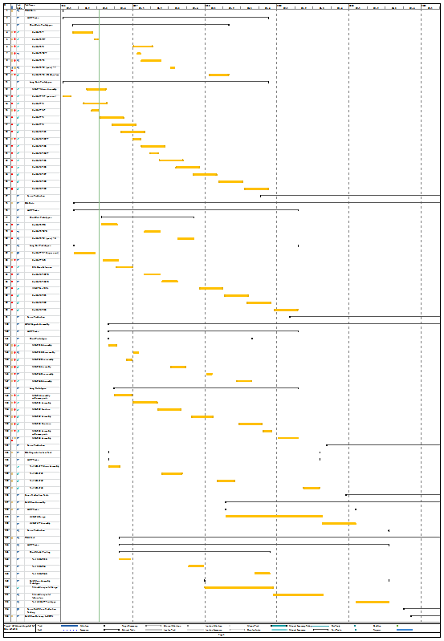
LARP Prototypes Schedule (FY16-FY20)
FY16
FY17
FY18
FY19
FY20
LARP Prototypes
  3 Long Magnets
    1st two for CD-3 approval by mid-FY18
    3rd for value engineering and cold mass assembly prototype
      1st prototype coils are 4.0 m long instead of 4.2 m long
  1 Cold Mass Assembly
    Uses 2nd and 3rd long magnets prototypes
    Delivered to CERN for string test
    Will try to meet HL-LHC tunnel installation requirements
      Opportunity to become one of the project spare deliverables
FNAL Short Coils
FNAL Long Coils
BNL Short Coils
BNL Long Coils
LBNL Short Magnets
LBNL Long Magnets
BNL Long Magnet Test
FNAL Cold Mass Assembly*
FNAL Test*
*Topics of this Conceptual Review

Slide 10
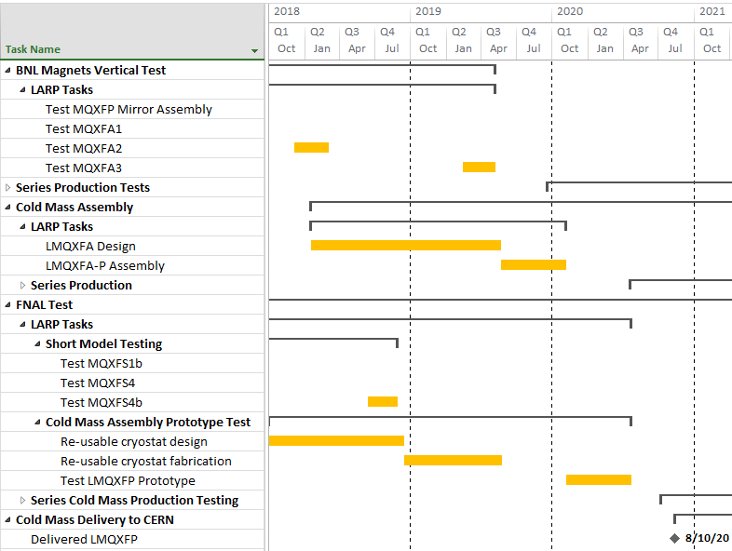
Cold Mass Prototype Preliminary Schedule
BNL Long Magnet Test
FNAL Cold Mass Assembly*
FNAL Horizontal Test*
*Topics of this Conceptual Review

Slide 11
Functional Requirements
Classified into two groups:
  Threshold Requirements (T): project must meet
  Objective Requirements (O): project should meet and will strive to achieve
    Example: magnetic field harmonics target
A draft magnet (MQXFA) functional requirement specification (US-HiLumi-doc-36) has already gone through several iterations with CERN
  First draft May 2015, latest draft Feb. 18, 2016:
  https://us-hilumi-docdb.fnal.gov:440/cgi-bin/ShowDocument?docid=36
  Main open issues are alignment requirements and hipot requirements
The first draft Cold Mass Assembly (LMQXFA) requirement specification (US-HiLumi-doc-34) was presented at CERN on Oct. 28, 2015 and has not gone through substantial iterations yet
  https://us-hilumi-docdb.fnal.gov:440/cgi-bin/ShowDocument?docid=64
  Less developed than the magnet requirements, many items are still undefined
Requirements verification procedures and acceptance criteria will be defined in a separate document
  Not started yet
  Acceptance procedure of objective requirements need to be clearly agreed upon
    Acceptance related to objective requirements is less straightforward than threshold requirements
    Example: a magnet that does not meet the magnetic field harmonics target

Slide 12
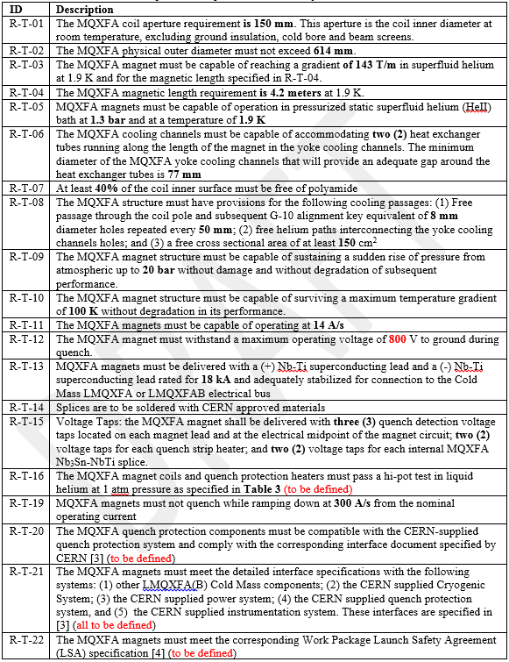
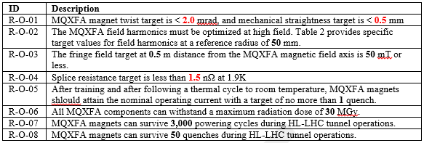
MQXFA Requirements Table
Threshold Requirements
Objective Requirements
Items in red are less certain and need more discussion
ΔT < 100K: important for cold mass assembly test stand

Slide 13
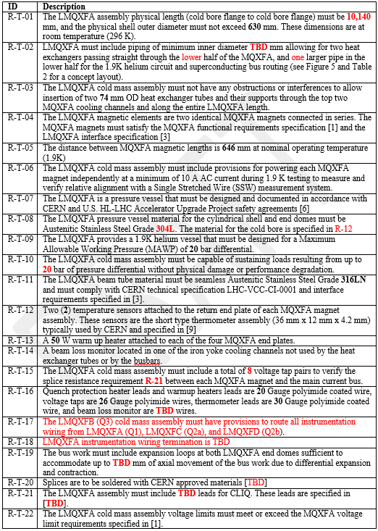
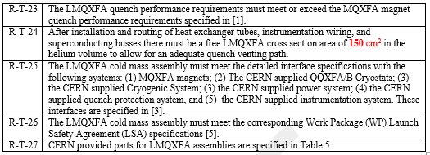
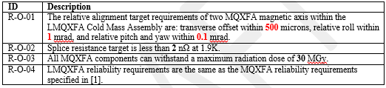
LMQXFA Requirements Table
(This review)
Threshold Requirements
Objective Requirements
Items in red are less certain and need more discussion

Slide 14
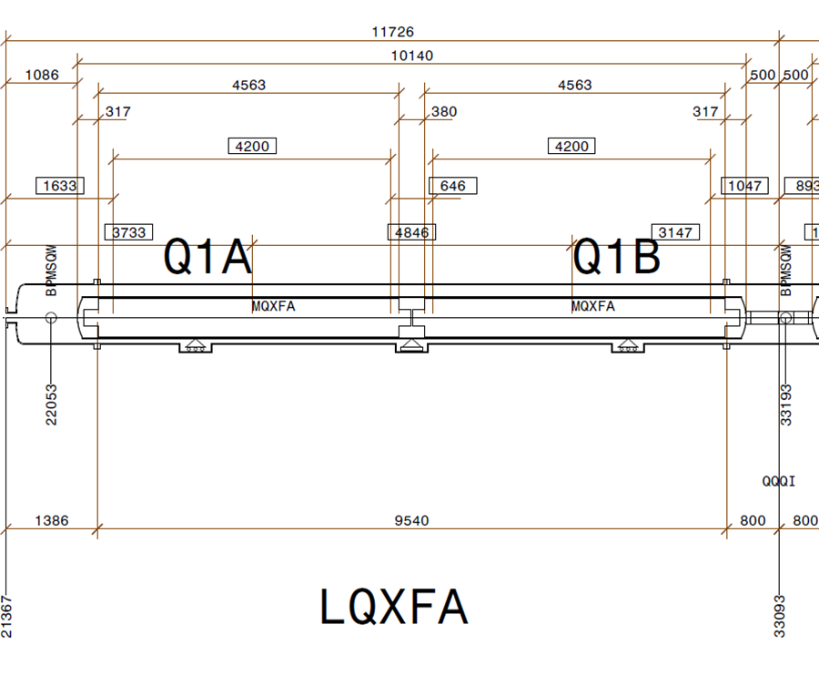
LMQXFA Physical Requirements
T: Cold Mass Assembly length (end dome to end dome) is 10,140 mm and diameter is 630 mm (at room Temperature)
T: Distance between MQXFA magnetic lengths is 646 mm (at 1.9K)
HL-LHC Layout for LQXFA (from CERN Drawing LHCLSXH_0010)

Slide 15
LMQXFA Alignment Requirements
O: Relative MQXFA magnetic axis: transverse offset < 500 um, relative roll < 1 mrad, relative pitch/yaw < 0.1 mrad
  These values are for the present Q2a and Q2b and are under discussion with CERN for LMQXFA
T: To verify with SSW system, each MQXFA magnet must be capable of being independently powered with a minimum of 10 A AC current during 1.9K testing

Slide 16
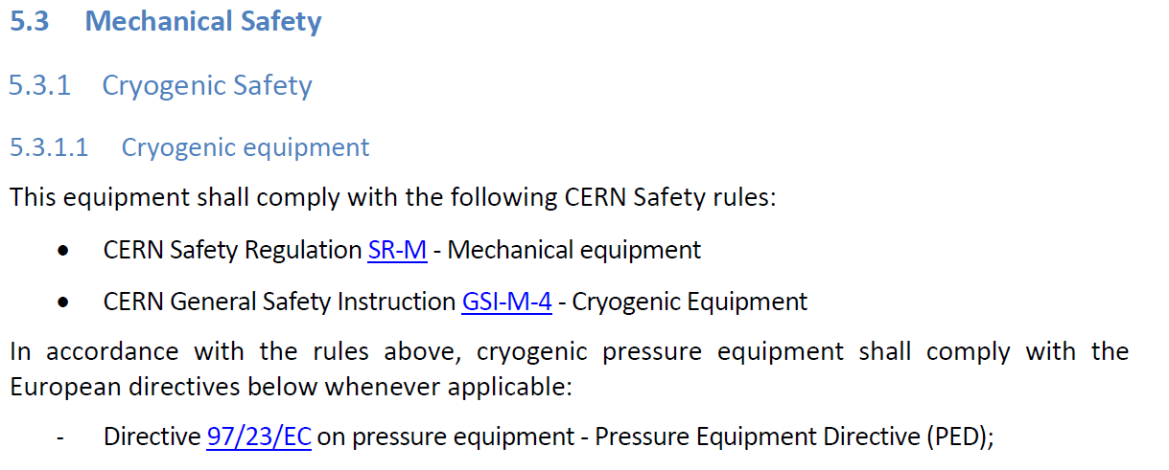
LMQXFA Pressure Vessel Requirements
T: Must comply with CERN and US HL-LHC Accelerator Upgrade Project safety agreement
  CERN formally requires a PED-compliant pressure vessel for installation in the LHC tunnel. From the “Launch Safety Agreement” recently issued for the HL-LHC IR Magnets (CERN Work Package 3):
  Recently, CERN seems to be more open to the U.S. requesting exception to this requirement by issuing a letter describing the Fermilab process for pressure vessel safety
    This will be done soon
    Best outcome would be that CERN accepts the Fermilab process, similar to what was done for the present USLHC triplets delivered by the U.S.
    Worst outcome is strict PED compliance… Need to carefully assess cost and schedule impact

Slide 17
LMQXFA Pressure Vessel Requirements
T: Material is 304L SS, except cold bore which is 316LN and compliant with LHC-VCC-CI-0001
  Proposed cold bore be supplied by CERN
T: Maximum Allowable Working Pressure (MAWP) of 20 bar differential at 1.9K

Slide 18
LMQXFA Forces Requirement
T: Capable of sustaining loads resulting from up to 20 bar of differential pressure
  Originate from quenching of neighboring cold masses and cryogenic commissioning activities in the LHC tunnel

Slide 19
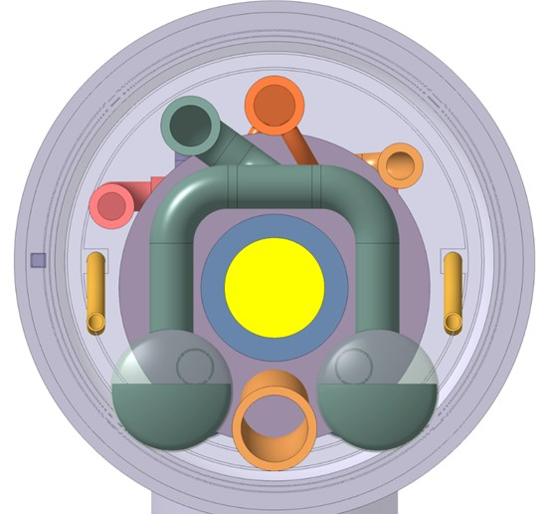
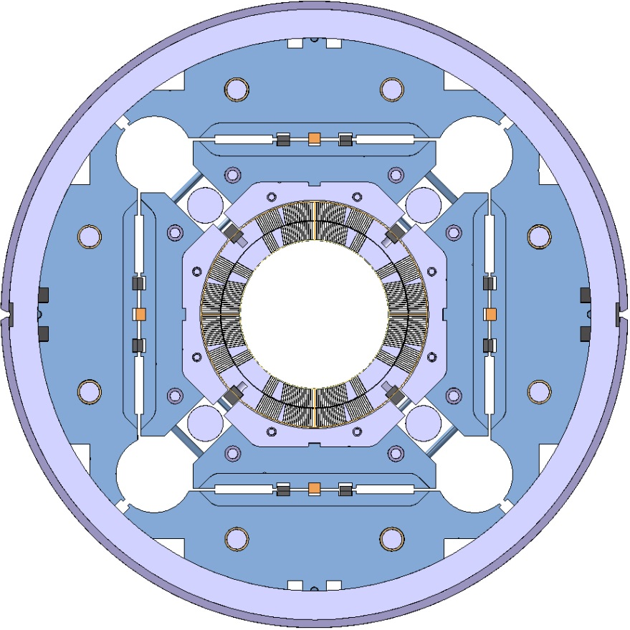
LMQXFA Heat Exchanger Reqs
T: Heat Exchangers: Must allow insertion of two 74 mm OD heat exchanger tubes and their supports through the lower two MQXFA cooling channels along the entire LMQXFA Length
    Proposed Heat Exchanger tubes be supplied by CERN

Slide 20
LMQXFA Instrumentation Requirements
T: Two (2) temperature sensors attached to return end plate of each MQXFA magnet
  Proposed temperature sensor blocks be supplied by CERN
T: A 50 W warm up heater attached to each of the four MQXFA end plates, independently powered
  Proposed warmup heaters be supplied by CERN
T: Beam Loss monitor located in one of the free iron yoke cooling channels
  Proposed beam loss monitor be supplied by CERN
T: 8 Voltage Taps pairs to verify splice resistance

Slide 21
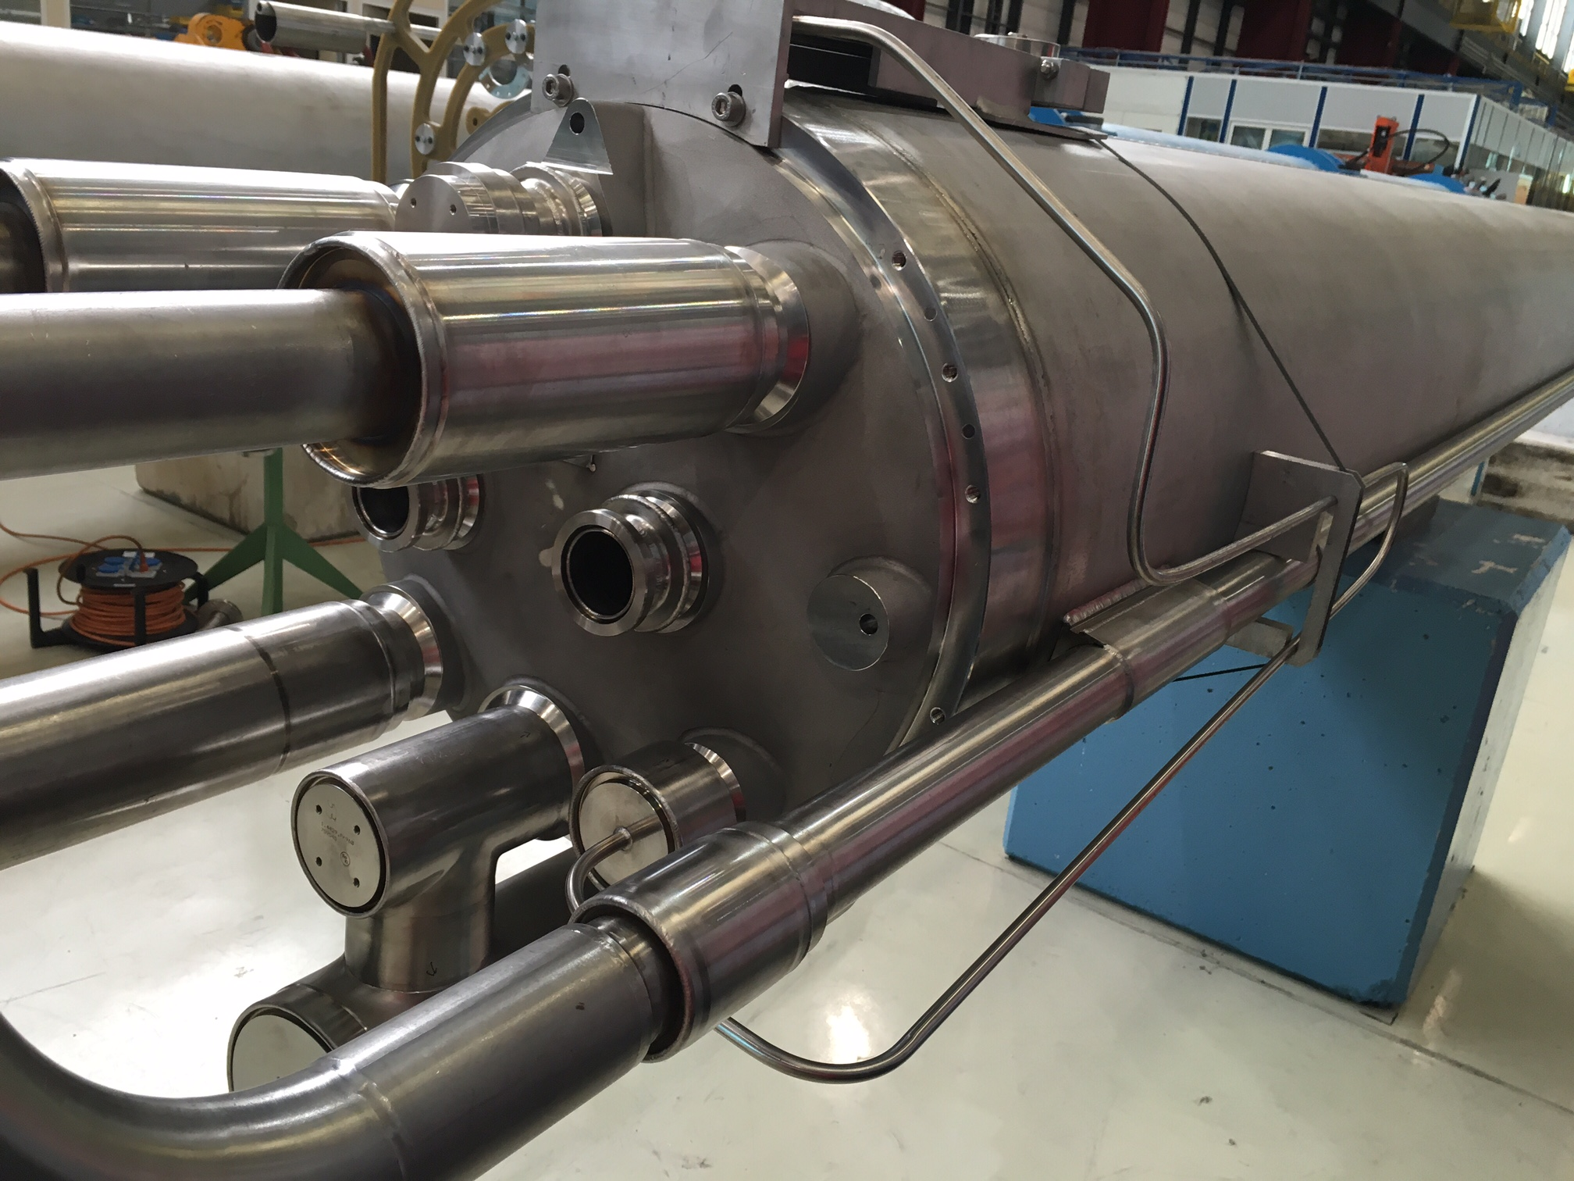
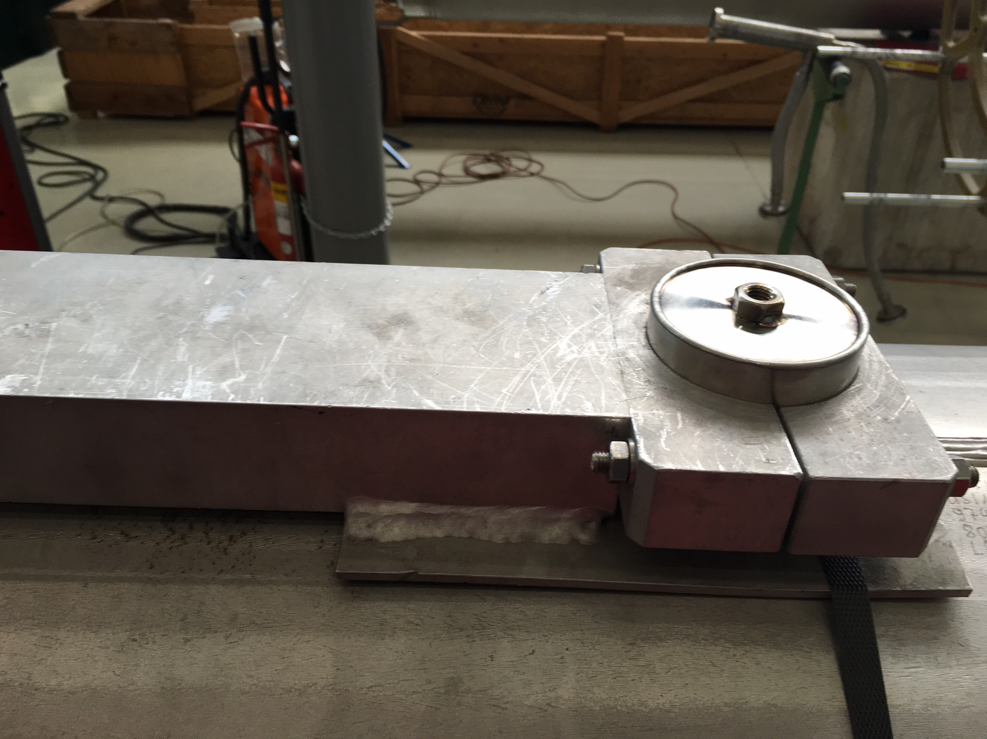
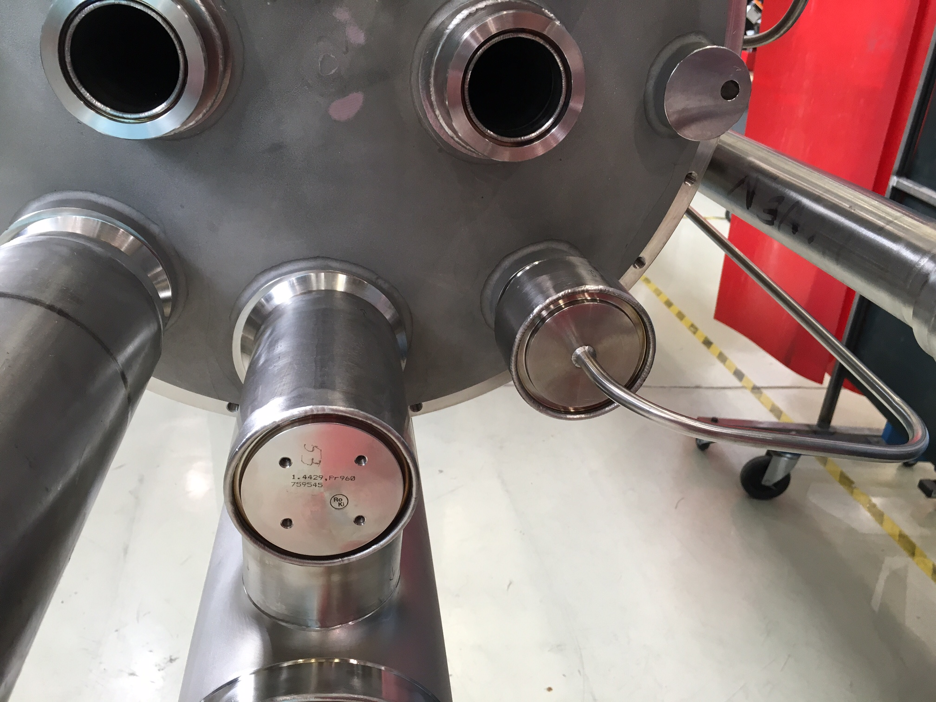
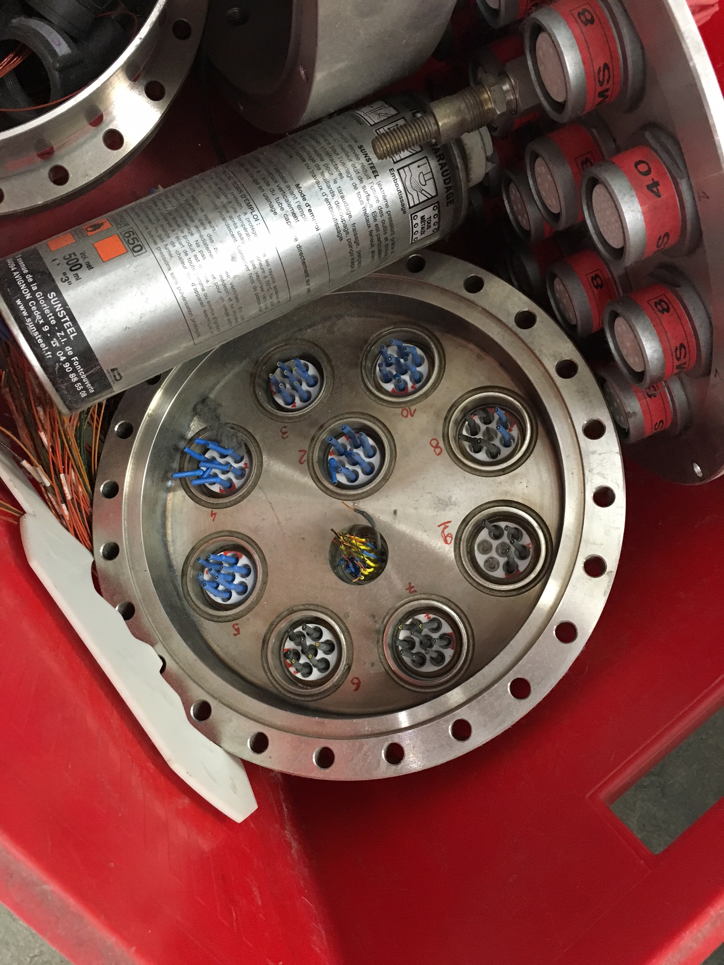
Instrumentation Termination – CERN design for LHC dipoles?
Instrumentation for each cold mass assembly terminated on each assembly with connectors on the vacuum space
  No Hypertronic connectors inside the helium volume

Slide 22
LMQXFA Electrical Bus Requirements
T: Main bus made of Nb-Ti Cable rated for 20 kA (specs?) plus TBD leads for CLIQ
T: Must include expansion loops at both LMQXFA End Domes to accommodate up to TBD mm of axial movement
T: Splices soldered with CERN approved materials
O: Slice resistance target is less than 1.5 nΩ at 1.9K
  May be lowered to 1 n Ω depending on prototype measurements

Slide 23







Inner Triplet Busbars Integration Proposal
(until a 18kA cable is developed and proven)
Splices
External busbars
(round cable type)
2kA
+ | 13
+ | 11
 | 2
 | 2
 | 2
 | 24
 | 36
 | 18
200A
2kA
200A
2.8kA,
12Hz fast decay
In Q2 cold masses
Total 108
Internal busbars
(stabilized Rutherford cable)
18kA
Courtesy of Cedric Eymin
18kA

Slide 24
LMQXFA Voltage, Quench, Radiation, Reliability
T: Voltage Limits same as MQXFA.
  Hipot values under discussion with CERN, no decision yet
Quench requirements same as MQXFA:
  T: Trained to 108% of nominal operating current (17.8 kA, nominal operating current is 16.5 kA).
  O: Must remember training and reach nominal operating current with a target of no more than 1 quench after a room temperature thermal cycle
  T: Must not quench while ramping down at 300 A/s from nominal current
Radiation requirements same as MQXFA
  O: All MQXFA components must withstand a maximum radiation dose of 30 MGy
Reliability Requirements same as MQXFA
  O: Survive 3,000 powering cycles and 50 quenches

Slide 25
LMQXFA Free Cross Section
T: After installation and routing of heat exchanger tubes, instrumentation wiring, and superconducting busses there must be a free LMQXFA cross section area of at least 150 cm² in the helium volume to allow for an adequate venting path
  This also sets the free cross sectional area of piping connecting the cold mass assembly to neighboring cold mass assemblies
150 cm²

Slide 26
LMQXFA Interface Requirements
T: Comply with Interface Specifications for:
  The MQXFA magnets
  CERN QQXFA Cryostats
  CERN Cryogenic System
  CERN Power System
  CERN Quench Protection System
  CERN Instrumentation System
All these interface specifications are To Be Defined

Slide 27
Proposed CERN Supplied LMQXFA Parts
Item | Quantity
Beam tubes | 11
Heat exchanger tubes | 22
Instrumentation wire AWG 20 | TBD km
Instrumentation wire AWG 26 | TBD km
Thermometer cable, 4 x AWG 30 (twisted) | TBD km
Temperature Sensors | 44
Warm up heaters | 22
Beam Loss Monitor | 11
Instrumentation Connectors and Feedthroughs (if applicable) | TBD

Slide 28
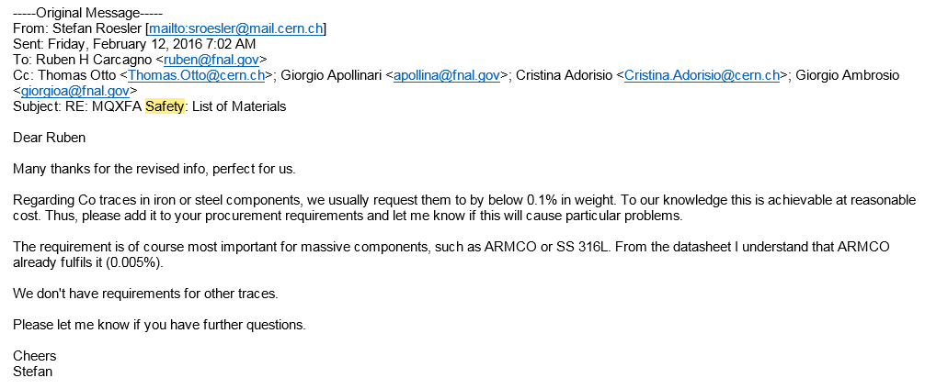
Other LMQXFA Safety Requirements
T: Comply with the corresponding CERN Work Package 3 Launch Safety Agreement (LSA) specification
  Unless special CERN-U.S. agreements are reached, e.g. regarding PED compliance for pressure vessels
Radiological Requirements
  Co traces content < 0.1% in weight

Slide 29
Summary
A draft LMQXFA functional requirements specification is available and under discussion with CERN
  Discussed at LARP/Hi-Lumi meetings (next one at SLAC 18-20 May 2016) and workshops
  Trying to converge by the DOE review of LARP in July 2016
  Input from this review very valuable to identify missing requirements and improvements
Key requirements to agree are alignment, hipot, parts supplied by CERN, and safety
  Important to quantify cost and schedule impact of requirements such as PED pressure vessel compliance and low Co traces

