Slide 1
CM Testing Equipment: Quench Protection, DAQ, Splice Resistance
Darryl Orris/Mike Tartaglia
25 April 2016
LMQXF Cold Mass Requirements and Conceptual Design Review

Slide 2
Overview
  Test Stand Controls –
  Existing Siemens PLC will be upgraded to Allen-Bradley
  DAQ monitoring –
  Existing VME/VxWorks front end, Sun/Unix are obsolete
  New system will integrate with PLCs
  Basis is design being developed for Mu2e experiment
  which is in final/detailed state
  Quench Detection and Characterization –
  Existing VME/VxWorks/Sun/Unix system is obsolete
  New FPGA-based system (3rd generation)
  Basis is design being developed for Mu2e experiment
  New Isoamp design already deployed in other test areas
  Splice Resistance Measurement –
    New Design based upon Mu2e Test Stand system (nano-Vmeter)

Slide 3
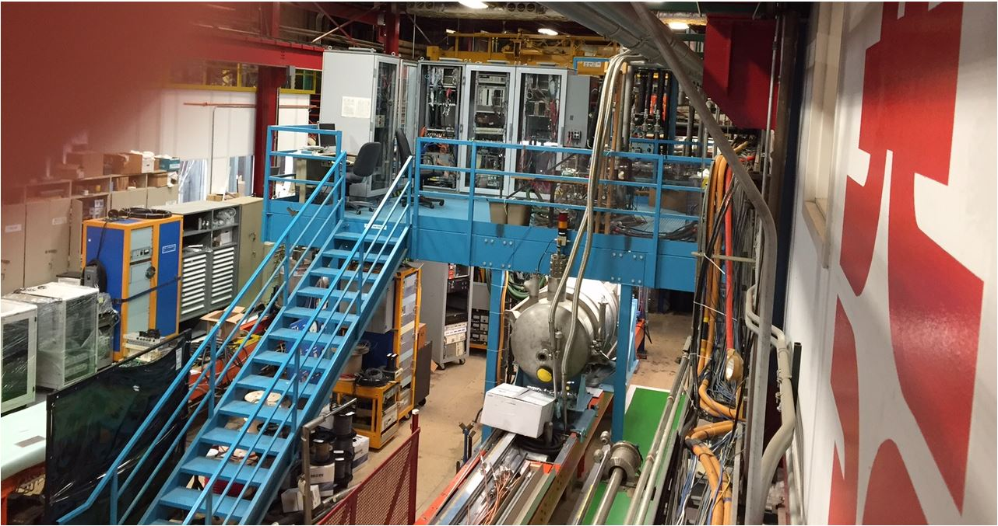
Test Stand 4 / DAQ Platform
Original Racks Include from the left:
Quench Antenna DAQ
Slow Scan System
Quench Detection / Quench Characterization
PLC Rack
End Rack with CVT Panel and Low Voltage Quench Logic Wiring

Slide 4
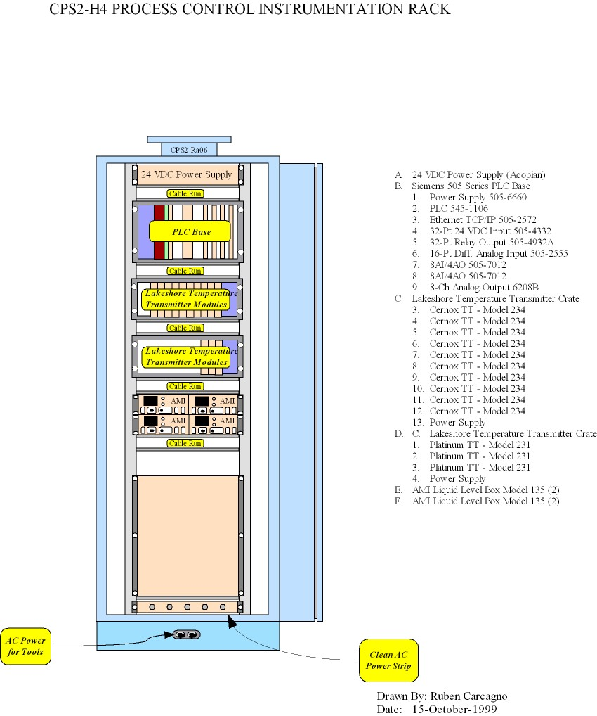
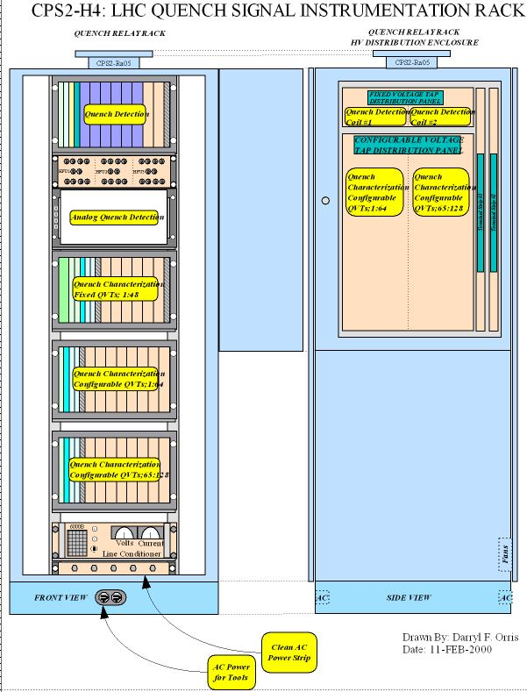
Test Stand 4 / DAQ Original Process Control and Quench Protection /Characterization Rack Layout

Slide 5
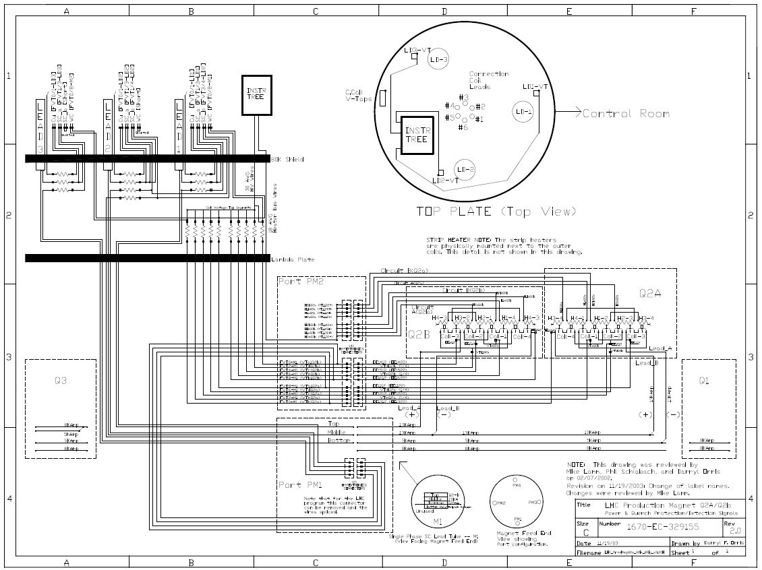
Test Stand 4 Existing Q2A/Q2B
Power Bus / Quench Protection Wiring
The Test Stand power bus and Quench Protection Wiring is Still in Place.

Slide 6
Proposed Upgrades
  Replace two 15kA vapor cooled copper leads with two 20kA vapor cooled copper leads
    Keep the third 15kA lead?
  Use the existing DAQ racks, cabling, and wiring
  Much of the existing Quench Protection End Rack wiring can probably be used
    The CVT panel will probably be used as is
  Depending on the number or protection heaters that are externally cabled, a new distribution panel made be needed
    A copy of the VMTF heater distribution panel could be made
  Implement a splice measurement system controlled by the PLC
  Upgrade the Quench Protection system
  All internal HV wiring will have to be tested to meet the new hipot requirements

Slide 7
Quench Protection Design
  Quench Protection Design –
  Implement complete redundancy from the connection to the magnet voltage tap wires through to the power supply and dump circuit – no single point failure modes
  Implement a three tier quench protection system
    Tier 1 – Digital Quench Detection (FPGA) will be used for the Primary QP
    Tier 2 – Analog Quench Detection will be used for the Reductant QP
    Tier 3 – System Monitor, Logic Analyzer with First Fault Detection, Fast Logger, etc.
  Standard quench signals include: Whole Coil, Whole Coil – IDot, Bucked Half Coils, Cu Leads , SC Leads, and Ground Fault
    The two magnet whole coils will be treated as half coils for bucking
    The SC thru bus will have to be protected – Summed with SC Leads

Slide 8
Quench Detection Signals
  Digital and Analog Quench Detection hardware will be in separate chassis powered by independent UPS’s
  Each isolation amplifier chassis can be expanded to accommodate the third lead if needed in the future
Implement one 24-Ch IsoAmp Box with 16 IsoAmps |  |  |  | Implement one 24-Ch IsoAmp Box with 16 IsoAmps
DQD Sig | I-AMP # | FPGA Q-Sigs. |  | AQD Sig | I-AMP # | AQD Q-Sigs.
WC Sum | 1 | 1 |  | WC Sum | 1 | 1
WC-1 | 2 | 2 |  | WC-1 | 2 | 2
WC-2 | 3 | 3 |  | WC-2 | 3 | 3
SC Lead 1 (+) | 4 | 4 |  | SC Lead 1 (+) | 4 | 4
SC Lead 2 (-) | 5 | 5 |  | SC Lead 2 (-) | 5 | 5
SC Thru Bus | 6 | 6 |  | SC Thru Bus | 6 | 6
SC Lead 3 -- NC |  |  |  | SC Lead 3 -- NC
Cu Lead 1 (20kA) | 7 | 7 |  | Cu Lead 1 (20kA) | 7 | 7
Cu Lead 2 (20kA) | 8 | 8 |  | Cu Lead 2 (20kA) | 8 | 8
Cu Lead 3 (15kA) -- NC | 9 |  |  | Cu Lead 3 (15kA) -- NC | 9

Slide 9
Quench Characterization Signals
Implement one 32-Ch IA Box with 32 IsoAmps
QC Sig | IsoAMPs | Loggers |  | QC Sig | IsoAMPs | Loggers
WC-1 | 1 | 1 |  | Strip Heater 1 | 21 | 21
+HC-1 | 2 | 2 |  | Strip Heater 2 | 22 | 22
-HC-2 | 3 | 3 |  | Strip Heater 3 | 23 | 23
WC-1 | 4 | 4 |  | Strip Heater 4 | 24 | 24
+HC-1 | 5 | 5 |  | Strip Heater 5 | 25 | 25
-HC-2 | 6 | 6 |  | Strip Heater 6 | 26 | 26
Thru Bus | 7 | 7 |  | Strip Heater 7 | 27 | 27
SC Lead 1 (+) | 8 | 8 |  | Strip Heater 8 | 28 | 28
SC Lead 2 (-) | 9 | 9 |  | Spare? | 29
SC Thru Bus | 10 | 10 |  | Spare? | 30
SC Lead 3 -- NC | 11 | 11 |  | Spare? | 31
Cu Lead 1 (20kA) | 12 | 12 |  | Spare? | 32
Cu Lead 2 (20kA) | 13 | 13 |  | Heater PS-1 Cur | N/A | 29
Cu Lead 3 (15kA) -- NC | 14 | 14 |  | Heater PS-1 V | N/A | 30
CLIQ Lead 1 | 15 | 15 |  | Heater PS-2 Cur | N/A | 31
CLIQ Lead 2 | 16 | 16 |  | Heater PS-2 V | N/A | 32
CLIQ Lead 3 | 17 | 17 |  | Heater PS-3 Cur | N/A | 33
CLIQ Bus 1 | 18 | 18 |  | Heater PS-3 V | N/A | 34
CLIQ Bus 2 | 19 | 19 |  | Heater PS-4 Cur | N/A | 35
CLIQ Bus 3 | 20 | 20 |  | Heater PS-4 V | N/A | 36
 |  |  |  | Magnet Current | N/A | 37
 |  |  |  | Magnet Idot | N/A | 38

Slide 10
Quench Protection System Estimate Assumptions
  Quench Protection Assumptions –
  DQD [WC, WC-Idot, HC’s, Cu Leads-I, SC Leads, GF]
    Iso amp: 12 ch (24-Ch. Chassis) – includes 4 spares
    Analog inputs: 16 ch (1 mod) + 16 ch (1 spare mod)
    8-slot cRIO FPGA chassis with controller (1 spare)
    24 V digital inputs: 16 ch (1 mod) + 16 ch (1 spare mod)
    24 V digital outputs: 16 ch (1 mod) + 16 ch (1 spare mod)
    TTL digital i0: 32 ch (1 mod) + 32 ch (1 spare mod)
  AQD DQD [WC, WC-Idot, HC’s, Cu Leads-I, SC Leads, GF]
    Iso Amp: 12 ch (24-Ch. Chassis) includes 4 spares
    AQD boards: 10 (includes 2 spares)

Slide 11
Quench Protection System Estimate Assumptions
  Quench Characterization and QD Monitor Assumptions –
  QC
    Iso amp: 32 ch (1 box)
    8-slot PXI chassis (1 Spare)
    PXI controller (1 Spare)
    Analog inputs 32 ch (4 mod) + 16 ch (2 spare mod)
  QD monitor
    24 bit analog inputs: 4 ch (1 mod) + 4 ch ( 1 mod spare)
    8-slot cRIO FPGA chassis with controller
    24 V digital inputs: 16 ch
    24 V digital outputs: 16 ch
    TTL digital i0: 32 ch

Slide 12
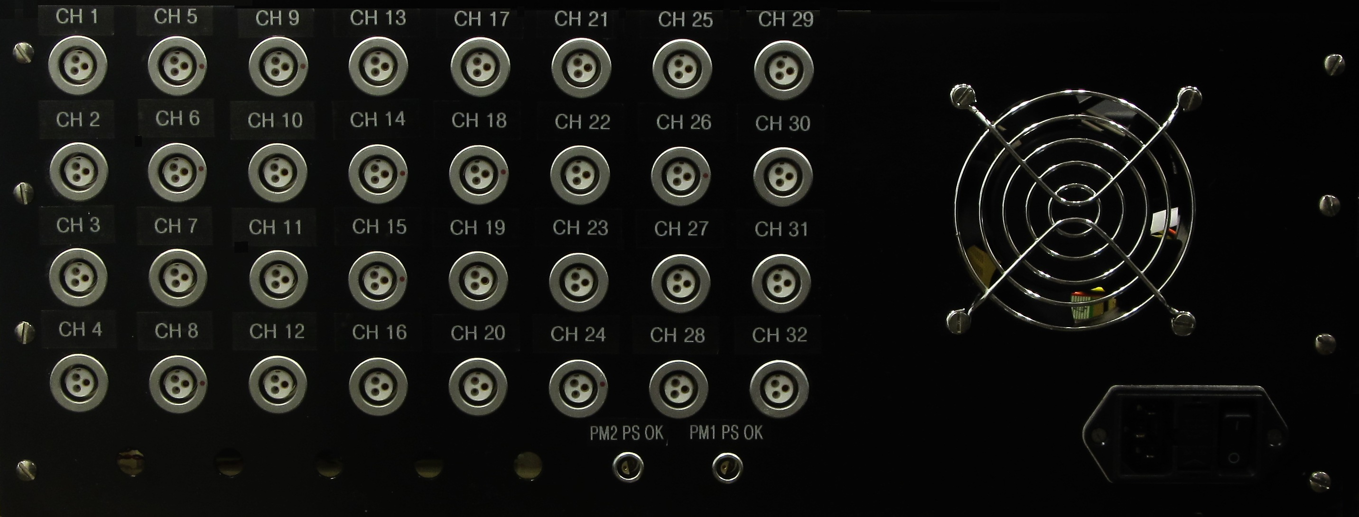
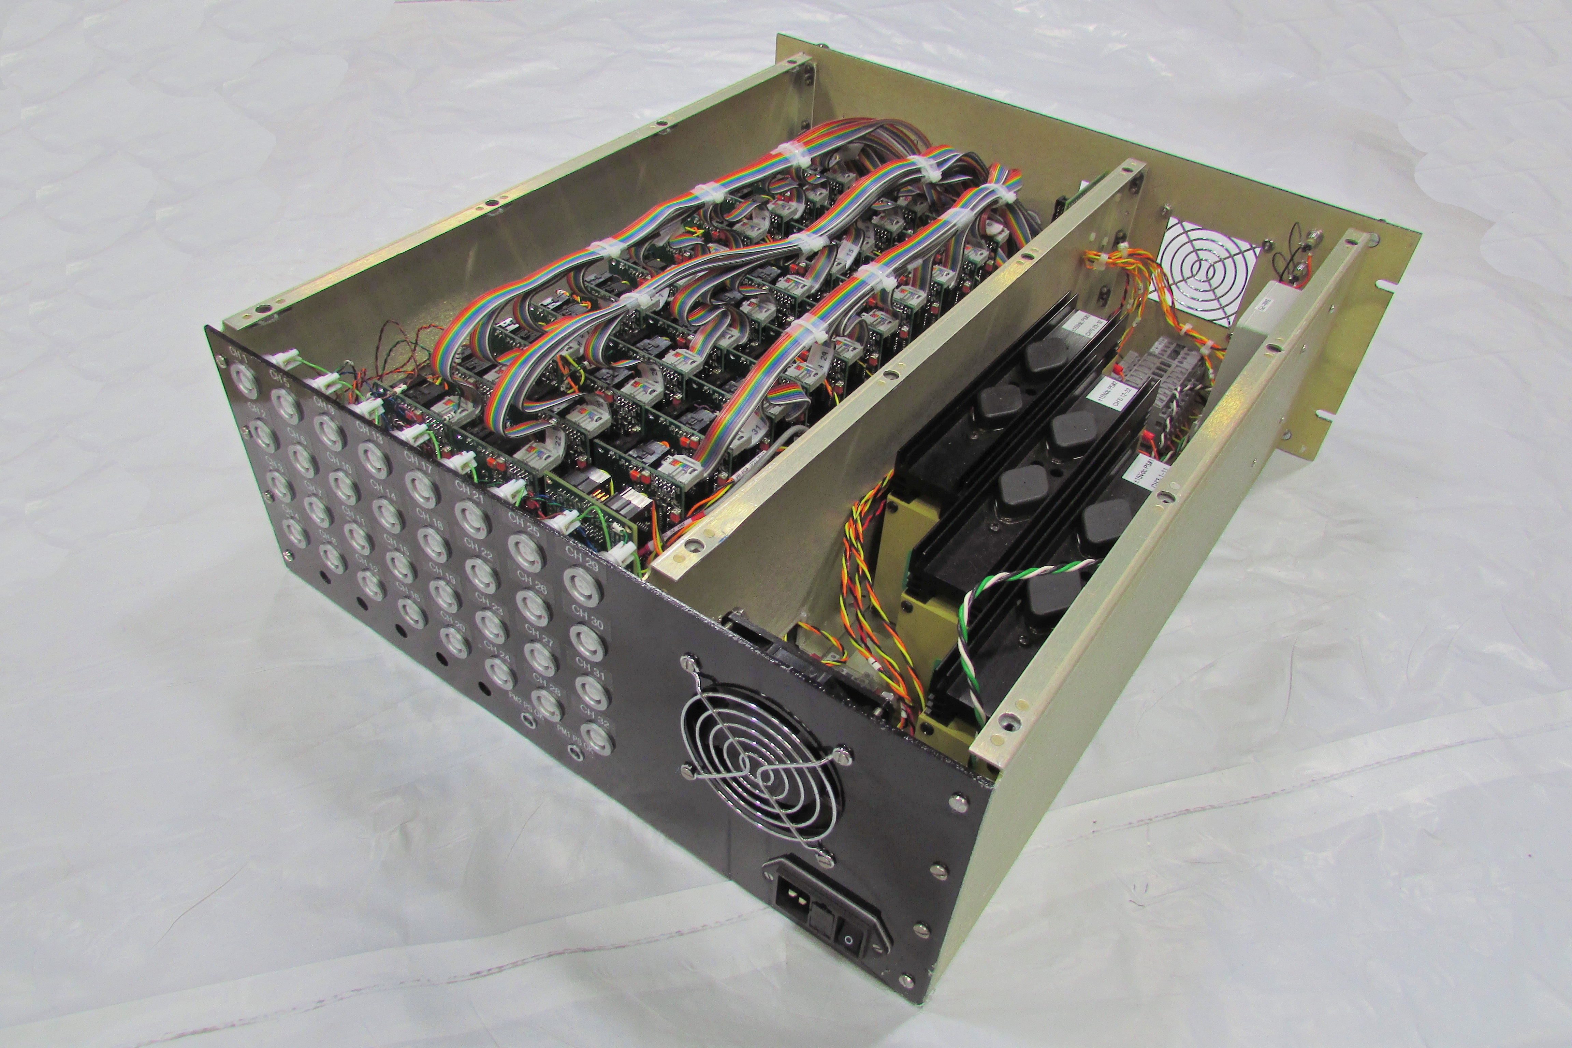
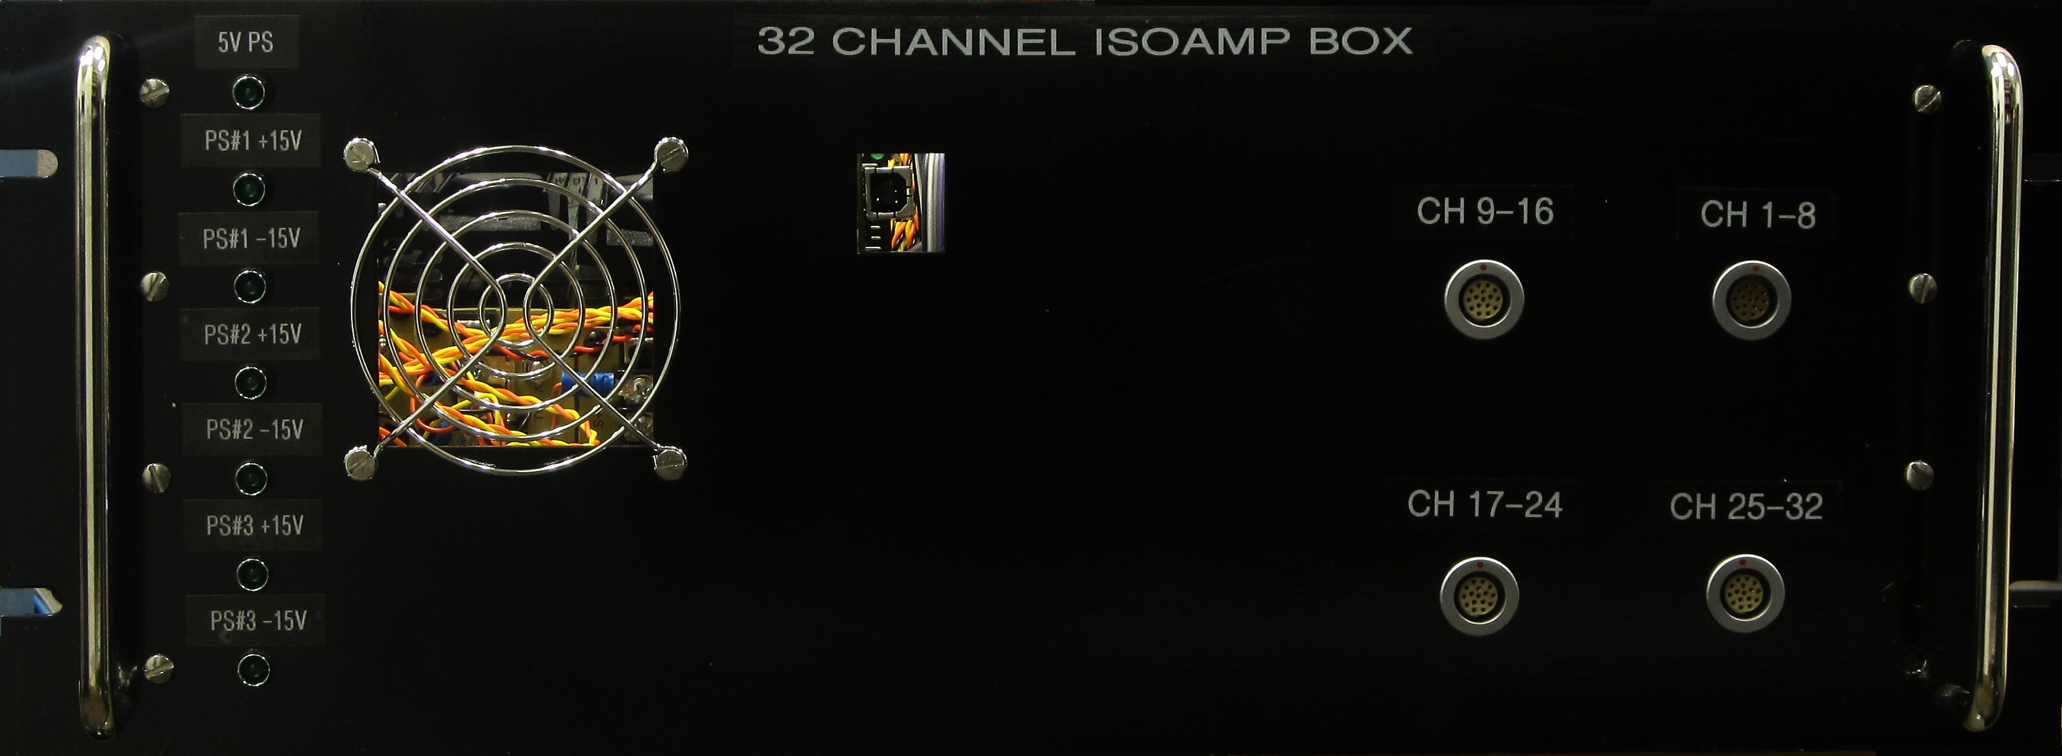
Quench Detection Estimate Assumptions
  Custom Versus Commercial –
  Custom hardware solutions will only be used when necessary
    The isolation amplifiers are a custom design but will be outsourced for commercial fabrication
    32 Channel Isolation Amplifier Box: Uses AD215 IA isolation amplifiers
    Fisher HV connectors will be used for the inputs, which will match the existing test stand 4 HV quench cables

Slide 13
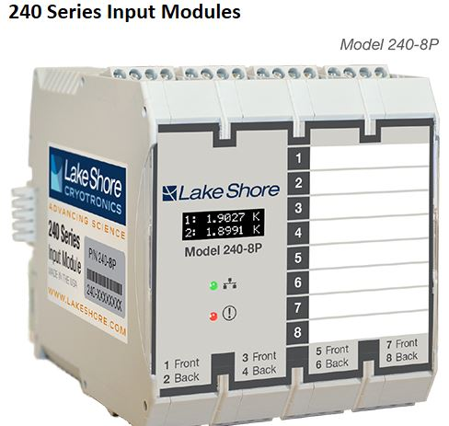
Slow Logging Estimate
  Cryo Montioring –
  All thermometry, liquid level, pressure, and flow will be scanned by a PLC
  RTDs can be readout via a new Lakeshore 240 Series, 8-ch cards -- $2,019 / 8-ch card
,
Coming soon
240 Series Features Two or eight cryogenic temperature sensor inputs Supports industry-leading Lake Shore Cernox, platinum, and other RTDs, plus DT-670 diodes Precision measurement circuitry with on-board conversion to calibrated temperature units Monitor temperatures down to 1 K and up to 800 K Current reversal to minimize thermoelectric offsets Front-mounted OLED screen for temperature and status reporting Fully configurable through direct USB connection PROFIBUS-DP communication integrates with distributed PLC-based control architectures Easy DIN rail mounting with integrated rear connections for shared power and network

Slide 14
Slow Logging Estimate
  Spice Measurements –
    Hardwired for production measurements
    Use high precession voltage measurement hardware including a multiplexor
  The two-channel Model 2182A Nanovoltmeter is optimized for making stable, low noise voltage measurements and for characterizing low resistance materials and devices reliably and repeatability. It provides higher measurement speed and significantly better noise performance than alternative low voltage measurement solutions. It offers a simplified delta mode for making resistance measurements in combination with a reversing current source, such as the Model 6220 or 6221.

Slide 15
Slow Logging Estimate
  Spice Measurements –
Keithley Model 7168
Nanovolt Scanner Card 8-channel, 2-pole
Keithley Model 7001
Switch/Control Mainframe 80-channel

Slide 16
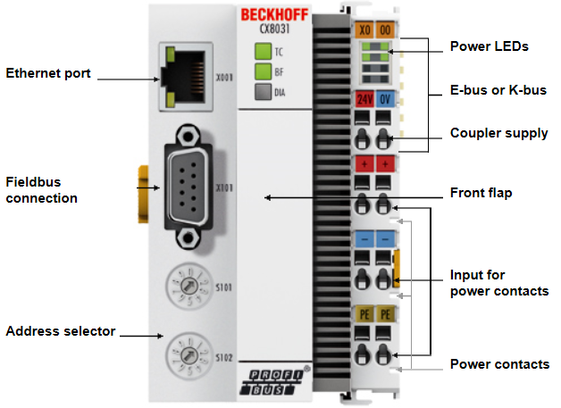
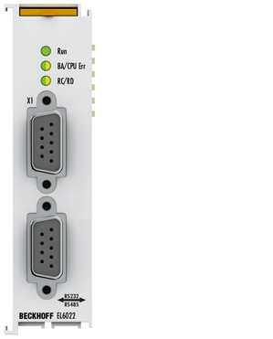
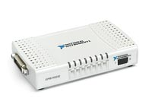
Slow Logging Estimate
  Spice Measurements –
CX8031 | Embedded PC for PROFIBUS
EL6002, EL6022 | 2-channel serial interfaces RS232/RS422/RS485, D-sub connection
GPIB-to-RS232 Converter

Slide 17
Splice Measurement Estimate
  Spice Measurements – Total cost is $14.6
Description | System | QTY | Unit Price ($k) | Total Price ($k)
8 channels, Splice measurements | Keithley Model 2182A Nanovoltmeter | 1 | $3.5 | $3.5
 | Keithley Model 7168 8-Ch Nanovolt Scanner Card | 1 | $3.5 | $3.5
 | Keithley Model 7001 Switch Mainframe | 1 | $2.6 | $2.6
 | Ni GPIB to RS232 Converter | 1 | 0.6 | $0.6
 |  |  | total = | $12.6
PLC with profibuss | Beckhoff CX8031 Embedded PC for PROFIBUS | 1 | $3.0 | $3.0
 | Beckhoff EL6002 | 1 | $0.4 | $0.4
 |  |  | total = | $3.4
Cables, Connectors | Cabling | 1 | $1.0 | $1.0
 |  |  | Total= | $14.6

Slide 18
Wire Routing Change
  CERN may require different routing of voltage tap and sensor wires –
  Existing stand instrumentation interface utilizes Hypertronics connectors in the helium interconnects
  An alternative would route wires to a connector flange in helium tubing, with connections to a vacuum flange on the cryostat
    Implementing this feedthrough close to the feed can (interface box?) should be considered in order to keep the signal distance as short as possible

Slide 19
Vacuum Feedthrough Cabling Cost Estimates
  Vacuum Feed though Cabling –
  Magnet Voltage Taps – Assuming all coil taps are brought out through a vacuum feedthough then new HV cabling will have to be installed
    Assumption – 1 WC and 2 HCs for two magnets
      Will require 1 4-pair HV cable for each magnet plus 1 spare cable
        M&S = $600.00
        Labor = 8 hours
  Protection heater power cables and voltage tap cables
    Assumption #1 – Assume only 4 heater circuits are powered (4 SHs internally wired in parallel in each circuit)
      Will require 2 power cables and 1 4-pair HV voltage tap cable
        M&S = $1k
        Labor = 6 hours
    Assumption #2 – Assume 16 independent heater circuits are powered
      Will require 8 power cables and 4 4-pair HV voltage tap cable
        M&S = $9k
        Labor = 54 hours
      Will require a VMTF style protection heater distribution panel
        M&S = $3.5k
        Labor = 80 hours

Slide 20
Total M&S Cost Estimate
  M&S Estimates –
  Quench Protection / Characterization -- $93,245
  Splice Measurements – $14,600
  RTD readout of16 channels = $4038
  Vacuum Feed though Cabling –
  Add $1.6k for vacuum feed through cabling with protection heater assumption #1
  Add $13.1k for vacuum feed through cabling with protection heater assumption #2

Slide 21
Labor Cost Estimate
Estimate of Labor for Quench System Upgrades –
Add 14 hours tech labor for vacuum feedthrough cabling with PH assumption #1
Add 142 hours tech labor for vacuum feedthrough cabling with PH assumption #2
 | Engineering Physicist | Electrical Design Engineer | Electrical Technician | Applications Development & Systems Analyst
Produce Detailed Design | 180 | 180 | 60 | 180
System Validation and Design Reviews | 120 | 120 |  | 120
Develop and Test Quench Protection Software | 180 | 180 | 40 | 200
Fabricate, Assemble, & Perform Acceptance Tests of Electronic Components | 120 | 120 | 320 | 120
Stage, Assemble, and Test Quench Protection and Slow Logging System | 180 | 180 | 200 | 180
Generate User Documentation | 100 | 100 | 40 | 100
Perform Quench Protection and Slow Logging Integration Tests | 140 | 140 | 140 | 140
Totals = | 1020 | 1020 | 800 | 1040
2.2 FTEs (1768 hrs/FTE) = | 0.58 | 0.58 | 0.45 | 0.59

Slide 22
Schedule
  Assuming commissioning in June 2019, this project should probably start a year in advance in order to support concurrent projects
  Work on the Mu2e Quench Protection and Monitoring system will use the same resources; however, that work will ramp up significantly in 2017, ahead of the LARP test stand upgrade

Slide 23
Summary
  The upgrades to the test stand 4 quench protection and monitoring systems will use the existing racks and cabling
  Test stand high voltage signals will have to be tested and possibly modified to meet the new hipot requirements
  The quench design configuration will be based on the latest design for Mu2e. The same engineering/technical resources will be supporting both systems so this is expected to be a more efficient use of labor
  The cryo scan controls will all be PLC based, including the splice measurements
  Commercial hardware solutions will be used whenever possible
    The few in-house designs will be commercially fabricated

