Slide 1


LMQXF
Plans and Options
G. Ambrosio
LMQXF Cold Mass Requirements and Conceptual Design Review
April 25, 2016
FNAL

Slide 2
Outline
MQXF magnets
LMQXFA cold mass
Plans & options for cold mass tests
Remarks

Slide 3
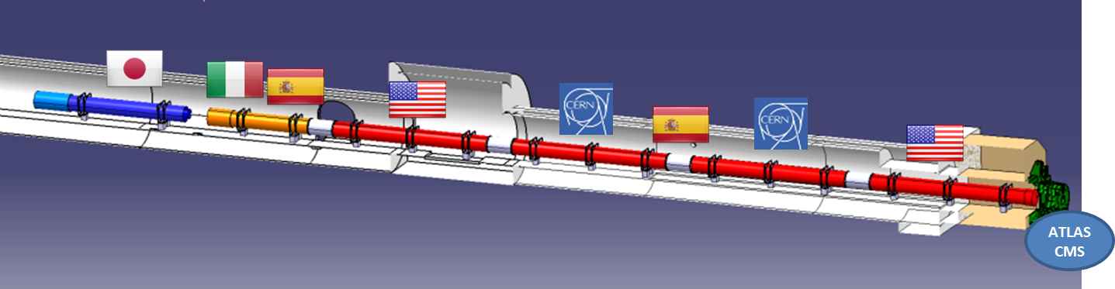
US Contribution to HL-LHC Inner Triplets baseline plan
Q1/Q3 cold masses by US (LMQXFA)
  magnetic length: 4.2 + 4.2 m (MQXFA)
Q2 cold masses by CERN
  magnetic length: 7.15 m (MQXFB)
All cryostats and integration by CERN
Max cold mass outer diameter: 630 mm
Operating temperature: 1.9 K
US cold mass

Slide 4
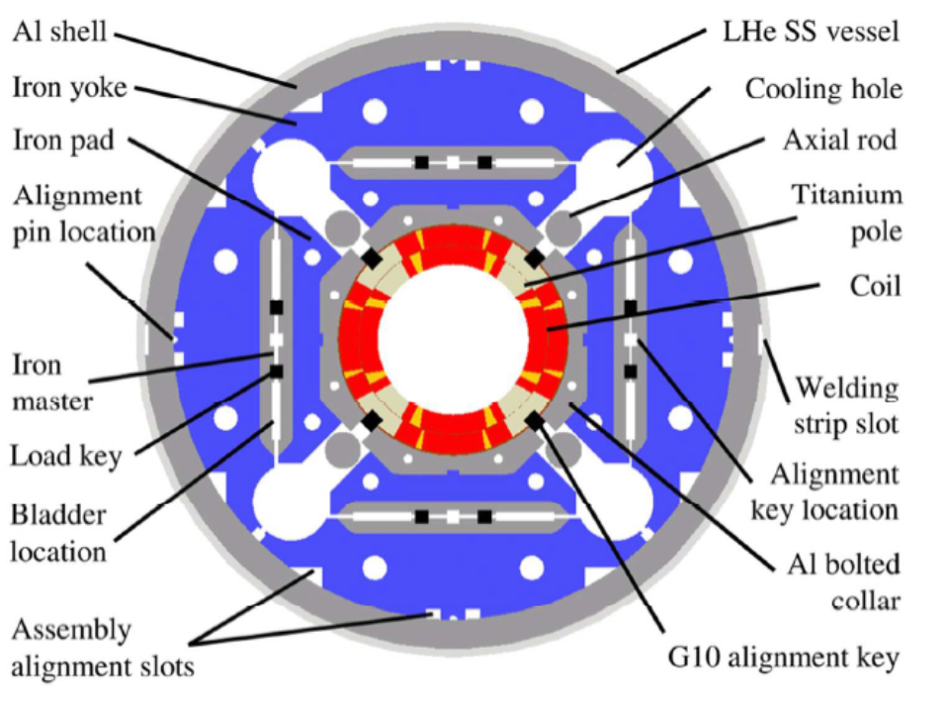
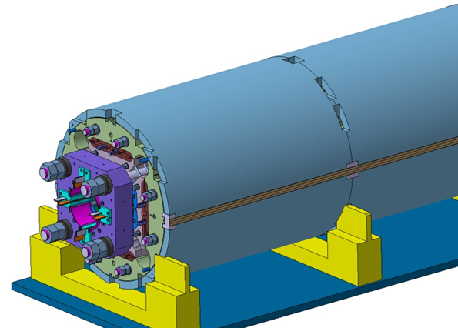
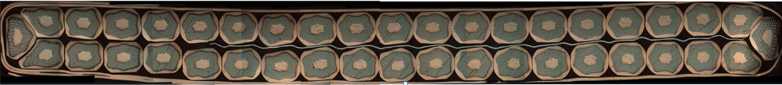
MQXFA/B Main Parameters*
Equal magnets in Q1/Q3 & Q2s
Parameter | Unit | MQXFA
Coil aperture | mm | 150
Magnetic length | m | 4.2
N. of layers |  | 2
N. of turns Inner-Outer layer |  | 22-28
Operation temperature | K | 1.9
Nominal gradient | T/m | 132.6
Nominal current | kA | 16.5
Peak field at nom. current | T | 11.4
Stored energy at nom. current | MJ/m | 1.2
Diff. inductance | mH/m | 8.2
Strand diameter | mm | 0.85
Strand number |  | 40
Cable width | mm | 18.15
Cable mid thickness | mm | 1.525
Keystone angle |  | 0.4
*MQXFS1 quadrupole design report
LARP DocDB 1074

Slide 5
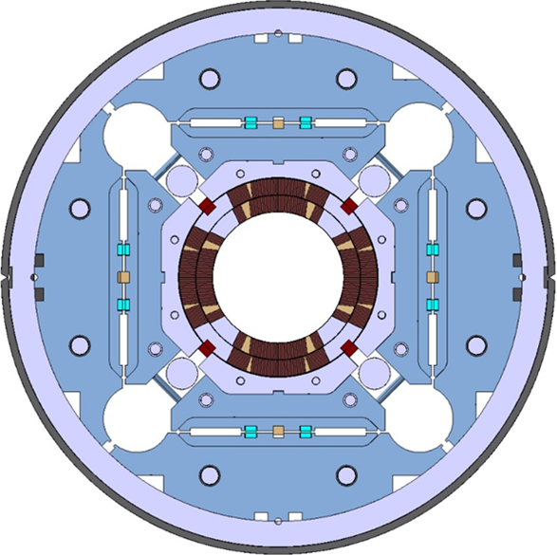
LMQXFA Cross Section
Helium vessel by welding two half SS shells

Slide 6
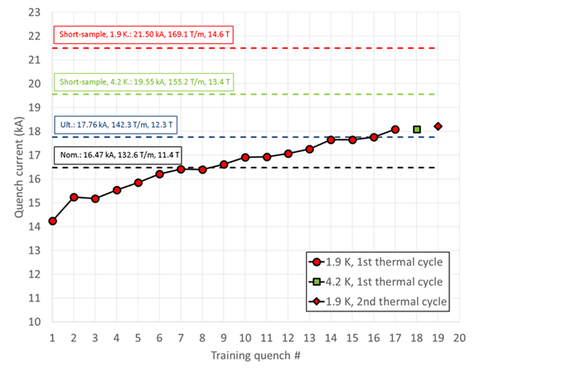
MQXF Status
1st short model (MQXFS1) performed very well
1st prototype to be tested in Spring 2017

Slide 7
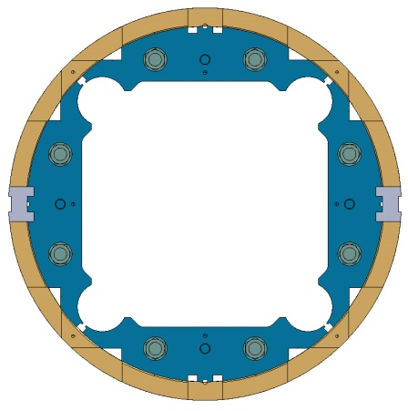
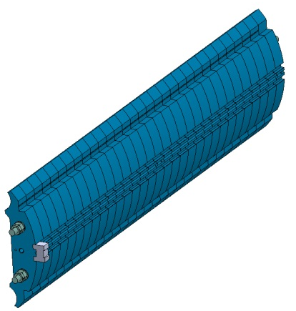
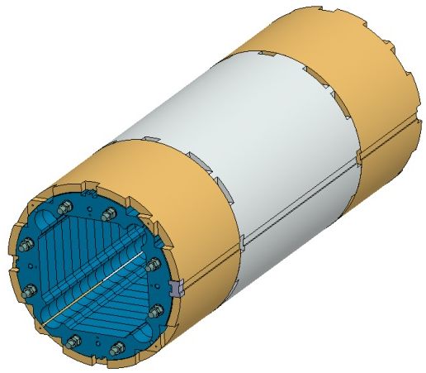
MQXF ➔ LMQXF
The Al-shell has features for longitudinal skin welding:
  Slots for accessing the yoke (for alignment)
  Grooves for the backing strip
The SS skin welding should make the He vessel with minimal impact on magnet stress distribution
  To be tested on short model MQXFS1c
Slot for access to the yoke and support
Welding block

Slide 8
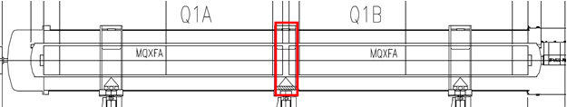
Q1/Q3 Cold Mass (LMQXFA)
Main features:
  Max OD: 630 mm
  SS shell thickness: 8 mm
  Length: 10.14 m
  Two magnets in one cold mass
Main challenges:
  Alignment (with two magnets in each cold mass)
  Welding & inspection
  Transportation without affecting alignment

Slide 9
LMQXFA
Two magnets in one cold mass:
  Different wrt to Q2
  8.4 m magnets have excessive risk for a US project
Leads at each end

Slide 10
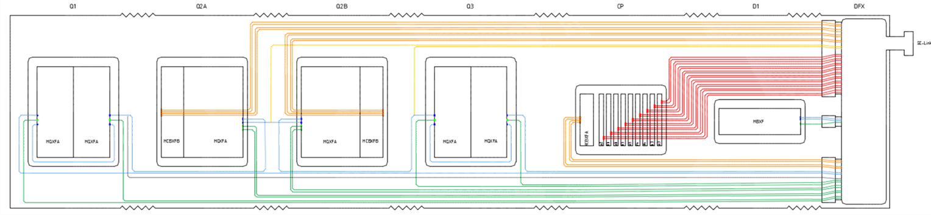
Bus bars
Bus bars design and routing will be based on CERN design and plan.
Options were presented at Conceptual Design Review of the Magnet Circuits for the HL-LHC
  https://indico.cern.ch/event/477759/timetable/#20160321.detailed
Cold mass design including bus bars integration is starting at CERN in these weeks

Slide 11


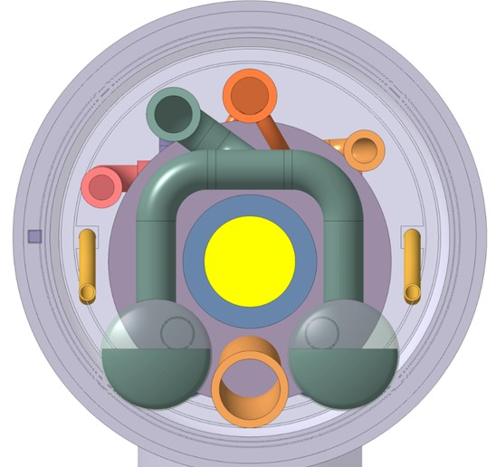



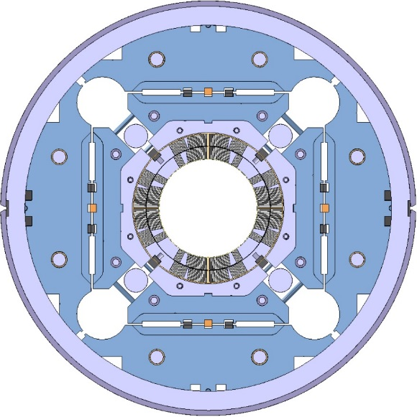


Inner Triplet Busbars Integration Proposal
(until a 18kA cable is developed and proven)
Splices
External busbars
(round cable type)
2kA
+ | 13
+ | 11
 | 2
 | 2
 | 2
 | 24
 | 36
 | 18
200A
2kA
200A
2.8kA,
12Hz fast decay
In Q2 cold masses
Total 108
Internal busbars
(stabilized Rutherford cable)
18kA
Courtesy of Cedric Eymin
18kA

Slide 12
Cold Mass Interfaces
The major interface is with the cryostat
Cryostat design is CERN responsibility, and is planned to start now
  CERN team had to design 11T cryostat first
We plan to have CM interfaces defined by the MQXF Review
  June 7-10, 2016 at CERN
Detailed mechanical layout is available
  LHCLSXH_0010-v0.3.pdf
Study of distance btw magnets is available
  HILUMILHC-Mil-MS39_final. pdf

Slide 13
Budget Challenge
Preparation for Cold Mass assembly & test, and prototype Cold Mass assembly & test, to be performed by LARP
  Prototype CM test: Nov 2019
  LMQXFA1 test: July 2020
LARP has very tight budget in FY16/17/18(?)
US-HiLumi Project has even tighter budget at start
Option analysis
  - Balance btw costs and risks

Slide 14
Tests Plan
Each US magnet (MQXFA) will be tested in vertical condition at 1.9 K
  At BNL Vertical Test Facility
  Current up 17.8 kA (108% of nominal current)
Each US cold mass (LMQXFA) will be tested in horizontal condition
  At FNAL, Test Stand 4
  Tests for requirement verification: TBD (see next slides)
Each cryostated CM will be cold tested at CERN
  Current up 17.8 kA (108% of nominal current)

Slide 15
Option 1 – “Bare bones”
Only tests at room temperature:
Cold-mass alignment
  Can be achieved using AC SSW technique at 10 A
He leak tests (under pressure and vacuum)
Electrical tests

Slide 16
Option 2 – “Cold, No power”
Cooldown of cold mass in re-usable cryostat:
Alignment, electrical and leakage tests at:
  a) 80 K in LN2
    alignment with most thermal changes
  b) 4.5 K in LHE
    alignment with all thermal changes, plus verify leak tightness
  c) 1.9 K in LHE
    additional benefit of checking superfluid helium leak tightness

Slide 17
Option 3 – “Cold & Powered”
Cooldown in re-usable cryostat to 1.9 K
Powering test up to 15 kA
  Using existing 15 kA current leads
Magnetic measurements with 46 mm probe
  with minimal test stand modifications using existing bore tube
  QD DAQ upgrade likely needed
➔ Advantages: validation of SC bus and splices; test of heaters and CLIQ in final configuration

Slide 18
Option 4 – “Full test”
Cooldown in re-usable cryostat to 1.9 K
Powering test up to 17.8 kA
Magnetic measurements with ~100 mm probe
  Needs upgrade of test facility above 15 kA
  Needs upgrade of feed can, return can, and warm bore
➔ Advantages: full qualification of US deliverable

Slide 19
Baseline
Baseline is Option 3: “Cold & Powered”
Option 2 is a fall back
Option 4 is a possible upgrade

Slide 20
Remarks
Next talks are going to present the conceptual design of the Cold Mass, Re-usable Cryostat, Test Facility, Test Equipment.
  Some requirements & interfaces to be finalized in June, no major changes expected
We are exploring options, and your feedback will be very appreciated:
  Is the risk of some options too high?
  Is the cost excessive wrt to the advantages?

Slide 21
Back up Slides

Slide 22
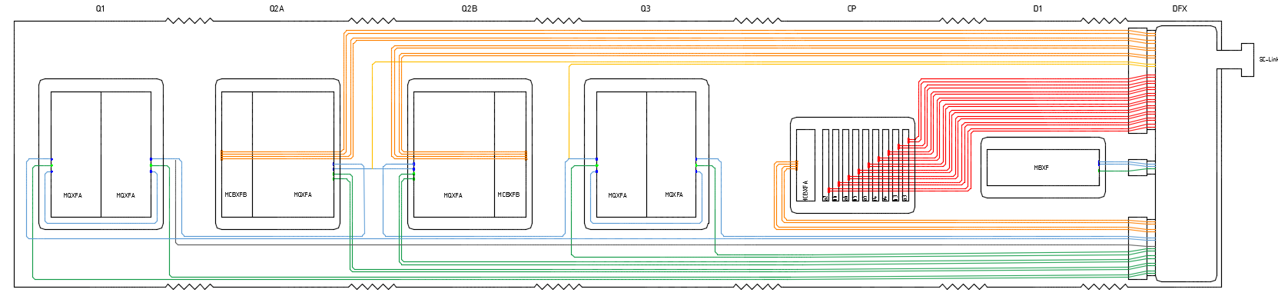
Inner Triplet String Busbars Integration Summary
Internal/External integration were compared
Cable/Busbars technologies were compared
Integration solution proposed as “best compromise”:
  For high current : Rutherford cable stabilized busbars routed through the cold masses as long as an appropriate 18kA cable has been developed
  For lower current : external cables routed in a dedicated line on top of the cold masses [2kA cable to be developed]
Alternate circuit design eases the busbars integration
Splices quantity varies from 96 to 176. 101 to 108 could be achieved depending on the retained scheme
Cold masses design including the busbars integration will start in the coming weeks
To be studied: Integration of 18 kA busbars in the D1 and CP

