Slide 1
Conceptual Design of the LMQXFA Test Cryostat
Don Mitchell
Preliminary Design Review
25 APR 2016

Slide 2
Agenda
Convert Test Stand #4 to test LMQXFA Coldmass
General overview
P&ID
Existing test stand components
Proposed modifications
Vacuum Vessel preliminary design and analysis
Design challenges
Estimated costs
Schedule
Summary

Slide 3
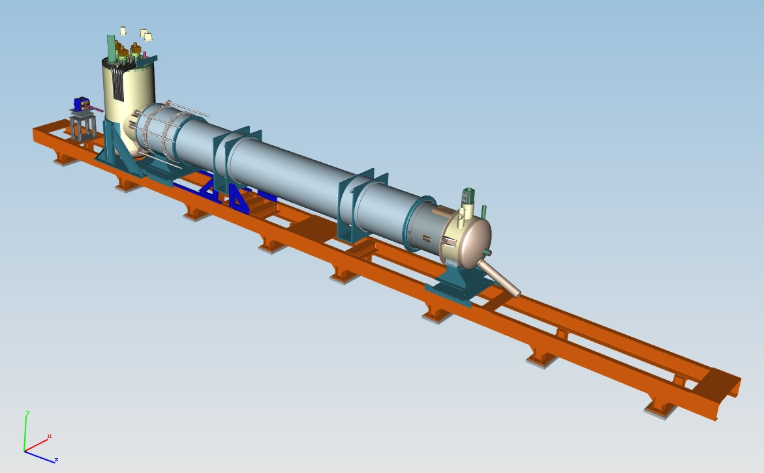
IB1 – Test Stand
“Jessica” Test Cryostat
Test Stand #4
Test Stand #6

Slide 4
Proposed LMQXFA Test Stand #4
Reuse as much of the existing test stand as possible.
New Test Cryostat
Feedcan
Alignment of cryostat in X and Y. Minimum alignment along axis.
Turn-a-round can

Slide 5
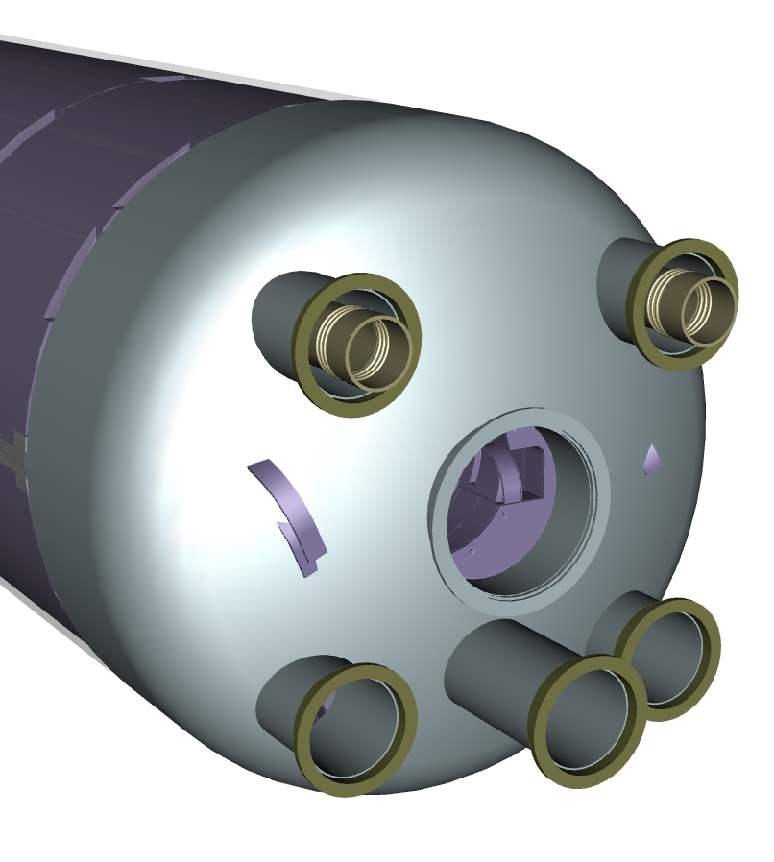
LMQXFA Coldmass
10140 mm
Weight = 32,957 Lbs

Slide 6
LQXFA Cryostat
Aluminum construction to minimize weight (crane limitation)
Initial design parameters:
½” wall thickness
1 ¼” reinforcement ribs
Reinforced base to support coldmass
Weight = 3,500 Lbs

Slide 7
LMQXFA Cryostat with Coldmass
Total weight = ~37,250 Lbs

Slide 8
LMQXFA Cryostat with Coldmass - sectioned
Coldmass supported at 3 points

Slide 9
LMQXFA Test Stand #4 - sectioned

Slide 10
Present Cryogenic Capabilities
With proper cryostat provisions (pumping line with cross-overs, cool-down return, thermal shield), the cryogenic process of LQX and MQX testing will be similar to the testing of the present LHC IR quads.
Lead flows
To compressor suction
Pumps
1.9 K saturated liquid
LHe/GHe
supply
1.9 K subcooled liquid
Cool-down/
warm-up return
LN₂ supply
4.5 K saturated liquid
Reliefs, quench
recovery
GN₂ vent
J-T HX
J-T valve
Fill valves
Return End
Cryostated cold mass with external pumping line
Interconnect
Feed Box

Slide 11
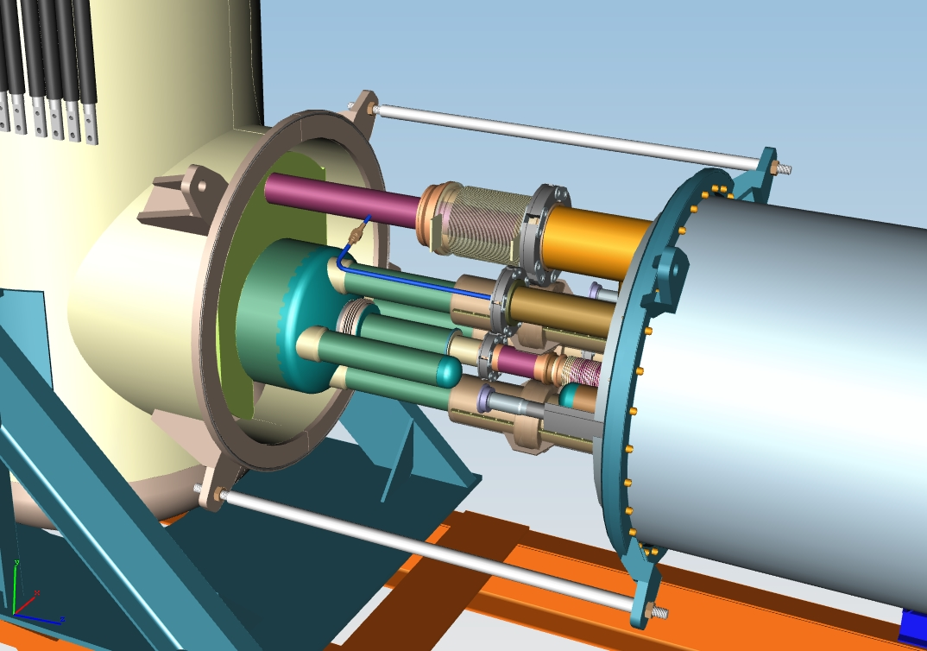
Existing Feedcan Piping Layout
Heat exchanger is external to the Coldmass.
The original coldmass is small relative to the LMQXFA coldmass.

Slide 12
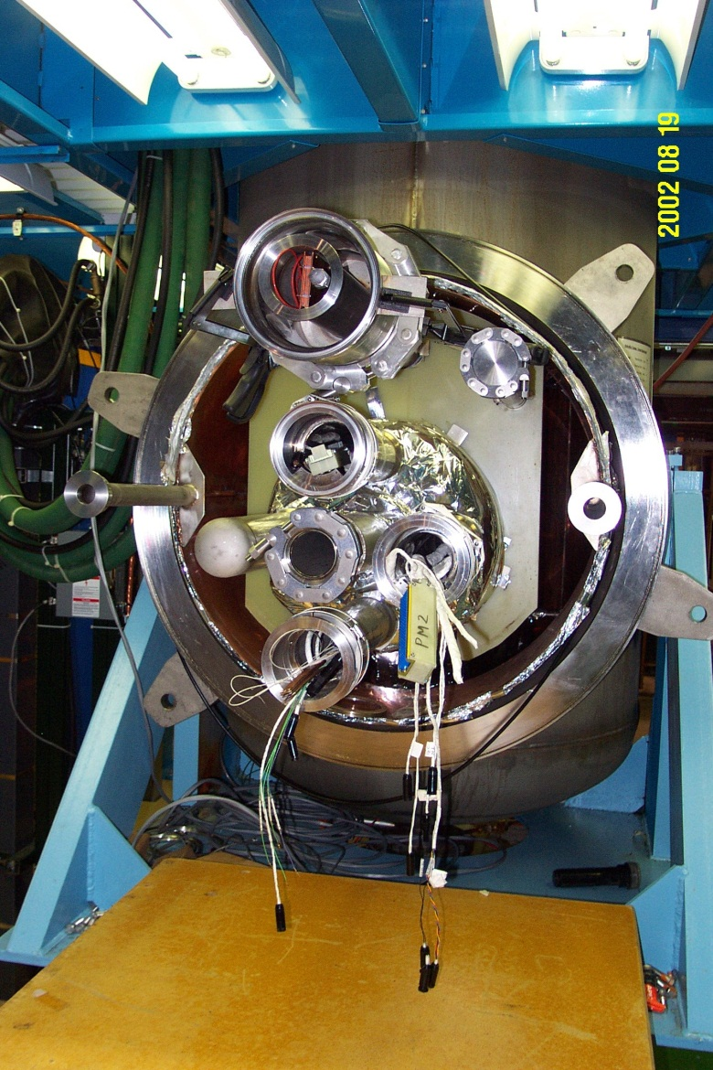
Existing Feedcan Piping Layout
Feed Box Connections
Heat exchanger (for present LHC IR quadrupoles, inner line is pumped 1.9 K two-phase and annular area is subcooled 1.9 K liquid)
Magnet He supply (two for instrumentation, one for power bus, one capped)
Beam pipe for warm bore/magnetic measurements
Cool-down return
Thermal shield LN₂ supply and return

Slide 13
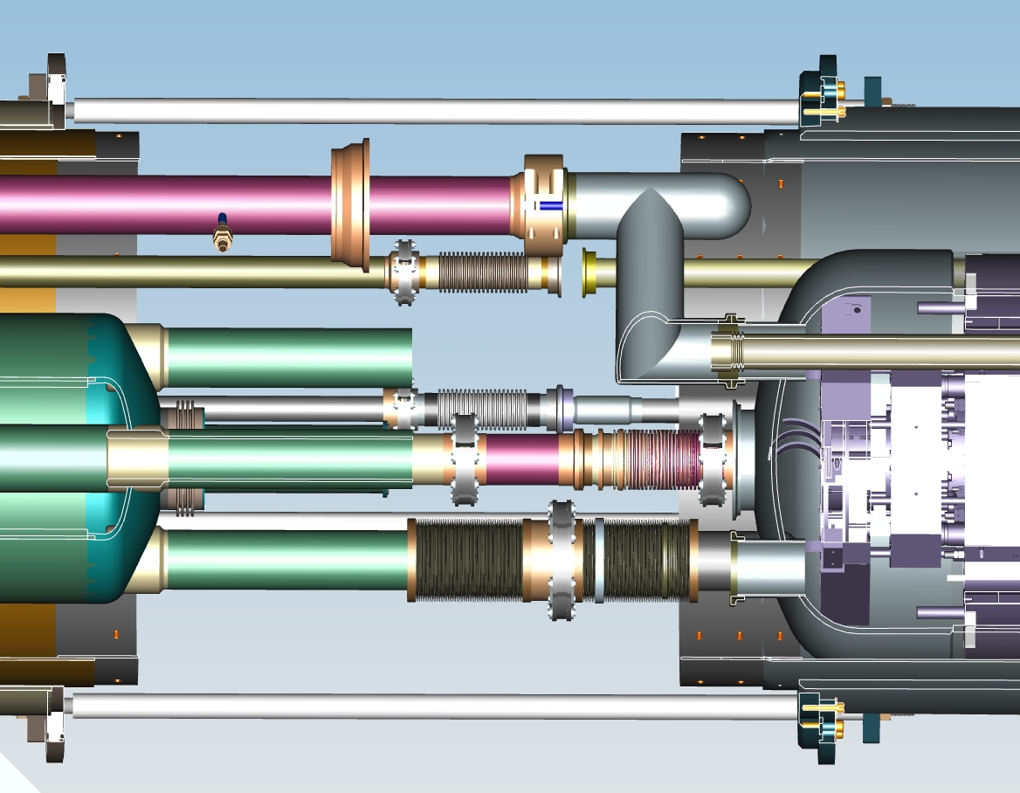
Proposed Feedcan Layout
Heat exchanger moved internal to the Coldmass, 2 locations.
Piping no longer matches the feedcan pipe locations. Possible re-route with flex-hose.

Slide 14
Existing Turn-a-round Can Layout
Existing can does not match the new piping layout.
Items to consider:
Instrumentation can
Liquid level probe
Cooldown line
Bus/Cable routing
HX location

Slide 15
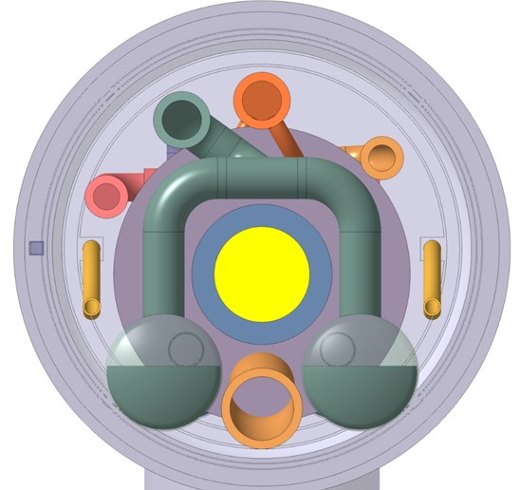
Inner Triplet Busbars Integration Proposal (until a 18kA cable is developed and proven)
Splices
External busbars
(round cable type)
2kA
+ | 13
+ | 11
 | 2
 | 2
 | 2
 | 24
 | 36
 | 18
200A
2kA
200A
2.8kA,
12Hz fast decay
In Q2 cold masses
Total 108
Internal busbars
(stabilized Rutherford cable)
18kA
Courtesy of Cedric Eymin
18kA

Slide 16
Proposal
Increase diameter of cryostat
Design new end-can
Reuse the existing Feedcan

Slide 17
Vacuum Vessel Design and Analysis
Initial design
6061-T6 Aluminum Construction
½” wall
1 ¼” reinforcement ribs
2” thick base plates
3,500 Lbs

Slide 18
Vacuum Vessel Loading
10,900 Lbs
11,757 Lbs
10,900 Lbs
14.5 psi external pressure
Vessel under its own weight

Slide 19
Vacuum Vessel FEM
Combination of 8-node 2-D quads and 10-node 3-D tets plus mating conditions

Slide 20
Vacuum Vessel Loading
14.5 psi external pressure, Gravity, Magnet Loading

Slide 21
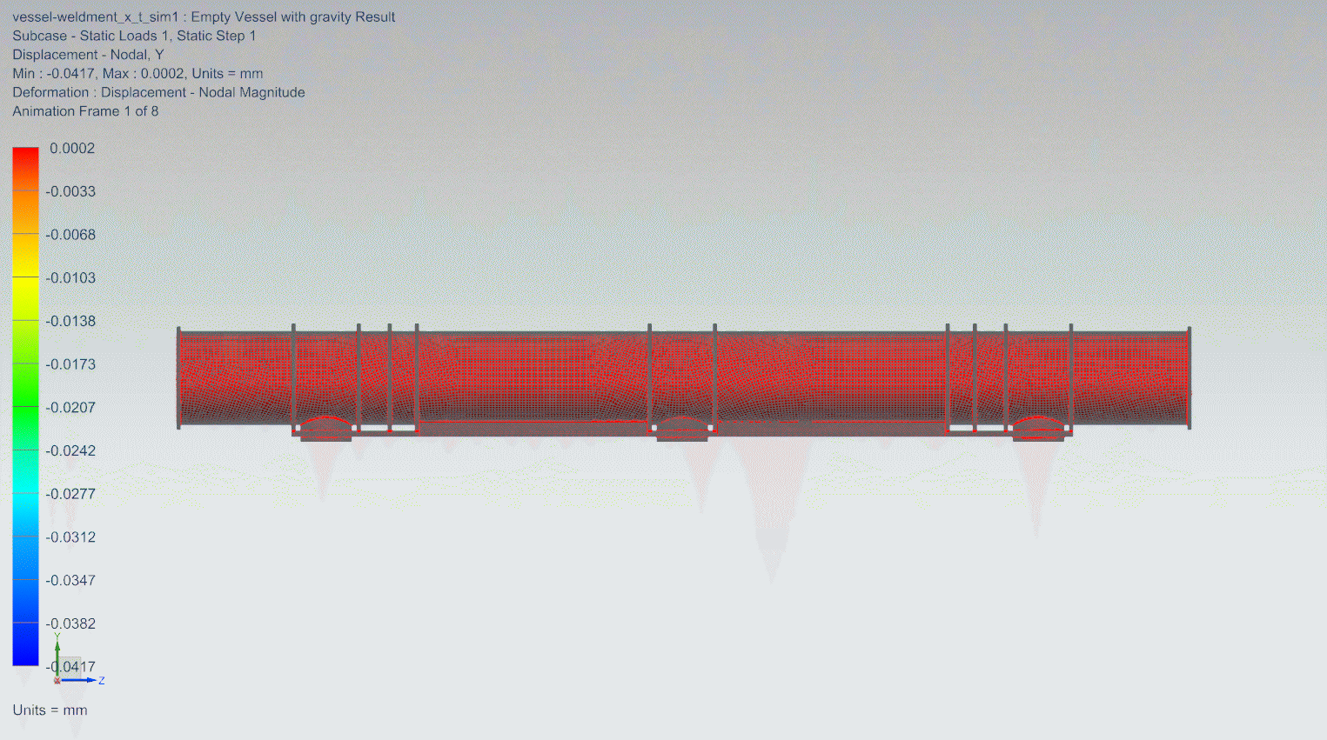
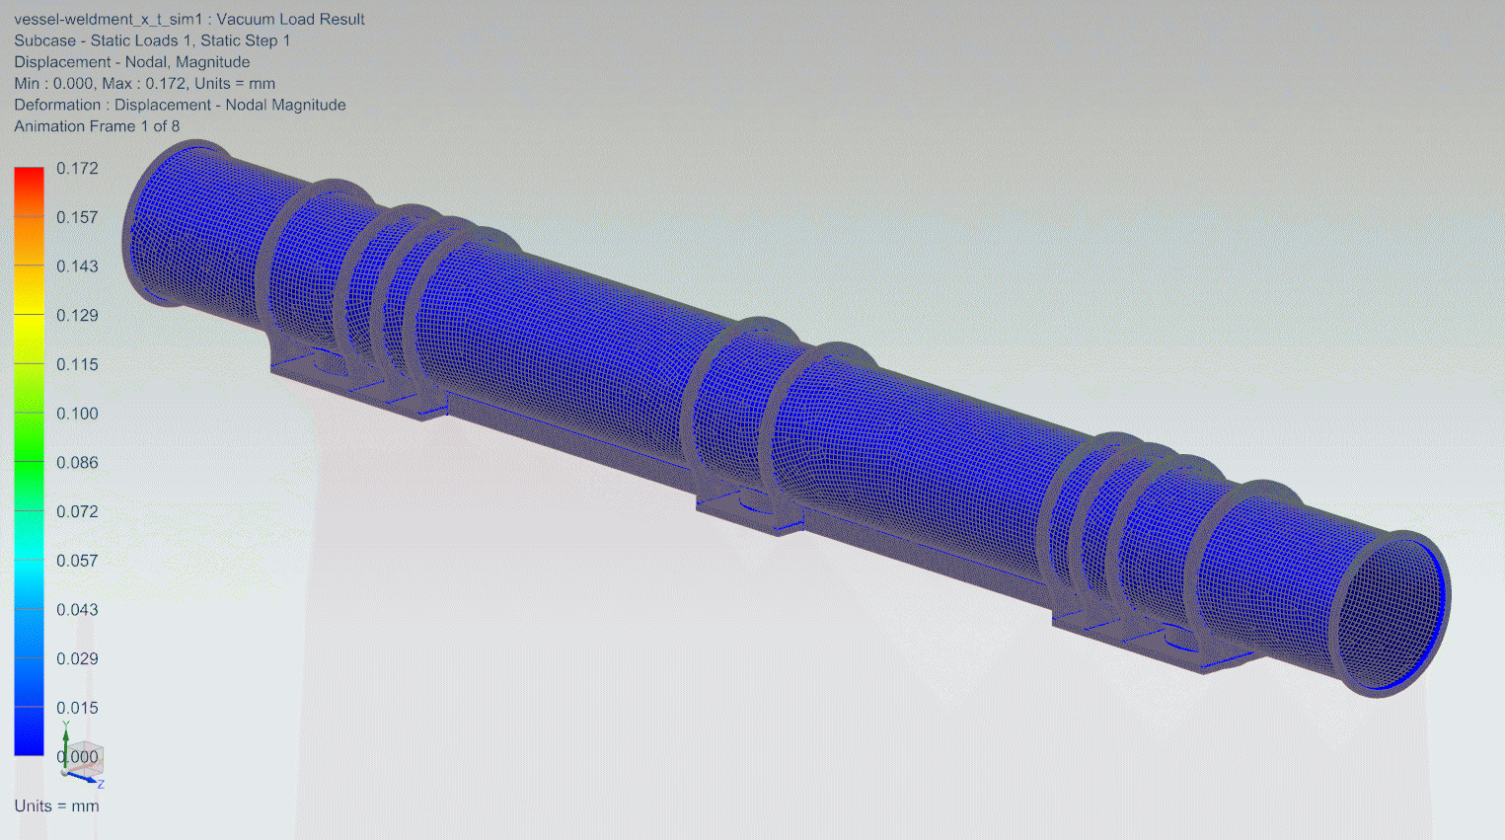
Vacuum Vessel FEA Results - Preliminary
Model validation:
1G loading
Reaction Forces:
Weight = 3,440 Lbs
Under Vacuum:
Δ = .007 inch

Slide 22
Fully Loaded Cryostat – Vacuum, Magnet, Gravity

Slide 23
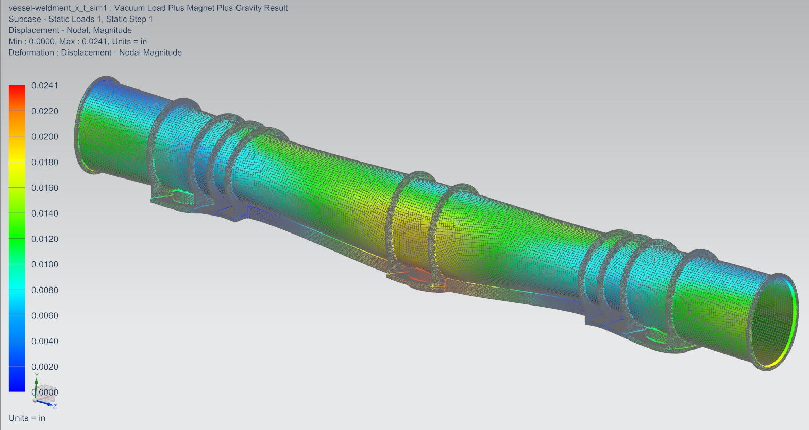
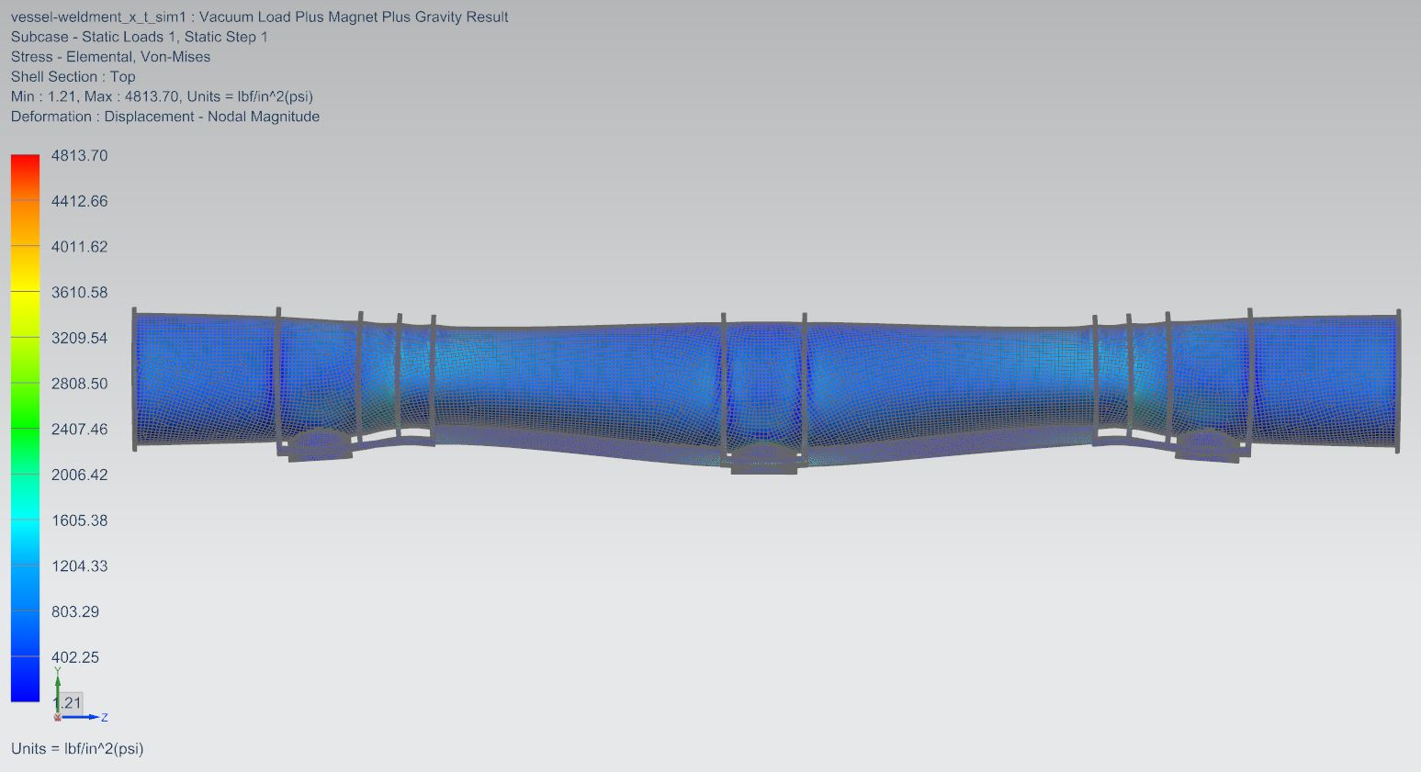
FEA Results
Δ = .024 inch
σ_{max} = 4,814 psi
Plenty of margin for redesign and optimization. Design to meet ASME B&PV code.

Slide 24
Design Challenges
Recent input from CERN is still developing
Location of internal heat exchangers – bottom two holes
(we assumed the top two holes)
Bus bar or cables, where to route them?
Re-routing items in the turn-a-round can
Ports don’t line up
Warm up / Cool down line in turn-a-round can
Routing is difficult
Do we design something new?
Do we need a larger Cryostat due to the large Coldmass diameter?

Slide 25
Cryostat Components
Vacuum Vessel
Cool-down line
Aluminum Heat Shields
Heat Exchanger pipe
Al-SS transition
MLI
Bellows

Slide 26
Cryostat Estimated Costs
Vacuum vessel: $ 90,000
Heat exchanger corrugated pipes (2): $ 7,000
Cryogenic pipes: $ 8,000
G10 pipe supports: $ 10,000
Coldmass supports (3): $ 25,000
Aluminum Heat Shields: $ 50,000
Al-SS transition pipes (4):$ 3,600
Flex hoses: $ 5,000
Alignment Stands (2): $10,000
MLI: $ 1,200
New end-can not costed
Total: $ 209,800 (BOE: previous history and best guess)

Slide 27
Labor Estimated Costs
FTE:
Skill | FY16 | FY17 | FY18 | FY19 | Total
Engineer | .25 | .25 | .25 | .25 | 1.0
Design | 0 | .2 | .3 | .3 | .8
Technician | 0 | 0 | 0 | 1.0 | 1.0

Slide 28
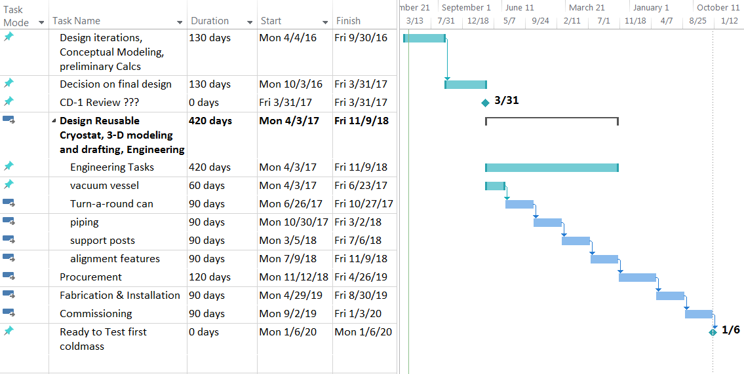
Schedule

Slide 29
Summary
Preliminary study has begun
Collected existing IB1 Test Stand #4 CAD data
Design requirements are still coming together
Basic FEA shows that a vacuum vessel can be designed to:
Meet ASME B&PV code
Work within the weight limitations of the IB1 crane
More iterations are needed
Identified the major components required
Preliminary cryostat system being 3-D modeled
Initial cost estimate for cryostat: $210,000
Minimal Engineering, Design, and Technician support over the next 4 years – next priority, CD-1 Review
Functional Test Cryostat ready by January 2020

