Slide 1
Test Stand 4 Cryogenics Conceptual Design Review
Roger Rabehl
Stand 4 Cryogenics
25 April 2016

Slide 2
Test Stand 4 Cryogenics
There are three potential operating temperatures to consider
80 K LN2 Operations (Option 2a)
4.5 K LHe Operations (Option 2b)
1.9 K LHe Operations (Options 2c, 3, 4)
From a process point of view, there is little difference in options 2c, 3, 4.
For each potential operating temperature, I will present:
A conceptual design for test stand preparations
Test stand upgrades/modifications
Technical risks
Test stand preparations cost estimate
Test stand preparations schedule estimate

Slide 3
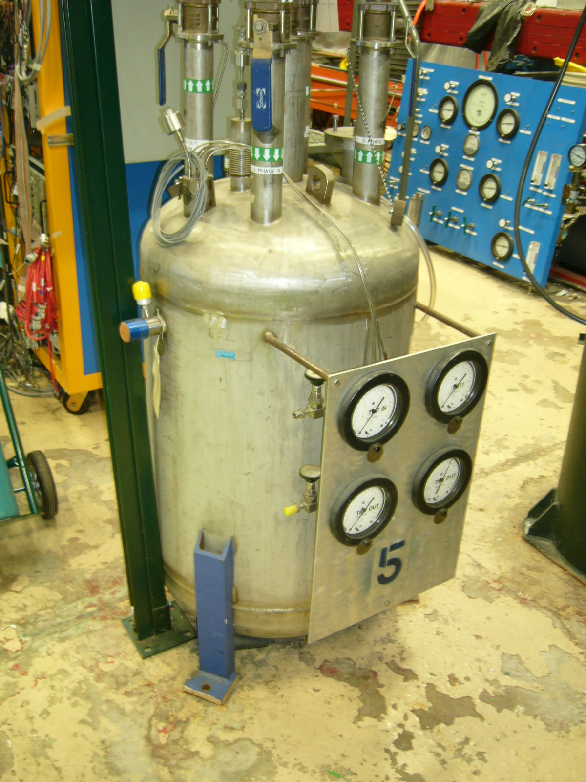
Test Stand 4 Cryogenics
80 K LN2 Operations – Test Stand Conceptual Design
Separate the test stand from the He cryogenics system, with only LN2 and GN2 supplied from the IB1 Distribution Box
Controlled cool-down/warm-up required
Propose using mass flow controllers and re-purposing a Tevatron helium subcooler as an LN2 bath to provide GN2 flow at the required temperature to the test stand.
T
FC
FC
L
P

Slide 4
Test Stand 4 Cryogenics
80 K LN2 Operations – Test Stand Upgrades/Modifications
Relocate LN2 bath closer to Test Stand 4.
New piping/transfer lines required
LN2 supply to bath, GN2 vent from bath (V-J)
GN2 supply to bath HX and bath bypass
Mixed GN2 flow to test stand (V-J)
Modify existing piping
Modify length of existing LHe supply transfer line in order to supply LN2 to test stand
Replumb all test stand returns to GN2 vent
Modify feed box insert instrumentation for LN2 service
RTD sensor sticks or capacitance probes instead of SC liquid level probes)
Valve and instrument upgrades
Upgrade insulating vacuum system

Slide 5
Test Stand 4 Cryogenics
80 K LN2 Operations – Technical Risks
None identified

Slide 6
Test Stand 4 Cryogenics
80 K LN2 Operations – Test Stand Preparations Cost Estimate
New or re-worked V-J transfer lines: $32k
4 x $8k ($5k stingers, $1k pipe/tube/fittings, $2k welding)
Valve & instrument upgrades: $20k
Upgrade insulating vacuum system
Turbo pump: $10k (Feb. 2016 pricing)
Instrumentation: $5k (Sept. 2014 purchase)
Control valves for LN2 service: $8k (May 2014 purchase)
Mass flow controllers: $8k (Dec. 2015 purchase)
Warm GN2 lines: $2k ($1k pipe/tube/fittings, $1k welding)
Replumb all test stand returns to GN2 vent: $2k (welding, fittings)
TOTAL: $87K

Slide 7
Test Stand 4 Cryogenics
80 K LN2 Operations – Test Stand Preparations Labor Estimate
Designer/drafter: 6 p-weeks (0.14 FTE)
4 p-weeks V-J lines (4 lines x 1 p-week/line)
2 p-weeks building model update
Engineering: 20 p-weeks (0.45 FTE)
8 p-weeks cryo safety documentation
3 p-weeks engineering oversight of transfer line fabrication, replumbing, subcooler placement, vacuum system upgrade
2 p-weeks valve and instrument upgrades
2 p-weeks controls modifications
2 p-weeks cryo safety review
2 p-weeks acceptance testing
1 p-week LN2 bath system design

Slide 8
Test Stand 4 Cryogenics
80 K LN2 Operations – Test Stand Preparations Labor Estimate
Mechanical Technician: 11 p-weeks (0.25 FTE)
4 p-weeks V-J line fabrication
2 p-weeks for insulating vacuum system upgrade
2 p-weeks for valve and instrument upgrades
1 p-week subcooler relocation
1 p-week for warm GN2 line fabrication
1 p-week for replumbing test stand returns to GN2 vent

Slide 9
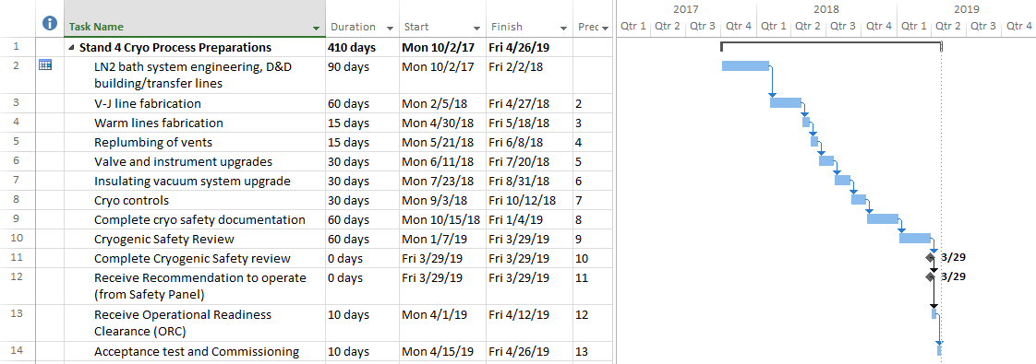
Test Stand 4 Cryogenics
80 K LN2 Operations – Test Stand Preparations Schedule Estimate

Slide 10
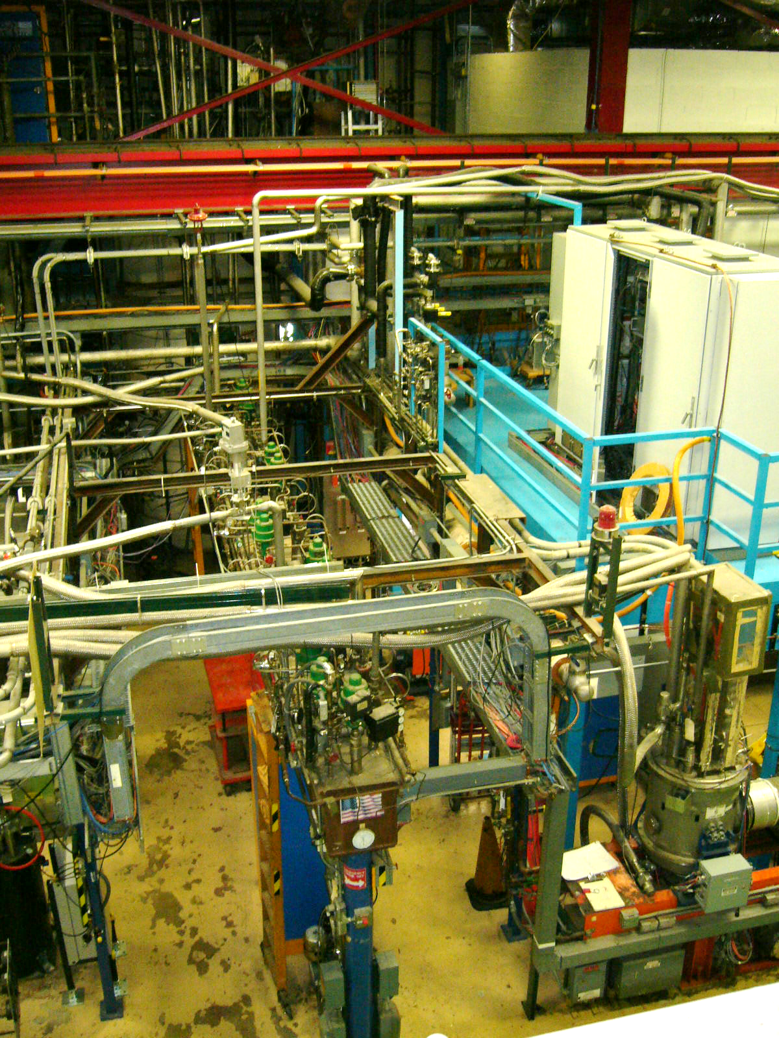
Test Stand 4 Cryogenics
4.5 K LHe Operations – Test Stand Conceptual Design
Conceptual design aims to minimize LHe usage by:
Using an external LN2 bath for controlled cool-downs/warm-ups.
Replumbing the LHe supply to the test stand to eliminate the Distribution Box from the circuit.

Slide 11
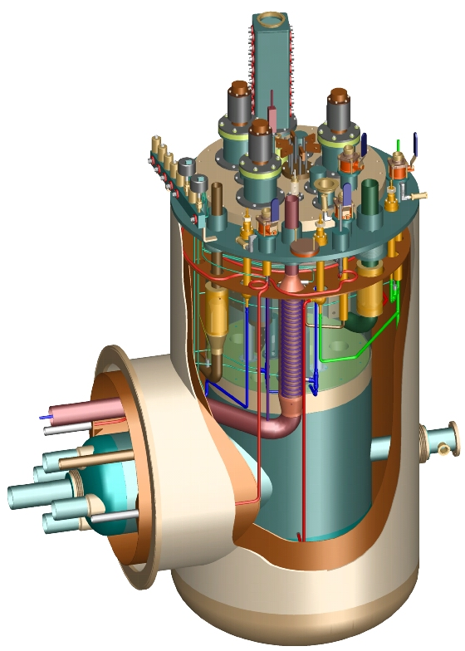
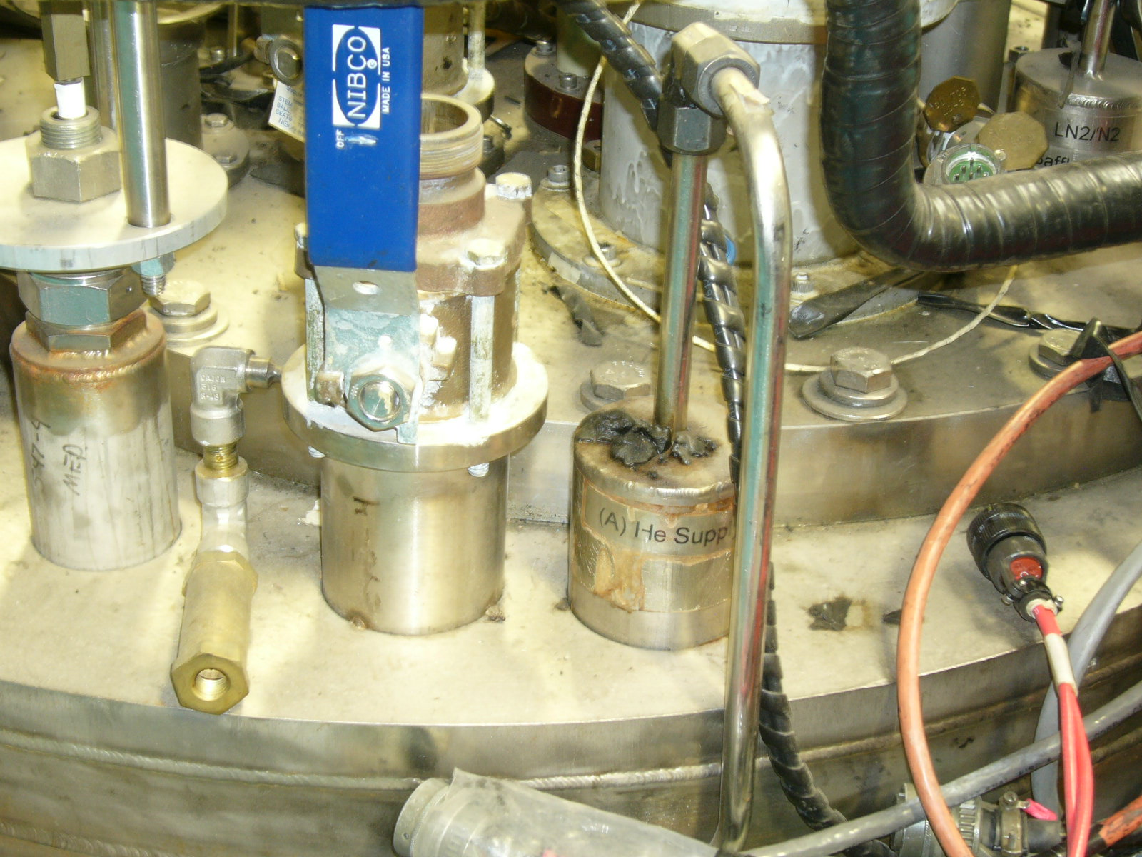
Test Stand 4 Cryogenics
4.5 K LHe Operations – Test Stand Conceptual Design
Controlled cool-down
Magnet can be cooled from 300 K to 180 K using an 80 LN2 bath (100 K ΔT). GHe of the appropriate temperature is supplied to the feed box GHe supply port.
The remainder of the controlled cool-down will mix LHe and GHe in the feed box tubing.
Feed box temperature sensor needs to be added to the insert and located near the bottom fill port.
Controlled warm-up
Warming the magnet using an LN2 bath and a 100 K ΔT would not require any LHe.
Otherwise, Test Stand 4 can operate at 4.5 K as presently configured.
T
FC
FC
L
Feed box
LHe supply
Feed box
GHe supply

Slide 12
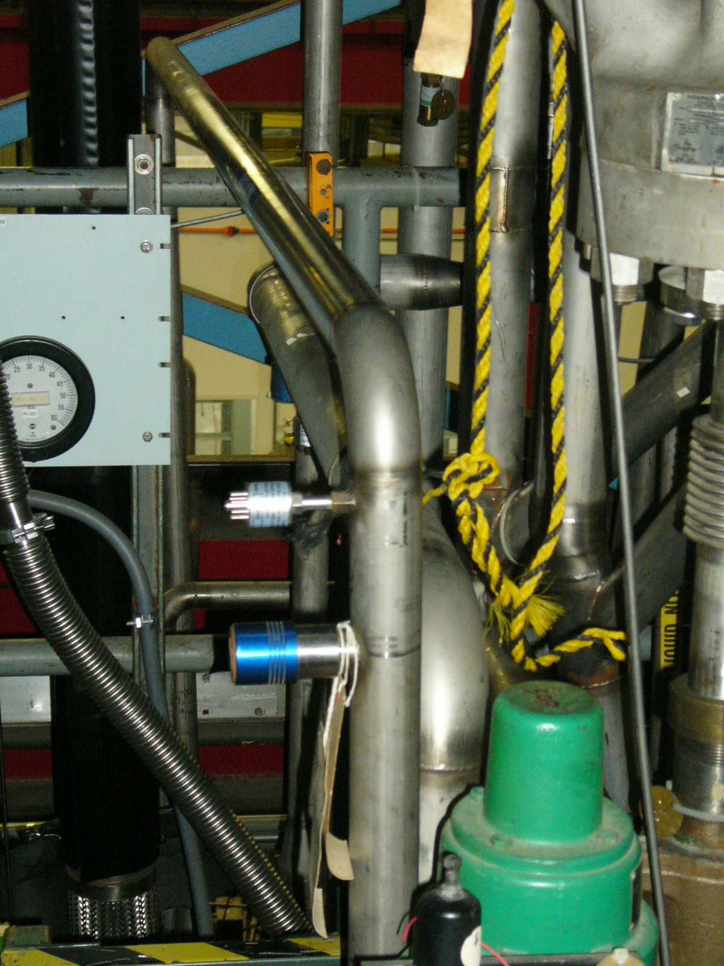
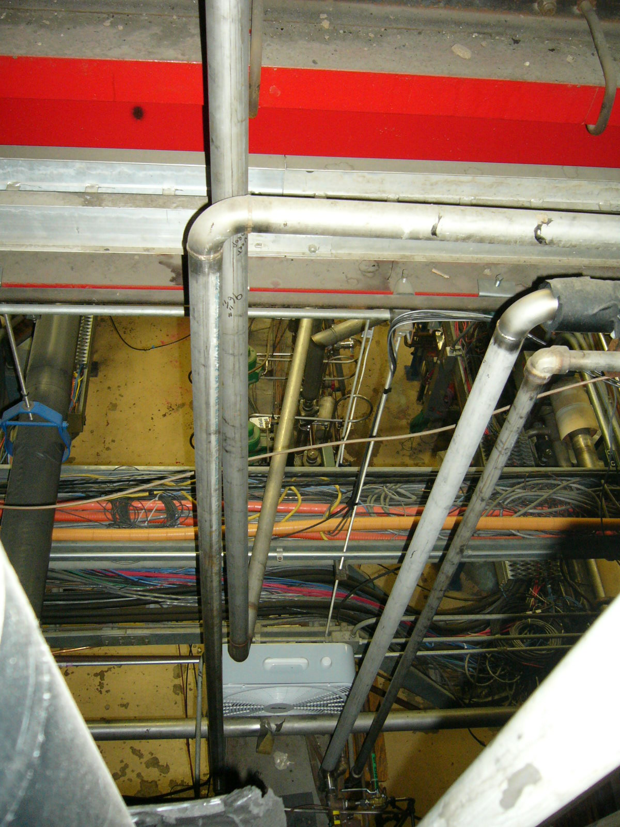
Test Stand 4 Cryogenics
4.5 K LHe Operations – Test Stand Upgrades/Modifications
Relocate LN2 bath closer to Test Stand 4.
New piping/transfer lines required
LN2 supply to bath, GN2 from bath (V-J)
GHe supply lines to bath HX and bath bypass
Mixed GHe flow to test stand (V-J)
Modify existing piping
LHe supply from Storage Dewar
LHe supply to test stand
Mass flow control required on GHe supply
Valve and instrument upgrades
Test stand ‘hardening’ to reduce He losses
Update insulating vacuum system

Slide 13
Test Stand 4 Cryogenics
4.5 K LHe Operations – Technical Risks
Available LHe inventory
As previously stated, the conceptual design minimizes LHe usage by using an external LN2 bath during controlled cool-downs and controlled warm-ups, and reconfiguring the test stand LHe supply to eliminate the Distribution Box from the circuit.
LHe inventory concerns are greater when powering the magnet, requiring liquid on the current lead flags for extended periods.
48 liters/hr for stand-by 2 x 15 kA leads
(60 + 48) = 108 liters/hr for fully-powered 2 x 15 kA leads
300 liter/hr nominal liquefaction rate

Slide 14
Test Stand 4 Cryogenics
4.5 K LHe Operations – Test Stand Preparations Cost Estimate
New or re-worked V-J transfer lines: $32k
4 x $8k ($5k stingers, $1k pipe/tube/fittings, $2k welding)
Valve & instrument upgrades: $20k
Upgrade insulating vacuum system
Turbo pump: $10k (Feb. 2016 pricing)
Instrumentation: $5k (Sept. 2014 purchase)
Re-work of LHe supply piping between Storage Dewar and Test Stand: $16k
($10k stingers, $2k pipe/tube/fittings, $4k welding)
Mass flow controllers: $8k (Dec. 2015 purchase)
Test stand ‘hardening’: $5k ($4k welding, $1k fittings)
Control valve for LN2 service: $4k (May 2014 purchase)
TOTAL: $100k

Slide 15
Test Stand 4 Cryogenics
4.5 K LHe Operations – Test Stand Preparations Labor Estimate
Designer/drafter: 8 p-weeks (0.18 FTE)
6 p-weeks V-J lines (4 lines x 1 p-week/line)
2 p-weeks building model update
Engineering: 20 p-weeks (0.45 FTE)
8 p-weeks cryo safety documentation
3 p-weeks engineering oversight of transfer line fabrication, vacuum system upgrade, test stand hardening, subcooler placement
2 p-weeks valve and instrument upgrades
2 p-weeks controls modifications
2 p-weeks cryo safety review
2 p-weeks acceptance testing
1 p-week for subcooler system design

Slide 16
Test Stand 4 Cryogenics
4.5 K LHe Operations – Test Stand Preparations Labor Estimate
Mechanical Technician: 14 p-weeks (0.32 FTE)
6 p-weeks V-J manifold/transfer lines fabrication
2 p-weeks for insulating vacuum system upgrade
2 p-weeks for valve and instrument upgrades
2 p-weeks for test stand ‘hardening’
1 p-week for subcooler relocation
1 p-week for warm GHe line fabrication

Slide 17
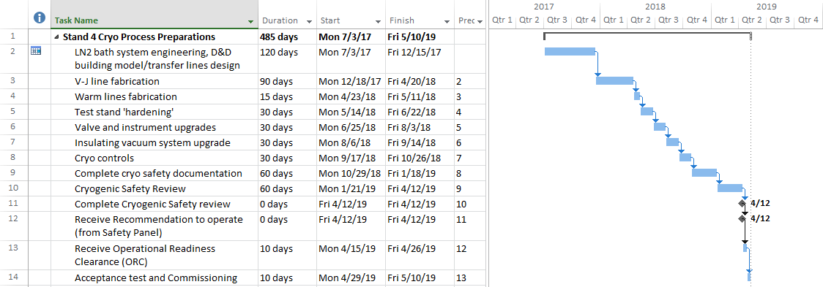
Test Stand 4 Cryogenics
4.5 K LHe Operations – Test Stand Preparations Schedule Estimate

Slide 18
Test Stand 4 Cryogenics
1.9 K LHe Operations – Test Stand Conceptual Design
Conceptual design same as that for 4.5 K LHe Operations
Otherwise, Test Stand 4 can operate at 1.9 K as presently configured.

Slide 19
Test Stand 4 Cryogenics
1.9 K LHe Operations – Test Stand Upgrades/Modification Req’d
For the warm vacuum pumps (Kinney Pumps), there are two options:
Refurbishment of existing Kinney I & II skids, including controls upgrade to match other recently-installed Kinney Pump skids.
Connection of the Test Stand to the new Kinney Pump skids.
Otherwise, all upgrades/modifications are the same as for 4.5 K LHe operations.

Slide 20
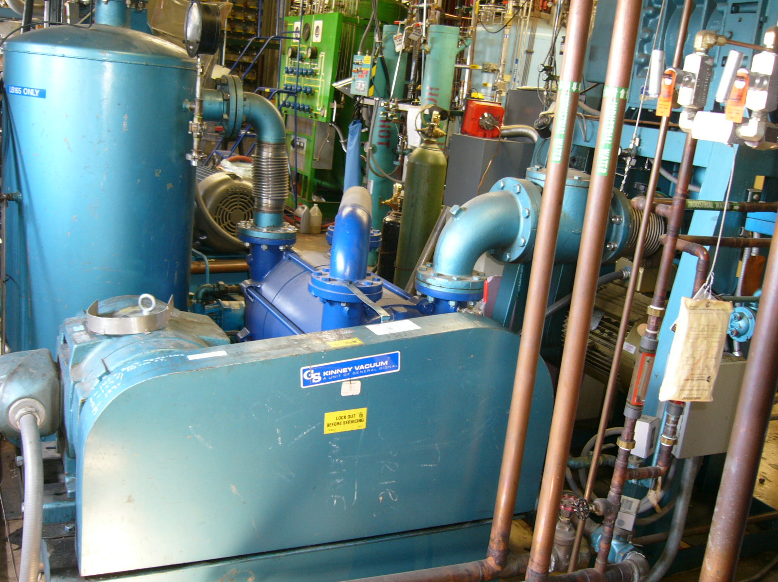
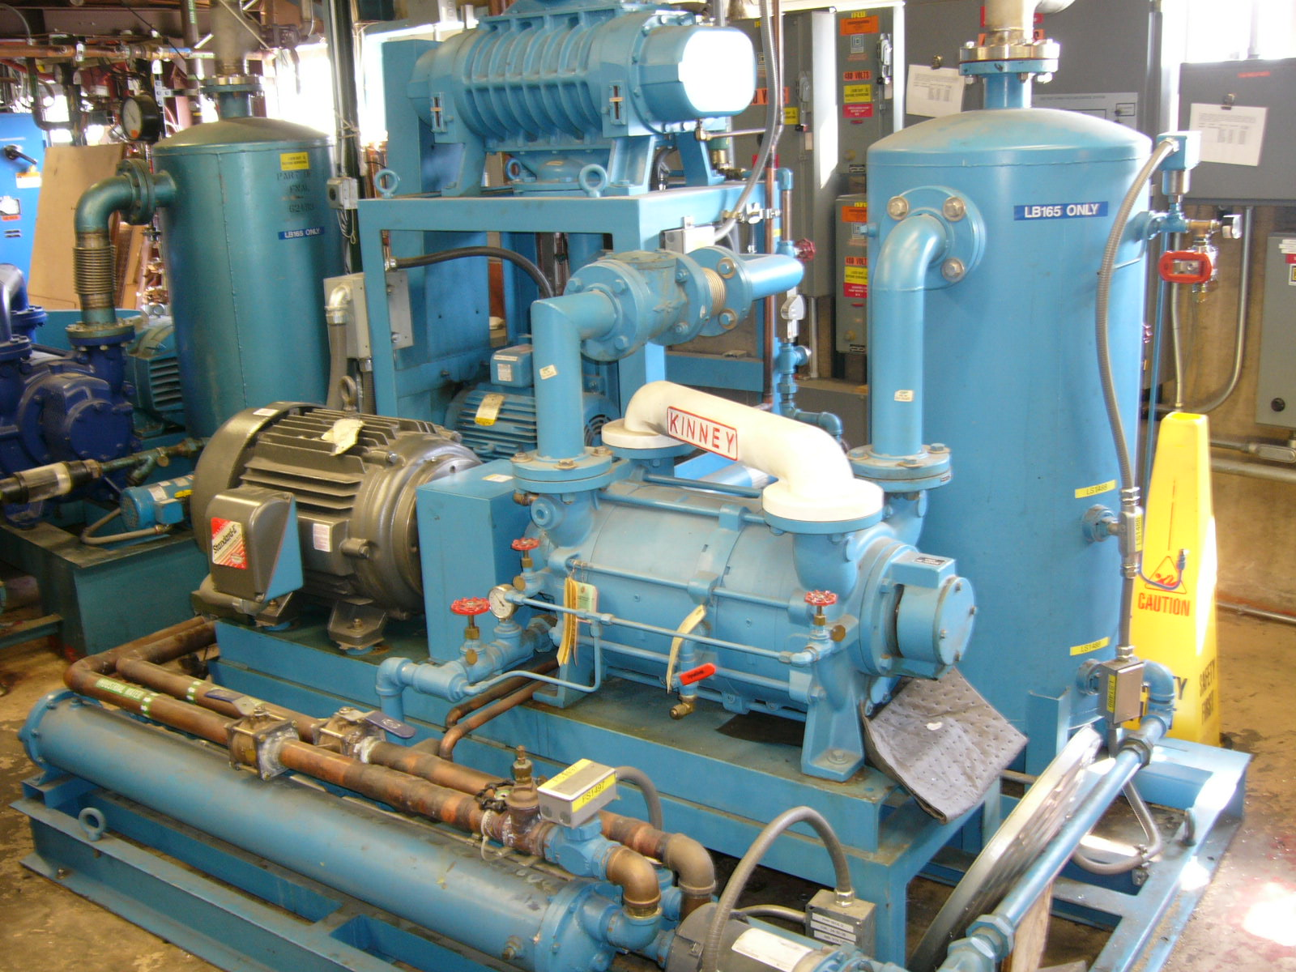
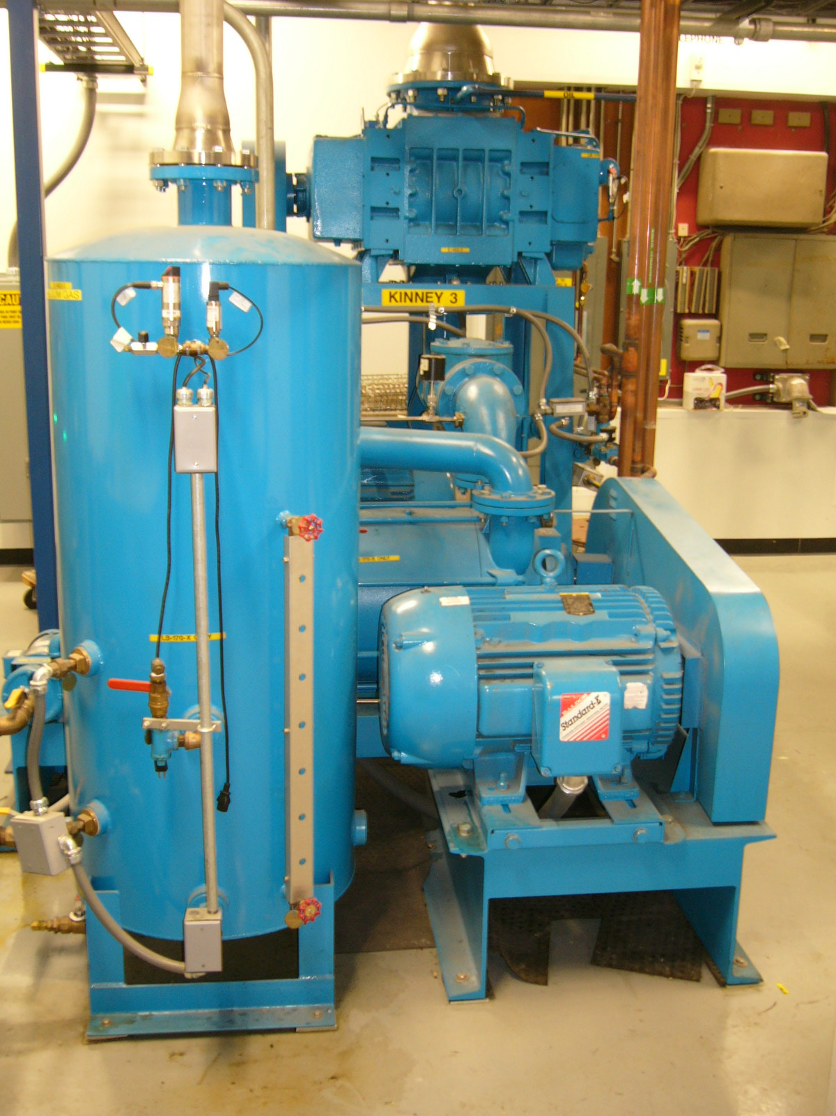
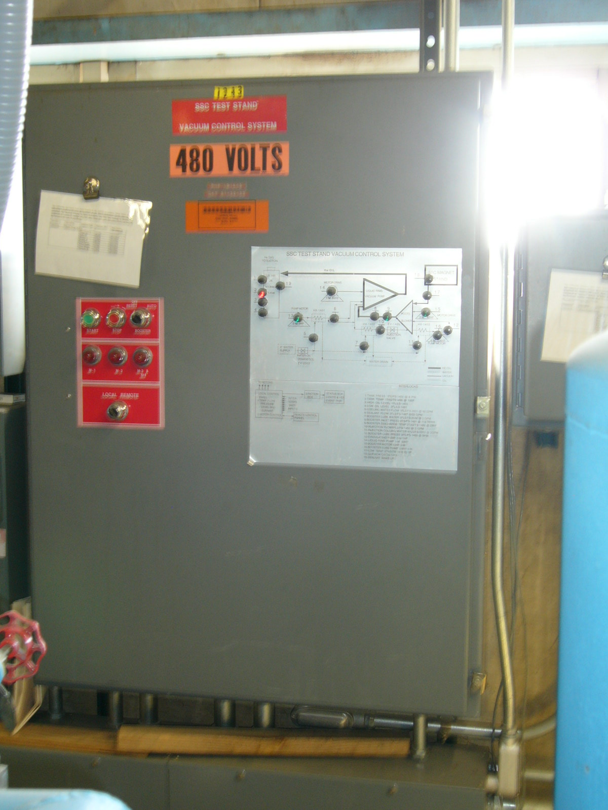
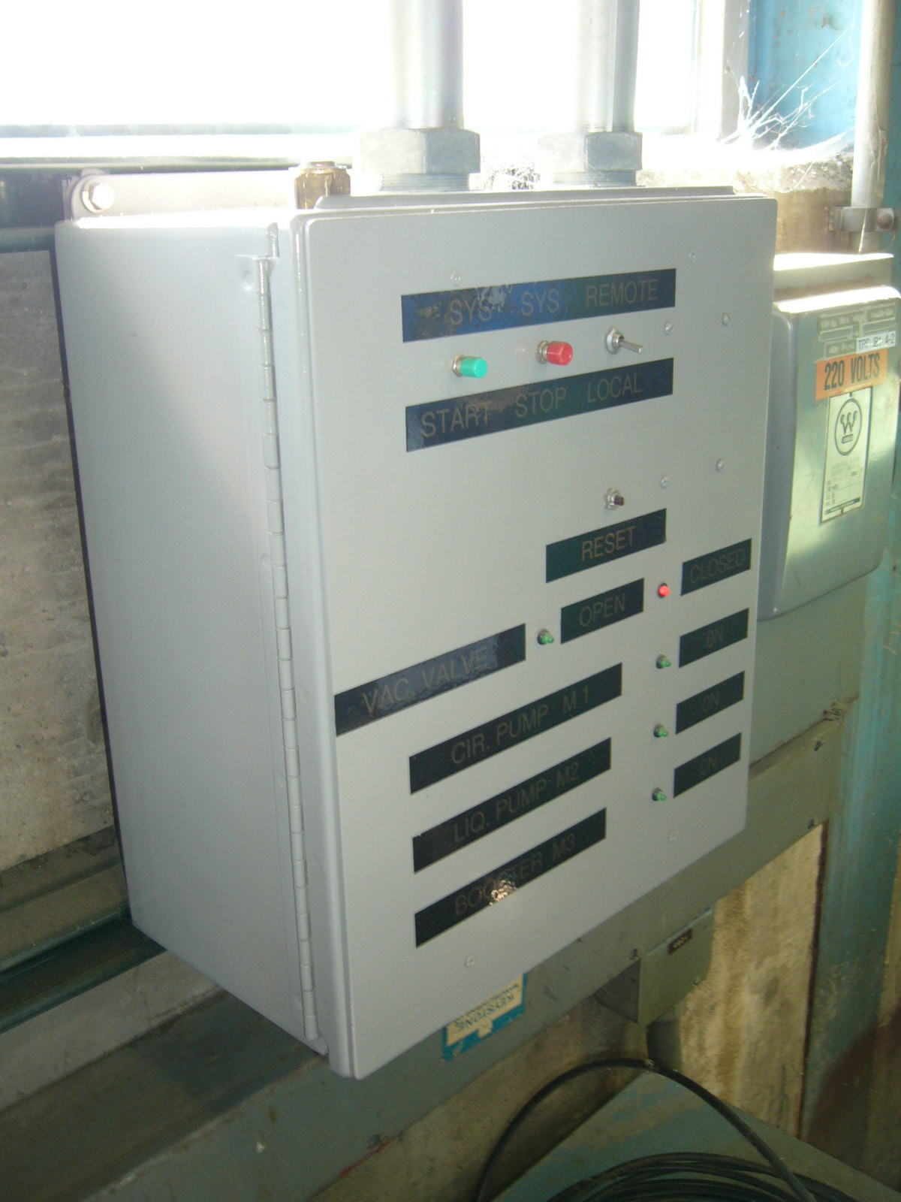
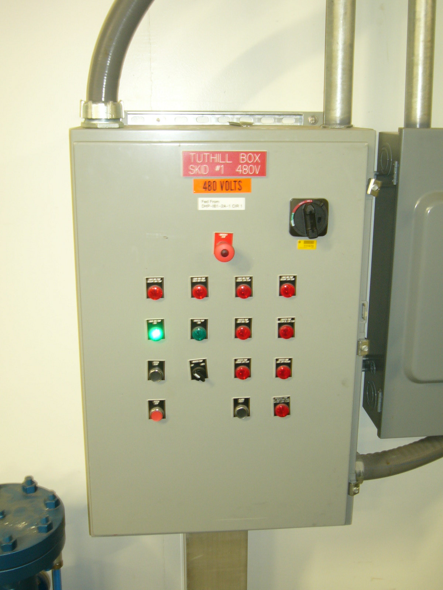
Test Stand 4 Cryogenics
1.9 K LHe Operations – Test Stand Upgrades/Modifications
Refurbishment of existing Kinney I & II skids, including controls upgrade to match other installed Kinney Pump skids.

Slide 21
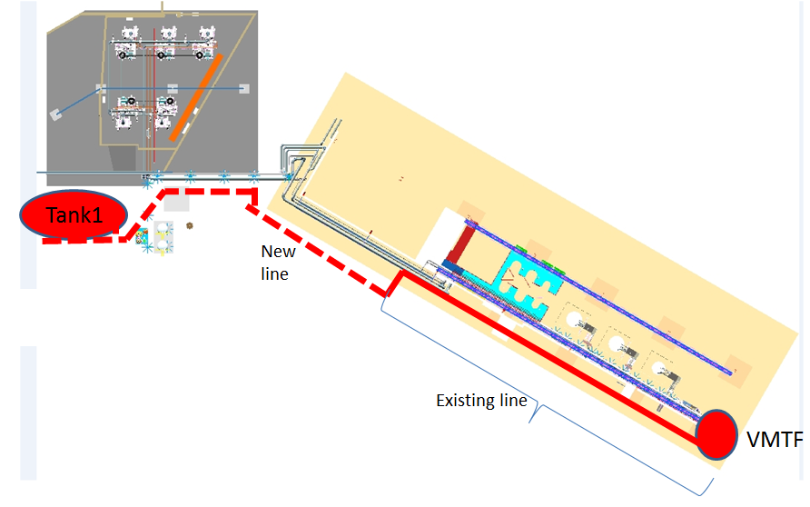
Test Stand 4 Cryogenics
1.9 K LHe Operations – Test Stand Upgrades/Modification Req’d
Connection of the Test Stand to the new Kinney Pump skids.
New Kinney Pumps
Existing old VTS-1 pumping line
Kinney I & II
Existing Stand 4 pumping line
Required tie-ins
Existing ‘new’ (~2010) Stand 4 pumping line

Slide 22
Test Stand 4 Cryogenics
1.9 K LHe Operations – Technical Risks
Available LHe inventory
LHe inventory concerns are greater when powering the magnet, pumping down to 1.9 K, and requiring liquid on the current lead flags for extended periods.
Additional 700 liters LHe required per 1.9 K pump-down.
Stand-by liquefaction loads
48 liters/hr for 2 x 15 kA leads
64 liters/hr for 2 x 20 kA leads
Powered liquefaction loads
(48 + 60) = 108 liters/hr for fully-powered 2 x 15 kA leads
(64 + 80 (18/20)^2) = 129 liters/hr for 2 x 20 kA leads powered to 18 kA
300 liters/hr nominal liquefaction rate

Slide 23
Test Stand 4 Cryogenics
1.9 K LHe Operations – Technical Risks
If operate with refurbished Kinney I & II skids, there is no redundancy in pumping capabilities although this was how the first-generation IRQs were tested, and now the pumps will have been refurbished.
This risk is eliminated if we connect to the new Kinney Pumps, where there are four skids installed in parallel.

Slide 24
Test Stand 4 Cryogenics
1.9 K LHe Operations – Test Stand Preparations Cost Estimate
Options: Kinney I & II Refurbishment, Tie-In to New Pumps
Refurbishment of Kinney Pumps: $122k (Nov. 2015 quote, assuming no major rework or replacement of pumps)
New or re-worked V-J transfer lines: $32k
4 x $8k ($5k stingers, $1k pipe/tube/fittings, $2k welding)
Valve & instrument upgrades: $20k
Re-work of LHe supply piping between Storage Dewar and Test Stand: $16k
($10k stingers, $2k pipe/tube/fittings, $4k welding)
Upgrade insulating vacuum system
Turbo pump: $10k (Feb. 2016 pricing)
Instrumentation: $5k (Sept. 2014 purchase)
Mass flow controllers: $8k (Dec. 2015 purchase)
Pumping line tie-ins: $5k ($3k welding, $2k pipe/fittings)
Test stand ‘hardening’: $5k ($4k welding, $1k fittings)
Control valve for LN2 service: $4k (May 2014 purchase)
TOTAL: $222k
TOTAL: $105k

Slide 25
Test Stand 4 Cryogenics
1.9 K LHe Operations – Test Stand Preparations Labor Estimate
Options: Kinney I & II Refurbishment, Tie-In to New Pumps
Designer/drafter: 8 p-weeks (0.18 FTE)
6 p-weeks V-J lines (6 lines x 1 p-week/line)
2 p-weeks building model update
Engineering: 22 p-weeks (0.50 FTE), 20 p-weeks (0.45 FTE)
8 p-weeks cryo safety documentation
4 p-weeks controls modifications
3 p-weeks engineering oversight of transfer line fabrication, vacuum system upgrade, test stand hardening, subcooler placement, Kinney pump removal/refurbishment/installation
2 p-weeks valve and instrument upgrades
2 p-weeks controls modifications
2 p-weeks cryo safety review
2 p-weeks acceptance testing
1 p-week for subcooler system design

Slide 26
Test Stand 4 Cryogenics
1.9 K LHe Operations – Test Stand Preparations Labor Estimate
Options: Kinney I & II Refurbishment, Tie-In to New Pumps
Mechanical Technician: 22 p-weeks (0.50 FTE), 15 p-weeks (0.34 FTE)
8 p-weeks for Kinney Pumps removal and re-installation
6 p-weeks V-J manifold/line fabrication
2 p-weeks for insulating vacuum system upgrade
2 p-weeks for valve and instrument upgrades
2 p-weeks for test stand ‘hardening’
1 p-week for pumping line tie-ins
1 p-week for subcooler relocation
1 p-week for warm GHe line modifications

Slide 27
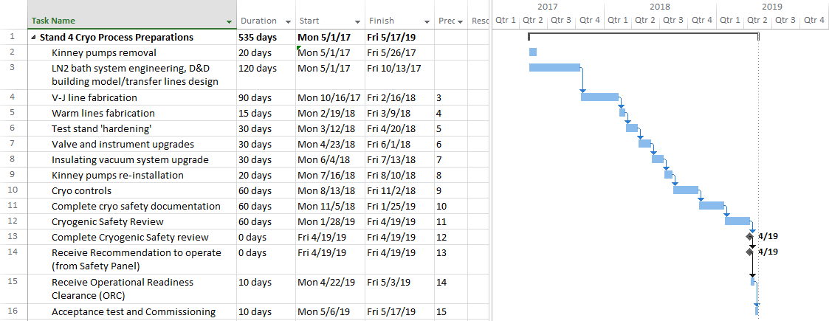
Test Stand 4 Cryogenics
1.9 K LHe Operations – Test Stand Preparations Schedule Estimate

Slide 28
Test Stand 4 Cryogenics
M&S and Labor Estimates Summary
Temperature | M&S | Labor (FTE) | Labor* | Total | Δ**
80 K | $87k | 0.84 | $210k | $297k | -$51k
4.5 K | $100k | 0.95 | $238k | $338k | -$10k
1.9 K - Refurbished pumps | $222k | 1.2 | $300k | $522k | $174k
1.9 K - Tie-in to new pumps | $105k | 0.97 | $243k | $348k | --
* Assumes 1 FTE = $250k.
** Assumes 1.9 K operation with tie-in to the new pumps is the baseline.

