Slide 1
All Experimenters’ Meeting
Duane Newhart
Accelerator Complex Status
18 April 2016

Slide 2
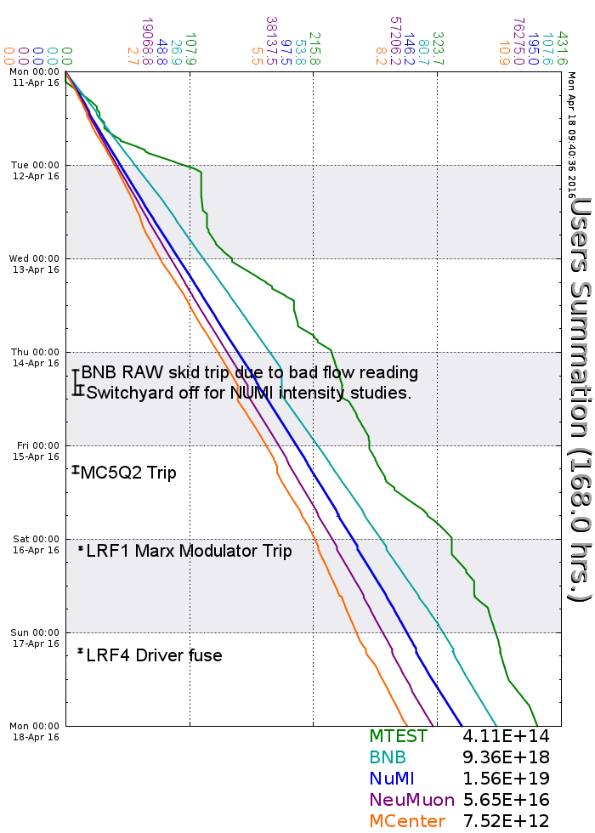
Accelerator Operations Summary
From: April 11, 2016 (0000 hours)
To: April 18, 2016 (0000 hours)
Calendar Week # 15
NuMI Weekly Integrated Intensity 1.56 E19 protons
Beam Hours To NuMI 161.2 hours
BNB Weekly Integrated Intensity 9.09 E18 protons
Beam Hours To BNB 155.5 hours
NMuon Weekly Integrated Intensity 5.65 E16 protons
Beam Hours To NMuon 154.4 hours
MTest Weekly Integrated Intensity 4.09 E14 protons
Beam Hours To MTest 119.5 hours
MCenter Weekly Integrated Intensity 7.30 E12 protons
Beam Hours To MCenter 154.6 hours

Slide 3
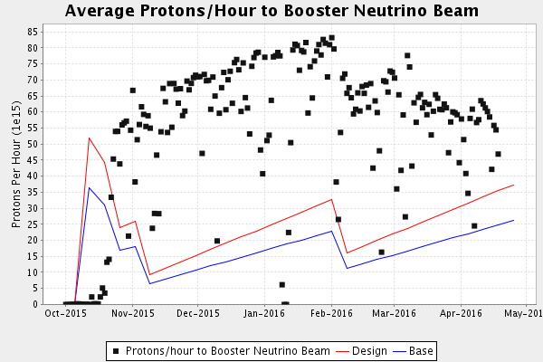
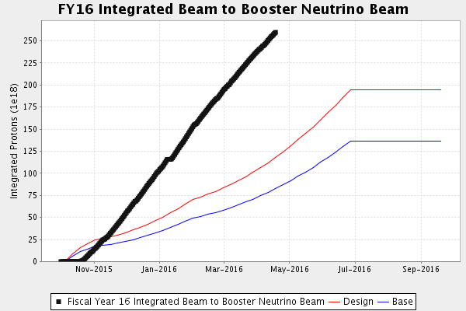
Performance measures: BNB

Slide 4
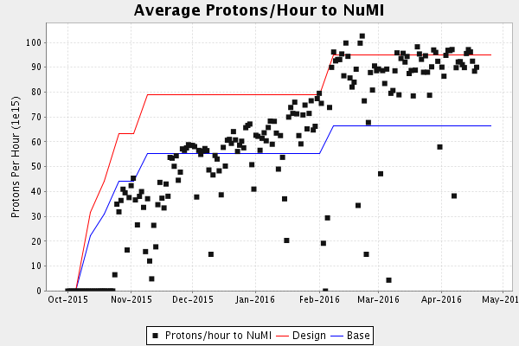
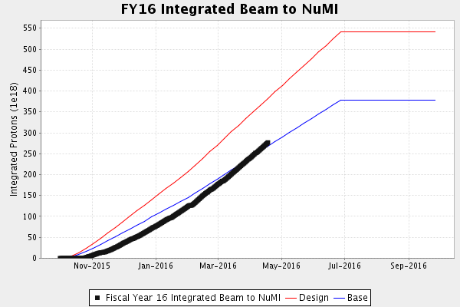
Performance measures: NuMI

Slide 5
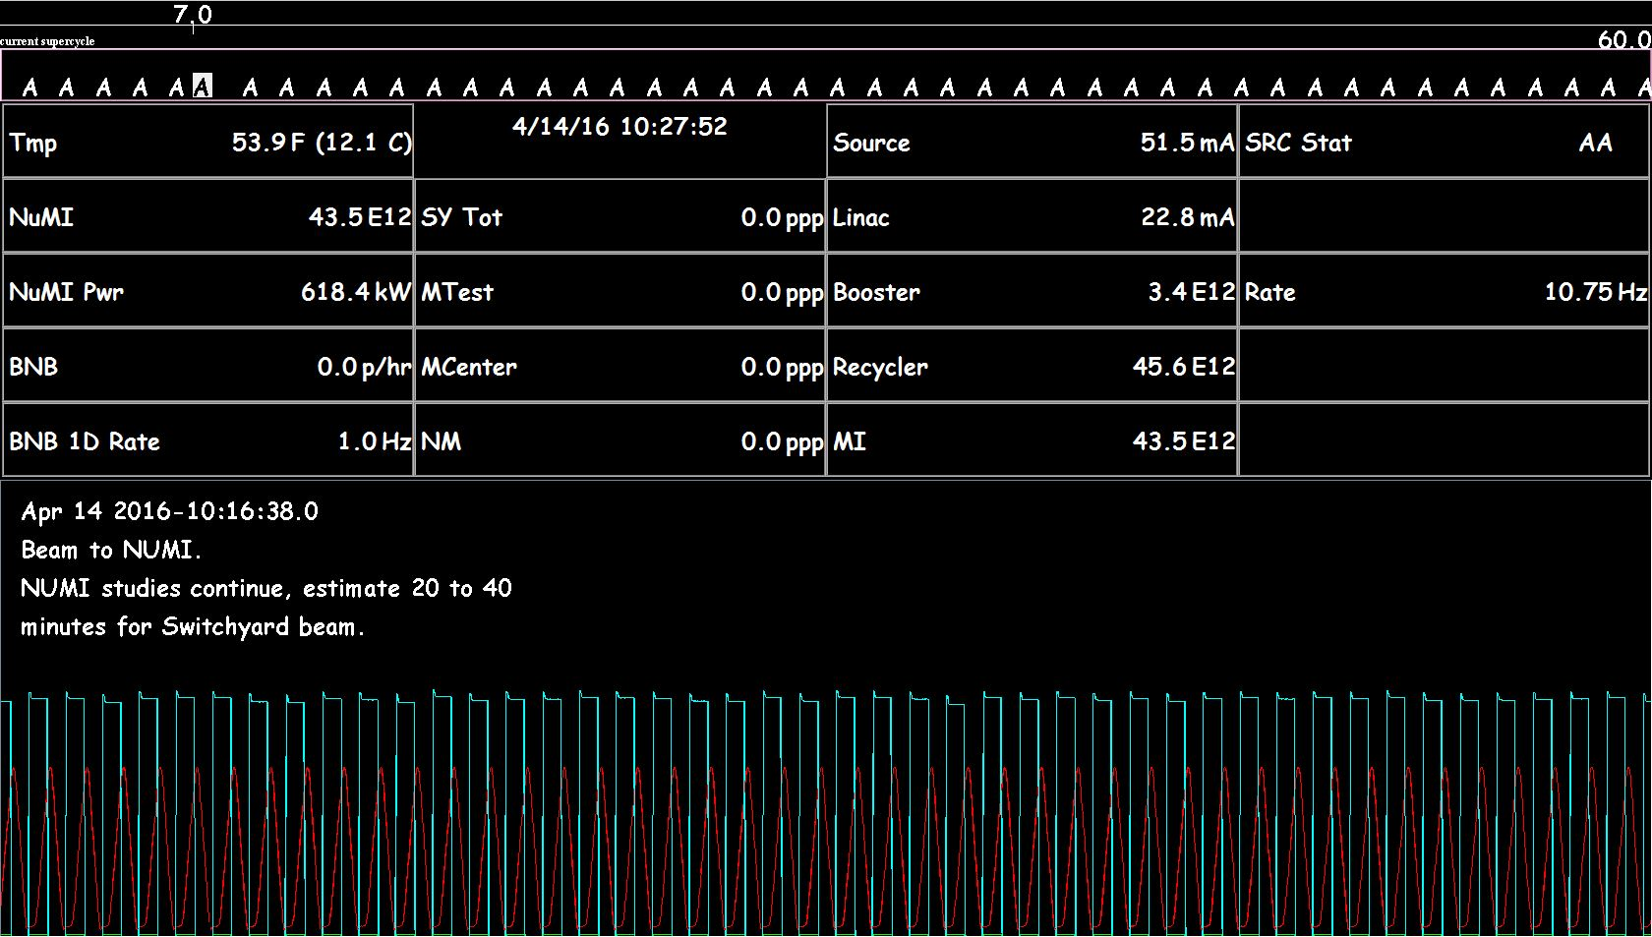
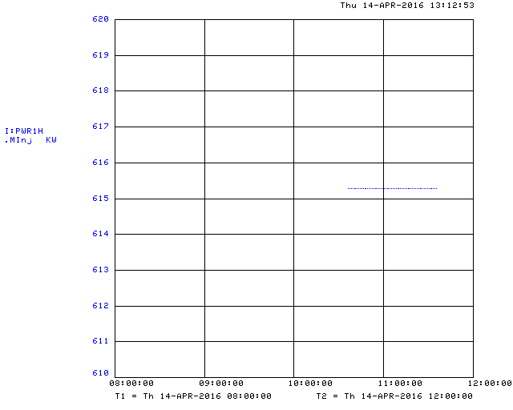
6+6 Slip Stacking
615.3 KW for one hour
6+6 Slip Stacking without switchyard

Slide 6
Complex Status
LINAC
  Running well
  LRF1 Marx Modulator
Booster
  Booster rate: 11.0 to 13.3 Hz
  Tuning up / studies
    Beam to BNB
    Beam to Main Injector/Recycler
MI/RR
  Delivering beam to NuMI & Switchyard
  Standard operation: 2As (1.33 Sec MI ramp rate) with 4+6 Slip stacking
  6+6 Slip Stacking Studies (~530 KW)
NuMI
  Took beam when available-
    Peak power 615.3 KW/hour without Switchyard
Booster Neutrino Beamline (BNB)
  Took beam when available
    Reduced rate/ maintained protons/pulse
Switchyard
  Meson beam
    MTest using beam
    MCenter using beam
  SeaQuest
    Running and using beam
General
  Wednesday, June 1st
    Tentative shutdown day

Slide 7
Schedules and Links
Schedule can be accessed from the Operations Home Page
  - Schedules -> Operations Schedule
Direct link to schedule
  - http://www-ad.fnal.gov/ops/schedule.html

