Slide 1
Program overview: motivation, target parameters, timeline
A.V. Zlobin
15 T dipole design review
28 April 2016

Slide 2
Current HFM R&D Program
As a part of the National HFM collaboration develop accelerator magnets with world record parameters
  Small-aperture 15-16 T Nb₃Sn dipole suitable for VHEppC (phase 1)
    background field for small 1-2 T HTS inserts
  Large-aperture 15 T Nb₃Sn dipole with stress management (phase 2)
    background field for 5+ T HTS inserts
Magnet cost optimization
Superconductor and structural material R&D for 15-20 T accelerator magnets
  Nb₃Sn composite wires
  Large Rutherford cables

Slide 3
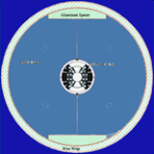
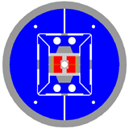
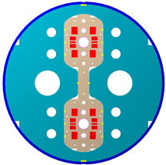
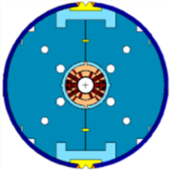
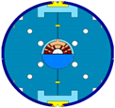
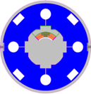
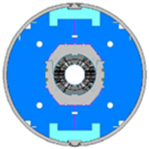
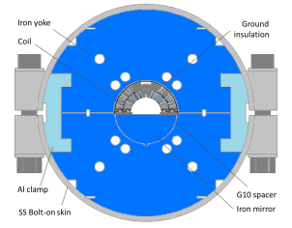
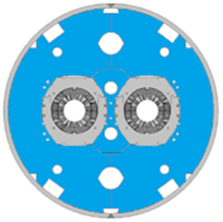
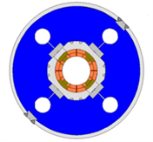
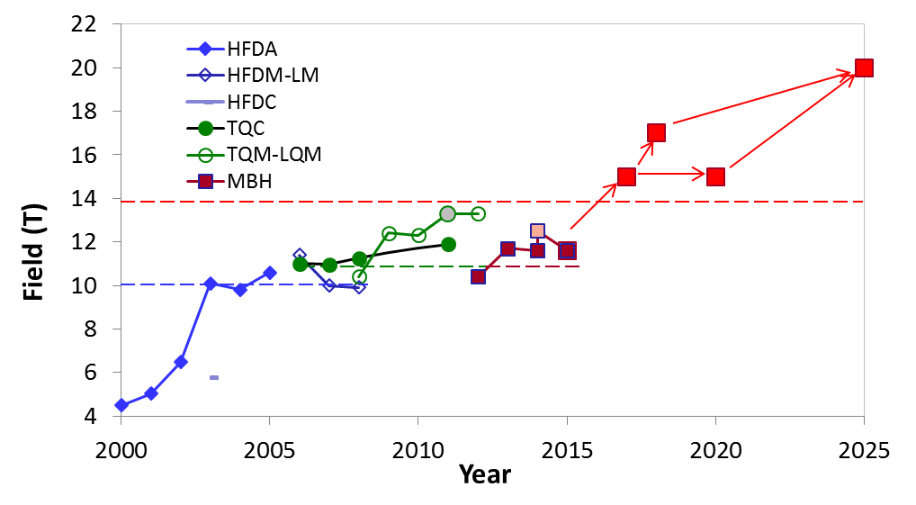
Program Timeline
VHEppC
Record field 13.8 T
D20 (LBNL)
50 mm dipole
13.5 T (1997)
Ph1 Ph2
HD2 (LBNL)
35 mm dipole
13.8 T (2008)
VLHC
LARP
HL-LHC
HFDC (R&W)
40 mm 10 T dipole
HFDA HFDM-LM 43.5 mm Dipole mirror
10 T dipole
TQC TQM-LQM
90 mm 200 T/m Quadrupole quadrupole mirror
MBHSP MBHSM
60 mm 11 T dipole Dipole mirror
MBHDP
60 mm 11 T dipole

Slide 4
Program Reviews
This plan was presented at the DOE magnet meeting in July 2015 in Washington DC. “There is a consensus we need to build demonstrations of 16 T Nb₃Sn magnets to define the ultimate limit of Nb₃Sn technology. The FNAL proposal to develop 16 T block cosine theta (BCT) suits this need, but must be a collaborative effort and needs to be done on a time scale commensurate with the GARD budget constraints”.
FNAL accelerator advisory committee (AAC) review in Dec 2015 confirmed that “the HFM program is reasonable and aligned with P5 goal of increasing performance toward 15 T, for accelerator class magnets”.
The program is being integrated into Magnet Development program (MDP) and will be reviewed later as its key part.

Slide 5
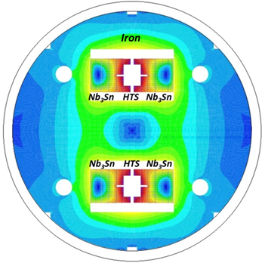
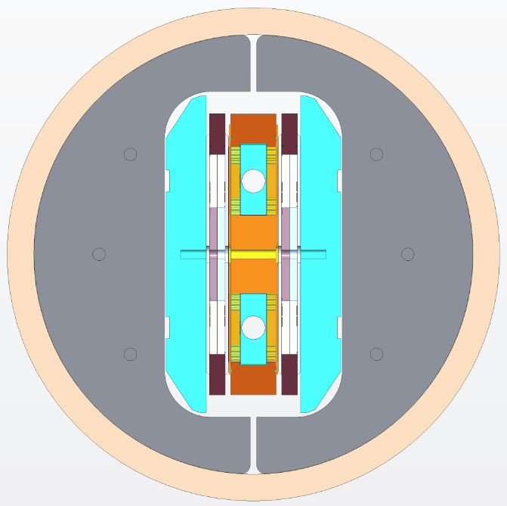
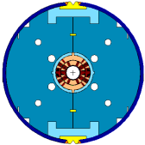
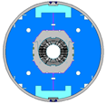
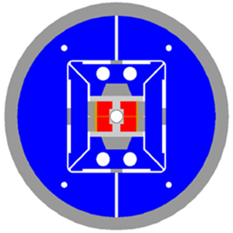
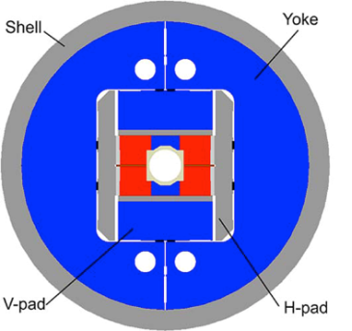
Magnet Design Options
Common coil design
RD3c (LBNL),
10 T, W&R, 2003
HFDC (FNAL),
~6 T, R&W, 2004
DCC017 (BNL),
10 T, R&W, 2007
HD2 (IHEP, China),
12-15-20 T, 2020-2025
LBNL: CCT
FNAL: BCT
HFDA (FNAL)
10 T, 2003-2006
MBHSP (FNAL)
11.7 T, 2011-2014
MBHDP (FNAL)
11.5 T, 2015
D20 (LBNL),
13.5 T, 1997
Cos-theta coil design
Block coil design
HD2 (LBNL),
13.8 T, 2008
FRESCA2 (CERN),
16 T, 2017

Slide 6
Magnet Concept Choice
2013 DOE review of HEP:
Recent efforts toward high field magnets have not been as successful as expected. Despite a doubling of the critical current density in Nb₃Sn, recent test magnets with a gap have not improved upon the earlier D20 field results of about 14 T... Given the lack of progress in increasing the bore field, it may be worthwhile to consider designing, fabricating, and testing a cos-theta magnet like D20 but using the recent advances in 2D/3D design techniques and the best available Nb₃Sn strand to see if there are any fundamental limitations to the present approach.
Fermilab has large experience with accelerator magnets based on the Nb₃Sn superconductor and cos-theta coils

Slide 7
Design Approach and Concept
Approach:
use the available tooling and FNAL fabrication and test infrastructure to reduce the magnet R&D cost and time
Design concept:
Coil aperture: 60 mm
  sufficient coil aperture is needed to accommodate beam, beam screen, cold bore, etc.
  coil stress and energy density strongly depend on coil ID
  coils with large aperture require stress management => magnet cost
  aperture optimization is a collective effort of accelerator, magnet and cryogenic experts
Coil design: modified cosθ,4 layers, graded
Cold mass design: collarless, cold iron yoke, OD<610 mm
Design optimization parameters: B_{max}, field quality, coil volume, azimuthal stress, quench protection

Slide 8
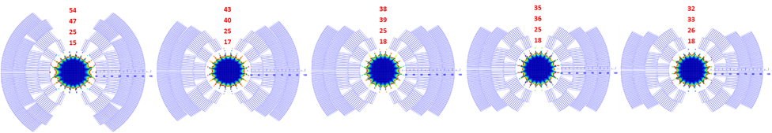
Coil Design Study
Parameter | Cable 1 | Cable 2
Number of strands | 28 | 40
Mid-thickness, mm | 1.870 | 1.319
Width, mm | 15.10 | 15.10
Keystone angle, deg | 0.805 | 0.805
4L-1
4L-2
4L-3
4L-4
4L-5

Slide 9
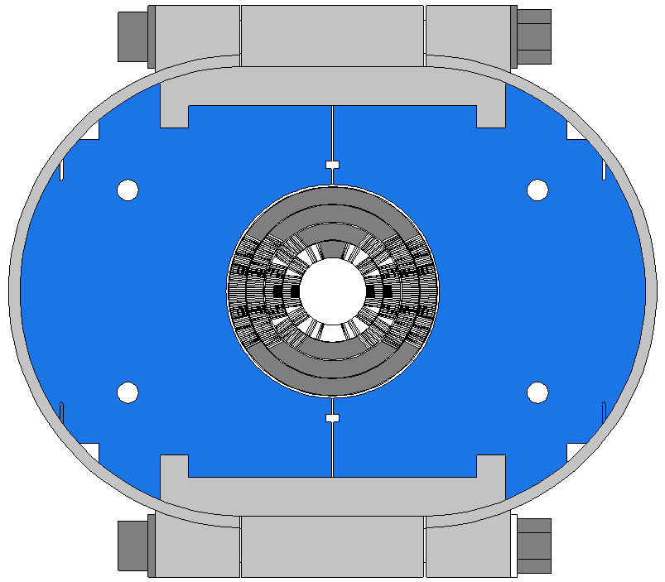
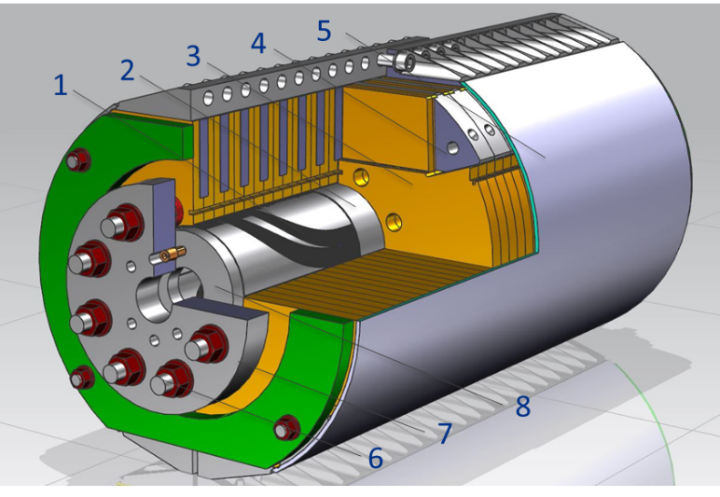
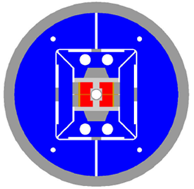
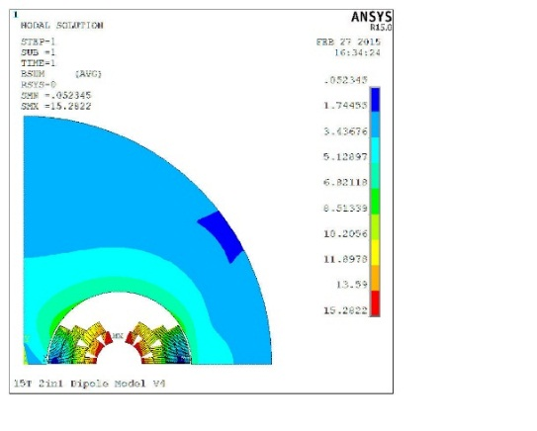
Mechanical Structure
Thin coil-yoke spacer (no collar)
2-piece vertically split yoke
Yoke clamp: SS C-clamps (v.1) vs. Al I-clamps (v.2)
Skin: SS bolted skin from 11 T dipole (v.1) vs. welded skin (v.2)
Cold mass OD<610 mm (VMTF Dewar limit)
Axial support: thick SS rods and end plates
HD2 structure:
cold mass OD=705 mm
Al shell thickness 40 mm

Slide 10
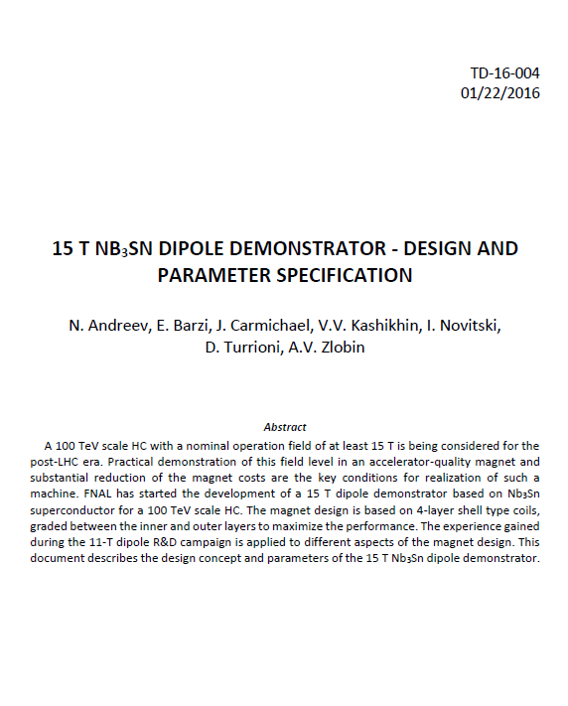
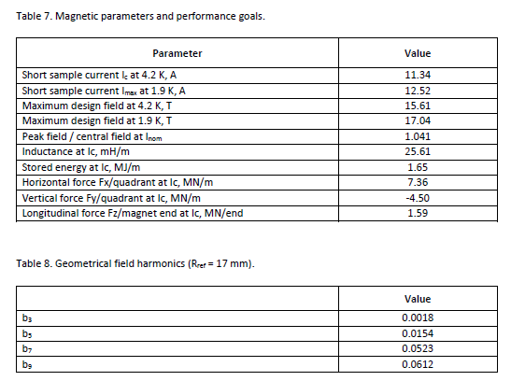
Magnet Design Specifications

Slide 11
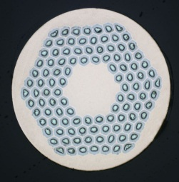
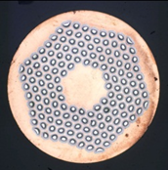
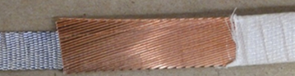


Strands and Cables
RRP108/127
RRP150/169
Magnet short sample estimated based on the cable test data:
  11.1 kA (B_{ap}=15.3 T) at 4.5 K
  12.2 kA (B_{ap}=16.7 T) at 1.9 K

Slide 12
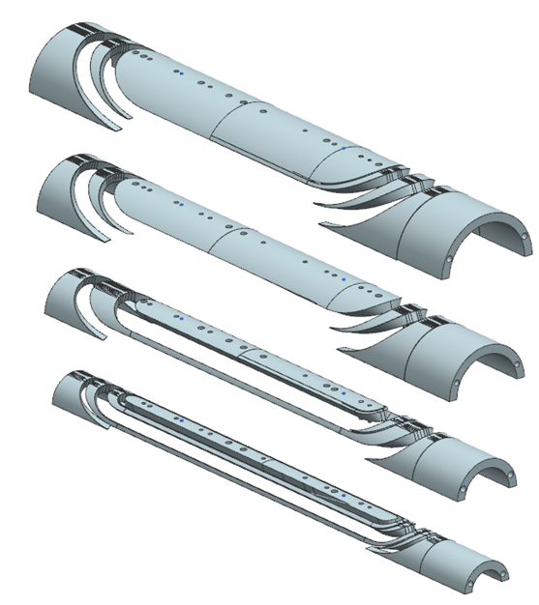
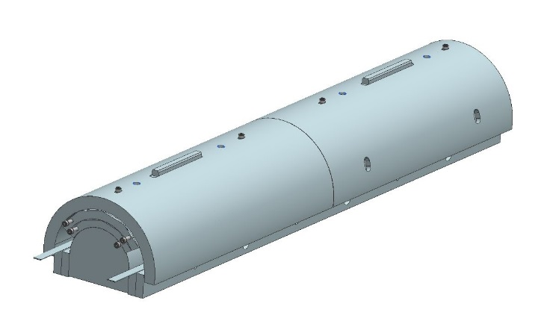
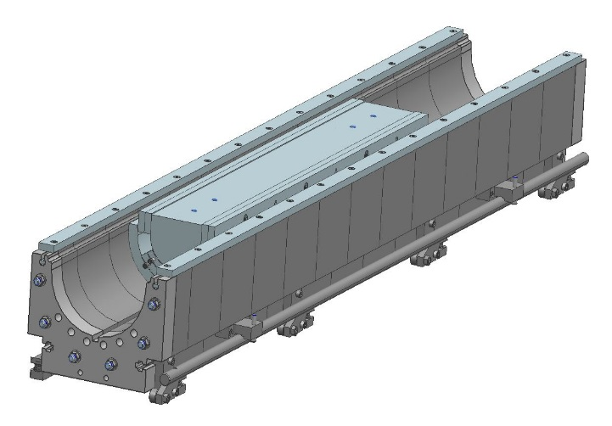
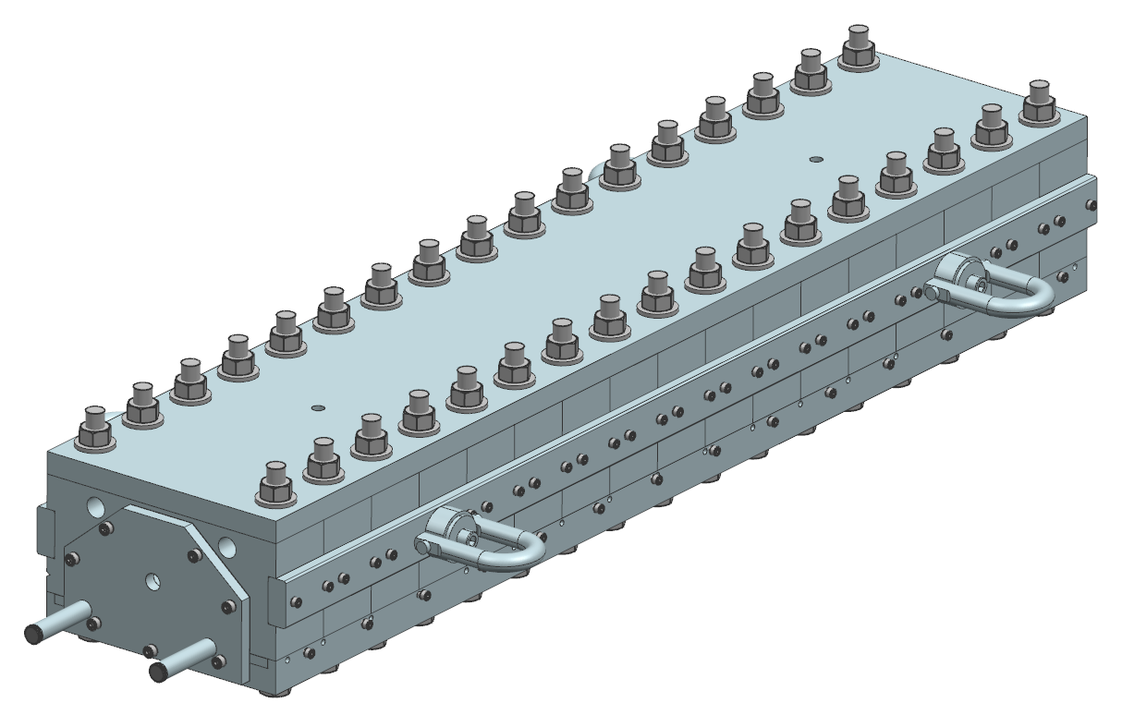
Magnet Engineering Design
Coil design
  layers #1 and #2
  layers #3 and #4
    end parts optimization
Coil tooling
  winding, curing, reaction, impregnation
Cold mass design
  yoke, clamps, skin, end plates
Cold mass assembly tooling
  yoke clamping
  skin welding

Slide 13
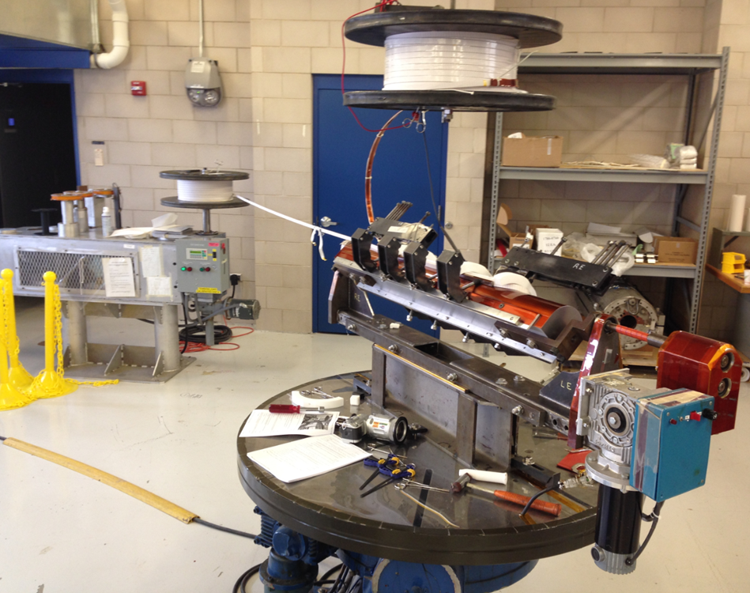
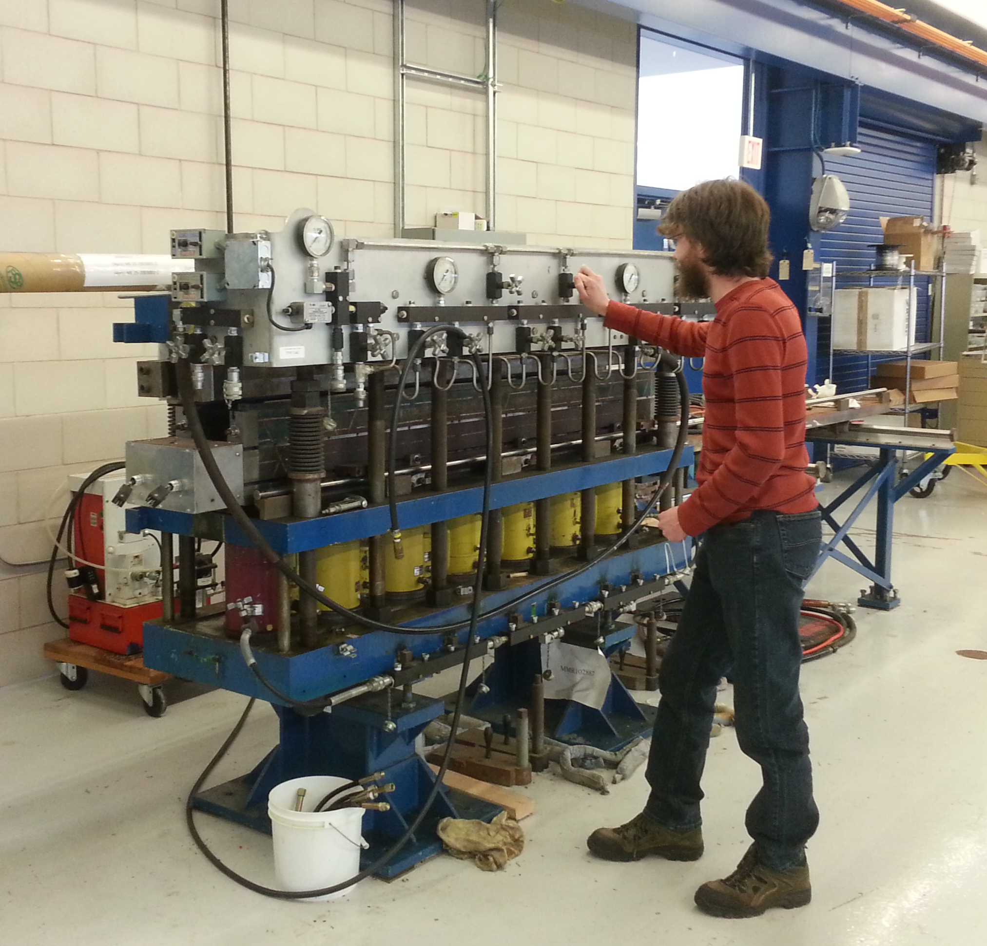
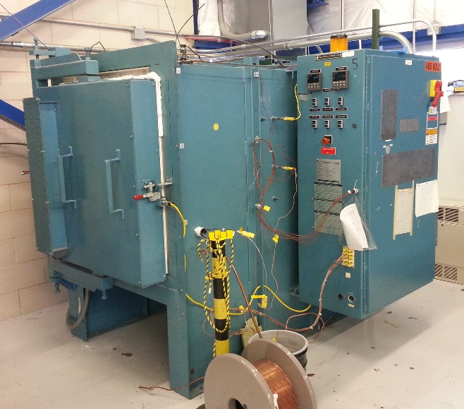
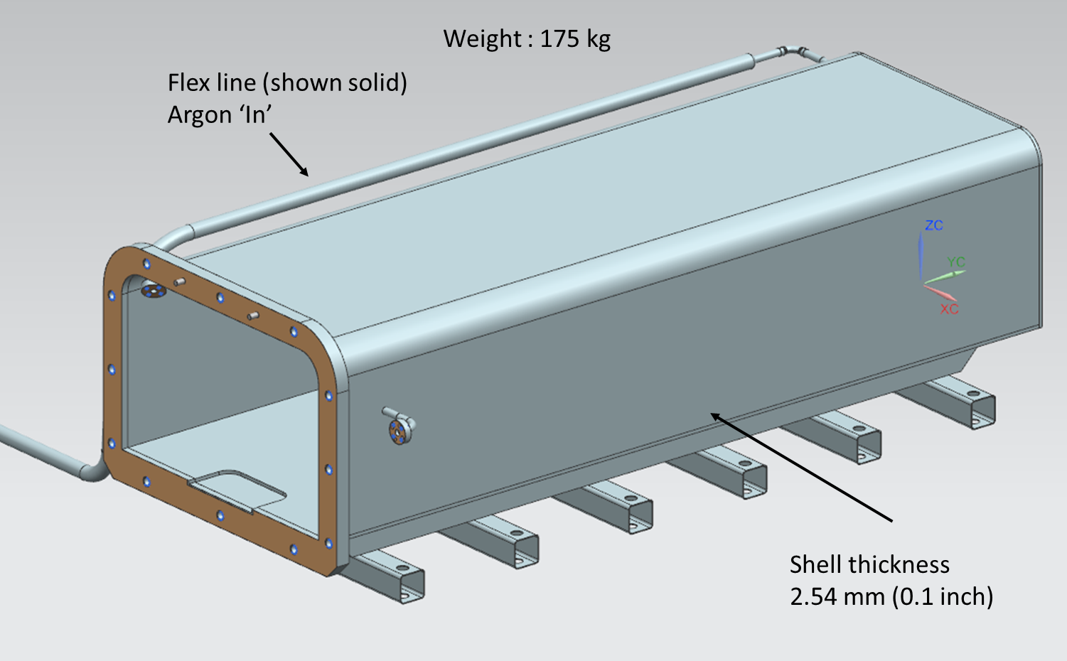
Coil Fabrication Infrastructure
To avoid infrastructure and stuff conflicts with LARP, new coil fabrication line has been created in IB3A (next to SCRD Lab).
SCRD techs are being trained to wind short coils.

Slide 14
Test Goals
Demonstration of 15-16 T field level
Study and optimization of
  magnet quench performance
    training, degradation, memory, effect of coil pre-load
  ramp rate sensitivity
  operation margin
  quench protection
    heater efficiency, radial quench propagation, coil quench temperature
  field quality
    geometrical harmonics, coil magnetization, iron saturation, dynamic effects

Slide 15
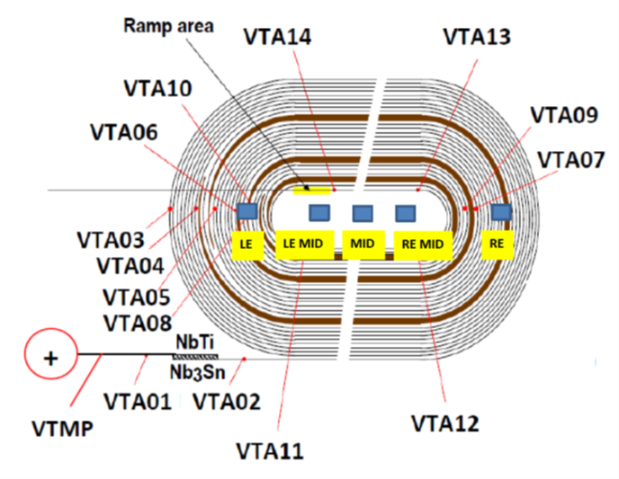
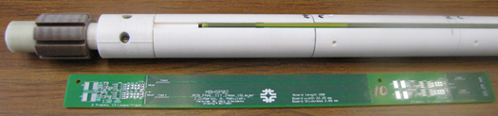
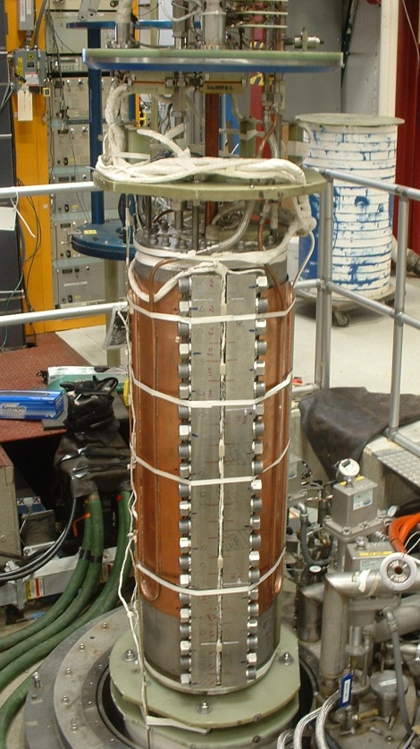
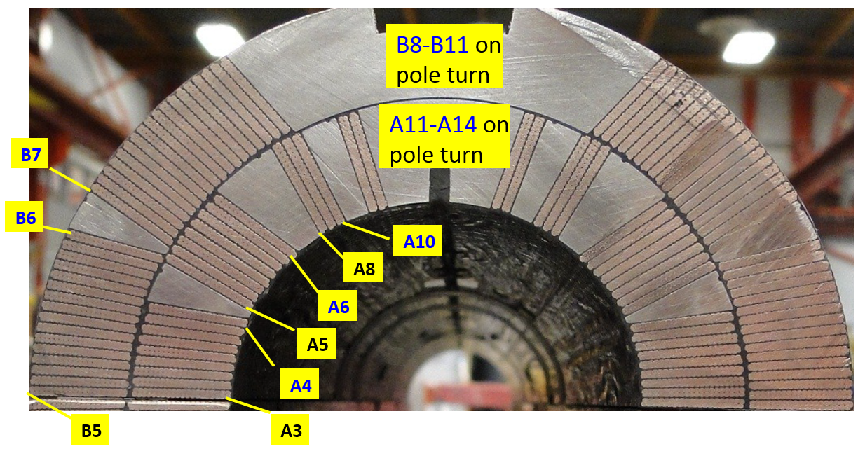
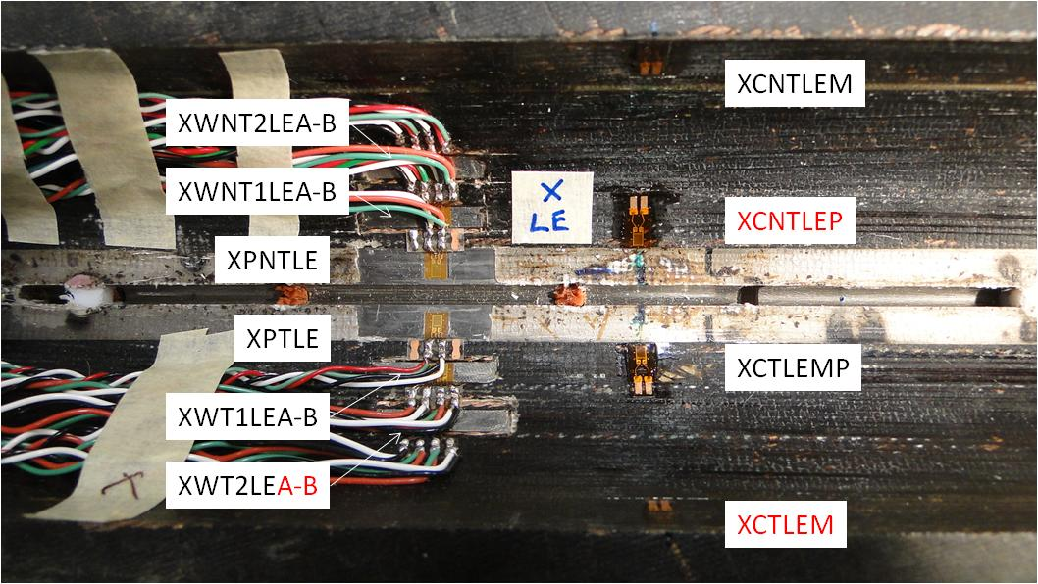
Instrumentation
Quench antenna
Voltage taps
Instrumentation
Voltage taps
Strain gauges
Quench antenna
Rotating probes
Temperature sensors
Vertical Magnet Test Facility (FNAL)
Test temperature range 1.9-4.6 K

Slide 16
Conclusions
R&D of a 60-mm aperture 15 T Nb₃Sn dipole demonstrator for future VHEppC has started at Fermilab:
  Magnet design study phase is complete
  Magnet and tooling engineering design and parts procurement are in progress
  Cable for inner coils was developed, fabricated and tested
  Cable for outer coils is available from the 11 T dipole
  Practice outer coil (layers #3 and #4) is being wound
  Magnet fabrication and first tests are planned for 2017
  Schedule is coordinated with CERN FCC Design Study Report

Slide 17
Publications
IPAC2015
A.V. Zlobin, N. Andreev, E. Barzi, V.V. Kashikhin, I. Novitski, “Design concept and parameters of a 15 T Nb3Sn dipole demonstrator for a 100 TeV hadron collider”, IPAC2015.
CEC/ICMC2015
V.V. Kashikhin, N. Andreev, E. Barzi, I. Novitski, A.V. Zlobin, “Magnetic and structural design of a 15 T Nb₃Sn accelerator dipole model”, CEC/ICMC2015, Tucsan (AR), June 2015.
MT-24
I. Novitski, N. Andreev, E. Barzi, J. Carmichael, V. V. Kashikhin, D. Turrioni, M. Yu, A. V. Zlobin, “Development of a 15 T Nb₃Sn Accelerator Dipole Demonstrator at Fermilab”, IEEE Trans. on Appl. Supercond., 2016.
E. Barzi, N. Andreev, P. Li, V. Lombardo, D. Turrioni, A. V. Zlobin, “Nb₃Sn RRP® Strand and Cable Development for a 15 T Dipole Demonstrator,” IEEE Trans. on Appl. Supercond., 2016.

Slide 18
Program Presentations and Discussions
The program was presented and discussed inside the National magnet collaboration and at
  October 2014 – FCC meeting at ASC2014
  March 23-27, 2015 – FCC meeting in WDC
  June 2015 – ICFA magnet mini-workshop
  July 14-15, 2015 – magnet meeting at FNAL
  July 28, 2015 – magnet workshop at WDC
  December 9, 2015 – FNAL AAC
  December 17, 2015 – DOE briefing on FNAL GARD program
  February 8-10, 2016 – LTSW2016
  April 10-15, 2016 – FCC meeting in Rome

