Slide 1
Additional information
Vadim Kashikhin
15-T Dipole Design Review
28-29 April 2016

Slide 2
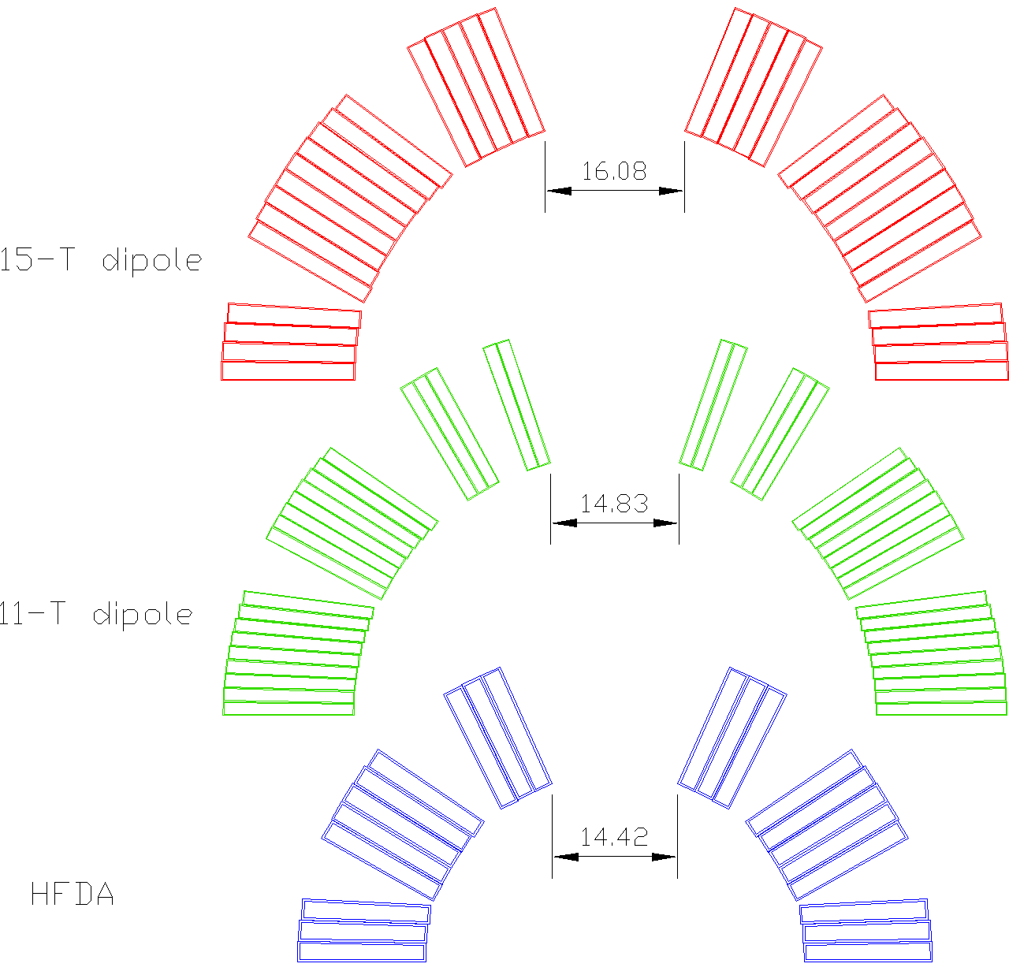
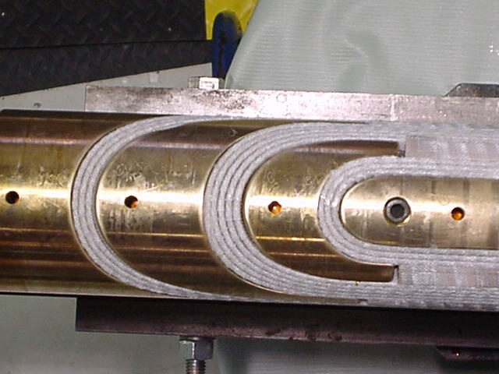
Minimum pole width

